Slide 1
Helsinki - LIBER 2016 Forum for Digital Cultural Heritage
The Wood for the Trees – Discoverability of Digital Collections
Open cultural heritage data @ the
Saskia Scheltjens
Head of Research Services department

Slide 2
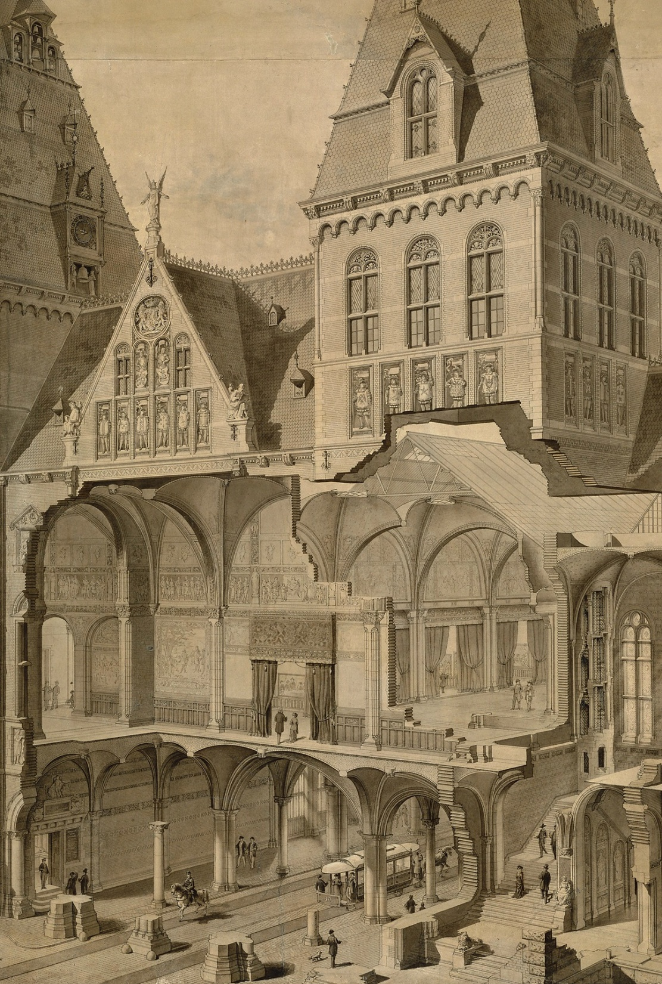
Facts and Figures
Rijksmuseum collection
National Museum of Art ánd History
Largest art historical collection online
Physical Collection
Collection of ~1,200,000 objects
Print collection ~700.000 prints
Artworks on display ~8.000 (in flux)
Digital Collection
+ 650,000 metadata object records
553.275 objects online
230.854 high res images online
in CC0

Slide 3
DIGITISATION
Museum closed between 2003-2013 due to renovations
Focus on collection registration
Start of large digitisation projects (re-shooting collections, PK Online, …)
Ambition is to have the complete collection registrered & online by 2020
Launch of new DAM system (MediaBin) in 2016
Integrated visualisations of digital content (Google Street View +)
Experiments with 2+3D photography (conferences 2015, 2017)

Slide 4
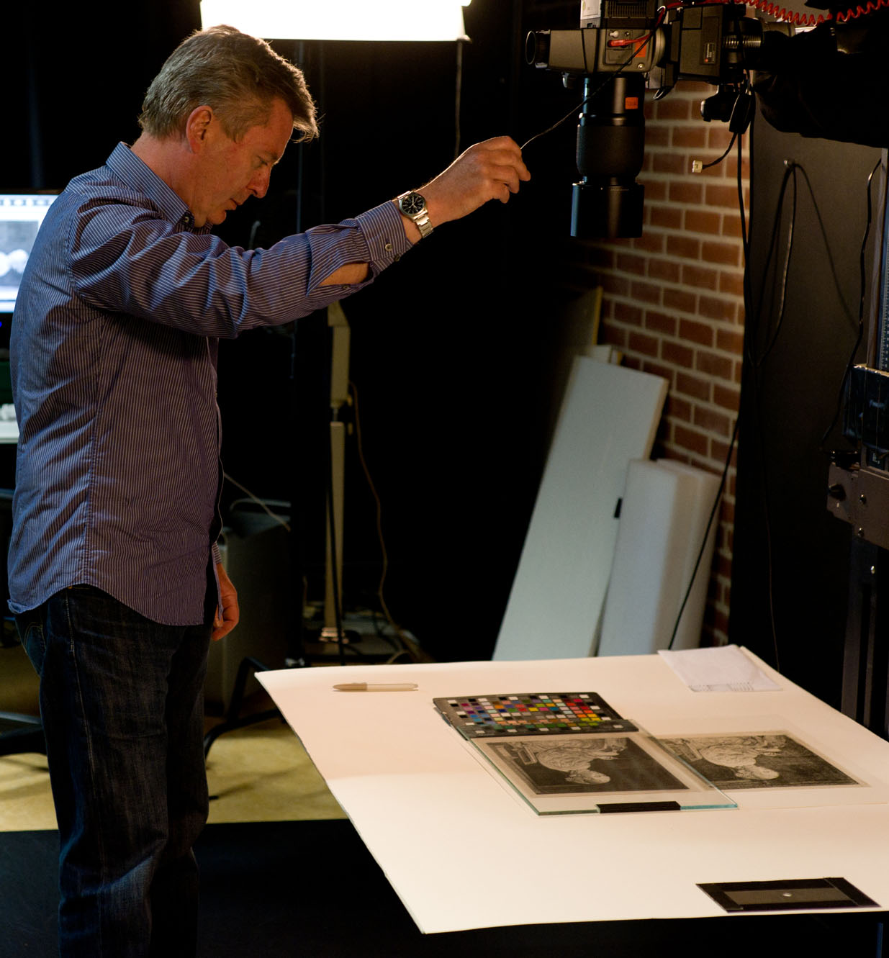
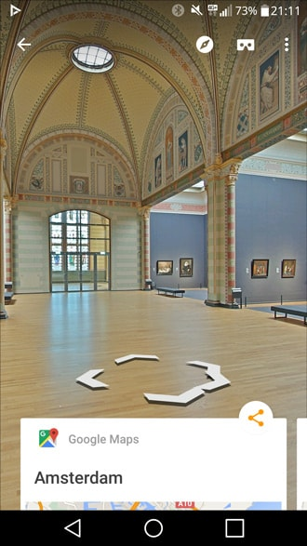

Slide 5
OPEN DATA
2003-2011
  Discussions with curators about opening up the collections online
  CC-BY licence
  Limited selection of the collection online & available
  Co-operations with museums re digital heritage data (VU, CWI, Ue)
End 2011 -
  Europeana participation (and discussion)
  New Open Data Policy Rijksmuseum
  Change to CC0 licence for the whole collection
  Persistent identifiers for all objects in the collection
  Maximum of the collection is online & available
Notes:
Joris Pekel (2014). Democratising the Rijksmuseum : a case-study. Online presentation.
Online: http://pro.europeana.eu/files/Europeana_Professional/Publications/Democratising%20the%
20Rijksmuseum.pdf
Harry Verwayen, Martijn Arnoldus, and Peter B. Kaufman (2011). The Problem of the Yellow Milkmaid: A Business Model Perspective on Open Metadata, Europeana White Paper No. 2.
Online: http://www.scribd.com/doc/73652620/Europeana-White-Paper-2.

Slide 6
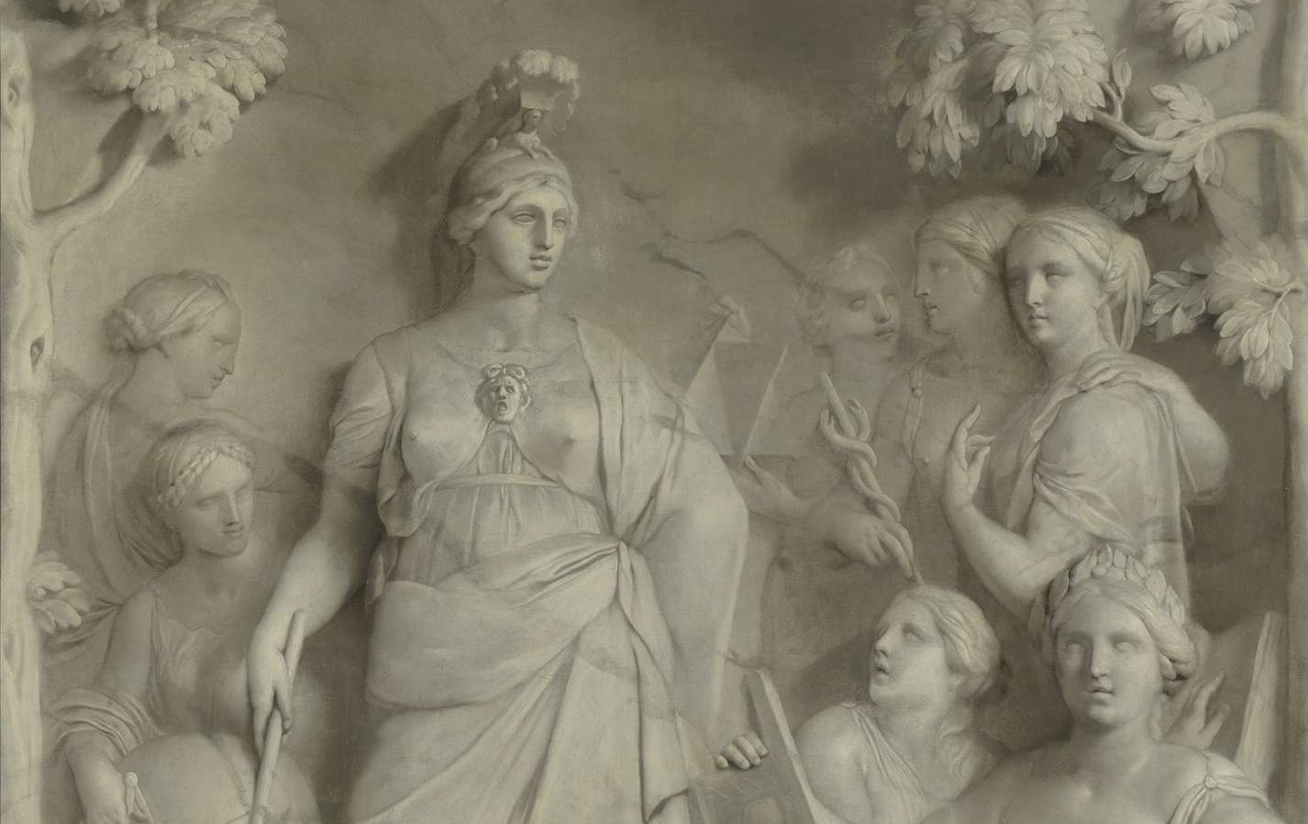
Core of current Open Data Policy
Knowledge needs to be shared
Taco Dibbits
Director-elect Rijksmuseum
Notes:
Variation on a theme:
Information wants to be shared / Joshua Gans
Information wants to be free / Stewart Brand -> Whole Earth Catalog (counter culture magazine, 1968-1972)

Slide 7
REORGANISATION
Reorganisation Research Services (February – May 2016)
  Centralisaton of different departments & new mission
  Focus on integrated collection information management
Centralised former (sub-)departments
  Collection Systems & Data Management
  Rijksmuseum Research Library
  Collection Documentation
  Study Room / Print Room

Slide 8
REORGANISATION
Reorganisation Research Services 2016 (February – May)
  Centralisaton of different departments & new mission
  Focus on integrated collection information management
Centralised departments => data galore!
  Collection Systems & Data Management
  Rijksmuseum Research Library
  Collection Documentation
  Study Room / Print Room
Collection data
Bibliographical data
Documentary data
Research data:
Provenance data
Conservation & Restoration data

Slide 9
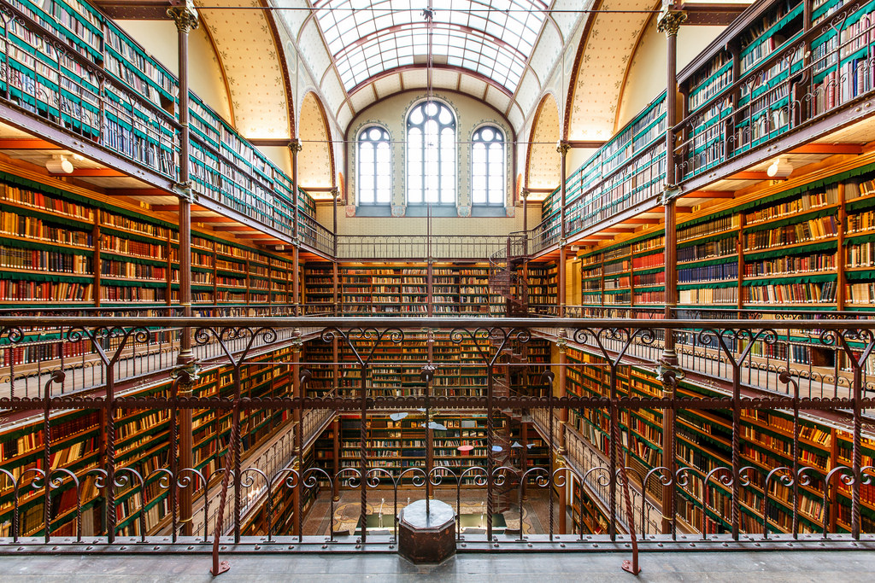

Slide 10
FUTURE DEVELOPMENTS
Consolidating integrated semantic collection data infrastructure
Data Modelling EDM & CIDOC-CRM (2015-2016)
Triplestore Rijksmuseum (release end of 2016)
  Start with linked open collection data / SPARQL endpoint
  Testing with DYDRA - cloud-based RDF store (db-as-a-service)
Extending Open Collection Data Strategy
New focus on research data management & institutional repository
Notes:
22.846.996 triples, 351.814 objects (tests March 2016)

Slide 11

Italiaans landschap met parasoldennen by Hendrik Voogd (1807) http://hdl.handle.net/10934/RM0001.COLLECT.6477

