Slide 1

CERL Alumni present their research
27 January 2021
Camilla Marangoni
Rosa Parlavecchia

Slide 2
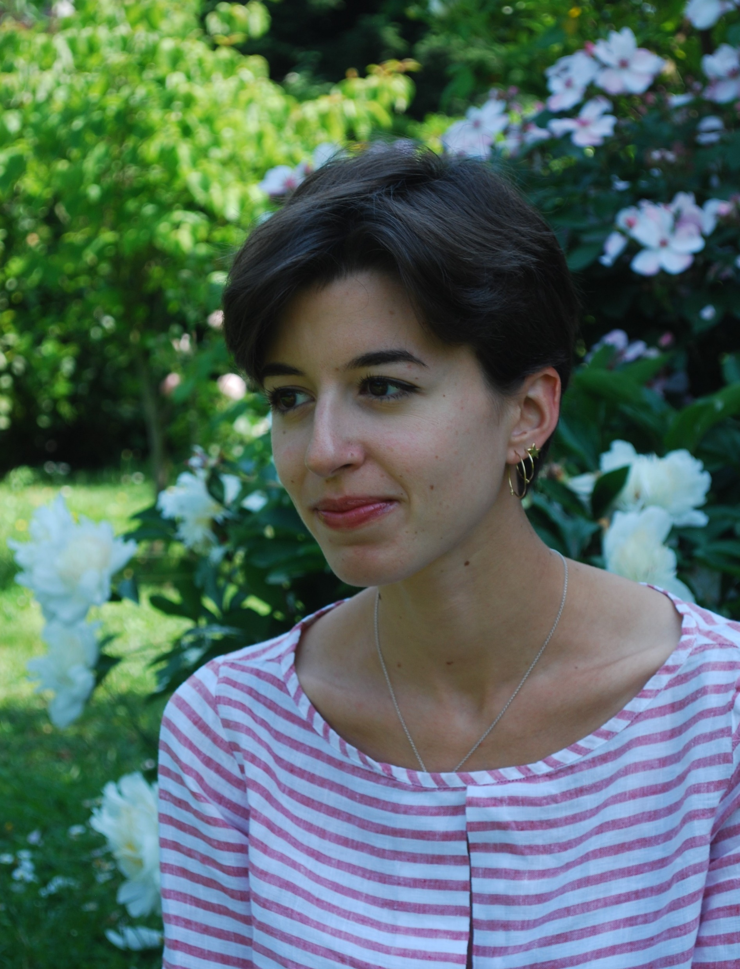
Camilla Marangoni
I live in Milan
BA in Cultural Heritage, MA in Archaeology and Art History at Università Cattolica del Sacro Cuore
Art historian with a passion for rare books, particularly interested in the interaction between written words and drawings, as well as the use of illumination in correlation to the medium of print.

Slide 3
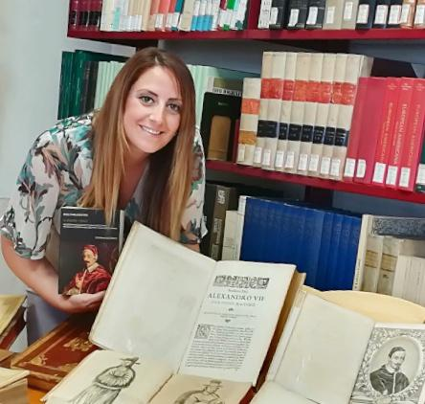
Rosa Parlavecchia
I live in Salerno
MA in Library Science at Salerno University, Vatican School of Library science, Ph.D. in Humanities at University of Calabria, postdoc researcher at ICCU where I am working on the research project POST-I-IT (Post Incunaboli ITaliani), contract professor of Printing History at Salerno University.
My main research interest concerns the history of books and libraries in the modern age.

Slide 4



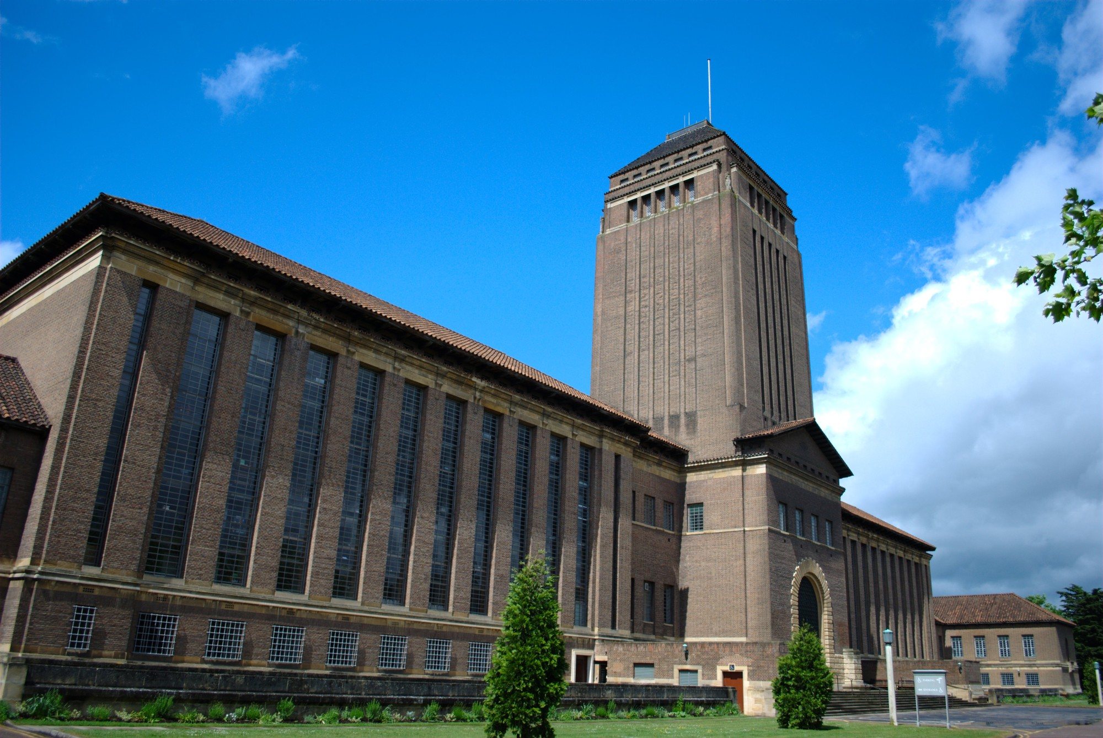



Our CERL internship
January 2020: our application for an internship at Cambridge University Library.
Beginning of March 2020: Italy declares state of lockdown, the internship had to be thought over.
Now: After a remote training, we are working on MEI database
Our new contribution to MEI database:
Our tool: the new incunabula catalogue of Biblioteca Medicea Laurenziana, curated by Ida Giovanna Rao and published in 2019
Creating new records for every item (533 in total), as well as new records for Owners of Incunabula when it’s needed
Instead of studying physical specimen: carefully analising details written by Rao and uploading them as new data on the database
Linking records, owners, providing material evidence

Slide 5
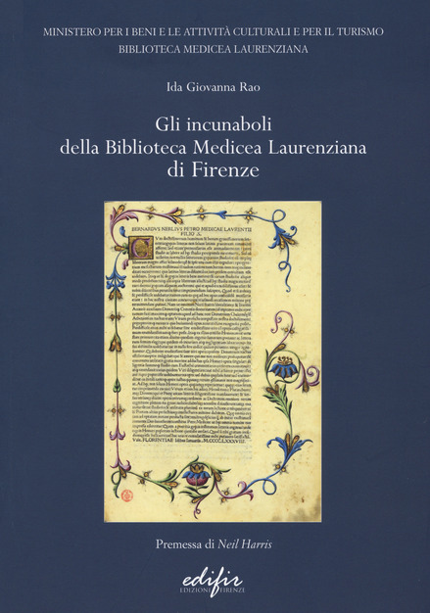
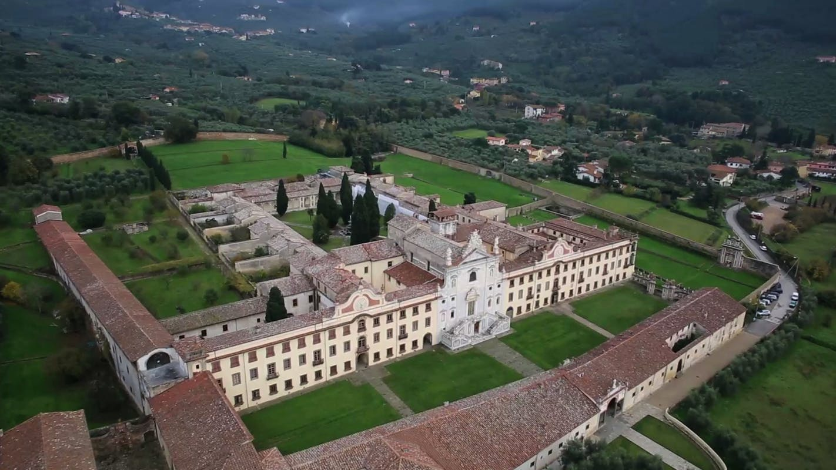
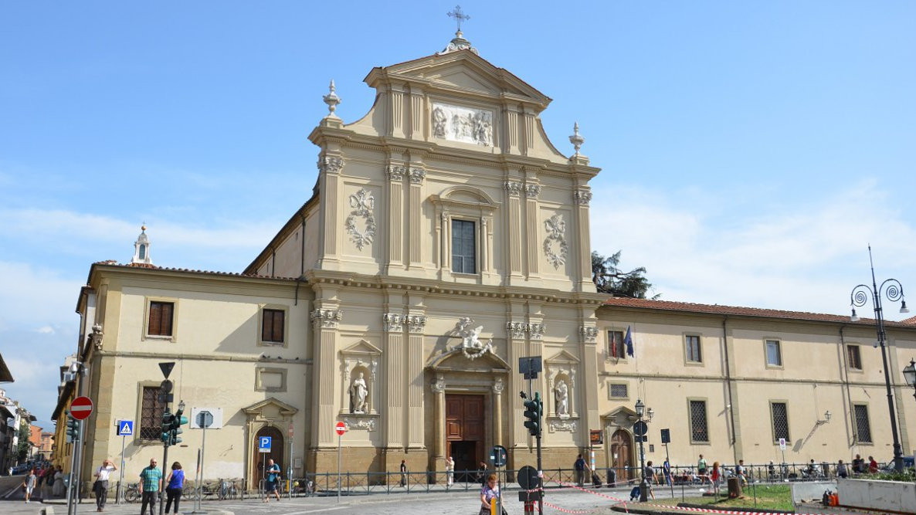
The value of Laurenziana’s Heritage
555 incunabula, 533 different editions
Most of the editions (376) come from the donation of count Angelo Maria Pannocchieschi d’Elci (1754-1824)
More acquisitions from important institutions, eg. S. Marco, Certosa di Calci
Many luxurious copies, with beautiful illuminations and woodcuts, prestigious owners

Slide 6
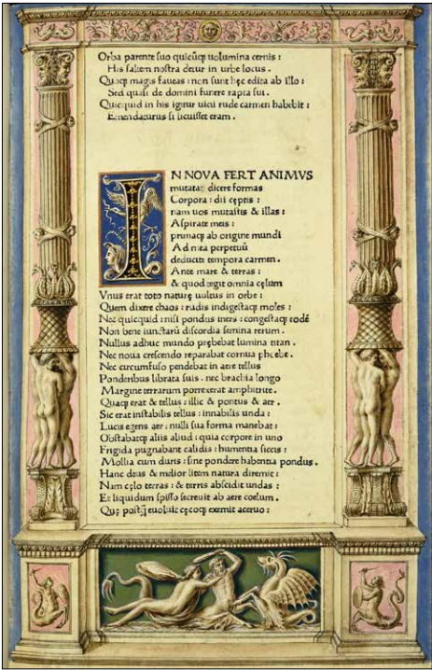
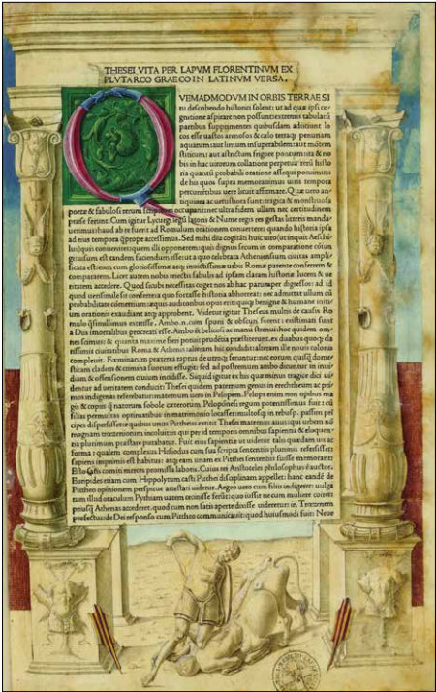
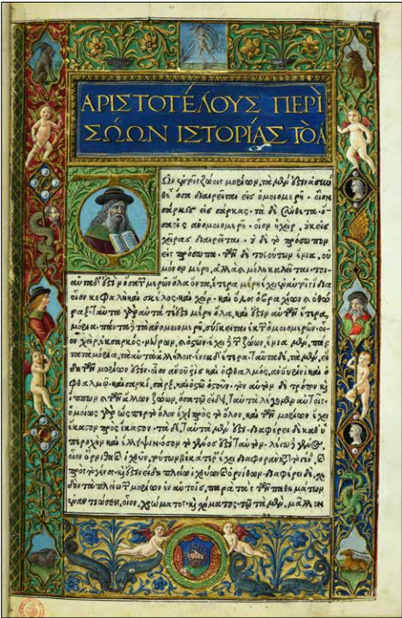
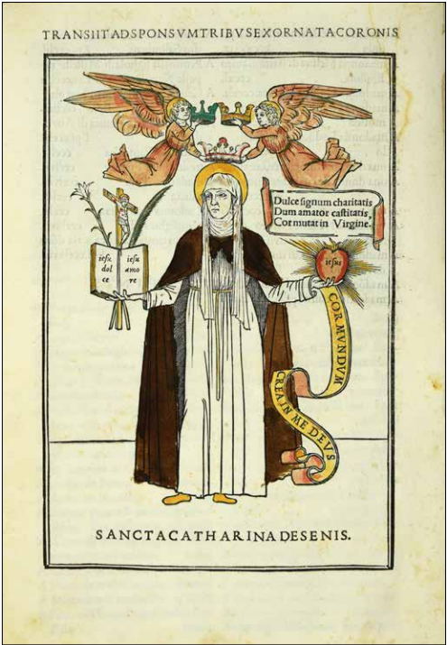
Some observations on working with the printed catalogue
Challenges:
Necessity of interpretation of synthetic information
No chance of creating a complete record, some fields must be left empty
What we have gained:
A deeper understanding of the structure of a catalogue
Faster process
Despite the current health emergency, we have the great opportunity to work on the MEI database.

