Slide 1
Why consider remote storage? Some thoughts to warm up…
Ulrich Niederer
CERL Seminar
18/19 November 2019, The Hague

Slide 2
Common reasons
… your stacks are filled up, and an extension on site is not possible
… you want to use stack space for something different, like public space
… your stacks pose preservation problems
… your stack space in the city centre is too expensive

Slide 3
A concept with a long tradition
Alexandria Library: remote storage for 48’000 scrolls in the Serapeum Temple
1902: Ch. W. Eliot (HUL): «The division of a library into books in use, and books not in use, with different storage methods for the two classes of books” Library Journal, 27 (1902), pp. 51-56
First actual remote storage facilities in the 1940ies

Slide 4
…but what is ‘remote’?
in the same city?
in the countryside, but sort of close by?
really, how far is too far?
Notes:
Californian example: 120 m

Slide 5
Remote storage in Europe
Notes:
CTLes: Paris – Bussy St Georges = ~20 km (but: City!) ; Munich: similar
CSLS: B – Lucerne: 30 km; B – BS, ZH = 80 km; B – St. Gall = 145 km
BL: London – Boston Spa = ca 300 km?
Finland: eg Helsiniki – Kuopio = ca. 300 km?
Norway: Oslo – Mo i Rana = 1’000 km!

Slide 6
United States, and elsewhere
Situation USA, 2012
About 60% of ARL member libraries have remote storage facilities (most of them of the so-called ‘Harvard type’)
ca. 90 remote storage facilities
of individual libraries (Harvard: HD, Yale: LSF, …)
of several libraries = cooperative (RECAP, PASCAL, …)
Canada: comparable to the US
Australia: CARM and CARM2
Asia: Japan, Hongkong, …
Notes:
RECAP: Research Collections and Preservation; Princeton, Columbia University, NYPL
PASCAL: Preservation and Access Services Center for Colorado Academic Libraries
CARM : CAVAL Archival and Research Materials Centre

Slide 7
A final question
individual or cooperative?
Advantages and disadvantages
Cooperative usually means “rr” for some libraries
Clear cost advantages for cooperation

Slide 8
Answers from a concrete example
CSLS in Büron, Switzerland
cooperation of 6 libraries (academic and public)
high density: high bay, automated, oxygen-reduced
All kinds of storage needs of all participating libraries
Preservation
Cost (but full cost calculation and comparability is important!)
Logistics
Development potential

Slide 9
… and remote special collections?
similar questions, only more pronounced
plus questions of transport damages
Example CSLS:
some libraries have parts of their heritage collection in Büron
the Central and University Library keeps the most valuable volumes (incunabula, manuscripts) in Lucerne, but has a large part of their 17th to 20th century special collection in Büron
but careful preparation:
acid free cardboard boxes
careful packing of containers
tuning of all moving units (robots, conveyor belts, lifts)

Slide 10
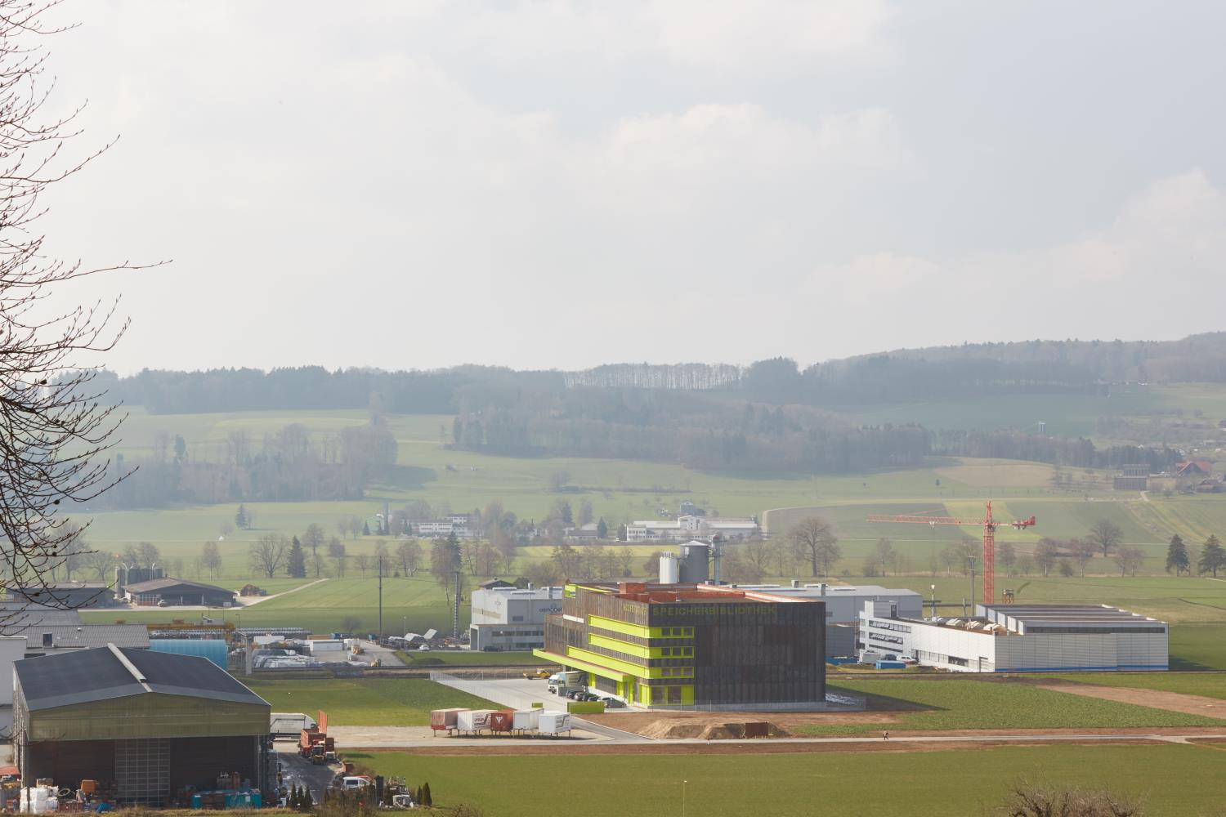
Now for the real questions! and thanks for your attention.
ulrich_niederer@bluewin.ch

