Slide 1
The actual move recollections and lessons learned
Ulrich Niederer
CERL Seminar
18/19 November 2019, The Hague

Slide 2
Who
The CSLS started operations in February 2016:
  5 libraries to start ingestion
  ~ 2 million books
  some under pressure, some under extreme pressure…
  some not finished with preparations
Notes:
Pressure = cost
Extreme pressure = cost and space – freeing space imperative!

Slide 3
What we did
Move for all libraries as one move
GATT/WTO competition
i.e. one contractor
(but perhaps with subcontractor partners)
Planning complex, but easier with one contractor

Slide 4
Planning
Planning for six libraries is difficult
each library is different, has its own speed
Planning for ongoing work is difficult
final preparations and packing don’t always correspond to the move timetable
→ An able coordinator is extremely important
(preferably someone on the storage facility team)

Slide 5
and experiences
clear contract, but with flexibility
  as to day-to-day capacity
  as to overall volume / timetable
clear contract: where to be taken over (stacks, ramp of library?), and where to be delivered (ramp, or work place / ingestion place)
clear requirements from library: handling of books and material
clear requirements: who is packing (but unpacking is not a question)
Notes:
Californian example: 120 m

Slide 6
technical requirements for the transport machinery / lorries: Euro 6 conformity
direct transports (i.e. no unloading during transport), and certainly no shared goods on transports)

Slide 7
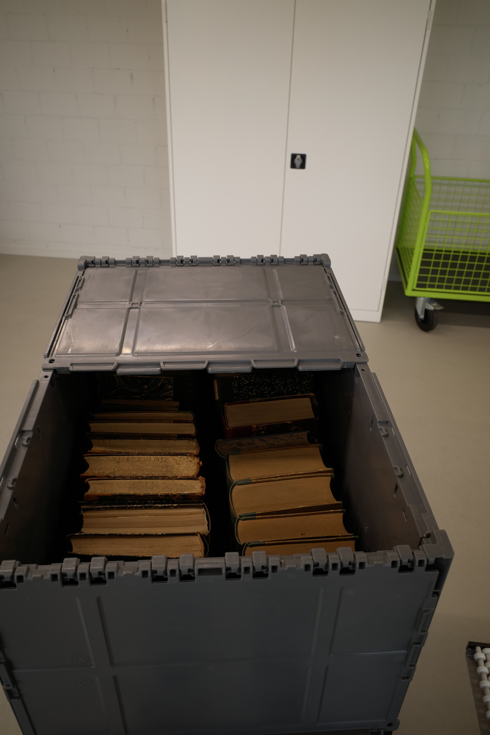
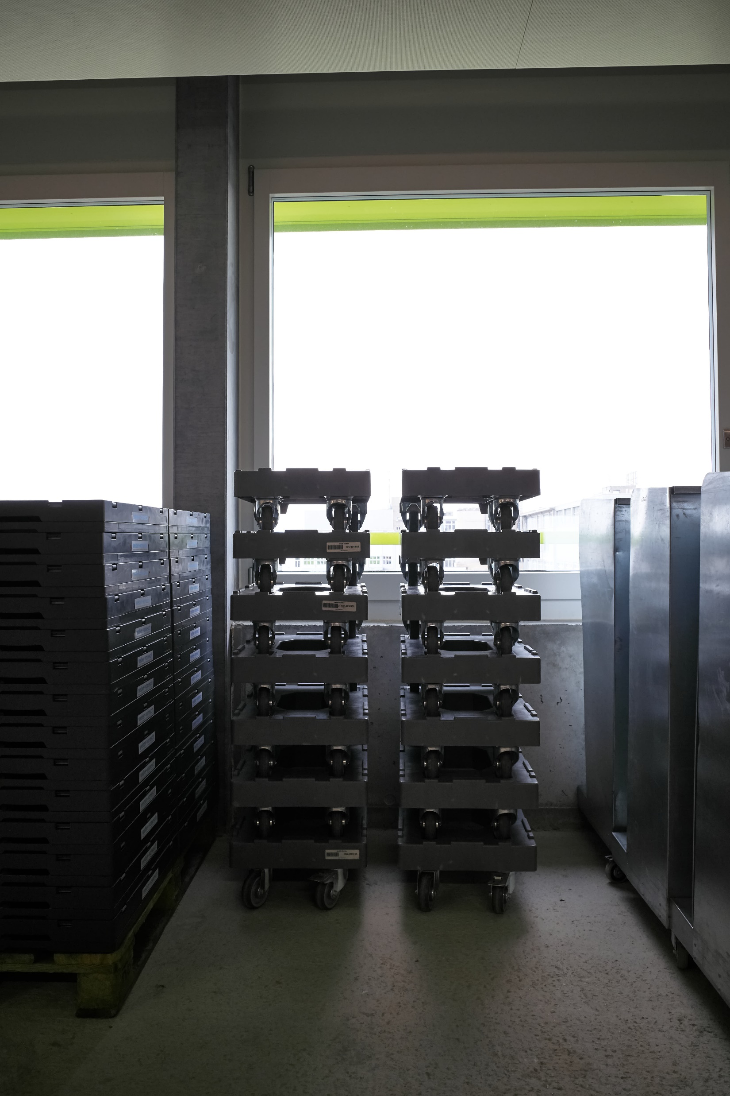
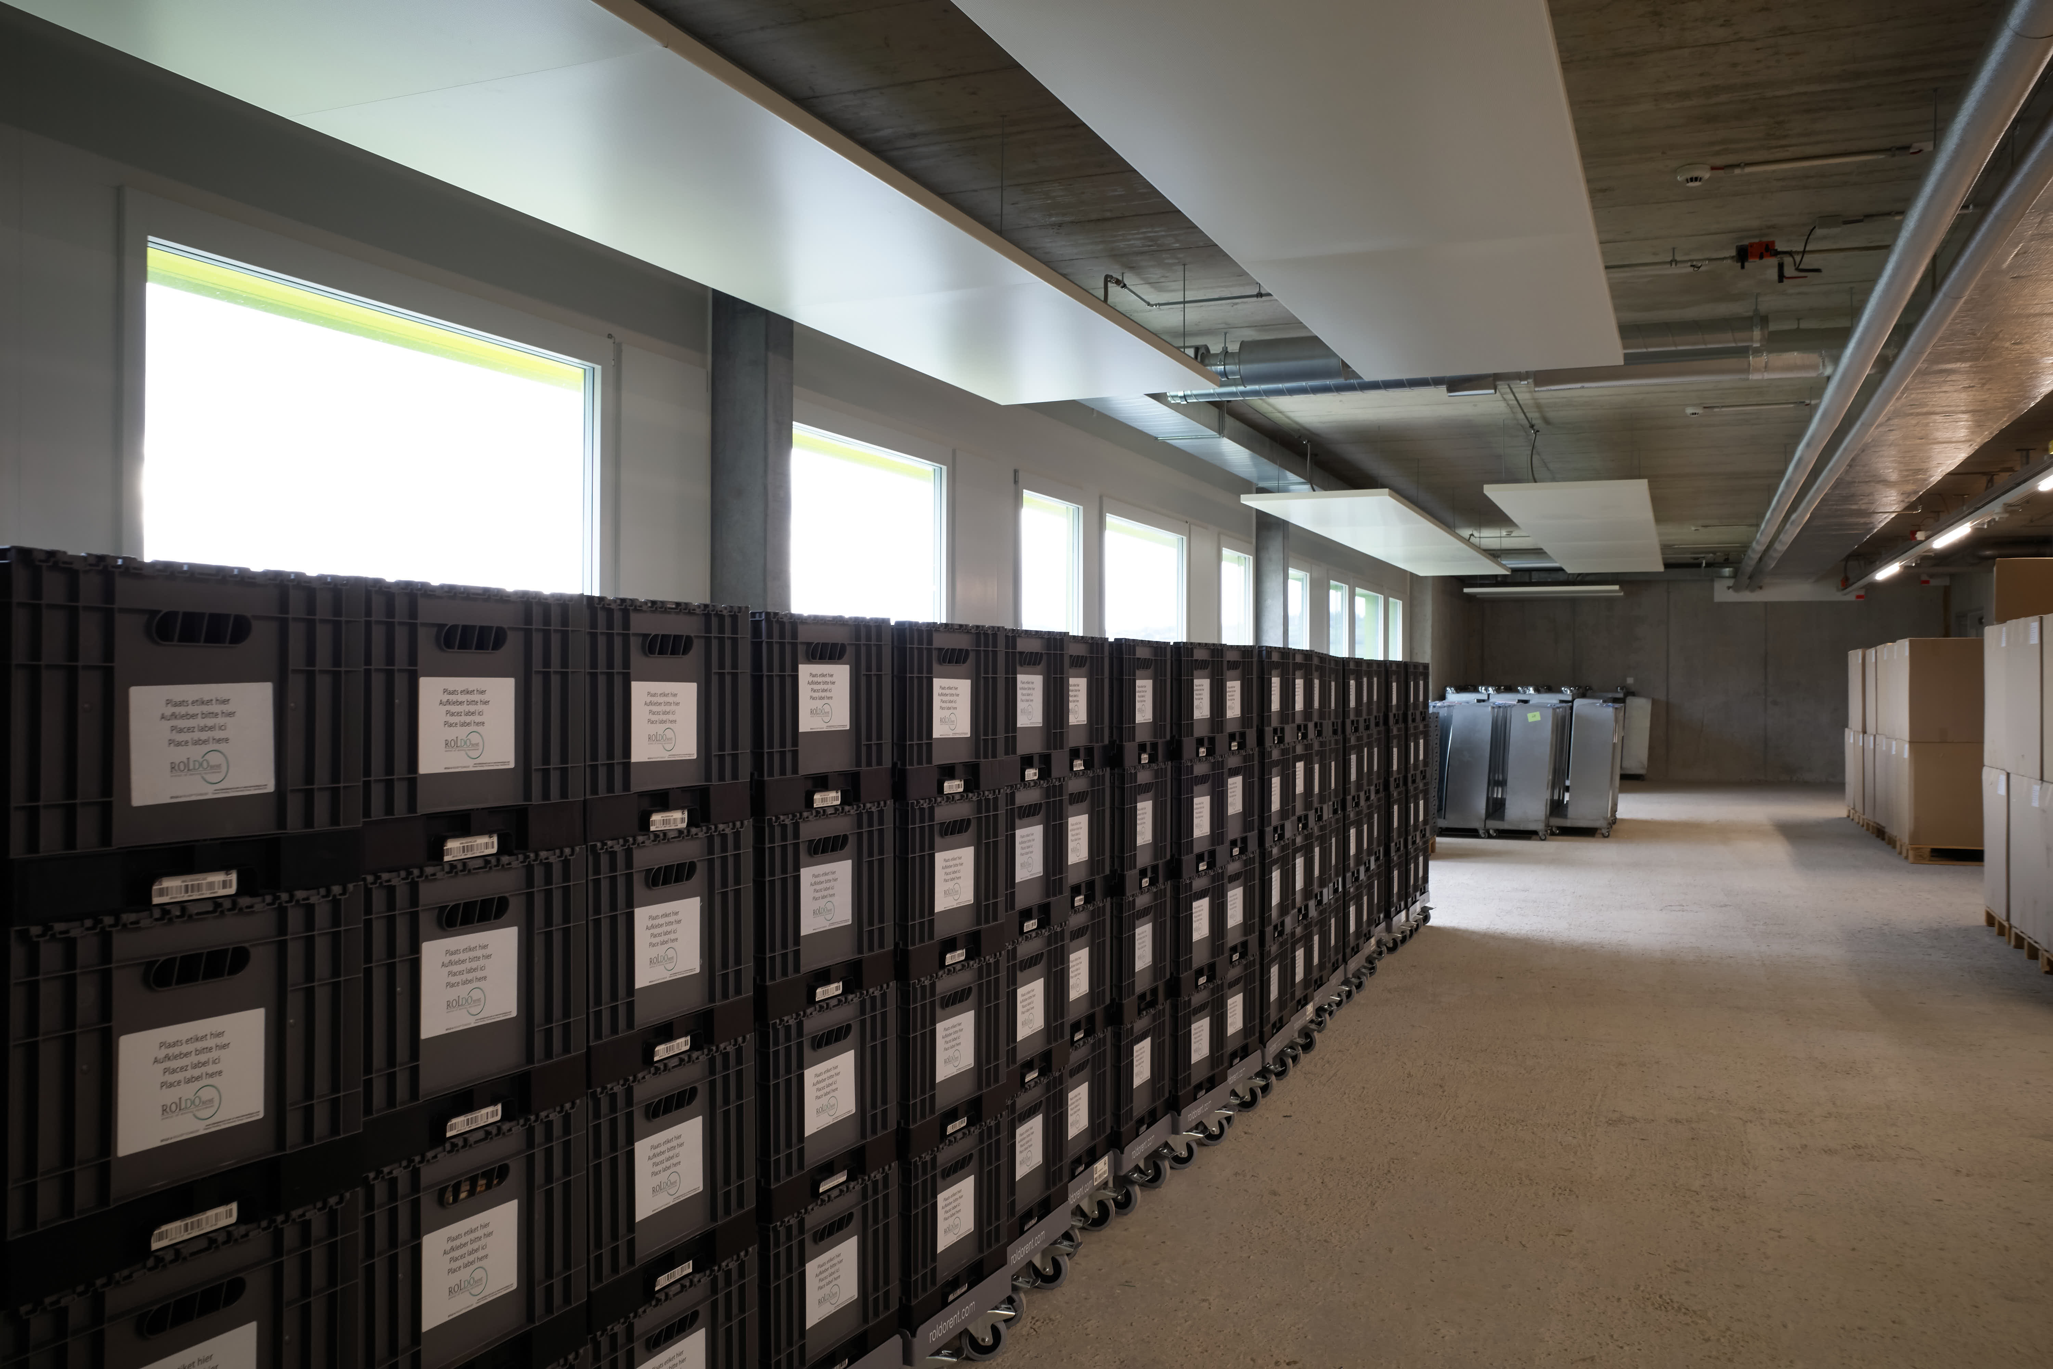
What kinds of transport carts/containers
Depends on the mover, and on the material moved

Slide 8
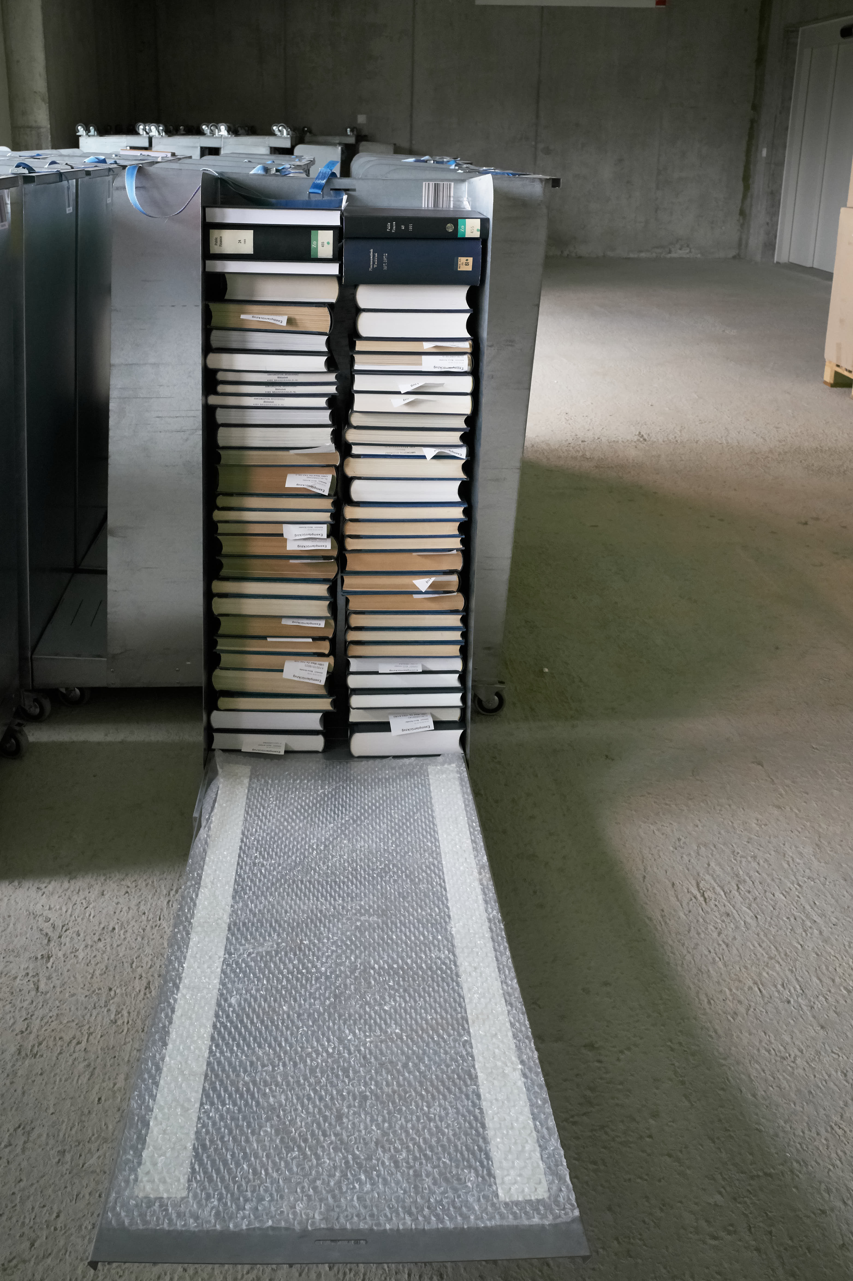
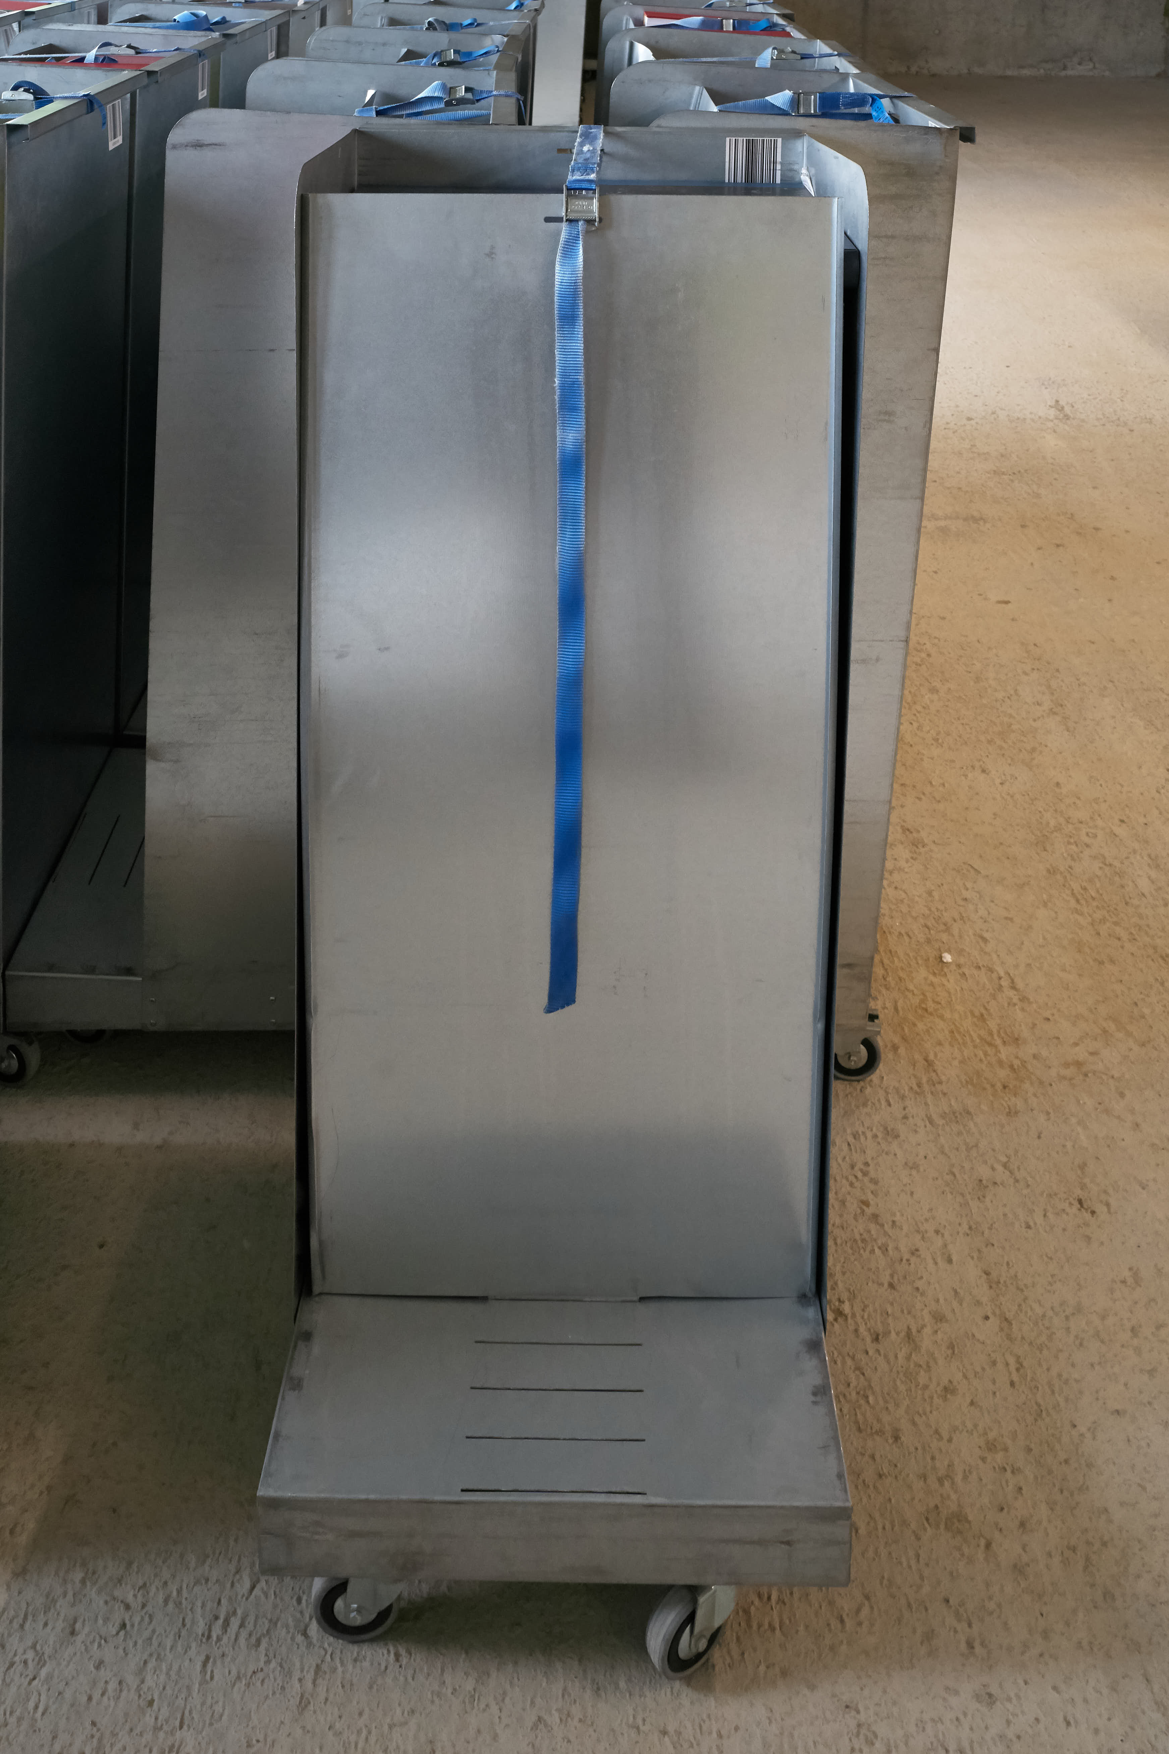

Slide 9
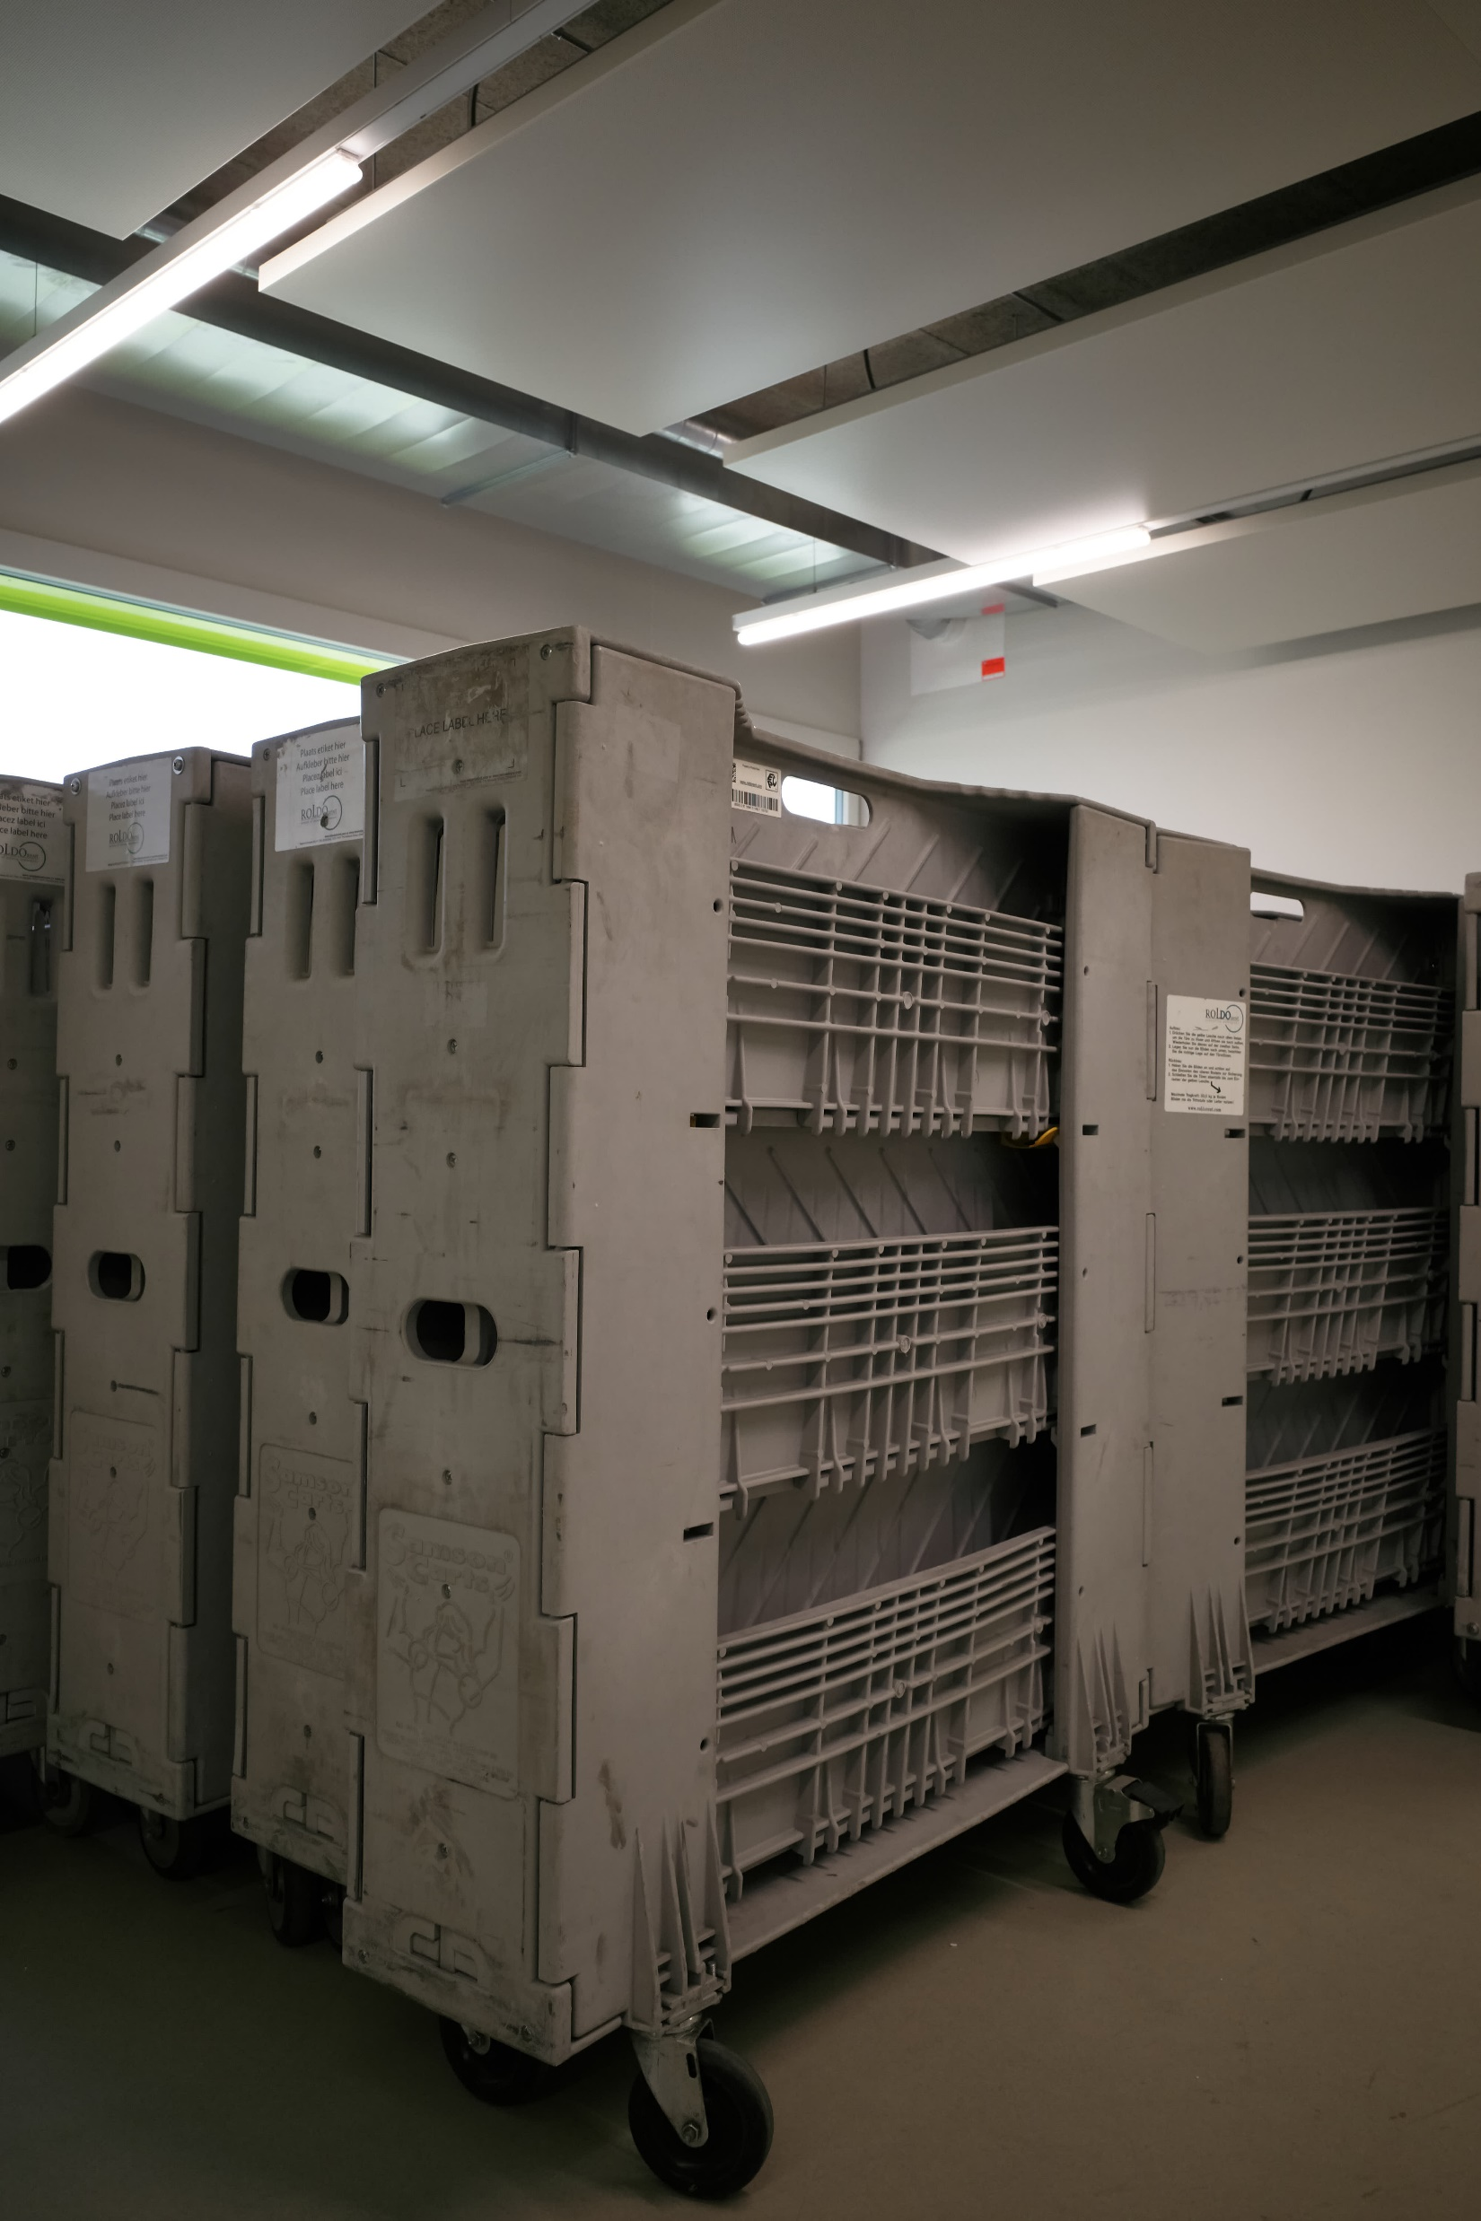
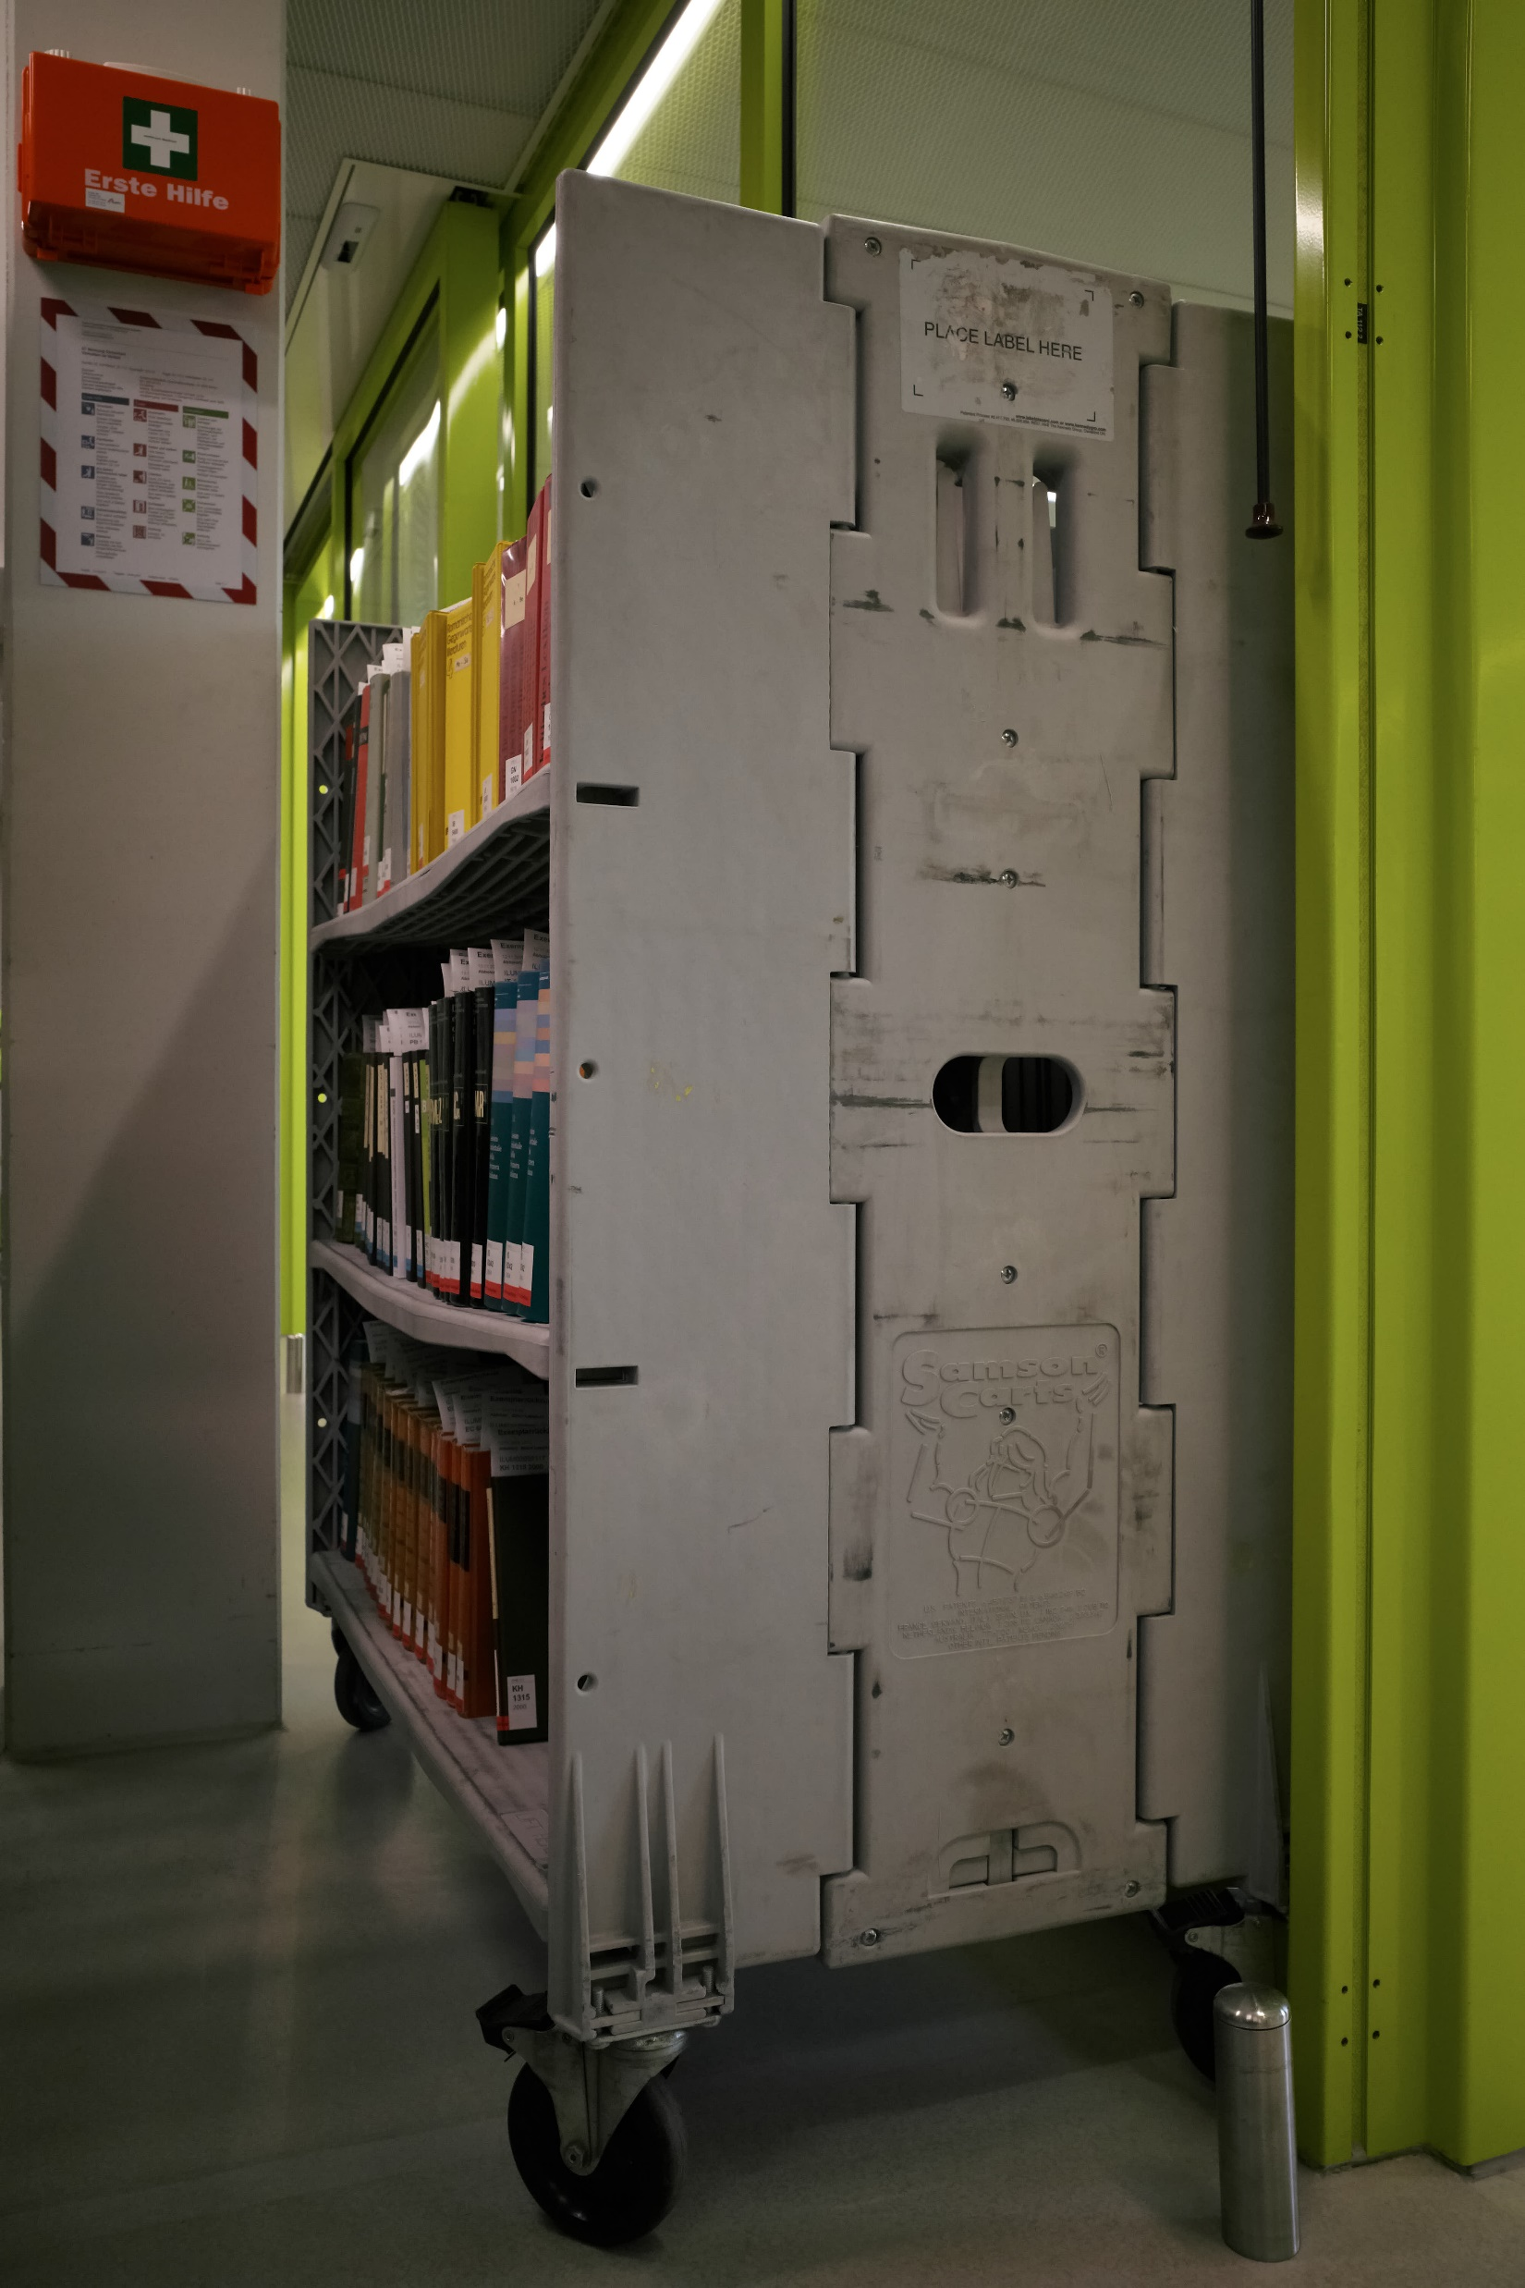
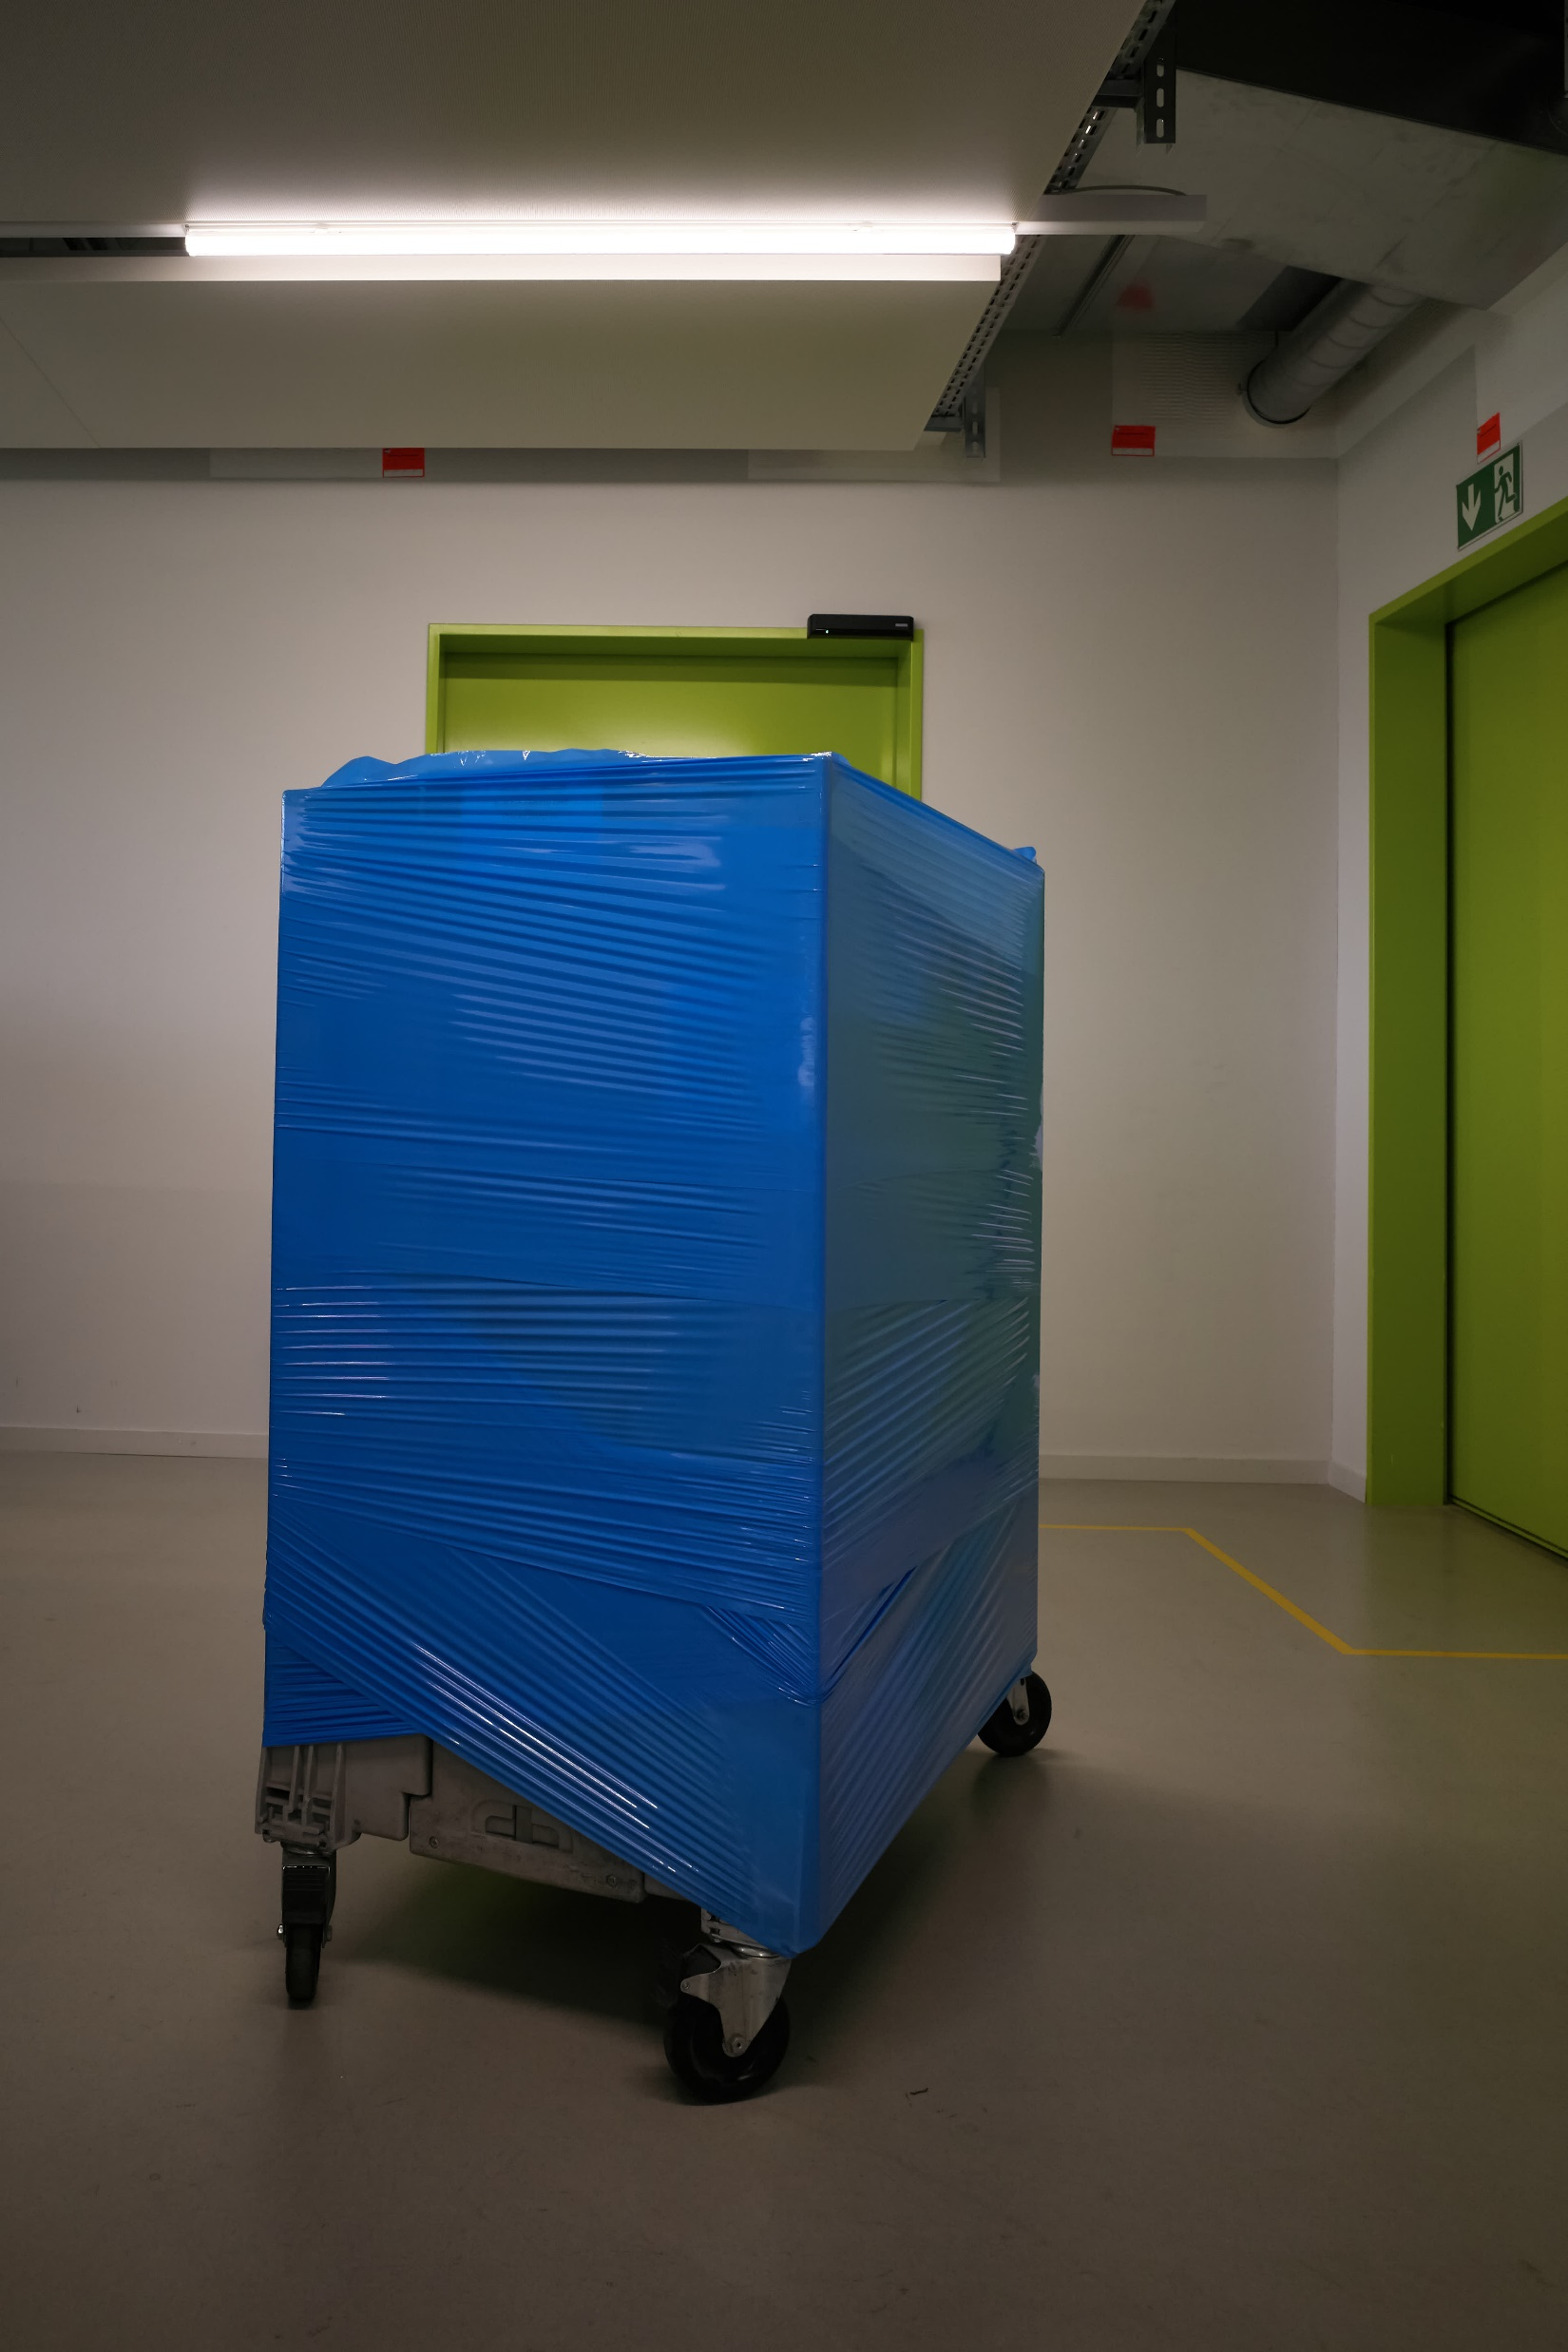
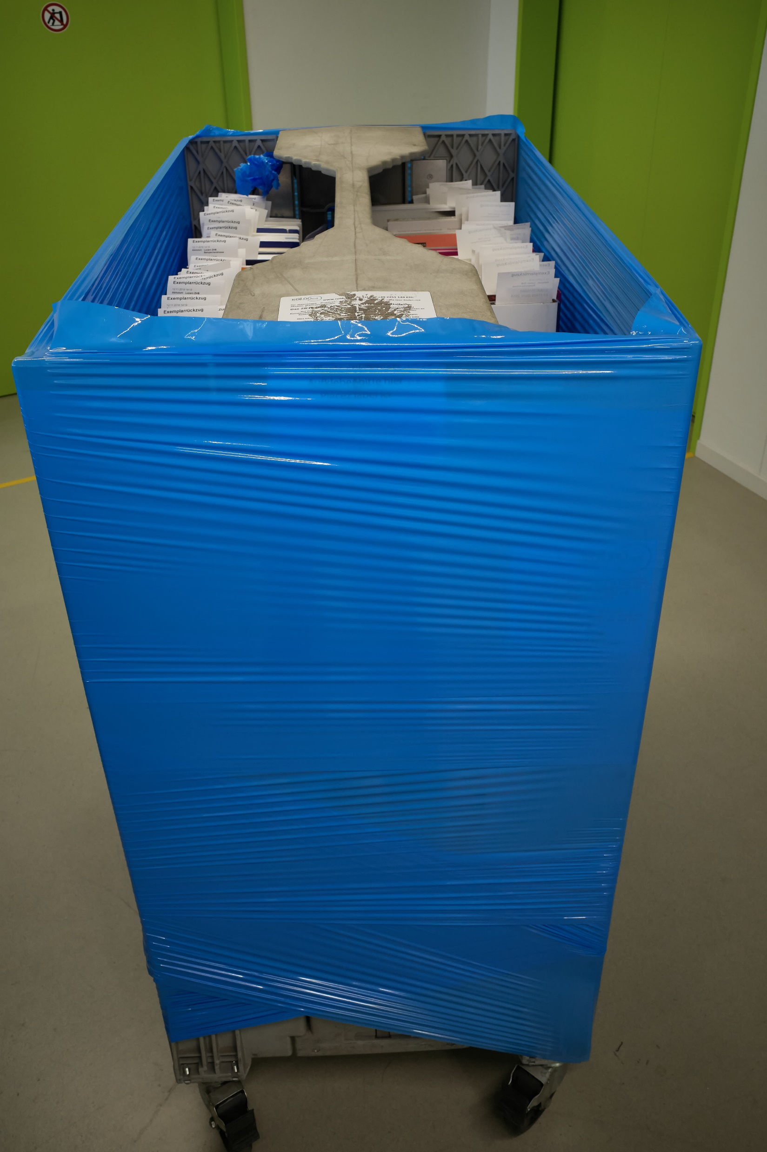
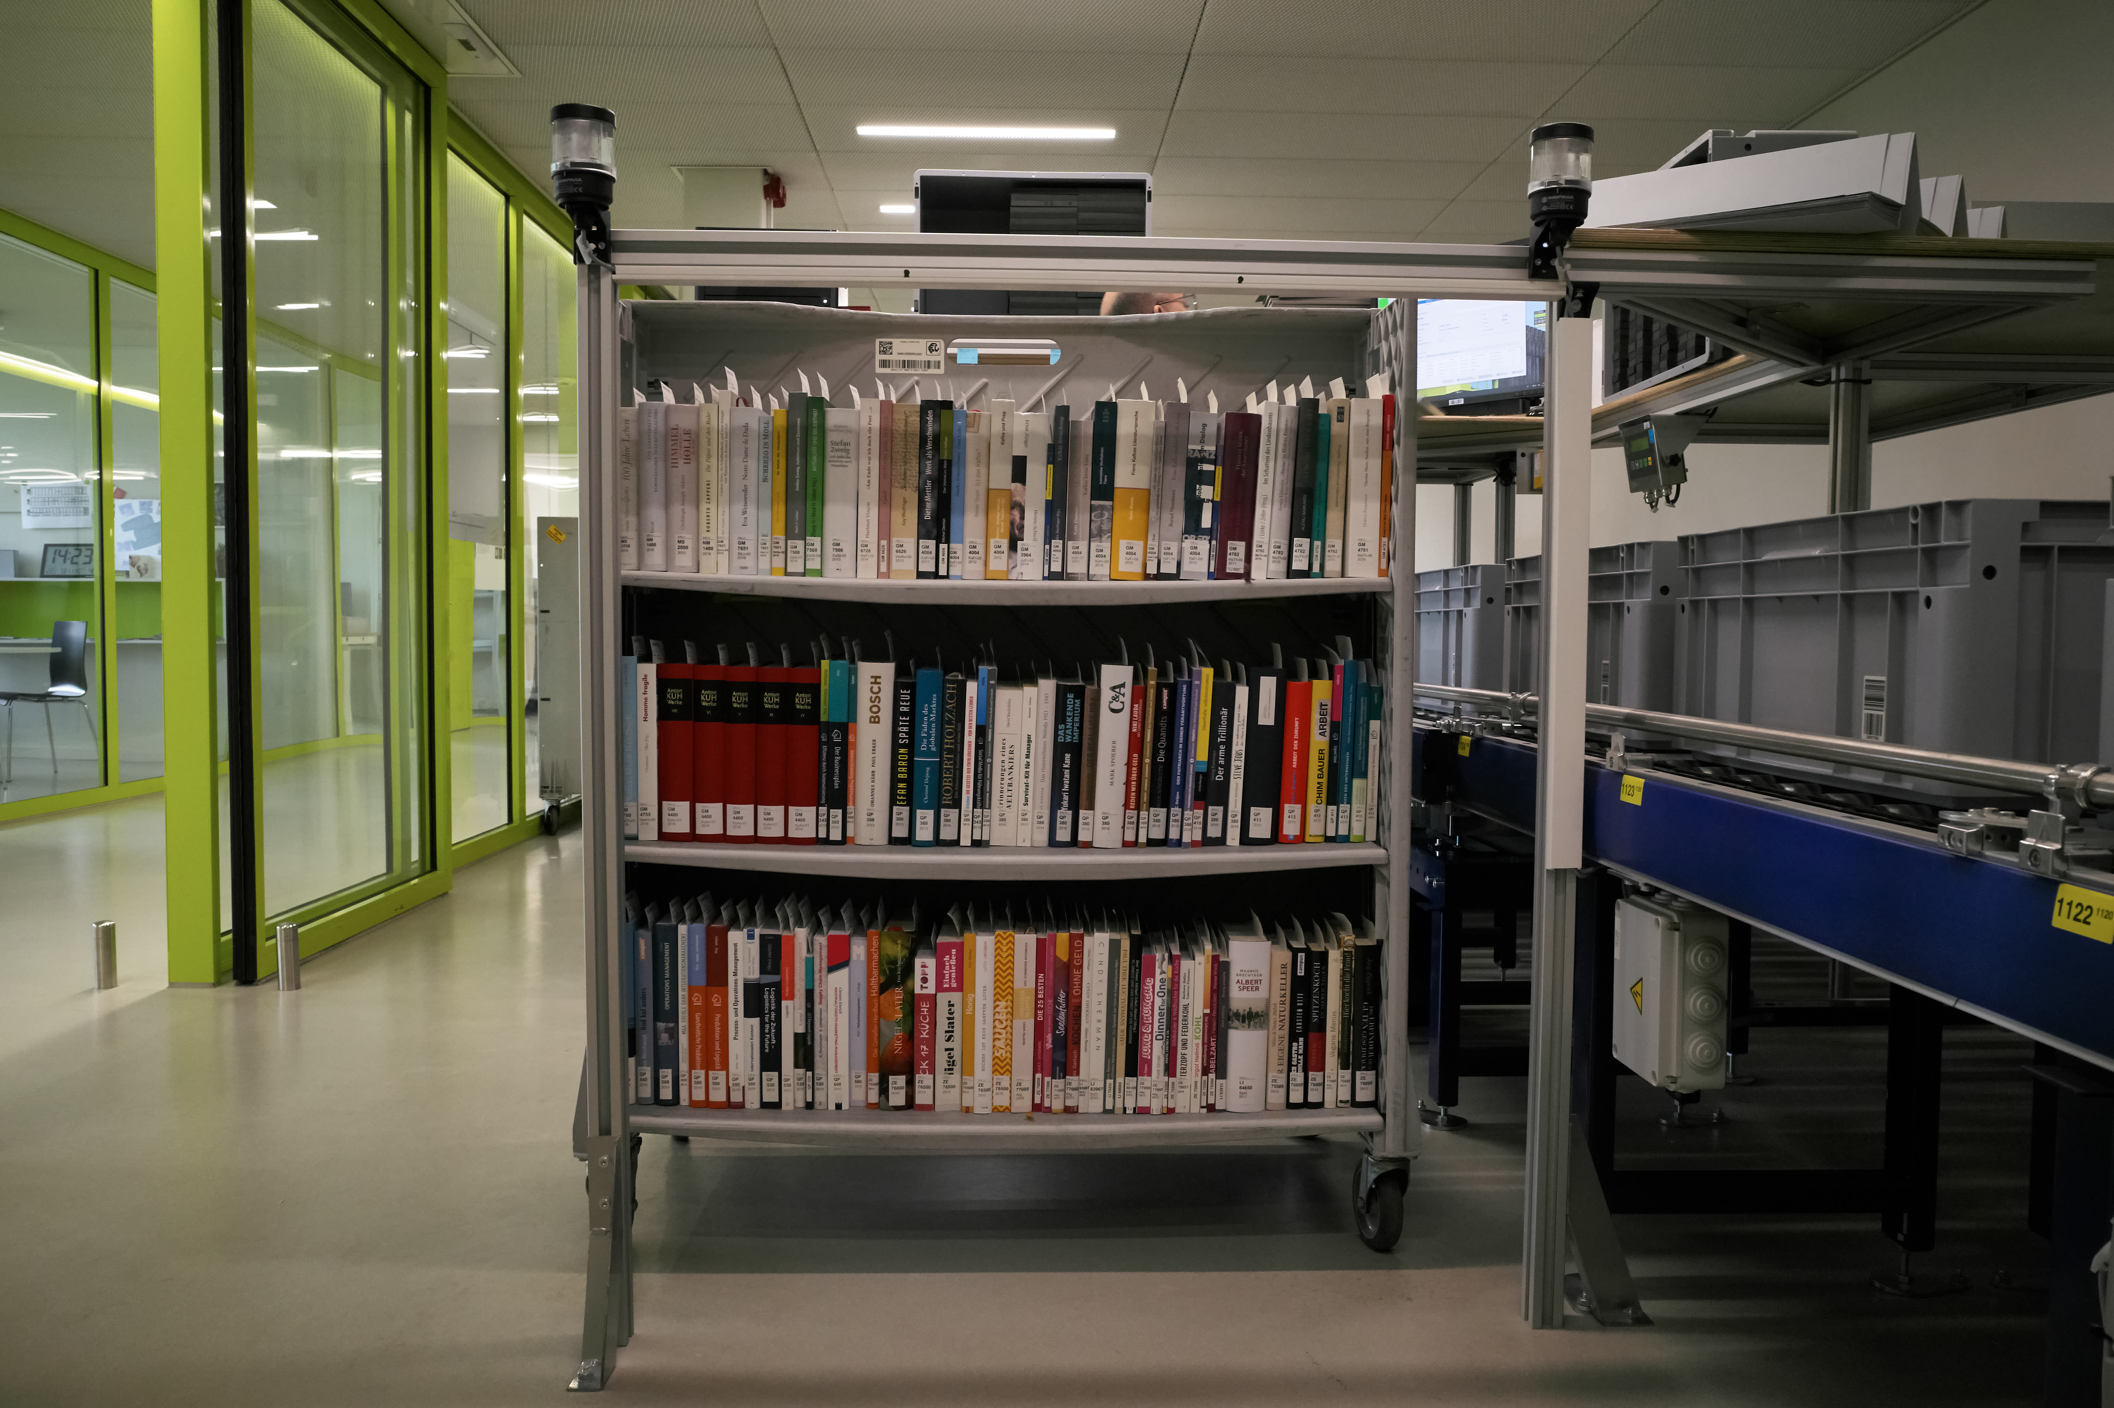

Slide 10
First ingestion
Capacity and precision!
Capacity: experience from Büron:
1 working place, 8 hours = 1’800 items (average material)
4-6 working spaces equal max capacity of 7’200 items (or 2 truckloads)
→ huge differences in material: volumes, boxes, brochures

Slide 11
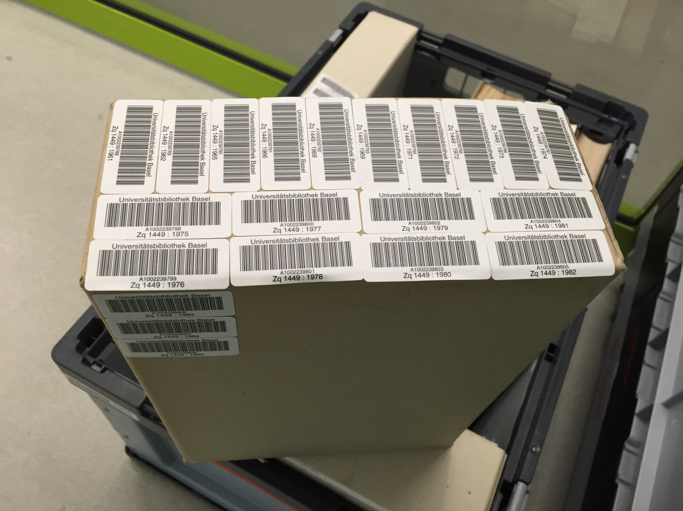
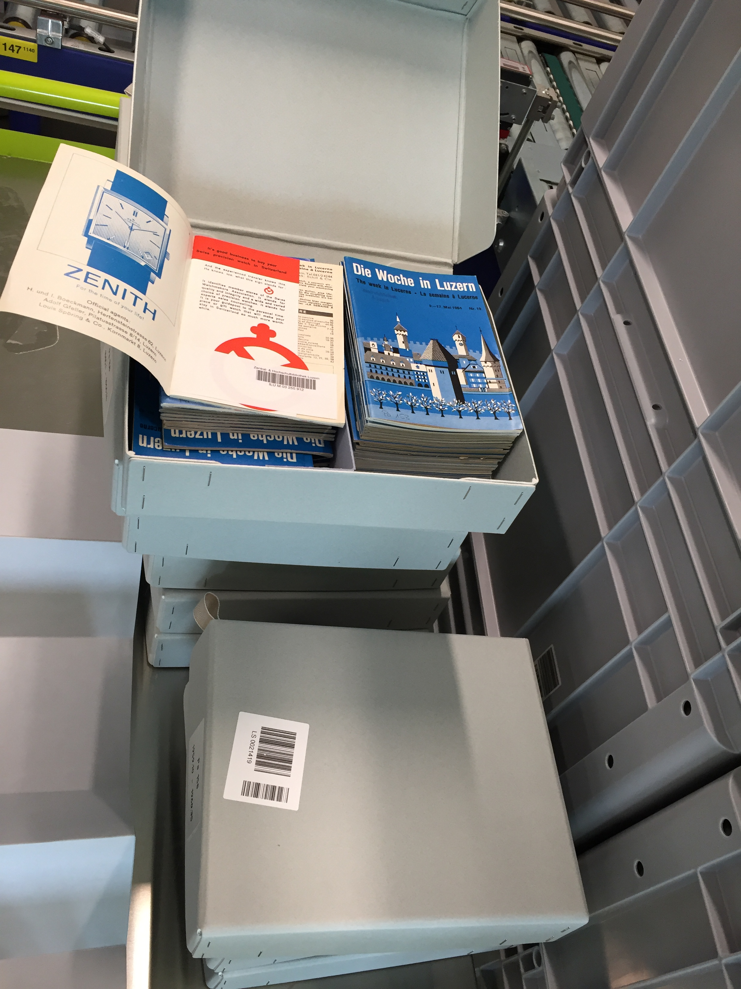
specialties
Omnibus volumes
Boxes with (usu. thin) volumes / brochures
→ Another level of hierarchy!
(an important requirement for the WMS)

Slide 12
Precision: first ingestion defines “find success” of operations later on
Experience from Büron:
  LMS delivers basic data to WMS
  Ingestion process:
    Operator chooses size of container
    Reads barcode of item
    WMS shows basic data for item; confirmation
    Operator chooses virtual section of container and puts item in
    Finishes with another confirmation.

Slide 13
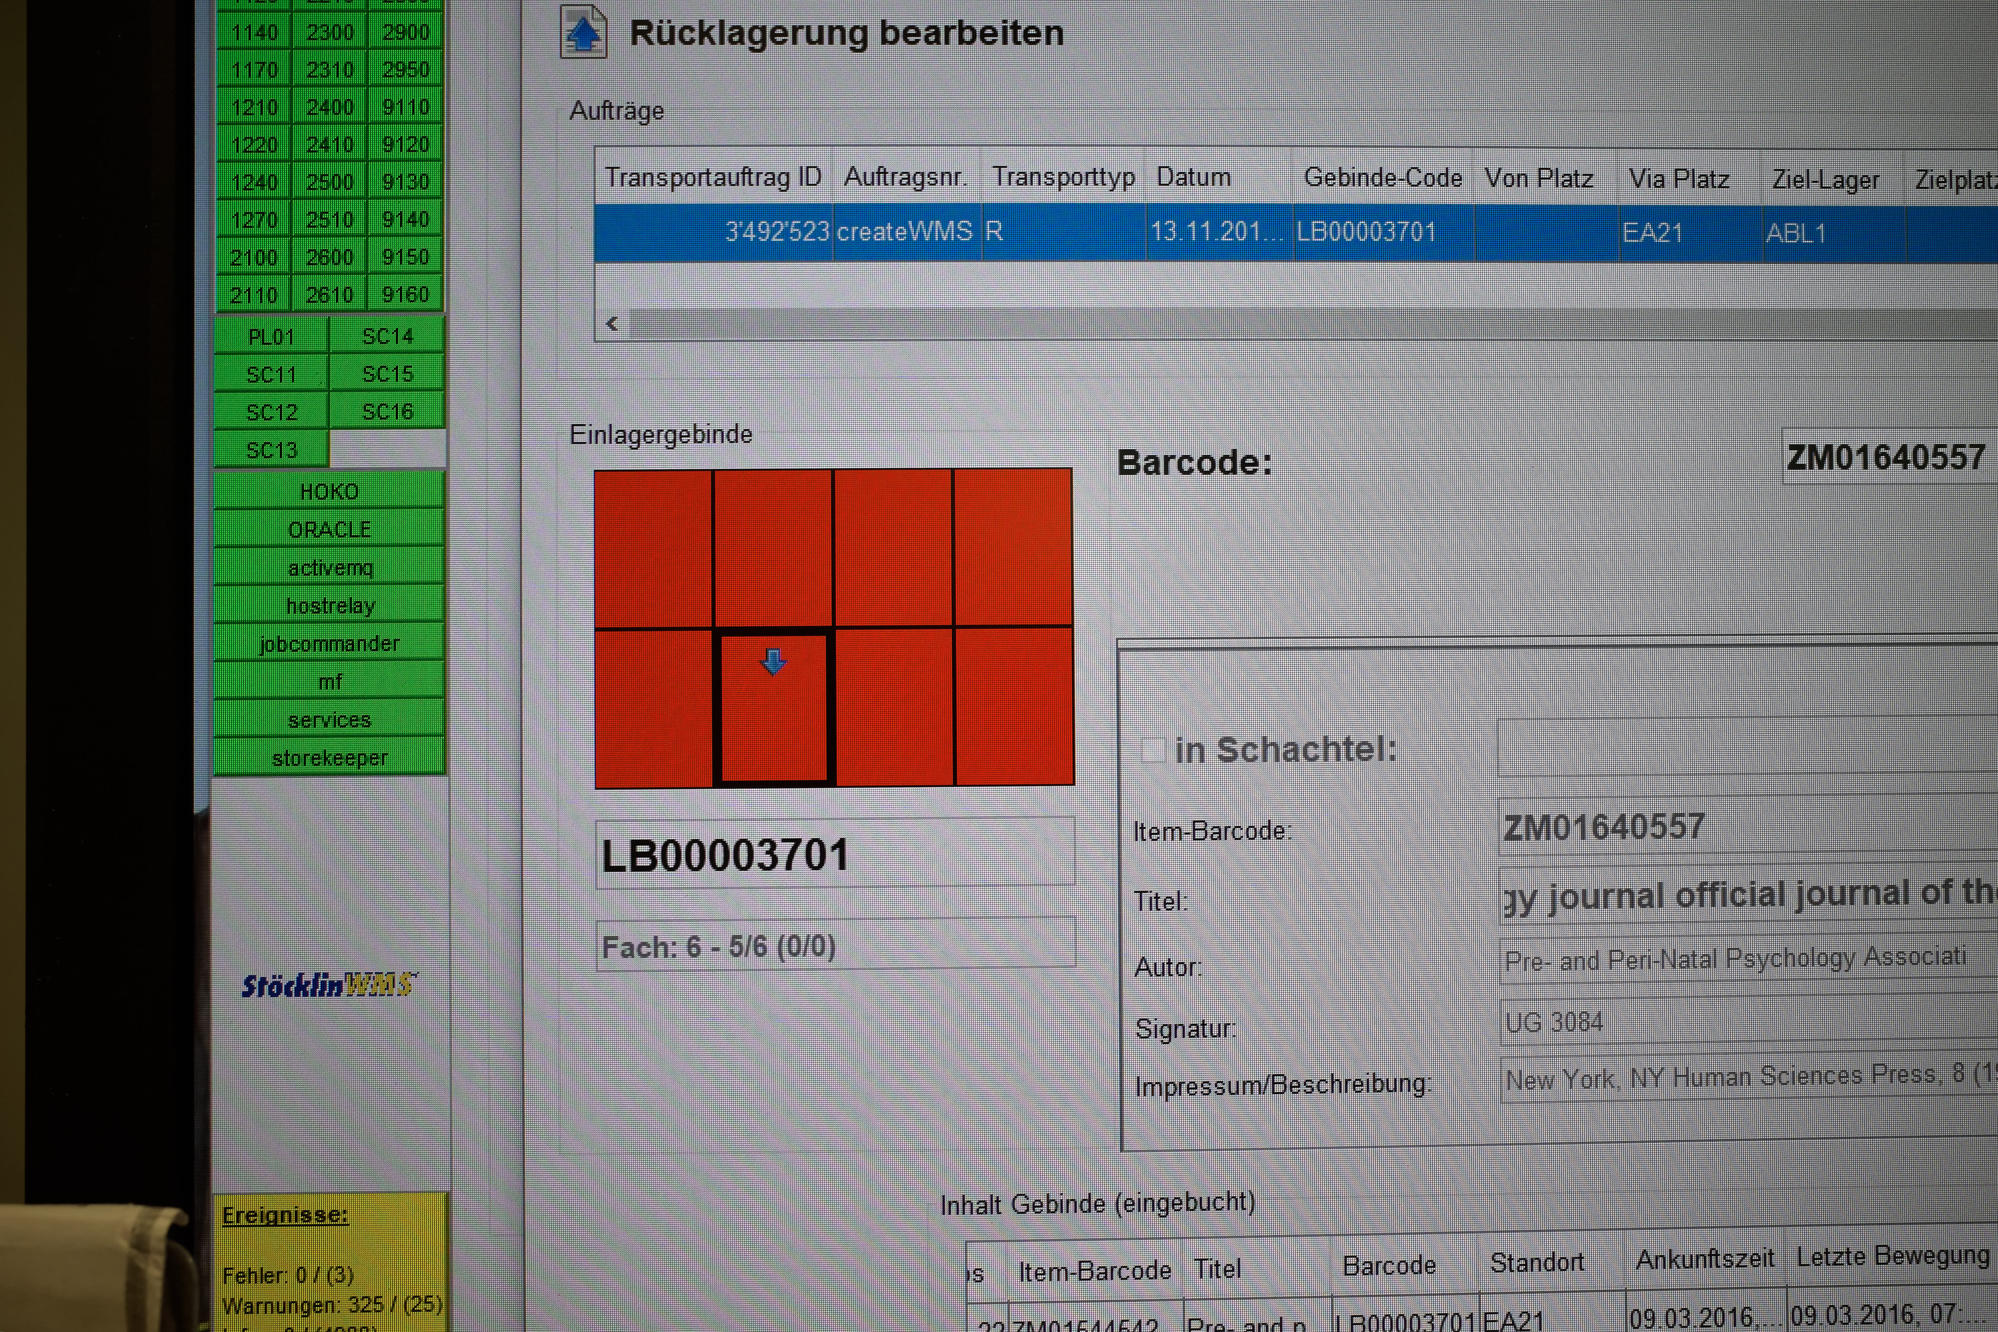
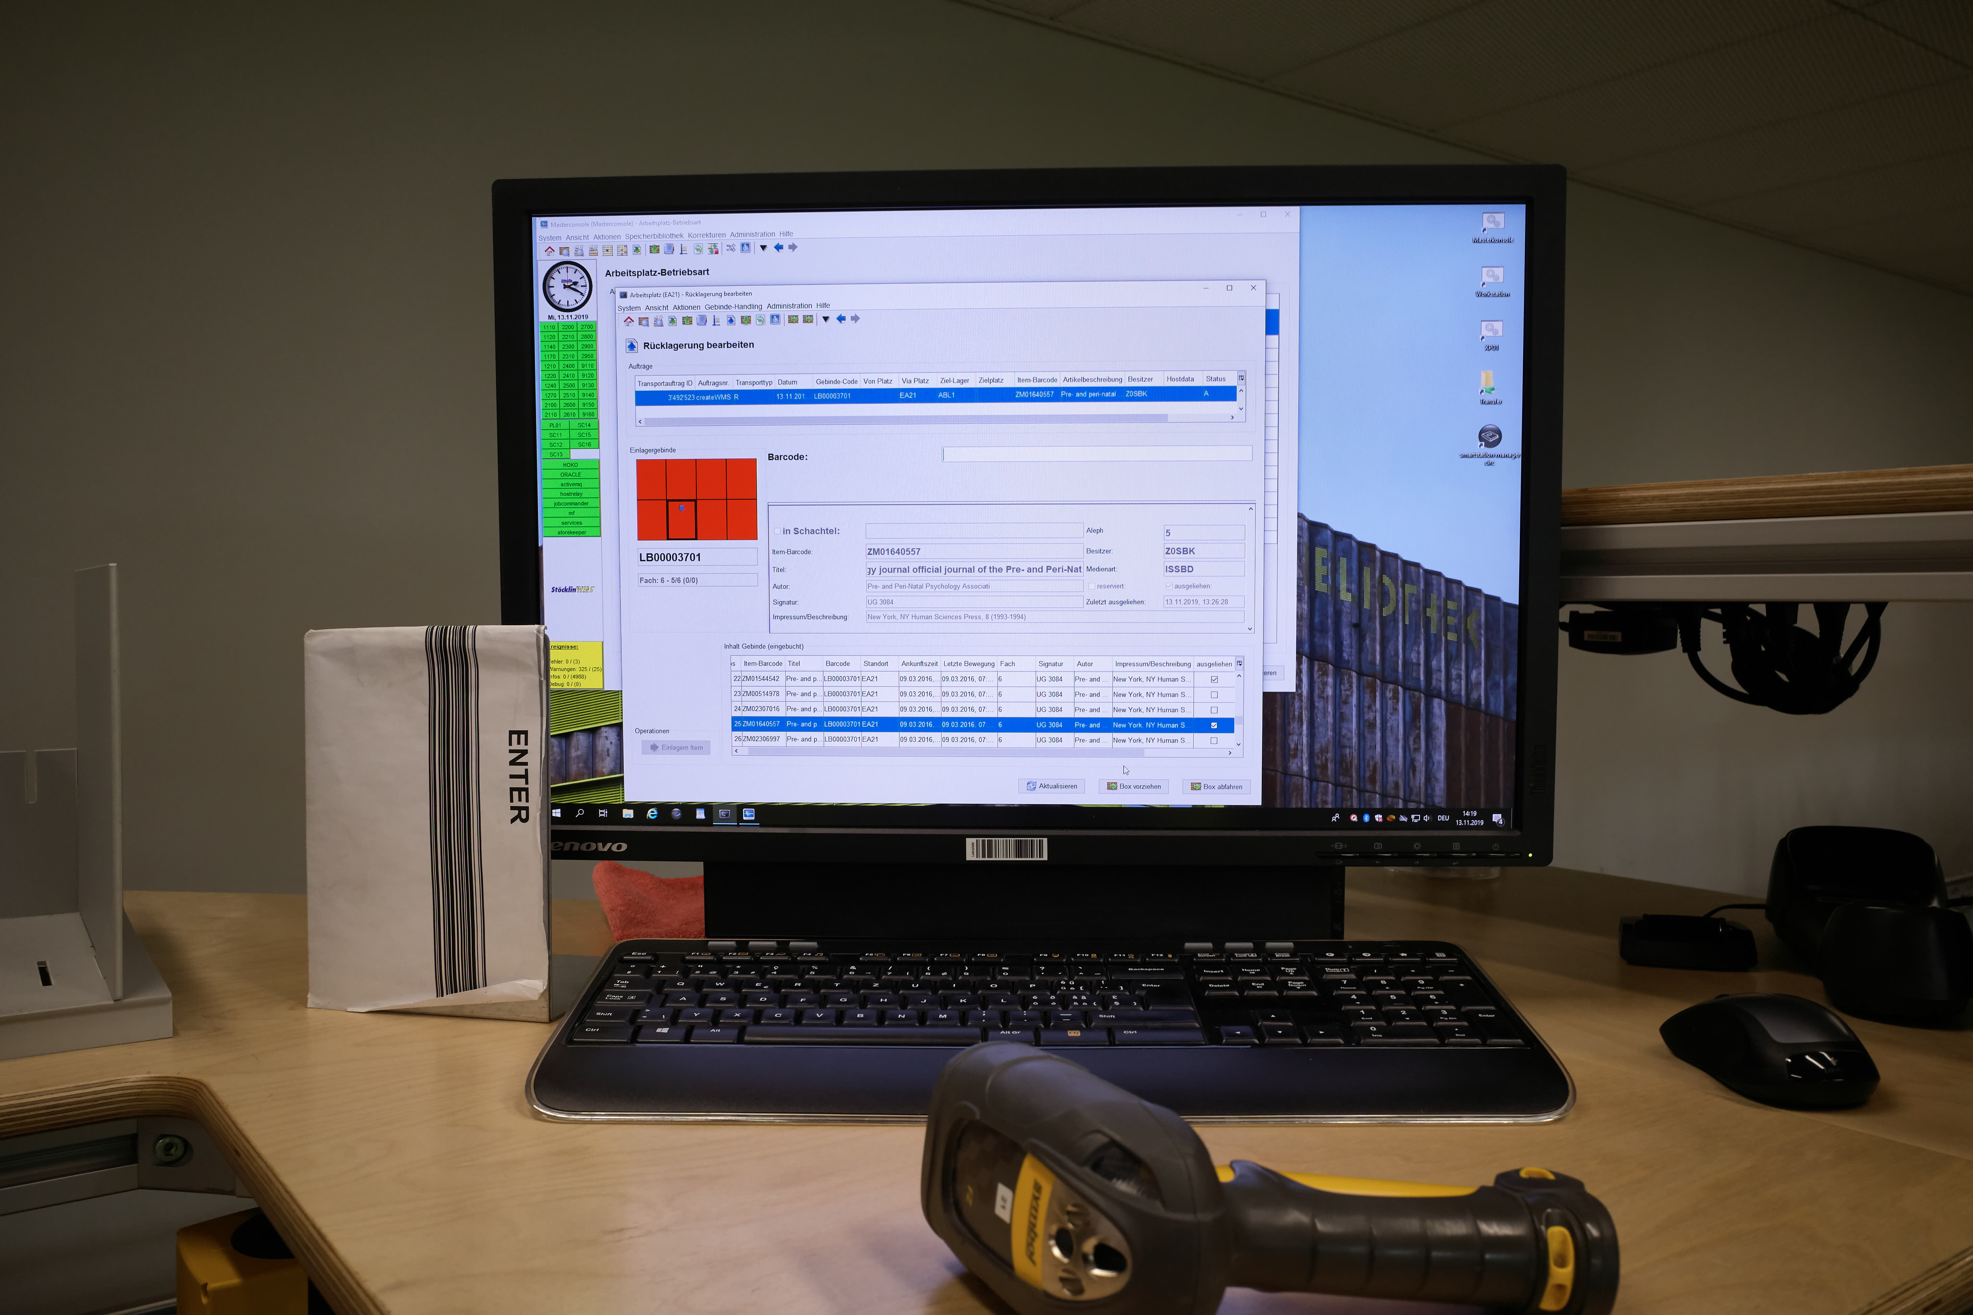
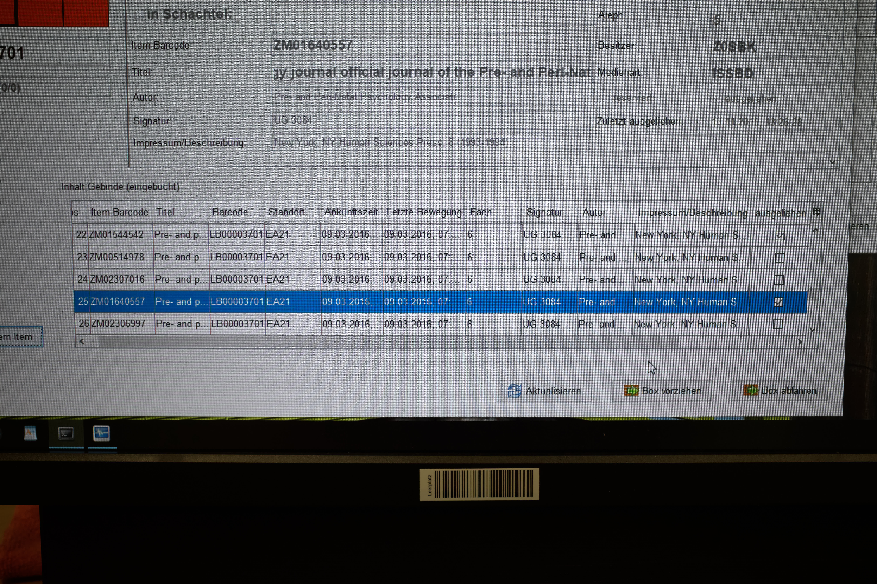

Slide 14
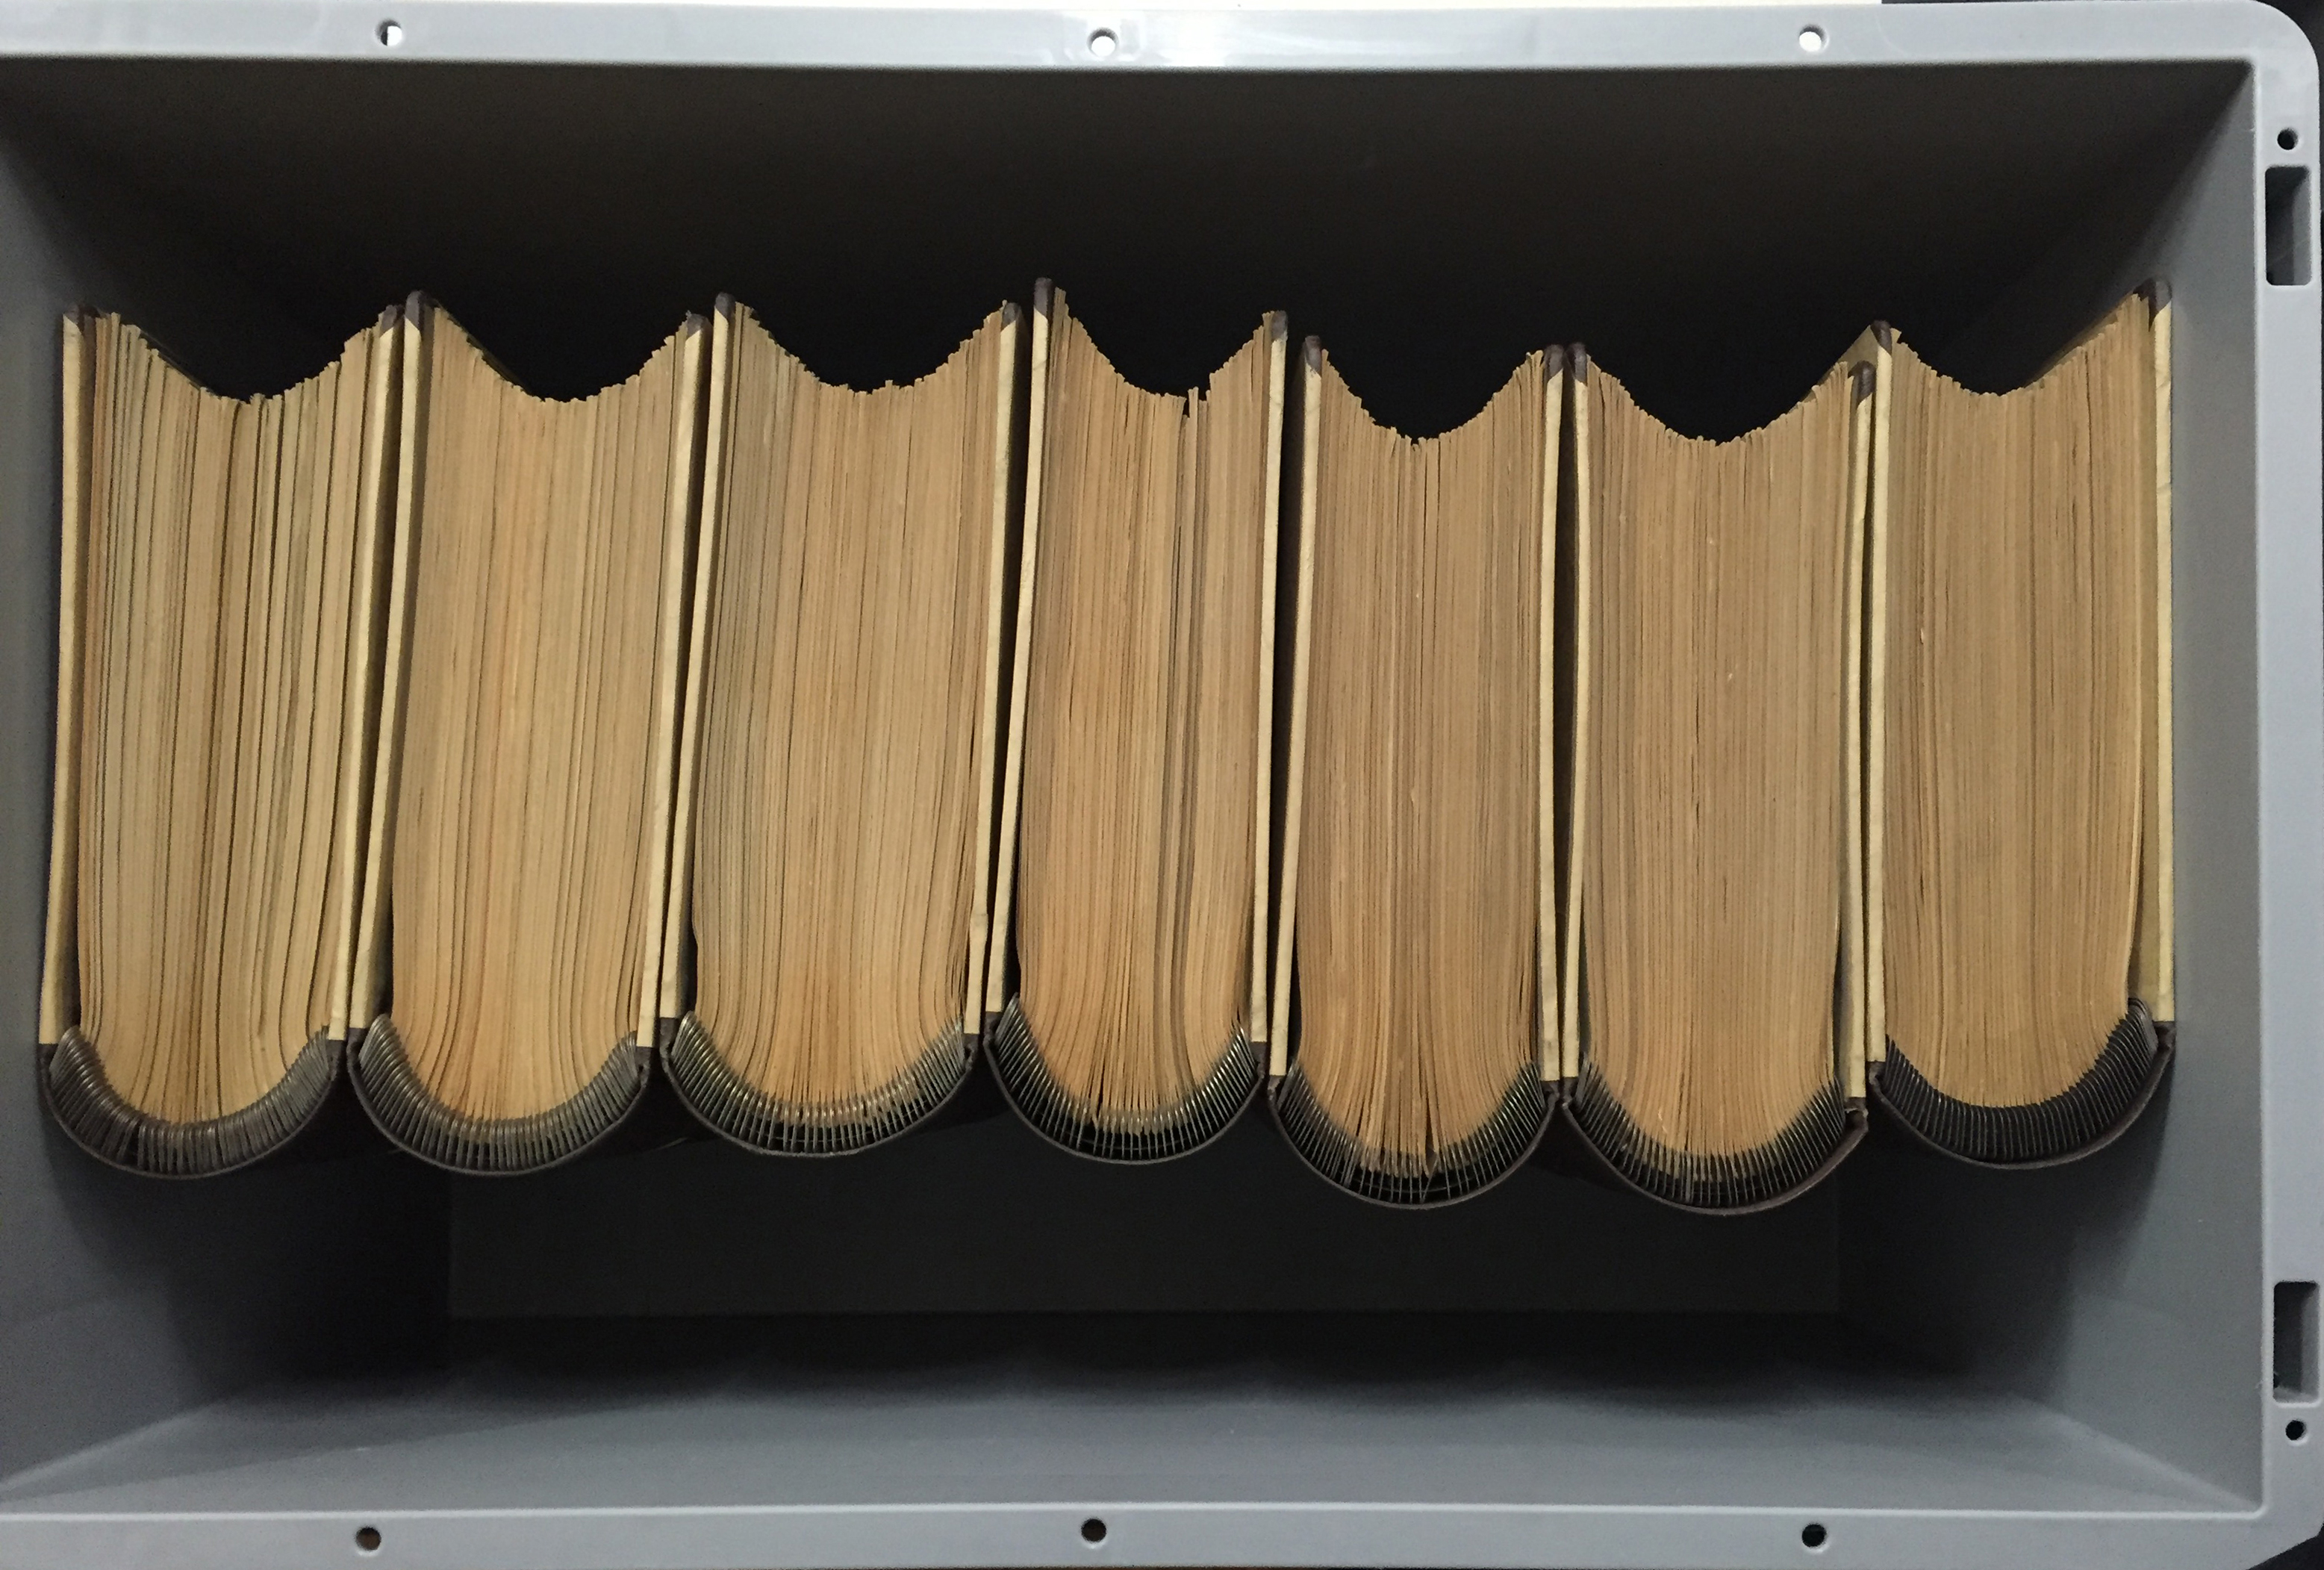
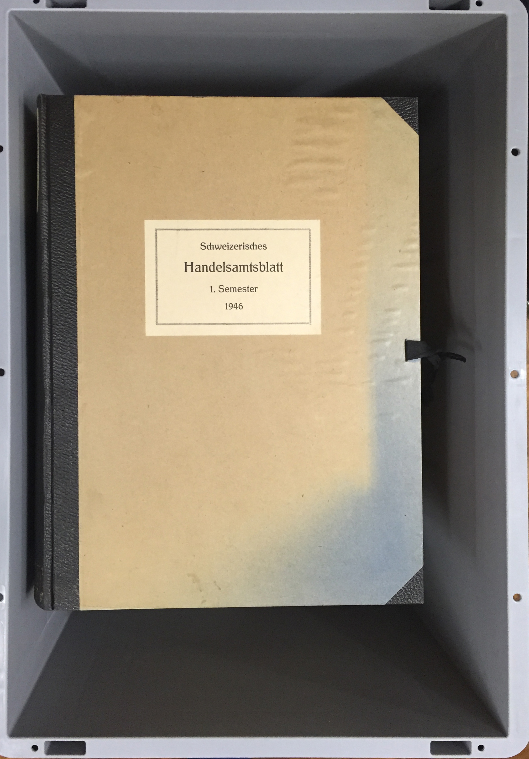
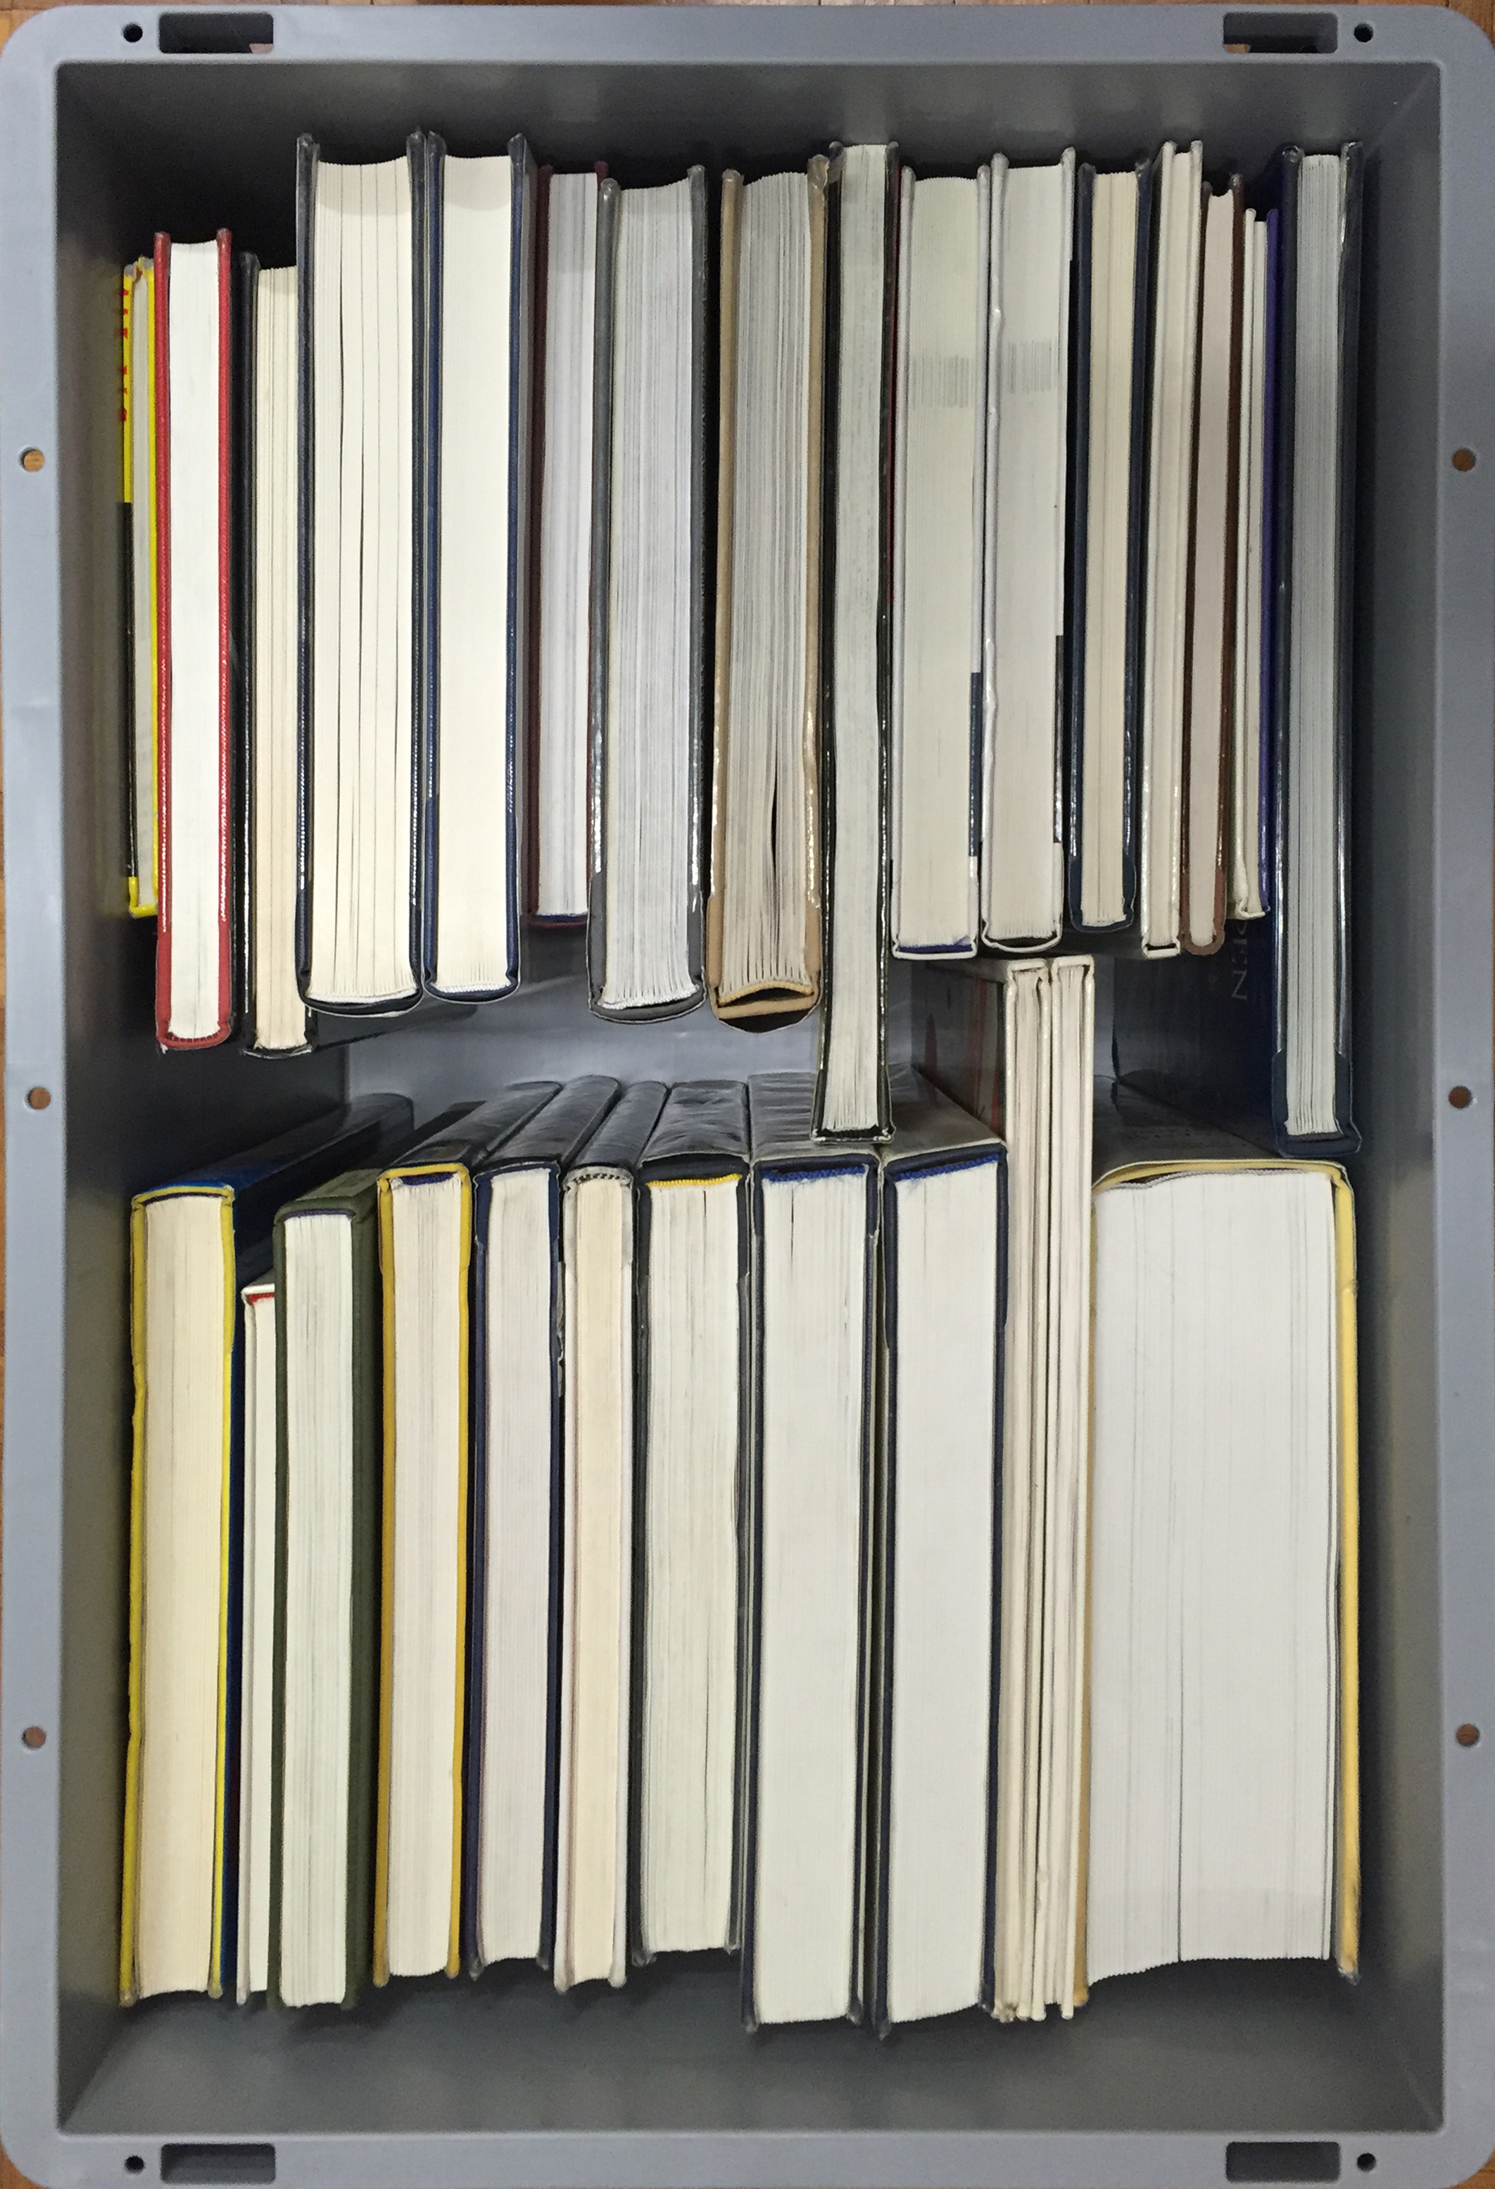
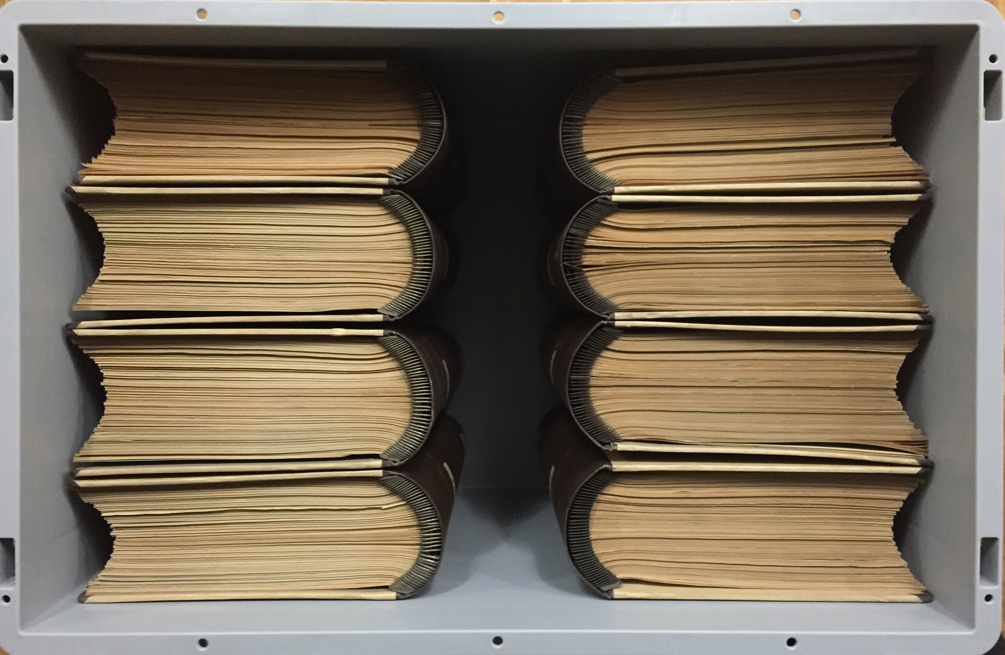
How to fill containers

Slide 15
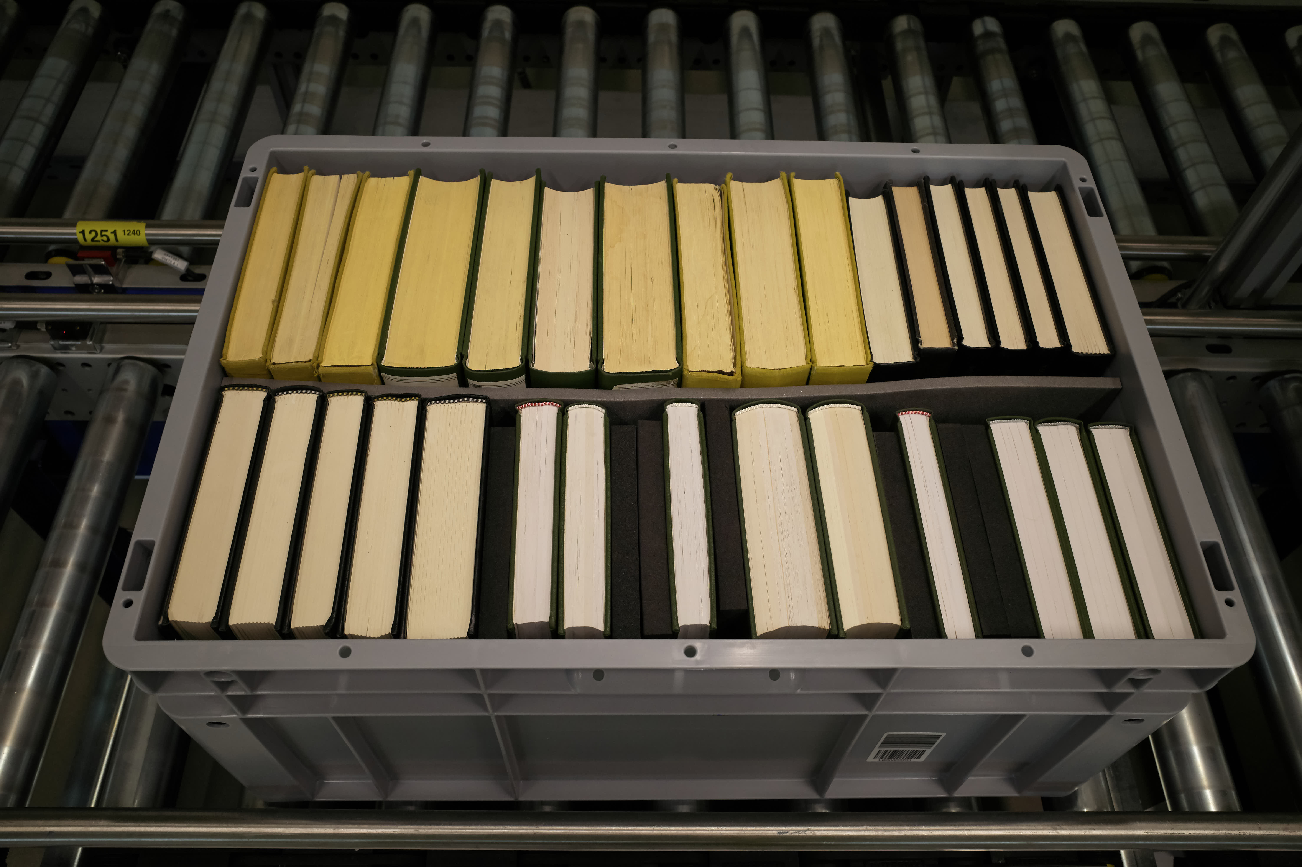
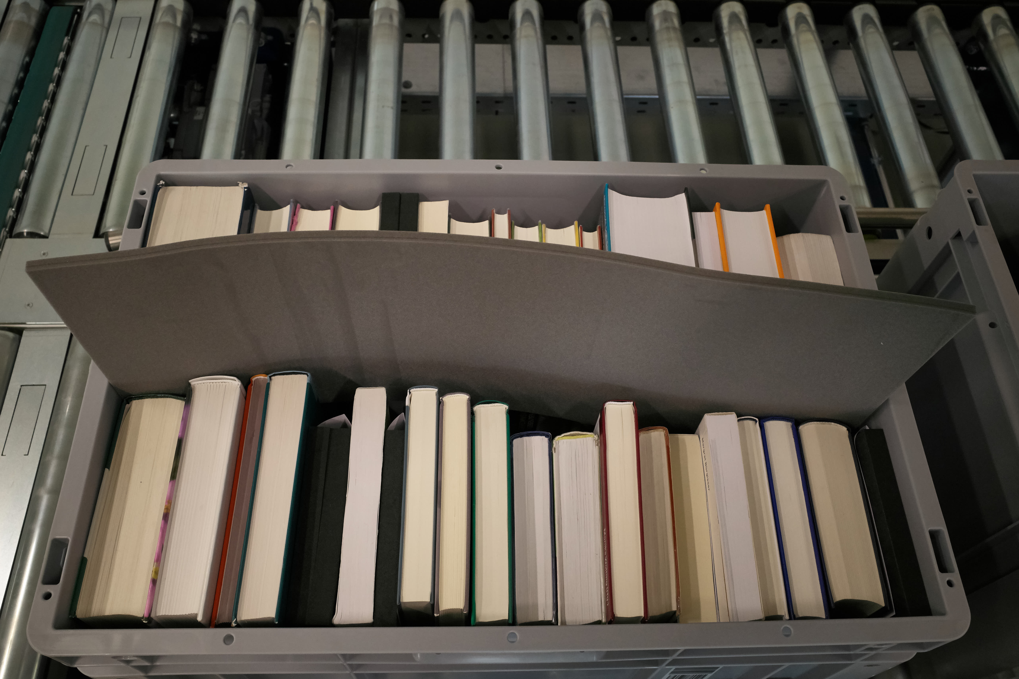

Slide 16
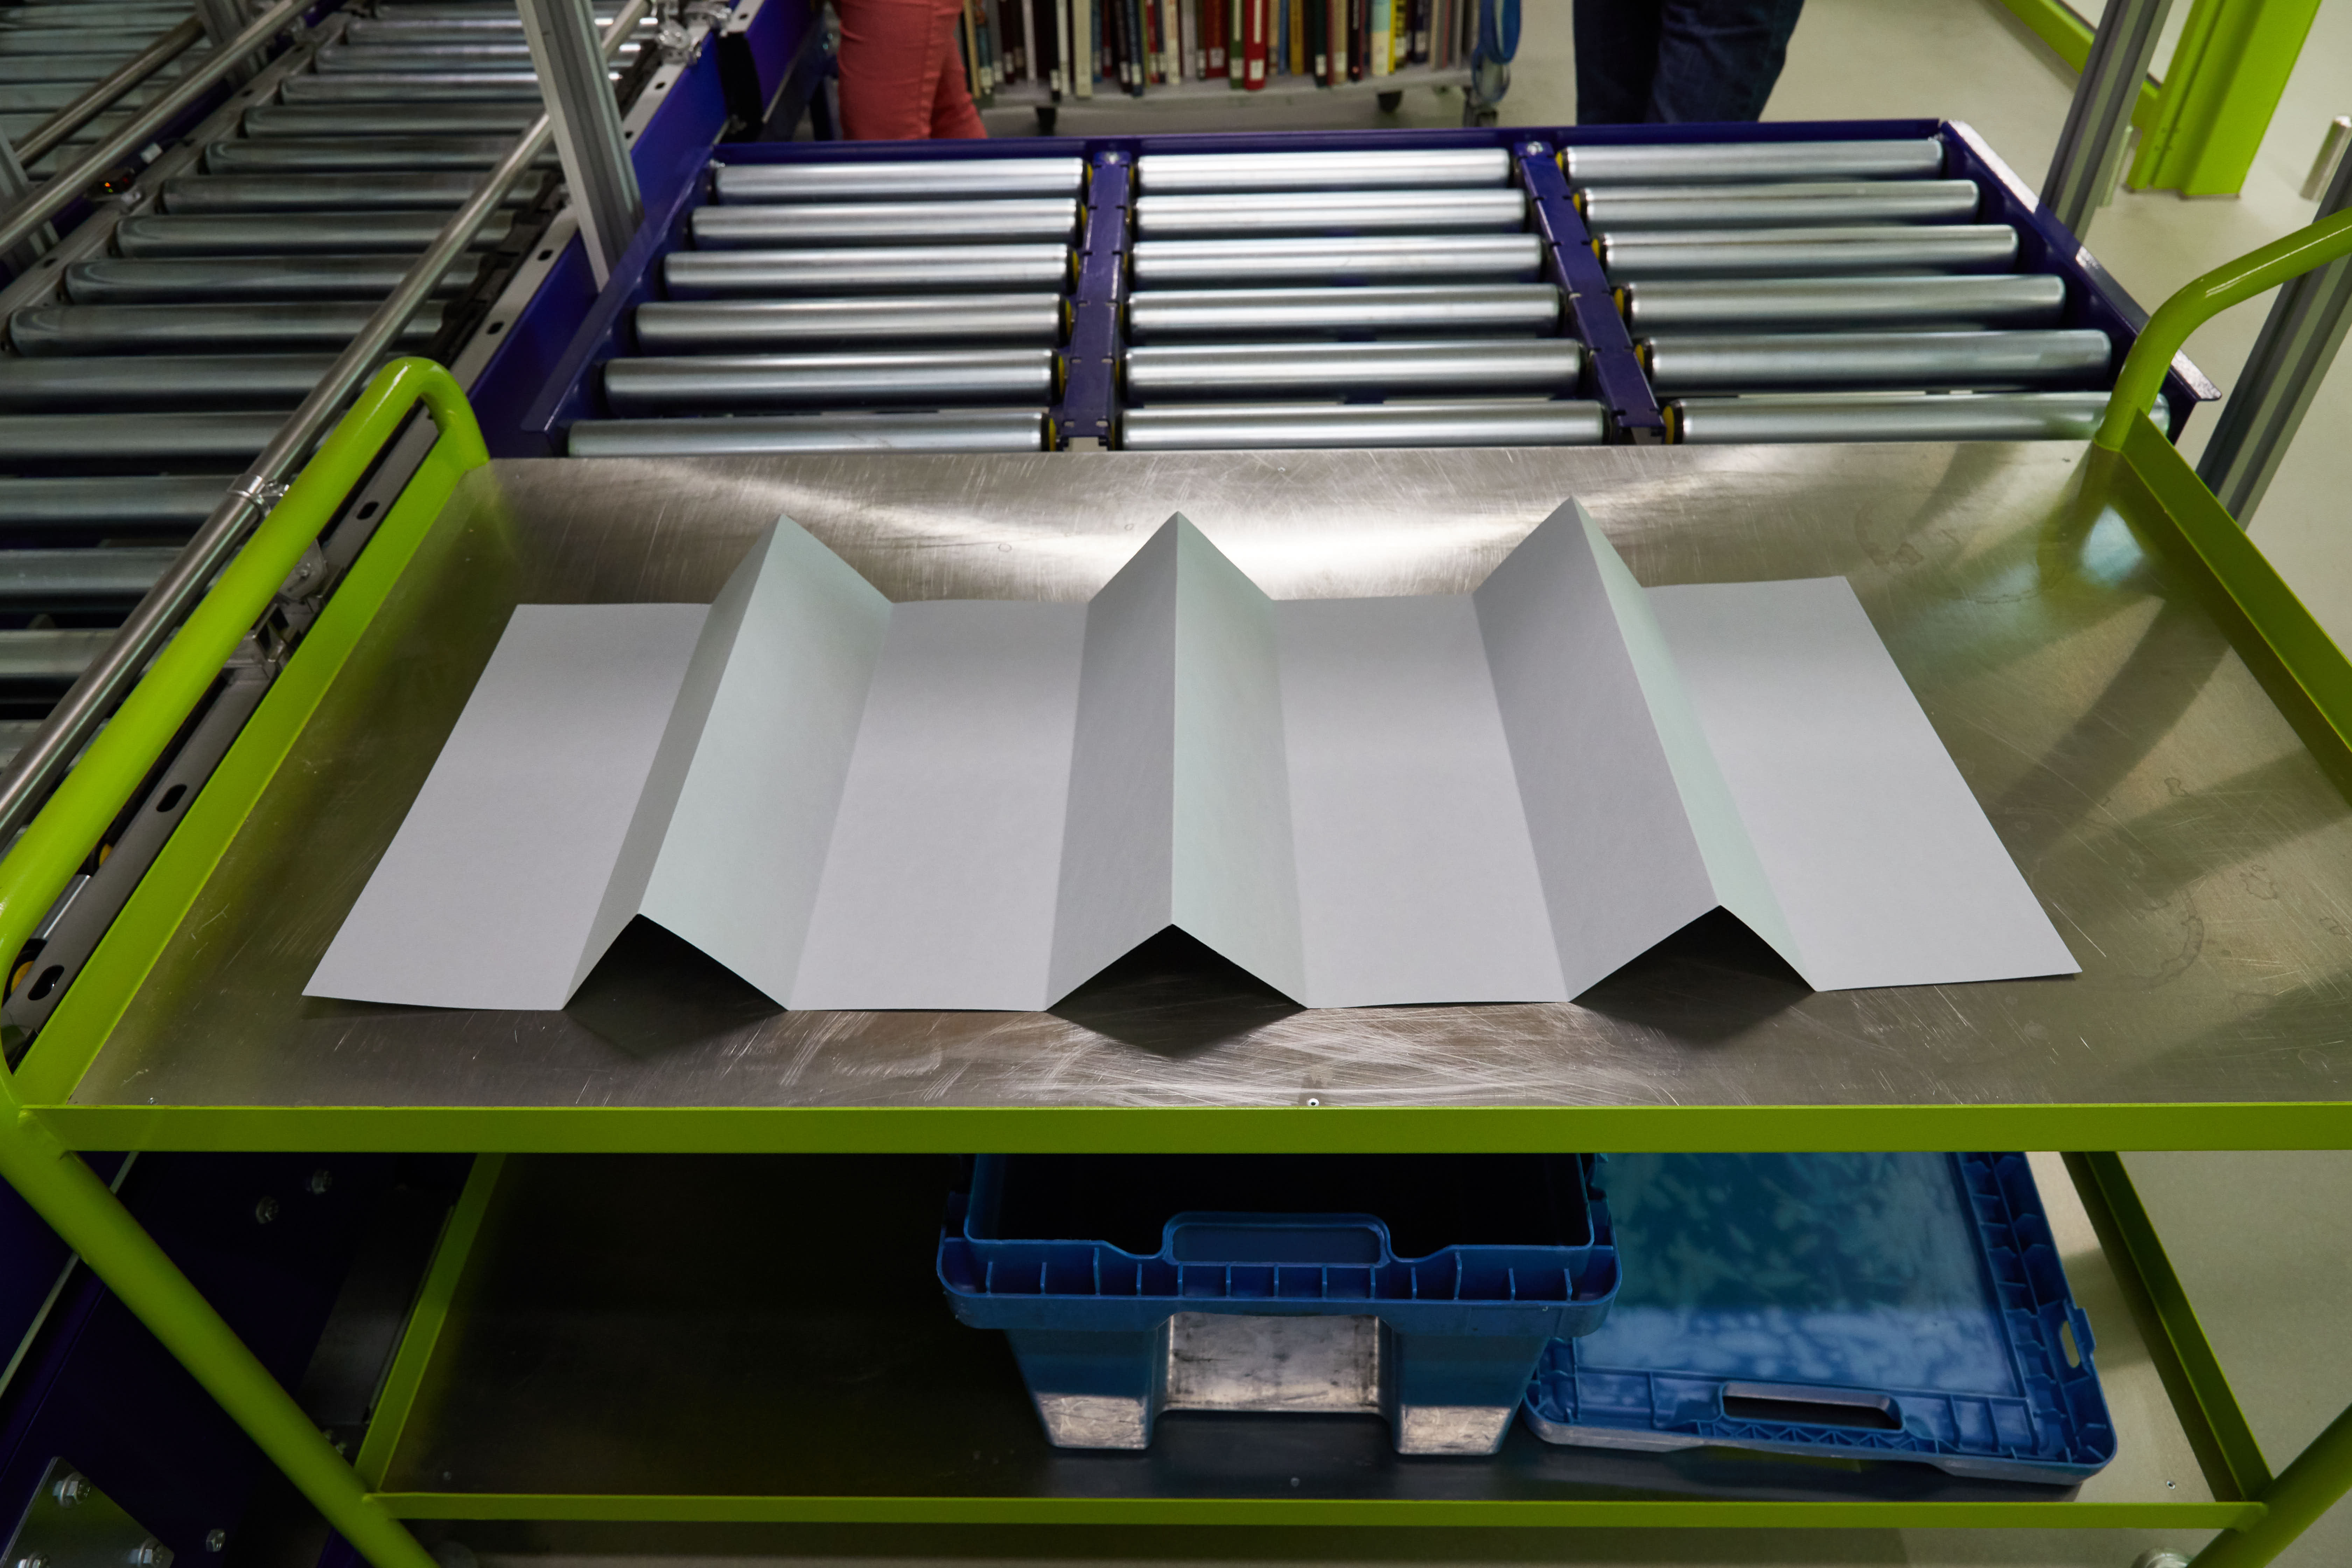
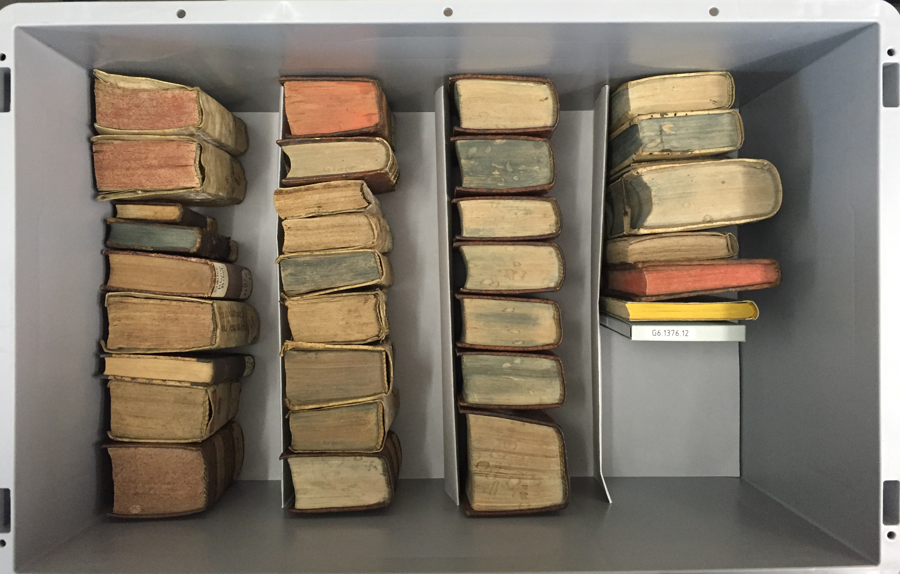
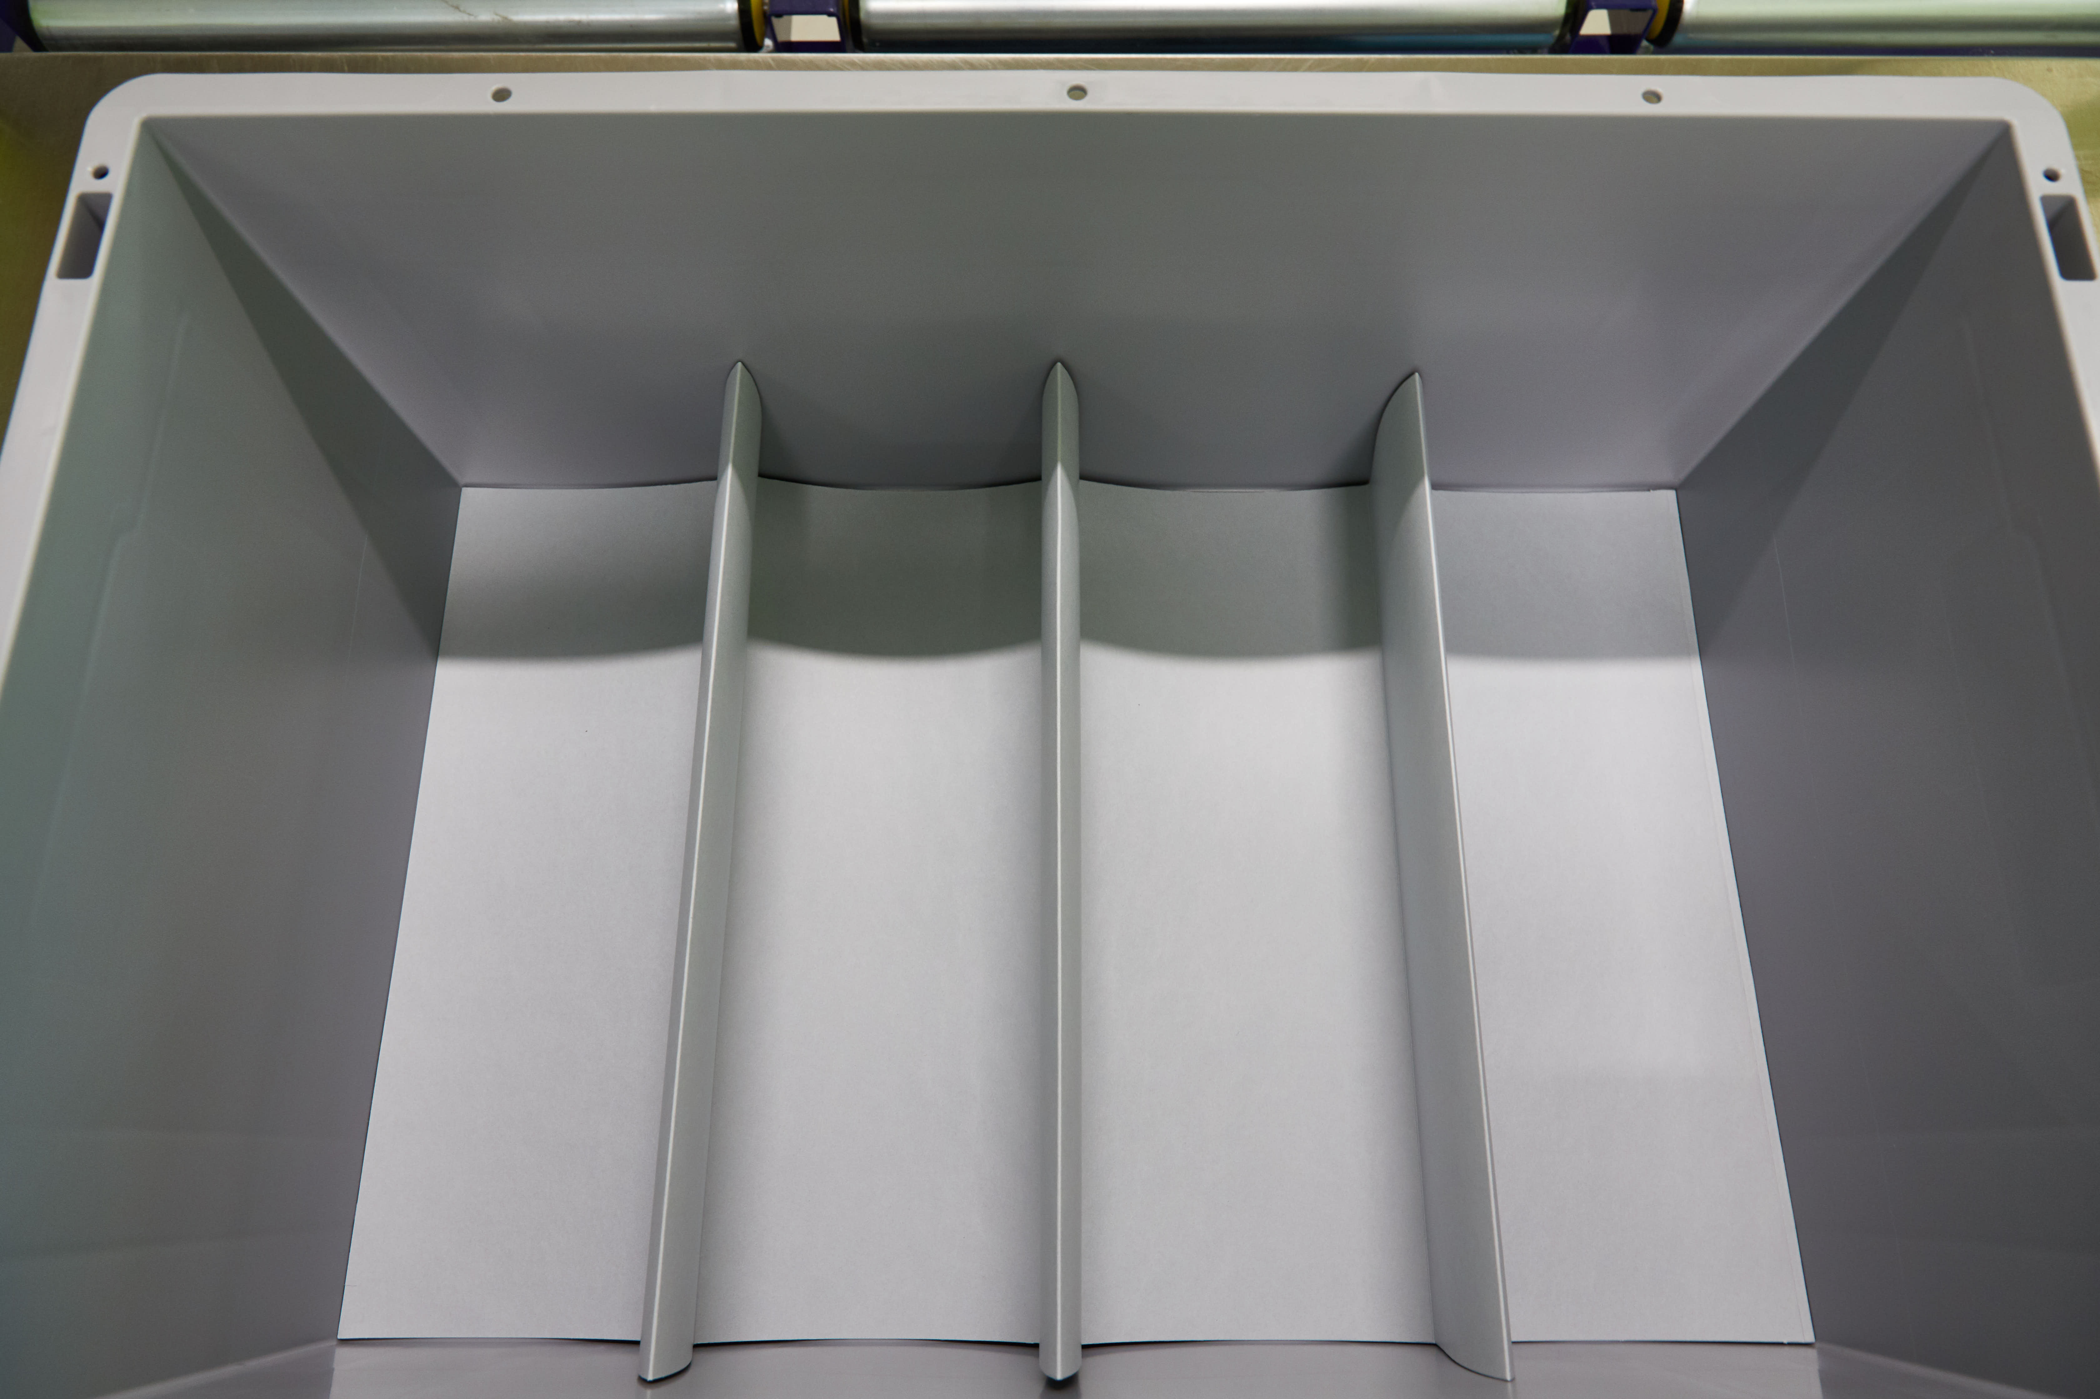

Slide 17
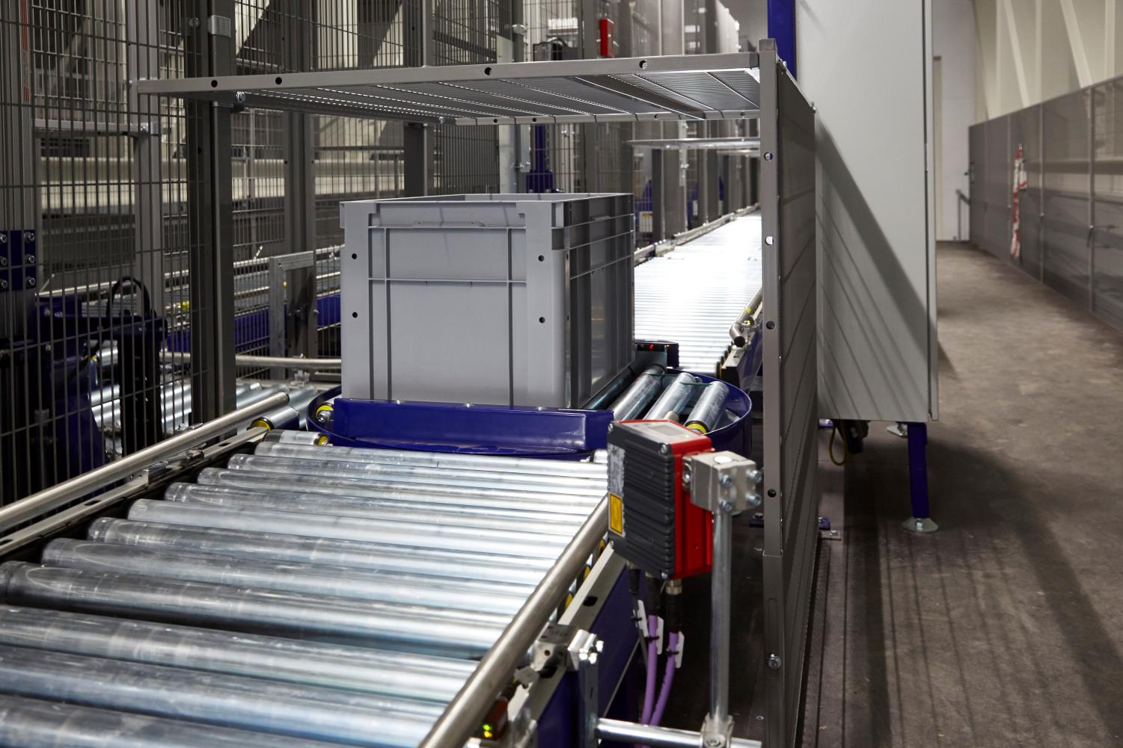
Again: thanks for your attention! ulrich_niederer@bluewin.ch

