Slide 1
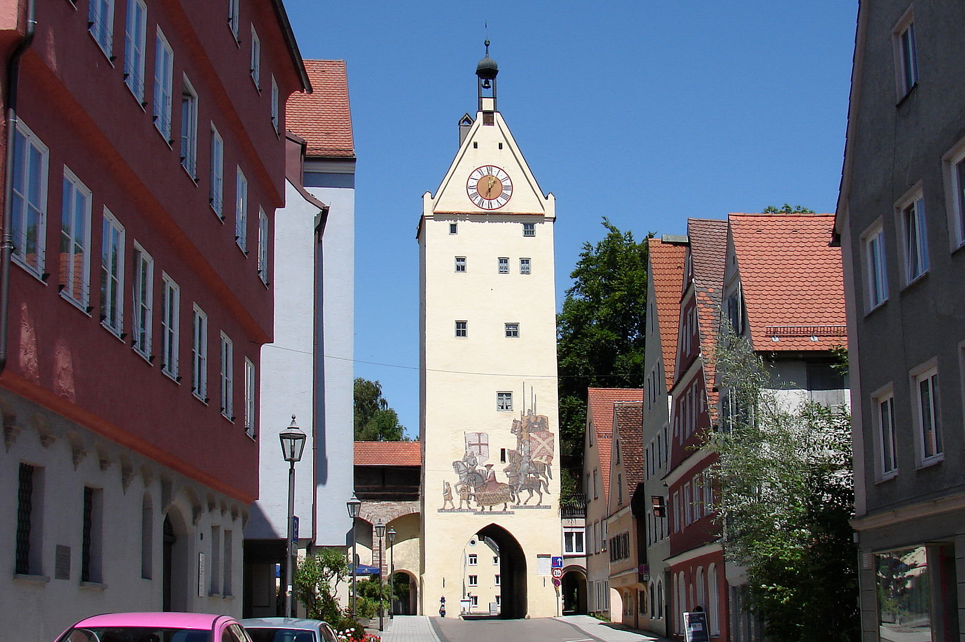
Cataloguing Memmingen Incunabula
MEI seminar, 2 March 2021
Claire M Bolton
clairembolton@googlemail.com

Slide 2
Some Statistics
598 editions, from 38 different towns
and include
- 351 printed in Germany
- 122 printed in Venice
fragments from 14 editions printed on vellum used as covers on bindings
fragments from 25 editions used as pastedowns in bindings
11 unique editions
478 volumes, including 13 duplicate editions
of which 316 bindings have had workshops identified
156 bindings from Memmingen workshops (probably were more)

Slide 3
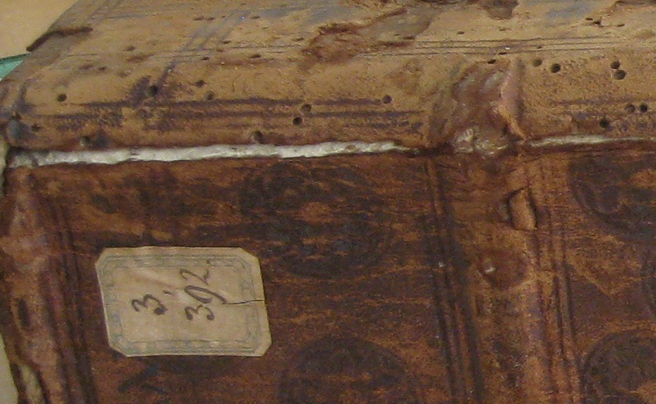
Early Catalogues
1643 shelfmarks on upper free endleaves
1868 label added on top of 1643 shelfmark

Slide 4
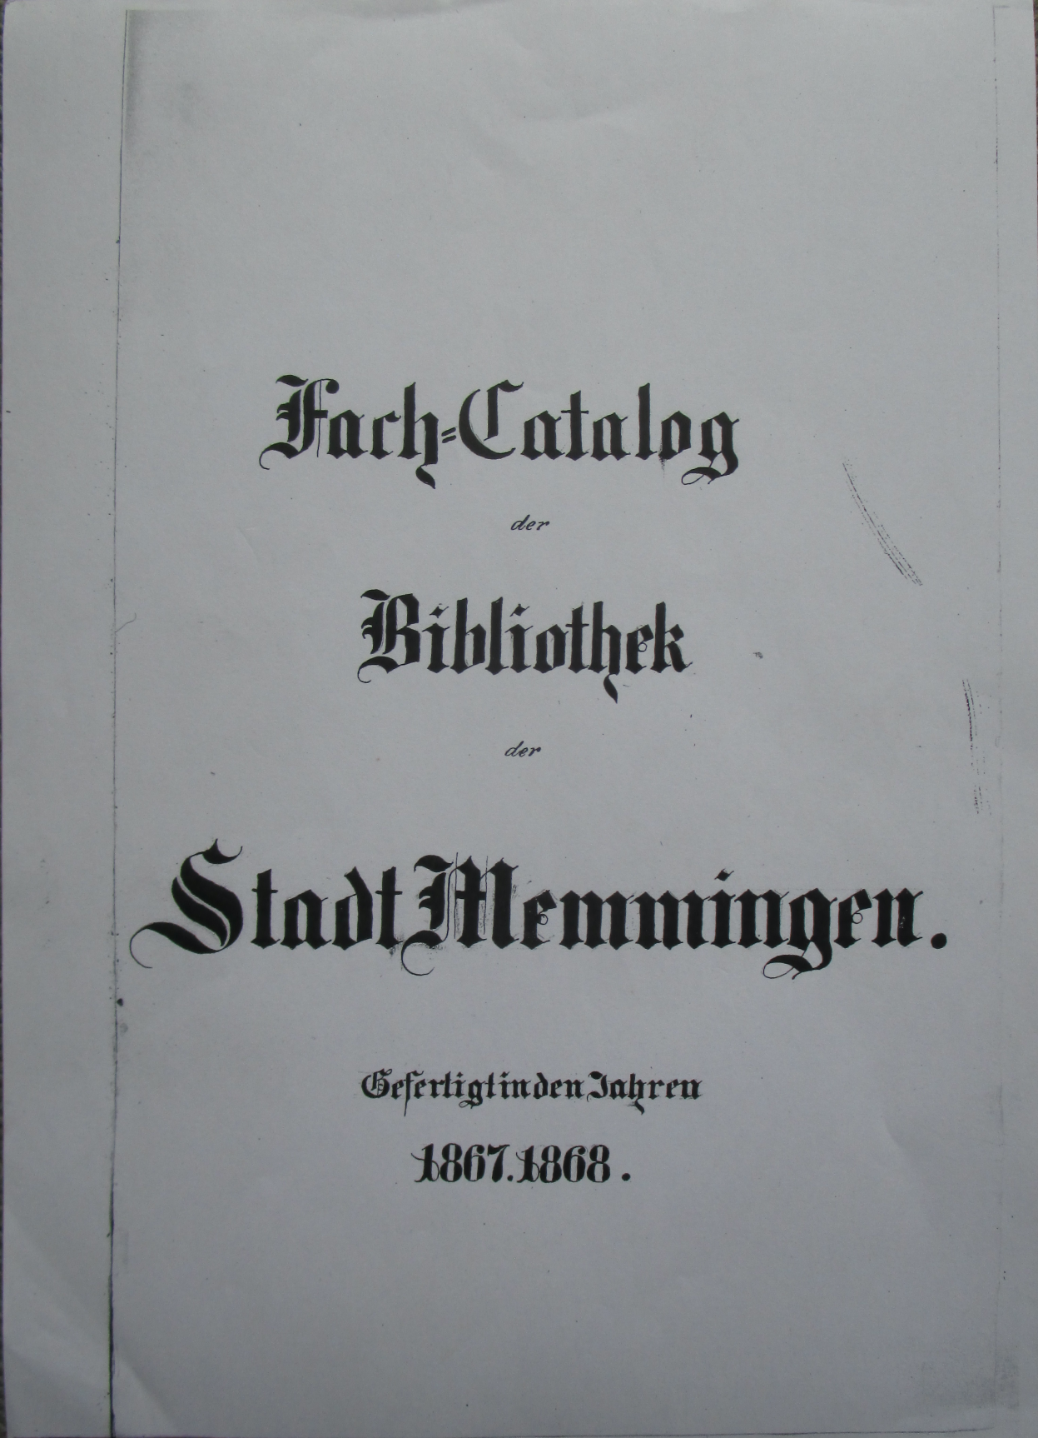
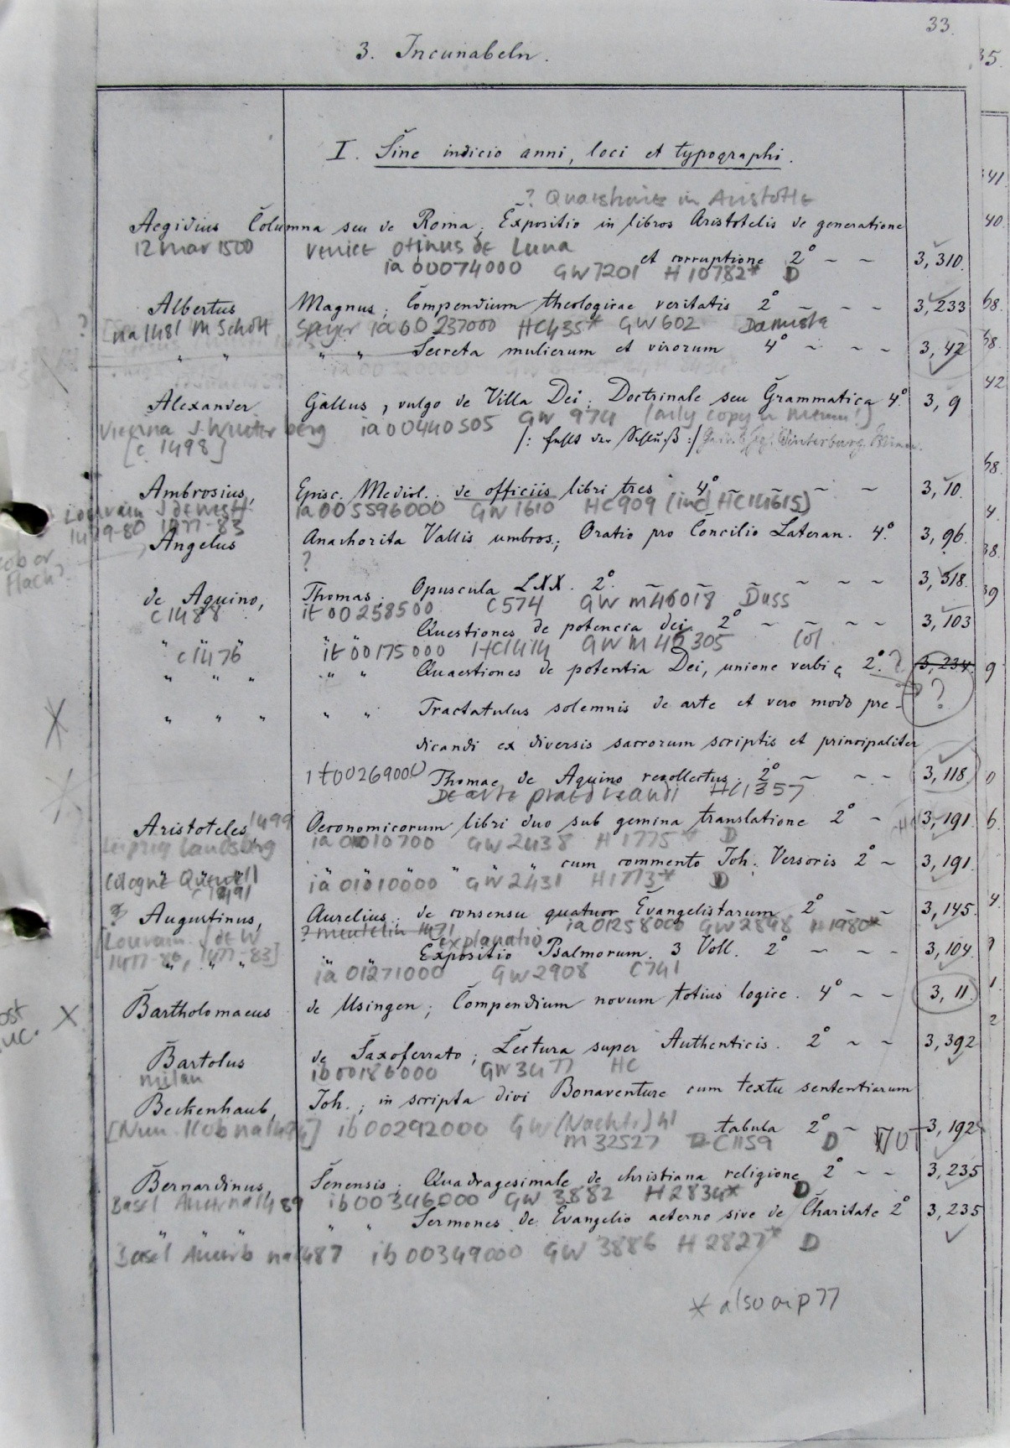
Catalogue from 1867/68 by Friedrich Dobel

Slide 5
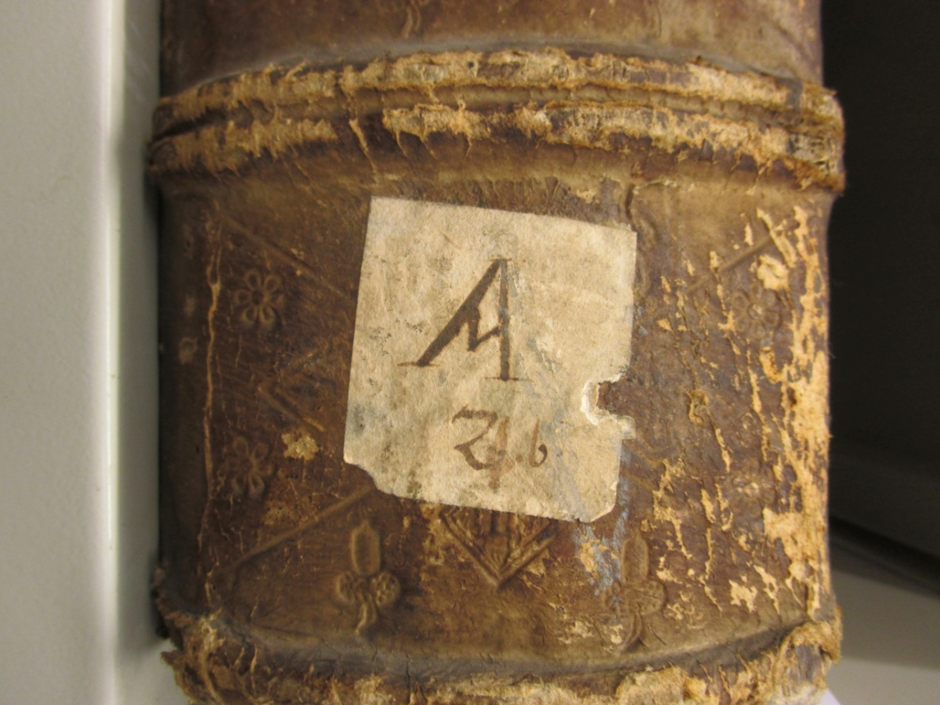
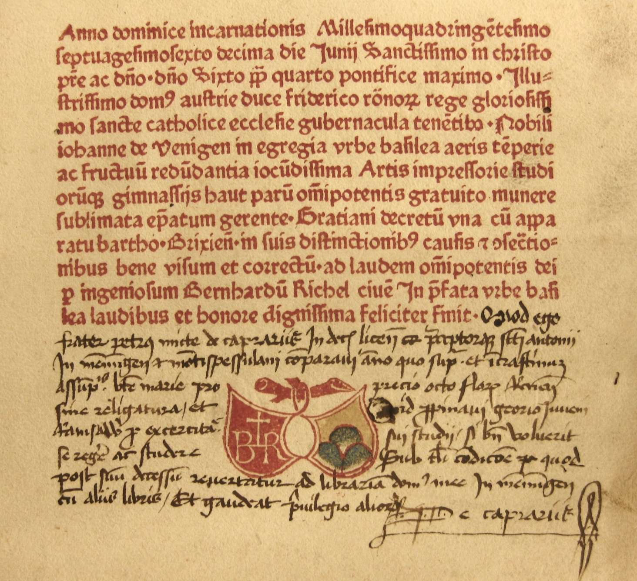
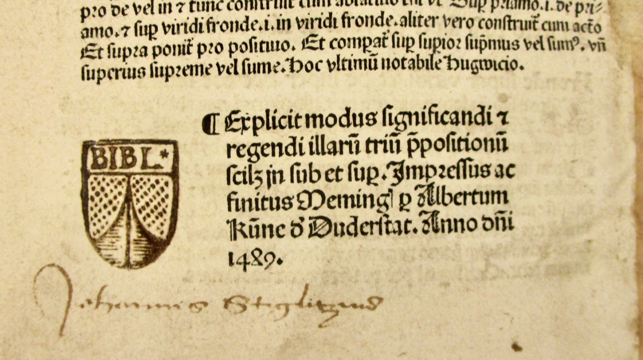
Provenance
Augustine Order shelfmark
stamp from Seyfried’sche collection
from Petrus Mitte de Caprariis,
Antoinerhaus collection

Slide 6
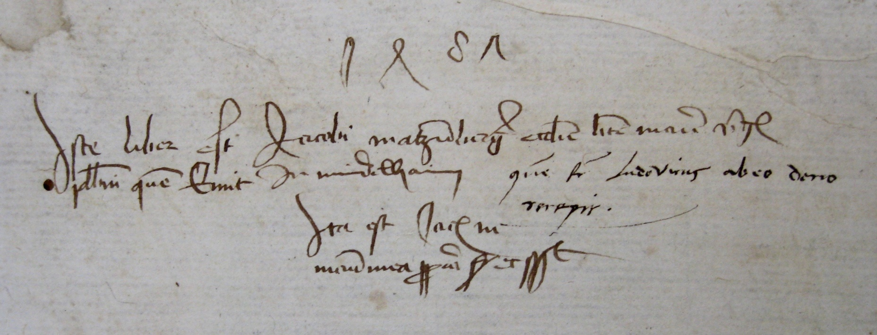
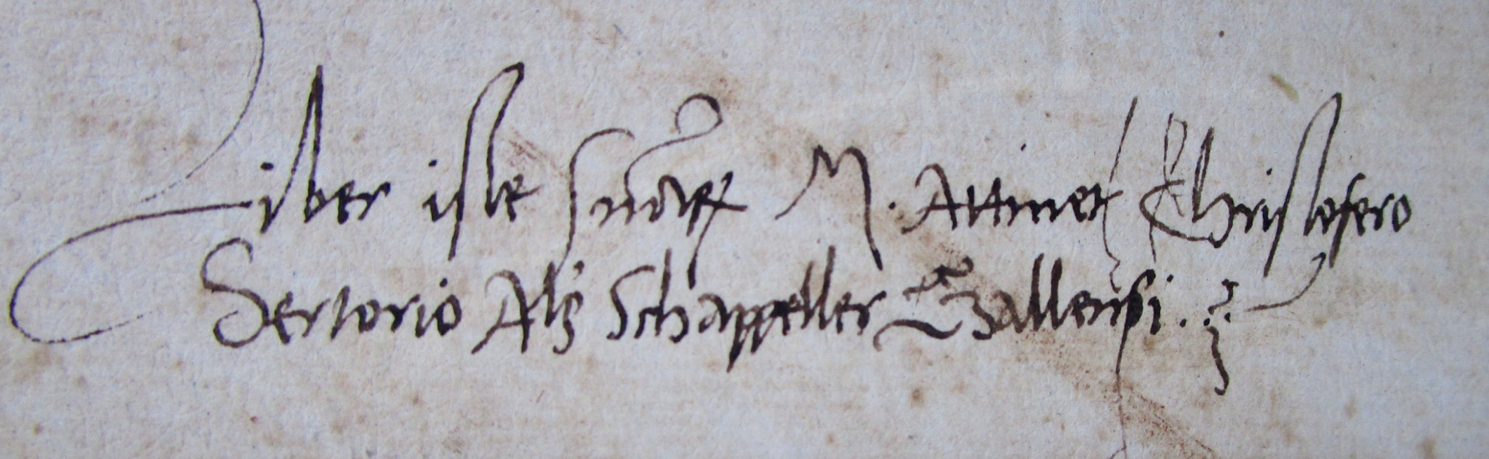
provenance inscriptions from
(top) Eustachius Funck;
(centre) Dr Jacob Matzenberger
(below) Magister Christofer Schapeller

Slide 7
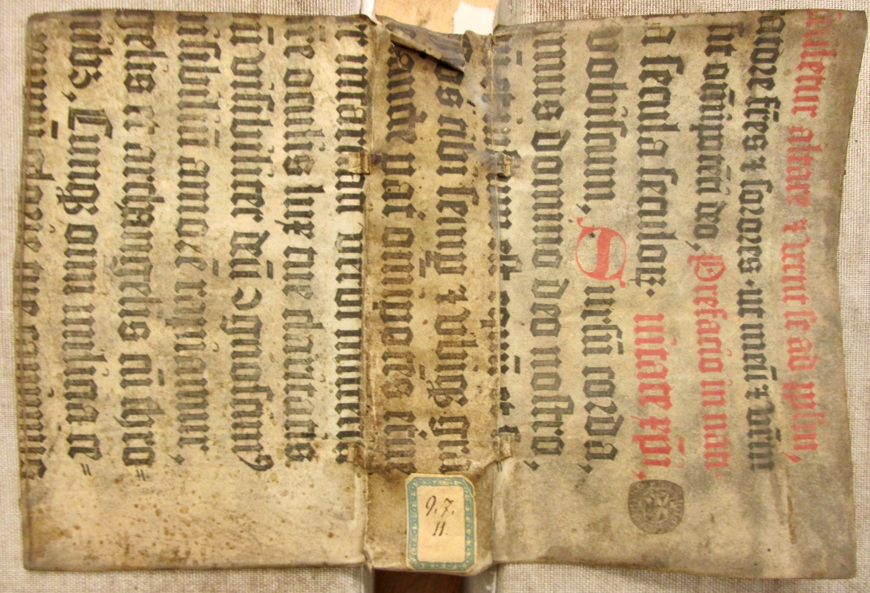
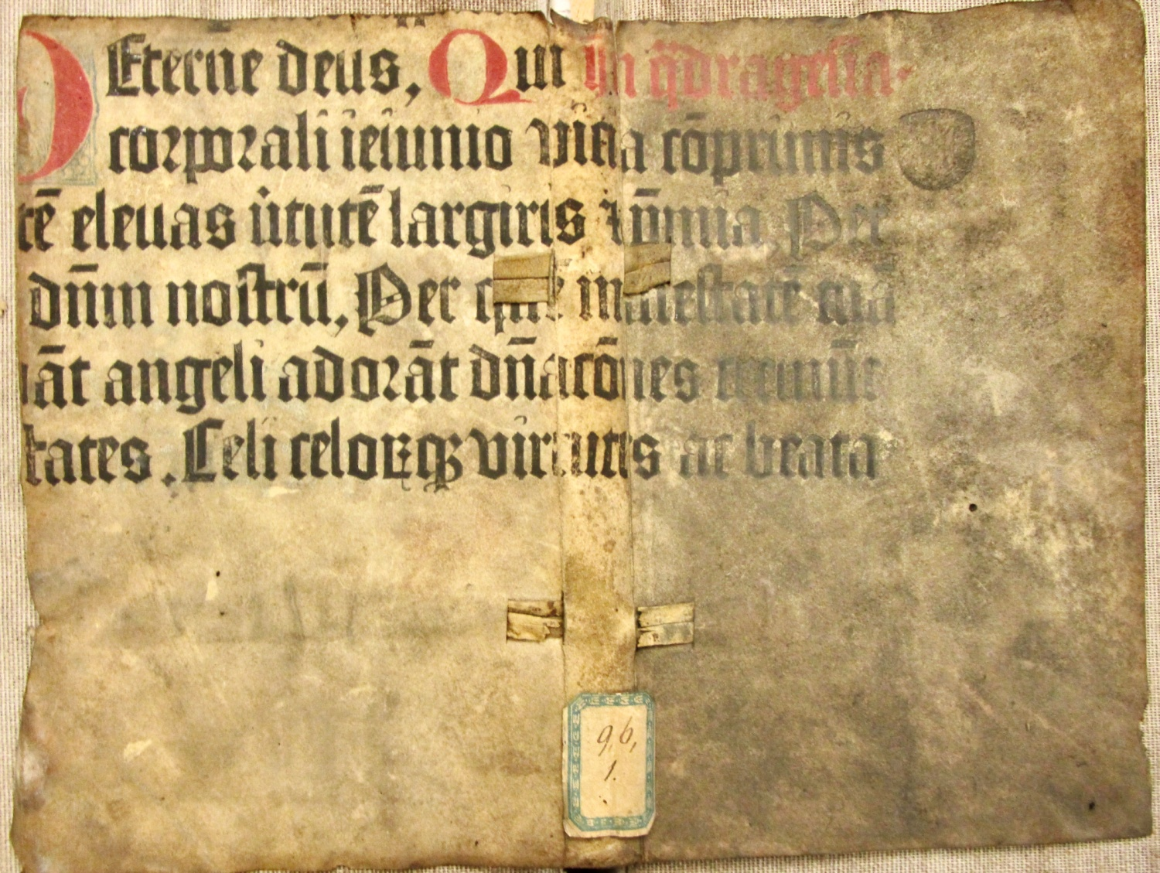
Some Highlights
- the earliest printing in the collection
two fragments used as binding covers, from leaves [2] and [3] from Schöffer’s, Canon Missae,
1458, ISTC im00736000
(Mem-inc M-33(f), shelfmarks 9.6.1 and 9.7.11)

Slide 8
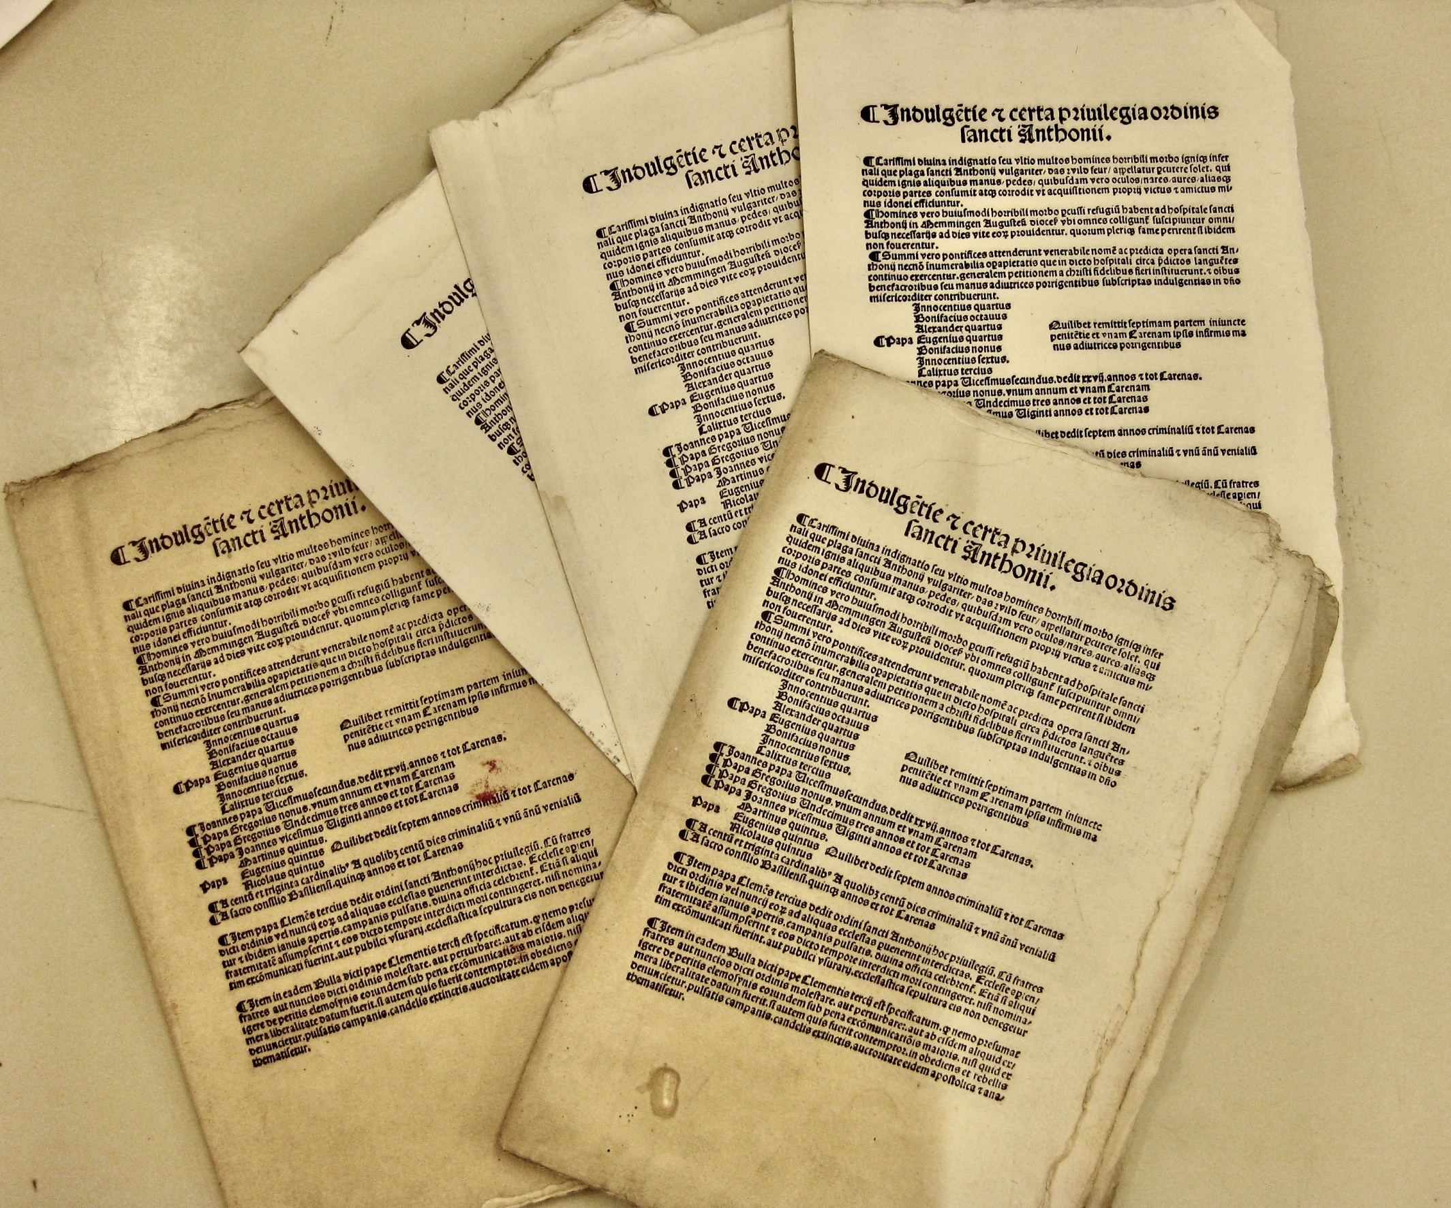
- multiple copies
69 + 2 copies of an Indulgence
ISTC ii00069000, printed by Albrecht Kunne, Memmingen c.1515 (Mem-inc I-3, shelfmark 3.128)

Slide 9
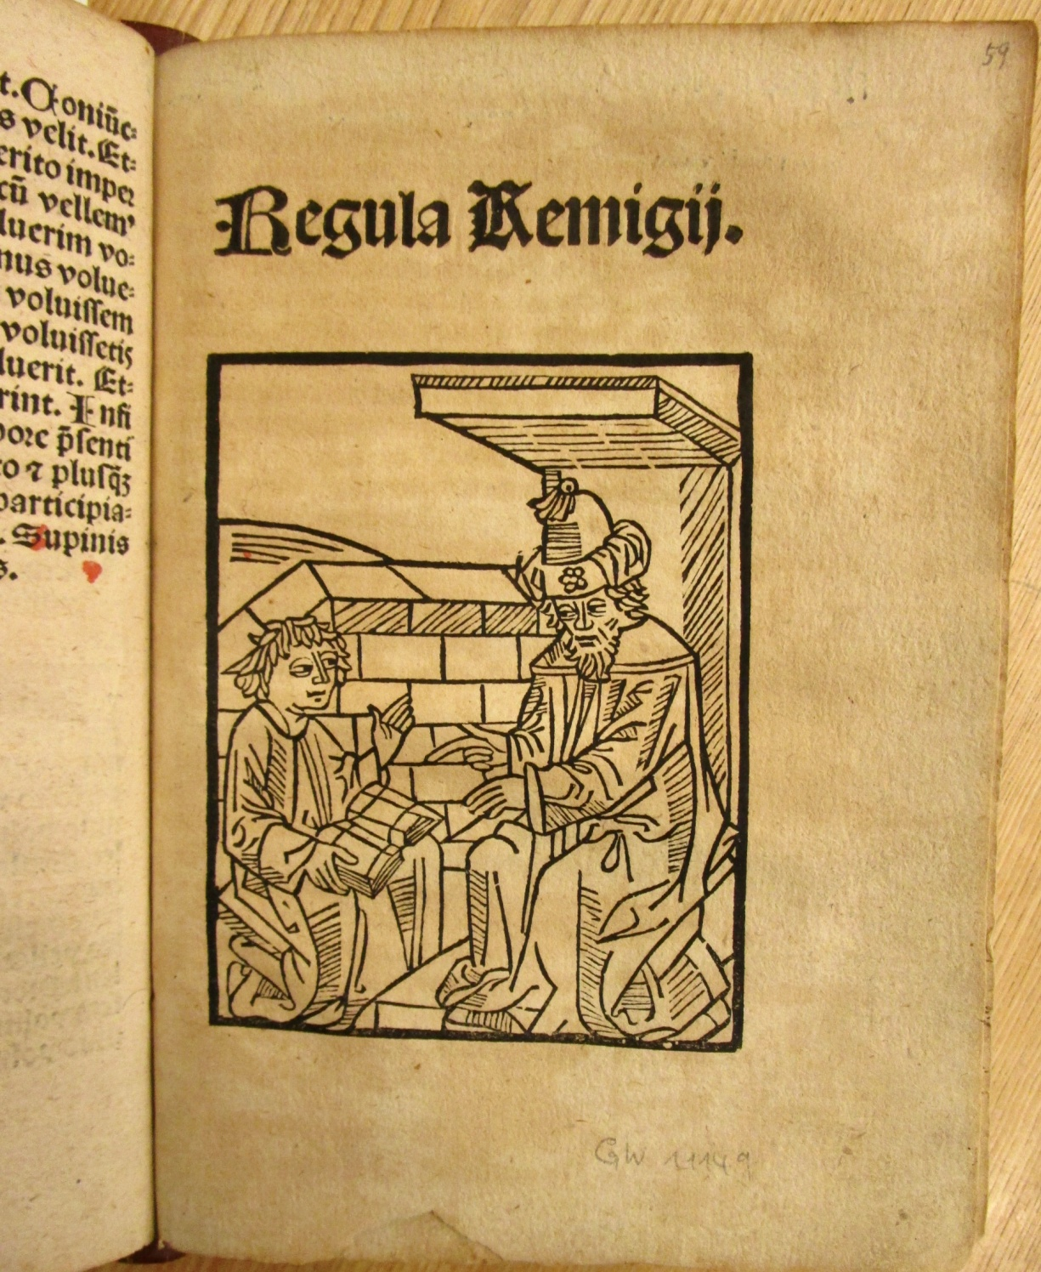
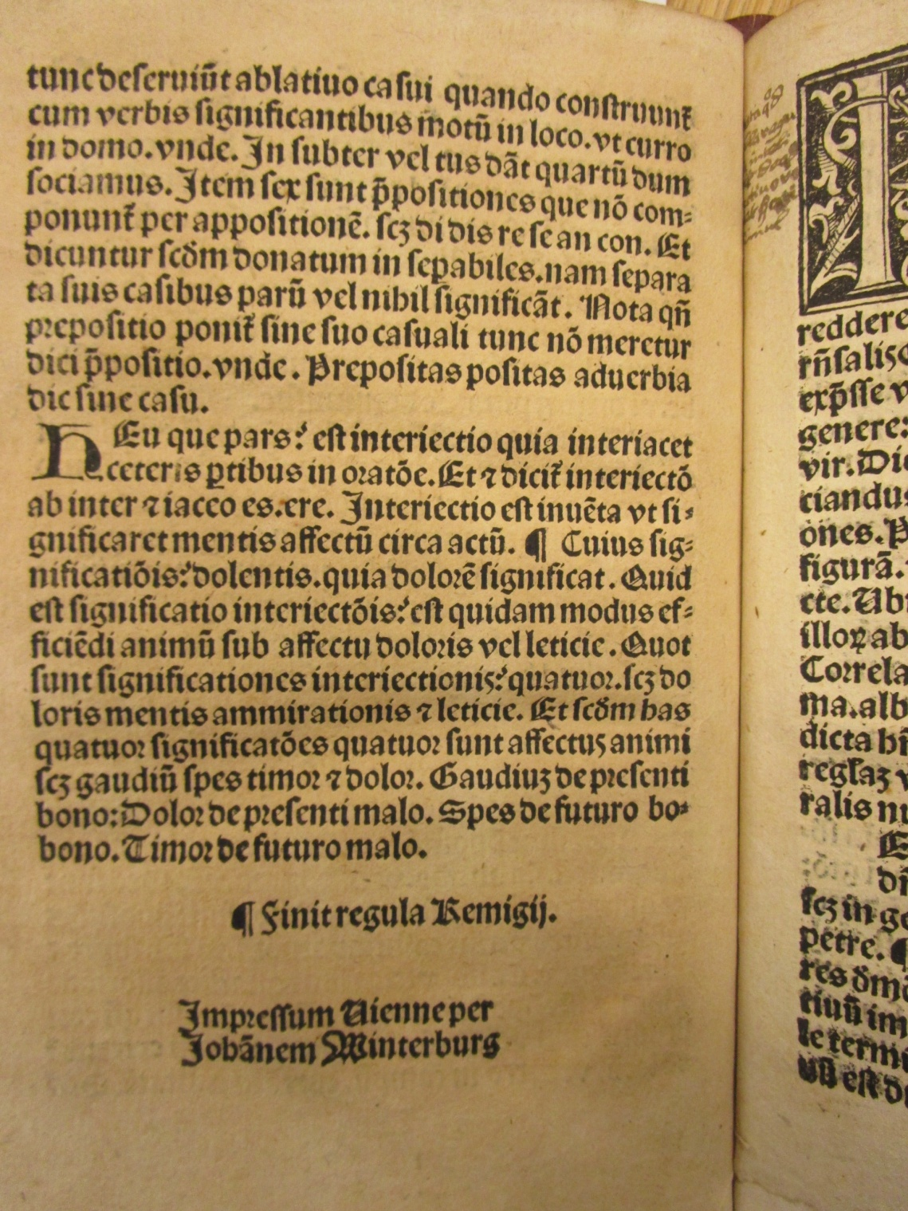
the rarest
five unique editions, bound together, all printed by Johannes Winterburg,
Vienna from 1495-1500.
This edition Remigius, [c.1500], ISTC ir00144000. (Mem-inc A-22, D-11, O-9, R-8, R-11, shelfmark 3.31)

Slide 10
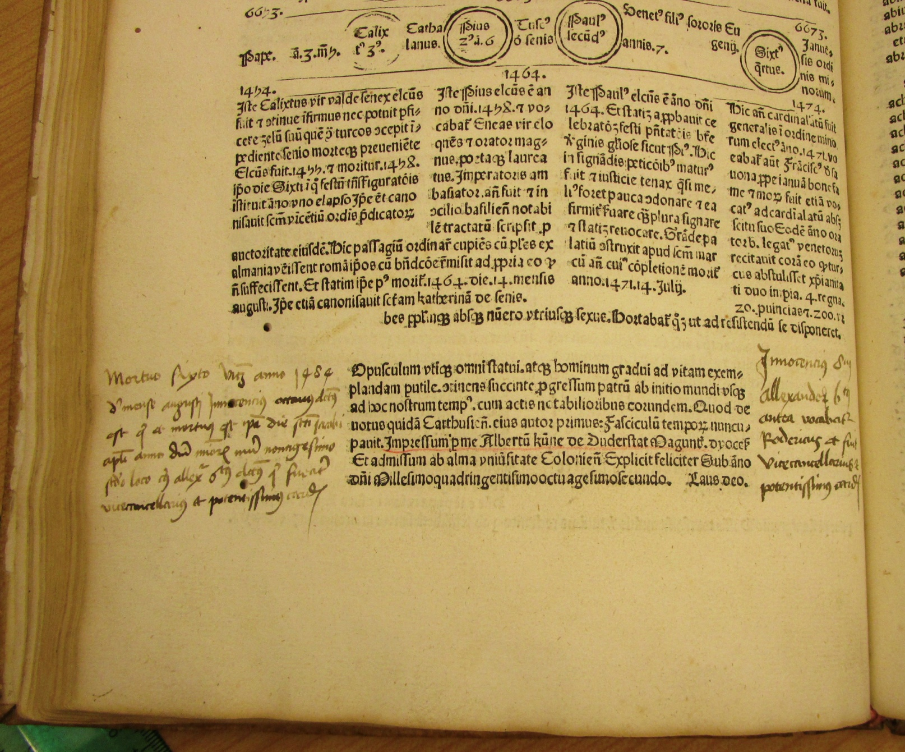
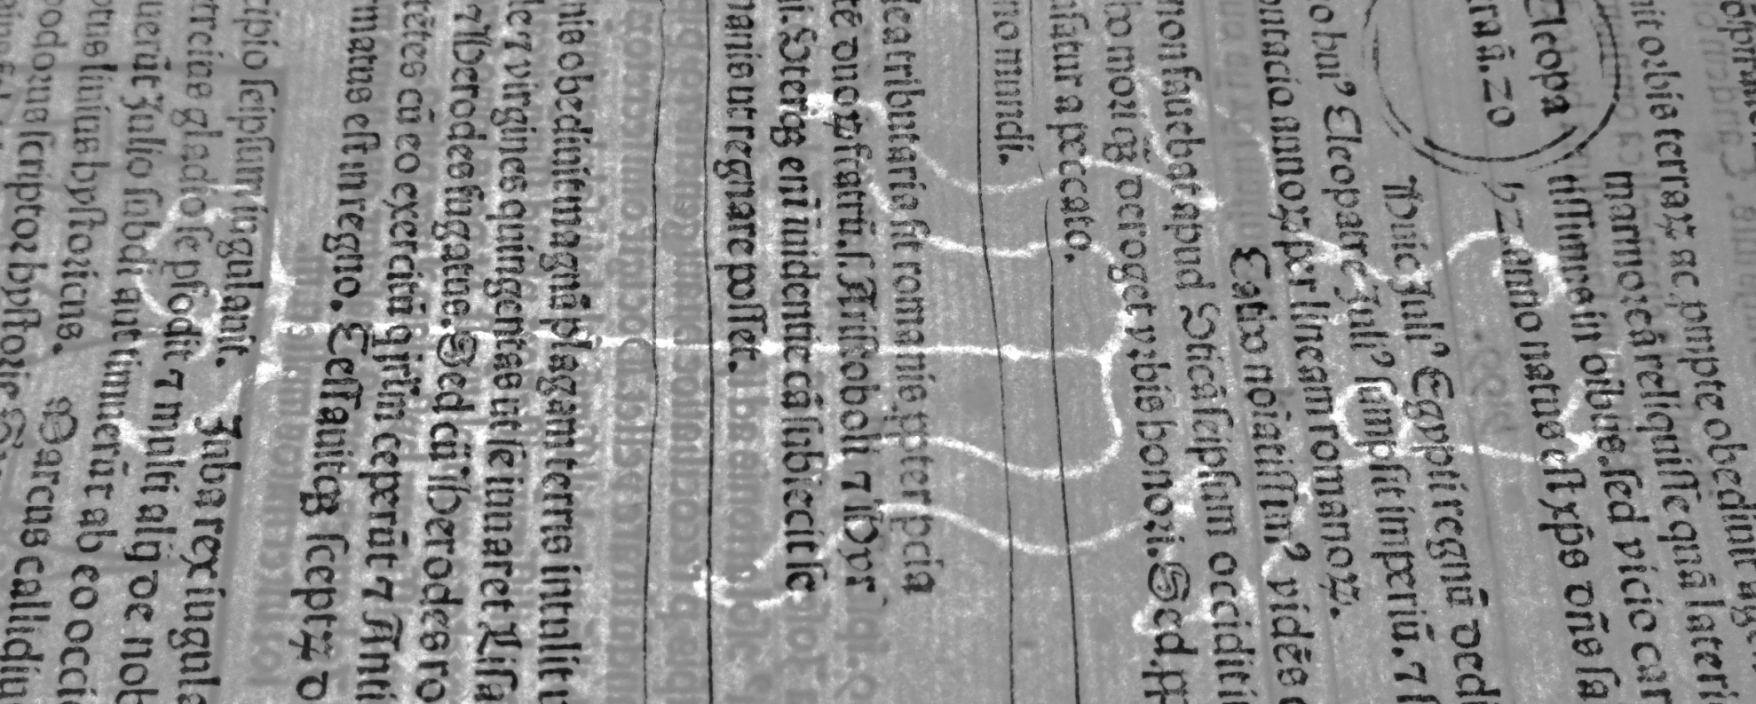
- Albrecht Kunne
Rolenwinck, Fasciculis temporum, 1482,
ISTC ir00268000.
(Mem-inc R-13, shelfmark 3.149)
Printed in Memmingen
on Memmingen made paper, and
bound in Memmingen, K 176

Slide 11
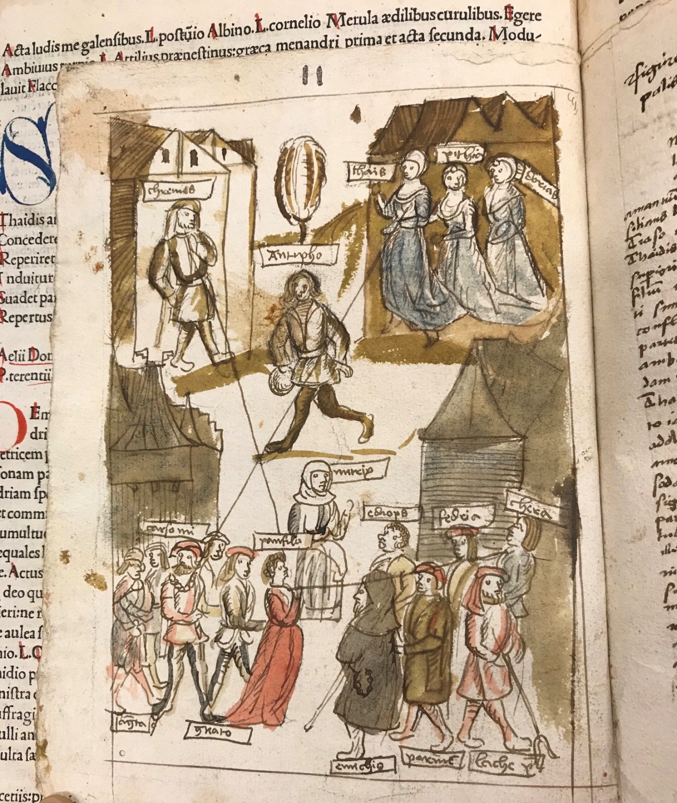
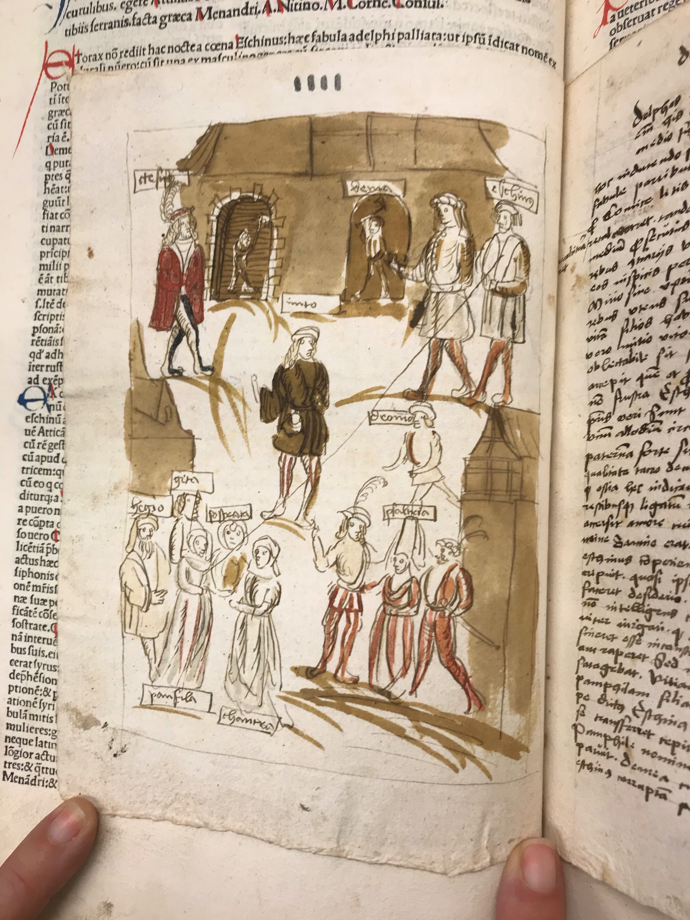
- surprises!
Terentius, Comodiae, printed by Reinhard Grüninger, Strassburg, 1496. ISTC it00094000
(Mem-inc T-2, shelfmark 3.246)
hand drawn illustrations, tipped into the centre of each of the 6 comedies (after binding)
with accompanying manuscript notes.

Slide 12
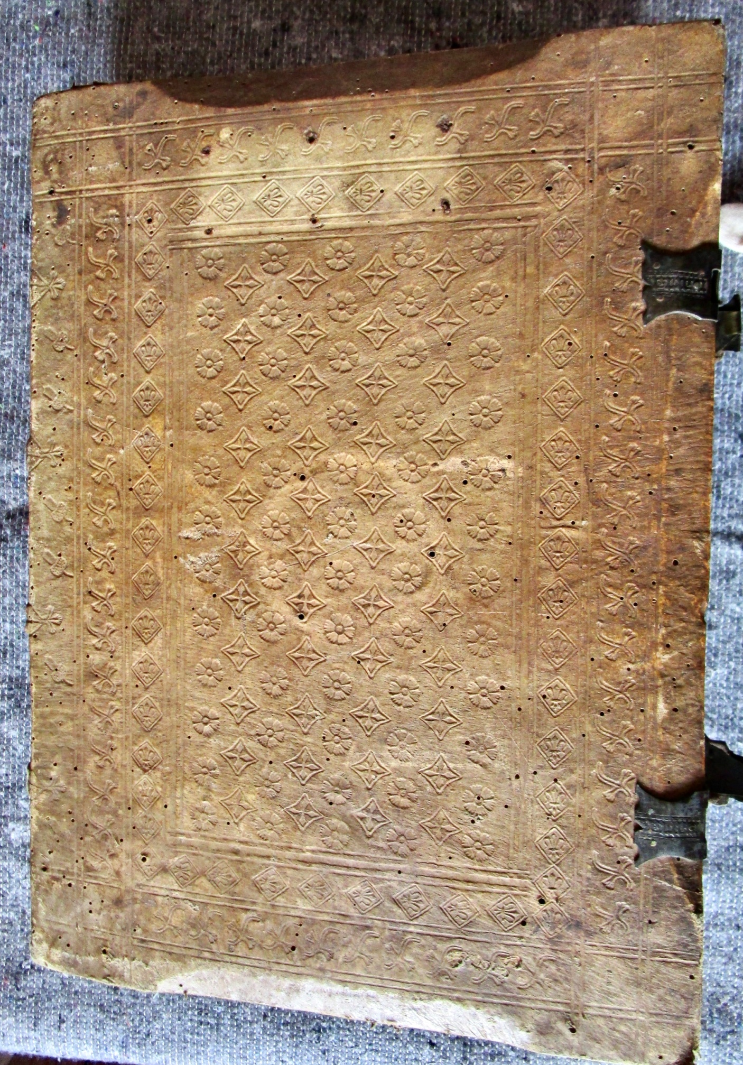
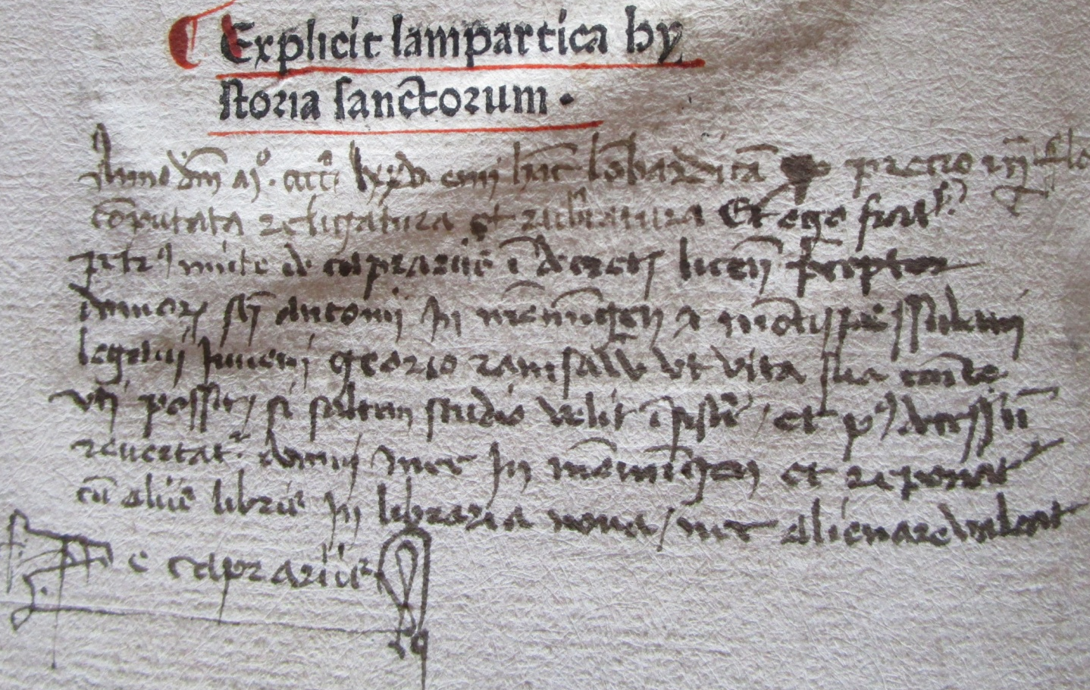
Bindings
Voragine, Legenda aurea…, printed by
Michael Wenssler, Basel [n.a.1474], ISTC ij00082000
(Mem-inc J-1, shelfmark 3.343)
note stating bound by Georio Ramsawer
(binding tools from K 176, Memmingen)

Slide 13
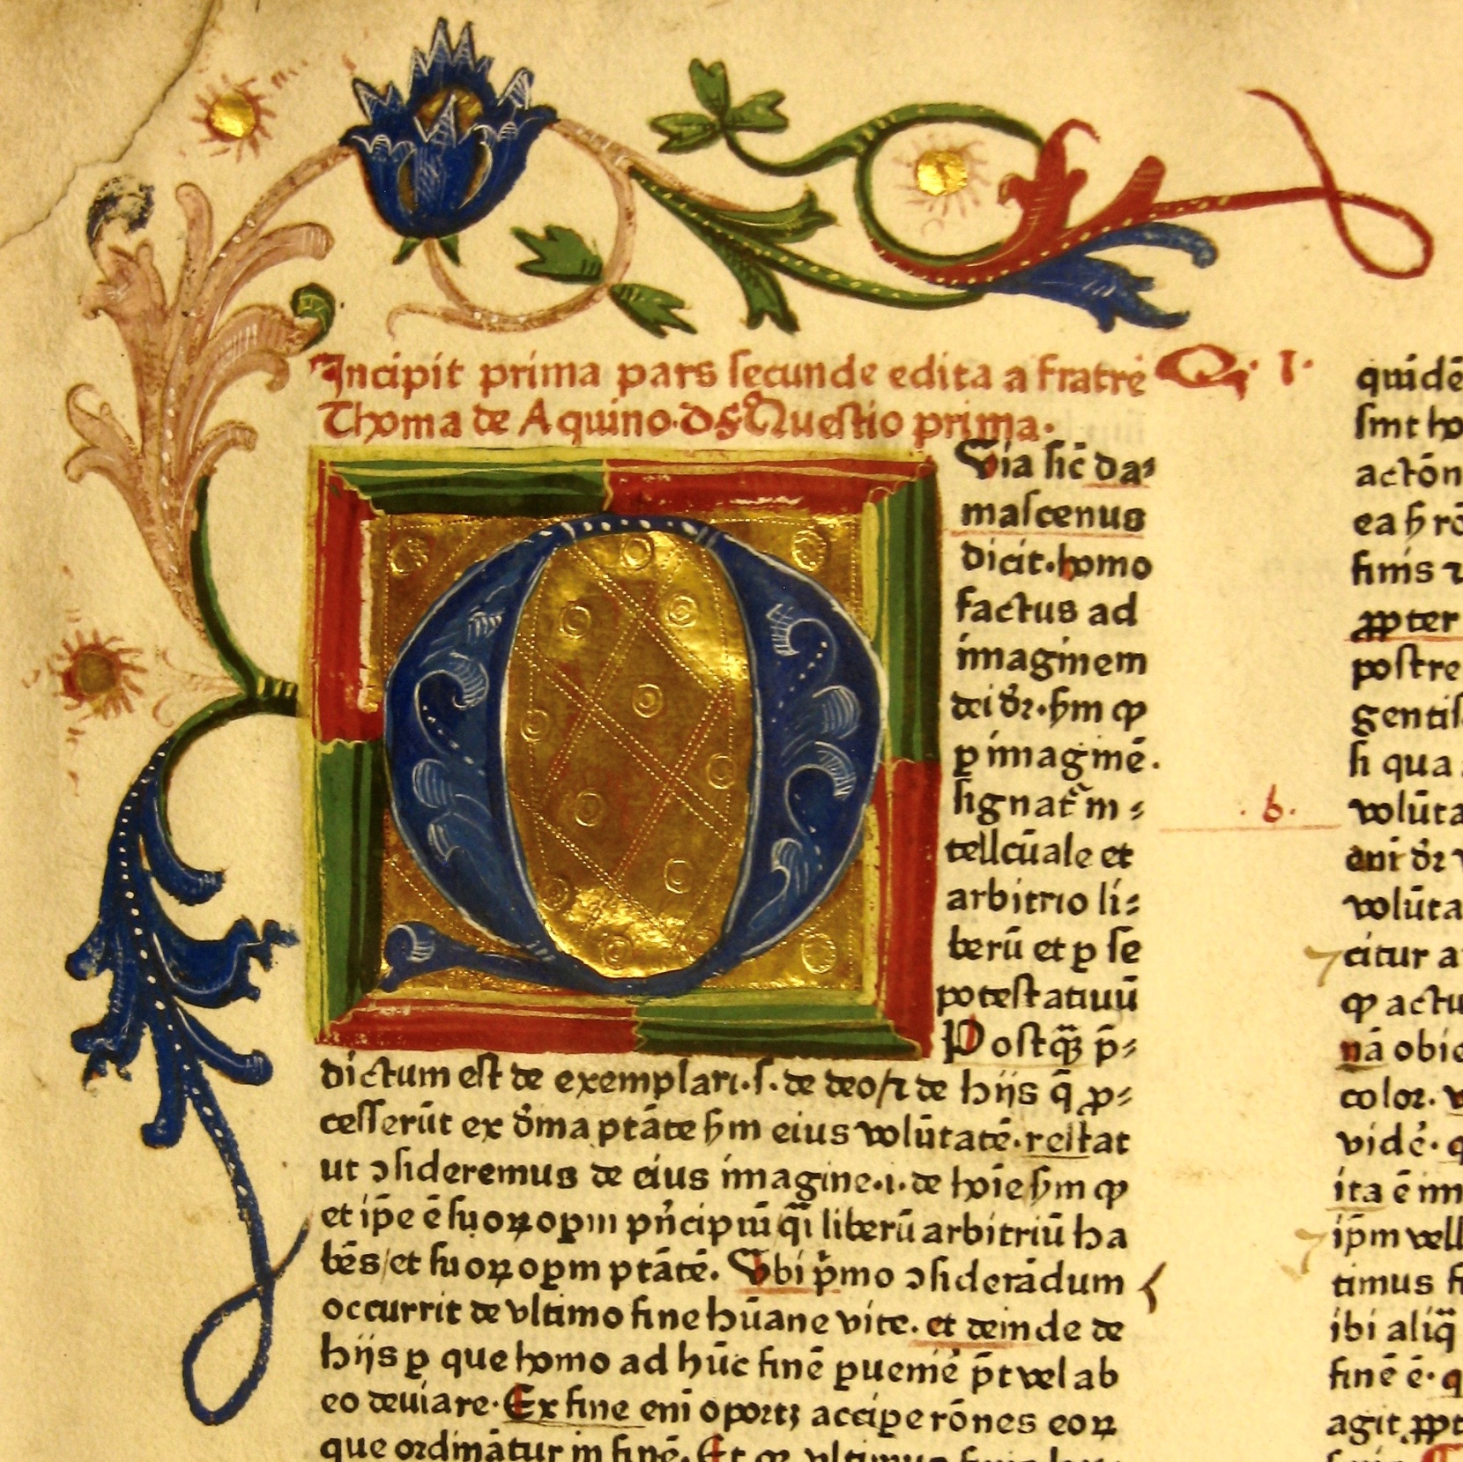
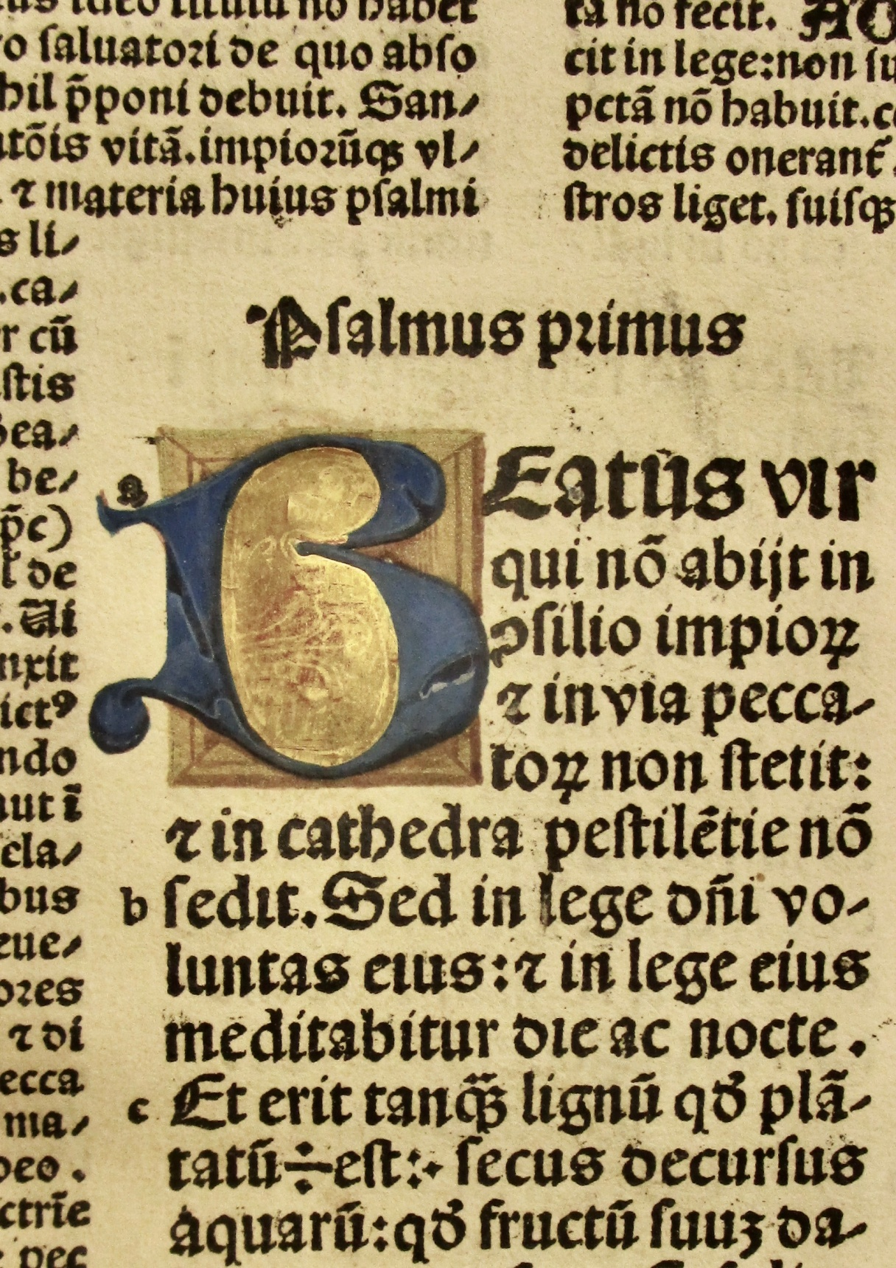
Illumination
13 letters in Augsburg style + 1 in a plainer style
Mem-inc T-1, shelfmark 3.365
Mem-inc T-38, shelfmark 3.244

Slide 14
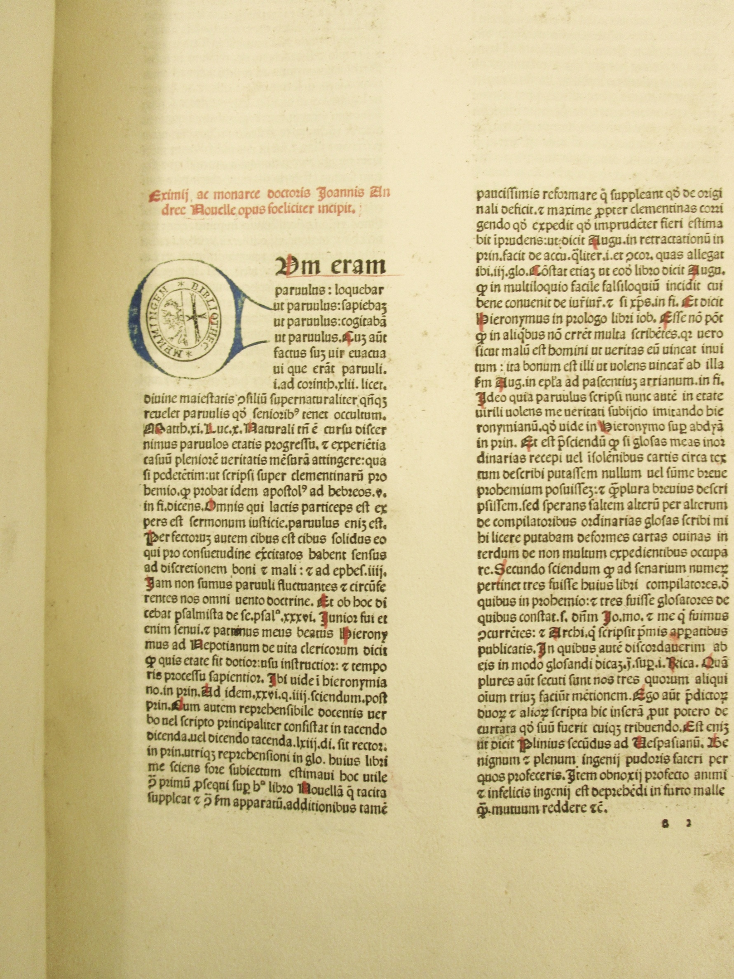
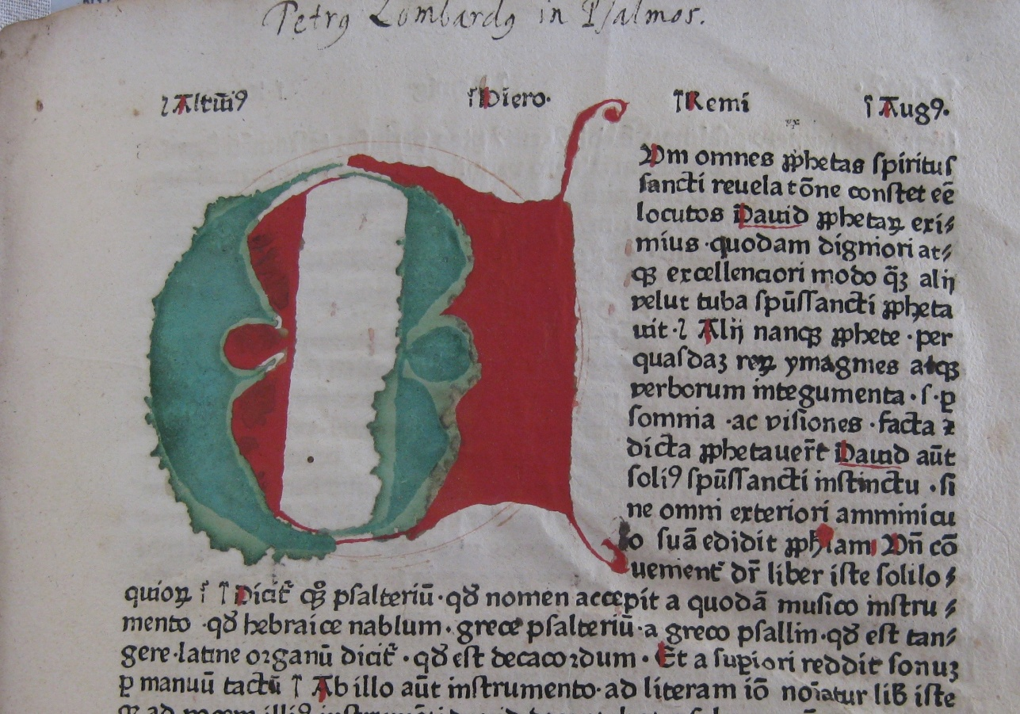
Rubrication

Slide 15
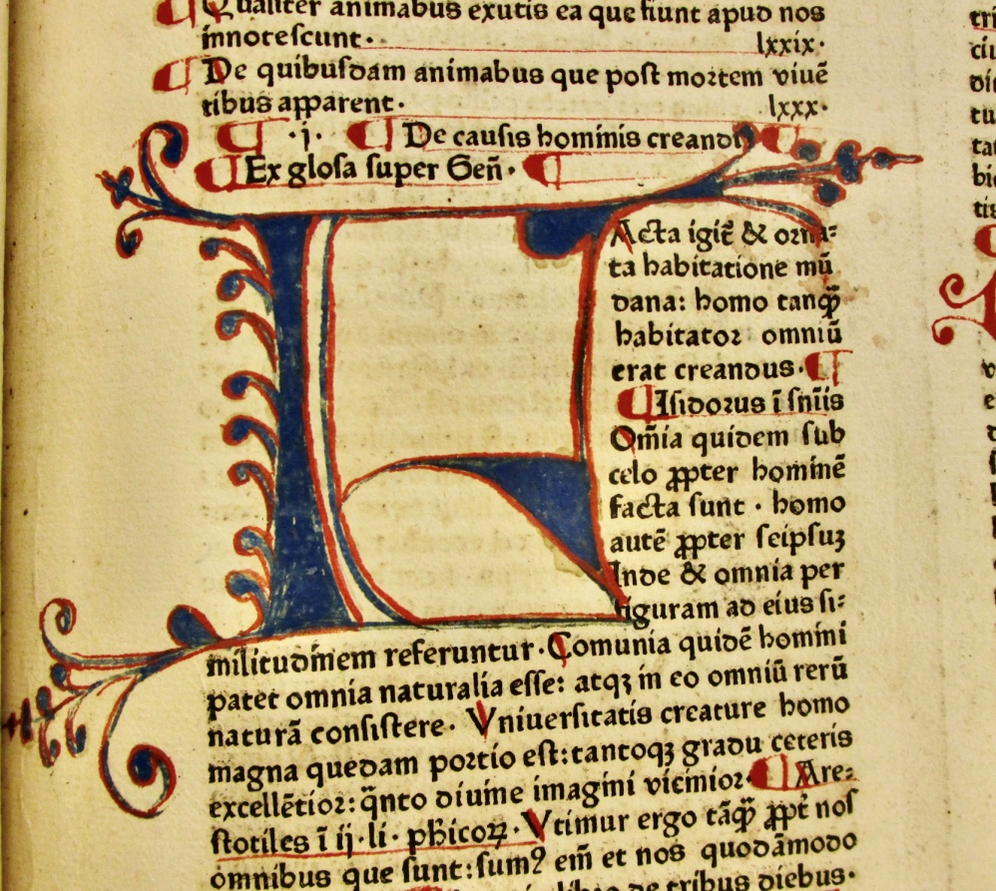
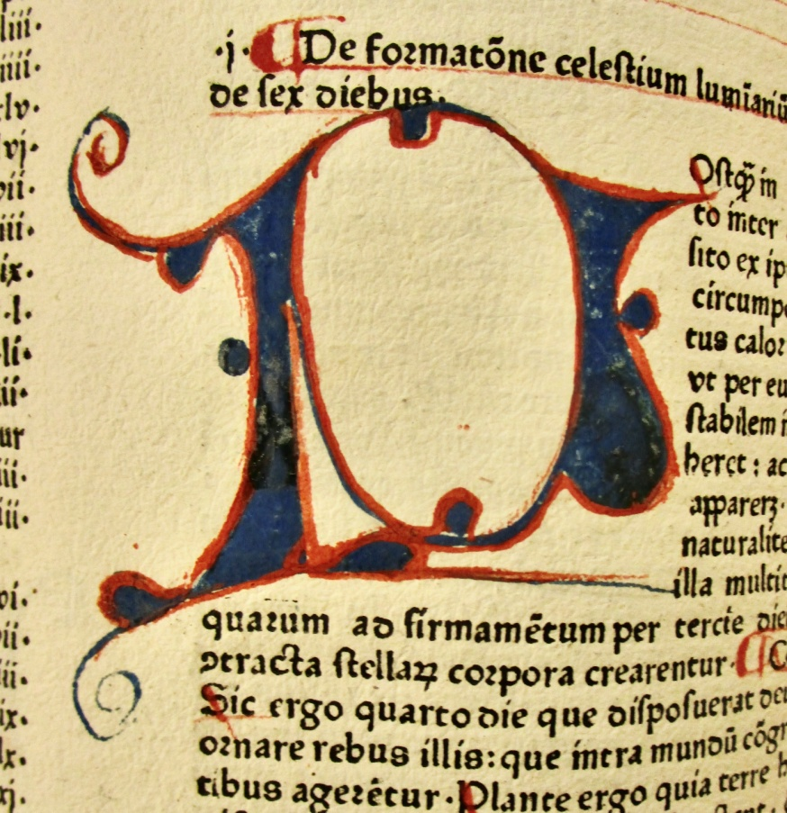
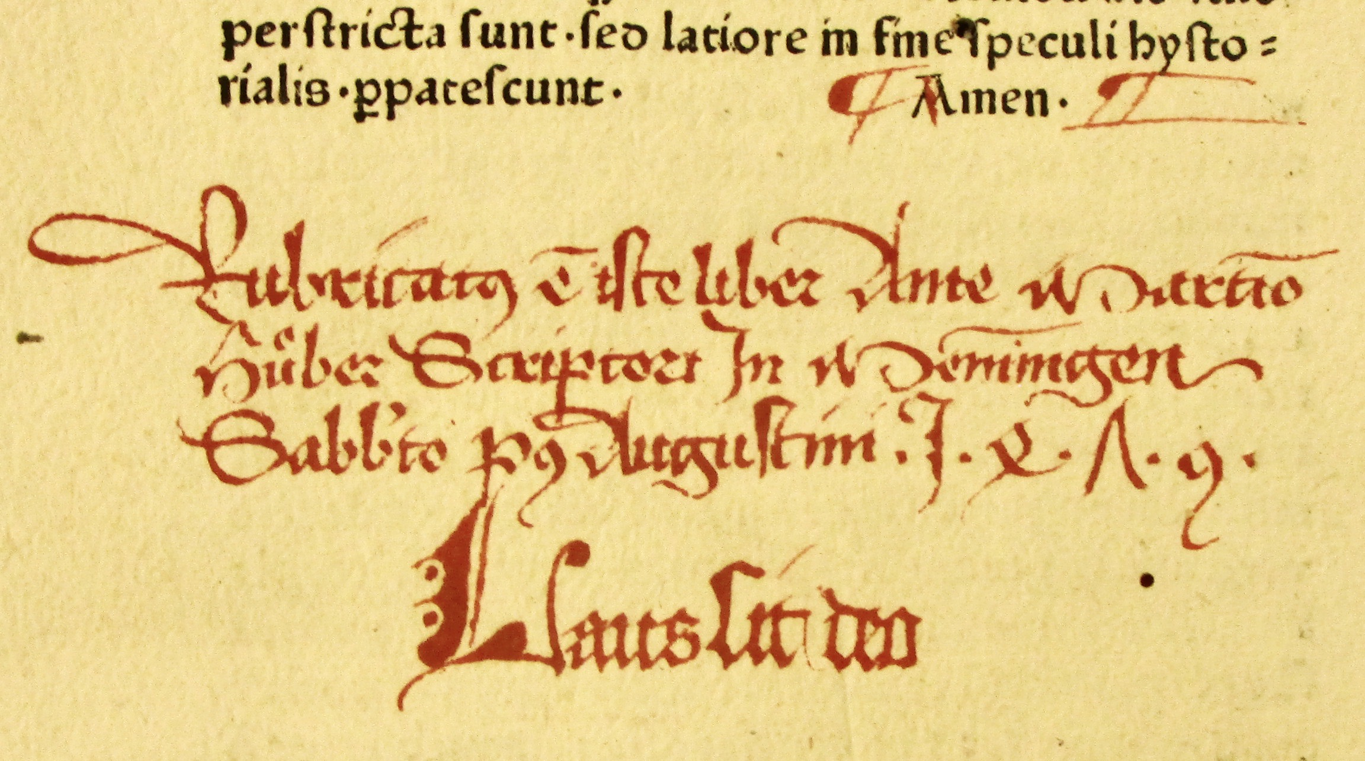
Memmingen - rubricator Martino Hüber scriptor (Kyriss 109)
Vincentius, Speculum naturale,
pr. Rusch, Strasburg, [na 1476].
(Mem-inc V-19, shelfmark 3.396)

Slide 16
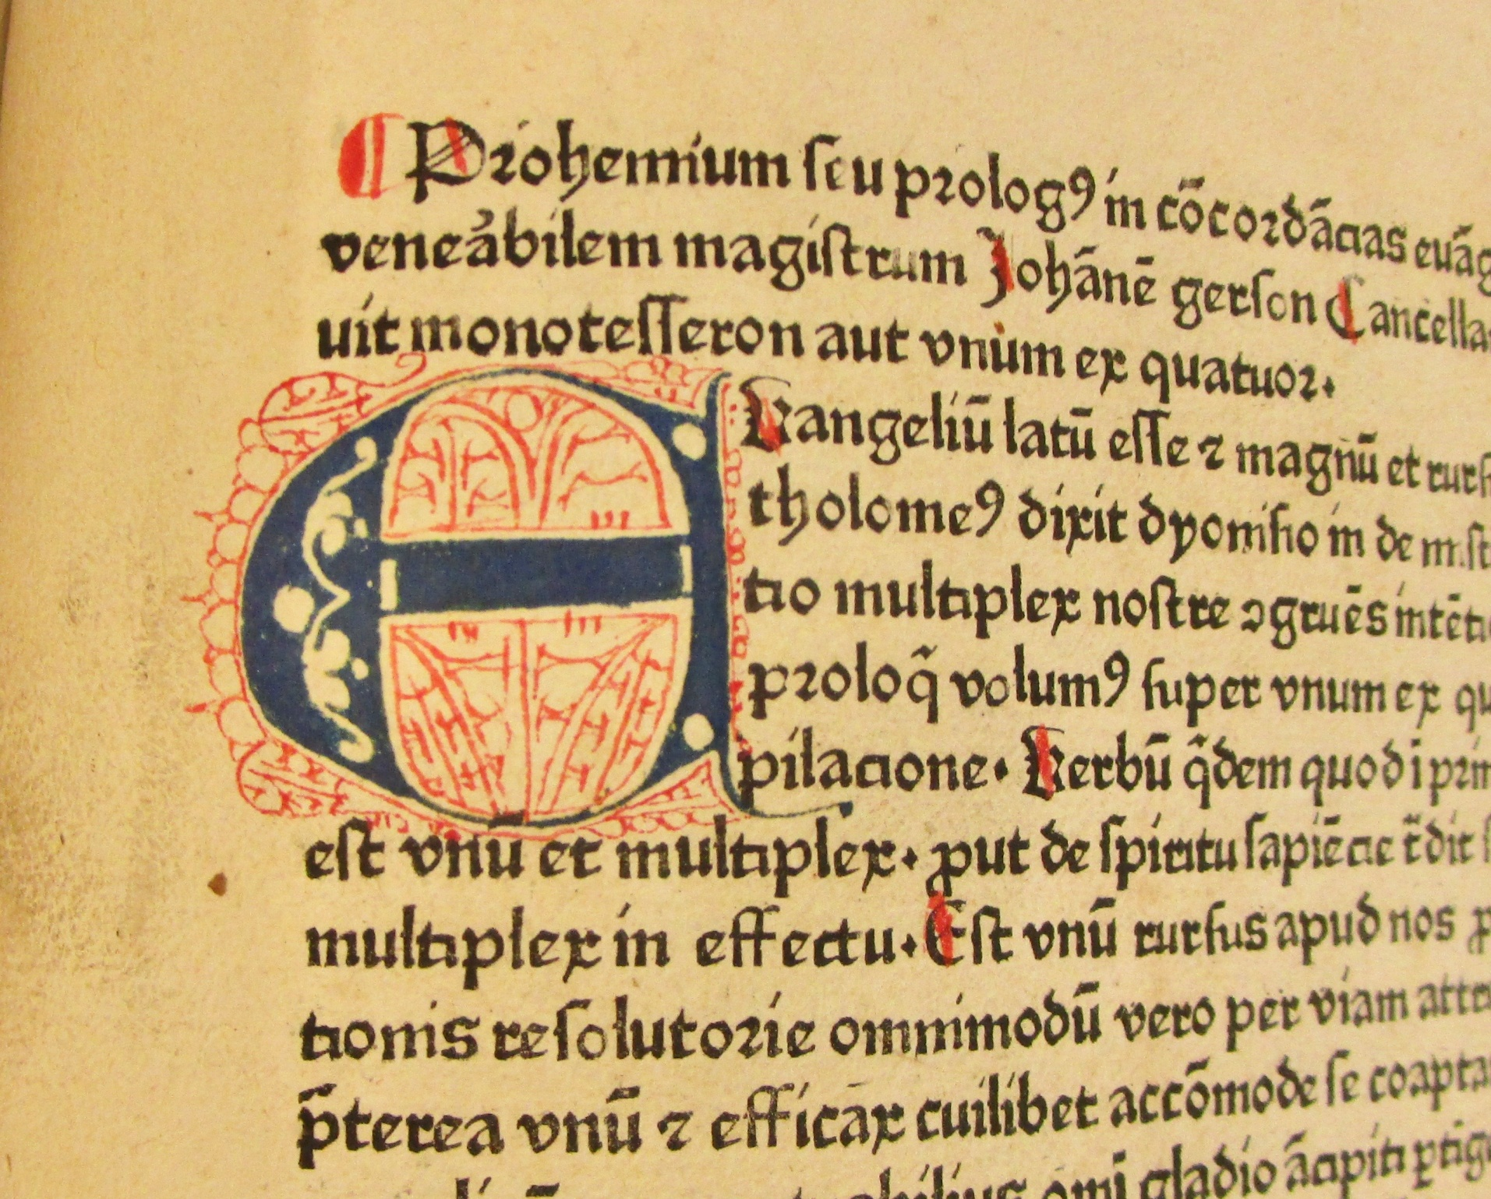
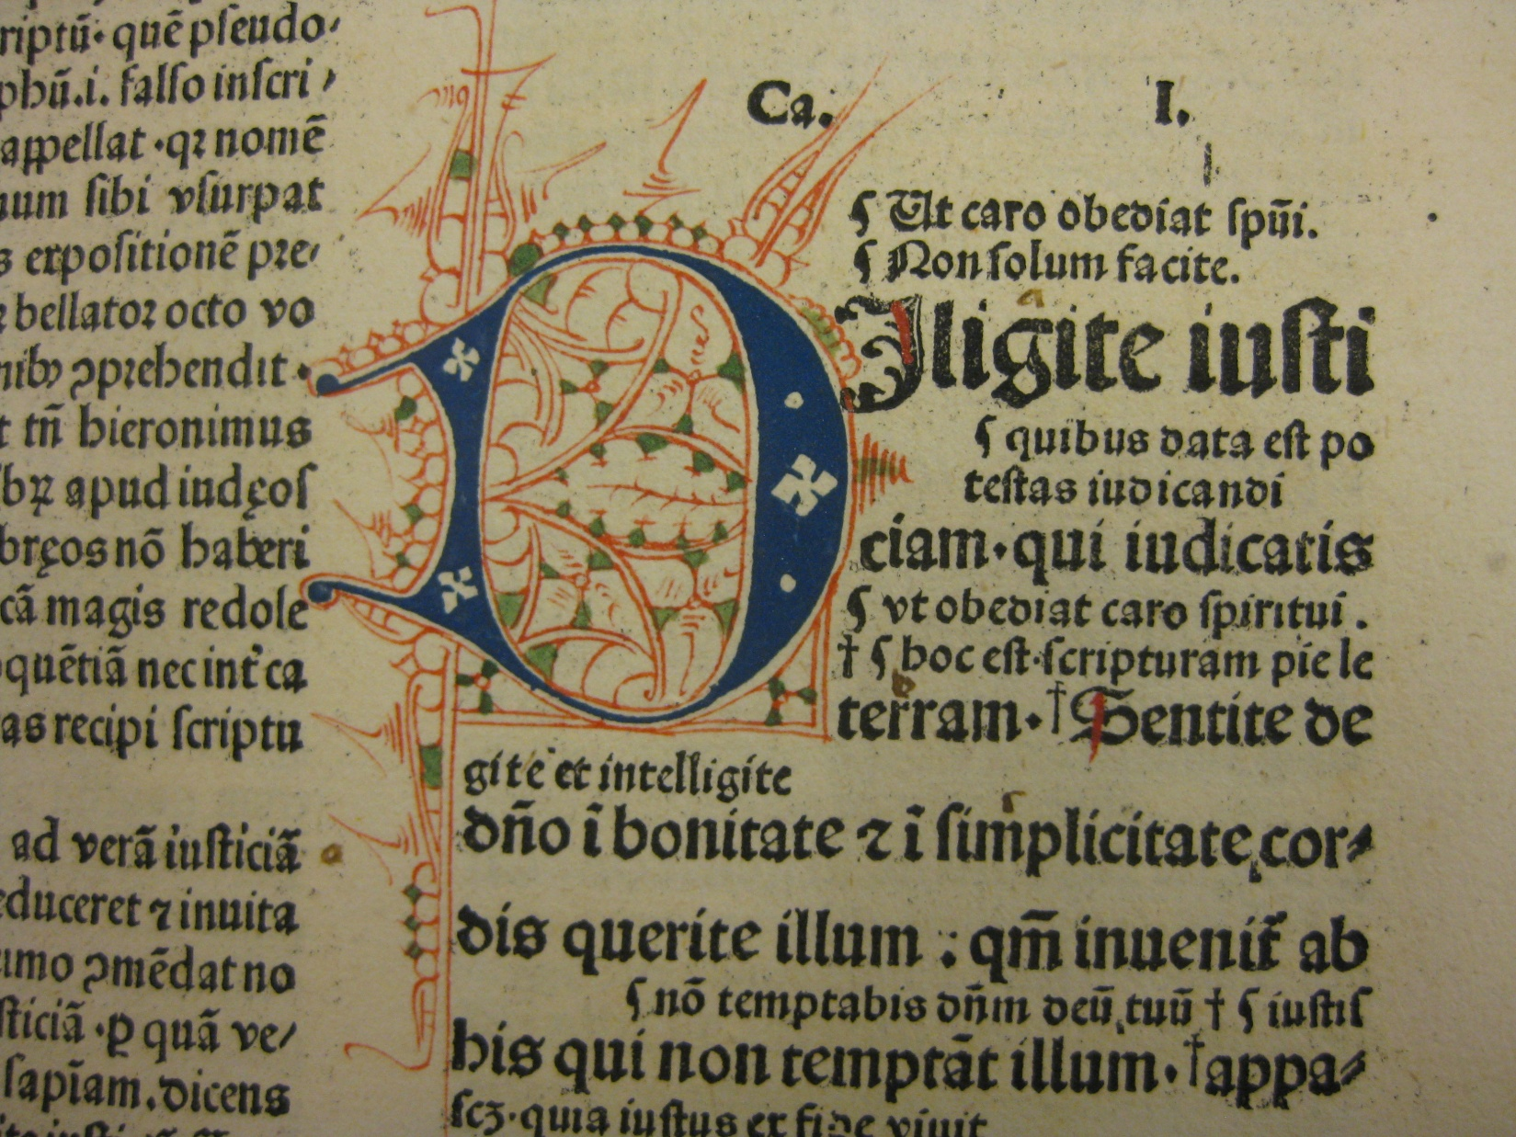
decorated initials - Cologne style
(Mem-inc B-29, shelfmark 3.414)
(Mem-inc G-9, shelfmark 3.108)

Slide 17
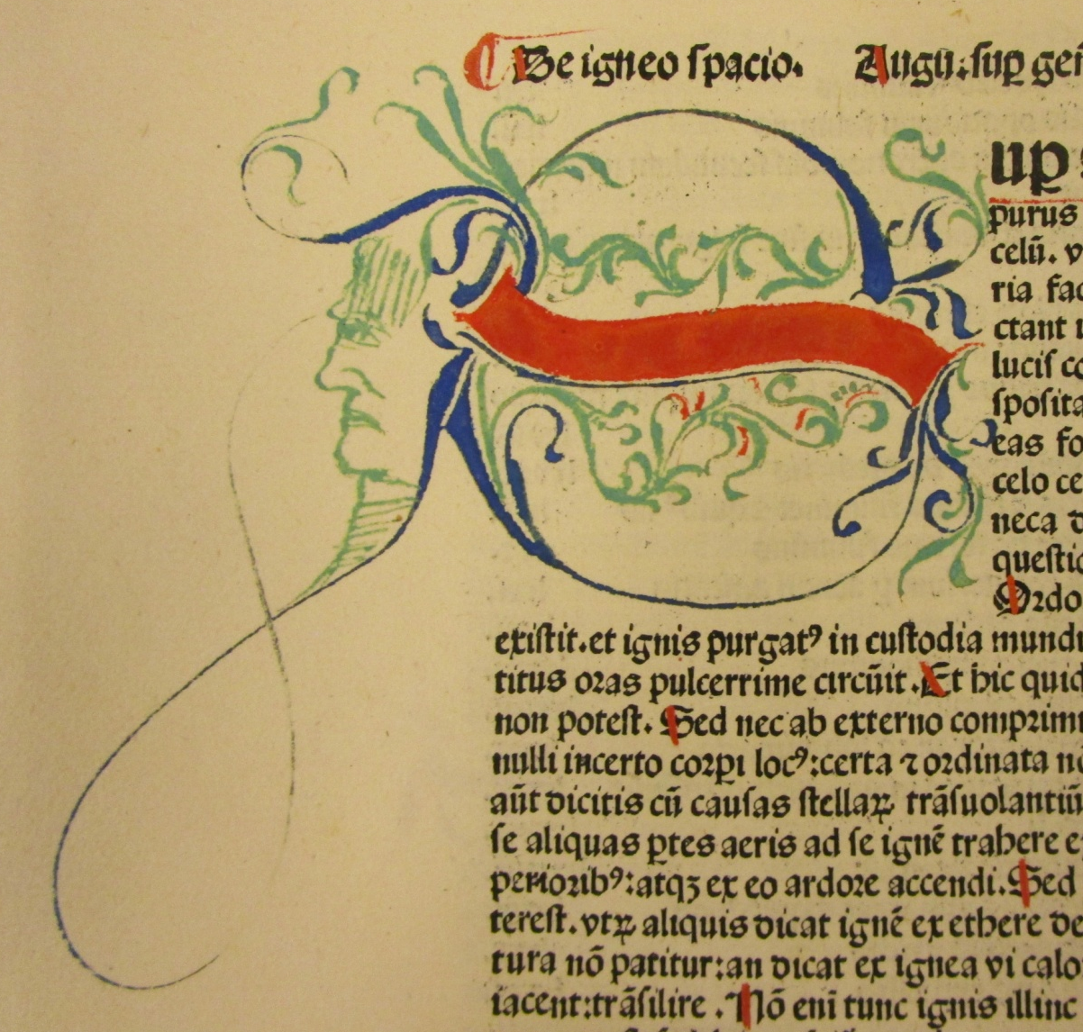
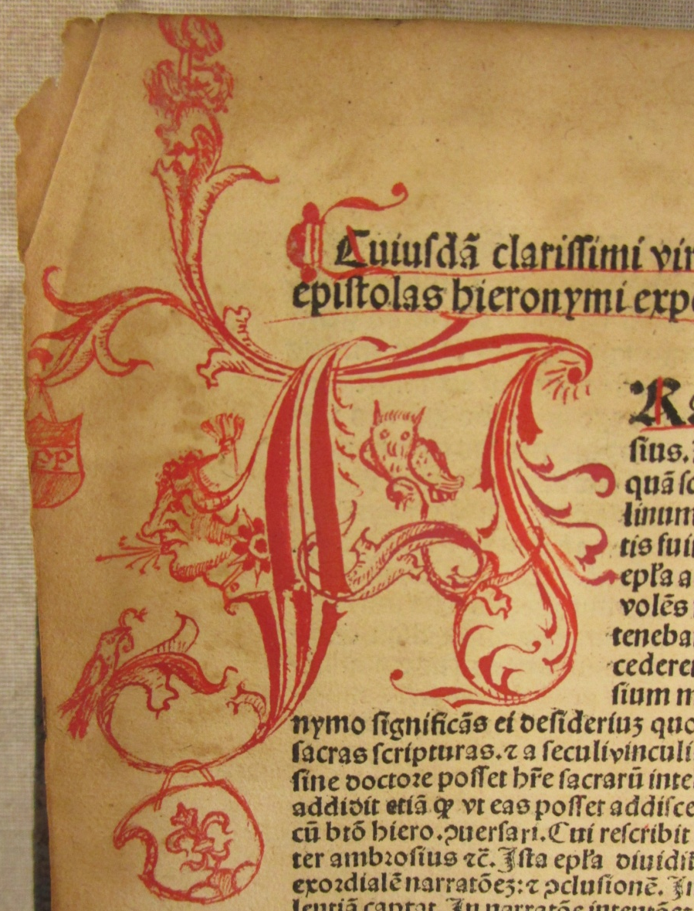
Cadelle style initials from Memmingen, Kyriss 109 and 110
K 110
(Mem-inc B-32,
shelfmark 3.332)
K 109
(Mem-inc V-20, shelfmark 3.400)
K 109
(Mem-inc R-12, shelfmark 3.376)

Slide 18
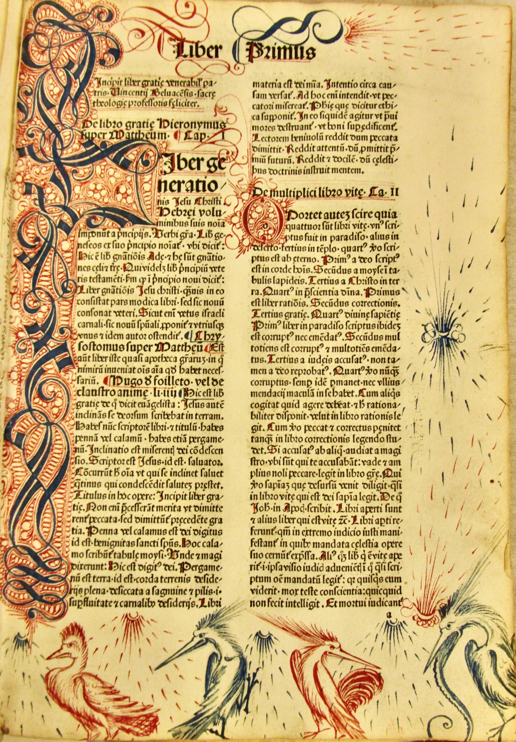
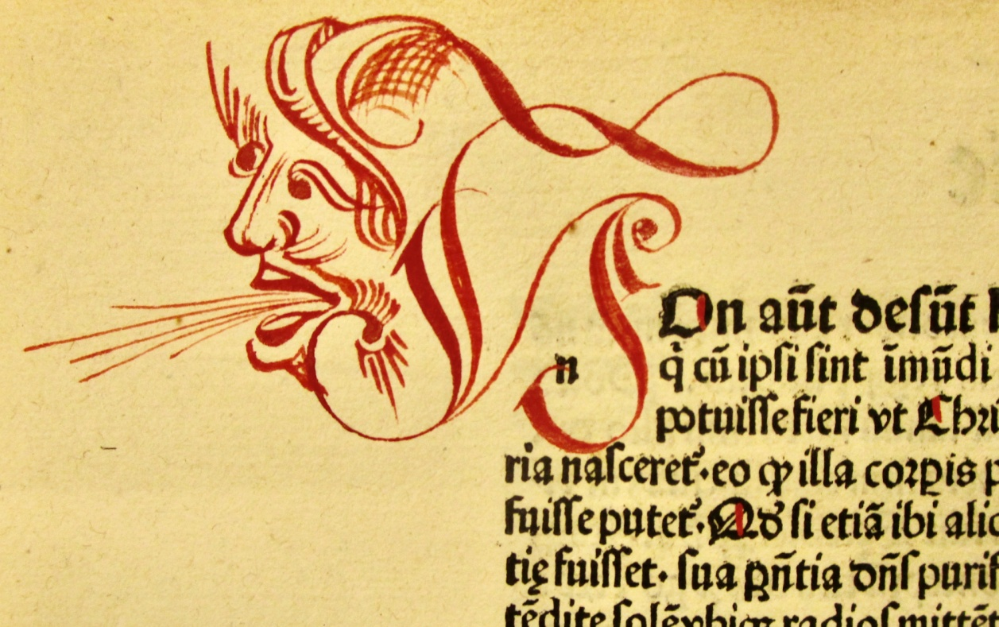
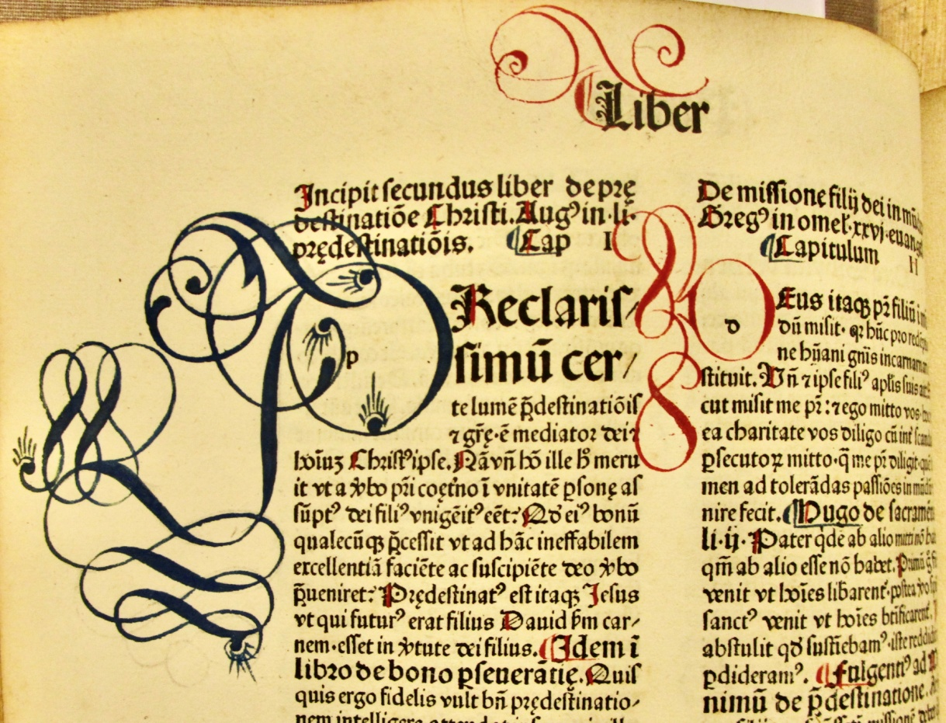
Vincentius, Opuscula, printed
Johann Amerbach, Basel, 1481;
ISTC iv00277000. Bound K 109.
(Mem-inc V-14, shelfmark 3.252)

Slide 19
a Catalogue entry
R-13
Rolewinck, Werner
Fasciculus temporum
Imprint: Memmingen: Albrecht Kunne, 1482
Format: 2º
References: ISTC ir00268000; HC 6931*; Saam 13; Goff R268; Bod-inc R-118; BMC II 602; BSB-Ink R-244; GW M38704
Book: 293 x 208 x 35mm Leaf: 282 x 200mm
Rubrication: red 6-line initial on a2. Red fill of some of the time-line circles. Red wash over woodcut town images.
Manuscript note around printed colophon. Printed on Memmingen made paper.
Binding: alum-tawed pigskin, blind-tooled from Memmingen, K 176, bindery. Old paper label with title on upper board and written on spine.
Note: a completely Memmingen book.
Shelfmark: 3.149

Slide 20
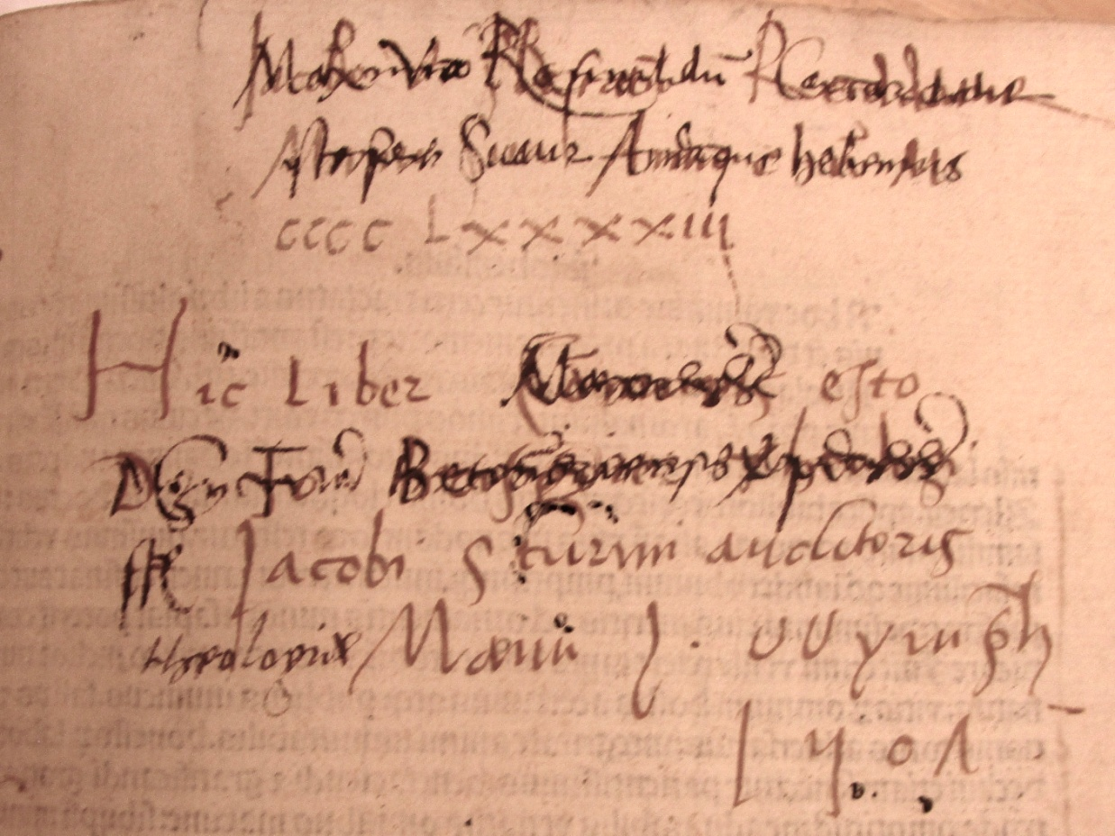
Memmingen style of initials -
has anyone seen similar?
unravelling some of the inscriptions!!!!
clairembolton@googlemail.com

