Slide 1
How MEI’s archaeological approach is shedding new light on incunables at the British Library.
John Goldfinch
Volunteer, British Library.
Notes:
How MEI’s archaeological approach is helping to refine our understanding of the histories of individual copies at the BL.
The British Museum began to publish its monumental catalogue of incunabula (BMC) in 1908. Its aims and methodology were set out by the editor, A.W. Pollard, in a long introduction. In brief, the catalogue was to place the books into a context based on production, giving detailed descriptions of the printed works in an arrangement classified by place of printing and printer.

Slide 2
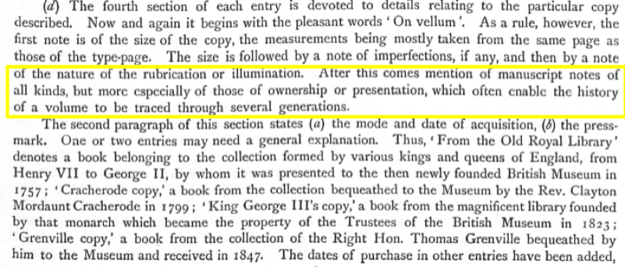
Notes:
The copy-specific aspect was not ignored – here is what Pollard said. As far as provenance goes, although he doesn’t say this specifically, the elements he describes are all taken from the book in hand.
Now when we come to prepare a MEI entry, we peel back the layers of sediment that have accumulated on the copies, looking at what we might call the stratigraphy of the book. But we can also, as archaeologists do, call on wider resources to help interpret what we see. Archaeologists draw on botany, or geology, carry out archival research. Where they are available, these other resources may be able to reveal aspects of the book’s history that might otherwise remain unnoticed. Any of you who have watched the Dig on Netflix will have met the prehistorian Stuart Piggott; he calls this the “potentialities of latent evidence”.
The example I’m taking is from the library of Sir Hans Sloane.
Although the 50,000 books from Sloane’s collection form the foundation of the British Museum Library (from 1753), now the British Library, they largely lurk out of sight. You’ll notice that Pollard doesn’t mention them. Sloane owned around 600 incunabula, counted by ISTC entries, in about 480 volumes, the difference being the number of tract volumes / Sammelbaende.

Slide 3
Notes:
A problem is that Sloane’s books in general show no obvious ownership markings; he had no distinctive bookbindings. It’s true that many volumes had a shelfmark of Sloane’s; but a lot of these have disappeared in rebinding and conservation, and for many years they weren’t recognised at all. The Sloane Printed Books project was begun in a small way over 20 years ago to record books that were clearly Sloane’s, and its website gives information about the clues we use to confirm their identity. Collections at the BL acquired more recently are much more distinctive; Grenville and King’s by binding, but also use of special stamp for King’s, Banks, Cracherode etc. led to greater awareness of these collections as opposed to Sloane’s.
Poor state of Sloane’s collections meant substantial rebinding. Many of the tract volumes seem to have fallen apart before 1753, so that many of the constituent parts of these volumes later found themselves moved into new combinations, especially after the Museum’s library was rearranged by subject in the 1790s. Further rearrangement, often with further losses to end- and flyleaves, took place as the incunabula collection was assembled around 1900, when individual editions were rearranged to fit the new order, classified on a typographic basis by country and town of printing. The Museum also undertook regular disposals of what it regarded as duplicates; perhaps 100 Sloane copies are not findable now at the BL, although I’ve managed to trace about 45 of these so far.
The lack of visibility of Sloane’s books proved paradoxically to be the clue to finding them. Books with no obvious marks of accession to the BM will as a rule have been acquired before around 1840, and they will be predominantly Sloane’s. This clue can be further refined by archival evidence, another tool used of course by archaeology, this time in the shape of Sloane’s library catalogues. Long hidden from view, and apparently unknown to A.W. Pollard and his colleagues, they are now with the BL’s Sloane MSS (there’s a separate catalogue of his medical books). Using these catalogues we can trace incunabula as they were acquired by Sloane, and then to try to match his entries with copies now at the BL.
In particular, it proved possible to place individual items back into the contexts in which they were acquired, enabling the reassembly of many of the dispersed tract-volumes, and further to make discoveries about the provenance of individual items.

Slide 4
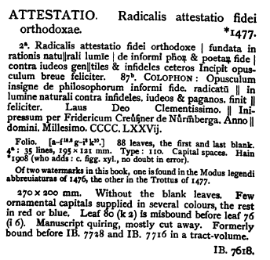
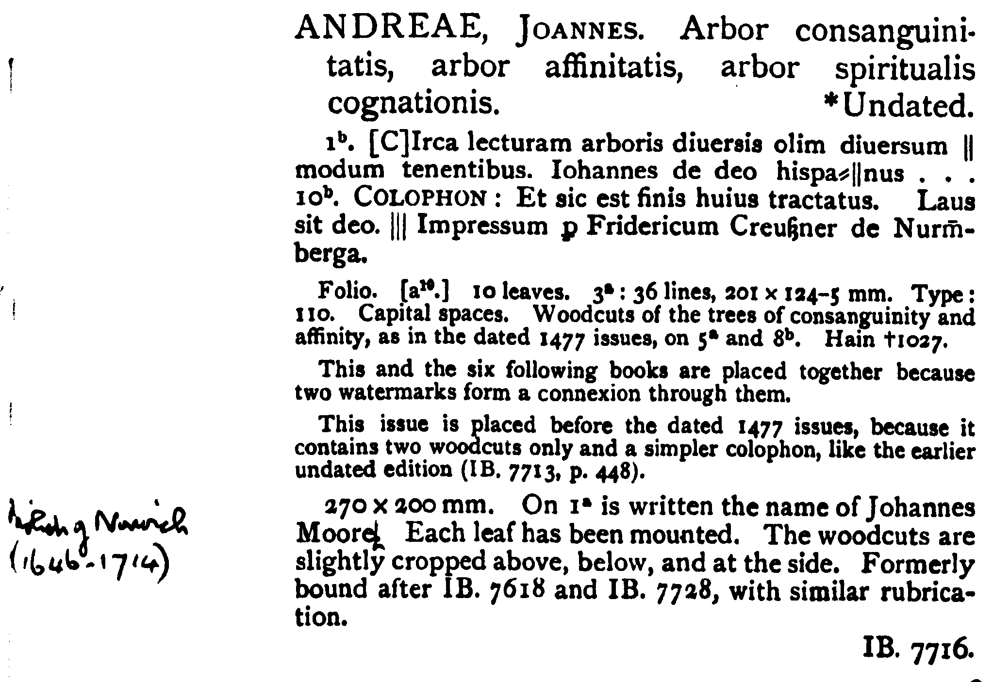
ISTC ia01177000 ISTC ia00605000
Notes:
To move to the books, from Sloane’s library catalogue, we can tell that in 1707 he acquired 28 incunables, bound in 15 volumes, one being a tract-volume consisting of five folio editions, four printed in Nuremberg in 1477 along with a Cologne-printed book of 1471. Three of the Nuremberg items were printed by Friedrich Creussner, the other by Anton Koberger. Here are the descriptions of the first two of these as they appear in the Museum catalogue, BMC. And here I must say how wonderful it is that KLH has managed to get most of BMC scanned and onto the BL website, and is now following up with scans of BL incunabula. As you can see in the first, a Creussner edition of the Attestatio fidei orthodoxae, there is no note of provenance, but the copy description shows that the cataloguer was aware that it had been bound with two other books, and from the copy-note to the second of the Creussner items, the Arbor consanguinitatis, the cataloguer had also noticed that the three items had similar decoration. But without the archival help, the catalogue couldn’t note that the original volume had contained two further items.

Slide 5
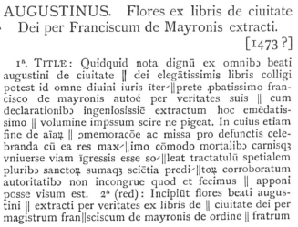
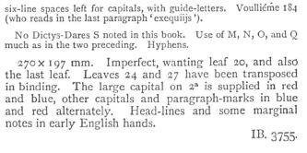
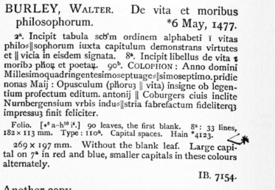
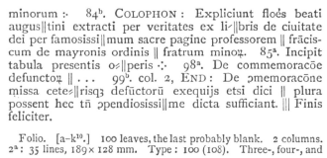
ISTC im00087000 ISTC ib01320000
Notes:
Here are the descriptions of these other two, and you can see that no connection has been made between them, or with the Creussner items.
Armed however as we are by knowing that the five items arrived together in Sloane’s library in 1707, we can look at them to see what they tell us.

Slide 6
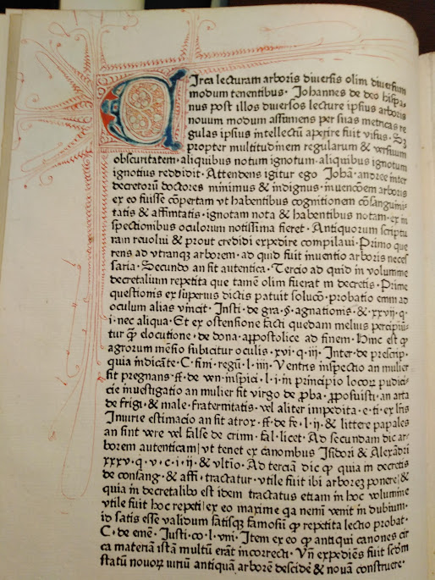
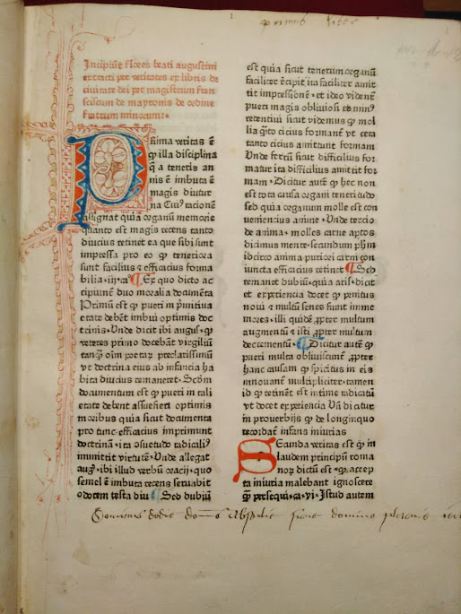
Notes:
Here are two – the Arbor consanguinitatis and the Flores Augustini, the Flores with manuscript notes said to be in English hands. The annotation at the bottom of the Flores leaf is the well-known passage from the Book of Job, the Lord hath given and the Lord hath taken away. But please look at the decoration – it is clearly similar, and it’s equally clear that it is not German. Again calling on other sources of information, in this case the BL manuscript cataloguer Eleanor Jackson, we were able to confirm that the decoration is English.

Slide 7
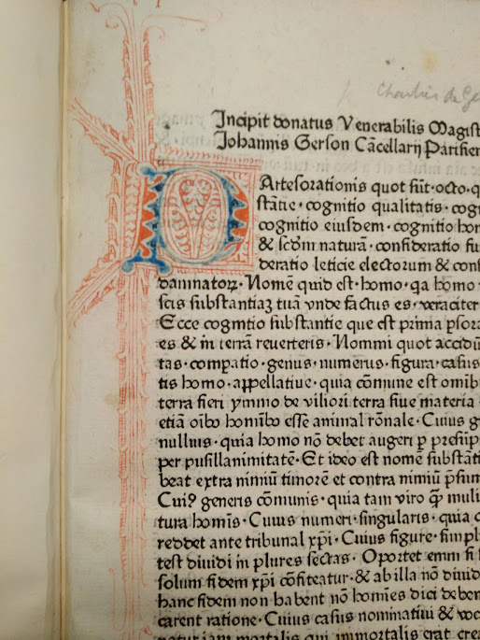
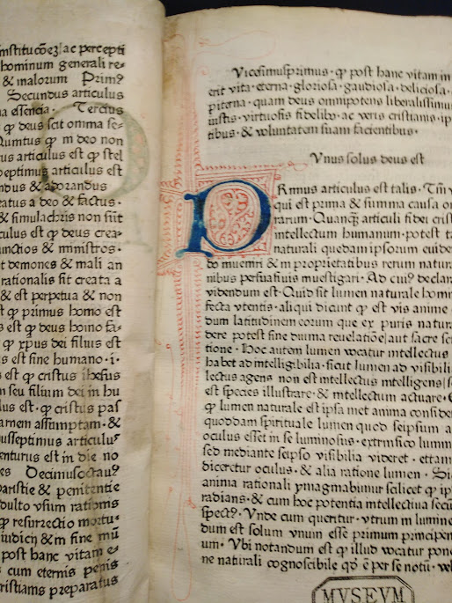
Notes:
Look at images from two other items in the volume and the link is clear.
So the opportunity that MEI has provided of looking at these five separated items together and of placing them into a historical context has allowed us to make another contribution to the record of the early arrivals of continental incunabula into England.

Slide 8
