Slide 1
CERL Internship at CUL (2018/2019) and my new research projects between italian illustrated editions, bibliophilia and antiquarian booktrade
By Marianna Morreale – m.morreale21@gmail.com

Slide 2
CERL Internship and Placement Grant at Cambridge University Library September and October 2019
Two months working for CERL with MEI (Material Evidence in Incunabula) at CUL’s Rare Books Department
Worked on italian incunabula: firstly incunabula printed in Milan (covered all Milan incunabula at CUL) and then incunabula from Bologna, Brescia, Pavia, Naples, Vicenza, Modena, Como, Torino

Slide 3
Main tasks
Working on MEI database along with Owners of incunabula by updating provenance information and copy section of each record
Organizing and creating, when necessary, multiple provenance blocks (chronological and geographical), in order to restructure these data in the right order of provenance
Edited approximately 230 MEI records and worked on ca. 50 owner records on Owners of incunabula, both created or uptdated

Slide 4
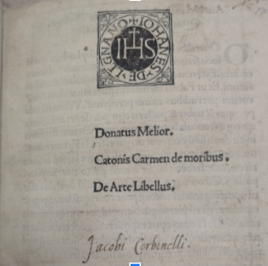
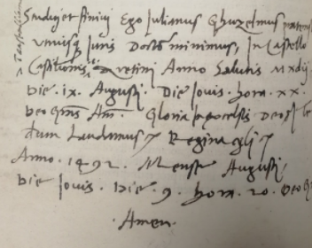
Example of provenance: inscriptions and manuscript notes
Studui et finiui Ego Julianus Ghuzelmus pratensis utriusque Juris Doctor minimus in Castello Castilionis id est Aretinj Anno Salutis Mxdij. Die .ix. Augusti. Die Jouis. hora .xx. Deo Gratias Amen. Gloria ... laudamus regina ... Anno 1492 mense Augusti … Amen
Jacopo Corbinelli Inc.5.B.7.19[1913], leaf [a1] recto https://data.cerl.org/mei/00559910
Italian humanit (1535-1590)
Previously unidentified inscription from Giuliano Guizzelmi of Prato Inc.5.B.8.19[2023], leaf f5 verso https://data.cerl.org/mei/02132284
Italian jurist (1446-1518)

Slide 5
Engravings in early italian printed books: a bibliographic tool and a cultural web portal
University research project financed by Sapienza University
Head of the project is Maria Teresa Biagetti, professor at the Department of Literature and modern culture of Sapienza University, teaching Library and Information Science
-

Slide 6
Italian illustrated editions
Focus on engravings as illustrations of the texts
First step of the project: detailed census of illustrated italian editions between 1501 and 1830
Final goal: creation of a web portal, freely accessible, containing bibliographic data in linked open data format with previously digitized images
Technical descriptions of each engraving for every edition

Slide 7
Specialization degree in Archive and Library heritage (Scuola di Specializzazione in beni archivistici e library, Sapienza University)
Specialization degree dissertation
Bibliophilia, book collecting
Antiquarian book trade
Specific focus: ancient books and manuscripts in auction houses
Interviews with Filippo Lotti, Managing Director of Sotheby’s Italia and Fabio Massimo Bertolo, Managing Director of Finarte

