Slide 1
LUX: Cross-Collection Discovery at Yale
https://lux.collections.yale.edu/
Robert Sanderson
Senior Director for Digital Cultural Heritage
CERL Seminar for Cross-Collection Search
National Széchényi Library, Budapest, Hungary

Slide 2
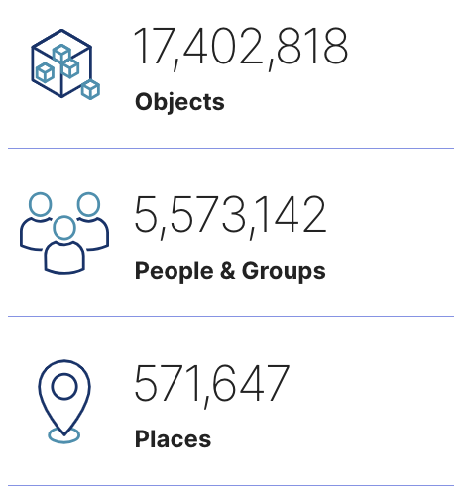
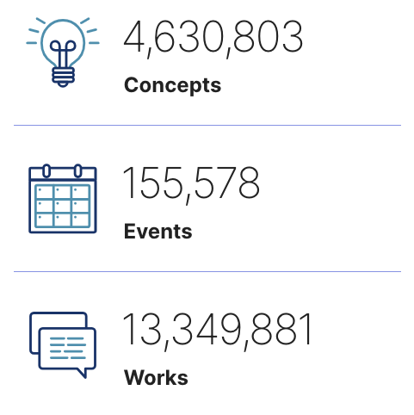
What is LUX?
A ground-breaking discovery and research platform, providing unified digital access to the collections of our museums, libraries and archives

Slide 3
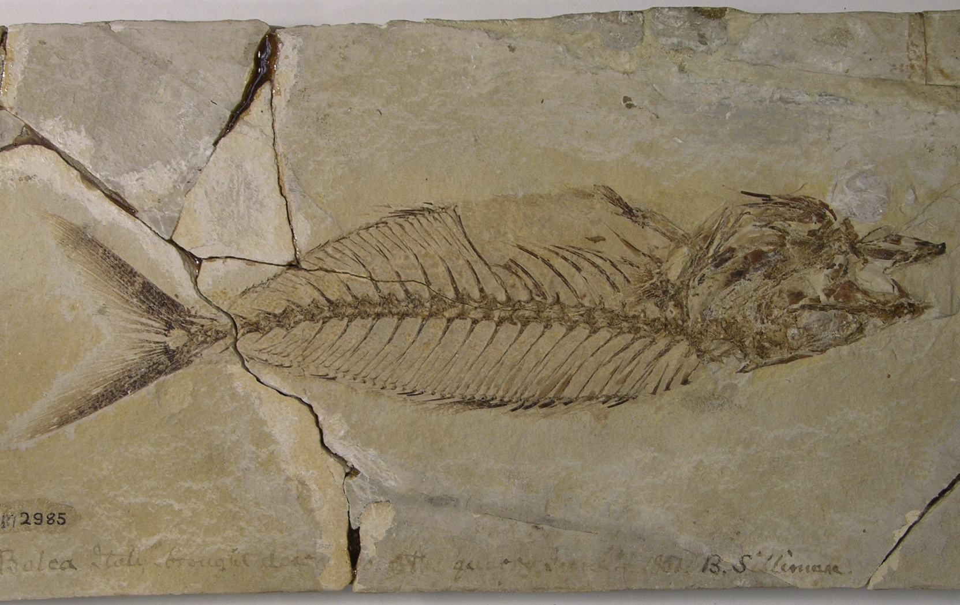
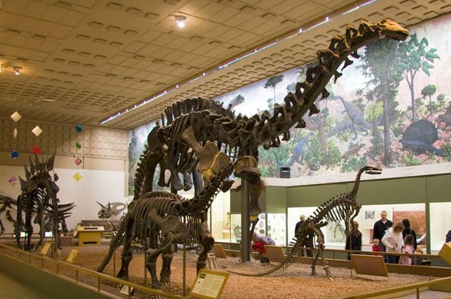
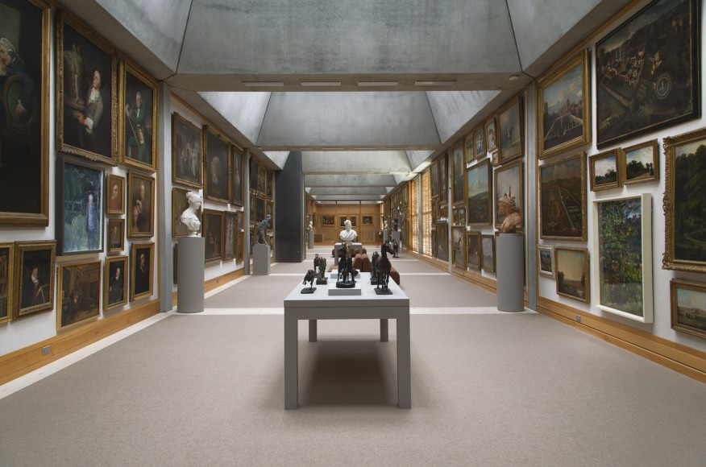
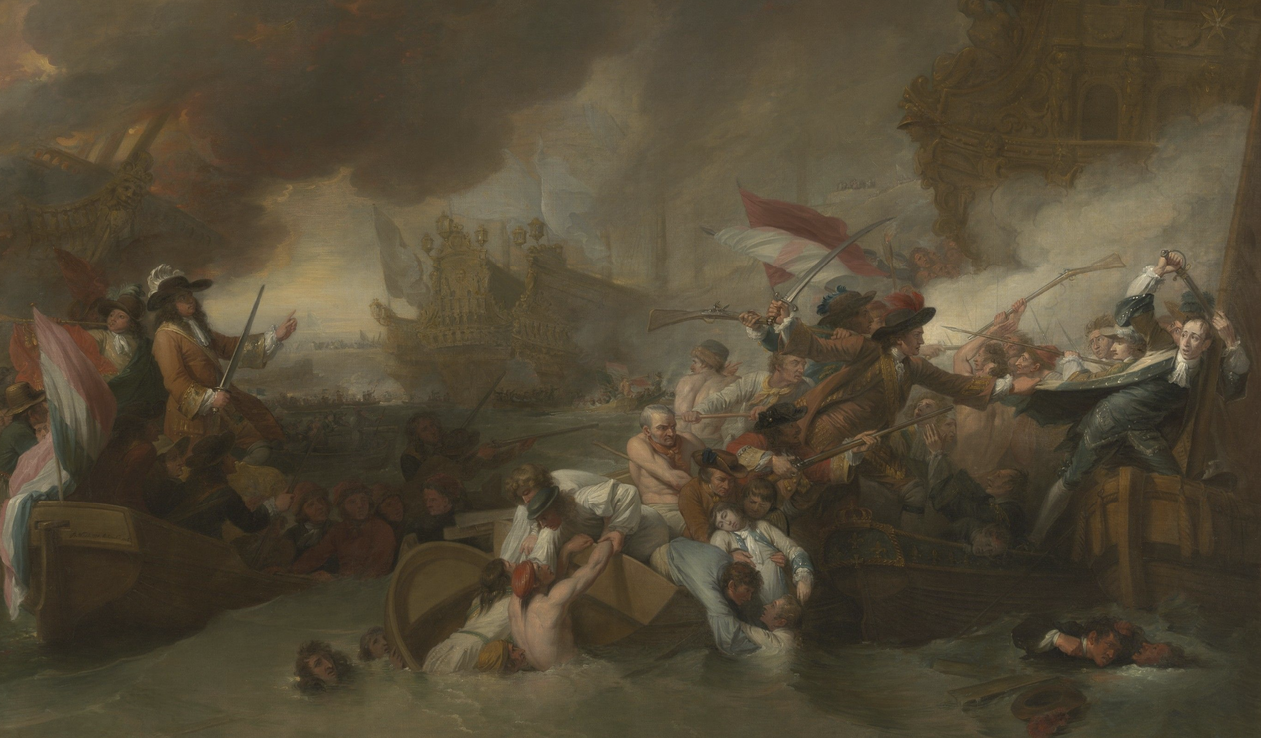
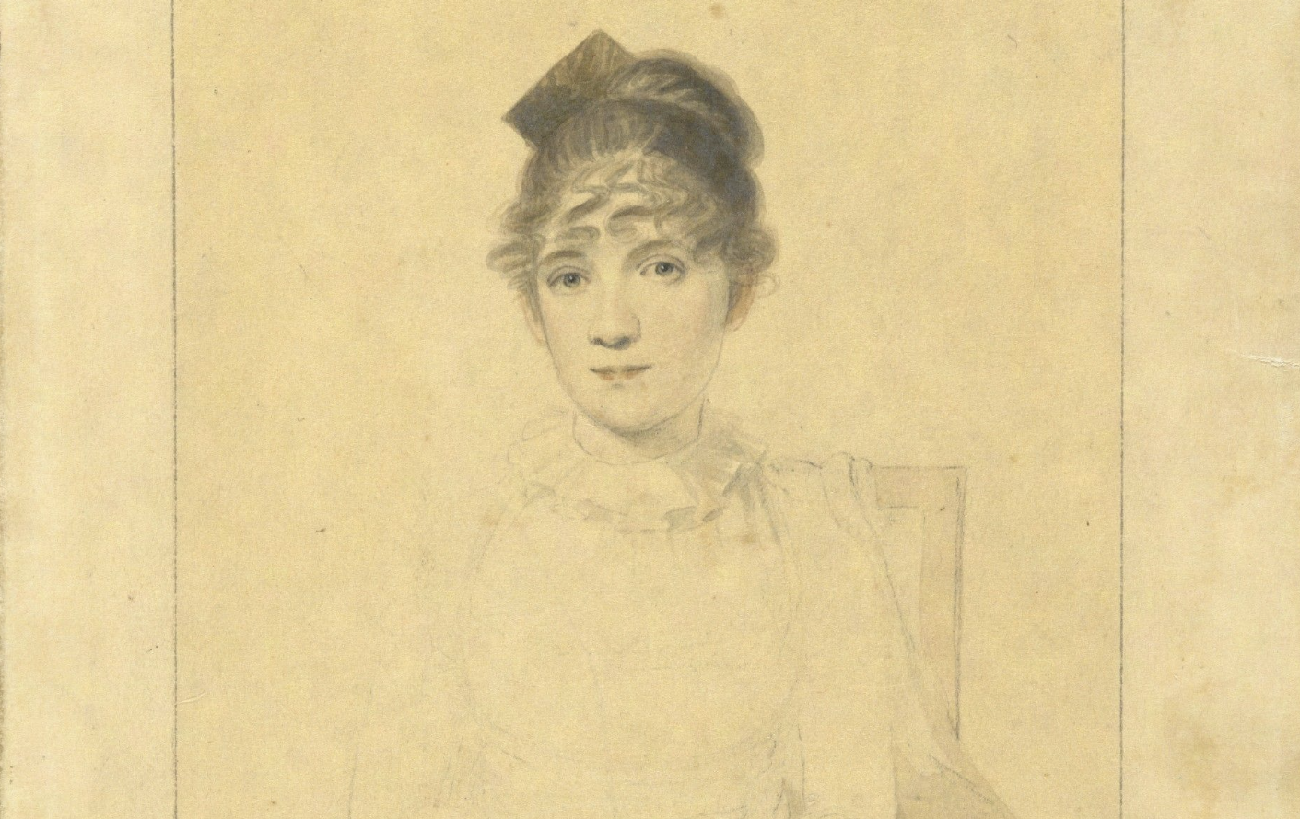
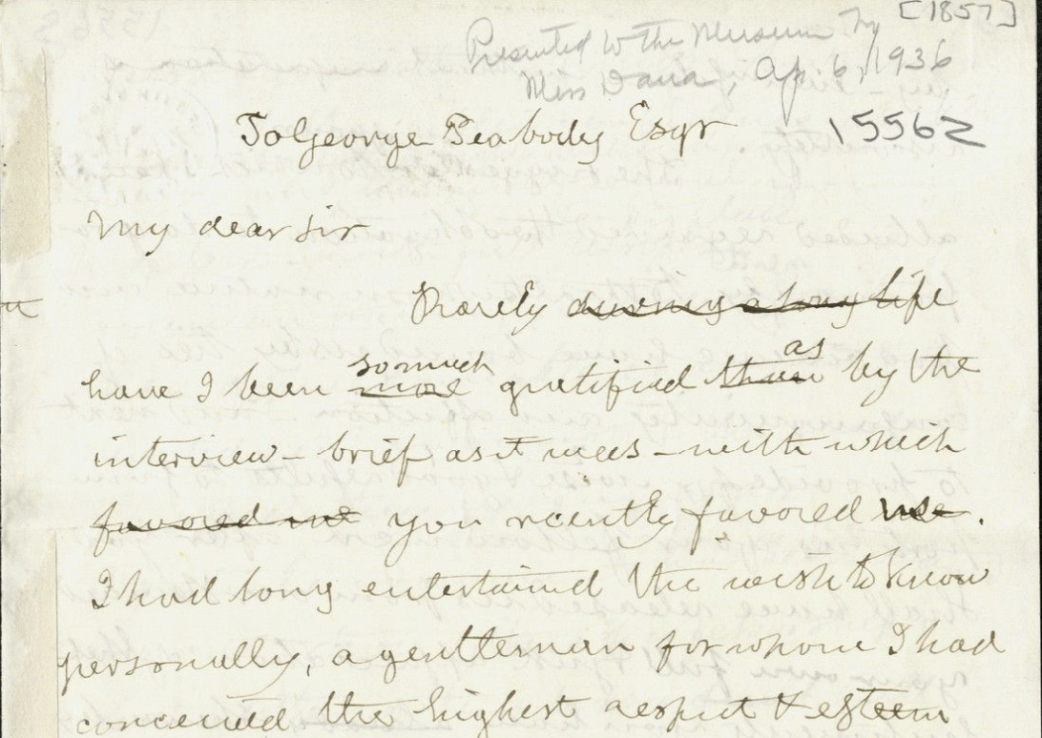
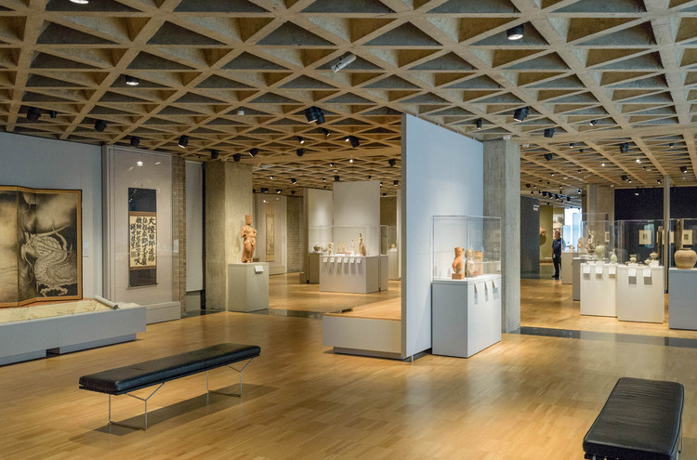
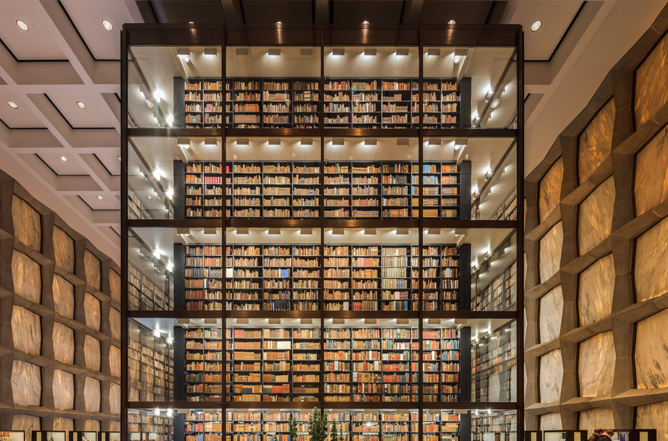
Cultural & Natural History Collections
Yale Peabody Museum
Yale Center for British Art
Yale University Art Gallery
Yale University Library
Notes:
We need to start with that recognition that everything is connected.
Fish in the Peabody found by Benjamin Silliman, a science professor who wrote to George Peabody, the letter now in the Archives, and was married to Harriett Trumbull, picture from the Gallery, who was the daughter of the governor and niece of the artist John Trumbull, who painted this work in the YCBA with his teacher, Benjamin West.
Also CMI, CAC, IPCH, PMC

Slide 4
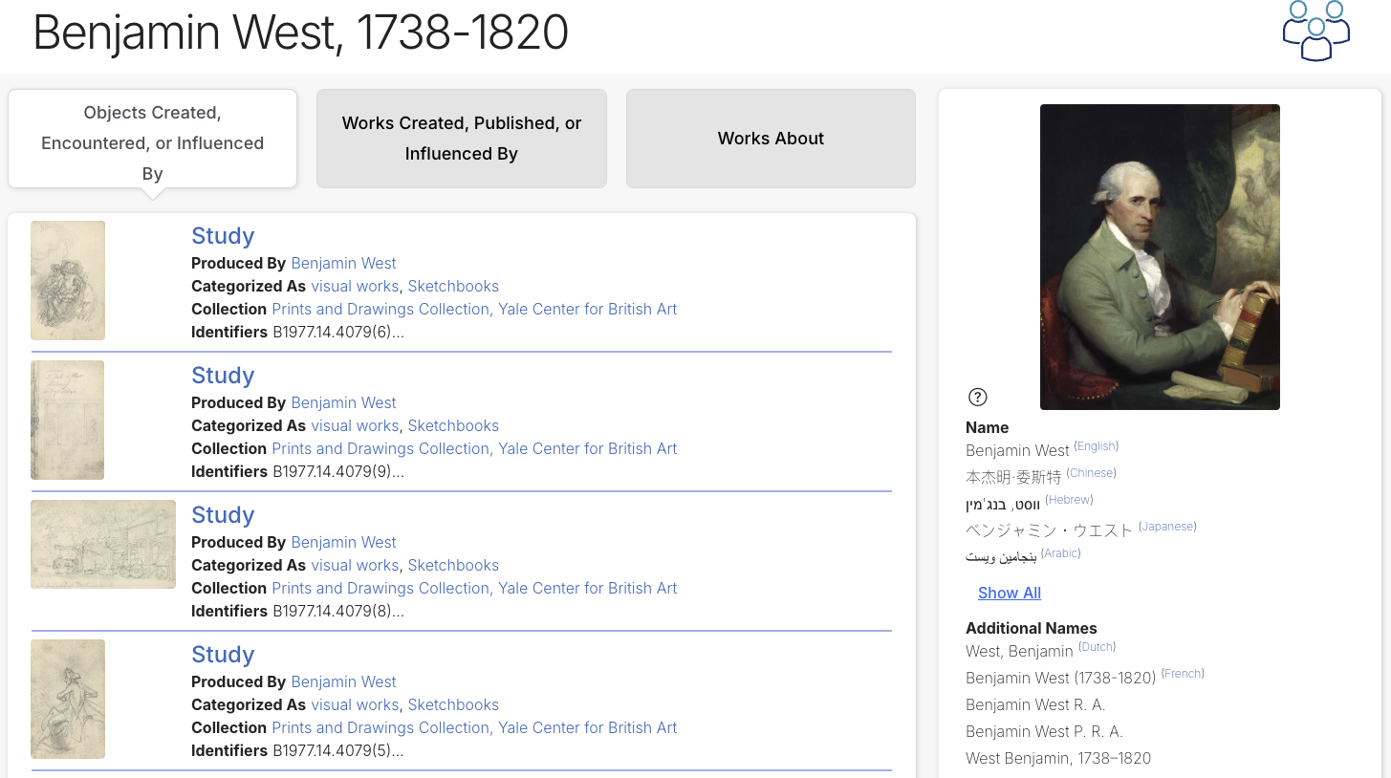
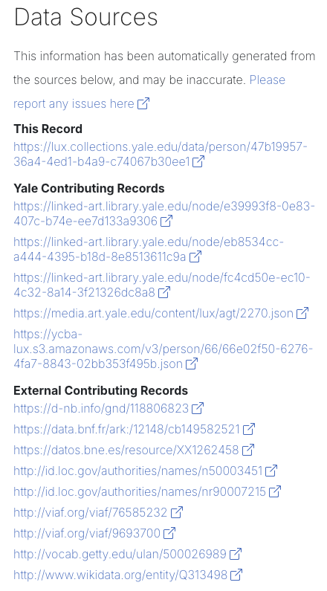
Unified?
There should be one record for each entity, not one per source database (reconciled)

Slide 5
Unified?
The record should have as much knowledge presented as we can collect (enriched)

Slide 6
Unified?
The record should link to the records of all other entities that are related to this entity (connected)

Slide 7
What is LUX?
A ground-breaking knowledge graph, providing unified digital access to the collections of our museums, libraries and archives

Slide 8
Knowledge Graph?
Notes:
Hardest part of conceptual modeling – the empty whiteboard!

Slide 9
Single Entity
B2009.2

Slide 10
References to other Entities
West
Trumbull
by
by
created
B2009.2

Slide 11
Entities can be Conceptual
West
Trumbull
by
by
painting
type
created
B2009.2

Slide 12
And Geospatial
West
Trumbull
by
by
painting
type
created
B2009.2
depicts
La Hogue

Slide 13
With Hierarchical Relationships
West
Trumbull
by
member of
by
painting
type
created
broader
B2009.2
Royal Academy
depicts
within
visual works
La Hogue
Normandy

Slide 14
And Non-Hierarchical
West
Trumbull
by
member of
by
painting
type
created
broader
B2009.2
Royal Academy
depicts
about
within
visual works
Auction Catalog
La Hogue
Normandy

Slide 15
Knowledge Graph!
about
Trumbull Archive
created
by
West
Trumbull
about
by
member of
by
painting
type
created
broader
B2009.2
Royal Academy
depicts
about
within
visual works
Auction Catalog
La Hogue
Normandy

Slide 16
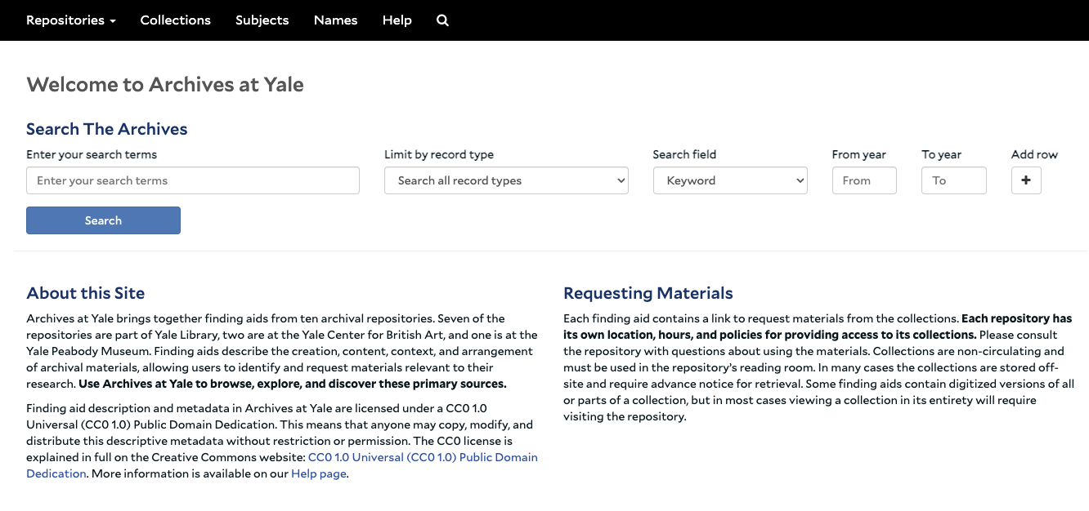
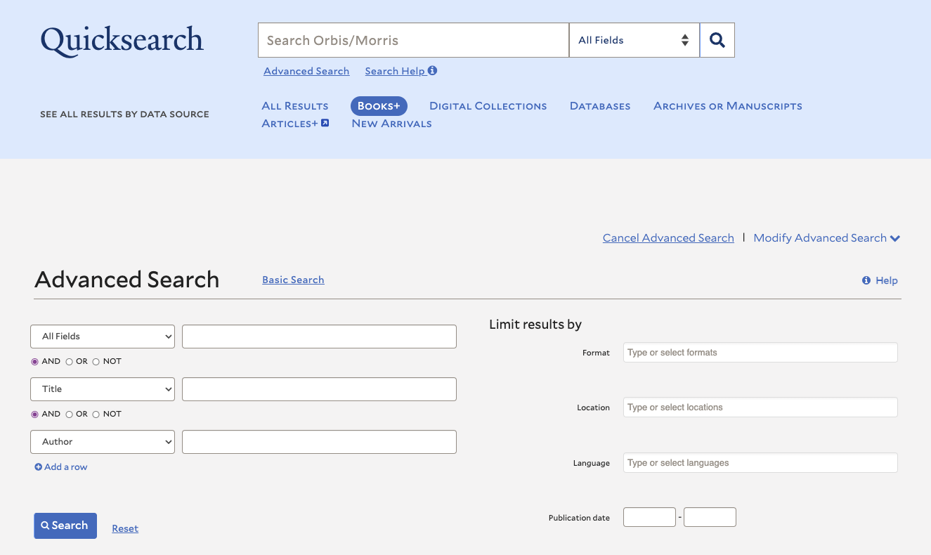
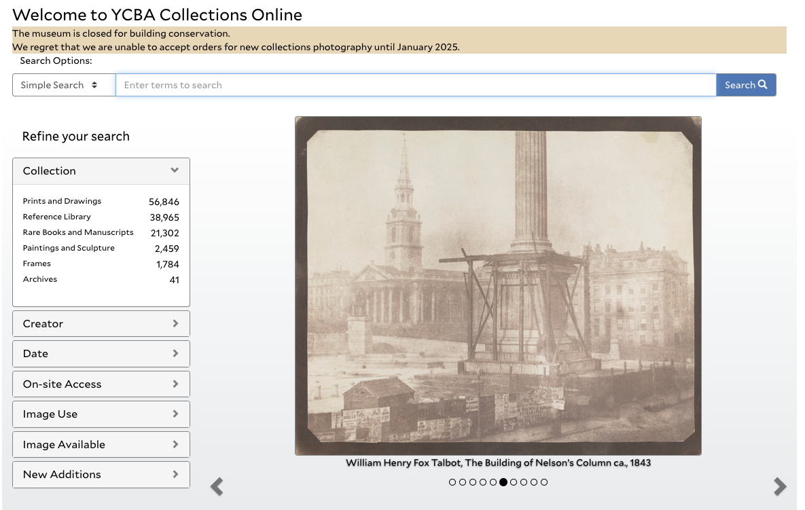
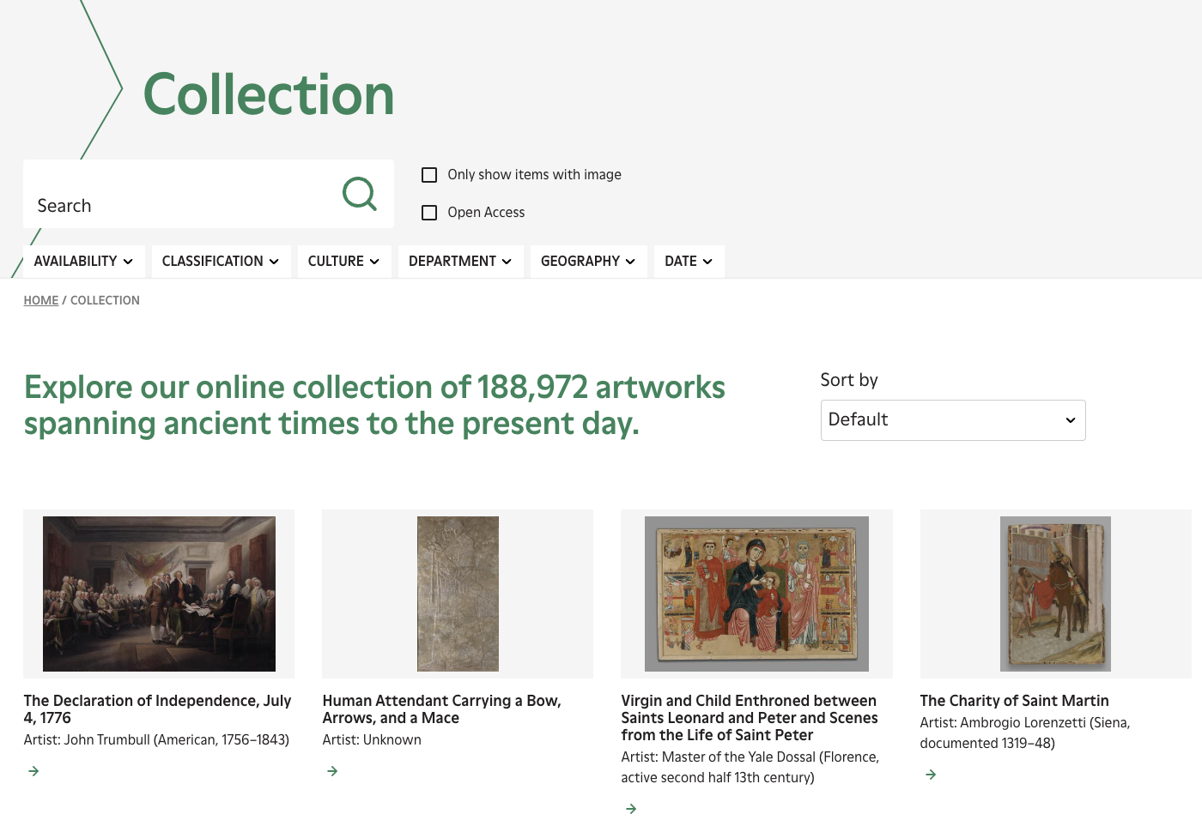
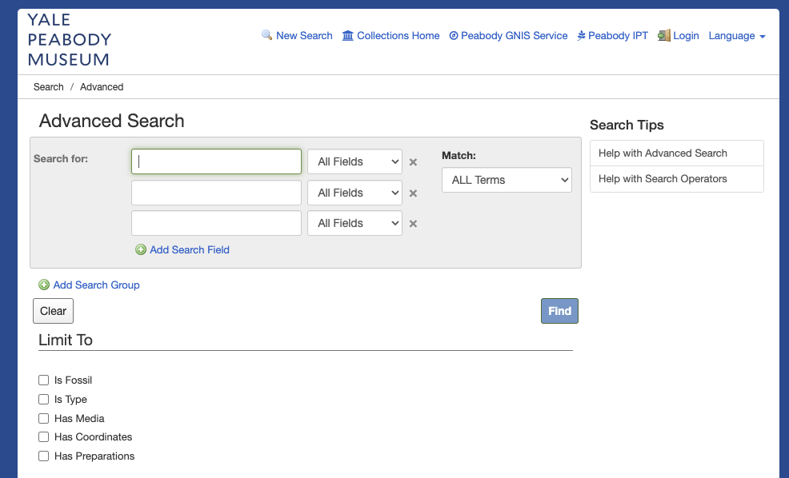
Why Even Attempt This?
Users do not, and should not, need to know all of the different systems in which they would need to search to collect together this information!
😱

Slide 17
Mission Critical Functions
LUX directly advances the mission of the University:
Excellence in teaching and learning
Excellence in research
Prepare our students to be leaders
LUX directly advances the goals of the heritage division:
Preserve our collections and make them accessible
Improve our decision making and efficiency through well-managed knowledge
Notes:
Prepare students by helping reveal the broader connections and context of the world they’re entering, through the collections

Slide 18
Demo! https://lux.collections.yale.edu/
Notes:
5-10 minutes here

Slide 19
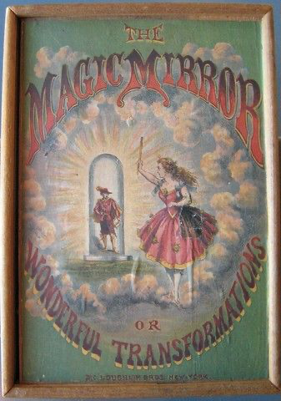
How Did We Do This?
Collaboration!
Trust and cultural transformation has led to generosity, accountability and excellence
With Progress / MarkLogic
Hard Work over Several Years
By more than 100 people
Core team of 7
https://artgallery.yale.edu/collections/objects/164129

Slide 20
Political Requirements
Several non-technical requirements:
No New Systems of Record
Must be rebuildable from code only
No editing interface / custom persistence (*)
Not replacing existing system, providing discovery interface only
Everyone is Welcome
Must enable cross-domain discovery
Must be easy and enjoyable to participate
Work process as well as technical product must scale
* We do have a few 100 rows in custom spreadsheets 😅

Slide 21
Records are a Necessary Construct
“The Graph” is not comprehensible. To anyone. Constructing records from a graph at run-time is hard. We need records for all requirements:
Unified: Need something to link to/from; an “anchor”
Usable: Graphs are not easy to understand; unit of search
Performant: Semantic facets, view construction expensive
Implementable: Graphs are hard to work with as data
Open: Allow others to use our data in their system

Slide 22
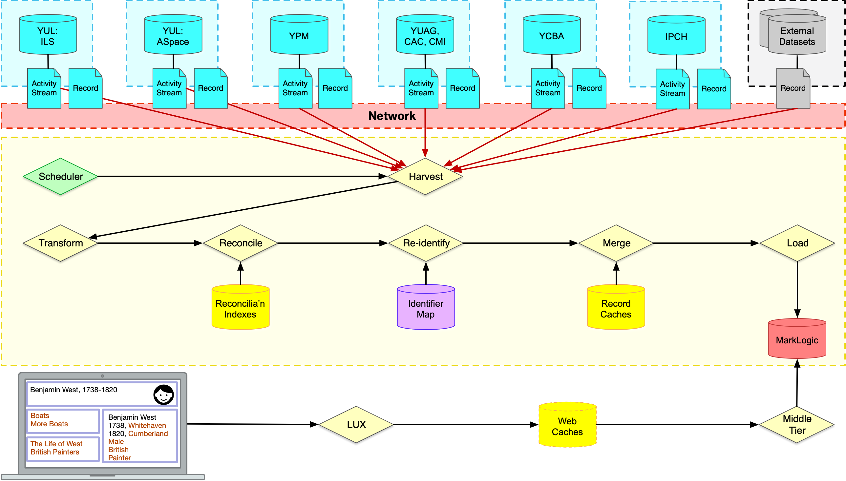
LUX Architecture

Slide 23
Continuous Improvement
Knowledge Graph
More collections, more external data for enrichment
More detailed modeling (eg stratigraphic layers for dinosaurs)
Increased alignment with standards
System
AI-powered natural language queries
Transitive queries for hierarchies (e.g. anywhere within)
Geospatial queries
Personal saved collections
Additional Visualizations

Slide 24
Thank You!
Discuss!
https://lux.collections.yale.edu/
https://github.com/project-lux/

