Slide 1

Managing Bequests & Digital Estates: a short introduction to the workshop through the example of the National & University Library Strasbourg
Frédéric Blin
Director for Heritage Collections and Preservation

Slide 2
What are bequests & estates in the context of digital cultural heritage?
« Bequest »:
  a disposition in a will
  a legacy

Slide 3
What are bequests & estates in the context of digital cultural heritage?
« Bequest »:
  a disposition in a will
  a legacy
« Estate »:
  a piece of landed property, especially one of large extent with an elaborate house on it: to have an estate in the country.
  property or possessions.
  the legal position or status of an owner, considered with respect to property owned in land or other things.
  the degree or quantity of interest that a person has in land with respect to the nature of the right, its duration, or its relation to the rights of others.
  interest, ownership, or property in land or other things.
  the property of a deceased person, a bankrupt, etc., viewed as an aggregate.

Slide 4
What are bequests & estates in the context of digital cultural heritage?
« Bequest »:
  a disposition in a will
  a legacy
« Estate »:
  a piece of landed property, especially one of large extent with an elaborate house on it: to have an estate in the country.
  property or possessions.
  the legal position or status of an owner, considered with respect to property owned in land or other things.
  the degree or quantity of interest that a person has in land with respect to the nature of the right, its duration, or its relation to the rights of others.
  interest, ownership, or property in land or other things.
  the property of a deceased person, a bankrupt, etc., viewed as an aggregate.
« Digital estates »: a new concept? The right concept?

Slide 5
What are bequests & estates in the context of digital cultural heritage?
What kind of documents?
  Archives: e.g. « digital manuscripts » of contemporary regional writers and composers

Slide 6
What are bequests & estates in the context of digital cultural heritage?
What kind of documents?
  Archives: e.g. « digital manuscripts » of contemporary regional writers and composers
  Audio-visual materials

Slide 7
What are bequests & estates in the context of digital cultural heritage?
What kind of documents?
  Archives: e.g. « digital manuscripts » of contemporary regional writers and composers
  Audio-visual materials
  Personal archives: e-mails, phone messages (sms, mms), tweets, Facebook account, etc.

Slide 8
What are bequests & estates in the context of digital cultural heritage?
What kind of documents?
  Archives: e.g. « digital manuscripts » of contemporary regional writers and composers
  Audio-visual materials
  Personal archives: e-mails, phone messages (sms, mms), tweets, Facebook account, etc.
  User generated content

Slide 9
What are bequests & estates in the context of digital cultural heritage?
What kind of documents?
  Archives: e.g. « digital manuscripts » of contemporary regional writers and composers
  Audio-visual materials
  Personal archives: e-mails, phone messages (sms, mms), tweets, Facebook account, etc.
  User generated content
  Items related to the act of creation
  Not a different mission for libraries

Slide 10
What are bequests & estates in the context of digital cultural heritage?
Excluding:
  Legal deposit?
  The Web?
  Scientific archives / research data?
  Institutional scientific publications?
  External academic E-ressources?

Slide 11
What are bequests & estates in the context of digital cultural heritage?
Excluding:
  Legal deposit?
  The Web?
  Scientific archives / research data?
  Institutional scientific publications?
  External academic E-ressources?
=> Not so simple: theory vs practice

Slide 12
Issues of born-digital estates
Organisational issues:
Finances: availability and sustainability of ressources
Defining the curatorial responsibility
Professional competences
Internal organisation

Slide 13
Issues of born-digital estates
Organisational issues:
Finances: availability and sustainability of ressources
Defining the curatorial responsibility
Professional competences
Internal organisation
Specific issues:
Technology
Data management
Copyright
Selection of content

Slide 14
Issues of born-digital estates
Organisational issues:
Finances: availability and sustainability of ressources
Defining the curatorial responsibility
Professional competences
Internal organisation
Specific issues:
Technology
Data management
Copyright
Selection of content
What kind of solutions, in a constrained environment?

Slide 15
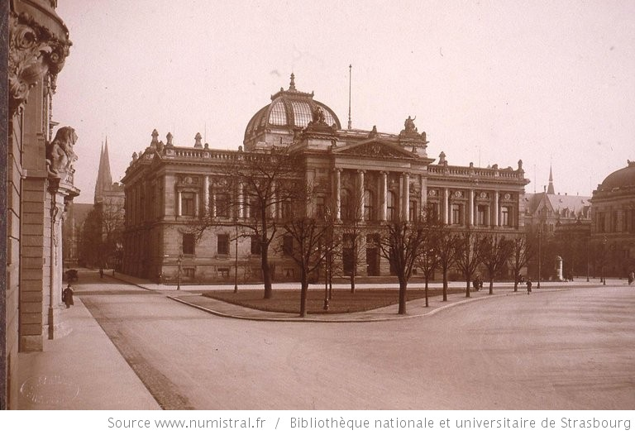
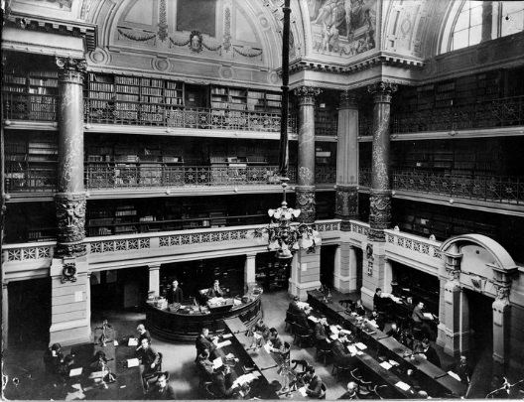
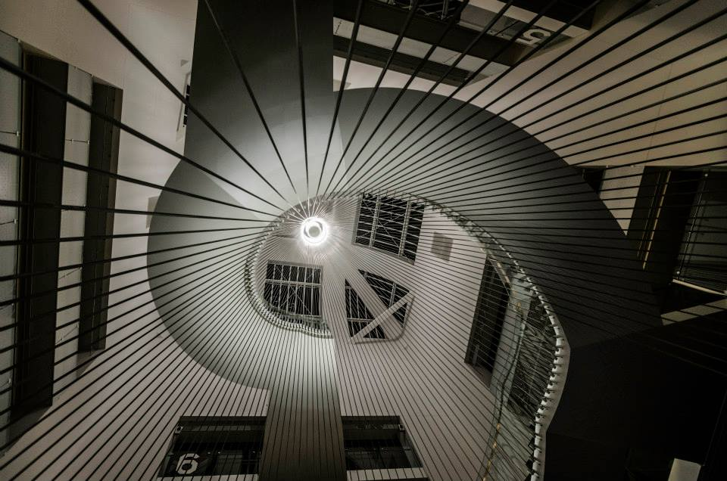
The National & University Library Strasbourg
24/08/1870: Burning of the 2 historical libraries in Strasbourg
1871: Creation of the new German Imperial, Regional and University Library
1895: Opening of the new library building
1926: French National & University Library
Today: Over 3.5M documents, 2nd library in France, main academic & research library

Slide 16
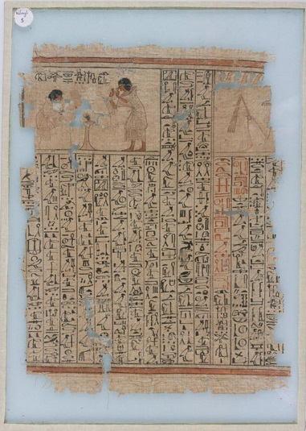
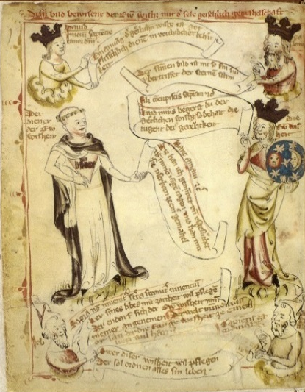
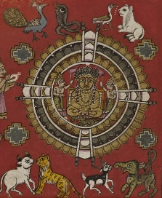
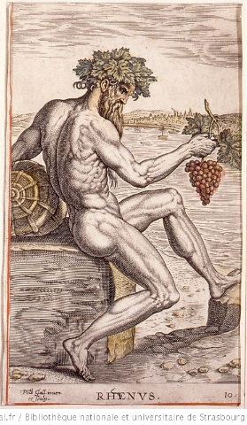
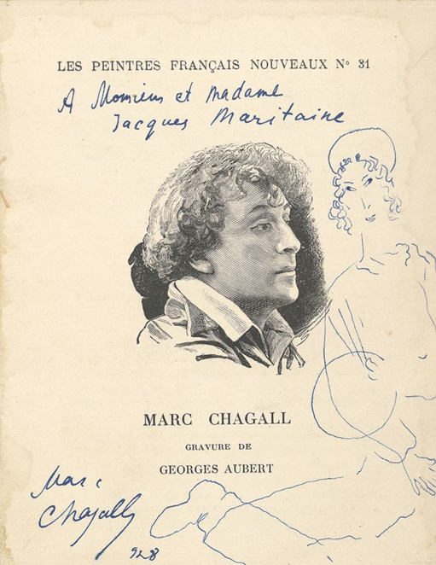
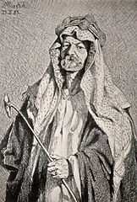
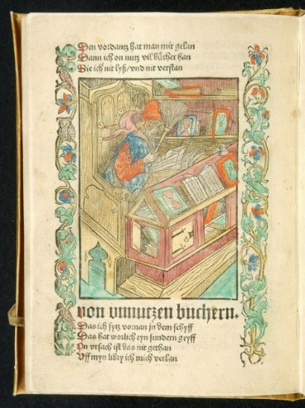
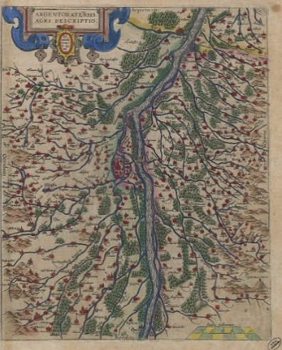
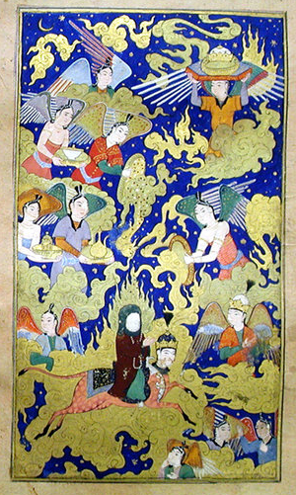
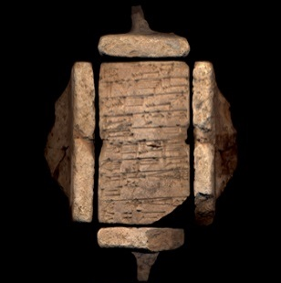
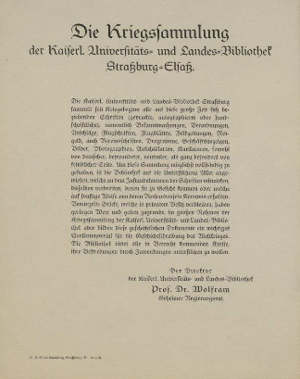
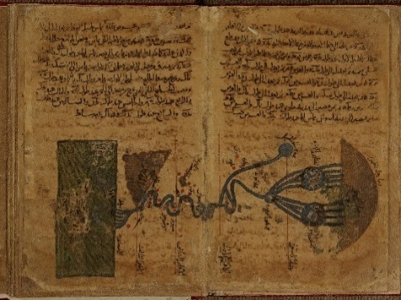
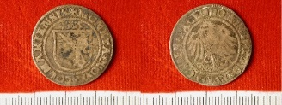
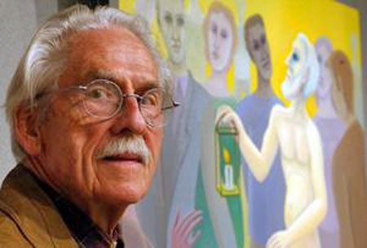
Traditional missions:
  Serving the academic & scientific needs
  Preserving the regional heritage

Slide 17
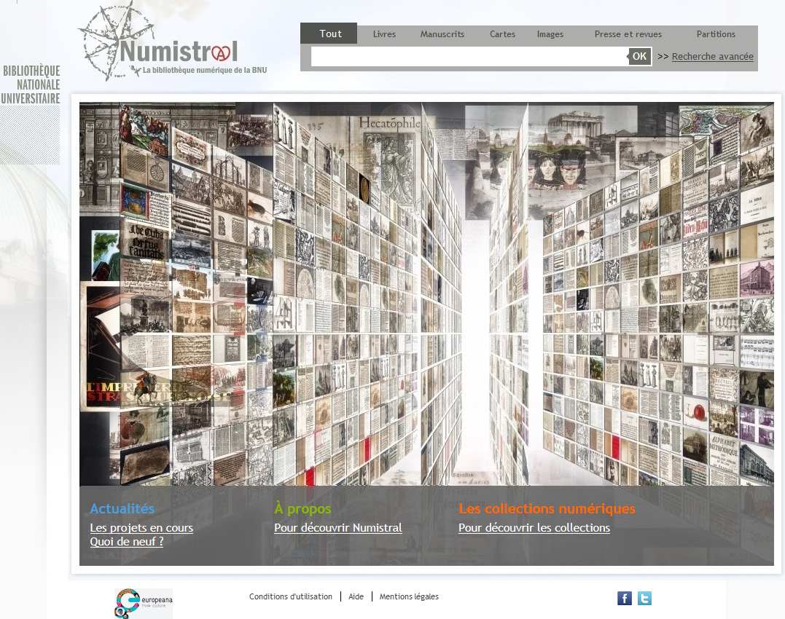
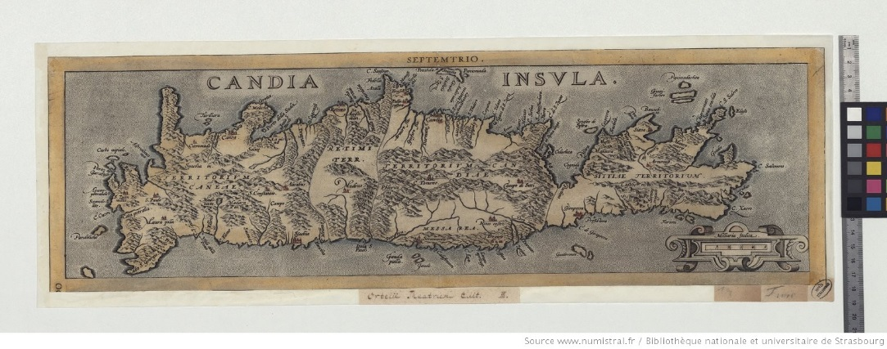
  Digitising our heritage for:
  Dissemination
  Preservation
  Scientific research
Numistral (www.numistral.fr)
Technical partnership with the BnF => Gallica infrastructure
Opened October 2013
Now 100,000 items online, +250,000 pages / year
Around 50 projects…
Digitisation on-demand
Contents on specialised digital libraries

Slide 18


Managing digital estates: what strategy for the BNU?
Through collaboration with the French National Library, a national service point for:
  Gallica Marque Blanche: digitised materials
  Legal deposit
  Web archiving
  With remote access in dedicated libraries to copyright-protected items
Through collaboration with the French National Audiovisual Institute (INA), a national service point for:
  Audiovisual & media archives
  With remote access in dedicated libraries to copyright-protected items

Slide 19
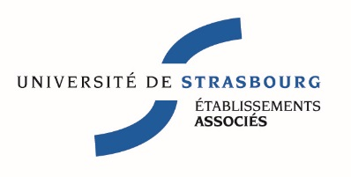



Managing digital estates: what strategy for the BNU?
Through a regional collaboration with alsatian universities:
  E-resources
  Digitisation & digital library
  Institutional repository
  Data management
  Data center

Slide 20
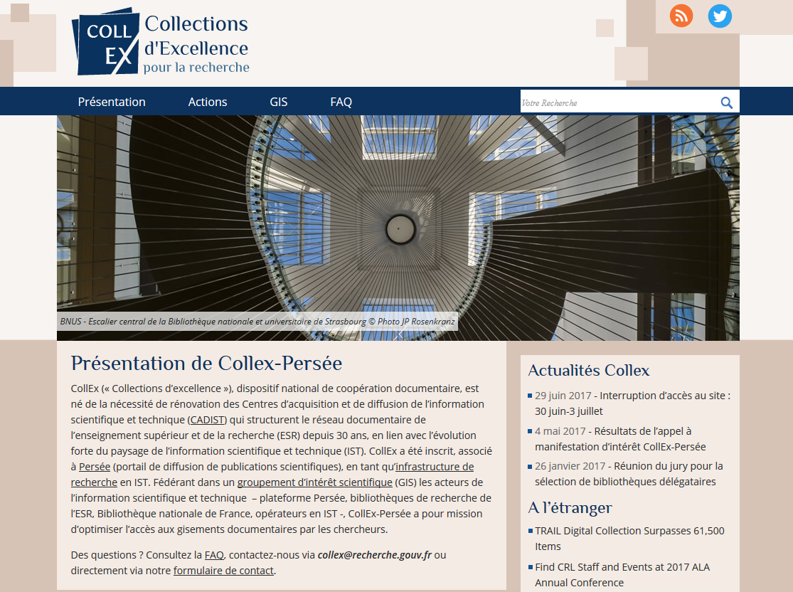
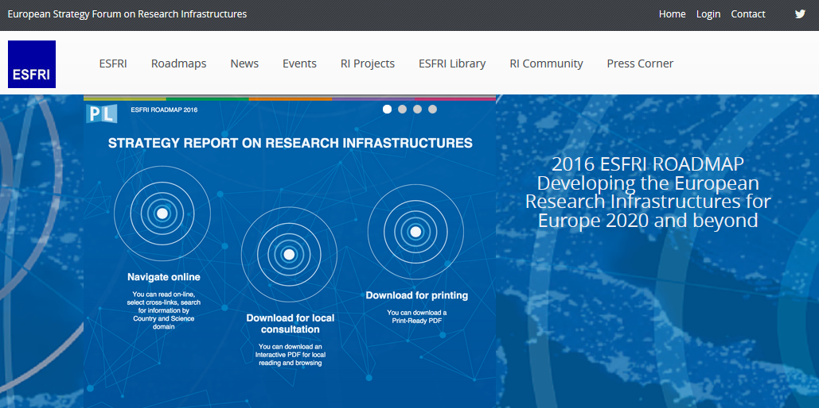

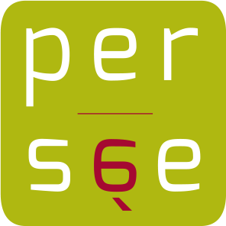
The opportunity of a national
Research Infrastructure

Slide 21

CollEx, an infrastructure:
BNU: host of the administrative responsibility
With the main institutions preserving cultural & scientific heritage (incl. BnF)
With the National Archives
Purposes:
Collection mapping and identification
Collection development for research
Digitalisation and digital services
Shared preservation
National & international services
Academic network animation
Opportunities for R & D partnerships on:
Implementing innovative technological developments
Creating new corpuses for research
Improving the discoverability of digital collections
Fostering innovative reuse of digital collections
The collaborative management and long-term preservation of scientific archives
Opportunity for a national collaboration to build a network of cultural & scientific born-digital estates

Slide 22
Managing digital estates: what strategy for the BNU?
Inclusion in the strategic development plan 2018-2022
Competence building
Stronger collaboration with the University
Leading the CollEx-PERSEE Research Infrastructure
New internal organisation (2018)

Slide 23
I thank you for your attention,
looking forward to learning from you
Frédéric Blin
frederic.blin@bnu.fr
@bfl50

