Slide 1
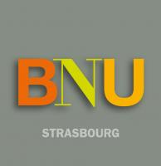
Numistral: an Infrastructure for the Discoverability of Digital Collections
Frédéric Blin
Director for Heritage Collections, Preservation and Digitisation
National and University Library (BNU) Strasbourg (France)
F. Blin, LIBER Forum for Digital Cultural Heritage
LIBER Conference 2016, Helsinki, 29.06.2016

Slide 2
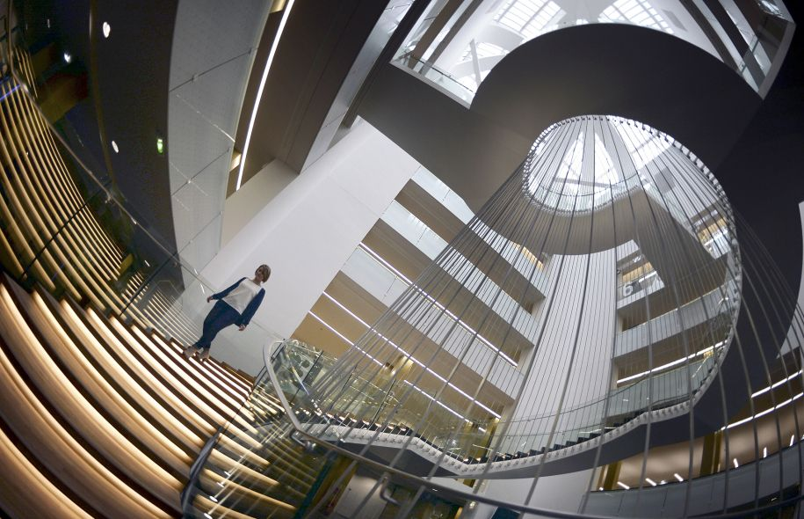
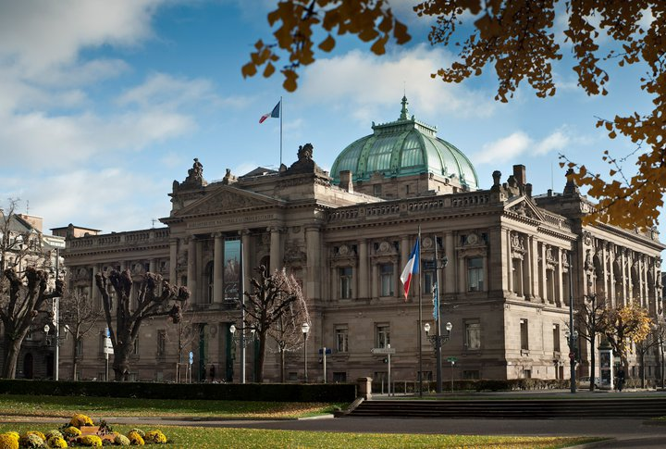
The BNU and Numistral in short
BNU: main French academic library (4M items, 1/3 “heritage”)
Partner of the Alsatian academic cooperation
National role (Programme BSN: Scientific Digital Library) and ambitions
F. Blin, LIBER Forum for Digital Cultural Heritage
LIBER Conference 2016, Helsinki, 29.06.2016

Slide 3
The BNU and Numistral in short
BNU: main French academic library (4M items, 1/3 “heritage”)
Partner of the Alsatian academic cooperation
National role (Programme BSN: Scientific Digital Library) and ambitions
Numistral (www.numistral.fr): Digital library of the BNU, and of its partners (1M pages, increasing)
Built with the BnF on “Gallica White Label” technologies
Visibility on Gallica, TEL, Europeana
F. Blin, LIBER Forum for Digital Cultural Heritage
LIBER Conference 2016, Helsinki, 29.06.2016

Slide 4
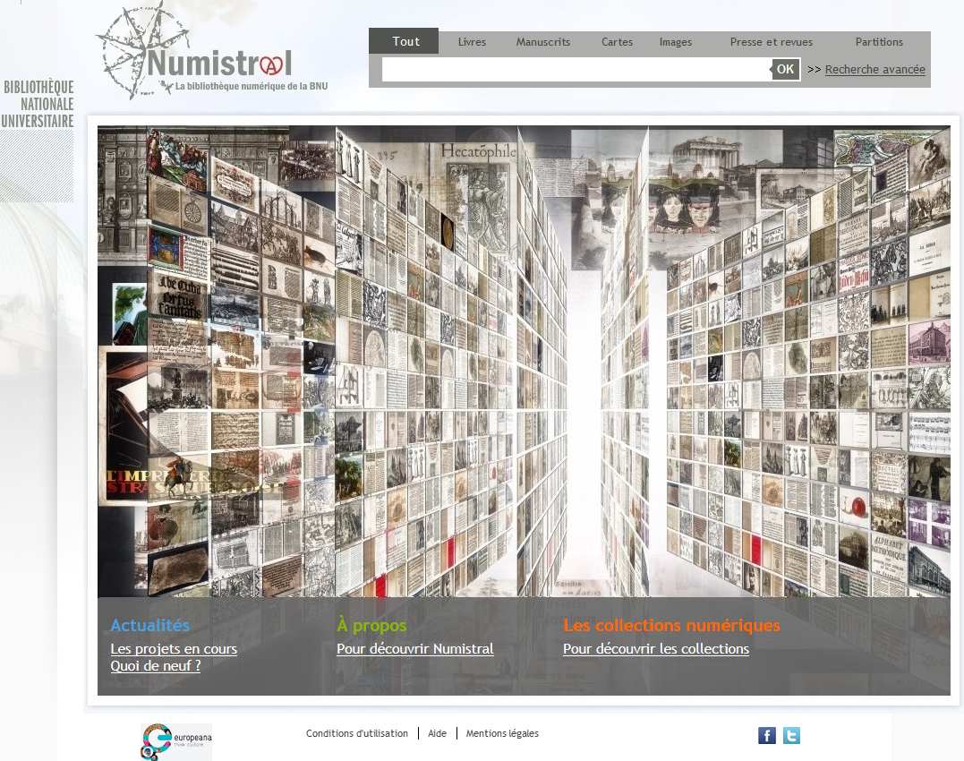
Numistral: a scientific ambition
A tool for Digital Humanities:
Choice of a second DL solution: Islandora
Collaboration with academics
A Research Infrastructure:
Within a national policy for RI
A leading role among academic libraries
R & D for innovation
F. Blin, LIBER Forum for Digital Cultural Heritage
LIBER Conference 2016, Helsinki, 29.06.2016

Slide 5
Research Infrastructures & French Libraries
F. Blin, LIBER Forum for Digital Cultural Heritage
LIBER Conference 2016, Helsinki, 29.06.2016

Slide 6
Research Infrastructures & French Libraries
F. Blin, LIBER Forum for Digital Cultural Heritage
LIBER Conference 2016, Helsinki, 29.06.2016

Slide 7
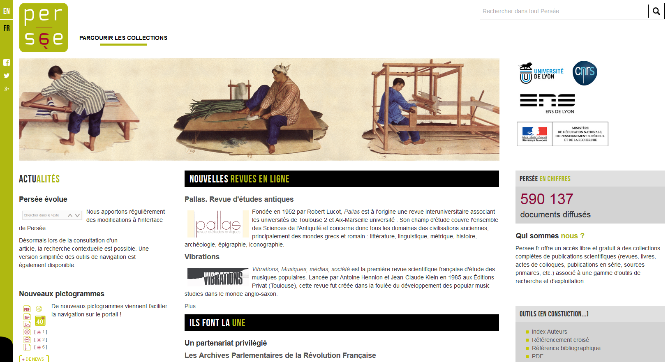
Research Infrastructures & French Libraries
F. Blin, LIBER Forum for Digital Cultural Heritage
LIBER Conference 2016, Helsinki, 29.06.2016

Slide 8
Numistral as a Research Infrastructure
Opportunity for a R & D partnership for:
Implementing technological developments
Creating new corpuses for research
Improving the discoverability of digital collections
Fostering innovative reuse of digital collections
F. Blin, LIBER Forum for Digital Cultural Heritage
LIBER Conference 2016, Helsinki, 29.06.2016

Slide 9
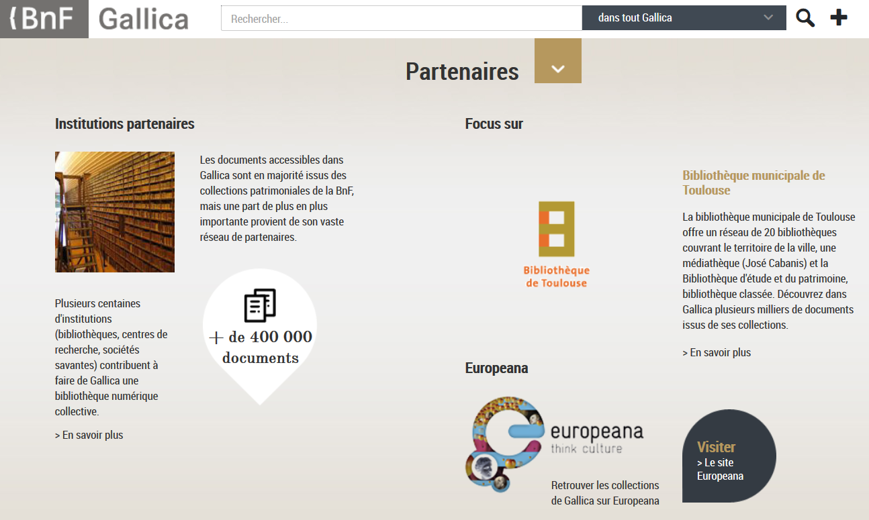
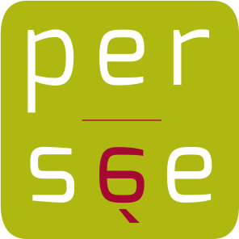
Numistral as a Central Hub for Alsatian Digital Collections
http://www.rechercheisidore.fr/
F. Blin, LIBER Forum for Digital Cultural Heritage
LIBER Conference 2016, Helsinki, 29.06.2016

Slide 10
I thank you for your attention
Questions?
frederic.blin@bnu.fr
@BFL50
F. Blin, LIBER Forum for Digital Cultural Heritage
LIBER Conference 2016, Helsinki, 29.06.2016

