Slide 1
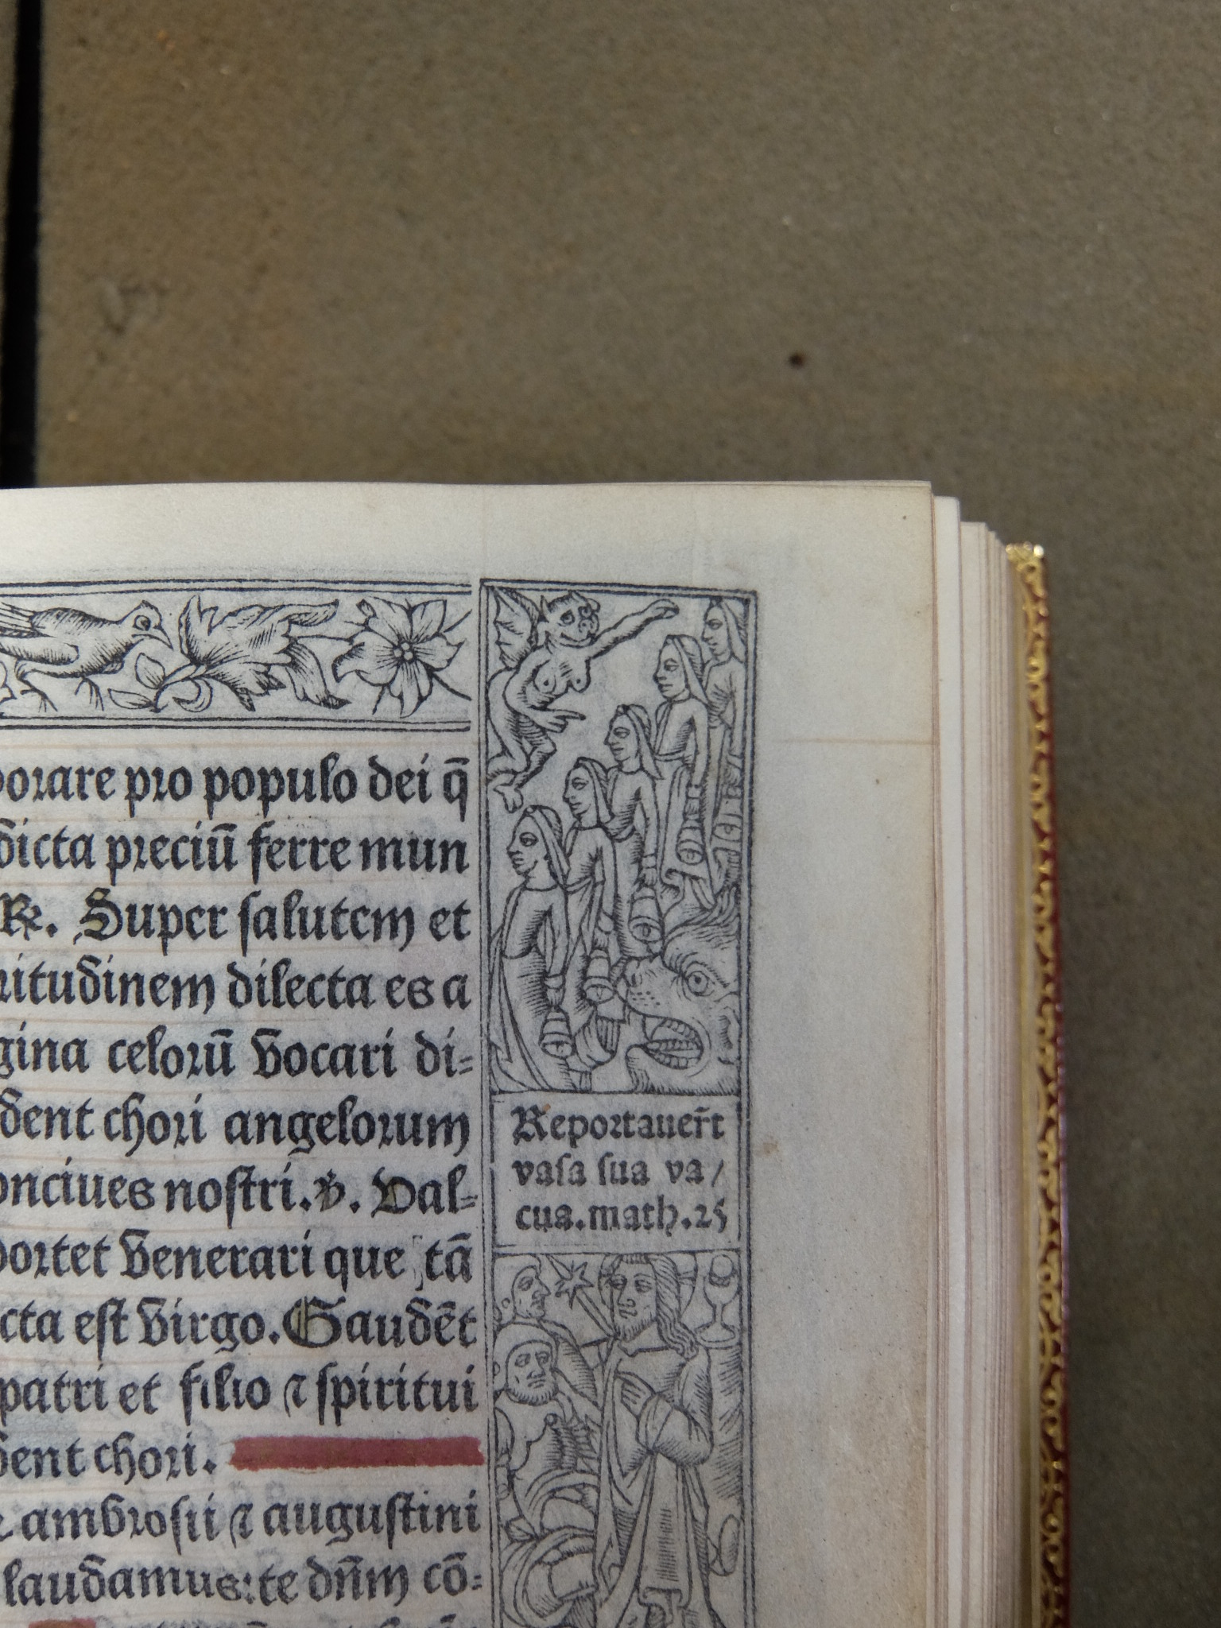
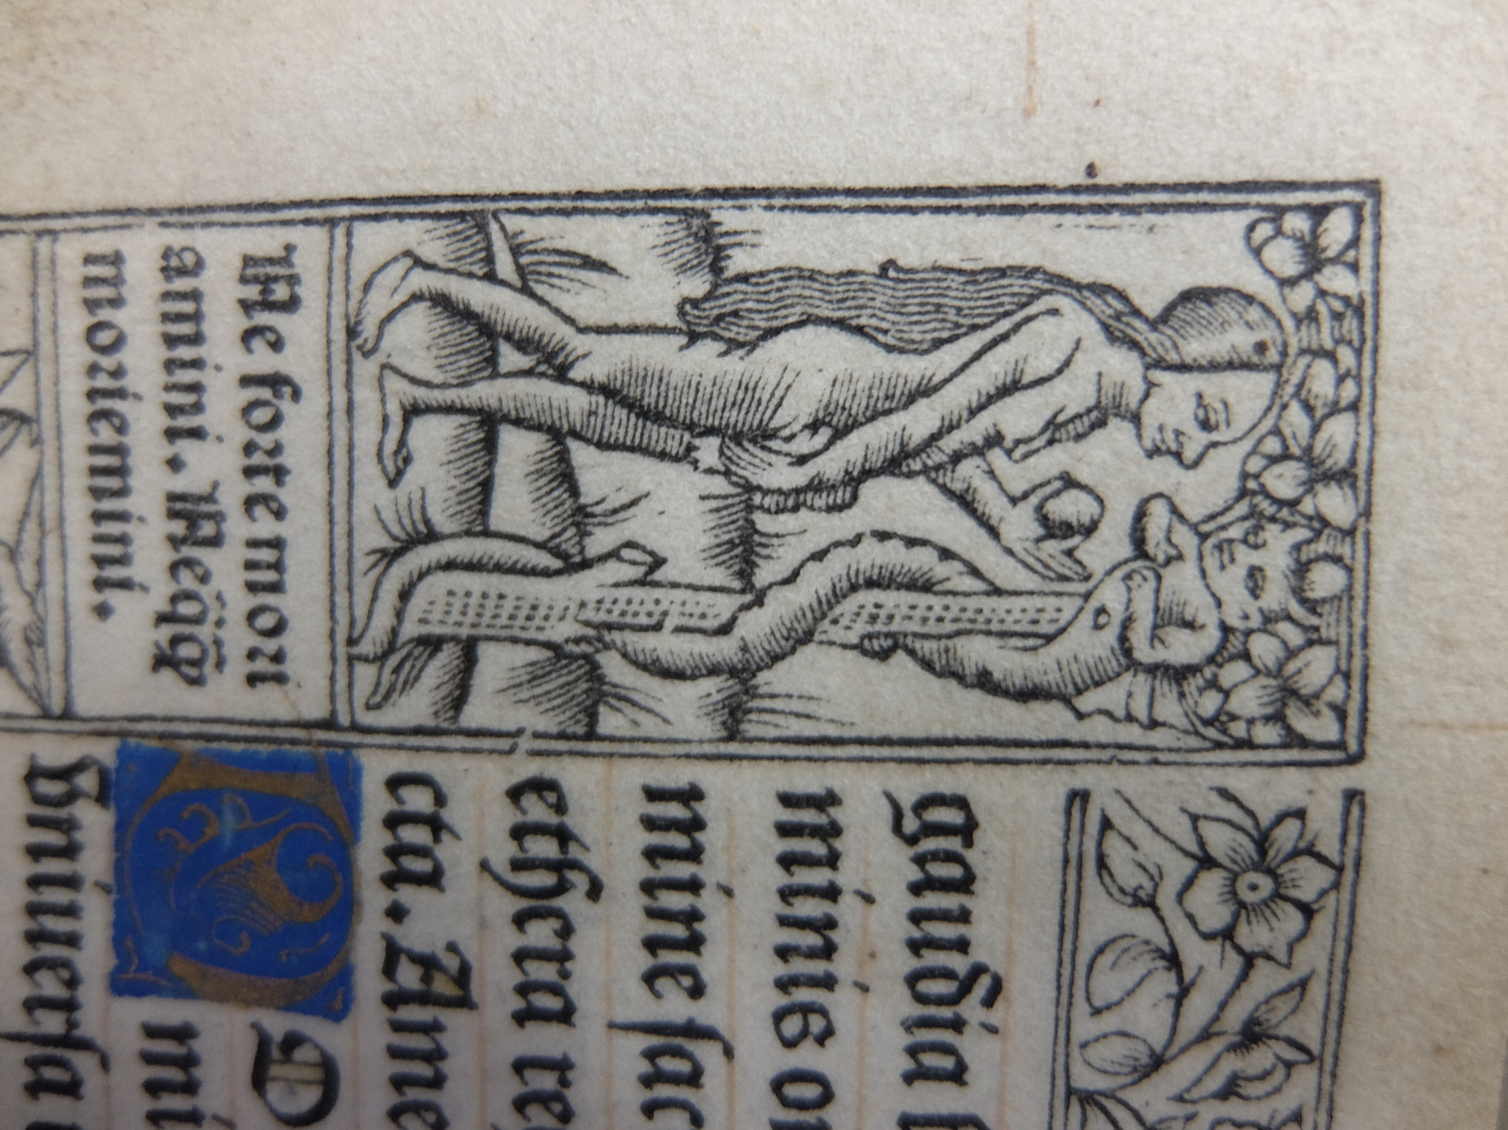
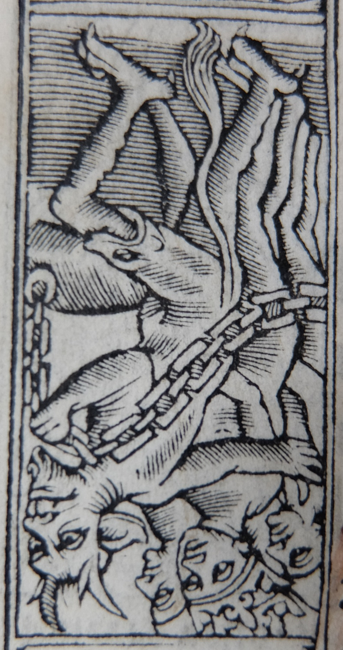

Treasures in private and ecclesiastical collections in Central-Eastern Europe
Krisztina Rábai
CERL intern 2017/18
National Library of Scotland, Edinburgh

Slide 2
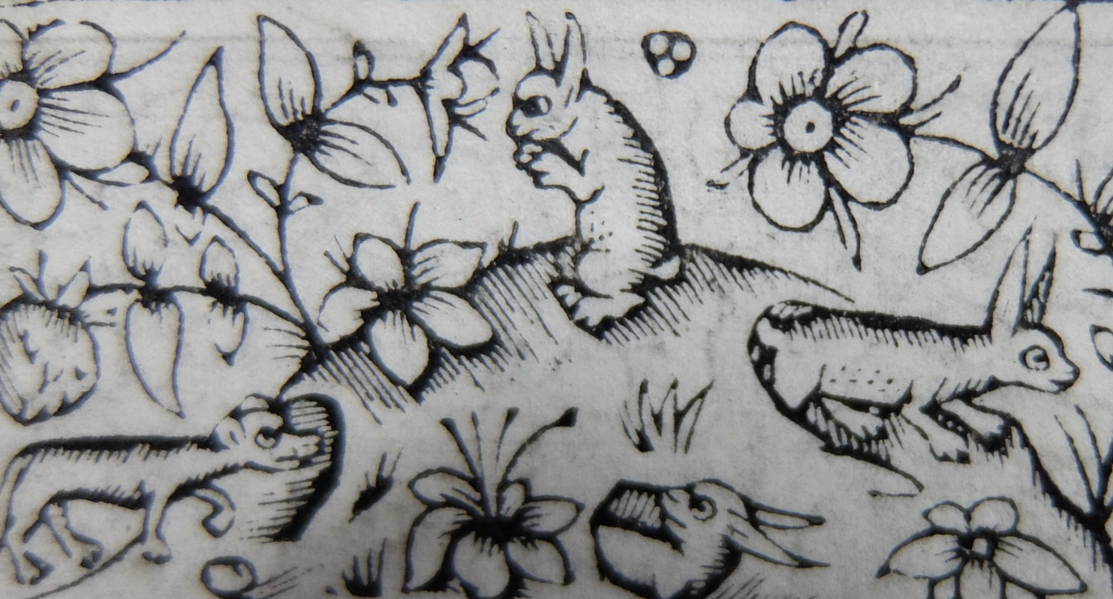
NLS, RARE BOOKS, MAPS & MUSIC COLLECTION
Supervisors: Dr Anette Hagan, Dr Robert Betteridge
May – June 2018
Printed & online catalogues
More than 600 incunabula
MEI upload: 269 editions in 276 copies

Slide 3
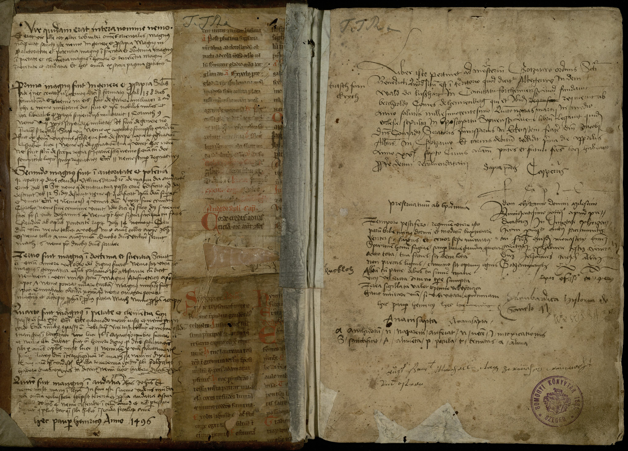
Somogyi Károly Városi és Megyei Könyvtár
January 2019
No catalogue
MEI upload: 35 editions in 37 copies
ISTC & GW
Plan: printed incunabula catalogue

Slide 4
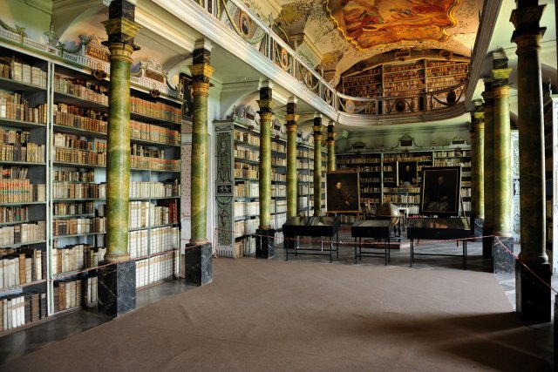
Klášterní knihovna Broumov
Gate project
August – November 2020 (MEYS grant)
List of inc. (1969); historical catalogues (18-19th cent.); online catalogue
MEI upload: 136 editions in 157 copies
Publication: K. Rábai, “The Incunabula Collection of the Benedictine Monastery in Broumov,” in Monastica Historia (V): Monastic Libraries in East Central and Eastern Europe between the Middle Ages and the Enlightenment., vol. 5, 2020, pp. 229–249.
ISTC & GW

Slide 5
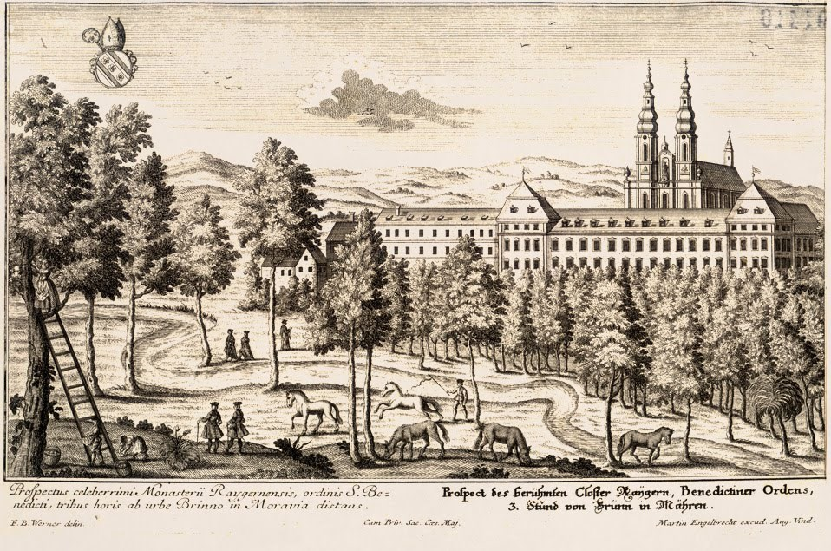
Future plans
The Benedictine Monastery in Rajhrad
http://www.rajhradskyklaster.cz/klasterni-a-historie-sbirky/knihovna
Cathedral Library of Esztergom (Bibliotheca Ecclesiae Metropolitanae Strigoniensis)
http://www.bibliotheca.hu/index_eng.html

Slide 6
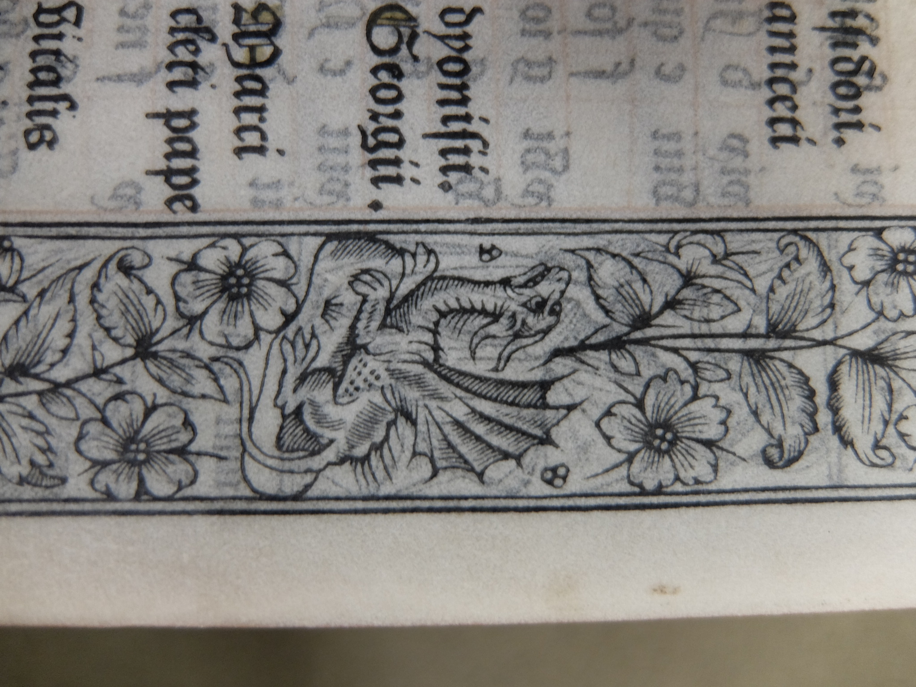
Thank you for your attention!

