Slide 1

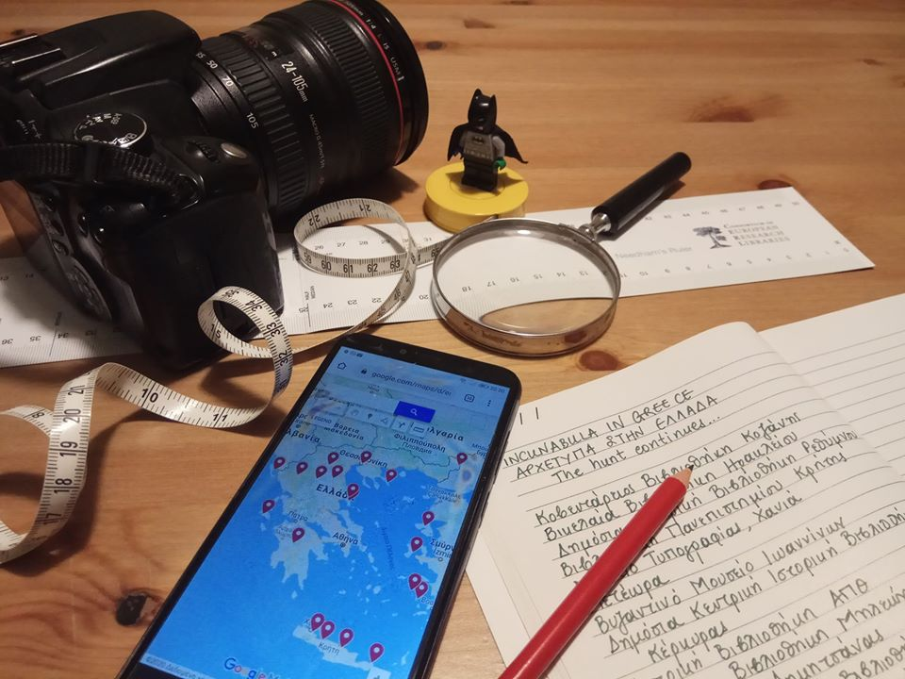
Incunabula treasure hunt
Challenges and rewards of research in Greek libraries
Vera Andriopoulou, PhD Byzantine Studies
Kleopatra Kyrtata, MA Classics
Angeliki Papadopoulou, MPhil Classics
Curators of Special Collections
Historical Library
Aikaterini Laskaridis Foundation
MEI Seminar, 2 March 2021

Slide 2
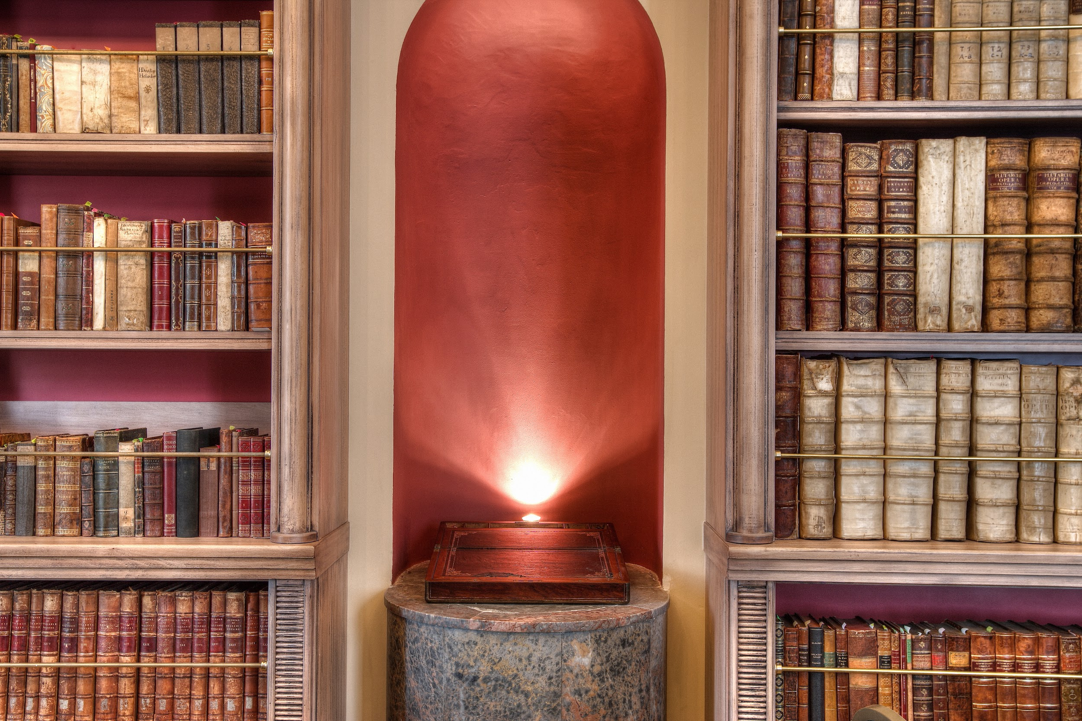

The Aikaterini Laskaridis Foundation
Incunabula Collection
Bibliotheca Graeca
(Collection of Athanasios Oikonomopoulos)
Panagiotis Laskaridis Collection
118 editions in 124 copies
Many Greek and Greek-centred editions
Prominent examples of Latin, medieval
and later literature

Slide 3
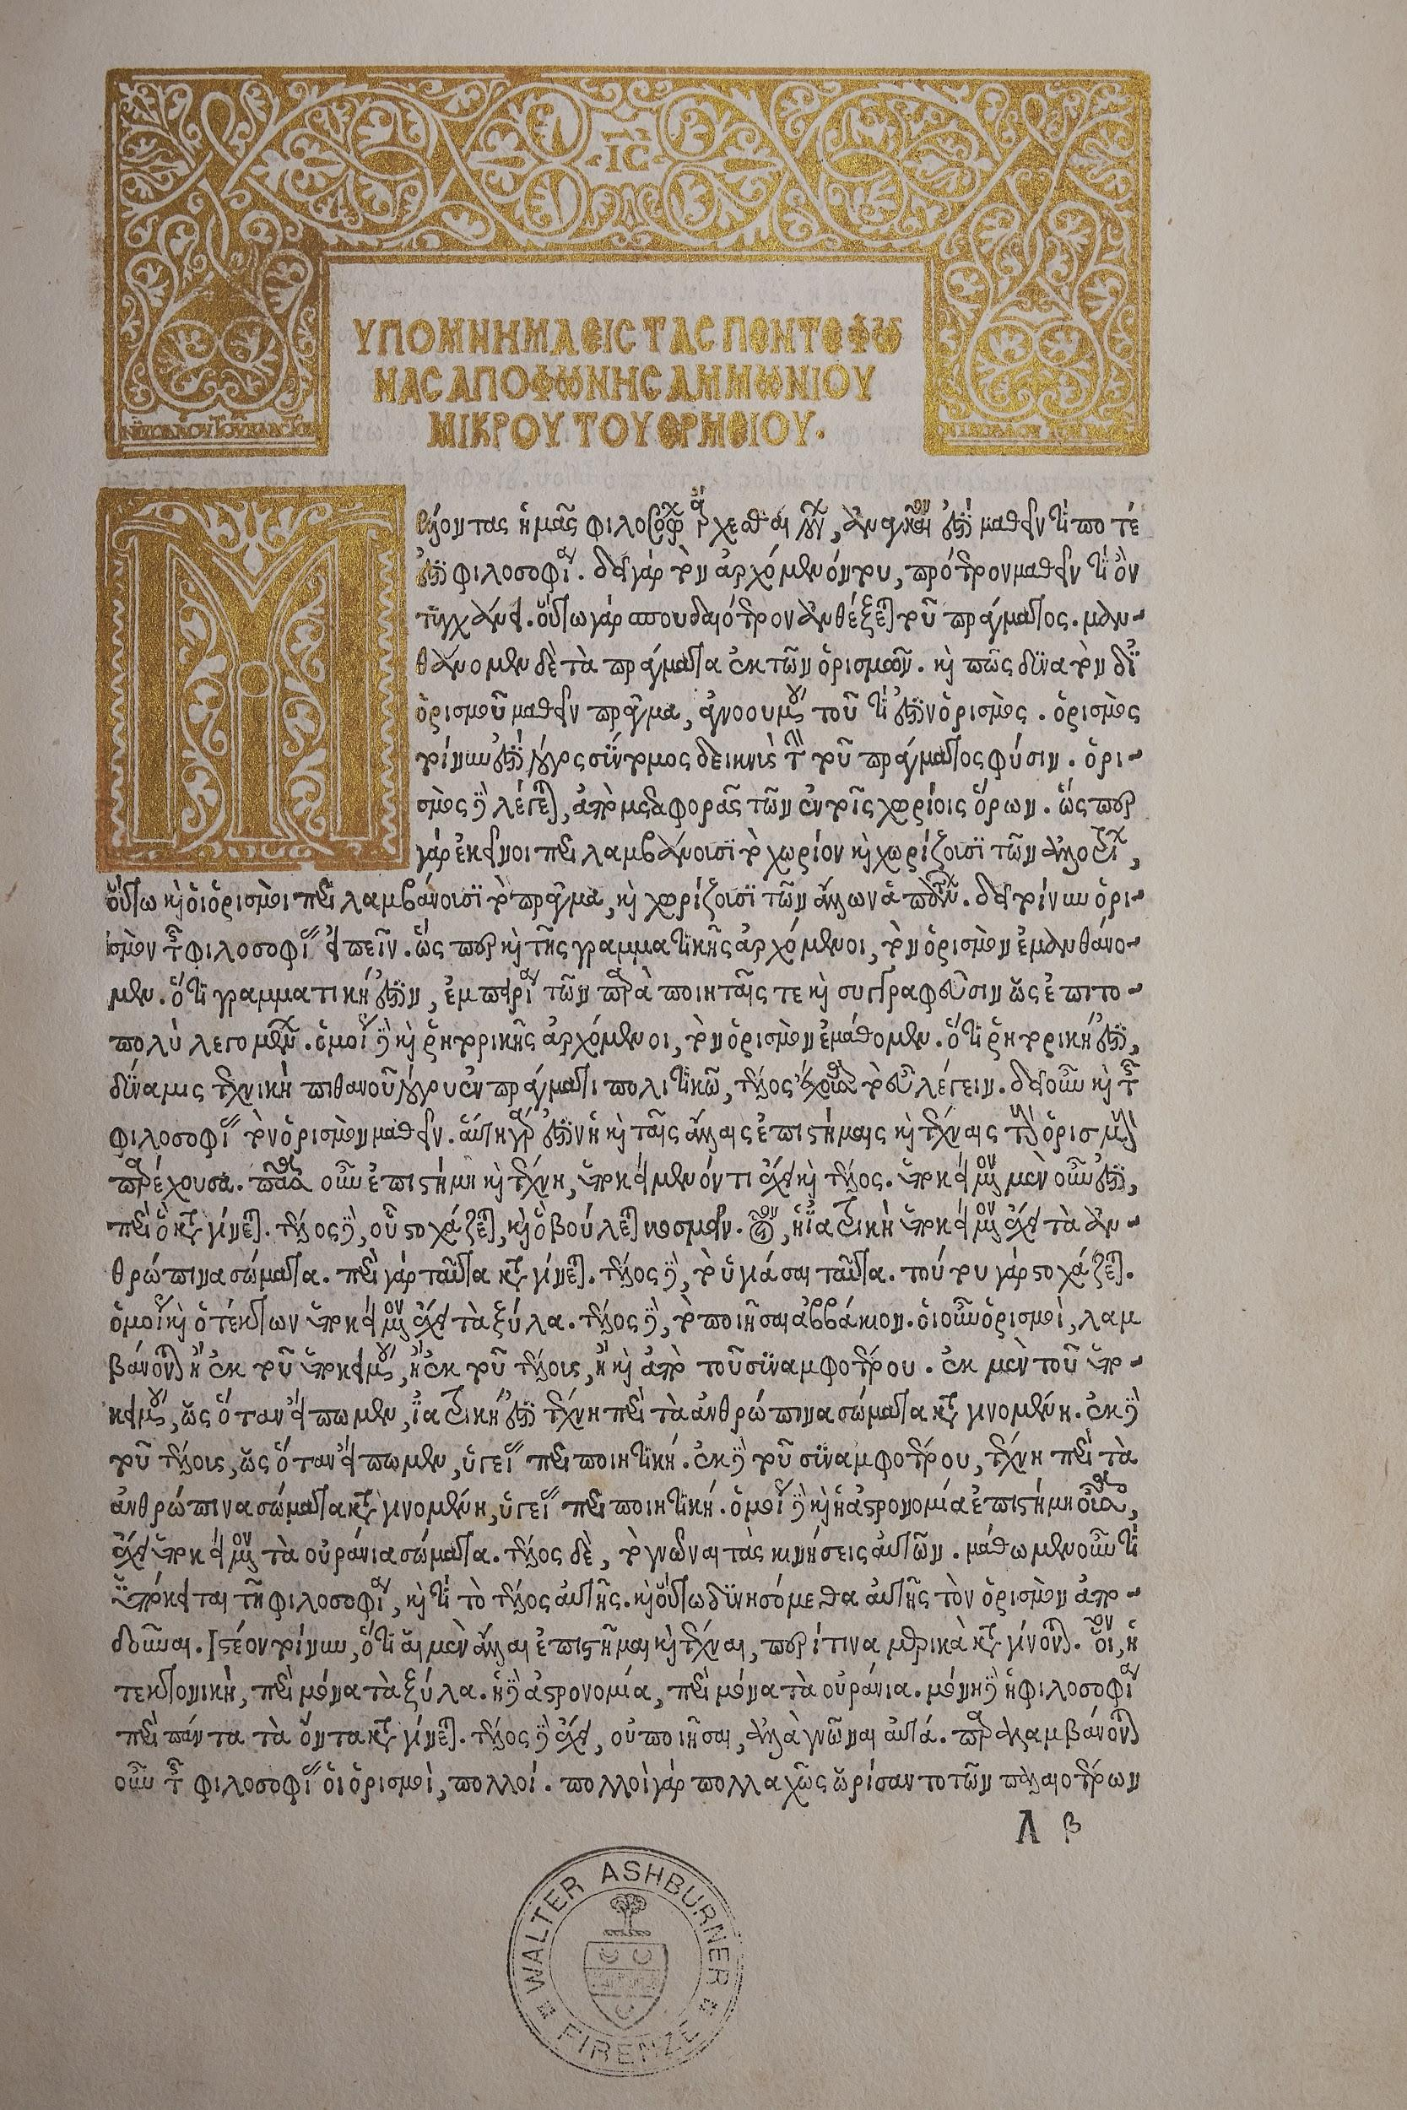
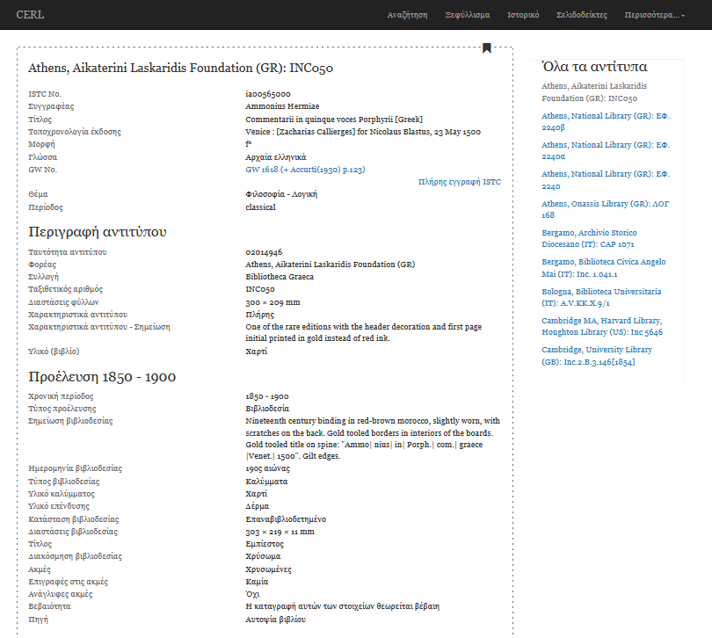
Ammonius Hermiae, Commentarii in quinque voces Porphyrii, Venice : [Zacharias Callierges] for Nicolaus Blastus, 1500

Slide 4
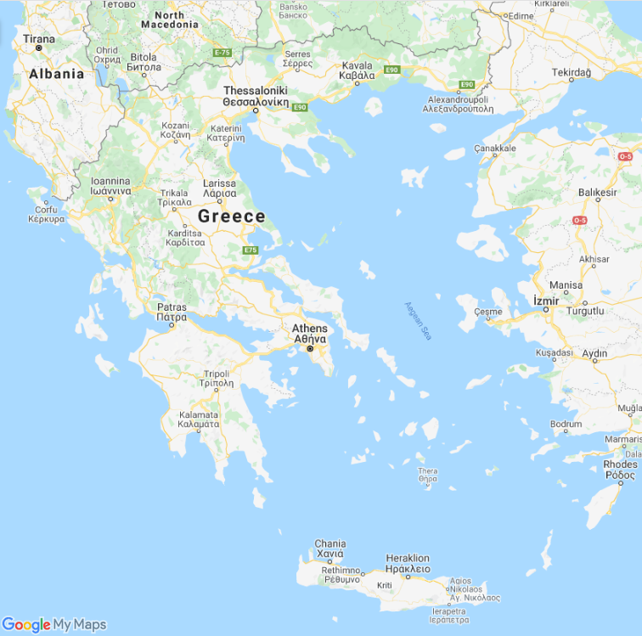
Clues
Dennis Rhodes
Incunabula in Greece: a first census
(1980)
15cBOOKTRADE
Geri Della Rocca de Candal
& collaborators (2016-2018)
Library catalogues
Bibliographical sources
Colleagues

Slide 5
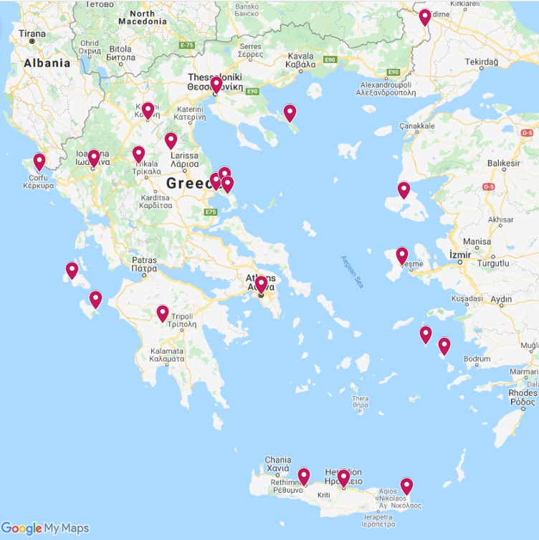
Mostly Greek incunabula
Non-Greek mostly in Athens
22 locations
56 libraries
21 in Athens
35 in the rest of Greece
550 copies
443 in Athens
107 in the rest of Greece

Slide 6
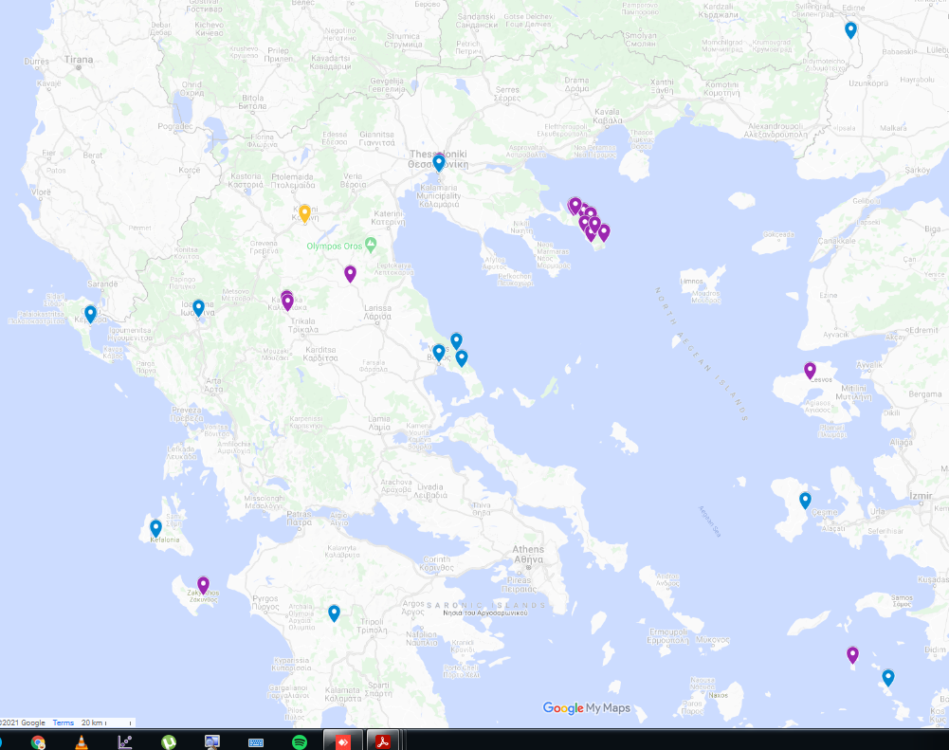
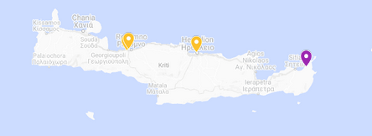
Challenges
Scarcity and dispersion of information
Geographic dispersion
Conditions - Public and municipal libraries
Accessibility - Monastic Libraries
Travel restrictions

Slide 7
107 copies in 35 libraries
76 copies in monastic libraries
36 titles
27 Greek
4 libraries visited so far

Slide 8
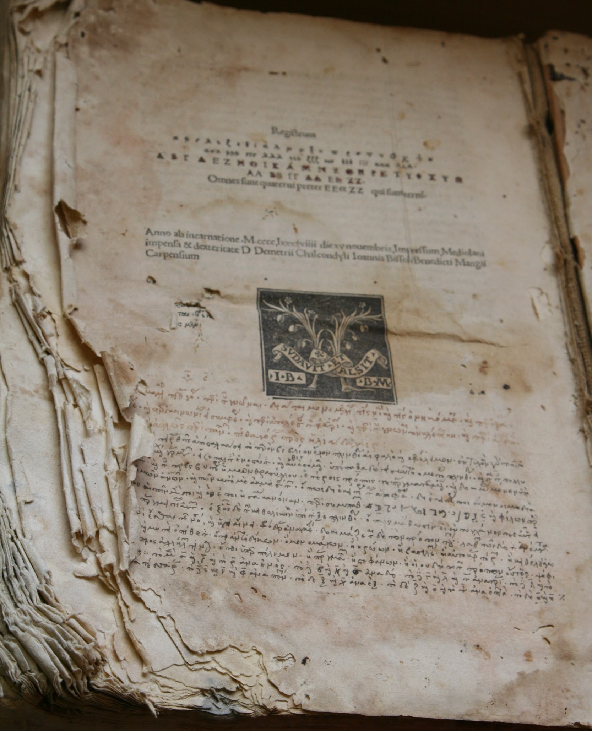
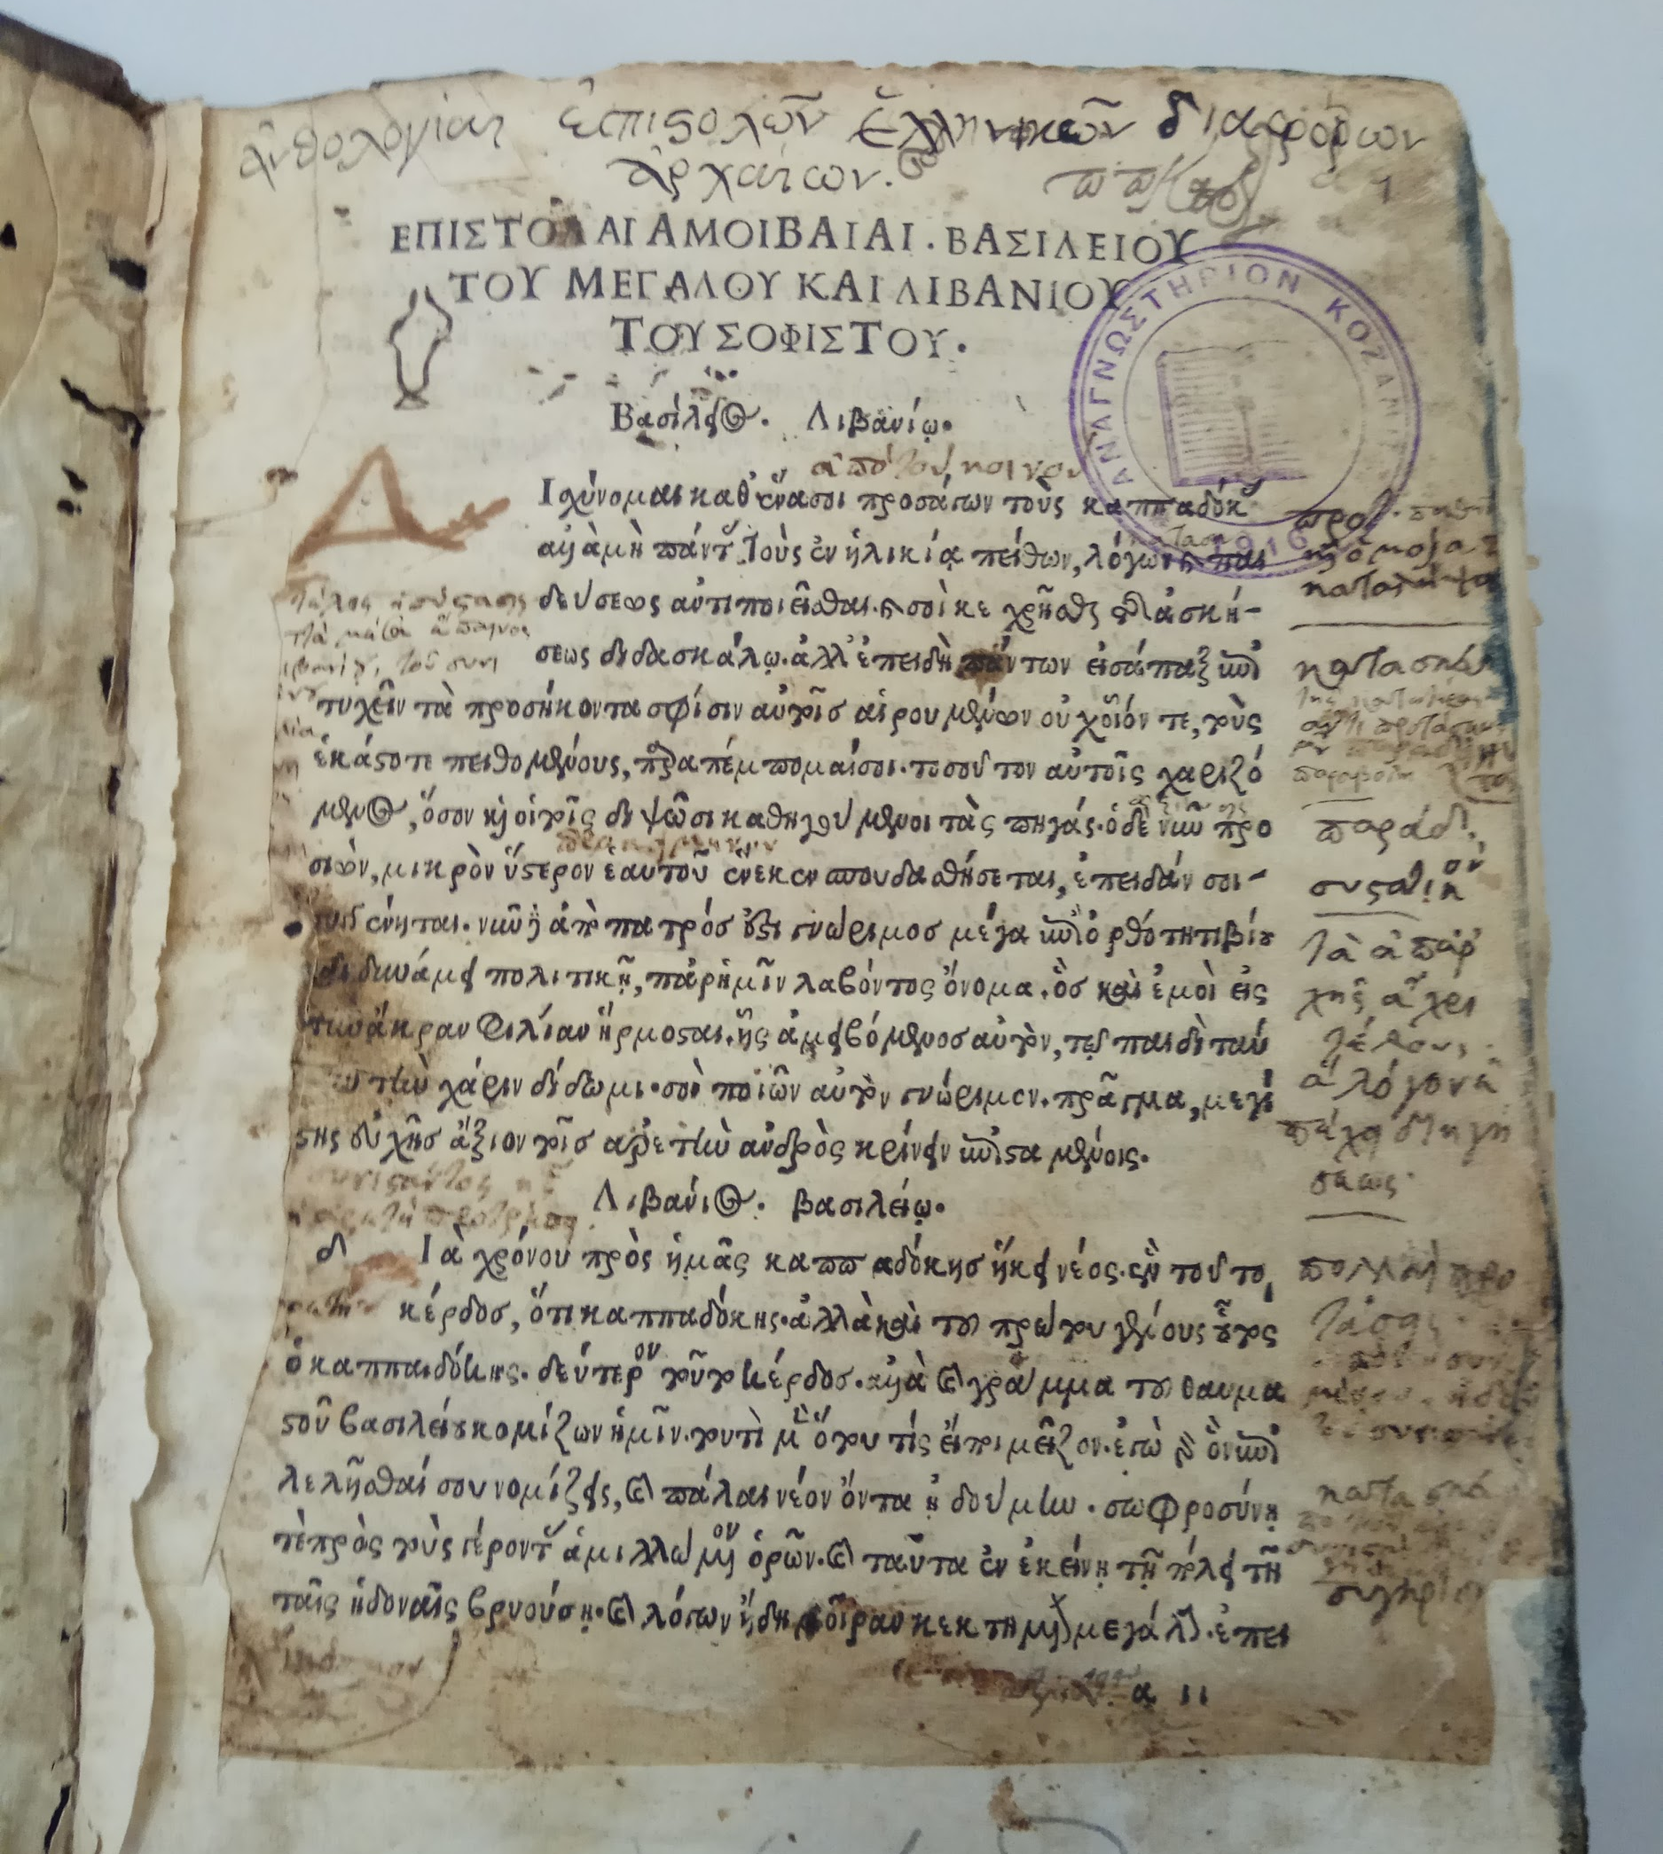
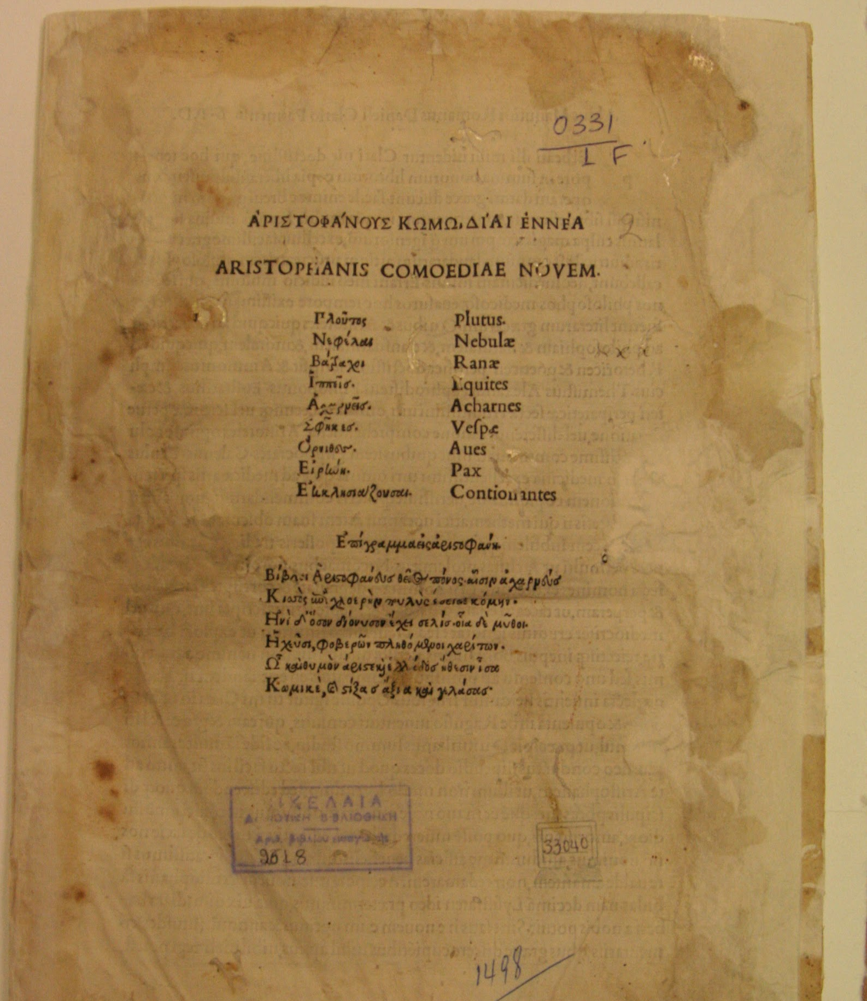
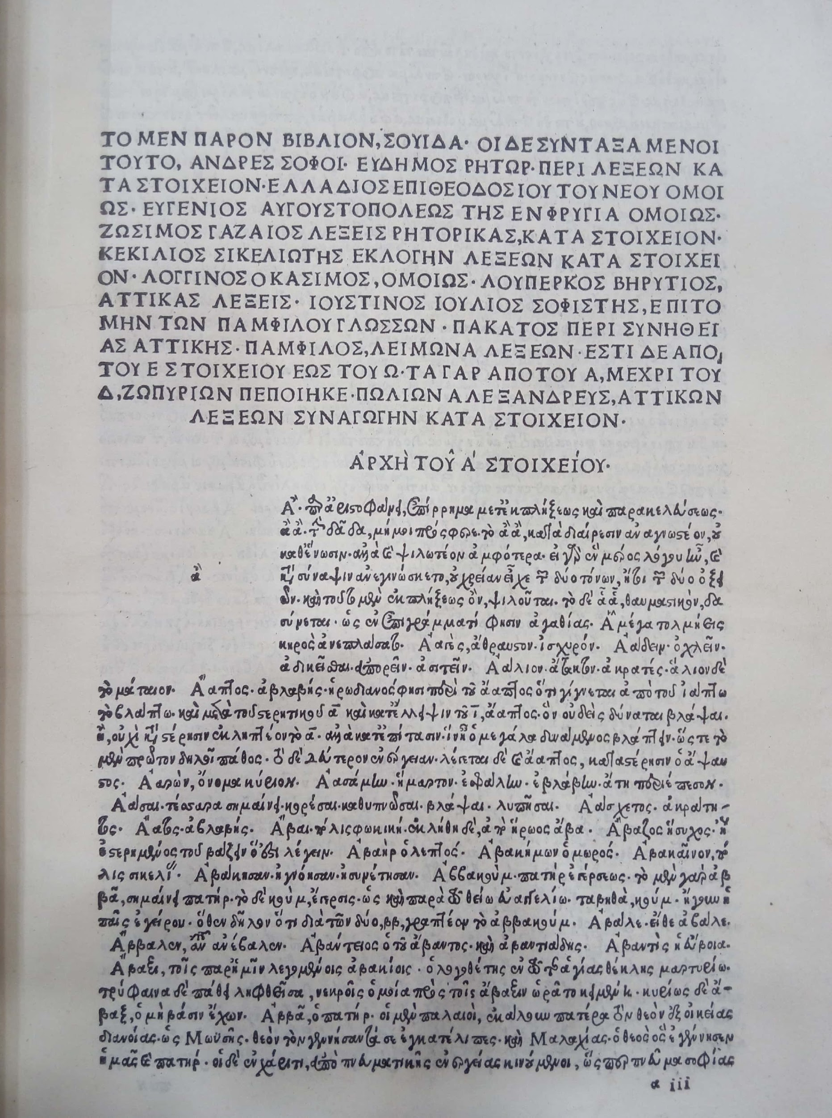
Suidas, Lexicon graecum
14 copies
Epistolae diversorum philosophorum, oratorum, rhetorum
12 copies
Aristophanes,
Comoediae novem
12 copies
Milan : Johannes Bissolus and Benedictus Mangius, for Demetrius Chalcondylas, 1499
Photo: Koventareios Library copy (Kozani)
Venice : Aldus Manutius, Romanus, 1499
Photo: Koventareios Library copy (Kozani)
Venice : Aldus Manutius, Romanus, 1498
Photo: Vikelaia Library copy (Heraklion)

Slide 9
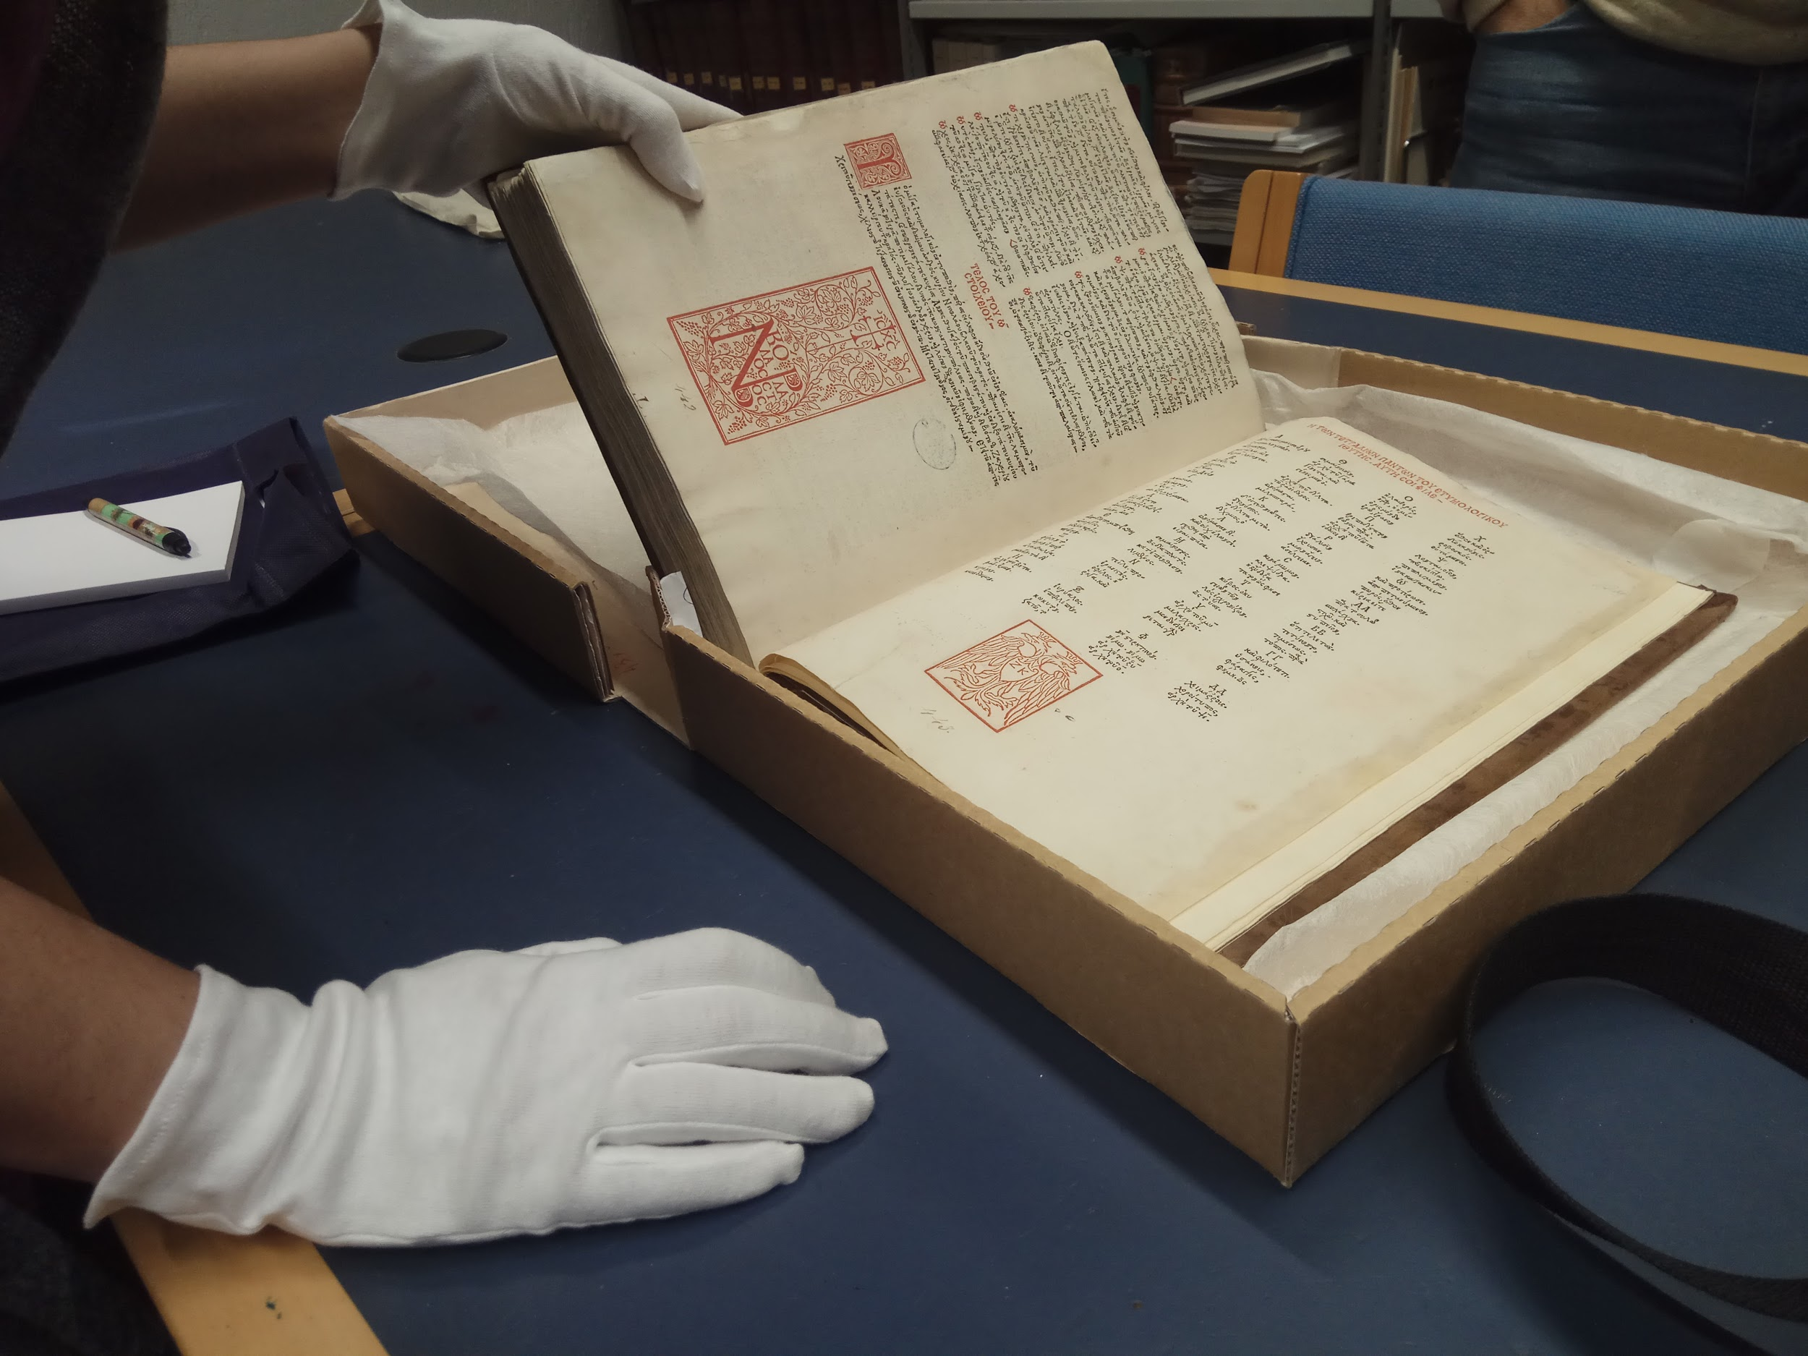
27 Greek titles
Printers of Greek
Aldus Manutius (10)
Zacharias Callierges (3)
Francesco di Alopa (3)
Significant works
Homer, Aesop, Isocrates
Dictionaries, grammars
9 non-Greek titles
6 religious
52 copies in MEI
9 from our project
Etymologicum Magnum Graecum
Venice : Zacharias Callierges for Nicolaus Blastus and Anna Notaras, 1499
Photo: University of Crete Central Library copy

Slide 10
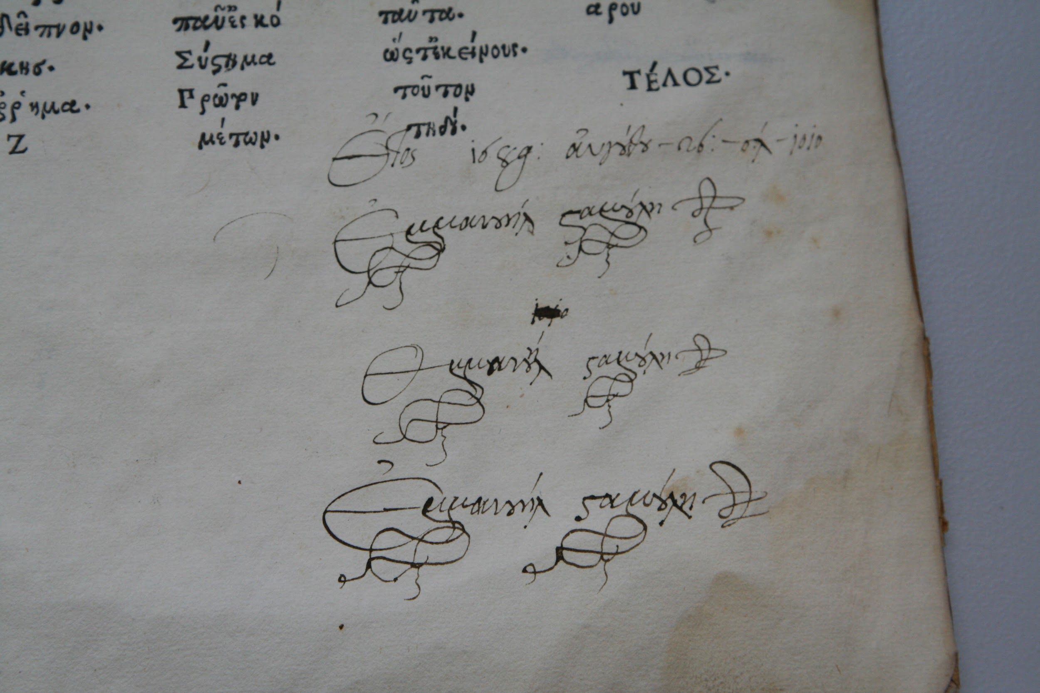
Aristophanes, Comoediae novem, Venice : Aldus Manutius, Romanus, 1498
Photo: Koventareios Library copy (Kozani)

Slide 11
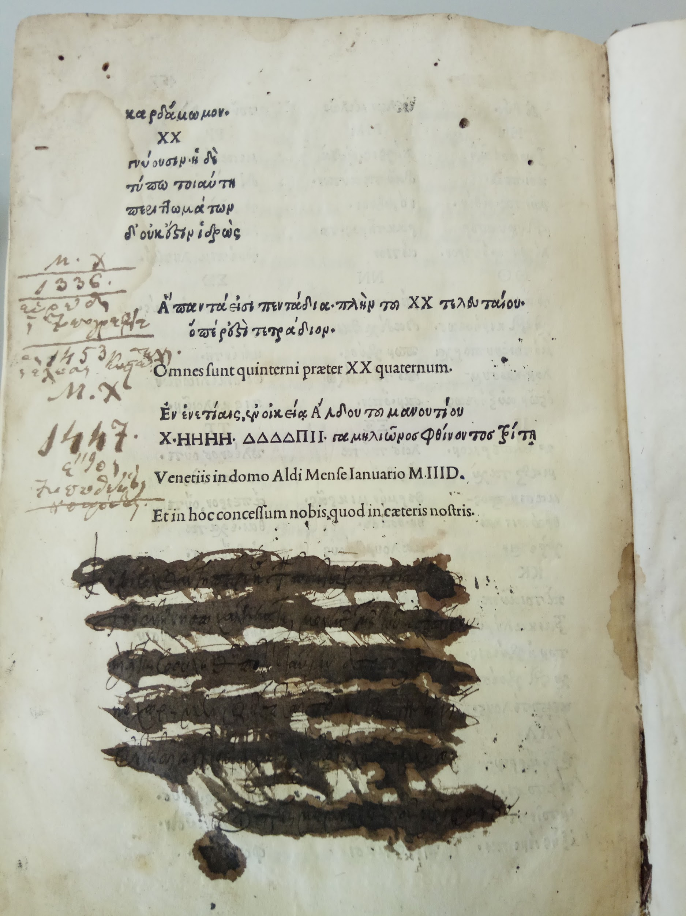
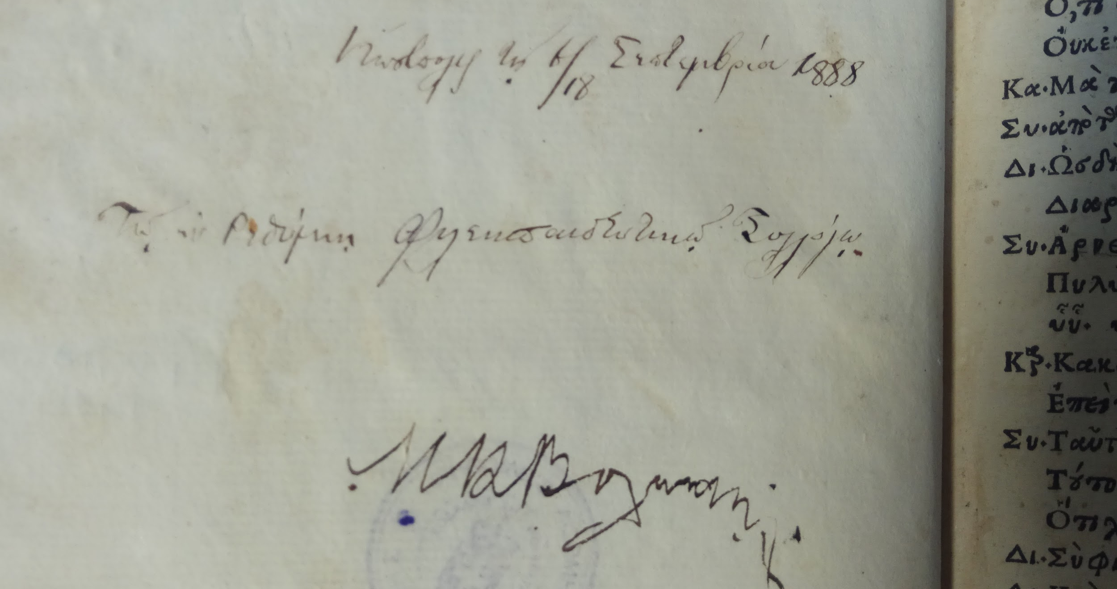
Aristophanes, Comoediae novem,
Venice : Aldus Manutius, Romanus, 1498
Inscription of donation on front flyleaf
Photo: Public Central Library copy (Rethymno)
Aristoteles, Opera, Part III,
Venice : Aldus Manutius, Romanus, 1497
Ownership inscription / book curse of the Chalke Monastery blotted out on ΧΧ7v, below the colophon
Photo: Koventareios Library copy (Kozani)

Slide 12
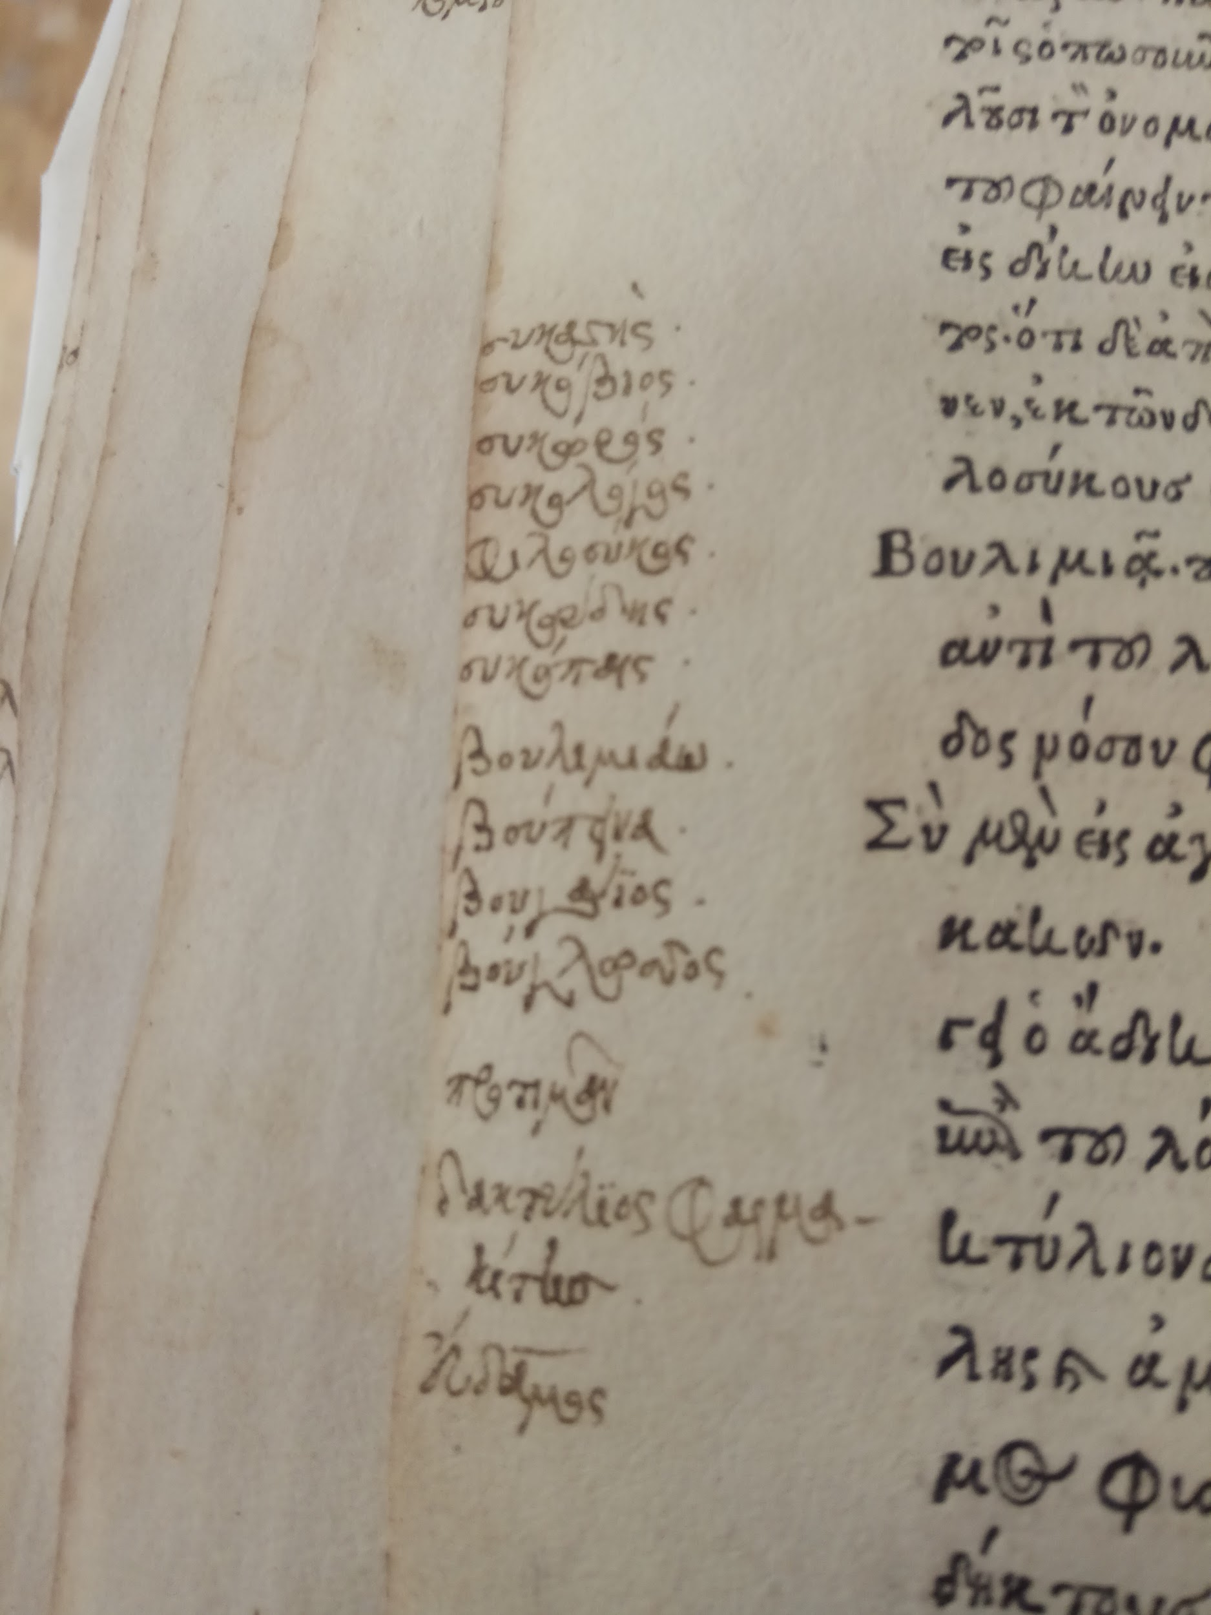
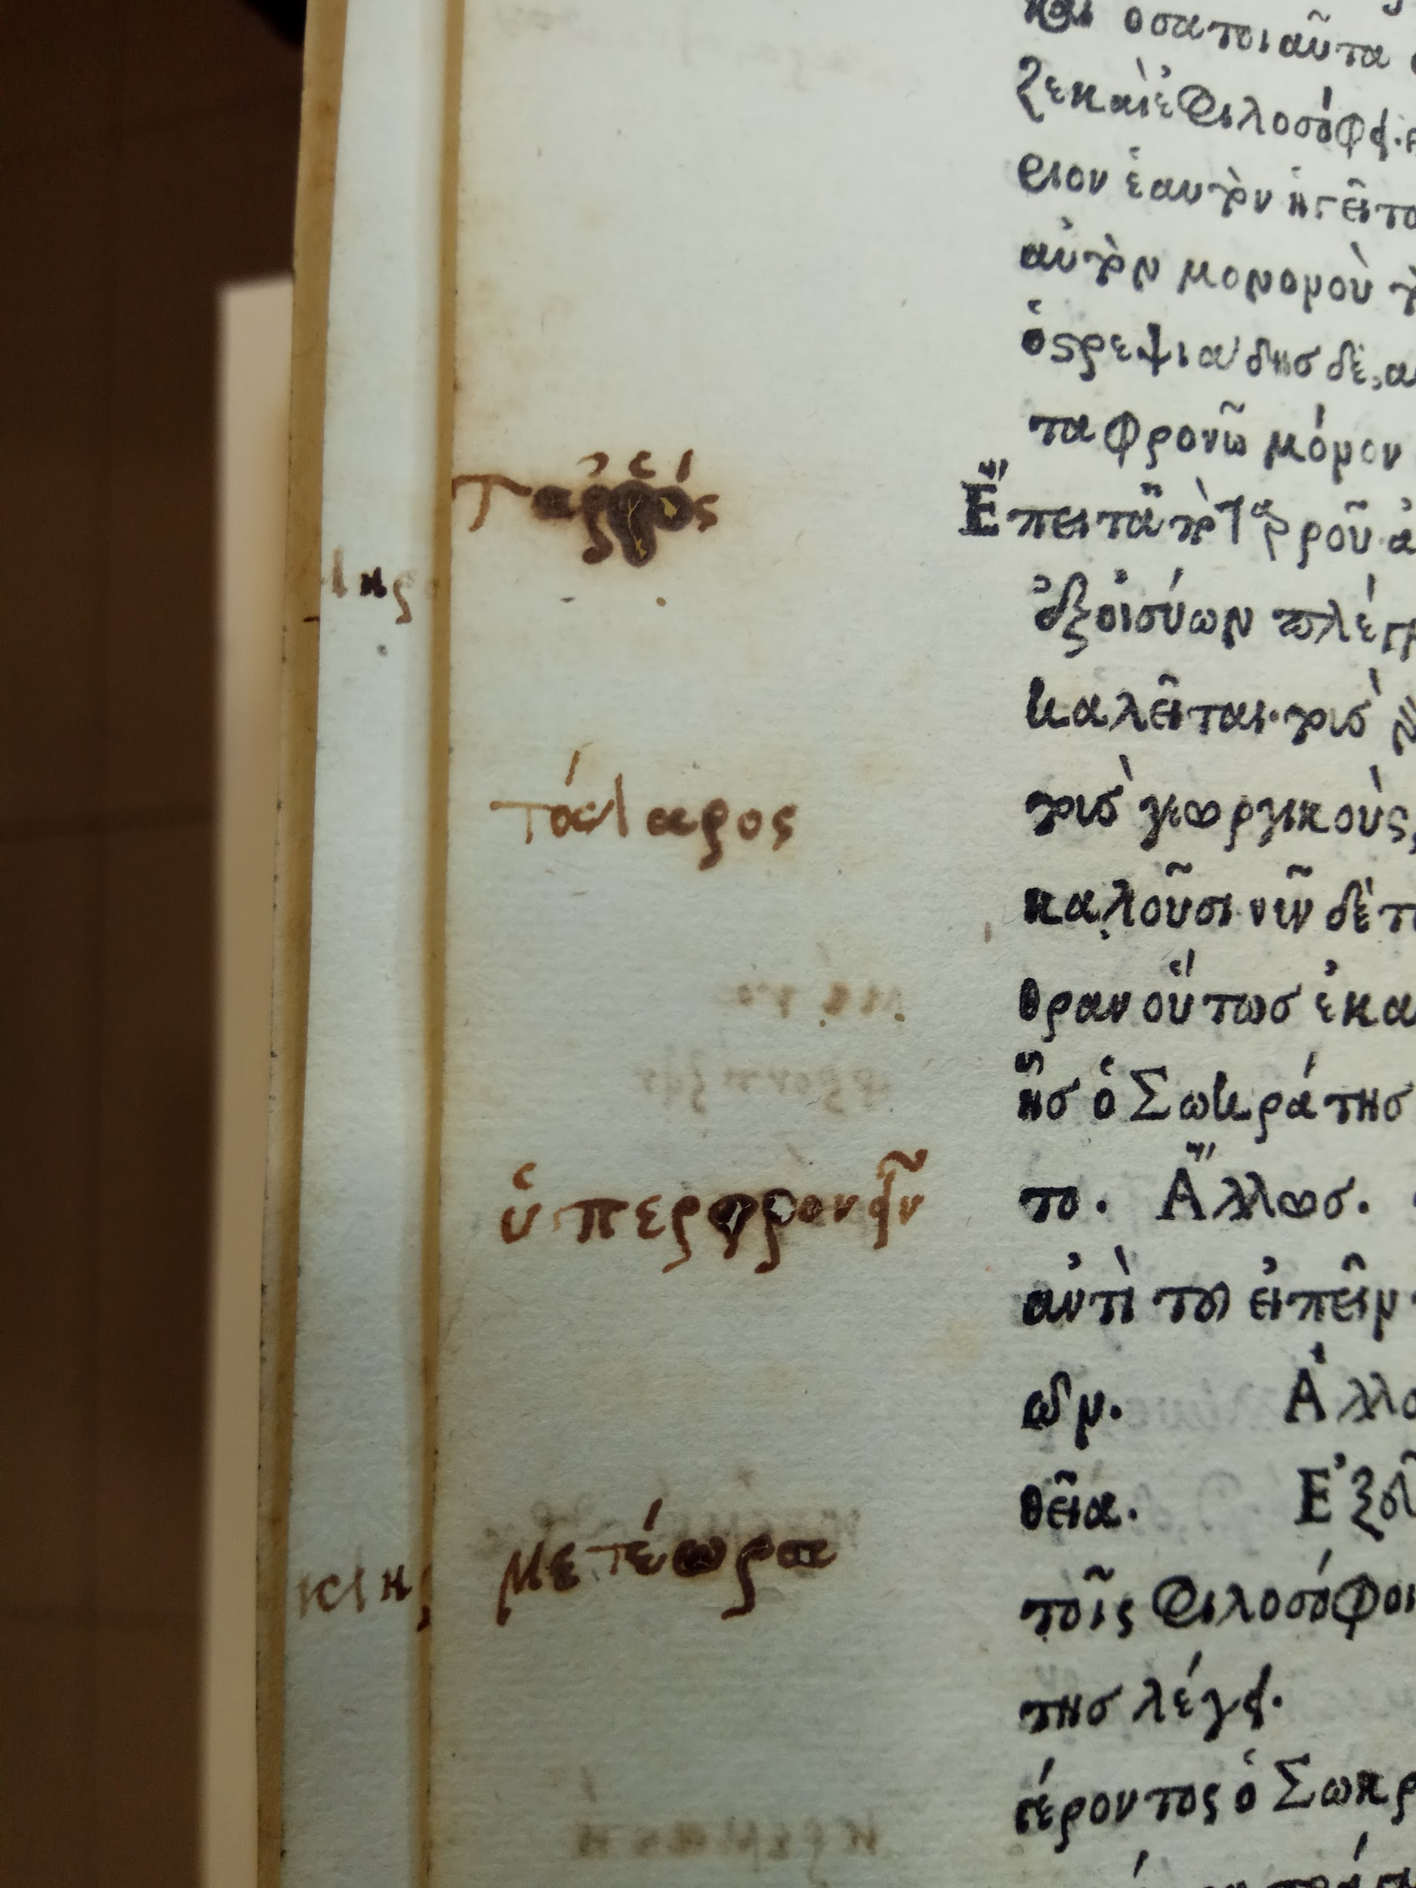
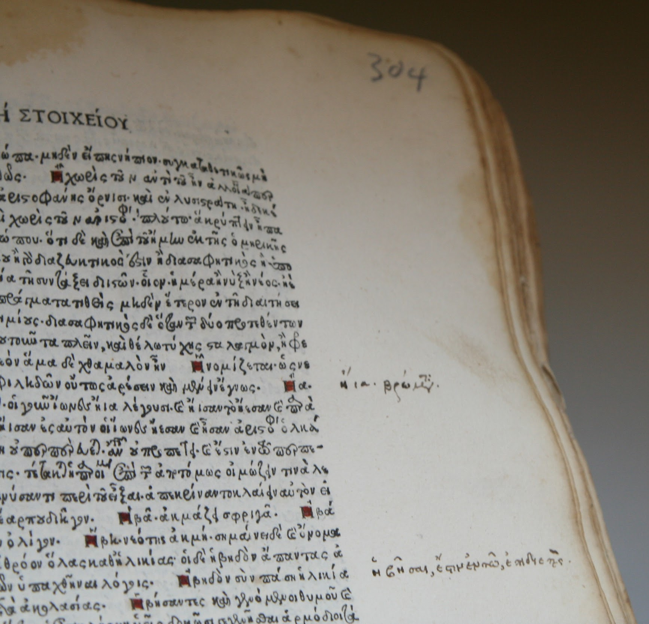
Suidas, Lexicon graecum,
Milan : Johannes Bissolus and Benedictus Mangius, for Demetrius Chalcondylas, 1499
Photo: Koventareios Library copy (Kozani)
Aristophanes, Comoediae novem, Venice : Aldus Manutius, Romanus, 1498
Photo: Koventareios Library copy (Kozani)
Aristophanes, Comoediae novem, Venice : Aldus Manutius, Romanus, 1498
Photo: Vikelaia Library copy (Heraklion)

Slide 13
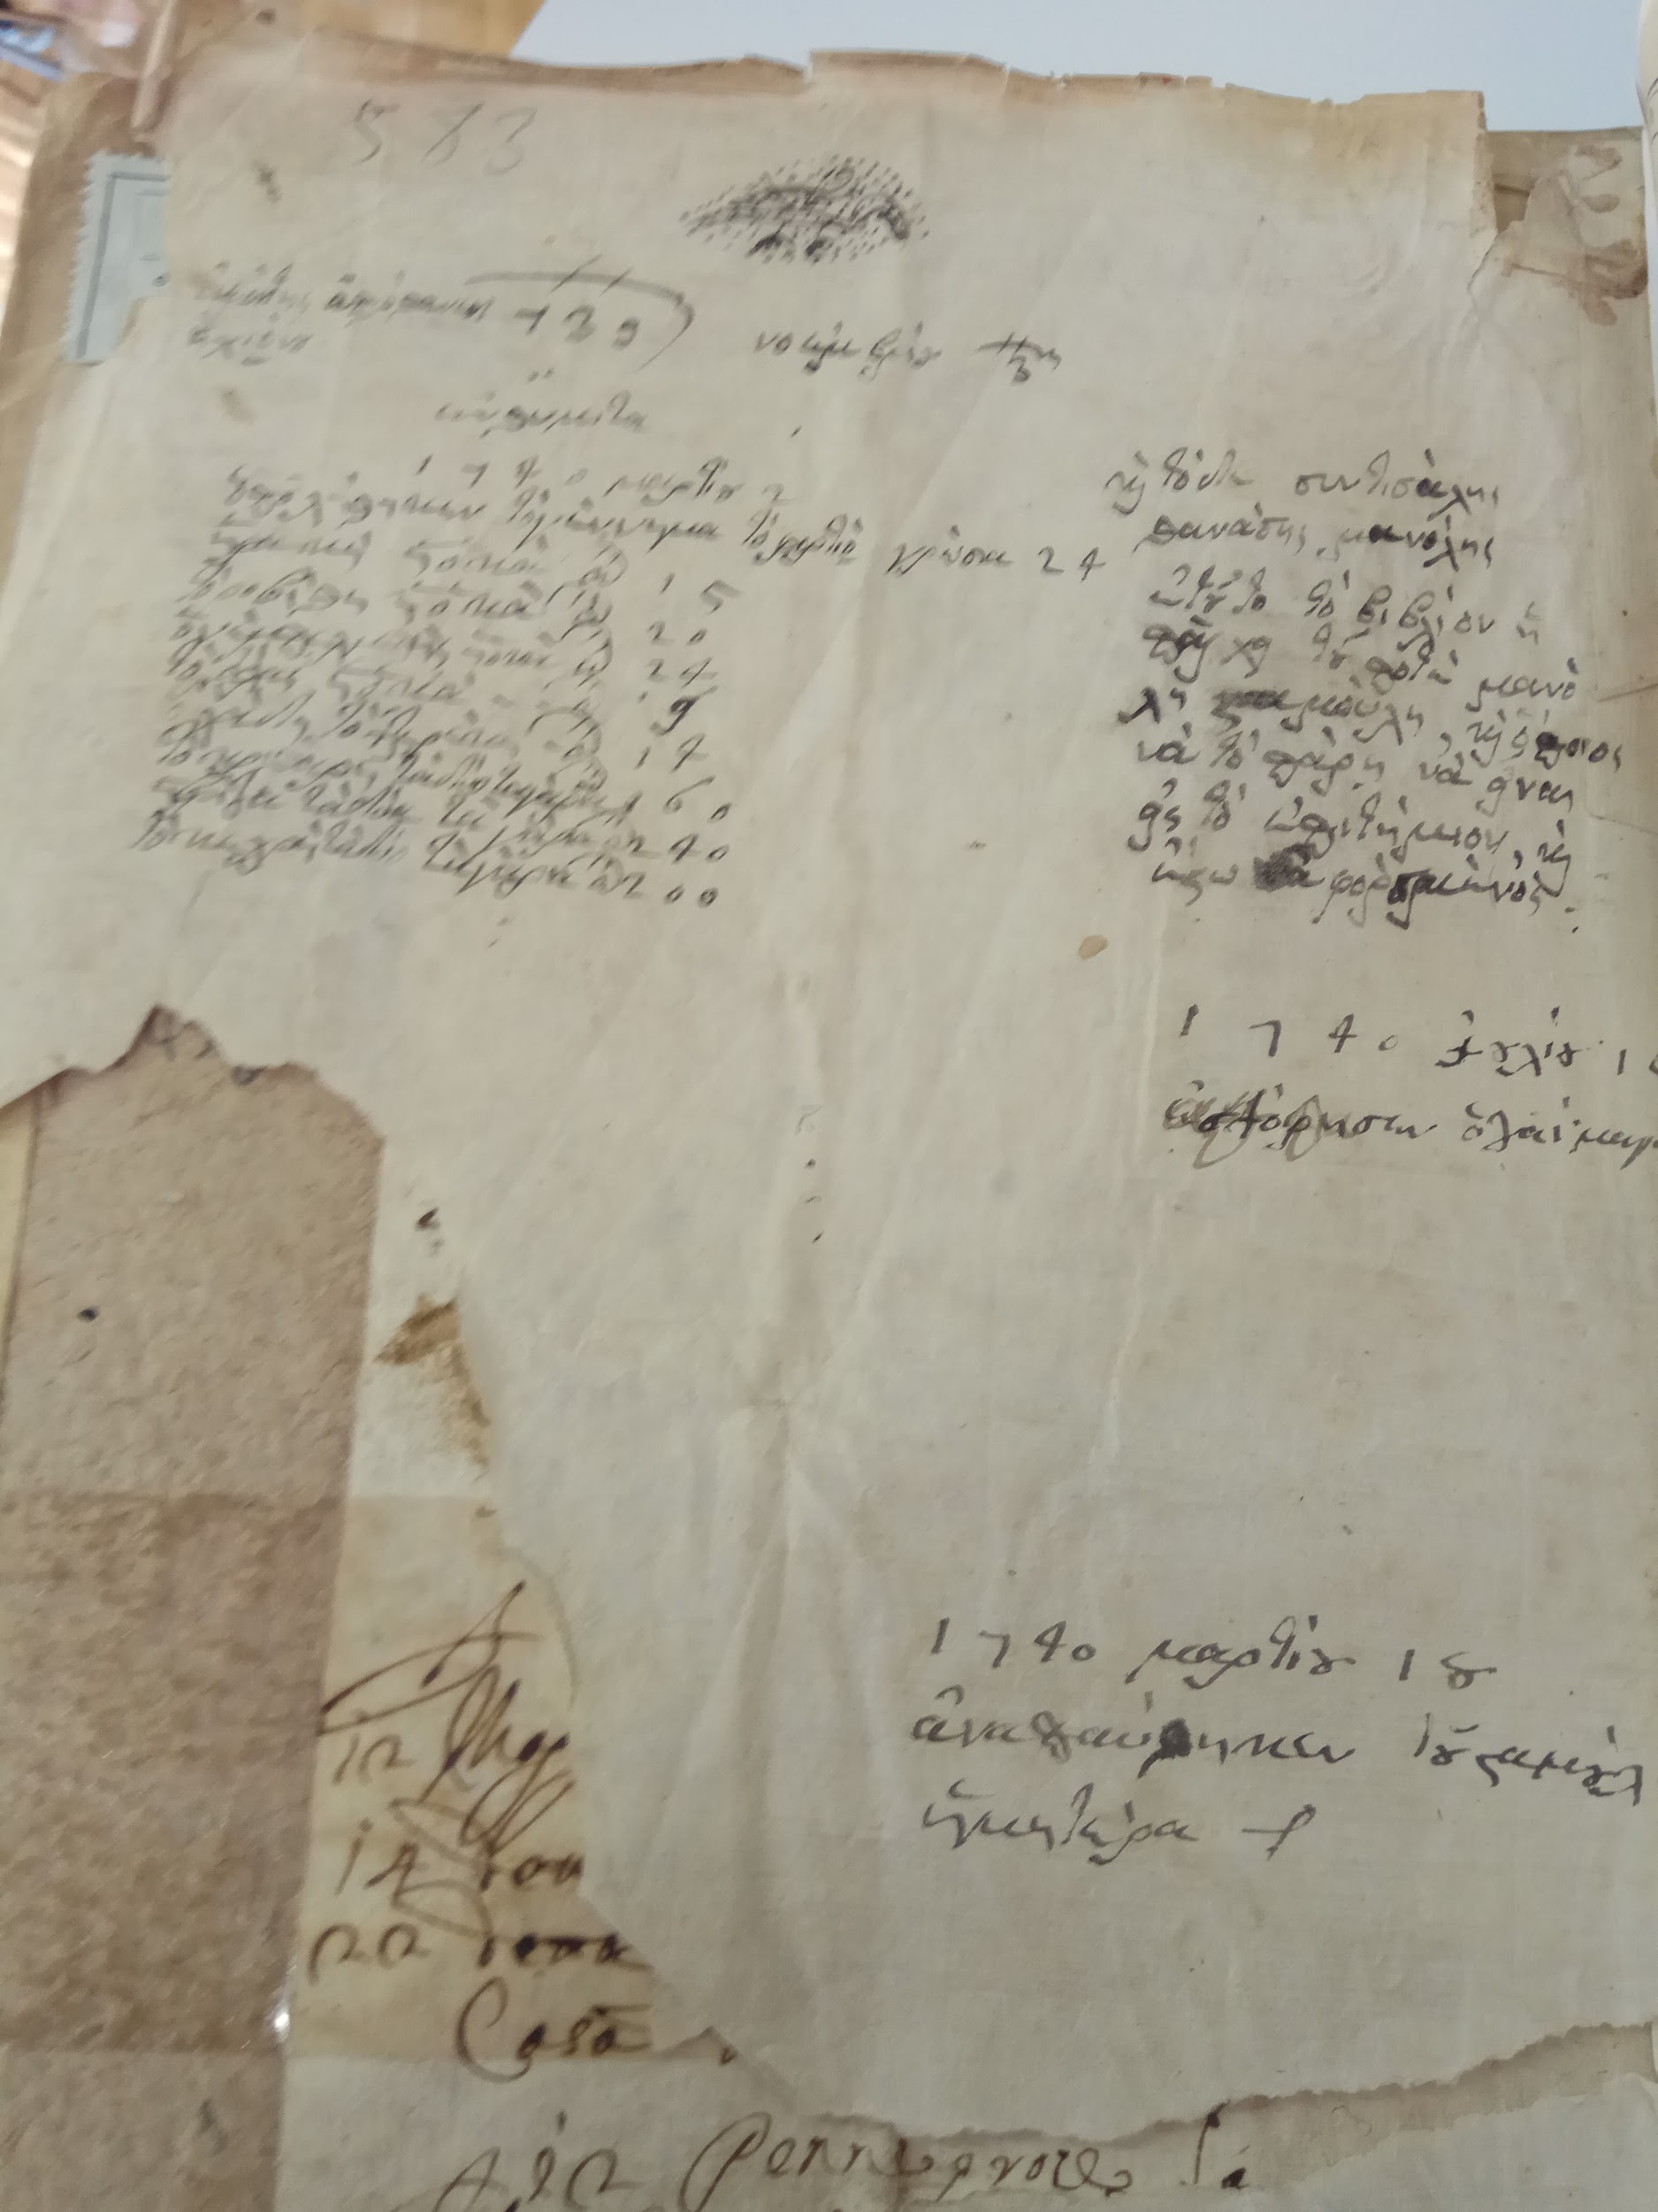
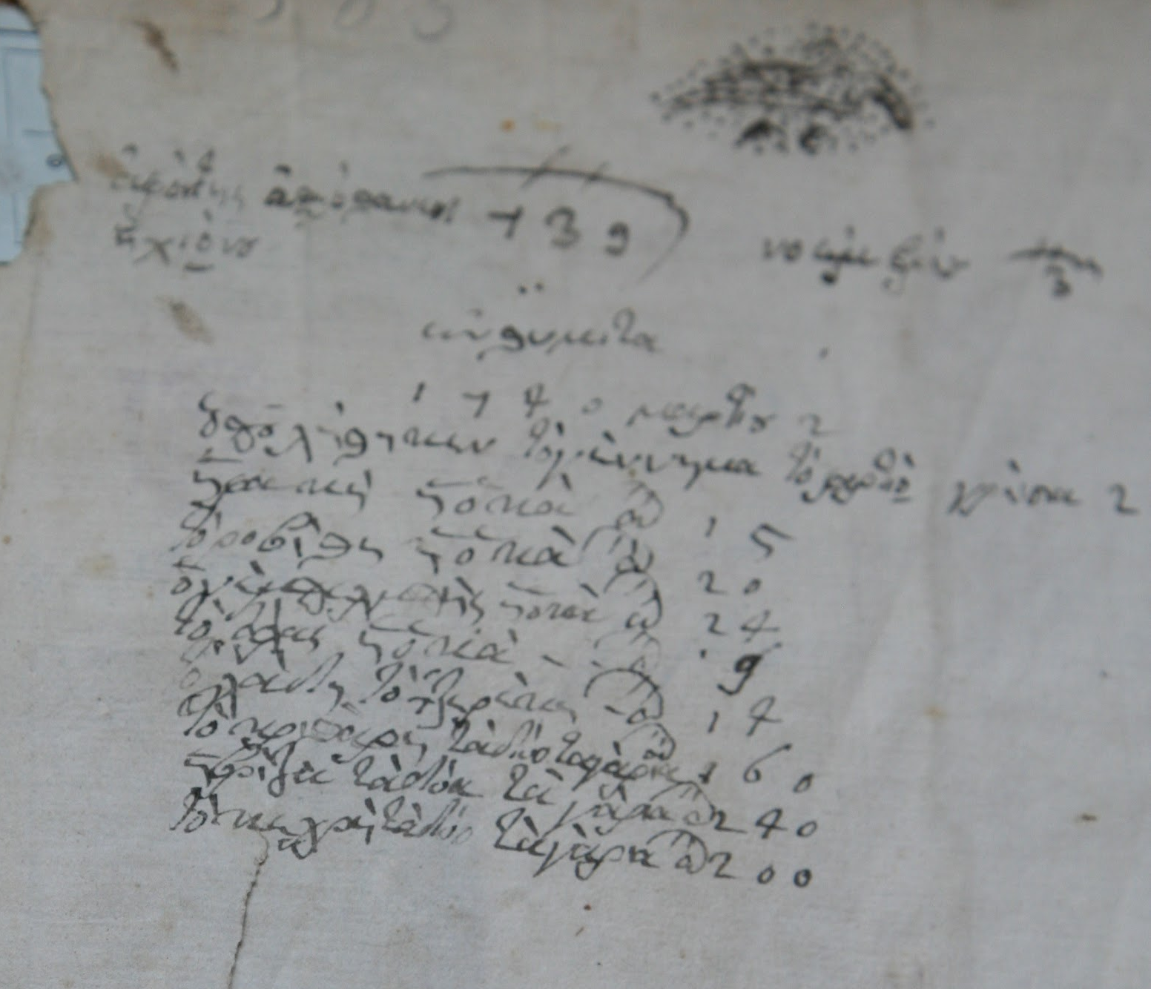
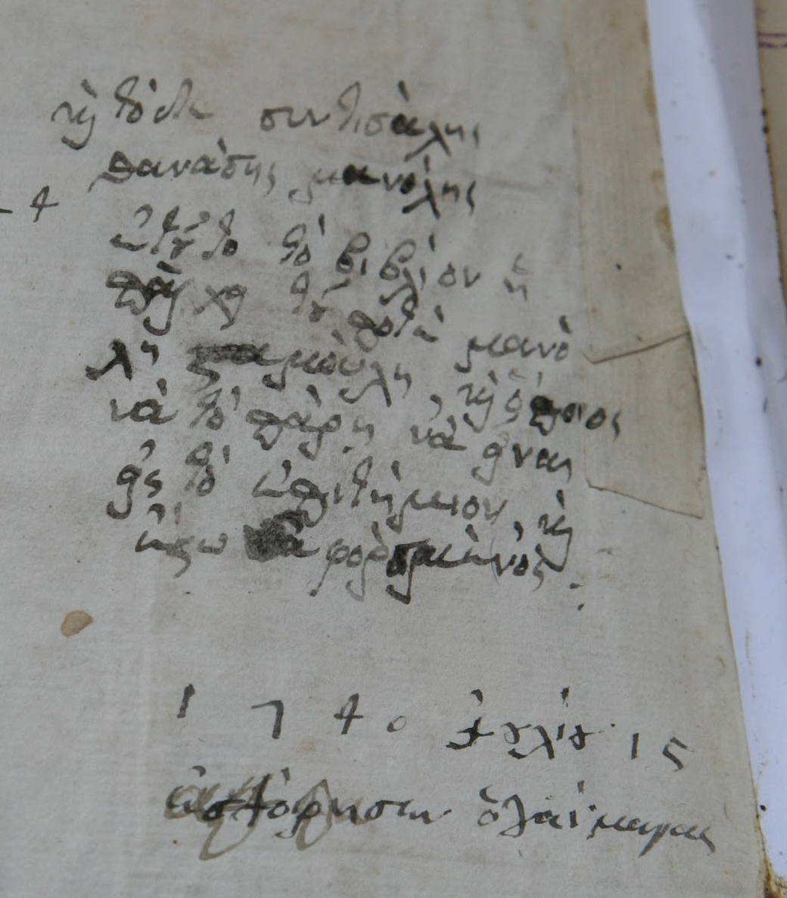
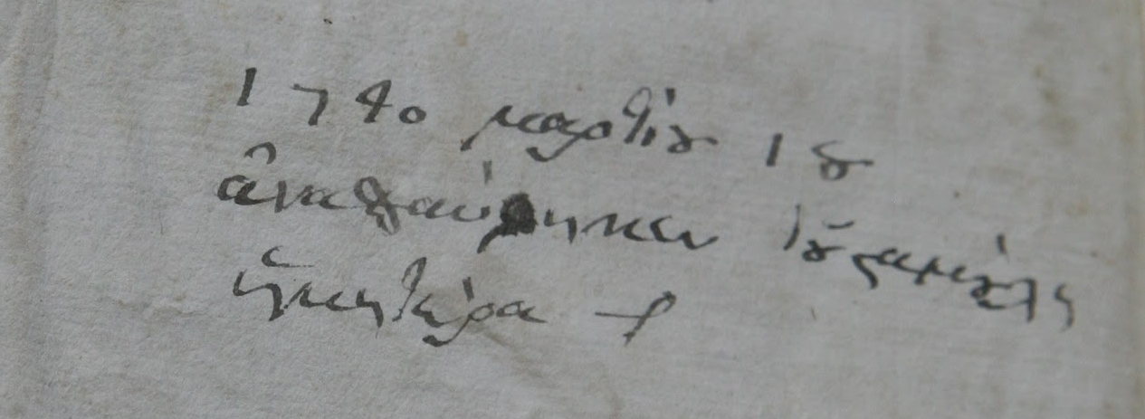
Aristophanes, Comoediae novem, Venice : Aldus Manutius, Romanus, 1498
Photo: Koventareios Library copy (Kozani)

Slide 14
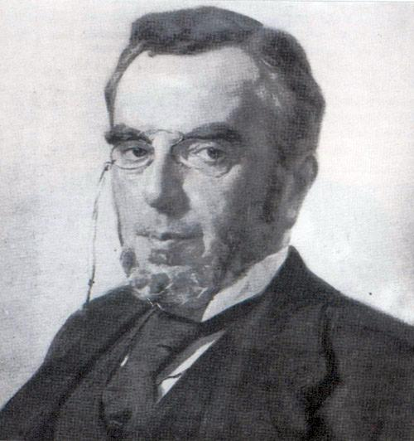
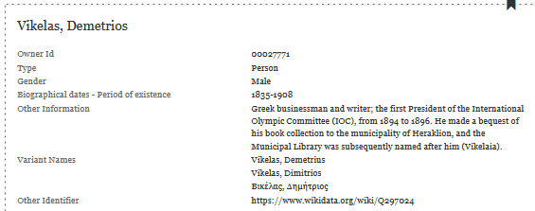
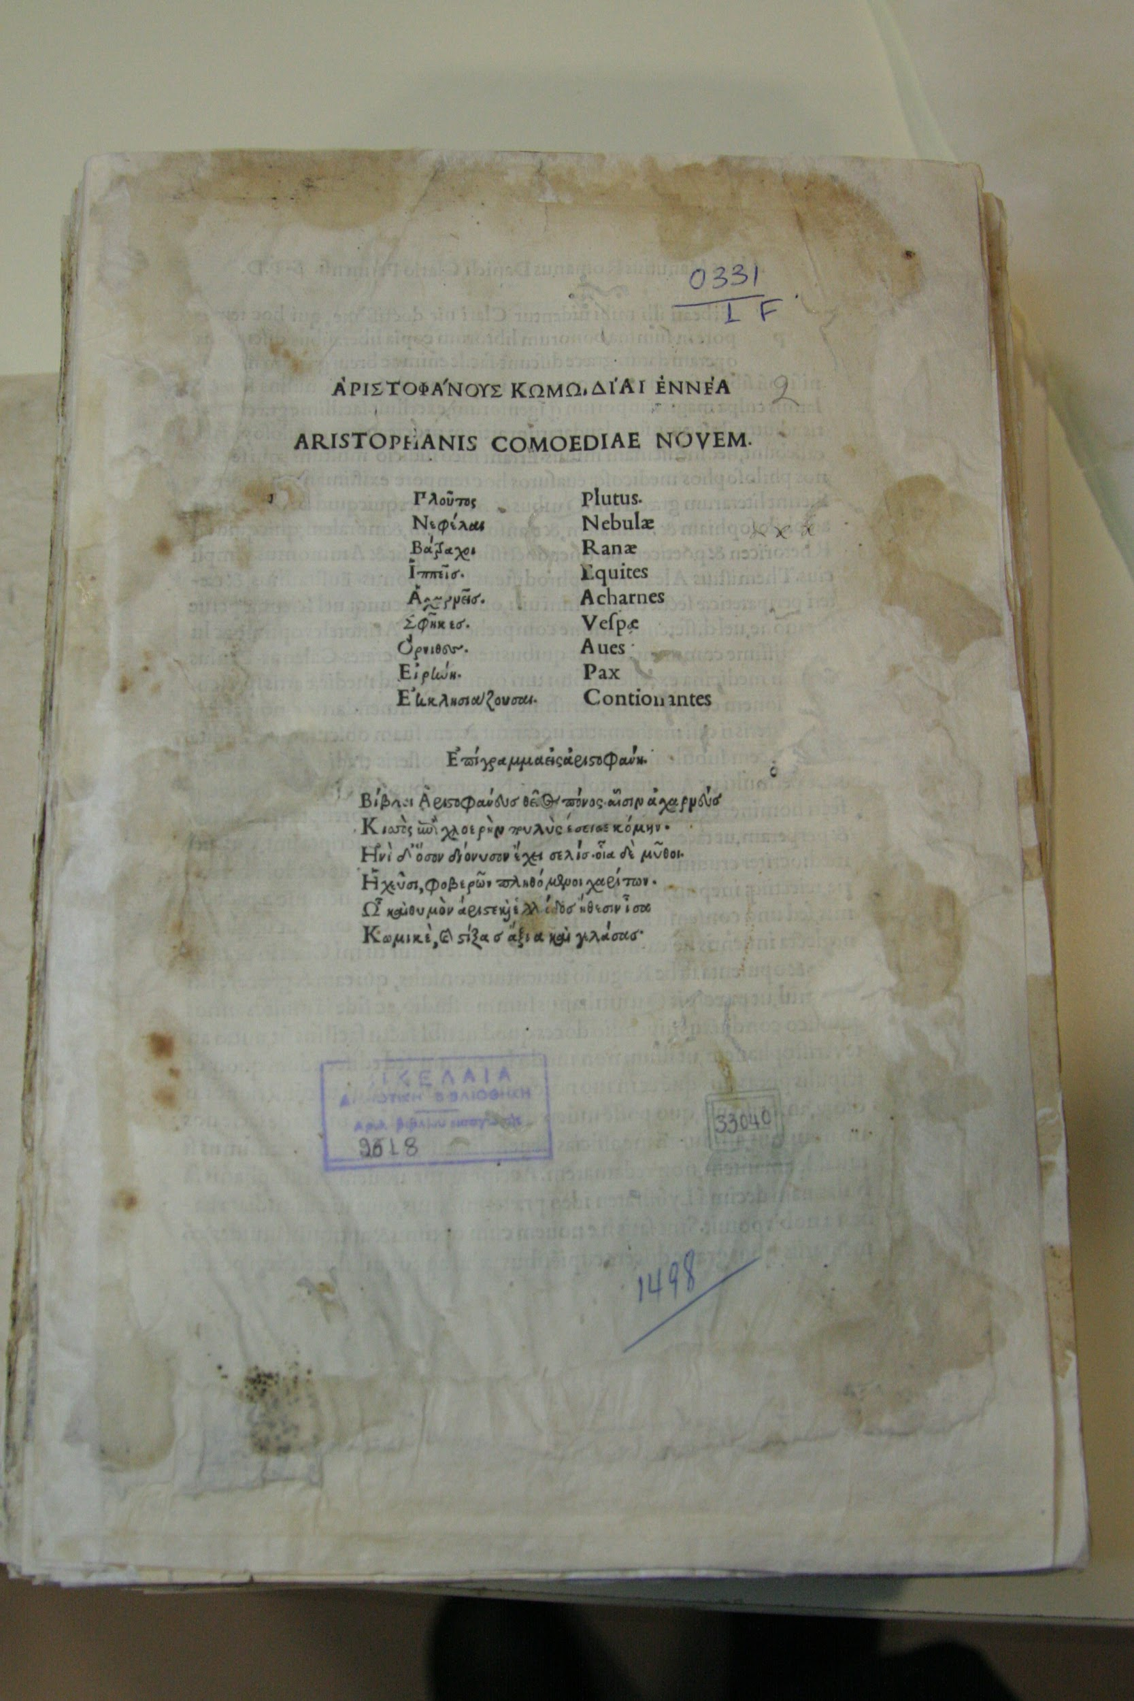
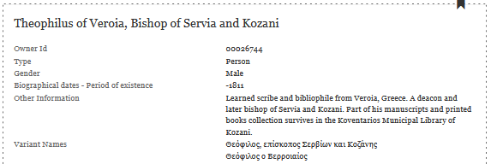
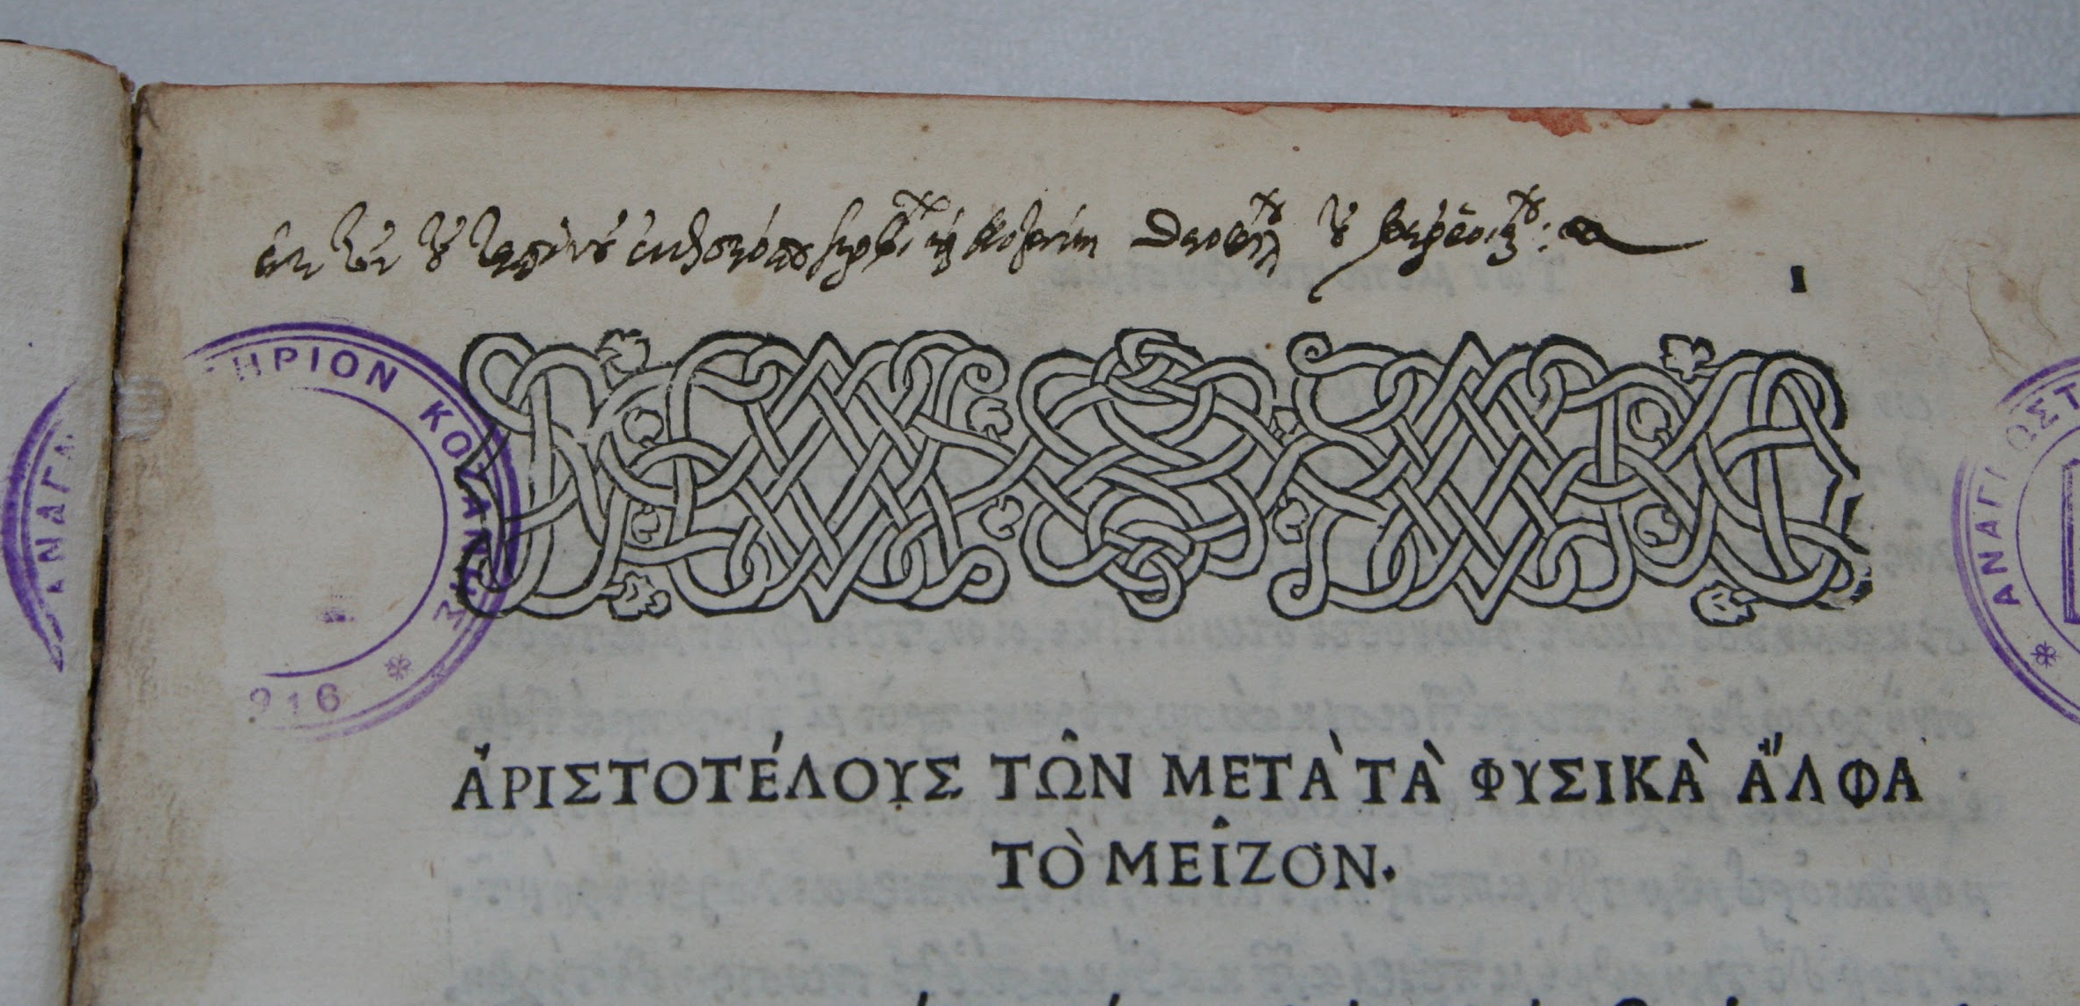
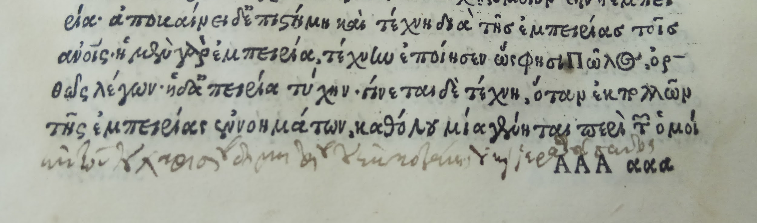
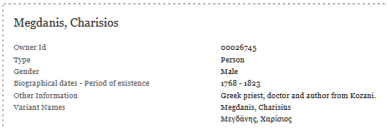

Slide 15
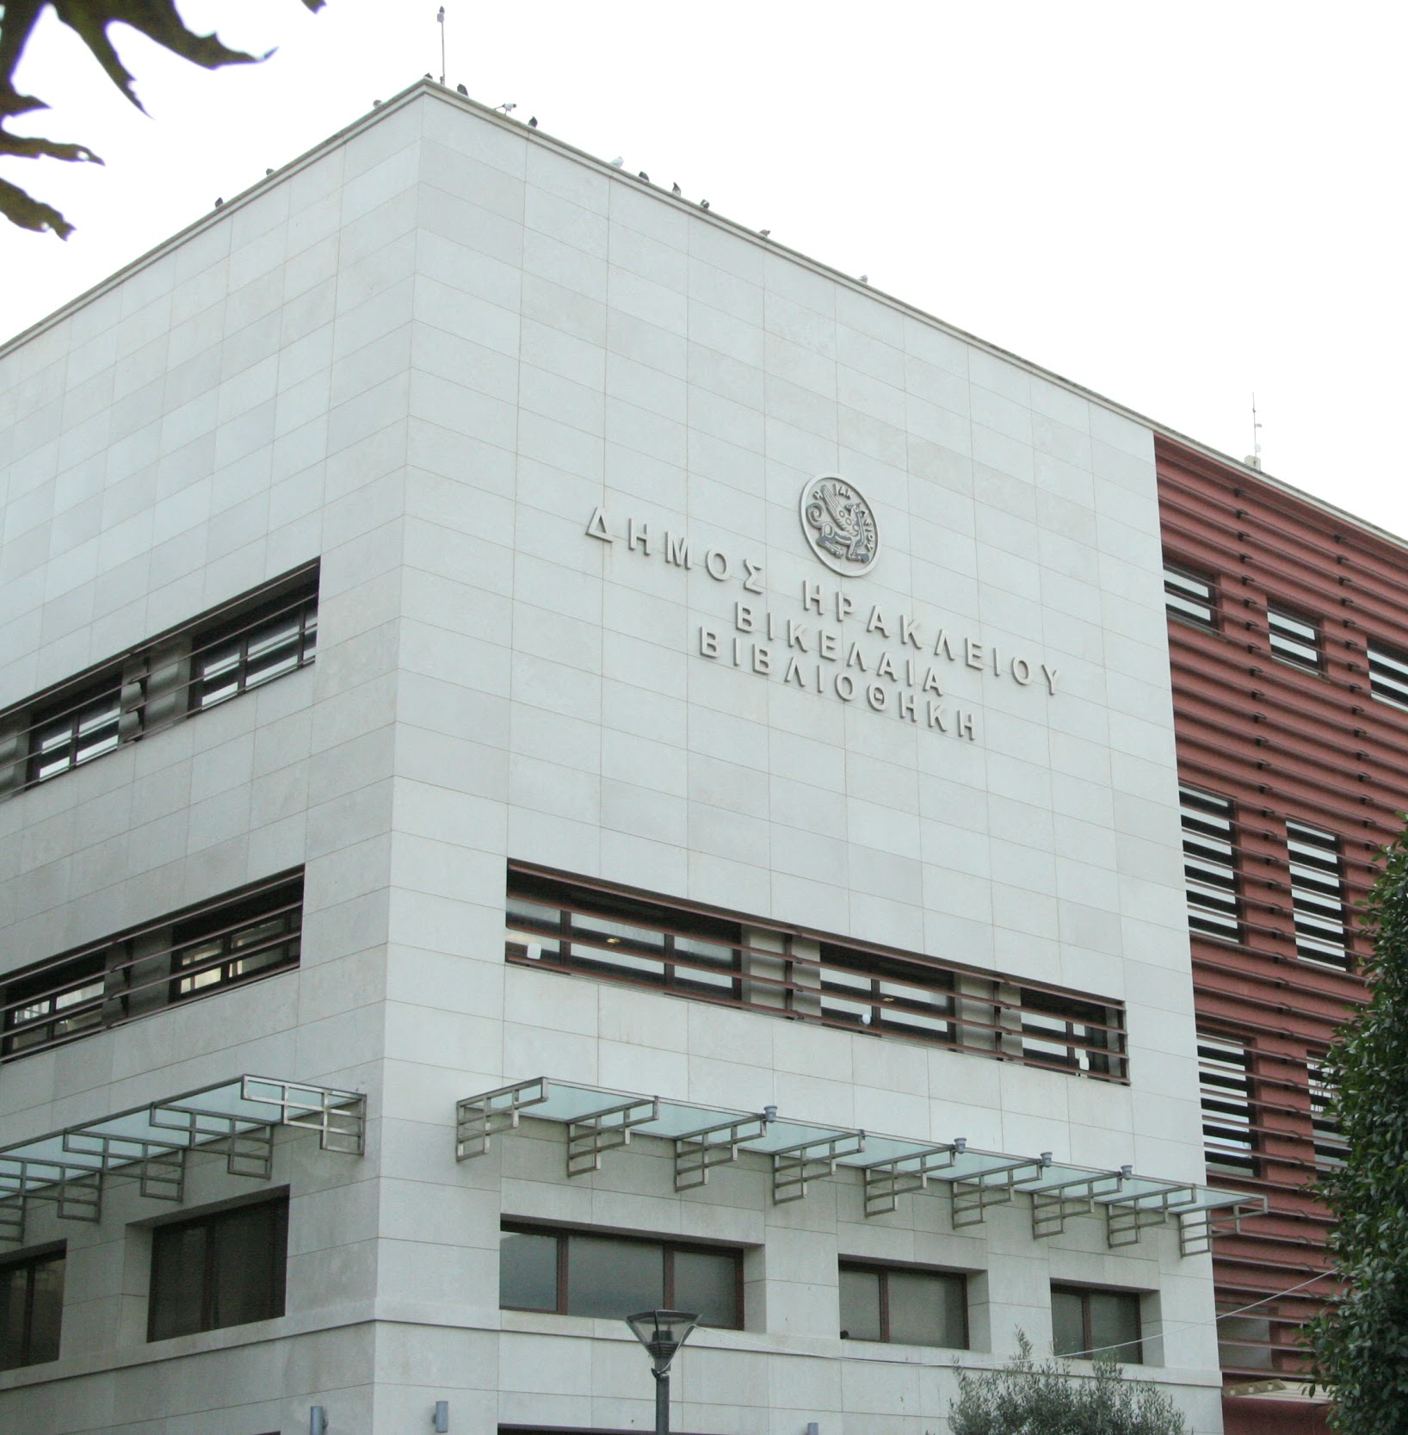
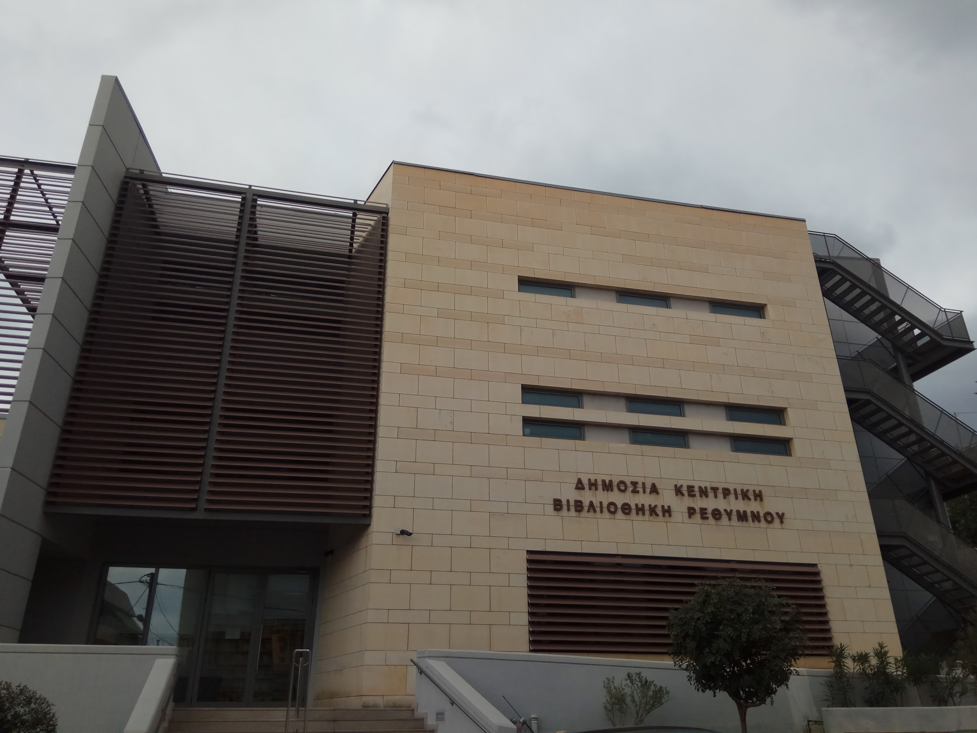
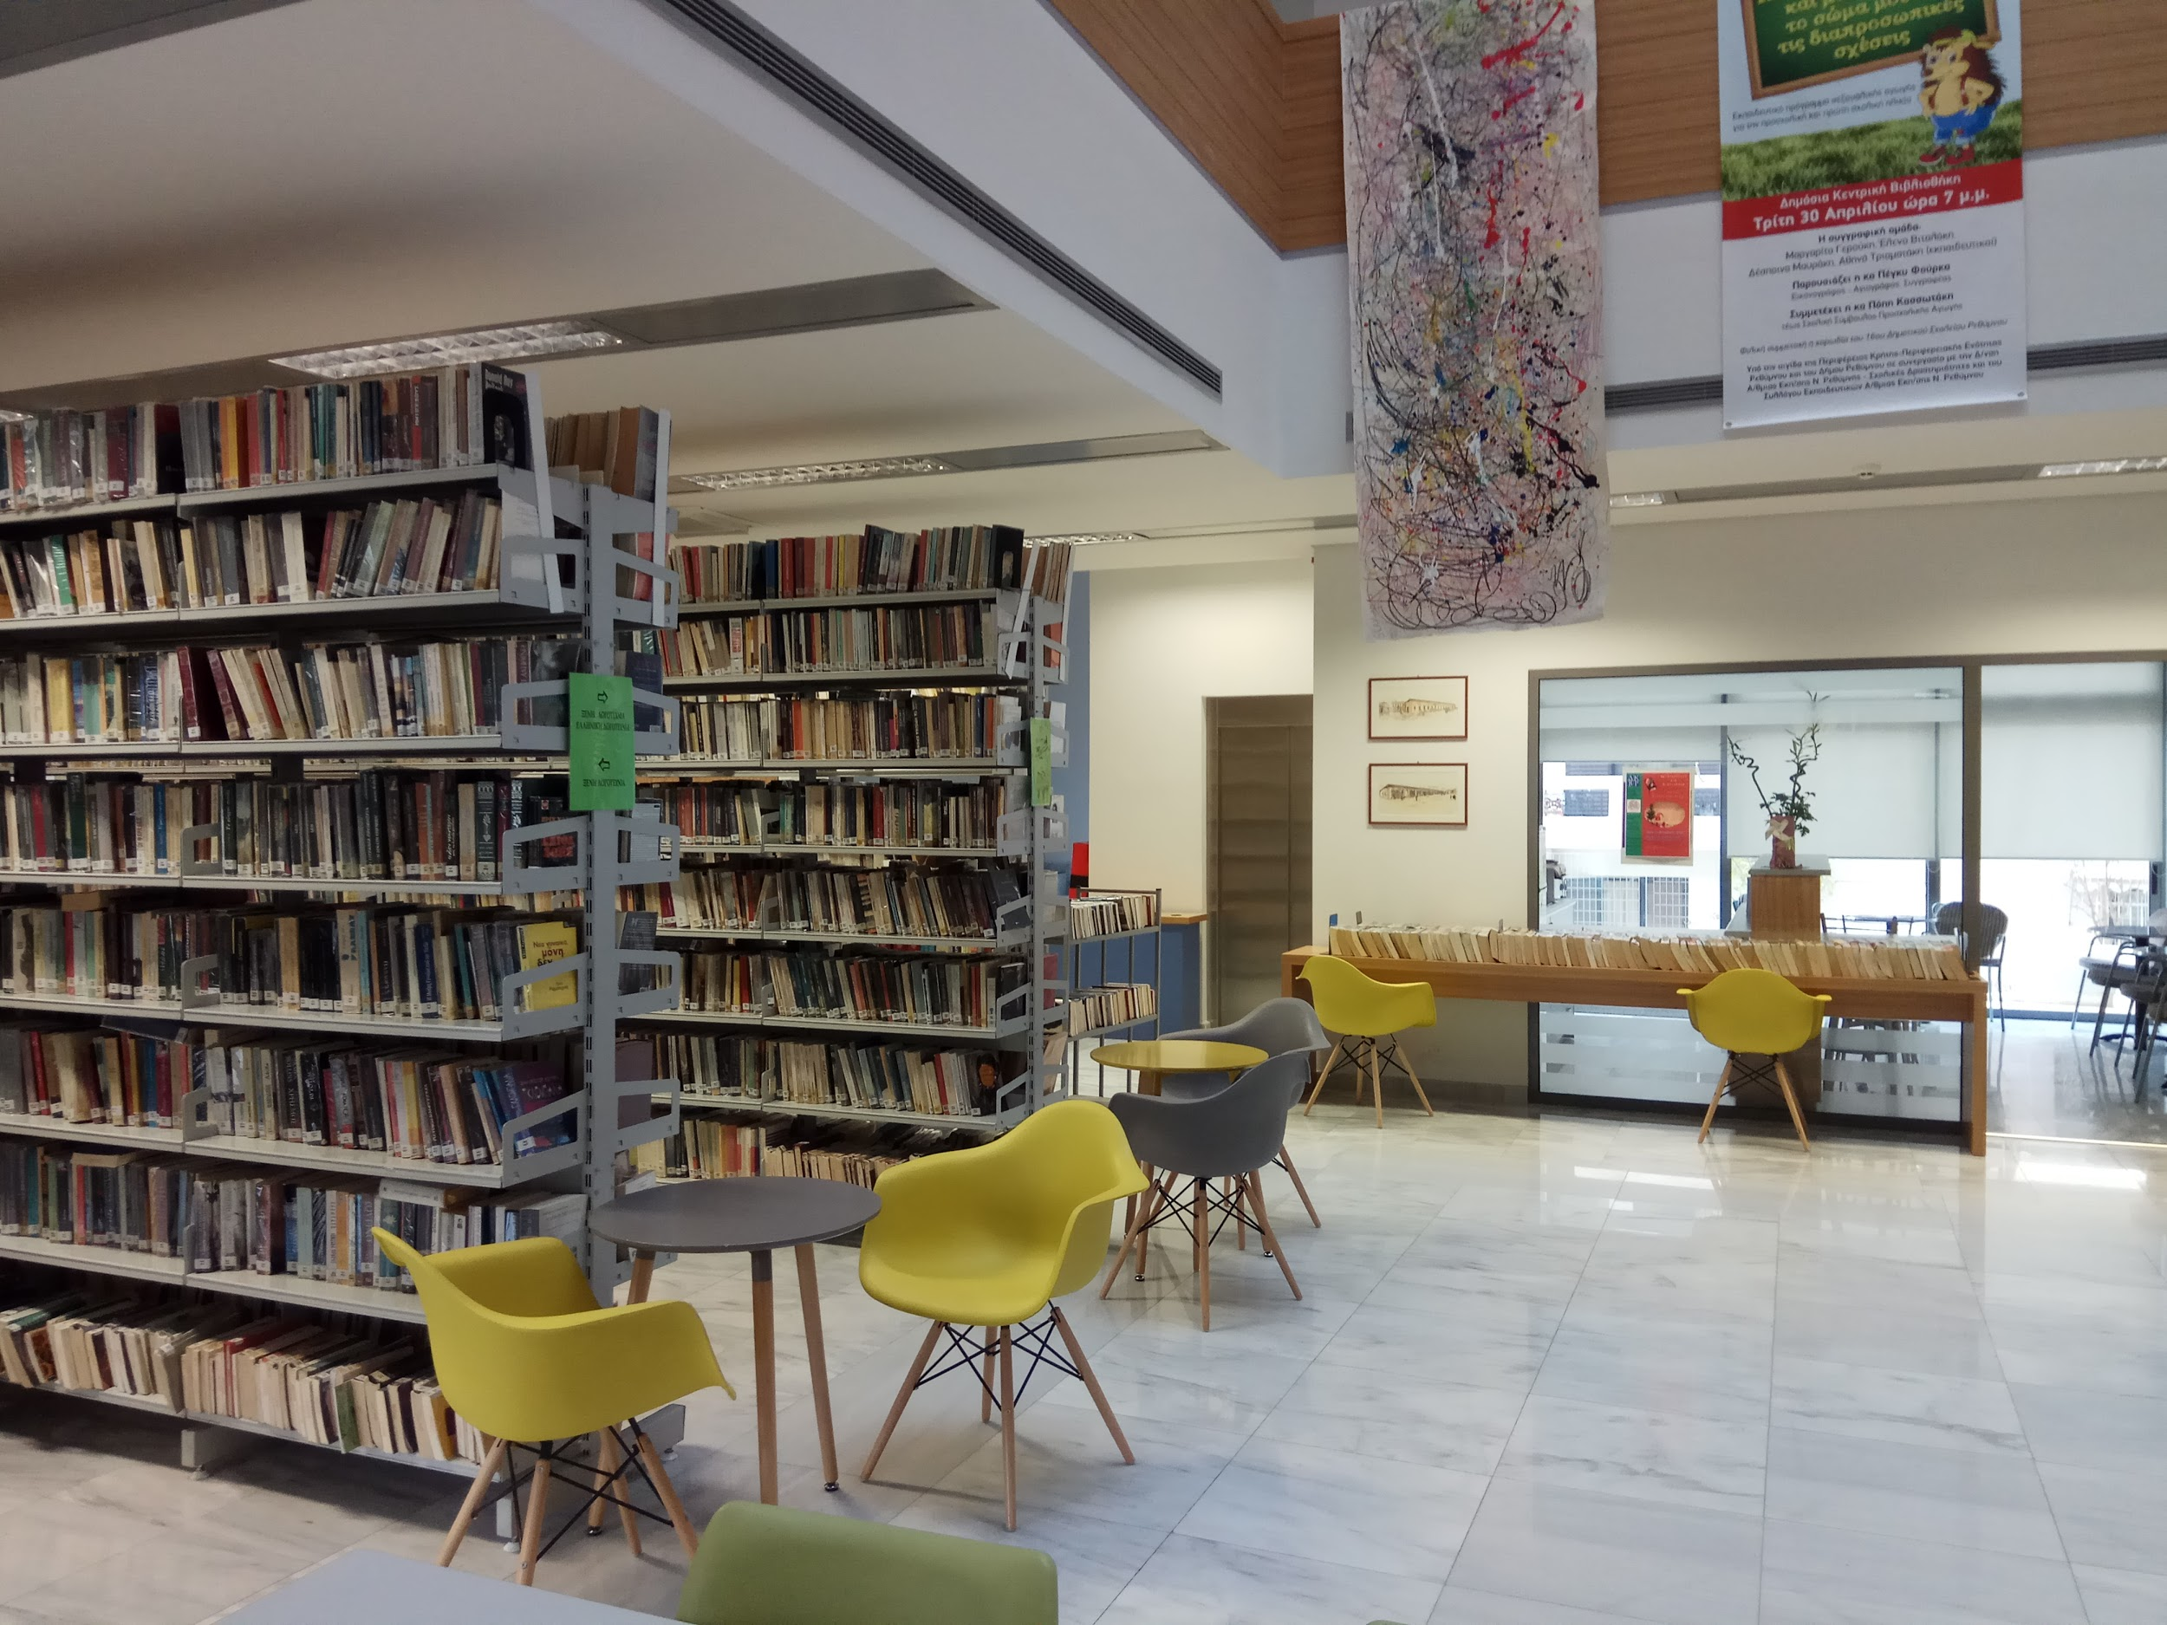
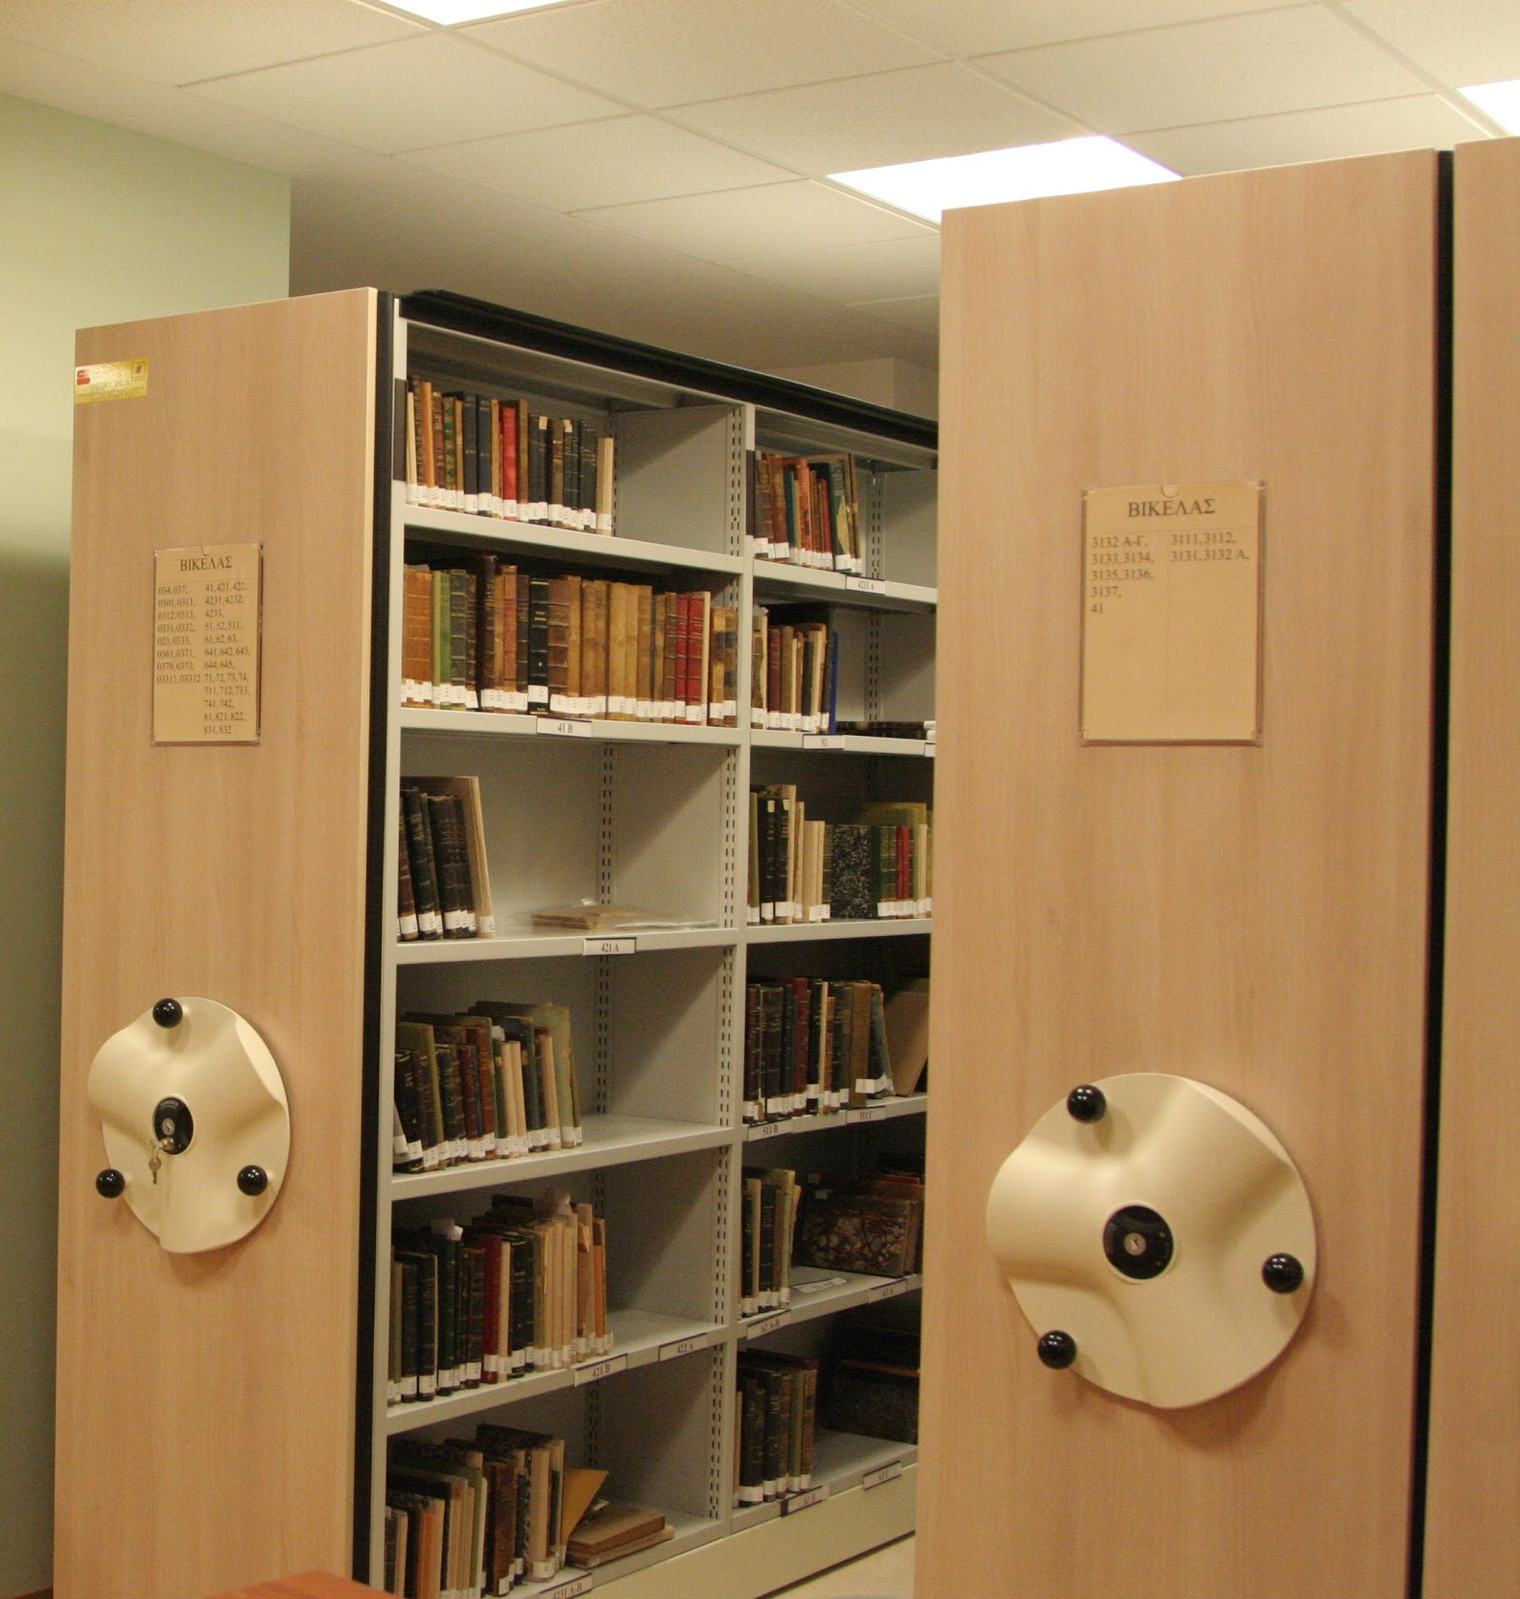
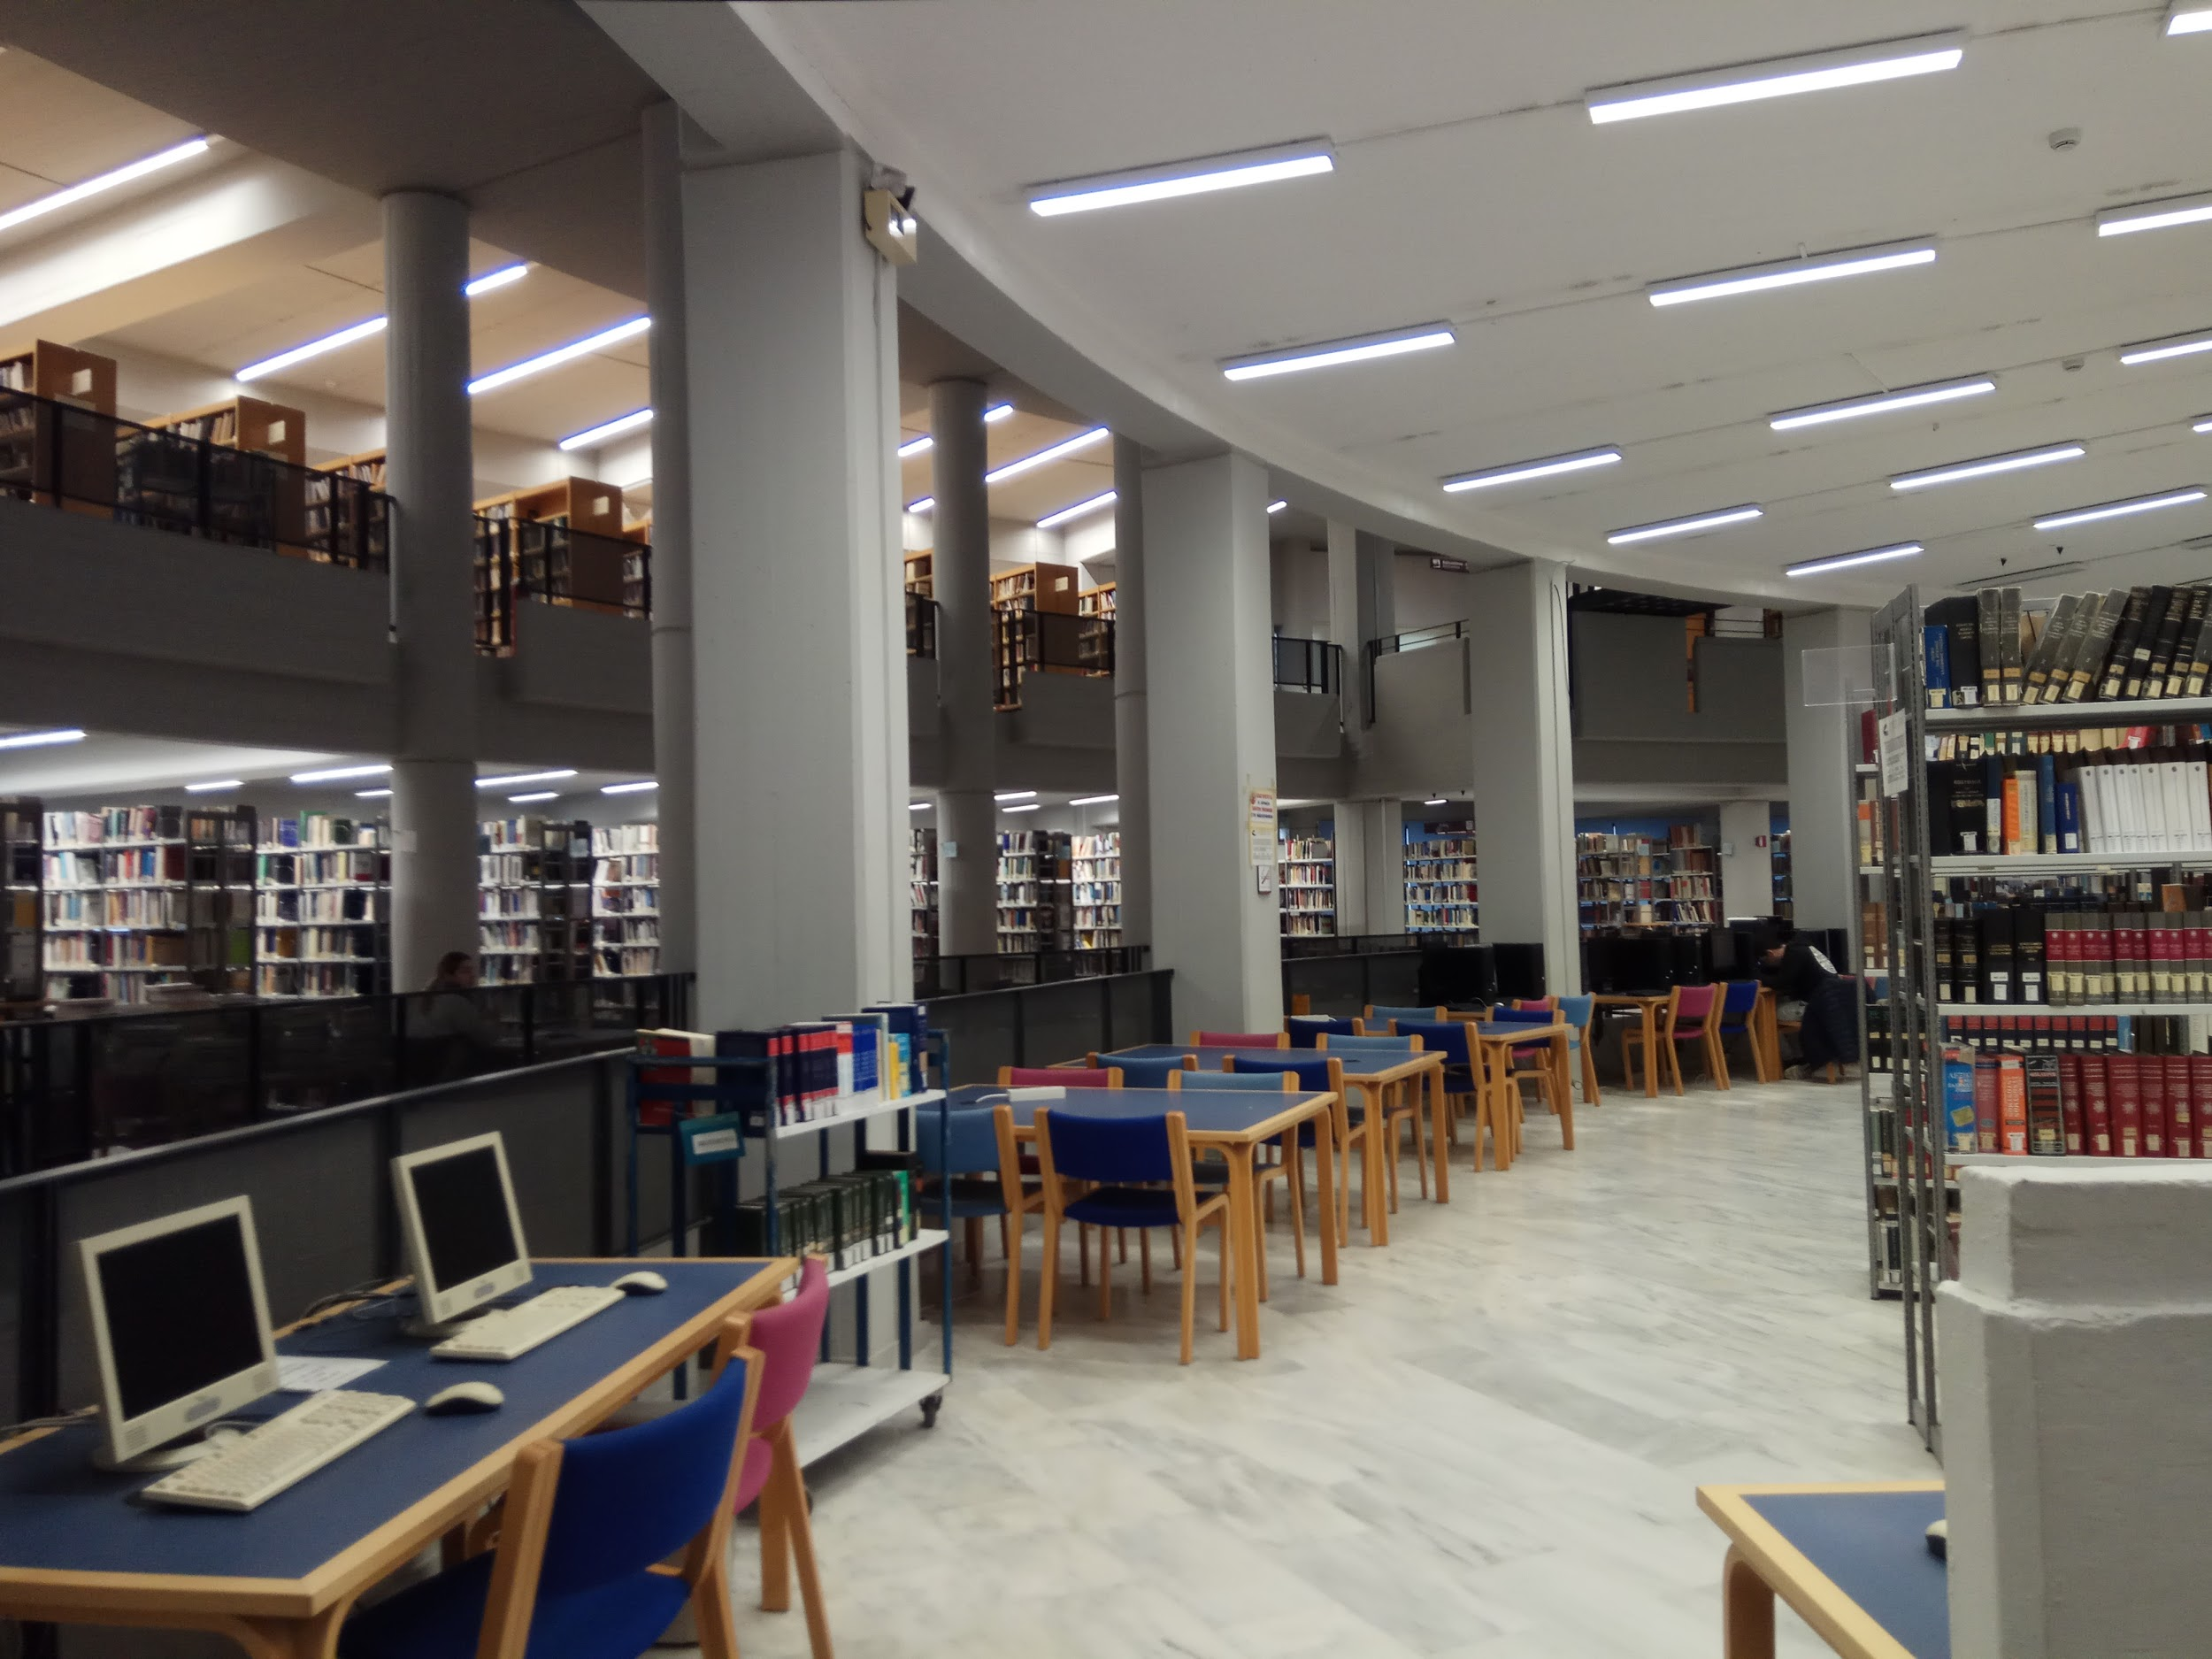
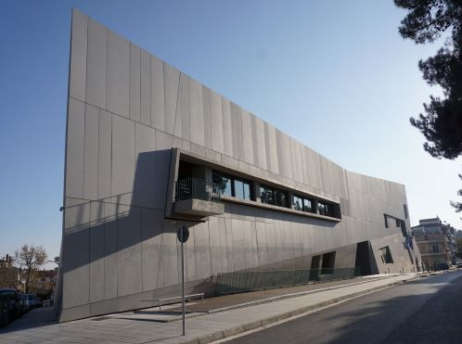
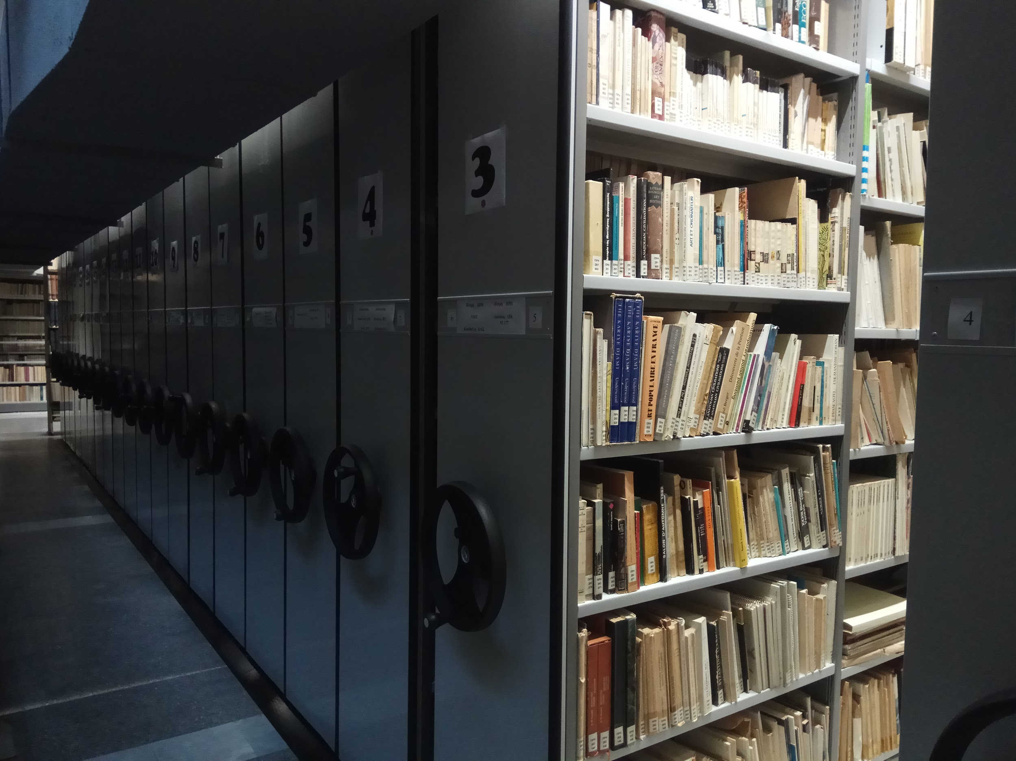
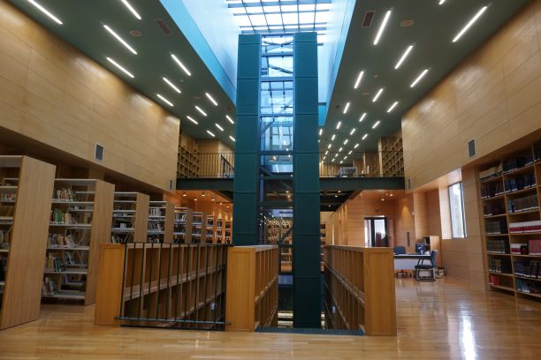
Public Central Library of Rethymno
Vikelaia Municipal Library of Heraklion
University of Crete Central Library, Rethymno
Koventareios Municipal Library of Kozani

Slide 16
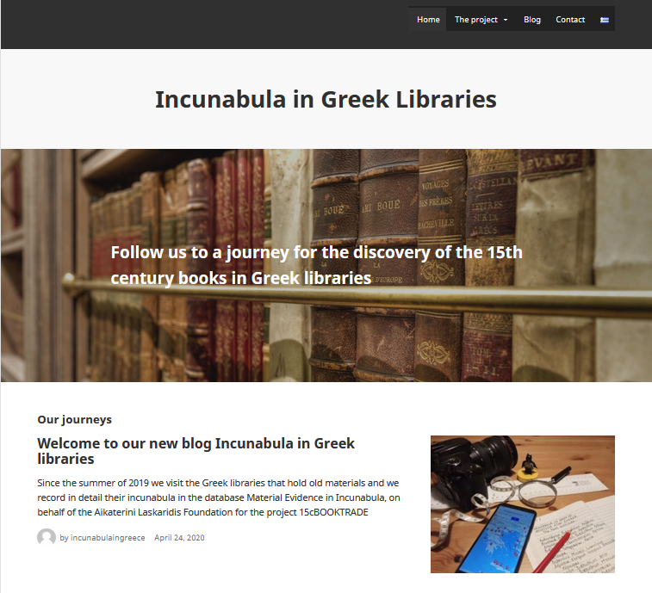
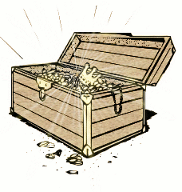
https://incunabulagreece.laskaridisfoundation.org
Thank you!
Photo credits
- Demetrios Vikelas portrait: Wikimedia Commons
- Koventareios Municipal Library of Kozani
building: provided by the Library
- Maps: created with Google Maps
- All other photos: taken by the authors, shared with permission of the respective institutions

