Slide 1
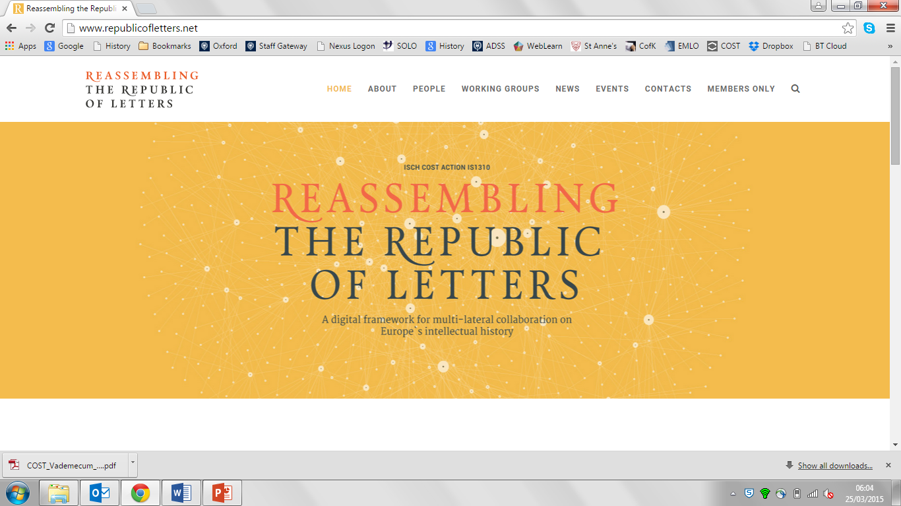
Howard Hotson (Oxford)
Collaborative systems design
CERL Annual Seminar, SUB Göttingen, 9 October 2019
Notes:
Which brings us to the second main piece of news: Cultures of Knowledge
Since Prague we negotiated a third grant application with the Mellon Foundation
Submitted it in December -- And received word last week that our application was successful -- So we are in business for another two years – that is, until the end of March 2017
More importantly, we are now headed down the road of collaborative systems development as well:
Semi-automated metadata standardization: Eetu Mäkelä, another STSM recipient as post-doc of Eero Hyvönen in Aalto
Visualization: Palladio, developed in Stanford in collaboration with the Density Design lab in Milan
Collaborative population: EMLO Phase II
Collaborative systems development: CofK Phase III
Collaborative systems design: COST Action
All leading in the direction of

Slide 2
Collaborative systems design
WEBSITE: www.republicofletters.net
Notes:
Which brings us to the second main piece of news: Cultures of Knowledge
Since Prague we negotiated a third grant application with the Mellon Foundation
Submitted it in December -- And received word last week that our application was successful -- So we are in business for another two years – that is, until the end of March 2017
More importantly, we are now headed down the road of collaborative systems development as well:
Semi-automated metadata standardization: Eetu Mäkelä, another STSM recipient as post-doc of Eero Hyvönen in Aalto
Visualization: Palladio, developed in Stanford in collaboration with the Density Design lab in Milan
Collaborative population: EMLO Phase II
Collaborative systems development: CofK Phase III
Collaborative systems design: COST Action
All leading in the direction of

Slide 3
Collaborative systems design
BOOK: Göttingen University Press, 2019
Notes:
Which brings us to the second main piece of news: Cultures of Knowledge
Since Prague we negotiated a third grant application with the Mellon Foundation
Submitted it in December -- And received word last week that our application was successful -- So we are in business for another two years – that is, until the end of March 2017
More importantly, we are now headed down the road of collaborative systems development as well:
Semi-automated metadata standardization: Eetu Mäkelä, another STSM recipient as post-doc of Eero Hyvönen in Aalto
Visualization: Palladio, developed in Stanford in collaboration with the Density Design lab in Milan
Collaborative population: EMLO Phase II
Collaborative systems development: CofK Phase III
Collaborative systems design: COST Action
All leading in the direction of

Slide 4
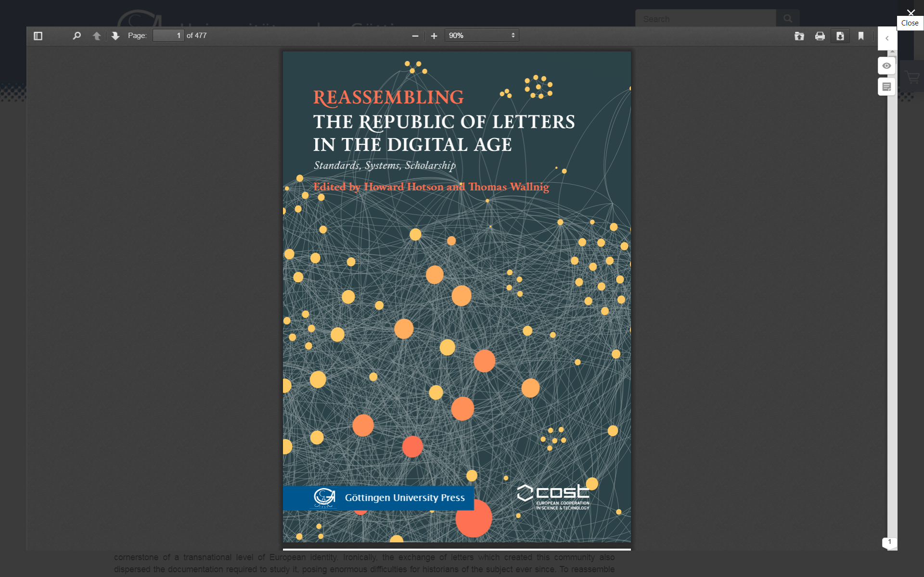
Collaborative systems design
BOOK: Göttingen University Press, 2019
DOI: doi.org/10.17875/gup2019-1146
Notes:
Which brings us to the second main piece of news: Cultures of Knowledge
Since Prague we negotiated a third grant application with the Mellon Foundation
Submitted it in December -- And received word last week that our application was successful -- So we are in business for another two years – that is, until the end of March 2017
More importantly, we are now headed down the road of collaborative systems development as well:
Semi-automated metadata standardization: Eetu Mäkelä, another STSM recipient as post-doc of Eero Hyvönen in Aalto
Visualization: Palladio, developed in Stanford in collaboration with the Density Design lab in Milan
Collaborative population: EMLO Phase II
Collaborative systems development: CofK Phase III
Collaborative systems design: COST Action
All leading in the direction of

Slide 5
Collaborative systems design
Objectives
Structure
Tools
Systems
Prospects
Notes:
Which brings us to the second main piece of news: Cultures of Knowledge
Since Prague we negotiated a third grant application with the Mellon Foundation
Submitted it in December -- And received word last week that our application was successful -- So we are in business for another two years – that is, until the end of March 2017
More importantly, we are now headed down the road of collaborative systems development as well:
Semi-automated metadata standardization: Eetu Mäkelä, another STSM recipient as post-doc of Eero Hyvönen in Aalto
Visualization: Palladio, developed in Stanford in collaboration with the Density Design lab in Milan
Collaborative population: EMLO Phase II
Collaborative systems development: CofK Phase III
Collaborative systems design: COST Action
All leading in the direction of

Slide 6
Collaborative systems design
Objectives
Structure
Tools
Systems
Prospects
Notes:
Which brings us to the second main piece of news: Cultures of Knowledge
Since Prague we negotiated a third grant application with the Mellon Foundation
Submitted it in December -- And received word last week that our application was successful -- So we are in business for another two years – that is, until the end of March 2017
More importantly, we are now headed down the road of collaborative systems development as well:
Semi-automated metadata standardization: Eetu Mäkelä, another STSM recipient as post-doc of Eero Hyvönen in Aalto
Visualization: Palladio, developed in Stanford in collaboration with the Density Design lab in Milan
Collaborative population: EMLO Phase II
Collaborative systems development: CofK Phase III
Collaborative systems design: COST Action
All leading in the direction of

Slide 7
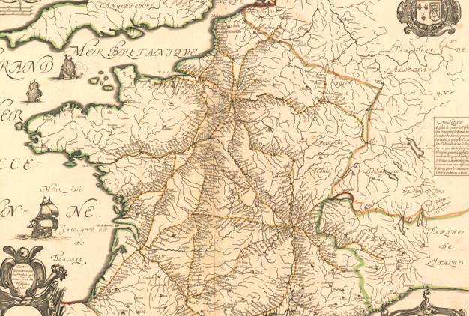
Between 1500 and 1800, the evolution of postal communication allowed ordinary men and women to scatter letters across and beyond Europe.
1. Objectives
Notes:
Between 1500 and 1800, the evolution of postal communication allowed ordinary men and women to scatter letters across and beyond Europe.

Slide 8
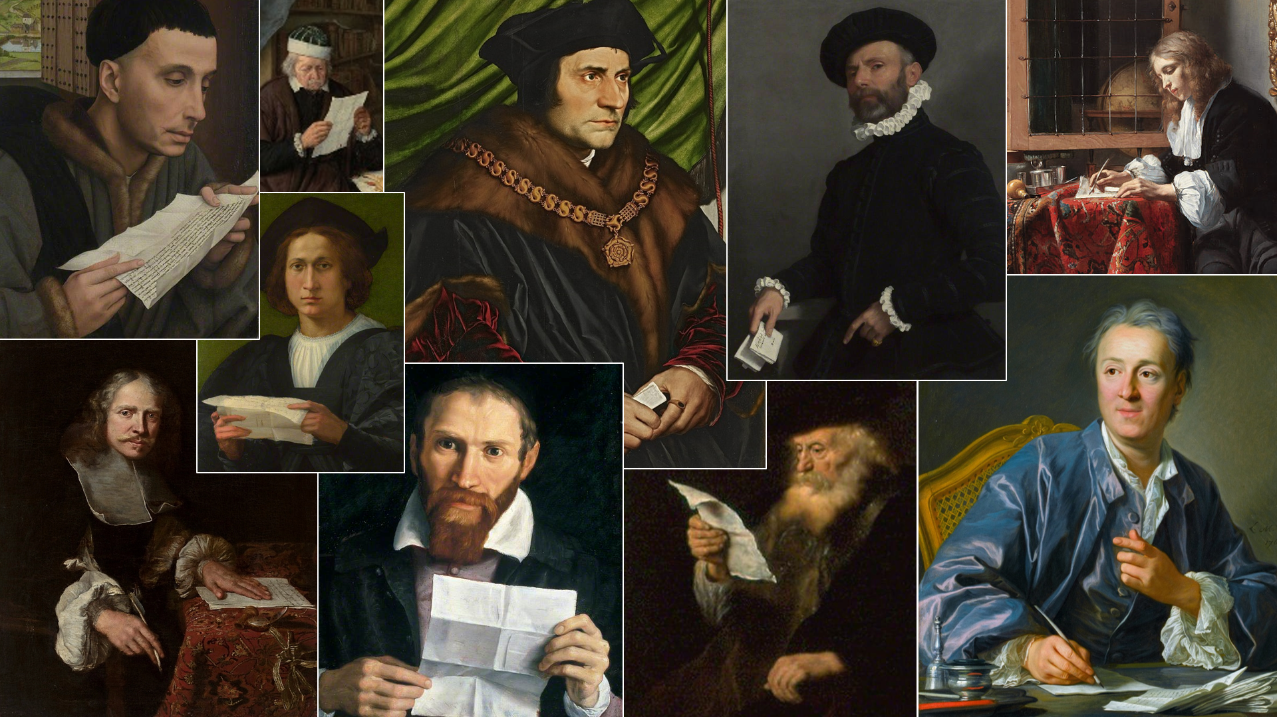
This exchange helped knit together what contemporaries called the respublica litteraria, a knowledge-based civil society, crucial to that era’s intellectual breakthroughs.
1. Objectives
Notes:
This exchange helped knit together what contemporaries called the respublica litteraria, a knowledge-based civil society, crucial to that era’s intellectual breakthroughs, and formative of many modern European values and institutions.

Slide 9
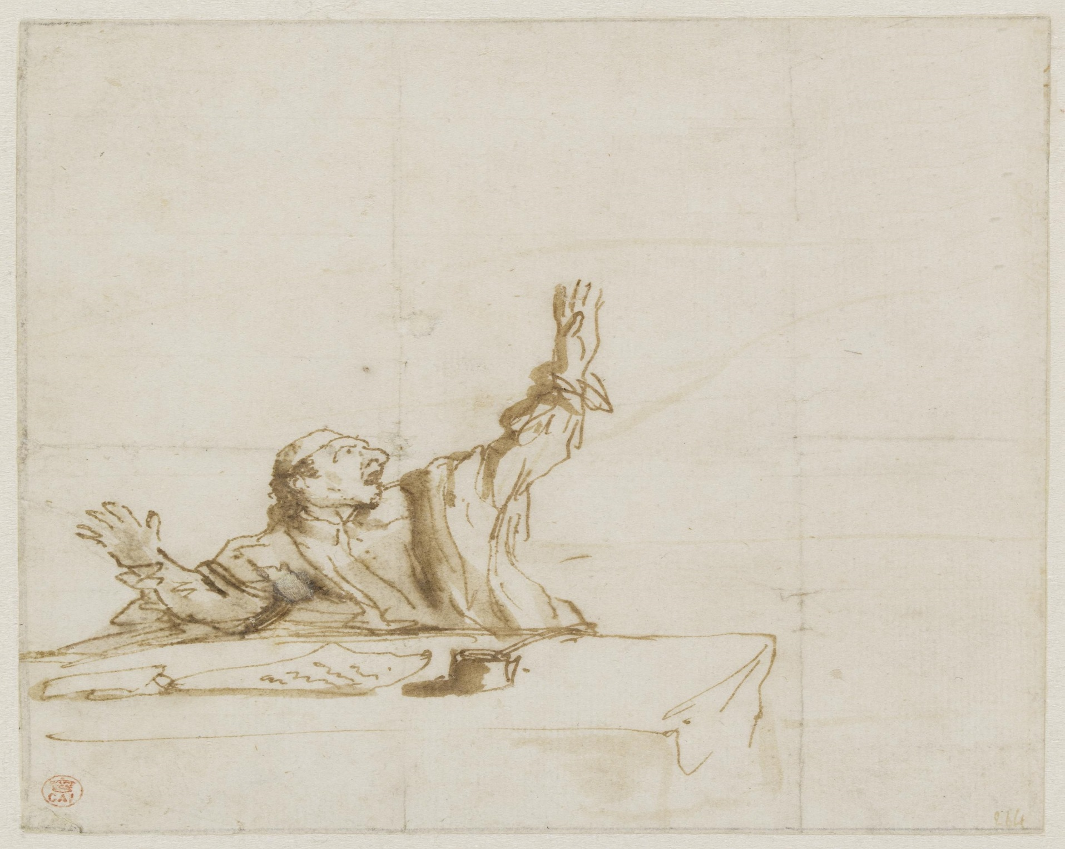
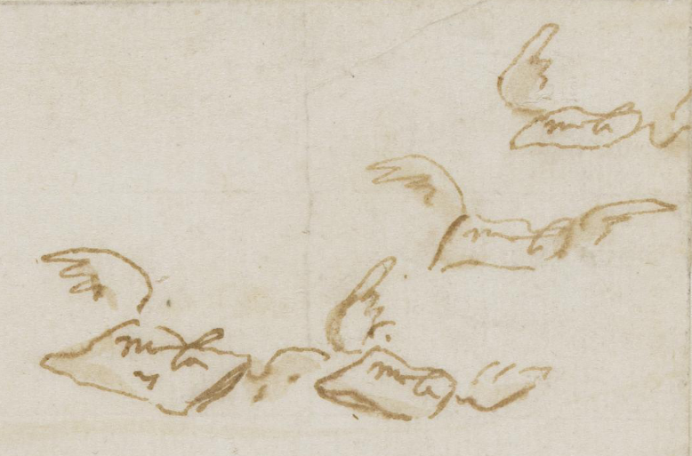
Letters only achieve their communicative function by being dispersed. The exchange of letters which created this community also scattered the documentation required to study it.
1. Objectives
Notes:
Yet the exchange of letters which created this community also dispersed the documentation required to study it, posing enormous difficulties for historians ever since.

Slide 10
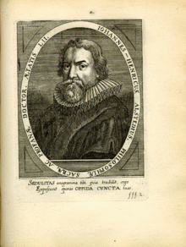
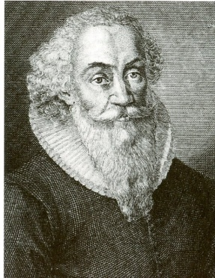
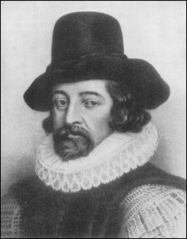
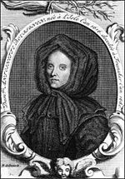

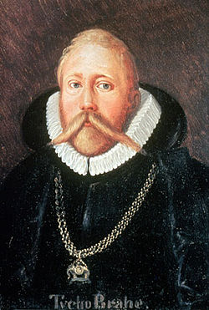
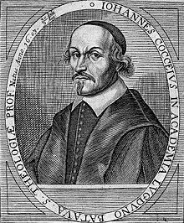

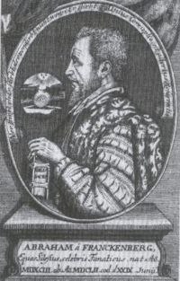
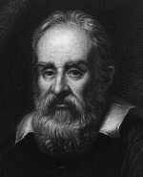
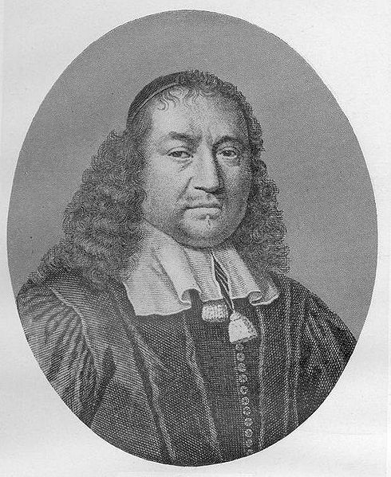
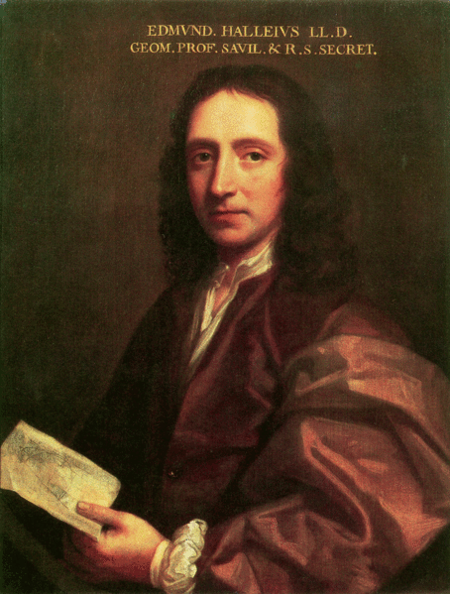
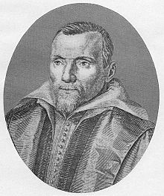
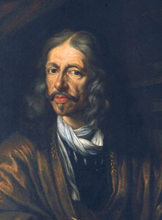
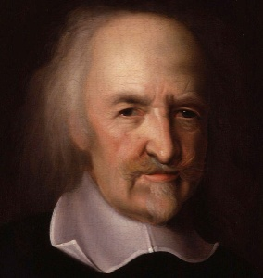
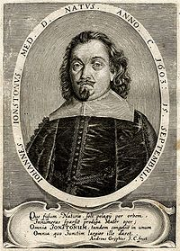
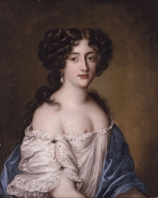
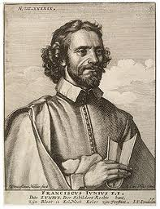
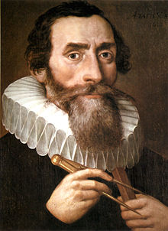
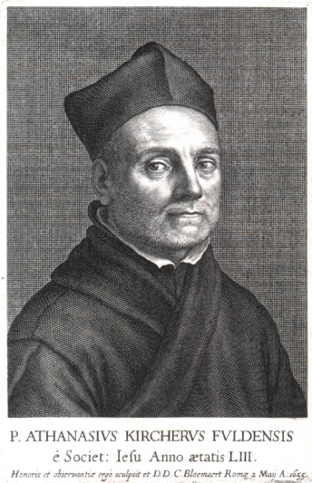
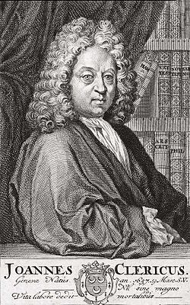
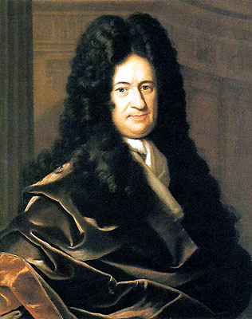
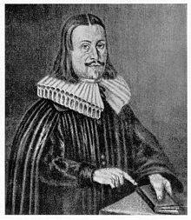
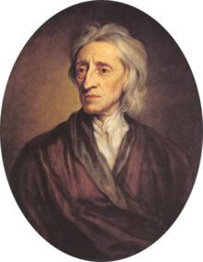
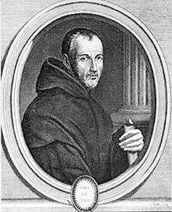

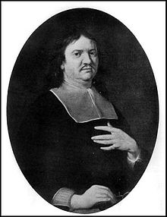
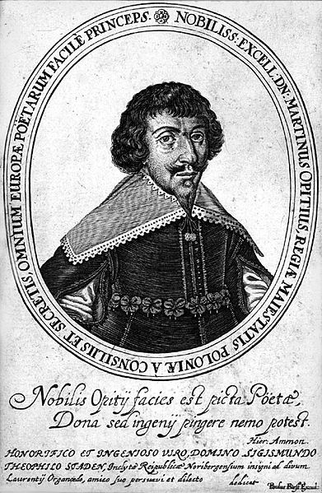
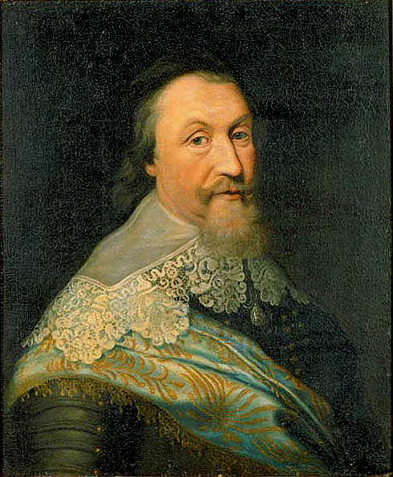
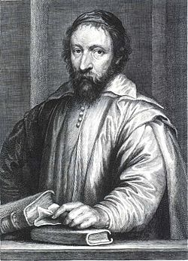
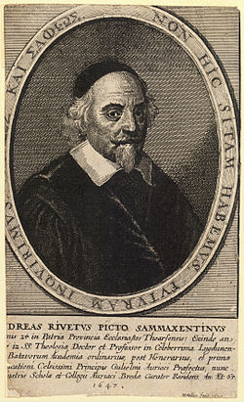
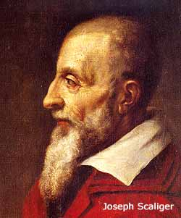
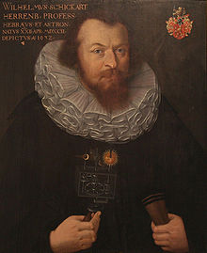
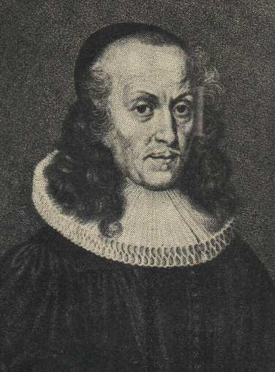
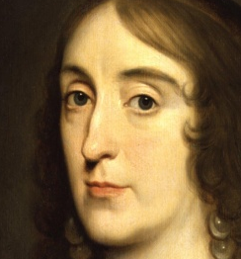
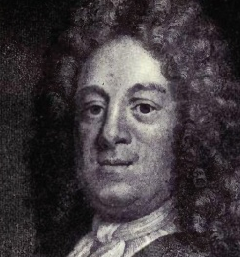
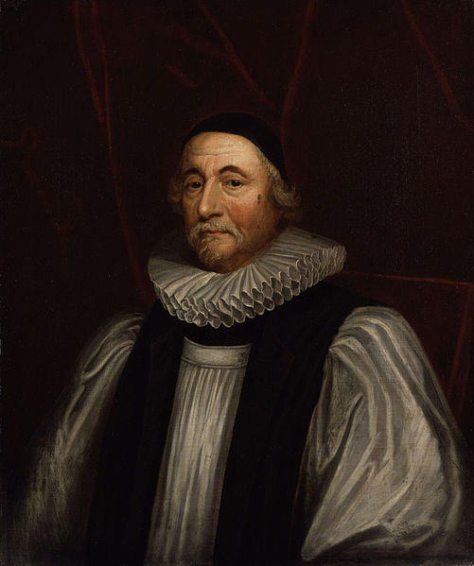
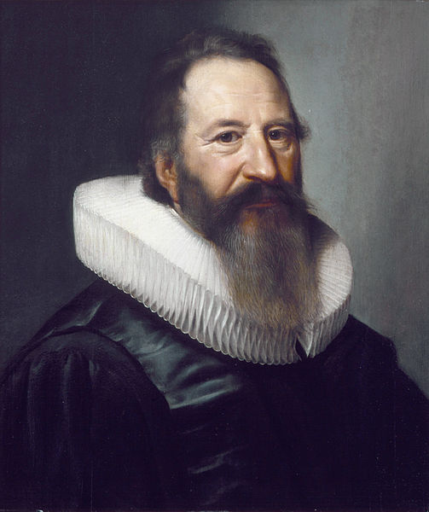
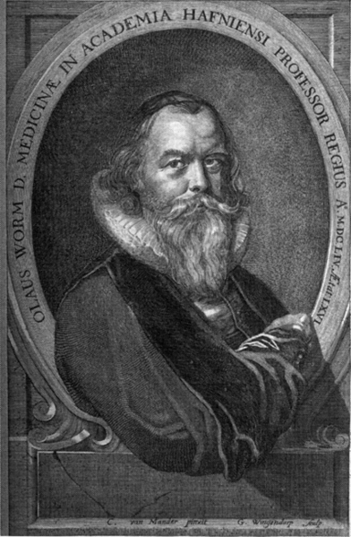
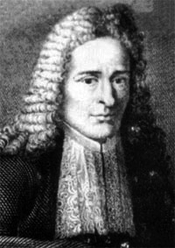
To reassemble the pieces of this puzzle and to realize the full potential of this new technology, we now need shared standards and infrastructure.
1. Objectives
Notes:
To reassemble the pieces of this puzzle and realize the full potential of this new technology, we now need shared standards and infrastructure.

Slide 11
For envisaging such infrastructure, COST is ideally adapted.
COST is an intergovernmental framework for European COoperation in Science and Technology devoted to providing the networking support needed to ensure that nationally funded initiatives add up to greater wholes.
COST does not fund research, systems development, or resource creation: instead it funds networking activities including
Conferences
Training Schools
Workshops
Short-Term Scientific Meeting
Dissemination Activities
1. Objectives
Notes:
For this purpose, COST funding is ideally adapted.
COST is an intergovernmental framework for European COoperation in Science and Technology devoted to providing the networking support needed to ensure that nationally funded initiatives add up to greater wholes.
COST-funded networking activities include
Conferences
Training Schools
Workshops
Short-Term Scientific Meeting
Dissemination Activities

Slide 12
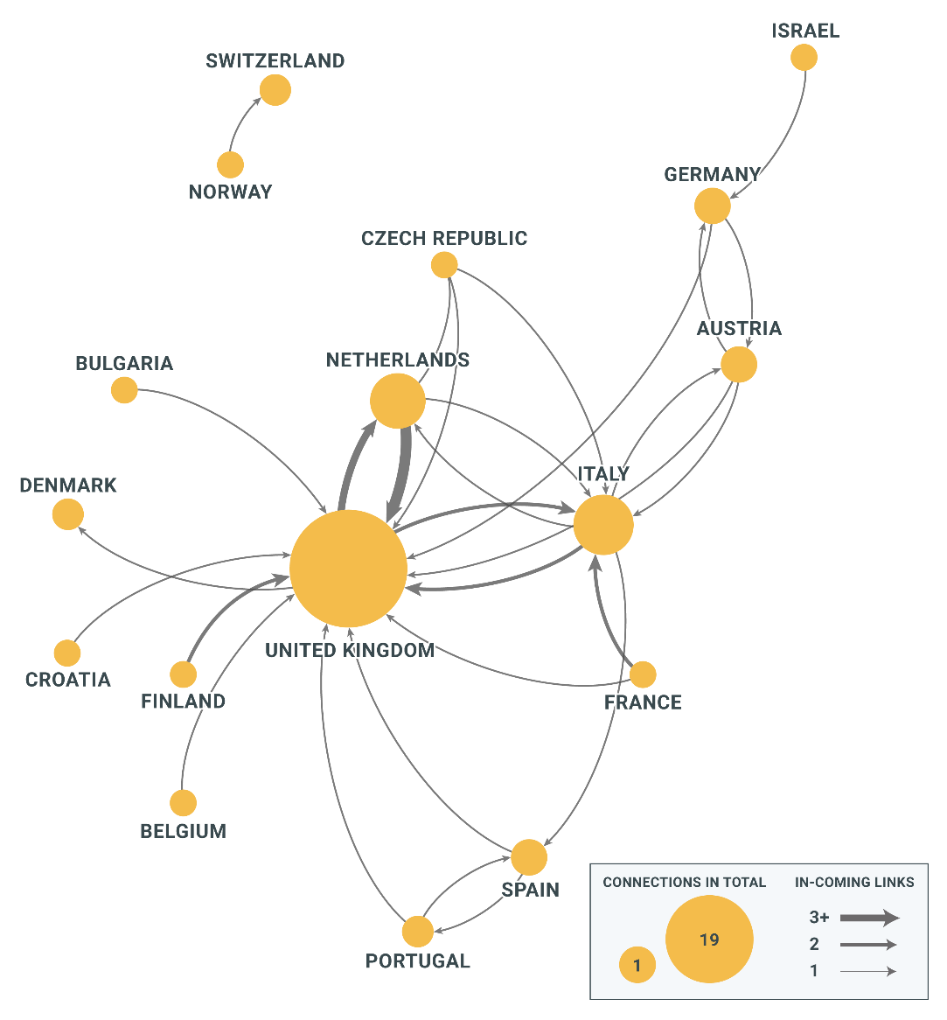
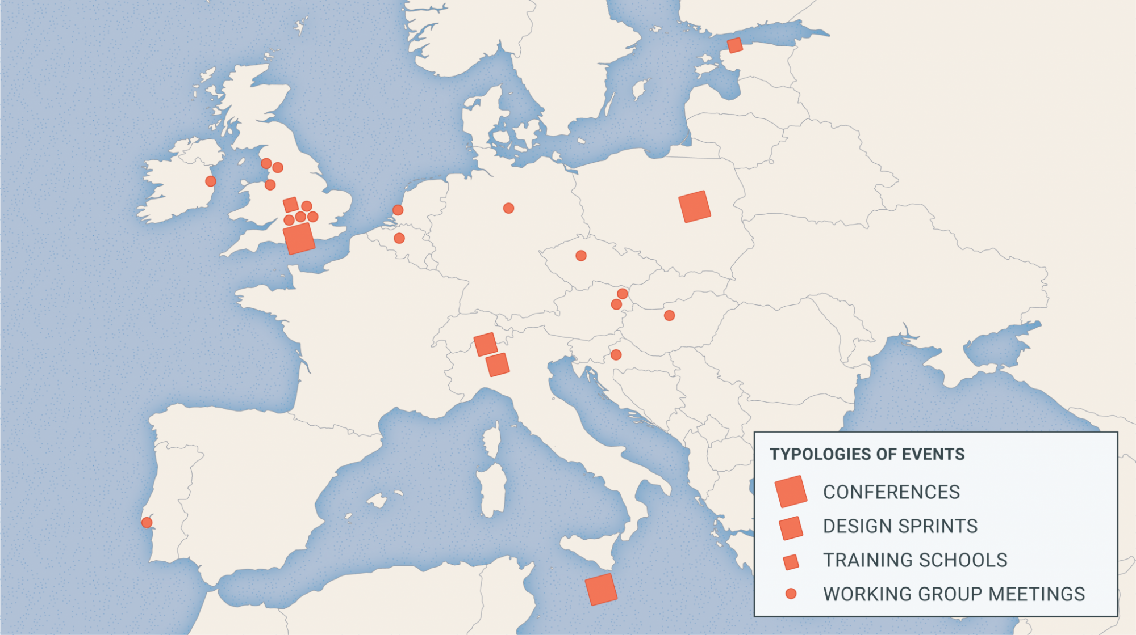
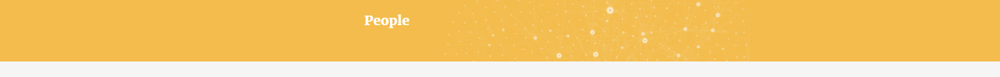
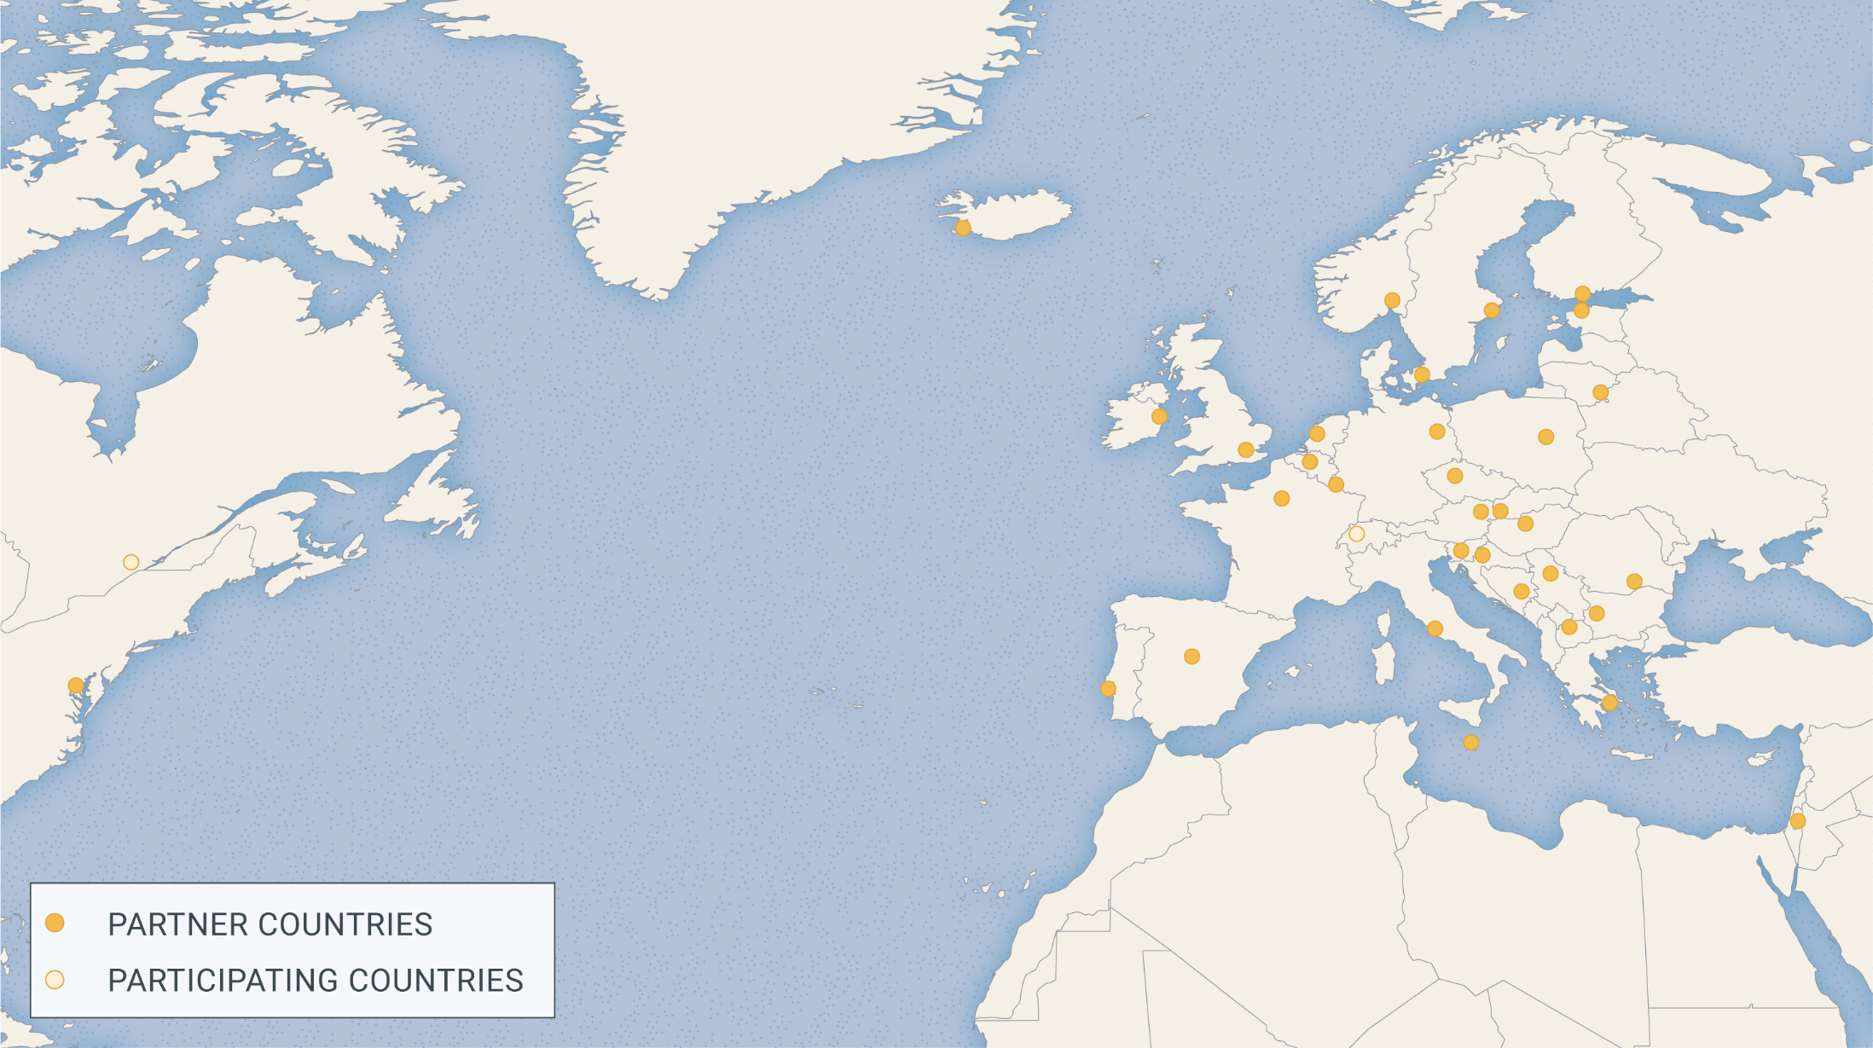
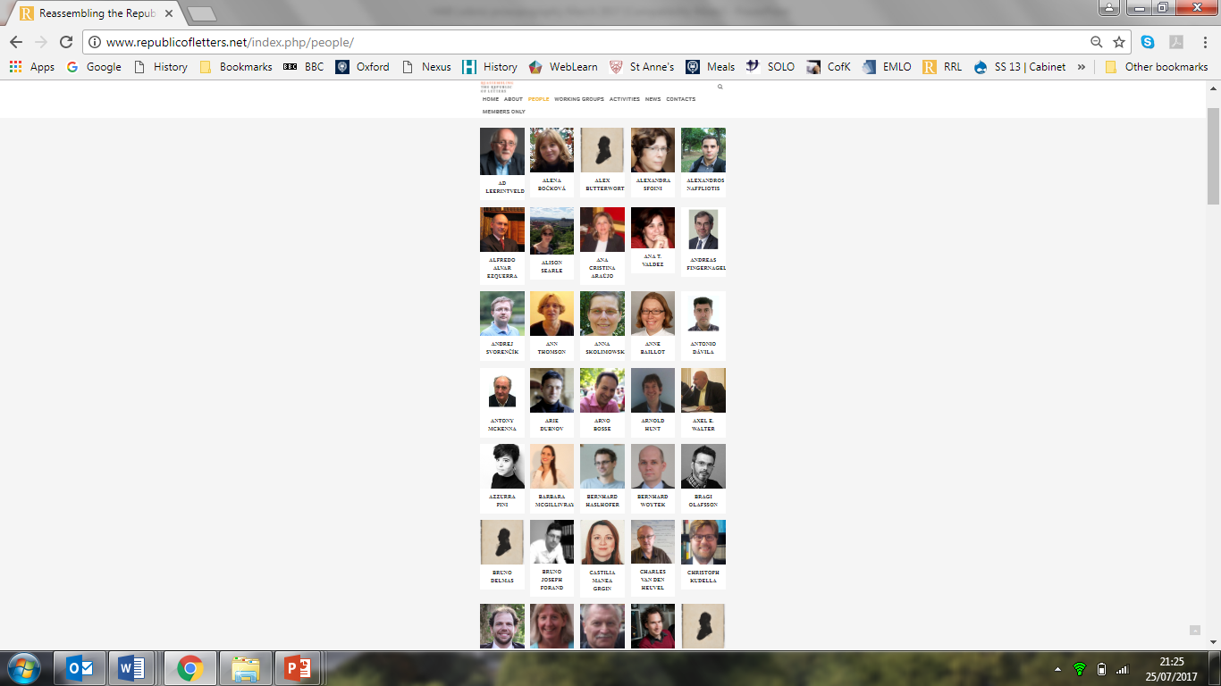
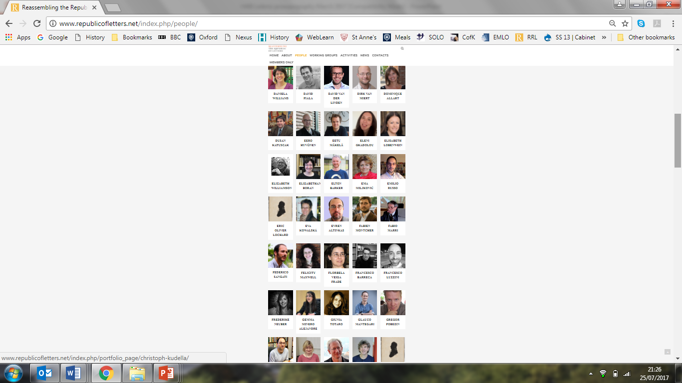
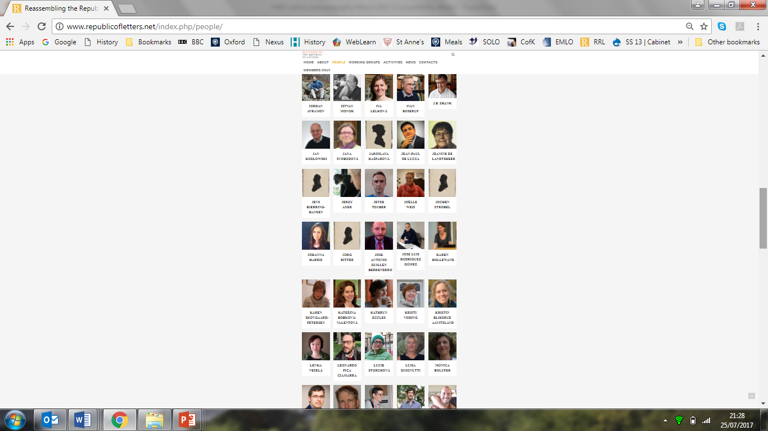


This Action was therefore continental in scope: it involved 33 countries, expanded to include nearly 200 people, who networked in 22 events and c. 50 short-term exchanges.
1. Objectives
Notes:
This Action is therefore continental in scope: it currently involves 30 of 35 COST countries and is expanding to include International Partner Countries as well.
Since November, Greece, Luxembourg and Slovakia have joined
Cyprus, Latvia, Malta, Switzerland, Turkey

Slide 13
Collaborative systems design
Objectives
Structure
Tools
Systems
Prospects
Notes:
Which brings us to the second main piece of news: Cultures of Knowledge
Since Prague we negotiated a third grant application with the Mellon Foundation
Submitted it in December -- And received word last week that our application was successful -- So we are in business for another two years – that is, until the end of March 2017
More importantly, we are now headed down the road of collaborative systems development as well:
Semi-automated metadata standardization: Eetu Mäkelä, another STSM recipient as post-doc of Eero Hyvönen in Aalto
Visualization: Palladio, developed in Stanford in collaboration with the Density Design lab in Milan
Collaborative population: EMLO Phase II
Collaborative systems development: CofK Phase III
Collaborative systems design: COST Action
All leading in the direction of

Slide 14
Collaborative systems design
Objectives
Structure
Tools
Systems
Prospects
Notes:
Which brings us to the second main piece of news: Cultures of Knowledge
Since Prague we negotiated a third grant application with the Mellon Foundation
Submitted it in December -- And received word last week that our application was successful -- So we are in business for another two years – that is, until the end of March 2017
More importantly, we are now headed down the road of collaborative systems development as well:
Semi-automated metadata standardization: Eetu Mäkelä, another STSM recipient as post-doc of Eero Hyvönen in Aalto
Visualization: Palladio, developed in Stanford in collaboration with the Density Design lab in Milan
Collaborative population: EMLO Phase II
Collaborative systems development: CofK Phase III
Collaborative systems design: COST Action
All leading in the direction of

Slide 15

At the centre of this Action were six Working Groups, the scope of which is determined by the basic features of letters themselves.
Letters are written documents sent by a one or more person(s) at a specific time and place to one or more other person(s) in another place.
WG1 ∙ Space and Time
WG2 ∙ People and Networks
WG3 ∙ Texts and Topics
WG4 ∙ Documents and Collections
WG5 ∙ Data Exchange and Strategic Planning
WG6 ∙ Visualization and Communication
2. Structure
Notes:
At the centre of this Action are six Working Groups, the scope of which is determined by the basic features of letters themselves.
Letters are written documents sent by a one or more person(s) at a specific time and place to one or more other person(s) in another place.

Slide 16
At the centre of this Action were six Working Groups, the scope of which is determined by the basic features of letters themselves.
Letters are written documents sent by a one or more person(s) at a specific time and place to one or more other person(s) in another place.
WG1 ∙ Space and Time
WG2 ∙ People and Networks
WG3 ∙ Texts and Topics
WG4 ∙ Documents and Collections
WG5 ∙ Data Exchange and Strategic Planning
WG6 ∙ Visualization and Communication
2. Structure
Notes:
At the centre of this Action are six Working Groups, the scope of which is determined by the basic features of letters themselves.
Letters are written documents sent by a one or more person(s) at a specific time and place to one or more other person(s) in another place.

Slide 17
At the centre of this Action are six Working Groups, the scope of which is determined by the basic features of letters themselves.
Letters are written documents sent by a one or more person(s) at a specific time and place to one or more other person(s) in another place.
WG1 ∙ Space and Time
WG2 ∙ People and Networks
WG3 ∙ Texts and Topics
WG4 ∙ Documents and Collections
WG5 ∙ Data Exchange and Strategic Planning
WG6 ∙ Visualization and Communication
2. Structure
Notes:
At the centre of this Action are six Working Groups, the scope of which is determined by the basic features of letters themselves.
Letters are written documents sent by a one or more person(s) at a specific time and place to one or more other person(s) in another place.

Slide 18
Howard Hotson and Thomas Wallnig, eds.,
Reassembling the Republic of Letters in the Digital Age: Standards, Systems, Scholarship,
Gottingen University Press, 2019.
WG1 ∙ Space and Time
WG2 ∙ People and Networks
WG3 ∙ Texts and Topics
WG4 ∙ Documents and Collections
WG5 ∙ Data Exchange and Strategic Planning
WG6 ∙ Visualization and Communication
Standards
2. Structure
Systems
Scholarship
Notes:
At the centre of this Action are six Working Groups, the scope of which is determined by the basic features of letters themselves.
Letters are written documents sent by a one or more person(s) at a specific time and place to one or more other person(s) in another place.

Slide 19
Howard Hotson and Thomas Wallnig, eds.,
Reassembling the Republic of Letters in the Digital Age: Standards, Systems, Scholarship,
Gottingen University Press, 2019.
Standards:
∙ Letters
∙ Space
∙ Time
∙ People
∙ Topics
∙ Events
∙ Letter Model
Systems:
∙ Assembling metadata
∙ Reconciling metadata
∙ Transcribing
and editing texts
∙ Modelling topics
∙ Exchanging data: systems
∙ Exchanging data: practices
Scholarship:
∙ Assembling
∙ Chronologies of
∙ Geographies of
∙ Prosopographies of
∙ Text-mining
∙ Networking
∙ Virtual Research Environment
the Republic of Letters
Notes:
At the centre of this Action are six Working Groups, the scope of which is determined by the basic features of letters themselves.
Letters are written documents sent by a one or more person(s) at a specific time and place to one or more other person(s) in another place.

Slide 20
Collaborative systems design
Objectives
Structure
Tools
Systems
Prospects
Notes:
Which brings us to the second main piece of news: Cultures of Knowledge
Since Prague we negotiated a third grant application with the Mellon Foundation
Submitted it in December -- And received word last week that our application was successful -- So we are in business for another two years – that is, until the end of March 2017
More importantly, we are now headed down the road of collaborative systems development as well:
Semi-automated metadata standardization: Eetu Mäkelä, another STSM recipient as post-doc of Eero Hyvönen in Aalto
Visualization: Palladio, developed in Stanford in collaboration with the Density Design lab in Milan
Collaborative population: EMLO Phase II
Collaborative systems development: CofK Phase III
Collaborative systems design: COST Action
All leading in the direction of

Slide 21
Collaborative systems design
Objectives
Structure
Tools
Systems
Prospects
Notes:
Which brings us to the second main piece of news: Cultures of Knowledge
Since Prague we negotiated a third grant application with the Mellon Foundation
Submitted it in December -- And received word last week that our application was successful -- So we are in business for another two years – that is, until the end of March 2017
More importantly, we are now headed down the road of collaborative systems development as well:
Semi-automated metadata standardization: Eetu Mäkelä, another STSM recipient as post-doc of Eero Hyvönen in Aalto
Visualization: Palladio, developed in Stanford in collaboration with the Density Design lab in Milan
Collaborative population: EMLO Phase II
Collaborative systems development: CofK Phase III
Collaborative systems design: COST Action
All leading in the direction of

Slide 22
At the centre of this Action are six Working Groups, the scope of which is determined by the basic features of letters themselves.
Letters are written documents sent by a one or more person(s) at a specific time and place to one or more other person(s) in another place.
WG1 ∙ Space and Time
WG2 ∙ People and Networks
WG3 ∙ Texts and Topics
WG4 ∙ Documents and Collections
WG5 ∙ Data Exchange and Strategic Planning
WG6 ∙ Visualization and Communication
3. Tools
Notes:
At the centre of this Action are six Working Groups, the scope of which is determined by the basic features of letters themselves.
Letters are written documents sent by a one or more person(s) at a specific time and place to one or more other person(s) in another place.

Slide 23

LETTER RECORD

Slide 24
Problem with dates: Multiple calendars.
Julian calendar: old style: year began on Lady Day (25 March)
new style: year began on 1 January
Gregorian calendar.
Eliminated ten days from 1582: the day following Thurs. 4 Oct. became Fri., 15 Oct.
Added on extra leap year per century: from 28 February 1700 onwards, the difference between Julian and Gregorian grew to eleven days; and after 28 February 1800 to twelve days.
Transition between calendars varies from place to place.
Most Catholic countries adopted Gregorian calendar in 1582
Until 1752, some Protestant countries (including England) continued to use the old style Julian calendar while others (including Scotland) used the new style Julian.
Russia continued to employ the old style Julian calendar until 1700, switching from new style Julian to Gregorian only in 1918.
Ecclesiastical calendars: dated with reference to the major feasts in the Christian year.
Roman and Latin calendars: dated from the ides or calends of the month.
Solution: tools to synchronize calendars automatically, with ref. to data on usage in different regions and times. Time varies with date and place.
PEOPLE
sender
recipient
DOCUMENTS
letter as sent
drafts, copies, etc.
LETTER RECORD
date of sending
date of receipt
TIME
place of sending
place of receipt
PLACE

Slide 25
Problem with dates: Multiple calendars.
Julian calendar: old style: year began on Lady Day (25 March)
new style: year began on 1 January
Gregorian calendar.
Eliminated ten days from 1582: the day following Thurs. 4 Oct. became Fri., 15 Oct.
Added on extra leap year per century: from 28 February 1700 onwards, the difference between Julian and Gregorian grew to eleven days; and after 28 February 1800 to twelve days.
Transition between calendars varies from place to place.
Most Catholic countries adopted Gregorian calendar in 1582
Until 1752, some Protestant countries (including England) continued to use the old style Julian calendar while others (including Scotland) used the new style Julian.
Russia continued to employ the old style Julian calendar until 1700, switching from new style Julian to Gregorian only in 1918.
Ecclesiastical calendars: dated with reference to the major feasts in the Christian year.
Roman and Latin calendars: dated from the ides or calends of the month.
Solution: tools to synchronize calendars automatically, with ref. to data on usage in different regions and times. Time varies with date and place.
PEOPLE
sender
recipient
DOCUMENTS
letter as sent
drafts, copies, etc.
LETTER RECORD
date of sending
date of receipt
TIME
place of sending
place of receipt
PLACE

Slide 26

Problems of nomenclature
A CITY known as Breslau (in German); Brassel (in Silesian German) Vratislav (in Czech); Vratislavia (in Latin); Boroszló (in Hungarian); ורוצלב‎ / Vrotsláv (in Hebrew); ברעסלוי / Bresloi (in Yiddish); etc.
IN A DUCHY also known as Breslau, etc.
IN A LARGER DUCHY known as Silesia (in Latin and English)
Śląsk (in Polish); Schlesien (in German);
Schläsing (in Silesian German);
Slezsko (in Czech); etc.
Problems of location
1469: passed from Poland into the Kingdom of Bohemia.
1490: the Kingdom of Bohemia, within the Holy Roman Empire.
1526: ruled by the Austrian Habsburgs, aside from
1618-1620: during the Bohemian Revolt
Saxon and Swedish occupations during the Thirty Years’ War
1742: the kingdom of Prussia (as part of the Holy Roman Empire)
1806: the Kingdom of Prussia (after the demise of the Holy Roman Empire)
PEOPLE
sender
recipient
DOCUMENTS
letter as sent
drafts, copies, etc.
Wrocław
LETTER RECORD
date of sending
date of receipt
TIME
place of sending
place of receipt
PLACE
place of sending
place of receipt
PLACE

Slide 27
Problems of nomenclature
A CITY known as Breslau (in German); Brassel (in Silesian German) Vratislav (in Czech); Vratislavia (in Latin); Boroszló (in Hungarian); ורוצלב‎ / Vrotsláv (in Hebrew); ברעסלוי / Bresloi (in Yiddish); etc.
IN A DUCHY also known as Breslau, etc.
IN A LARGER DUCHY known as Silesia (in Latin and English)
Śląsk (in Polish); Schlesien (in German);
Schläsing (in Silesian German);
Slezsko (in Czech); etc.
Problems of location
1469: passed from Poland into the Kingdom of Bohemia.
1490: the Kingdom of Bohemia, within the Holy Roman Empire.
1526: ruled by the Austrian Habsburgs, aside from
1618-1620: during the Bohemian Revolt
Saxon and Swedish occupations during the Thirty Years’ War
1742: the kingdom of Prussia (as part of the Holy Roman Empire)
1806: the Kingdom of Prussia (after the demise of the Holy Roman Empire)
PEOPLE
sender
recipient
DOCUMENTS
letter as sent
drafts, copies, etc.
Wrocław
LETTER RECORD
date of sending
date of receipt
TIME
place of sending
place of receipt
PLACE
place of sending
place of receipt
PLACE

Slide 28
Problems with people
Same name, different people.
E.g. the CERL Thesaurus includes 111 different people by the name of ‘Johannes Fabricius’ (the Latin translation of ‘John Smith’), all of them from the sixteenth and seventeenth centuries
Different names, same person.
E.g. the CERL Thesaurus lists 28 different spellings of ‘Hugo Grotius’, all taken from title pages of books in European libraries.
Letter writers far more numerous than book authors.
Modern authorities for disambiguating learned people derive mostly from national biographies and catalogues of printed books. But far more people wrote surviving letters from far more places than are found in those lists.
Disambiguation requires biographical data.
Disambiguation of relatively obscure people requires a resource capable of aggregating all the available scraps of biographical documentation.
PEOPLE
sender
recipient
CATEGORIES | SUB-CATEGORIES
Institutions | Universities
 | Academies and societies
 | Synods, congresses, etc.
 | Religious orders
 | State archives
Media | Personal papers
 | Books
 | Journals
Ego documents | (Auto)biographies
 | Diaries
 | Ephemerides
 | Travel diaries
 | Itineraries
 | Alba amicorum
 | Occasional poetry
PEOPLE
sender
recipient
DOCUMENTS
letter as sent
drafts, copies, etc.
LETTER RECORD
date of sending
date of receipt
TIME
place of sending
place of receipt
PLACE

Slide 29
Problems with people
Same name, different people.
E.g. the CERL Thesaurus includes 111 different people by the name of ‘Johannes Fabricius’ (the Latin translation of ‘John Smith’), all of them from the sixteenth and seventeenth centuries
Different names, same person.
E.g. the CERL Thesaurus lists 28 different spellings of ‘Hugo Grotius’, all taken from title pages of books in European libraries.
Letter writers far more numerous than book authors.
Modern authorities for disambiguating learned people derive mostly from national biographies and catalogues of printed books. But far more people wrote surviving letters from far more places than are found in those lists.
Disambiguation requires biographical data.
Disambiguation of relatively obscure people requires a resource capable of aggregating all the available scraps of biographical documentation.
PEOPLE
sender
recipient
PEOPLE
sender
recipient
DOCUMENTS
letter as sent
drafts, copies, etc.
LETTER RECORD
date of sending
date of receipt
TIME
place of sending
place of receipt
PLACE

Slide 30
DOCUMENTS
letter as sent
drafts, copies, etc.
DOCUMENTS
letter as sent drafts, copies, etc.
place of sending
place of receipt
PLACE
Problems with letters
Definition: What is a letter?
What is the minimal definition of a letter? Where to we draw the boundary between letters and not-letters?
Genres: What different kinds of letters are there?
What is the relationship between the categories employed in early modern epistolary manuals and modern genre definitions employed in literary history, archival science, and bibliography?
Texts: In what forms are letters preserved?
Can we develop a consensual typology for describing the various states in which a letter text can be preserved and documented (including missing letters inferred from other sources)?
Objects: The physical characteristics of letters.
Can we develop a controlled vocabulary for describing the physical characteristics of letters (e.g. folding, watermarks, etc.)?
PEOPLE
sender
recipient
DOCUMENTS
letter as sent
drafts, copies, etc.
DOCUMENTS
letter as sent
drafts, copies, etc.
DOCUMENTS
letter as sent
drafts, copies, etc.
DOCUMENTS
letter as sent
drafts, copies, etc.
place of sending
place of receipt
PLACE
place of sending
place of receipt
PLACE
LETTER RECORD
date of sending
date of receipt
TIME
place of sending
place of receipt
PLACE
place of sending
place of receipt
PLACE

Slide 31
Collaborative systems design
Objectives
Structure
Tools
Systems
Prospects
Notes:
Which brings us to the second main piece of news: Cultures of Knowledge
Since Prague we negotiated a third grant application with the Mellon Foundation
Submitted it in December -- And received word last week that our application was successful -- So we are in business for another two years – that is, until the end of March 2017
More importantly, we are now headed down the road of collaborative systems development as well:
Semi-automated metadata standardization: Eetu Mäkelä, another STSM recipient as post-doc of Eero Hyvönen in Aalto
Visualization: Palladio, developed in Stanford in collaboration with the Density Design lab in Milan
Collaborative population: EMLO Phase II
Collaborative systems development: CofK Phase III
Collaborative systems design: COST Action
All leading in the direction of

Slide 32
Collaborative systems design
Objectives
Structure
Tools
Systems
Prospects
Notes:
Which brings us to the second main piece of news: Cultures of Knowledge
Since Prague we negotiated a third grant application with the Mellon Foundation
Submitted it in December -- And received word last week that our application was successful -- So we are in business for another two years – that is, until the end of March 2017
More importantly, we are now headed down the road of collaborative systems development as well:
Semi-automated metadata standardization: Eetu Mäkelä, another STSM recipient as post-doc of Eero Hyvönen in Aalto
Visualization: Palladio, developed in Stanford in collaboration with the Density Design lab in Milan
Collaborative population: EMLO Phase II
Collaborative systems development: CofK Phase III
Collaborative systems design: COST Action
All leading in the direction of

Slide 33
At the centre of this Action are six Working Groups, the scope of which is determined by the basic features of letters themselves.
Letters are written documents sent by a one or more person(s) at a specific time and place to one or more other person(s) in another place.
WG1 ∙ Space and Time
WG2 ∙ People and Networks
WG3 ∙ Texts and Topics
WG4 ∙ Documents and Collections
WG5 ∙ Data Exchange and Strategic Planning
WG6 ∙ Visualization and Communication
4. Systems
Notes:
At the centre of this Action are six Working Groups, the scope of which is determined by the basic features of letters themselves.
Letters are written documents sent by a one or more person(s) at a specific time and place to one or more other person(s) in another place.

Slide 34
At the centre of this Action are six Working Groups, the scope of which is determined by the basic features of letters themselves.
Letters are written documents sent by a one or more person(s) at a specific time and place to one or more other person(s) in another place.
WG1 ∙ Space and Time
WG2 ∙ People and Networks
WG3 ∙ Texts and Topics
WG4 ∙ Documents and Collections
WG5 ∙ Data Exchange and Strategic Planning
WG6 ∙ Visualization and Communication
4. Systems
Notes:
At the centre of this Action are six Working Groups, the scope of which is determined by the basic features of letters themselves.
Letters are written documents sent by a one or more person(s) at a specific time and place to one or more other person(s) in another place.

Slide 35
Core and supplementary metadata gathered at nodes. Converted to LOD. Some enrichment.
Page images, full-text is sent to tools & service node
Contributing Project
Regional or National Node
Tool & Service Partners
Analysis, visualization, transcription,
OCR, etc.
Contributing Institution
Enhanced page images, full-text can return to data provider
Enrichments, comments and corrections can return to a node as overlay metadata
Export & Reuse
Regional or National Node
Contributing Project
Core metadata with data files as references is sent to a hub.
Contributing Institution
Reconciliation
Deduplication
Enrichment
Metadata Hub
Core metadata with data files as references sent to aggregation partners
Aggregation Partners (e.g. Google or Europeana)
Index
Search
Discovery
Comments
Annotations
Editorial Review
Indexing
Search
Discovery
Discovery by users

Slide 36
Core and supplementary metadata gathered at nodes. Converted to LOD. Some enrichment.
Contributing Project
Regional or National Node
Contributing Institution

Slide 37
Core and supplementary metadata gathered at nodes. Converted to LOD. Some enrichment.
Contributing Project
Regional or National Node
Contributing Institution
Core metadata with data files as references is sent to a hub.
Metadata Hub

Slide 38
Core and supplementary metadata gathered at nodes. Converted to LOD. Some enrichment.
Contributing Project
Regional or National Node
Contributing Institution
Core metadata with data files as references is sent to a hub.
Reconciliation
Deduplication
Enrichment
Metadata Hub
Comments
Annotations
Editorial Review
Indexing
Search
Discovery

Slide 39
Core and supplementary metadata gathered at nodes. Converted to LOD. Some enrichment.
Contributing Project
Regional or National Node
Contributing Institution
Enrichments, comments and corrections can return to a node as overlay metadata
Core metadata with data files as references is sent to a hub.
Reconciliation
Deduplication
Enrichment
Metadata Hub
Comments
Annotations
Editorial Review
Indexing
Search
Discovery

Slide 40
Core and supplementary metadata gathered at nodes. Converted to LOD. Some enrichment.
Contributing Project
Regional or National Node
Contributing Institution
Enrichments, comments and corrections can return to a node as overlay metadata
Regional or National Node
Contributing Project
Core metadata with data files as references is sent to a hub.
Contributing Institution
Reconciliation
Deduplication
Enrichment
Metadata Hub
Comments
Annotations
Editorial Review
Indexing
Search
Discovery

Slide 41
Core and supplementary metadata gathered at nodes. Converted to LOD. Some enrichment.
Contributing Project
Regional or National Node
Contributing Institution
Enrichments, comments and corrections can return to a node as overlay metadata
Regional or National Node
Contributing Project
Core metadata with data files as references is sent to a hub.
Contributing Institution
Reconciliation
Deduplication
Enrichment
Metadata Hub
Core metadata with data files as references sent to aggregation partners
Aggregation Partners (e.g. Google or Europeana)
Index
Search
Discovery
Comments
Annotations
Editorial Review
Indexing
Search
Discovery
Discovery by users

Slide 42
Core and supplementary metadata gathered at nodes. Converted to LOD. Some enrichment.
Page images, full-text is sent to tools & service node
Contributing Project
Regional or National Node
Tool & Service Partners
Analysis, visualization, transcription,
OCR, etc.
Contributing Institution
Enhanced page images, full-text can return to data provider
Enrichments, comments and corrections can return to a node as overlay metadata
Export & Reuse
Regional or National Node
Contributing Project
Core metadata with data files as references is sent to a hub.
Contributing Institution
Reconciliation
Deduplication
Enrichment
Metadata Hub
Core metadata with data files as references sent to aggregation partners
Aggregation Partners (e.g. Google or Europeana)
Index
Search
Discovery
Comments
Annotations
Editorial Review
Indexing
Search
Discovery
Discovery by users

Slide 43
Core and supplementary metadata gathered at nodes. Converted to LOD. Some enrichment.
Page images, full-text is sent to tools & service node
Contributing Project
Regional or National Node
Tool & Service Partners
Analysis, visualization, transcription,
OCR, etc.
Contributing Institution
Enhanced page images, full-text can return to data provider
Enrichments, comments and corrections can return to a node as overlay metadata
Export & Reuse
Core metadata with data files as references is sent to a hub.
Reconciliation
Deduplication
Enrichment
Metadata Hub
Core metadata with data files as references sent to aggregation partners
Aggregation Partners (e.g. Google or Europeana)
Index
Search
Discovery
Comments
Annotations
Editorial Review
Indexing
Search
Discovery
Discovery by users

Slide 44
Core and supplementary metadata gathered at nodes. Converted to LOD. Some enrichment.
Page images, full-text is sent to tools & service node
Contributing Project
Regional or National Node
Tool & Service Partners
Analysis, visualization, transcription,
OCR, etc.
Contributing Institution
Enhanced page images, full-text can return to data provider
Enrichments, comments and corrections can return to a node as overlay metadata
Export & Reuse
Regional or National Node
Contributing Project
Core metadata with data files as references is sent to a hub.
Contributing Institution
Reconciliation
Deduplication
Enrichment
Metadata Hub
Core metadata with data files as references sent to aggregation partners
Aggregation Partners (e.g. Google or Europeana)
Index
Search
Discovery
Comments
Annotations
Editorial Review
Indexing
Search
Discovery
Discovery by users

Slide 45
Collaborative systems design
Objectives
Structure
Tools
Systems
Prospects
Notes:
Which brings us to the second main piece of news: Cultures of Knowledge
Since Prague we negotiated a third grant application with the Mellon Foundation
Submitted it in December -- And received word last week that our application was successful -- So we are in business for another two years – that is, until the end of March 2017
More importantly, we are now headed down the road of collaborative systems development as well:
Semi-automated metadata standardization: Eetu Mäkelä, another STSM recipient as post-doc of Eero Hyvönen in Aalto
Visualization: Palladio, developed in Stanford in collaboration with the Density Design lab in Milan
Collaborative population: EMLO Phase II
Collaborative systems development: CofK Phase III
Collaborative systems design: COST Action
All leading in the direction of

Slide 46
Collaborative systems design
Objectives
Structure
Tools
Systems
Prospects
Notes:
Which brings us to the second main piece of news: Cultures of Knowledge
Since Prague we negotiated a third grant application with the Mellon Foundation
Submitted it in December -- And received word last week that our application was successful -- So we are in business for another two years – that is, until the end of March 2017
More importantly, we are now headed down the road of collaborative systems development as well:
Semi-automated metadata standardization: Eetu Mäkelä, another STSM recipient as post-doc of Eero Hyvönen in Aalto
Visualization: Palladio, developed in Stanford in collaboration with the Density Design lab in Milan
Collaborative population: EMLO Phase II
Collaborative systems development: CofK Phase III
Collaborative systems design: COST Action
All leading in the direction of

Slide 47
LETTER RECORD

Slide 48
PEOPLE
sender
recipient
DOCUMENTS
letter as sent
drafts, copies, etc.
LETTER RECORD
date of sending
date of receipt
TIME
place of sending
place of receipt
PLACE

Slide 49
PEOPLE
owner
subscriber
DOCUMENTS
album
ALBUM AMICORUM
(ego document)
date of entry
TIME
place of entry
PLACE

Slide 50
PEOPLE
rector
matriculant
DOCUMENTS
matriculation
register
MATRICULATION
(institutional records)
date of entry
TIME
place of institution
PLACE

Slide 51
PEOPLE
praeses, respondens, dedicatees, epigrams, printer, etc.
DOCUMENTS
Printed version
university records
DISPUTATION
(printed material)
date of disputation
date of publication
TIME
place of institution
PLACE

Slide 52
‘There is more to the republic of letters
. . . than letters’
CATEGORIES | SUB-CATEGORIES | DOCUMENTATION
Institutions
 | Universities
 |  | Matriculation records
 |  | disputations
 |  | Professorial prosopographies
 | Academies and societies
 |  | Professional associations
 |  | literary academies
 |  | scientific societies
 |  | salons
 | Synods, congresses, etc.
 | Religious orders
 | State archives
CATEGORIES | SUB-CATEGORIES | DOCUMENTATION
Media
 | Personal papers
 |  | correspondence
 |  | personal archives
 | Books
 |  | Production / printing
 |  | Distribution / market
 |  | Collection / libraries
 |  | marginalia
 |  | collected works
 | Journals
 |  | production
 |  | content
CATEGORIES | SUB-CATEGORIES
Institutions | Universities
 | Academies and societies
 | Synods, congresses, etc.
 | Religious orders
 | State archives
Media | Personal papers
 | Books
 | Journals
Ego documents | (Auto)biographies
 | Diaries
 | Ephemerides
 | Travel diaries
 | Itineraries
 | Alba amicorum
 | Occasional poetry
5. Prospects
Notes:
Between 1500 and 1800, the evolution of postal communication allowed ordinary men and women to scatter letters across and beyond Europe.

Slide 53
howard.hotson@history.ox.ac.uk
Action www.republicofletters.net
Book doi.org/10.17875/gup2019-1146

Slide 55
At the centre of this Action are six Working Groups, the scope of which is determined by the basic features of letters themselves.
Letters are written documents sent by a one or more person(s) at a specific time and place to one or more other person(s) in another place.
WG1 ∙ Space and Time
WG2 ∙ People and Networks
WG3 ∙ Texts and Topics
WG4 ∙ Documents and Collections
WG5 ∙ Data Exchange and Strategic Planning
WG6 ∙ Visualization and Communication
Notes:
At the centre of this Action are six Working Groups, the scope of which is determined by the basic features of letters themselves.
Letters are written documents sent by a one or more person(s) at a specific time and place to one or more other person(s) in another place.

Slide 56
At the centre of this Action are six Working Groups, the scope of which is determined by the basic features of letters themselves.
Letters are written documents sent by a one or more person(s) at a specific time and place to one or more other person(s) in another place.
WG1 ∙ Space and Time
WG2 ∙ People and Networks
WG3 ∙ Texts and Topics
WG4 ∙ Documents and Collections
WG5 ∙ Data Exchange and Strategic Planning
WG6 ∙ Visualization and Communication
Notes:
At the centre of this Action are six Working Groups, the scope of which is determined by the basic features of letters themselves.
Letters are written documents sent by a one or more person(s) at a specific time and place to one or more other person(s) in another place.

Slide 57
WG6 ∙ Visualization and Communication
Individual correspondences
Notes:
Between 1500 and 1800, the evolution of postal communication allowed ordinary men and women to scatter letters across and beyond Europe.

Slide 58

WG6 ∙ Visualization and Communication
Individual correspondences
Notes:
Between 1500 and 1800, the evolution of postal communication allowed ordinary men and women to scatter letters across and beyond Europe.

Slide 59

WG6 ∙ Visualization and Communication
Individual itineraries
Notes:
Between 1500 and 1800, the evolution of postal communication allowed ordinary men and women to scatter letters across and beyond Europe.

Slide 60

WG6 ∙ Visualization and Communication
Shifting patterns of academic mobility
Notes:
Between 1500 and 1800, the evolution of postal communication allowed ordinary men and women to scatter letters across and beyond Europe.

Slide 61
WG6 ∙ Visualization and Communication
Shifting patterns of academic mobility
Notes:
Between 1500 and 1800, the evolution of postal communication allowed ordinary men and women to scatter letters across and beyond Europe.

Slide 62


WG6 ∙ Visualization and Communication
Postal networks
Notes:
Between 1500 and 1800, the evolution of postal communication allowed ordinary men and women to scatter letters across and beyond Europe.

Slide 63



WG6 ∙ Visualization and Communication
Text mining
Notes:
Between 1500 and 1800, the evolution of postal communication allowed ordinary men and women to scatter letters across and beyond Europe.

