Slide 1
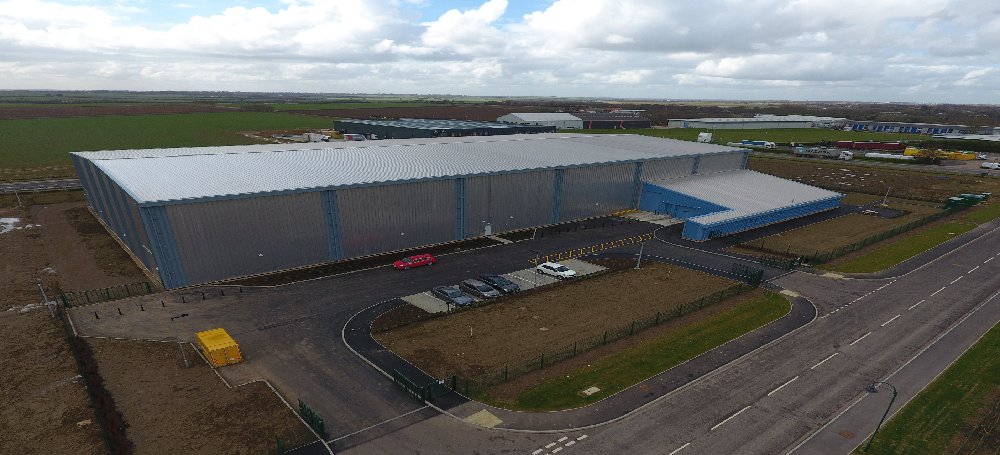
Moving to remote storage
Preparations for the actual move:
Cataloguing
Inventory
Barcoding
Notes:
As Michael has said Cambridge University Library opened its store in 2018 and it has now been open about 18 months. Although Oxford and Cambridge are surprisingly similar institutions the projects did have some differences and these were mostly in the areas of planning, preparation and processing. Today I will talk to you briefly about Cataloguing, Inventory and barcoding highlighting some things that went well and some things that were more challenging.

Slide 2
Things to consider:
Throughput
Role purpose
Location
Quality of metadata
Conservation
Boxes
Temporary storage
Advice
Understand the risks
Notes:
So, from our experience in Cambridge here are nine areas of consideration and I’ll take you through each in more detail.

Slide 3
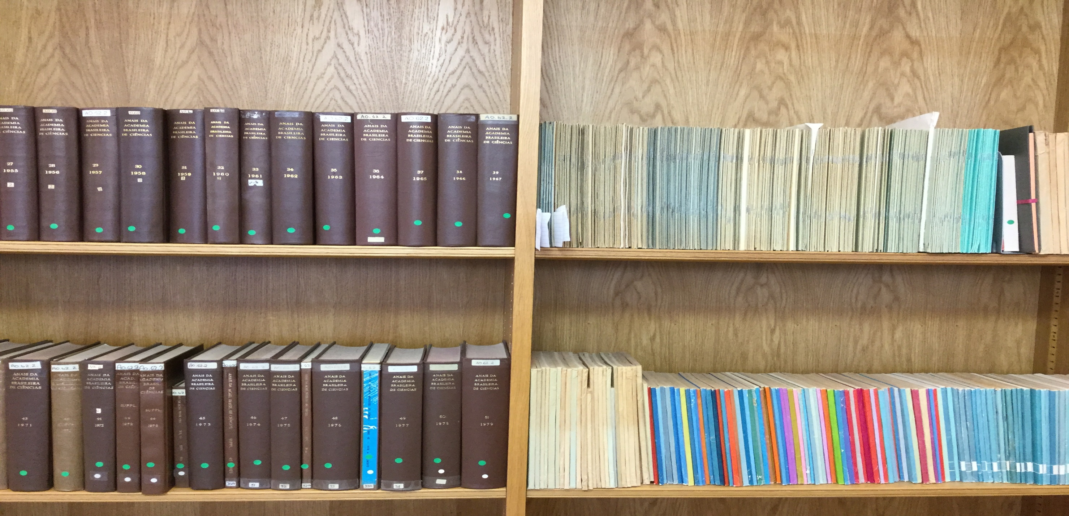
Throughput: Desired or Necessary?
Desired?
Target?
Deadline?
Unit of measure?
Time and motion
Notes:
At Cambridge our throughput was dictated by a builder set target, and I’ll talk about that a bit later in more detail but it is important to understand what dictates your throughput.
It may be dictated by a target or deadline imposed by a third party, it might be strictly limited by how much funding you have or it might simply be desired but you need to know what it is, how to work it out, and hope to implement it. It is also good to understand what the implications are if you are not able to sustain your through put at the desired levels, are there penalty clauses, or will the project simply take longer?
At Cambridge the preparation of material was not going as planned and I was asked to make a strategic analysis of the workflows to ascertain how to get them back on track. Our store wasn’t open at this point but we were preparing material in advance for when it did open. Although I have a background in book processing for me the only way to work out how long it takes to do the necessary processing is to break it down into phases and actually time staff doing them, you can then add the times together and produce a unit time and multiply this by the number of items you hope to, or must process in a given time and it will tell you how many staff members you will need to complete the task. It sounds simple but is an important part of achieving the correct through put to match your time or budget.
Another consideration is your unit of measure, is it physical items, linear metres or tonnes of books? Because books are not all the same size or weight you will find your chosen unit of measure can really make a difference t measuring productivity so do give it some thought.
And, as you can see from the photo, whether you process serials or monographs, bound or unbound items, the unit can be very variable so be cautious when measuring throughput or productivity. At Cambridge we recorded all three, weight, items and linear metres and generally speaking as long as one of these was high each week I was happy.

Slide 4
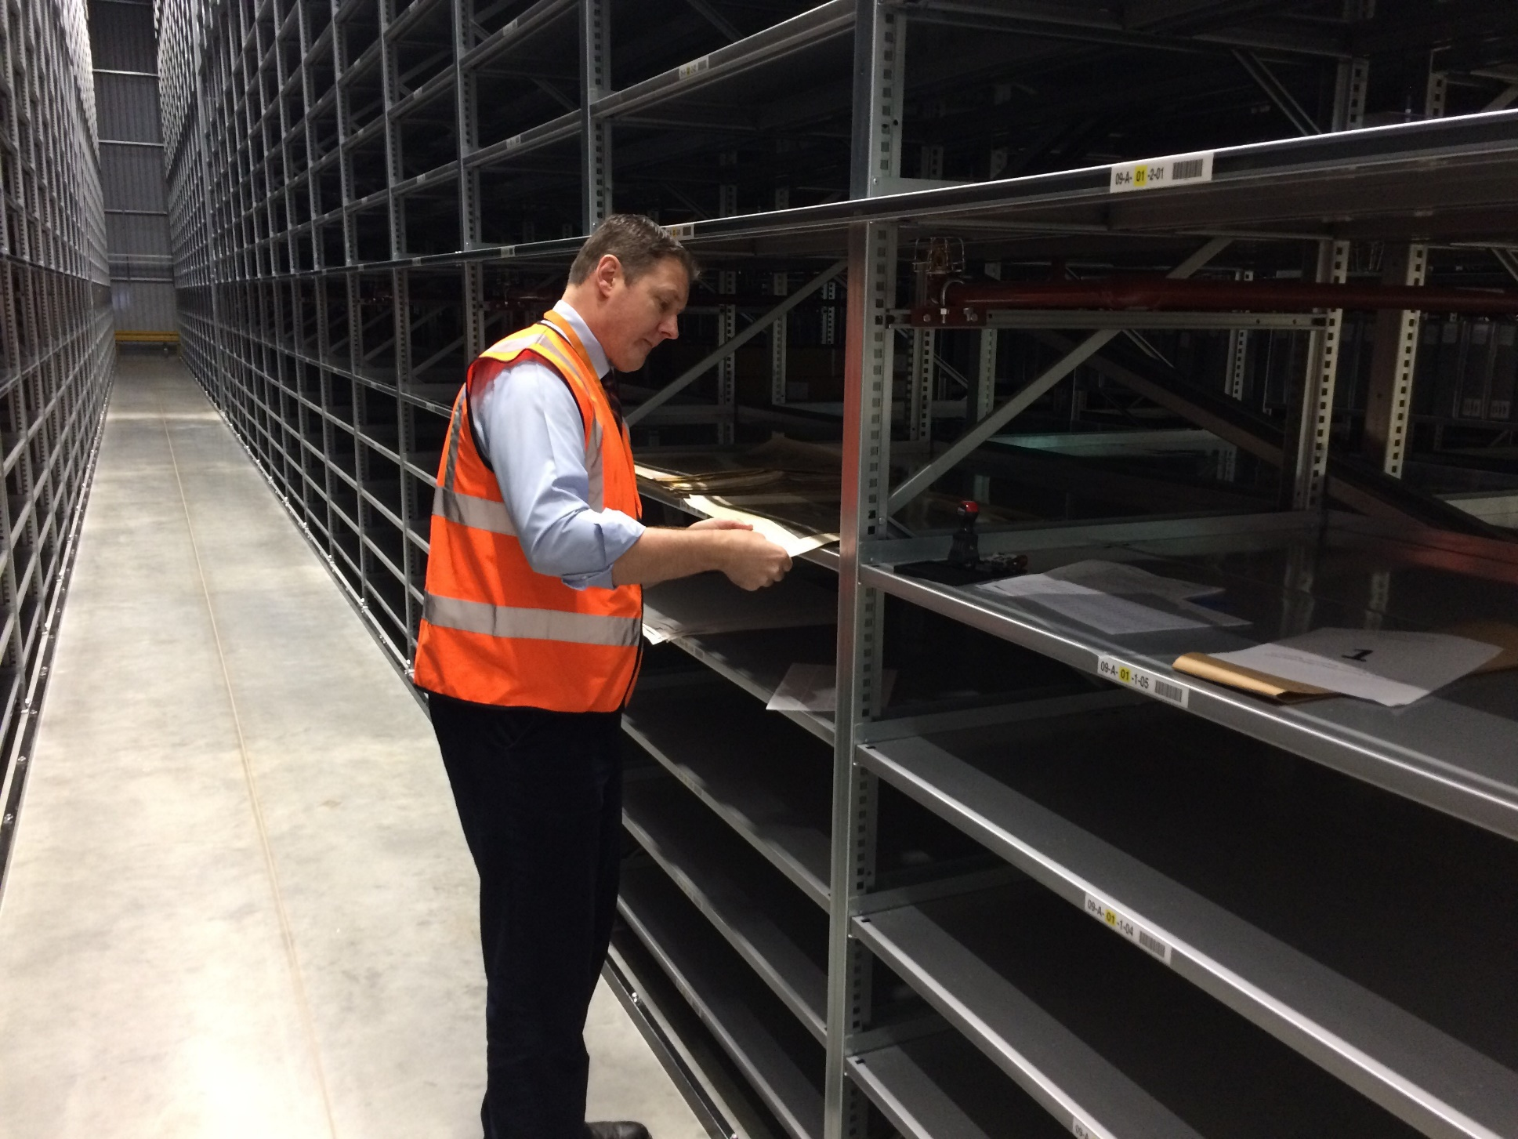
Role purpose?
Who does what?
Notes:
Unlike Oxford, at Cambridge we were running several projects together, so we were deduping, cataloguing and barcoding all at the same time. My staff undertook all aspects of this with each item they handled which was challenging and might have been better done separately but by the time I joined the project this wasn’t an option.
In the photo shown I am at our LSF analysing a potential map refiling project of our Deutsche Grundkarte map and photo collection, we were able to utilise the space at the store to interfile this collection and put it into the plan chests at the store. We had been unable to do this at the main library for ten years because of lack of space.

Slide 5
Location
Notes:
At Cambridge we opted to repurpose a reading room to do our processing and had a team of 35 staff undertaking the work. It made sense to do this where the majority of the collections were but it’s possible it might make more sense to do it at your offsite store, either in a purpose built area or in a temporary structure, it may also depend on how long you think your ingest process will take.

Slide 6
Quality of metadata
Notes:
Another consideration is the quality of the metadata, and whether any compromises are necessary to achieve your goals. At Cambridge we used trusted data sources for monograph copy cataloguing, with no metadata checking or authority control, and for serials concentrated on item level description only upgrading the bibliographic record if absolutely necessary. This allowed us to have a larger team of less well qualified staff.

Slide 7
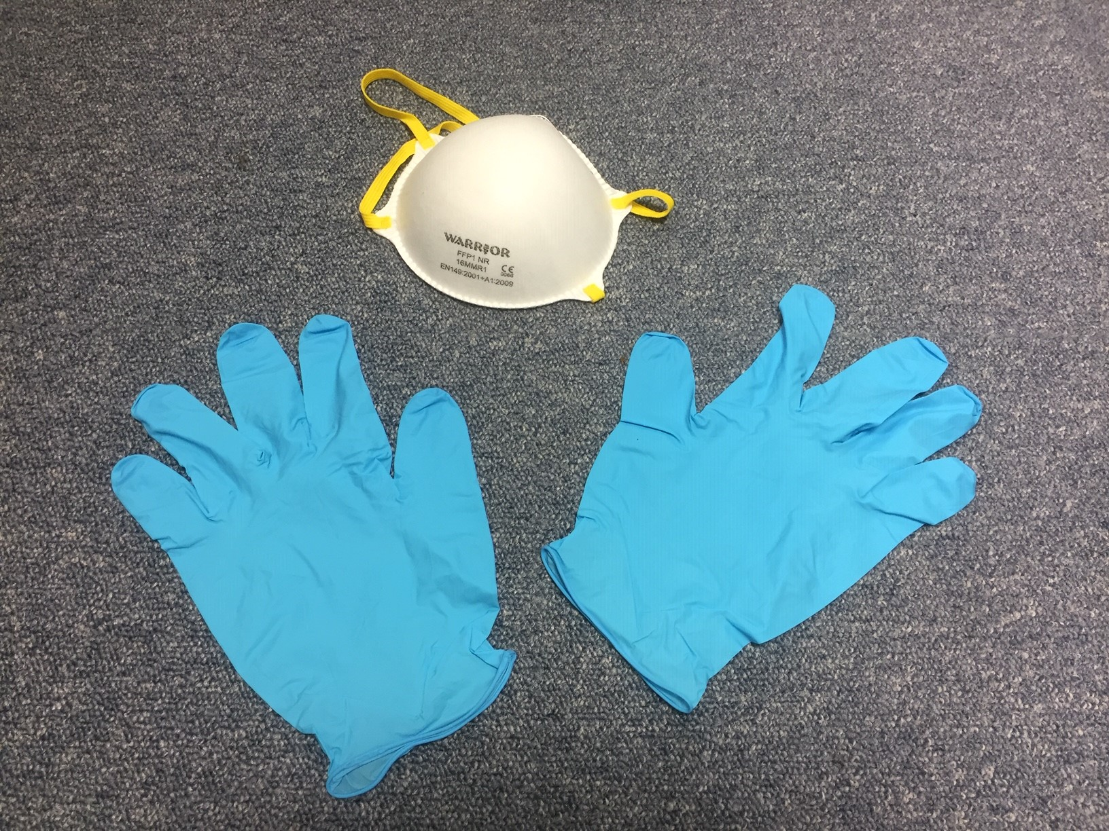
Conservation
Notes:
Conservation: or keeping bad things out of the new warehouse. We didn’t have dedicated conservation staff but had a quarantine room and were able to call on the Library’s conservation team urgently if we encountered anything we were unhappy with. This ranged from insects in the boxes to mould on the items but the rationale was to deal with problems before they enter the warehouse to keep the conditions there as perfect as possible.

Slide 8
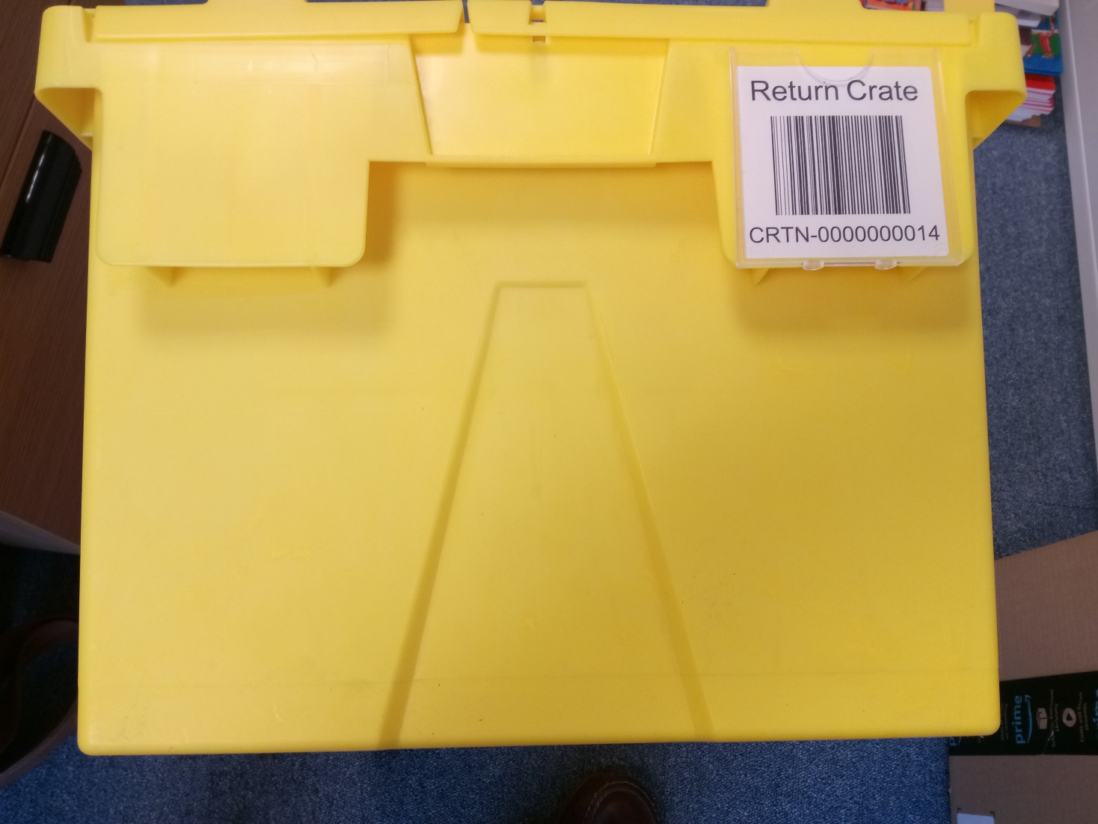
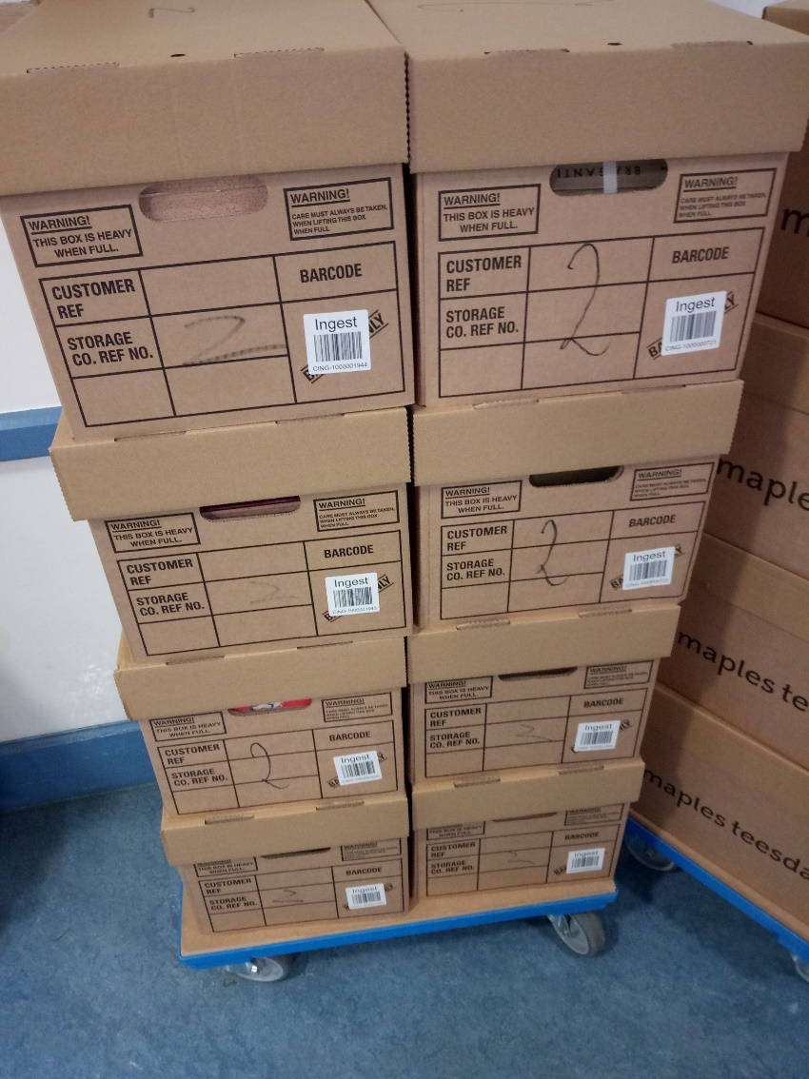
Boxes, a lot of boxes!
Notes:
Boxes (you will need a lot of these) and although we set out initially to use strong reusable plastic ones we had to move to disposable cardboard ones as we pre-staged material. Once our store opened we made sure we ingested the material from the plastic boxes first so that we could re-use these for ingest as soon as possible. We also used colour coded boxes for different roles so that incoming and outgoing material didn’t get mixed up.

Slide 9
Temporary Storage
Notes:
You may need some Temporary storage to give you space to work, it’s a good idea to rent it as close as possible to your new store.

Slide 10
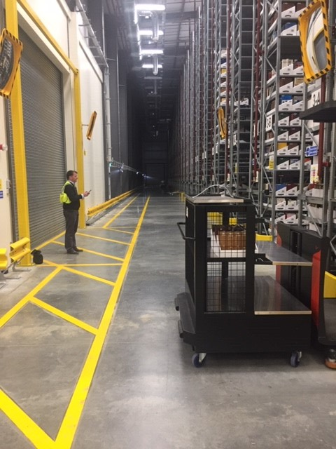
Advice
Notes:
Advice from others is incredibly helpful, find someone who has done it successfully before and visit their store as early as possible in your project. Take your senior managers and budget holders there and don’t be afraid to ask lots of questions. In a project like this, there are no silly questions.

Slide 11
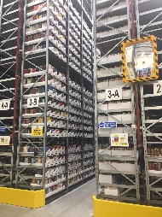
Understand risks
Notes:
A good risk register is essential – even for cataloguing, inventory and barcoding. Supposing you run out of barcodes…
Giving continuous thought to the various things that could go wrong on your project and how you might deal with, or mitigate those isn’t negative, it’s a constructive and positive approach. It’s also very satisfying as you pass stages of your project and can delete things from the register as they no longer pose a risk.

Slide 12
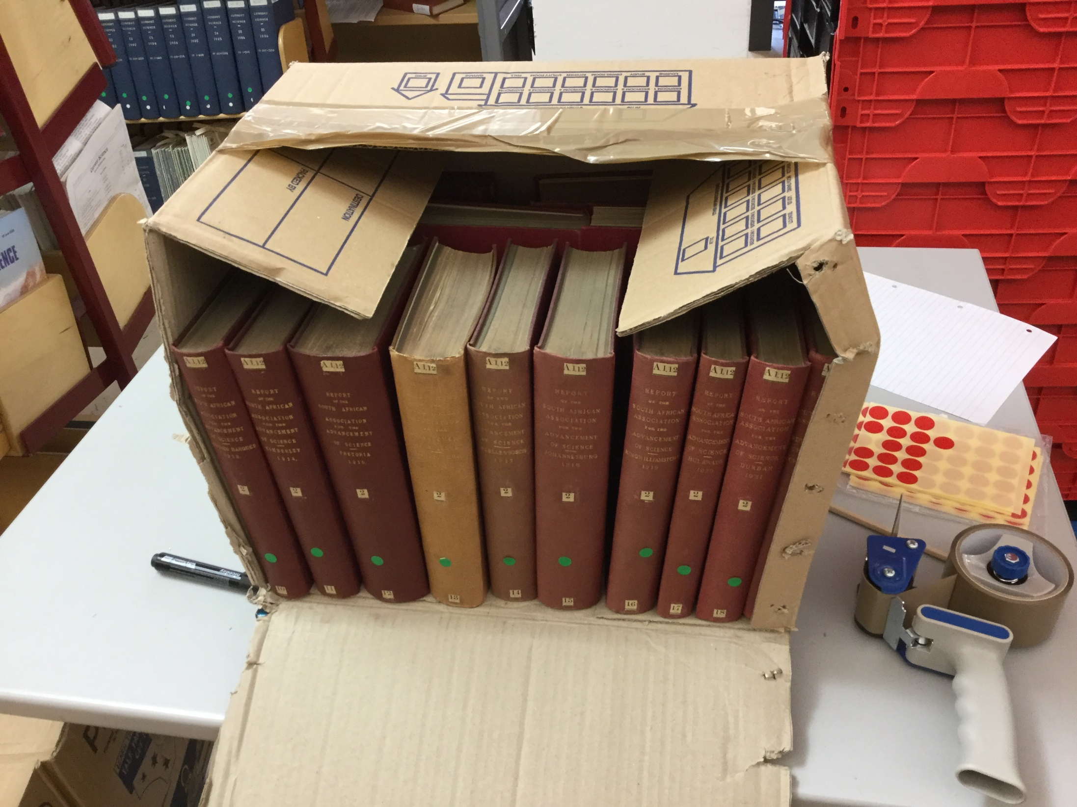
Things to avoid:
Surprises
Builder set targets
Bottlenecks
Product lead-in times
Unreasonable expectations or underestimation
Changing LMS during project
Metadata capitulation
Notes:
So now we’ve looked at things to consider, let’s have a quick look at some things to avoid…

Slide 13
Surprises
Notes:
Connection between LMS and WMS created by digital services but rejected material was responsibility of cataloguing team, initially our WMS was rejecting a 500 items a day which built up very quickly and was a rather unwelcome surprise, it took us a couple of weeks to work out what the problem was and stop it occurring. We had no way of predicting it but reacted very quickly to solve it.
Another surprise was that our store was finished slightly ahead of schedule and was handed over to the university’s estates people early. They in turn wanted to hand over to us early but we weren’t ready, the Warehouse Management System was still in test and we hadn’t recruited all the staff, we hadn’t planned for this but then who’d have thought it would be finished early?
In the slide the item shown was, ironically, the first title to be rejected by the warehouse management system and was about library expenditure!

Slide 14
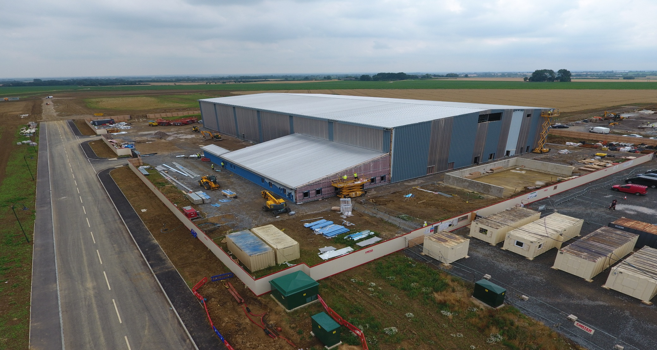
Builder set targets
Notes:
To test the environmental conditions in our chamber we had to ingest 12 tonnes of material each week over the first 18 months after handover. If we hadn’t done this the builder couldn’t be held responsible if the environment wasn’t right. But this was agreed to by the University’s estate management department who knew nothing about book processing and were surprised at our unhappiness at this rate. The Library only found out about this shortly before we took the building over!

Slide 15
Bottlenecks
Notes:
It is important to eliminate bottlenecks by dry running the process, and to be reactive with your staff and workflows if unexpected bottlenecks occur, so you can engineer them out. We moved small elements of the shelf to shelf workflow during our ingest to make it more efficient and transfer work to the LSF end which was the faster half and didn’t have any academic element to it.

Slide 16
Product lead-in times
Notes:
Be careful if you are dependent on an item and it has a long lead in time. Our barcode supplier struggled to keep up with demand and we almost ran out, which would have crippled our process and risked the success of the project. It’s a small item, but it was vital to the process, so I’ve always made sure I order well in advance and buy plenty.

Slide 17
Unreasonable expectations
Notes:
We had a lot of very senior non librarians on our project team and they had no understanding of what was reasonable, or even possible in a library environment. They didn’t see the importance of metadata, or good collection management, and this caused a lot of tension in the project. It’s good to be aware of these knowledge gaps before you start moving material.

Slide 18
New Library Management System anyone?
Notes:
It is impossible to overstate how important your LMS is in your move to an off site store, delays in our cut over to our new Alma system meant it occurred in the middle of our ingest project and we had a month of system downtime and had a brand new system to come back to. I would not recommend this.

Slide 19
Metadata capitulation
Notes:
At the library we have a backlog of 500,000 uncatalogued items, which was about 6 linear km. Throughout the project I was leaned on to move this directly to the store with the intention to catalogue it later. If we had moved this to the store it would be even further away from our cataloguers and would never have been catalogued. I would very strongly recommend not having uncatalogued material in your store and agreeing this firmly from the outset. Since opening our store I have created a batch loading system which has catalogued fifty thousand of these items in a couple of months and they are now heading to the store. There is always the easy and very tempting option of moving uncatalogued material to save time, but resist it.

Slide 20
Questions?

