Slide 1
'Specialised information service book studies, library and information science' – A first offering
CERL Annual Seminar 2019
Bettina Gierke
Herzog August Bibliothek Wolfenbüttel
gierke@hab.de
CERL Annual Seminar 2019
Niedersächsische Staats- und Universitätsbibliothek, Göttingen
Wednesday 9 October 2019

Slide 2
CERL Annual Seminar 2019
What are 'Specialised Information Services'?
'Specialised information service book studies, library and information science' – Who we are
The content of the Research Portal
How to use the Research Portal
What the future may hold

Slide 3
CERL Annual Seminar 2019
1. What are 'Specialised Information Services'
Started in 2014 by Deutsche Forschungsgemeinschaft, DFG (German Research Foundation)
Superseding the special subject collections programme whose main objective was to establish complete collections of literature relating to a certain field of research
Objectives for the SIS:
Providing specialist literature to academic researchers on a national level in addition to the basic information needs provided by university libraries
Establishing close relationships with the academic community to recognise information requirements
Setting up of an information infrastructure
39 Specialised Information Services (as of March 2019)

Slide 4
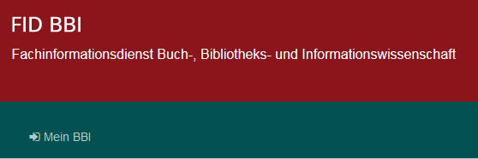
CERL Annual Seminar 2019
2. 'Specialised information service book studies, library and information science'
Who we are
Cooperation between Herzog August Bibliothek Wolfenbüttel and University Library Leipzig since 2017
Content development and coordination: Herzog August Bibliothek
Technical infrastructure and development: University Library Leipzig
Research Portal uses open source software VuFind
Using the index compiled by the finc association

Slide 5
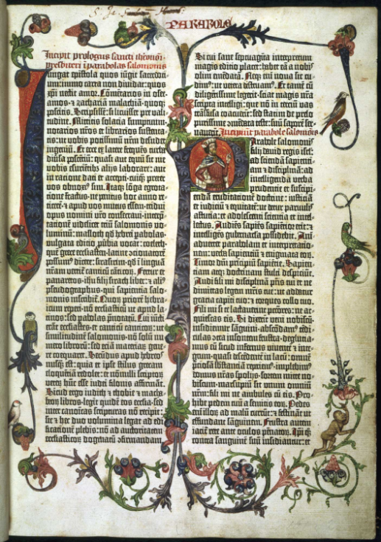
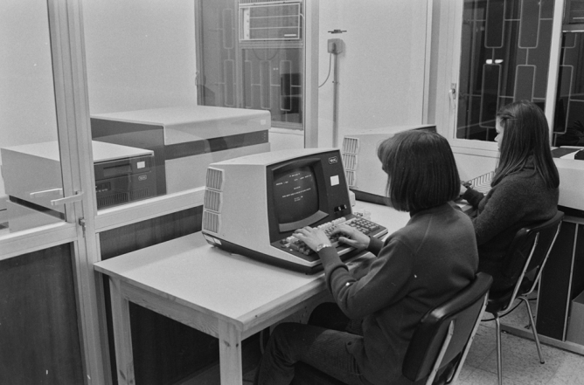
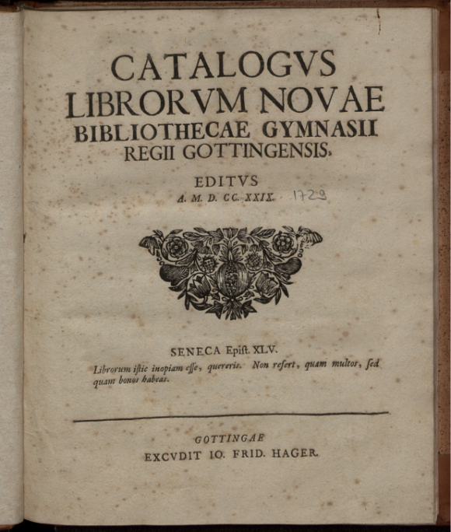
CERL Annual Seminar 2019
2. 'Specialised information service book studies, library and information science'
Who we are
Information Science
Museum Studies
Economics
Informatics
Book Studies
Digital
Humanities
Curs d'informàtica
Ajuntament de Girona, 1980
CC BY-NC-ND 4.0
Biblia latina, 42 lines
Mainz: Johann Gutenberg and Johann Fust, about 1455
BL, Public Domain
Archive Studies
Historic Studies
Library Science
Restoration
Conservation
Catalogus Librorum Novae Bibliothecae Gymnasii Regii Gottingensis
Gottingae: Hager, 1729
SUB Uni Göttingen, Public Domain
Law

Slide 6
CERL Annual Seminar 2019
3. The Content of the Research Portal
First Steps:
Incorporating the big national and international catalogues and repositories (K10+, Gallica, BL Main Catalogue, Base)
Aggregation of metadata from specialist sources (VD 16, 17, 18, ISTC, ESTC, Wolfenbütteler Bibliographie zur Geschichte des Buchwesens, Datenbank Buch und Papier)
Supply Access for OA-Publications and licenced material (EEBO, EECO, Qucosa)
Collection Policy:
Specialised literature for Book Studies, Library and Information Science main focus
Selective purchases from surrounding sciences
E-publication preferred
Customer-driven acquisitions
Focus on international literature and interdisciplinary topics

Slide 7
CERL Annual Seminar 2019
4. How to use the Research Portal
https://katalog.fid-bbi.de/

Slide 8
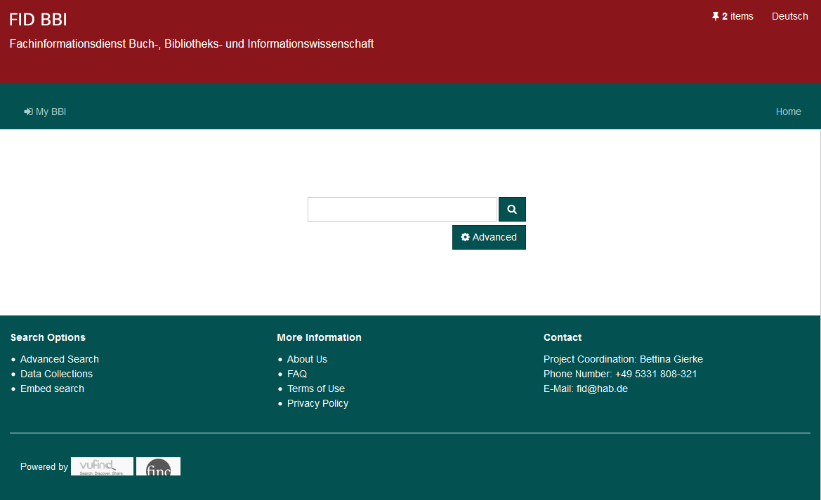
CERL Annual Seminar 2019
4. How to use the Research Portal

Slide 9
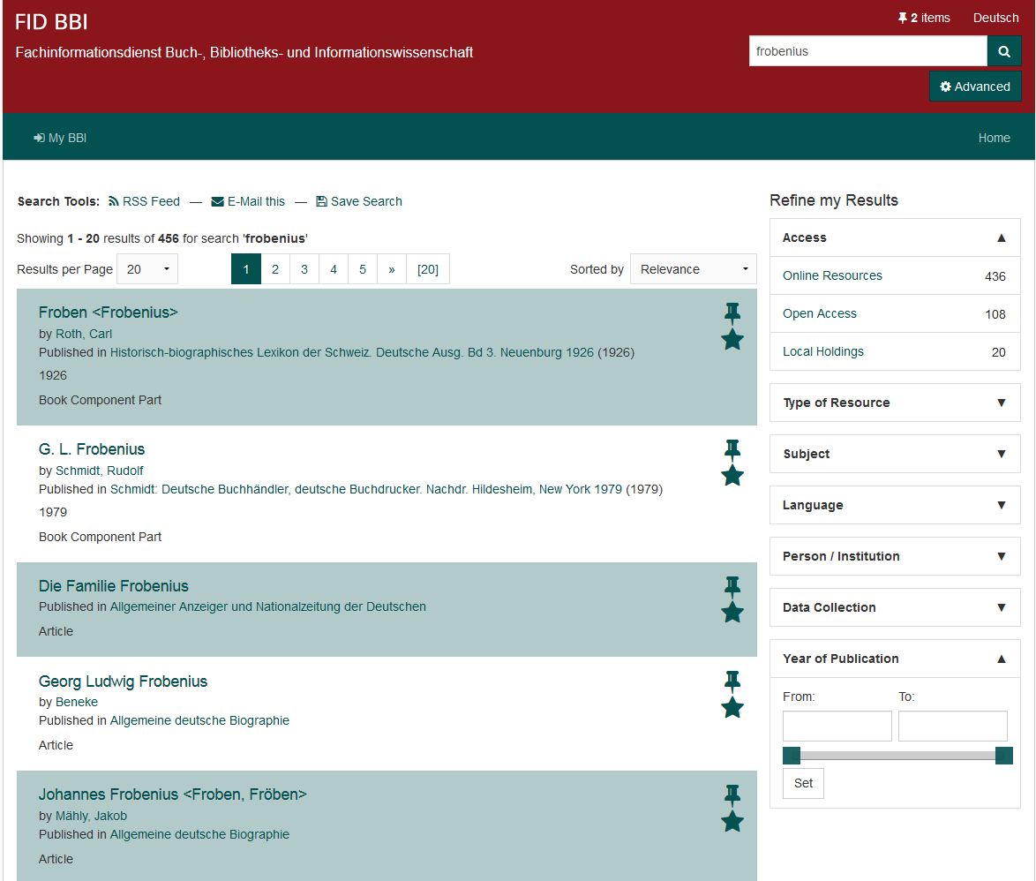
CERL Annual Seminar 2019
4. How to use the Research Portal

Slide 10
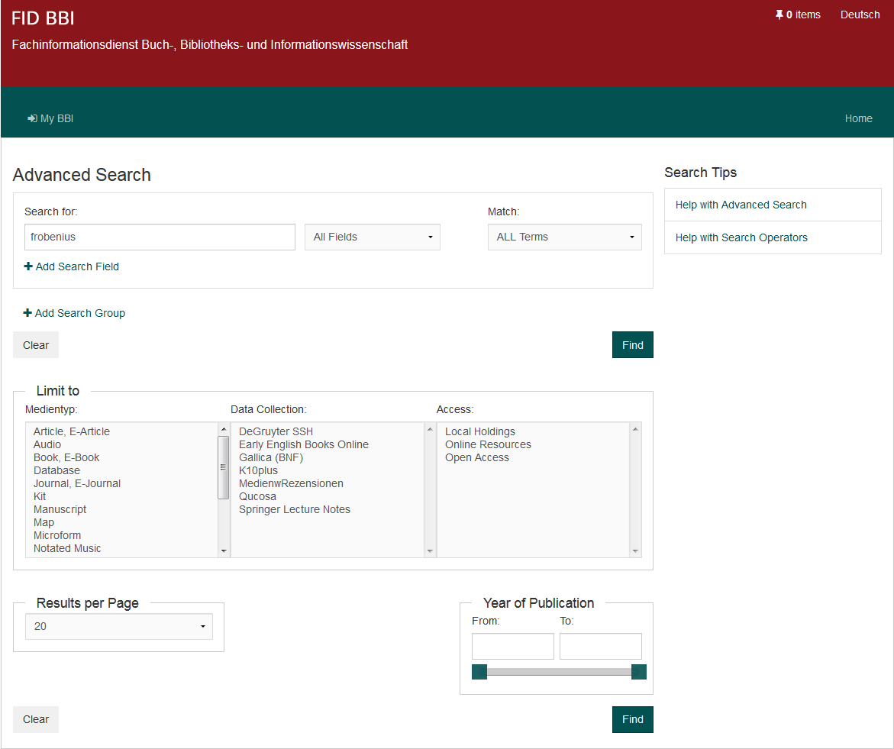
CERL Annual Seminar 2019
4. How to use the Research Portal

Slide 11
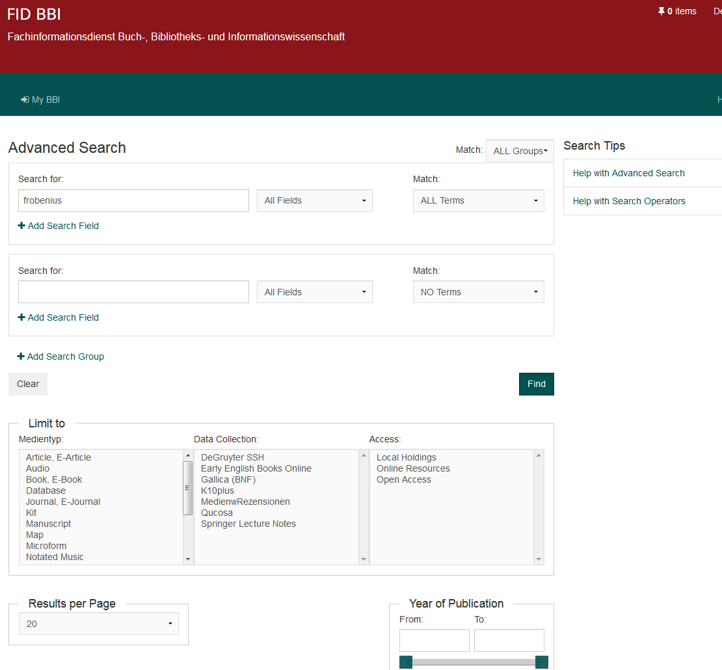
CERL Annual Seminar 2019
4. How to use the Research Portal

Slide 12
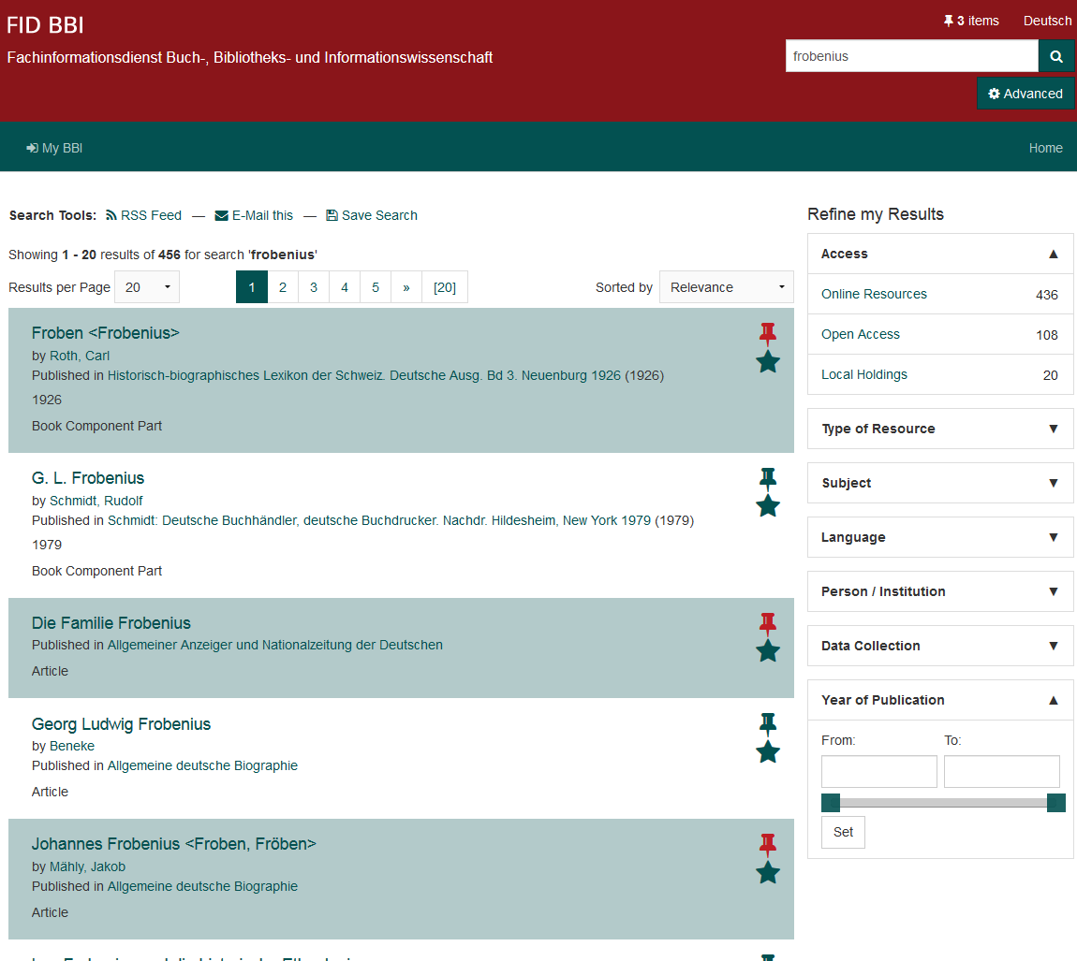
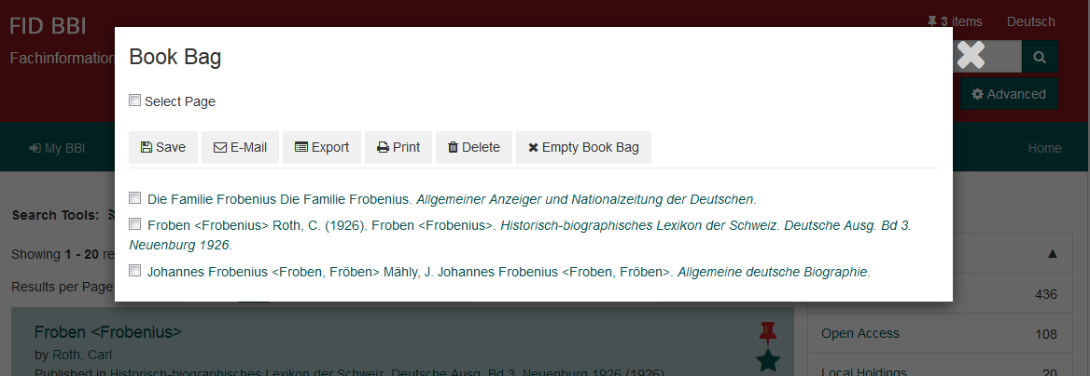
CERL Annual Seminar 2019
4. How to use the Research Portal

Slide 13
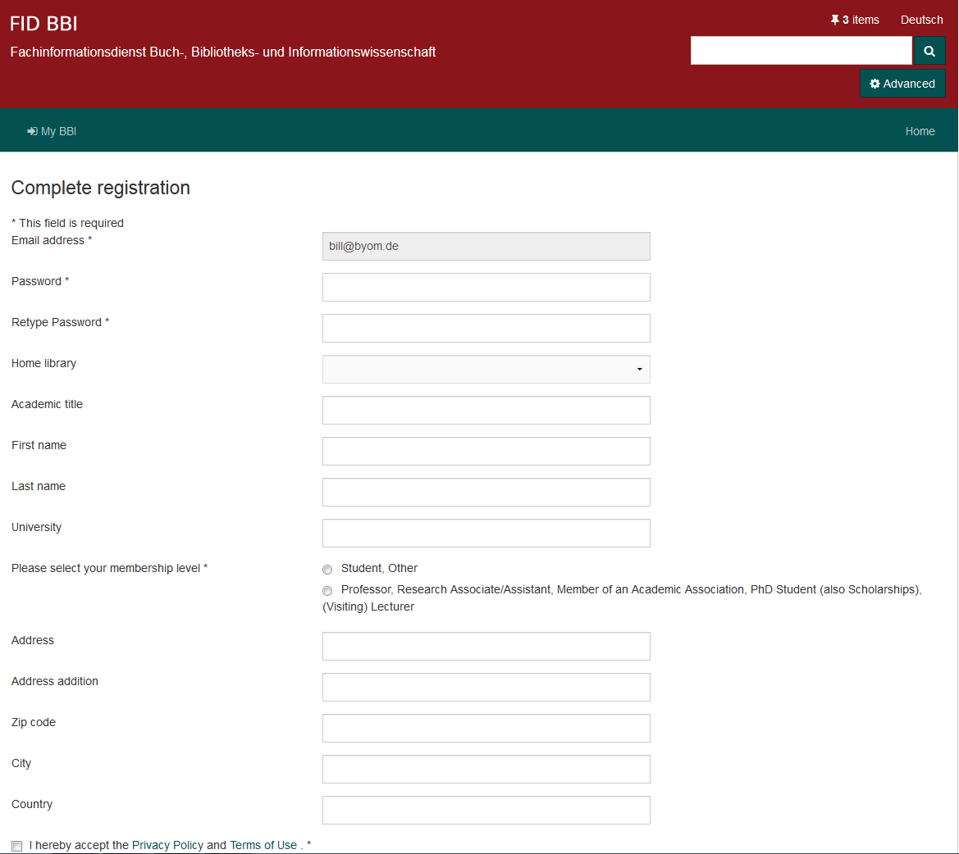
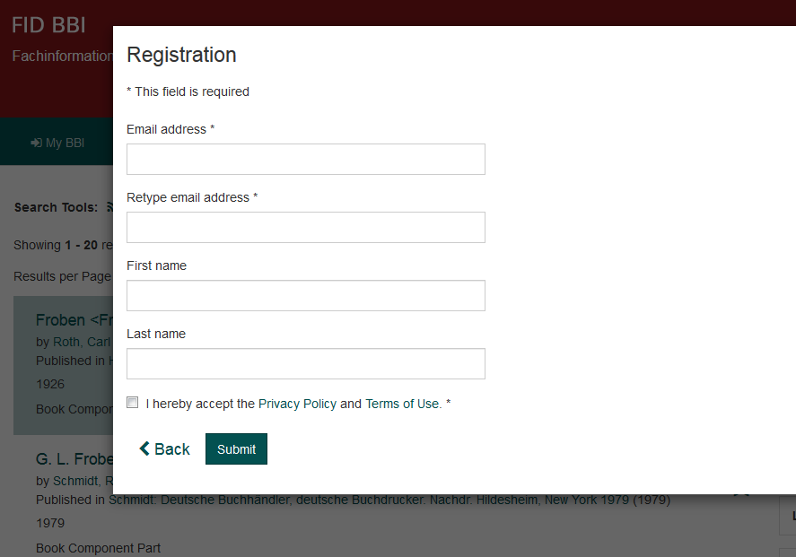
CERL Annual Seminar 2019
4. How to use the Research Portal

Slide 14
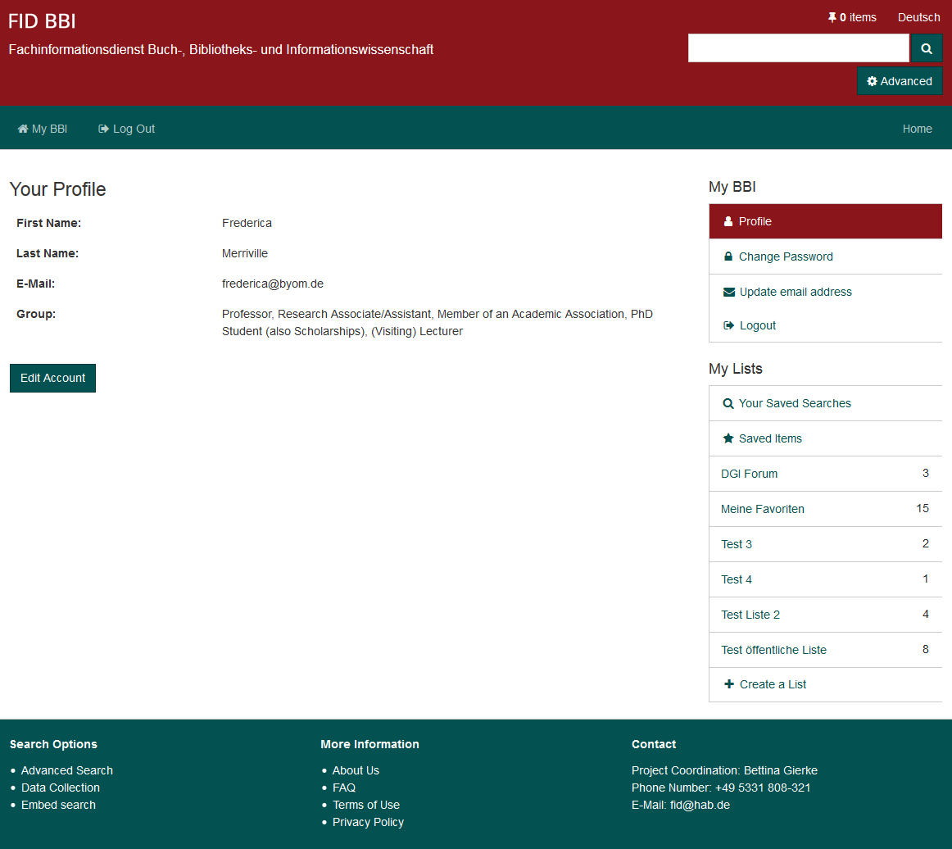
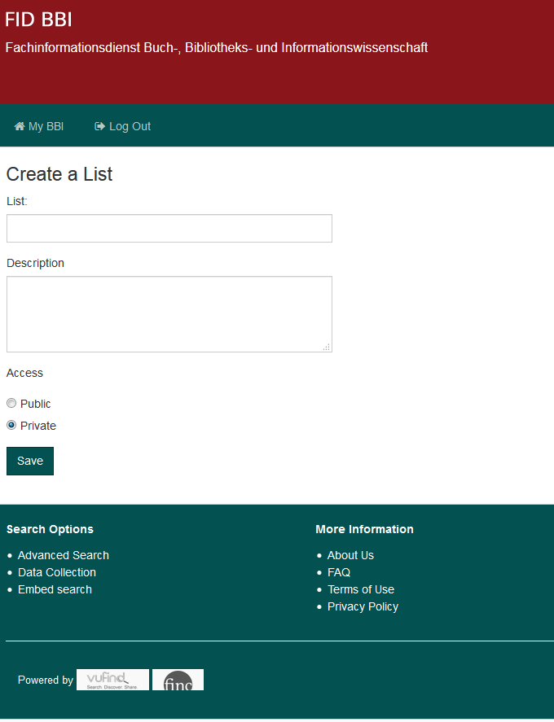
CERL Annual Seminar 2019
4. How to use the Research Portal

Slide 15
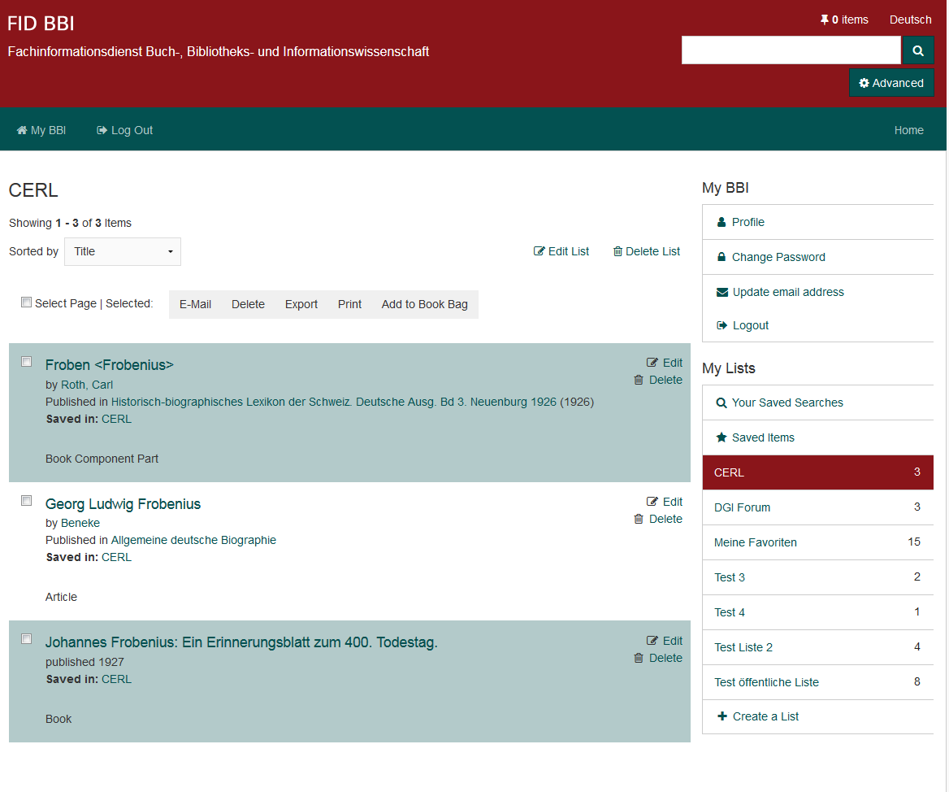
CERL Annual Seminar 2019
4. How to use the Research Portal

Slide 16
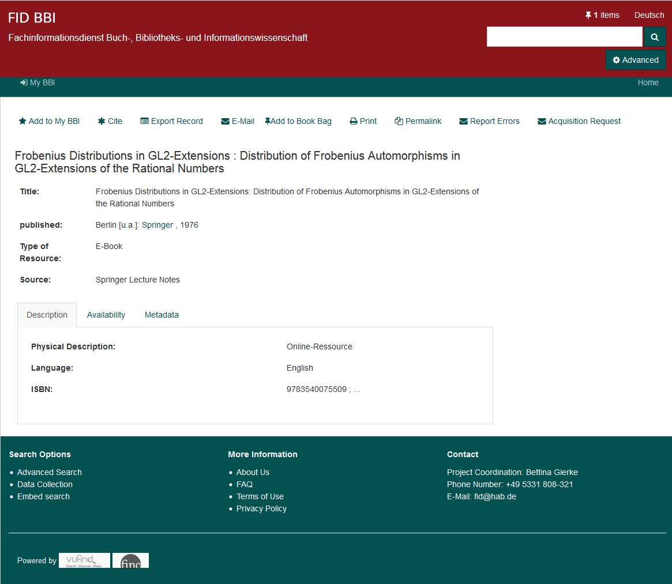
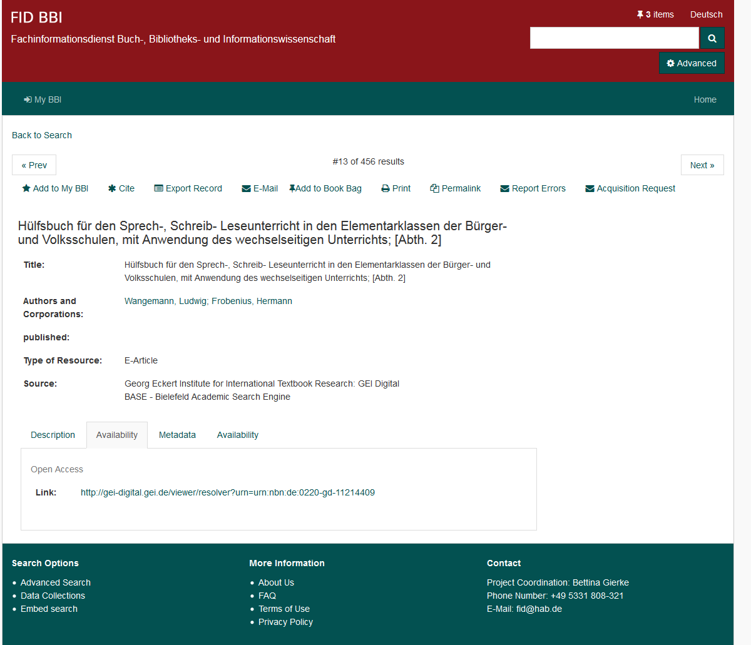
CERL Annual Seminar 2019
4. How to use the Research Portal

Slide 17
CERL Annual Seminar 2019
5. What the future may hold
What‘s next?
Digitisation of publications relevant to History of Libraries and History of the Book
Developing of digitise-on-demand service for out of copyright and out of stock publications
Negotiating licences for e-publications and repositories
Connecting with our audience
Developing repository functions for documents and research data
Incorporating new metadata resources
A new look for the Portal

Slide 18
CERL Annual Seminar 2019
Thank you very much!
If you would like to be in touch please don‘t hesitate:
Bettina Gierke
gierke@hab.de
+49 5331 808-321

