Slide 1
Working on a new German Manuscript Portal.
Descriptions and cultural objects

Slide 2
Working on a new German Manuscript Portal
Why and What
Who and How
Status
Data model

Slide 3
Working on a new German Manuscript Portal
Why and What
Setting
Aims
Phasing
Who and How
Update
Data model

Slide 4
Setting
  Digitization of Objects
    New Expectations
    Need for a Central Register
  Change of Roles
    Users actively participating
    Usefulness to Usability
  Interoperability of related services

Slide 5
Aims
Development of a central portal for descriptive-, meta- and image-data on manuscripts in German institutions
Basics
  Material „Manuscripts“
  Development from scratch
  Little or no Service Providers involved
  Open Source Technologies

Slide 6
Aims
Target-Groups
  (Scientific) User (group)s

Slide 7
Aims
Target-Groups
  (Scientific) Users
  Libraries and Archives

Slide 8
Aims
Target-Groups
  (Scientific) Users
  Libraries and Archives
  Cataloguers

Slide 9
Aims
Features
  Web-Presentation (usable)
    Up-to-date Presentation and Retrieval-Interface
    IIIF-compliant Viewer (MIRADOR)

Slide 10
Aims
Features
  Web-Presentation (usable)
    Up-to-date Presentation and Retrieval-Interface
    IIIF-compliant Viewer (MIRADOR)
  Data Storage and Administration
    Data Capturing
    Data Im- and Export

Slide 11
Aims
Features
  Web-Presentation (UBL)
    Up-to-date Presentation and Retrieval-Interface
    IIIF-compliant Viewer (MIRADOR)
  Data Storage and Administration (SBB)
    Data Capturing
    Data Im- and Export
  Authority Data
  Identity-Management

Slide 12
Aims
Content
All Content from Manuscripte Mediaevalia has to be migrated into the new portal

Slide 13
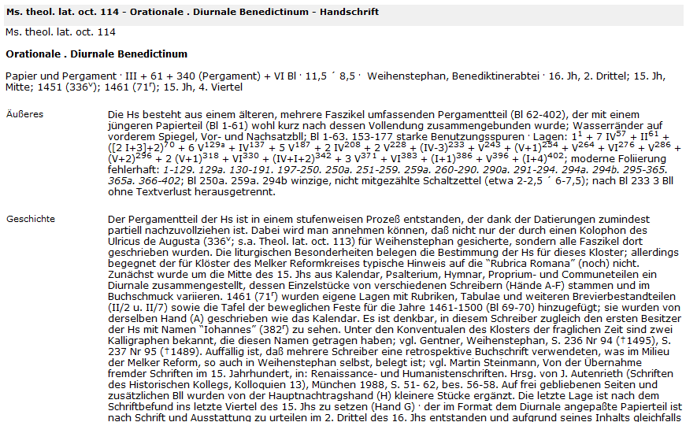
Aims

Slide 14
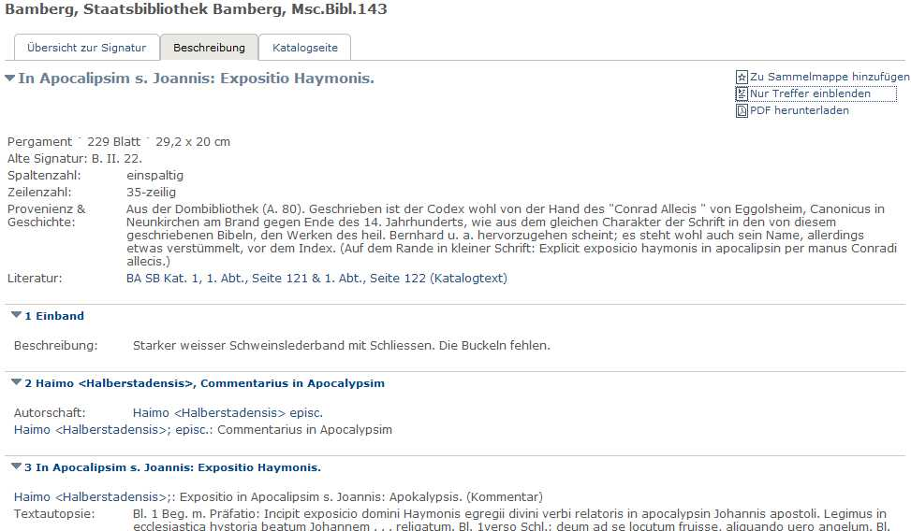
Aims

Slide 15
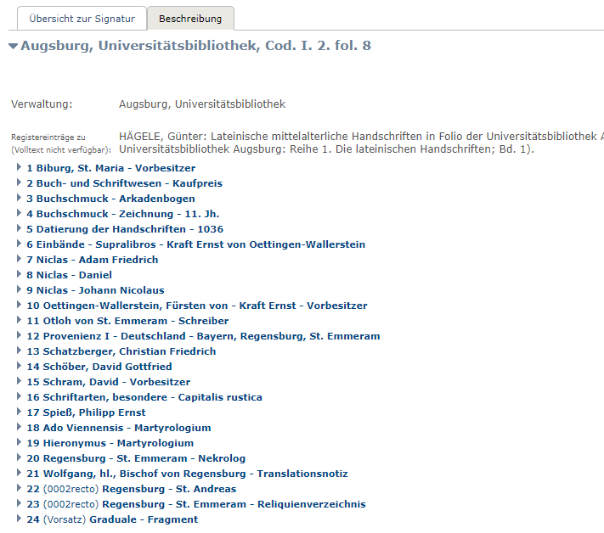
Aims

Slide 16
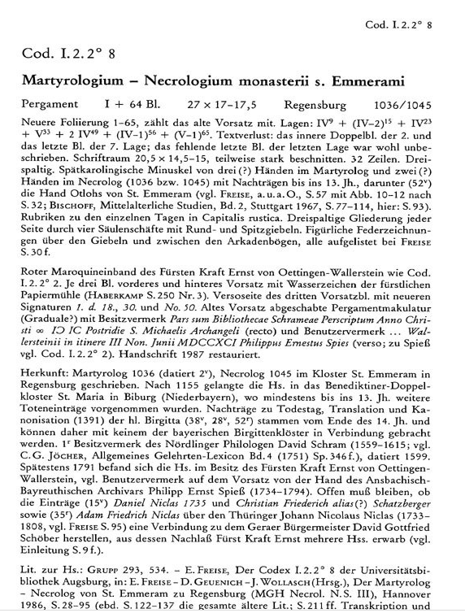
Aims

Slide 17
Aims
Content
All content from manuscripte Mediaevalia has to be migrated into the new portal
Present reliable and homogenious Data:
  Full Text
  Complete and Harmonize a certain Set of Data („Core-Data“)

Slide 18

Aims

Slide 19
Phasing
Second Phase:
  Workspaces
    Annotations
    Micropublications

Slide 20
Phasing
Second Phase:
  Workspaces
    Annotations
    Micropublications
  Catalogue Module
    Publish Descriptions and their Paratext

Slide 21
Working on a new German Manuscript Portal
Why and What
Who and How
Partners
Schedule
Navigation
Status
Data model

Slide 22
Partners
  Staatsbibliothek zu Berlin
  Universitätsbibliothek Leipzig
  Bayerische Staatsbibliothek München
  Herzog August Bibliothek Wolfenbüttel

Slide 23
Schedule
  Successful Application to the Deutsche Forschungsgemeinschaft in July / December 2017
  Start: 01.10.2018
  First Phase of three years

Slide 24
Navigation
Project Management
  Project: classical
  Local IT-development: agile – Scrum-Teams
  Milestones (6 Months)
  Detailed Specification Management (UseCases => UserStories)

Slide 25
Navigation
Transparency
  Application
  Workshops
  Public Relations

Slide 26
Navigation
Sustainability
  SBB and BSB: Common Data-Redaction
  SBB: Technical Infrastructure: Web Presentation and Backoffice
  UBL: Service to host IIIF-Data

Slide 27
Working on a new German Manuscript Portal
Who and How
Why and What
Update
Status Report
Data model

Slide 28
Working on a new German Manuscript Portal
Who and How
Why and What
Update
Data model
Descriptions
Cultural Object Documents

Slide 29
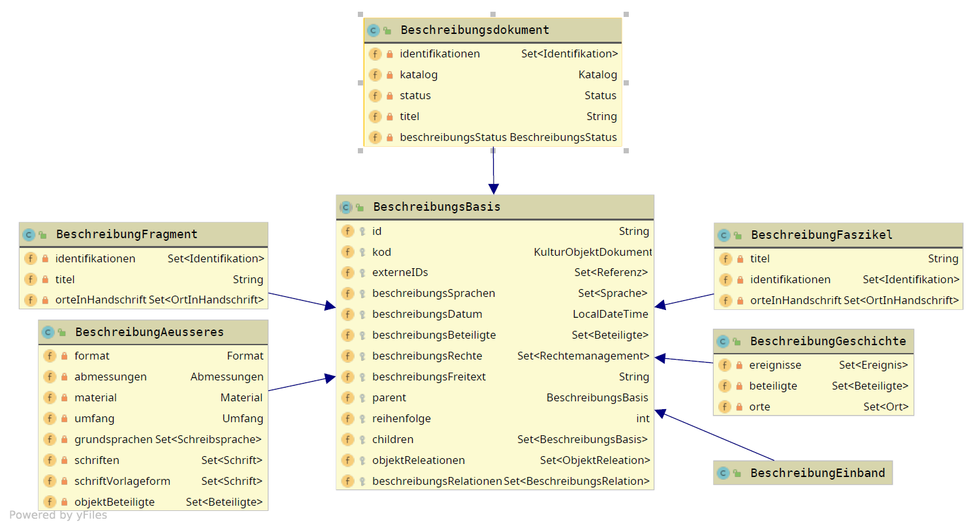
Data model
Descriptions

Slide 30
Data model
Description
Description
Outer
History
Binding
Outer
History
Fragment
Outer
History
Text
Fascicle
Outer
History
Text
Text

Slide 31
Data model
Descriptions
  Copyright
  Represent a certain historical State of Knowledge
  There is potentially more than one Description of a Manuscript
  Addenda and Corrigenda?
    Descriptions are not the logical Place for all available Information on a Manuscript

Slide 32
Data model
Cultural Object (CO)
  Any real Object from our Domain is a CO
Cultural Object Document (COD)
  Within the portal: Each CO is represented by one COD
  COD as distinct reference point for all information on a CO:
    Descriptions, Digital Reproductions, External Ressources, Annotations

Slide 33
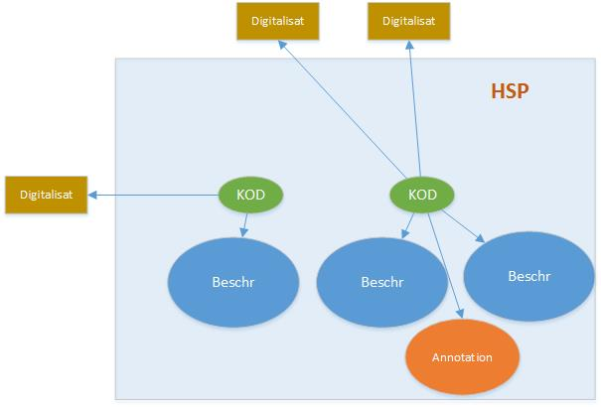
Data model

Slide 34
Data model
Cultural Object (CO)
  Any real Object from our Domain is a CO
Cultural Object Document (COD)
  Within the portal: Each CO is represented by one COD
  COD as distinct reference point for all information on a CO:
    Descriptions, Digital Reproductions, External Ressources, Annotations
  Nationally: Type of Works „Schriftdenkmal“ within the GND
  Internationally: ISMI

Slide 35
Data model
Dynamic COD
  Concise standardized information
  As up-to-date as possible
Static Descriptions
  Static from their Moment of Publication
Annotations
  User-generated Content
  On any Entity of the Portal

Slide 36
Thank you very much for your attention!

Slide 37
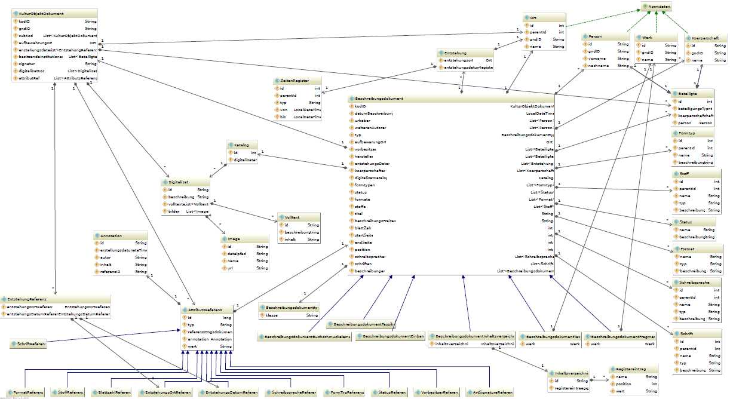
HSP – Datenmodell

Slide 38
Titel

Slide 39
Titel

