Slide 1
From the shelf into the world: Baron von Asch and the Göttingen University collections
Susanne Al-Eryani (SUB Göttingen)
CERL Seminar 2019
09.10.2019

Slide 2
Overview
Retrospection
Baron Georg Thomas von Asch (1729-1807)
The Asch Collection
Contextualisation: the ASCH project
The ASCH model
The Asch documents
Virtual reconstruction of the Asch Collection
The online portal of the Göttingen University collections
ASCH model: proof of concept

Slide 3
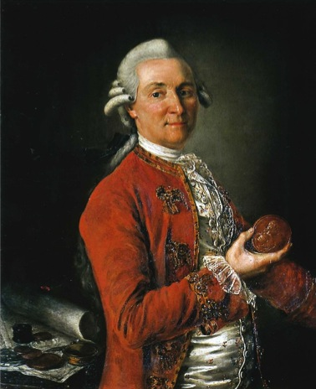
1. Retrospection: Baron von Asch and the history of the Asch Collection
Baron Georg Thomas von Asch
(1729-1807)
Göttingen University Library
(1747)

Slide 4
Provenance of Asch Items
GÖTTINGEN
Aleutian Range
Saint Petersburg
Black Sea
Kyakhta

Slide 5
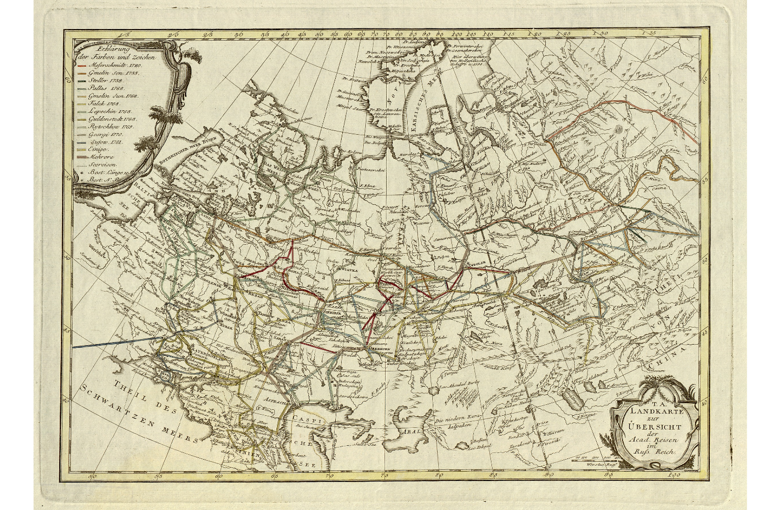
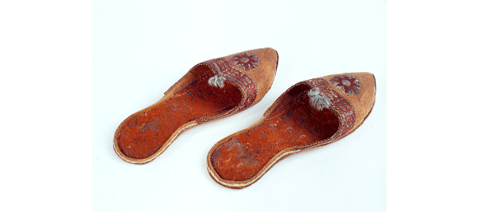
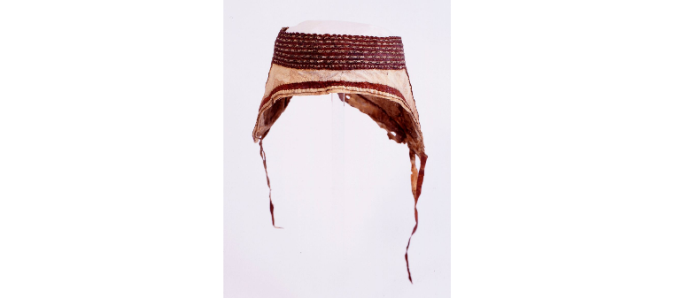
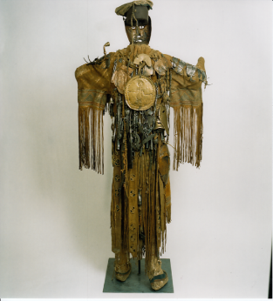
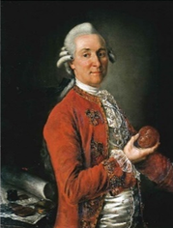
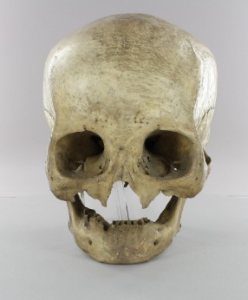
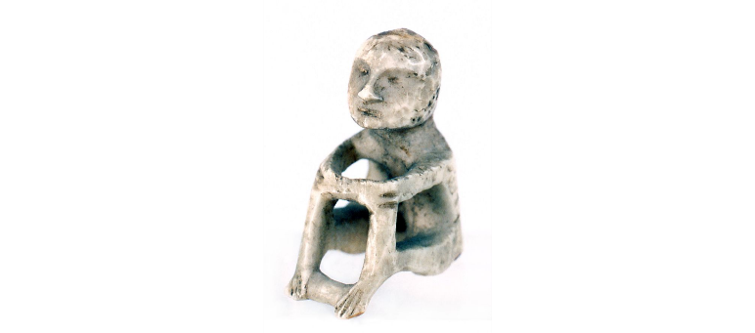
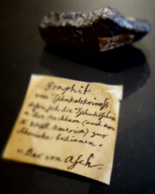
The Asch Collection
The Asch Collection

Slide 6
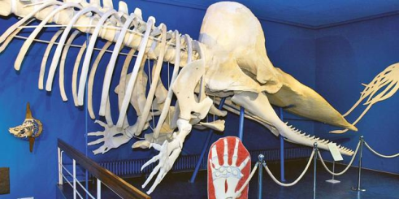
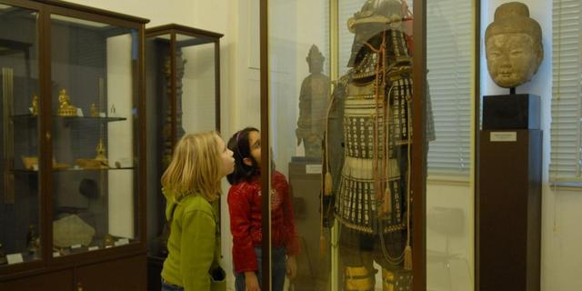
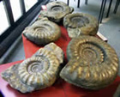
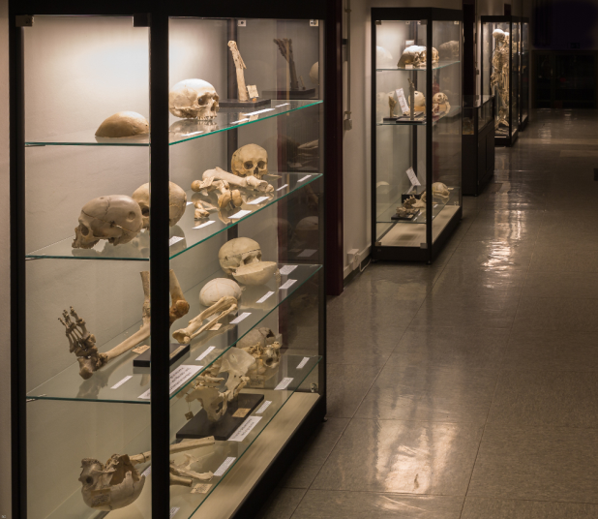
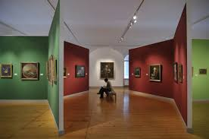
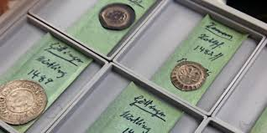
Asch holdings in collections of the Göttingen University

Slide 7
2. Contextualisation: the ASCH project
Items
Digital Representations
Events
Persons
Corporate Bodies
Collections
Time
Places
Names / Appellations
Concepts
Statements
The Asch Collection

Slide 8
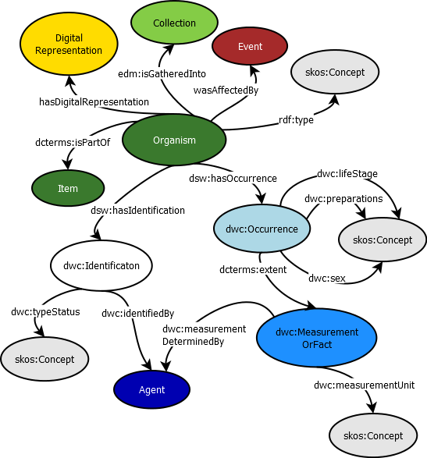
ASCH model: description of Item and Organism

Slide 9
ASCH model: description of Event

Slide 10
ASCH model: interlinking of models
model describing provenance (Event)
model describing Organism

Slide 11
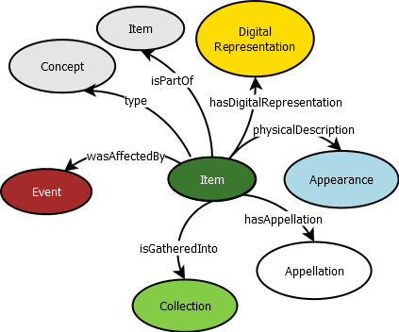
ASCH model: interlinking of models
model describing provenance (Event)
model describing Item

Slide 12
Relation between Event and evidence
Text Encoding Initiative (TEI)

Slide 13
Asch documents
Handwritten documents
Written by Baron v. Asch (in Latin and Cyrillic script)
letters to Christian Gottlob Heyne (1729-1812), director of the Göttingen University Library
lists of items dispatched to Göttingen University
notices on items found in letters or on wrapping paper
labeling of items
Written by others
letters mentioning the sendings of Baron v. Asch
notices on items
labeling of /on items
inventory books
Publications (e.g. Göttingische Gelehrte Anzeigen)

Slide 14
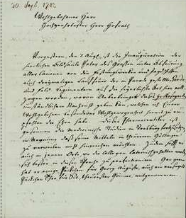
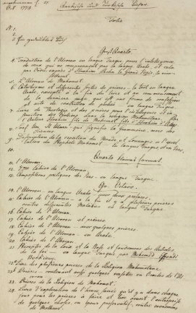
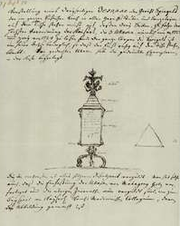
Evidence considered in the ASCH context
Handwritten documents from Baron Georg Thomas von Asch (SUB Göttingen)
126 letters
148 lists
item descriptions

Slide 15
The Pharmacopoea Rossica: mentioned in a letter and a list
Cod. Ms. Asch 1:1 (1772/79) bl 68vZ
Cod. Ms. Asch 1:1 (1772/79) bl 136r

Slide 16
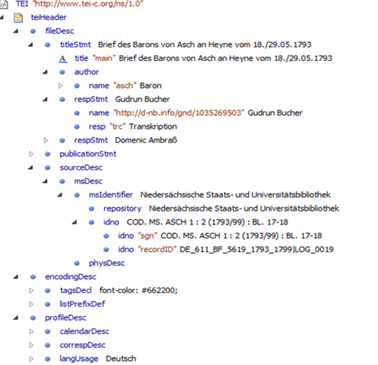
TEI: registers of entities

Slide 17
TEI: registers of entities

Slide 18
Encoding of the entity (thing) Pharmacopoea Rossica

Slide 19
Pharmacopoea Rossica in the OPAC of the SUB Göttingen

Slide 20
Pharmacopoea Rossica in the register of things

Slide 21
ASCH model: Statement

Slide 22
ASCH model: test

Slide 23
ASCH Item Database

Slide 24
ASCH Provenance Database

Slide 25
ASCH Statement Database

Slide 26
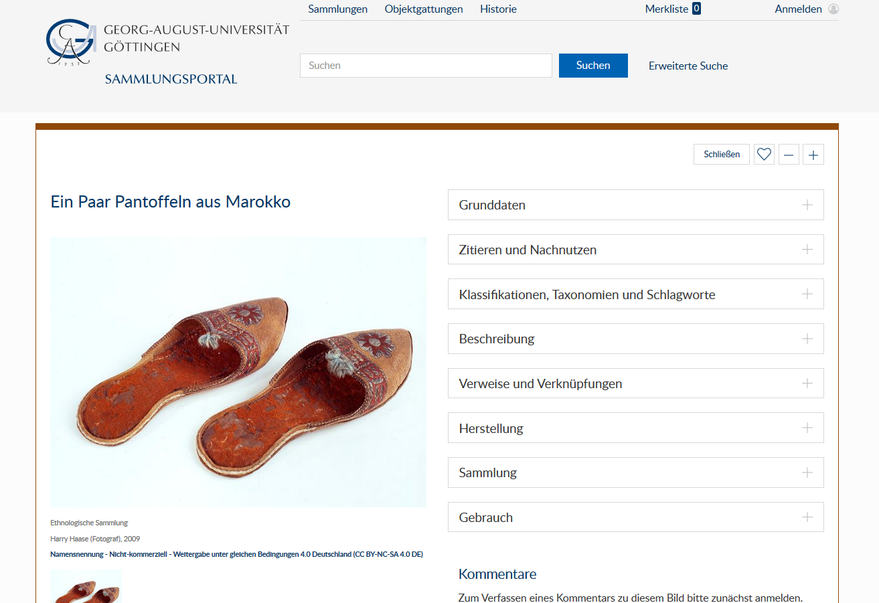
3. Virtual reconstruction of the Asch Collection
The collections of the Göttingen University and the Sammlungsportal

Slide 27
Opening the virtual shelves to the world
Blank Node
Subjekt
URI
Prädikat
URI
Objekt
URI oder Literal
source: https://opus4.kobv.de/opus4-th-wildau/files/1203/MA_Niemann_Knowledge_Graph_2019.pdf
LIDO
RDF

Slide 28
Mapping example
LIDO-XML
XSLT
RDF/XML
RIOT
Turtle

Slide 30
Thank you!
http://asch.wiki.gwdg.de/index.php/Main_Page
https://opus4.kobv.de/opus4-th-wildau/files/1203/MA_Niemann_Knowledge_Graph_2019.pdf

