Slide 1
The world beyond the Text -artefacts, media and interaction in the Bibelhaus Erlebnis Museum Frankfurt
Notes:
1. Opening
Thank you very much for inviting me. I feel honoured to present the museum's work on this occasion. What can the Bible Discovery Museum in Frankfurt contribute to the topic of "Research Access for Hybrid Collections"? Let's put it together!

Slide 2
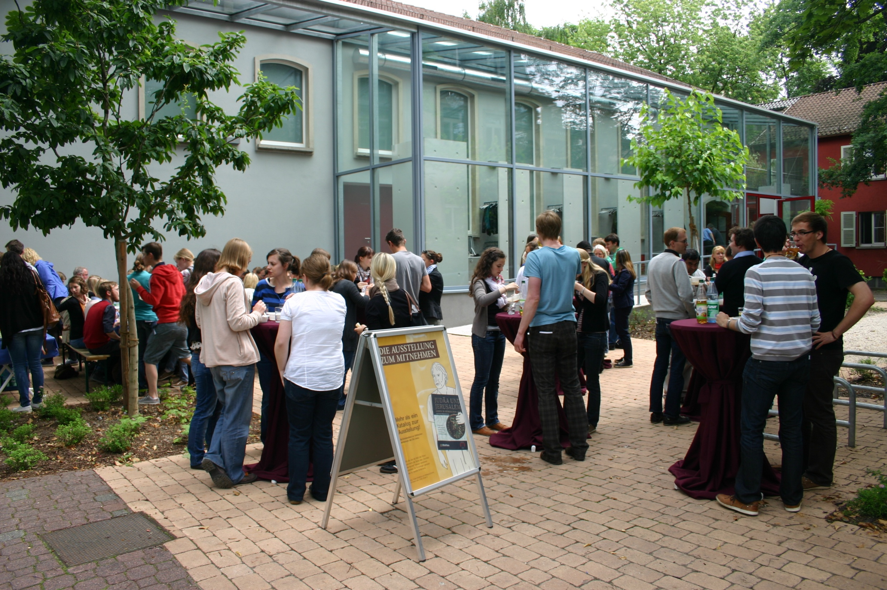
Notes:
2. Exterior
Religion is a proper school subject in Germany. Bible science hence has a part to play for the teaching at schools up to matriculation standard, in the teacher training at university, and beyond. As a special museum, we welcome all age groups, young and old. Given the teaching in schools and church communities, our visitors include a particularly great number of adolescents. This presents us with special challenges in the mediation of scientific contexts.

Slide 3
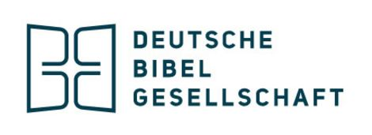
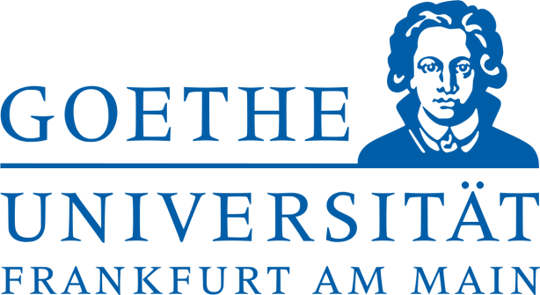
Notes:
3. Logos
For our exhibitions, we cooperate with universities in the fields of "ancient history", papyrology, "church history", textual science and theology. Our partners for the archaeological finds are the Israel Antiquities Authority and the Collection of Classical Antiquities of the Prussian Cultural Heritage Foundation in Berlin. For various exhibitions, we also cooperate with the Bavarian State Library in Munich, but also the Regional Library of Württemberg in Stuttgart, as well as other regional libraries run by the state or church. Our aim is to communicate historical contexts about the world that the texts we find in the Bible today come from, but also about book culture through the millennia. The "book of books" takes a leading role in this again and again throughout the centuries.

Slide 4
Notes:
4. Exhibition Luthers Meisterwerk
One of the guests at the opening of an exhibition about the history of Bible translation in the Late Middle Ages and Reformation was Federal President Joachim Gauck. You can see him here in front of invaluable block books and woodcuts of the Bavarian State Library. On the one hand, we showed 72 books and autographs from 150 years of 15th and 16th century book history in the display cases.

Slide 5
Notes:
5. Printing Press Septemberbible 1522
And on the other it was important to us that visitors engage with the ground-breaking technology of the time's book production interactively, enabled by proposals in the exhibition. If they wished to, every visitor could make his or her own print using the replica of a printing press: An own "pirate copy" in the type face of the New Testament's oldest translation by Martin Luther from the year 1522 – besides the precious first printings from this time. A broader public calls for the provision of such opportunities. With a print in their hand, they can take the next step: deciphering the type face and archaic German of that time. Where the Luther Bible is concerned, this led to recognition effects because the text is still read out with hardly any changes in Protestant churches to this day.

Slide 6
Notes:
6. Fold and stitch octave Psalm 1531
Every visitor was also invited to "fold and stitch" a book in octave format from a folio sheet. In the end, they would hold a book section in the original format and type face from 1531 in their hands and could once again try to decipher a psalm's German translation by Luther. The original was on show in the exhibition.

Slide 7
Notes:
7. Show case 2015
This is how we try to link the valuable museum objects with hand movements. The visitor is meant to gain an interactive insight into the time as it was then.

Slide 8
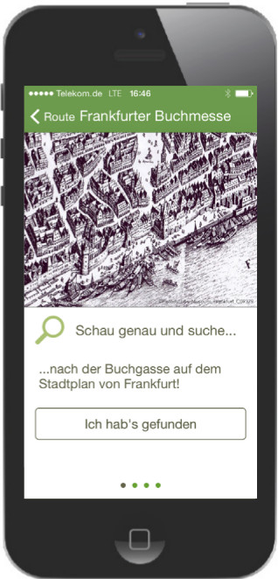
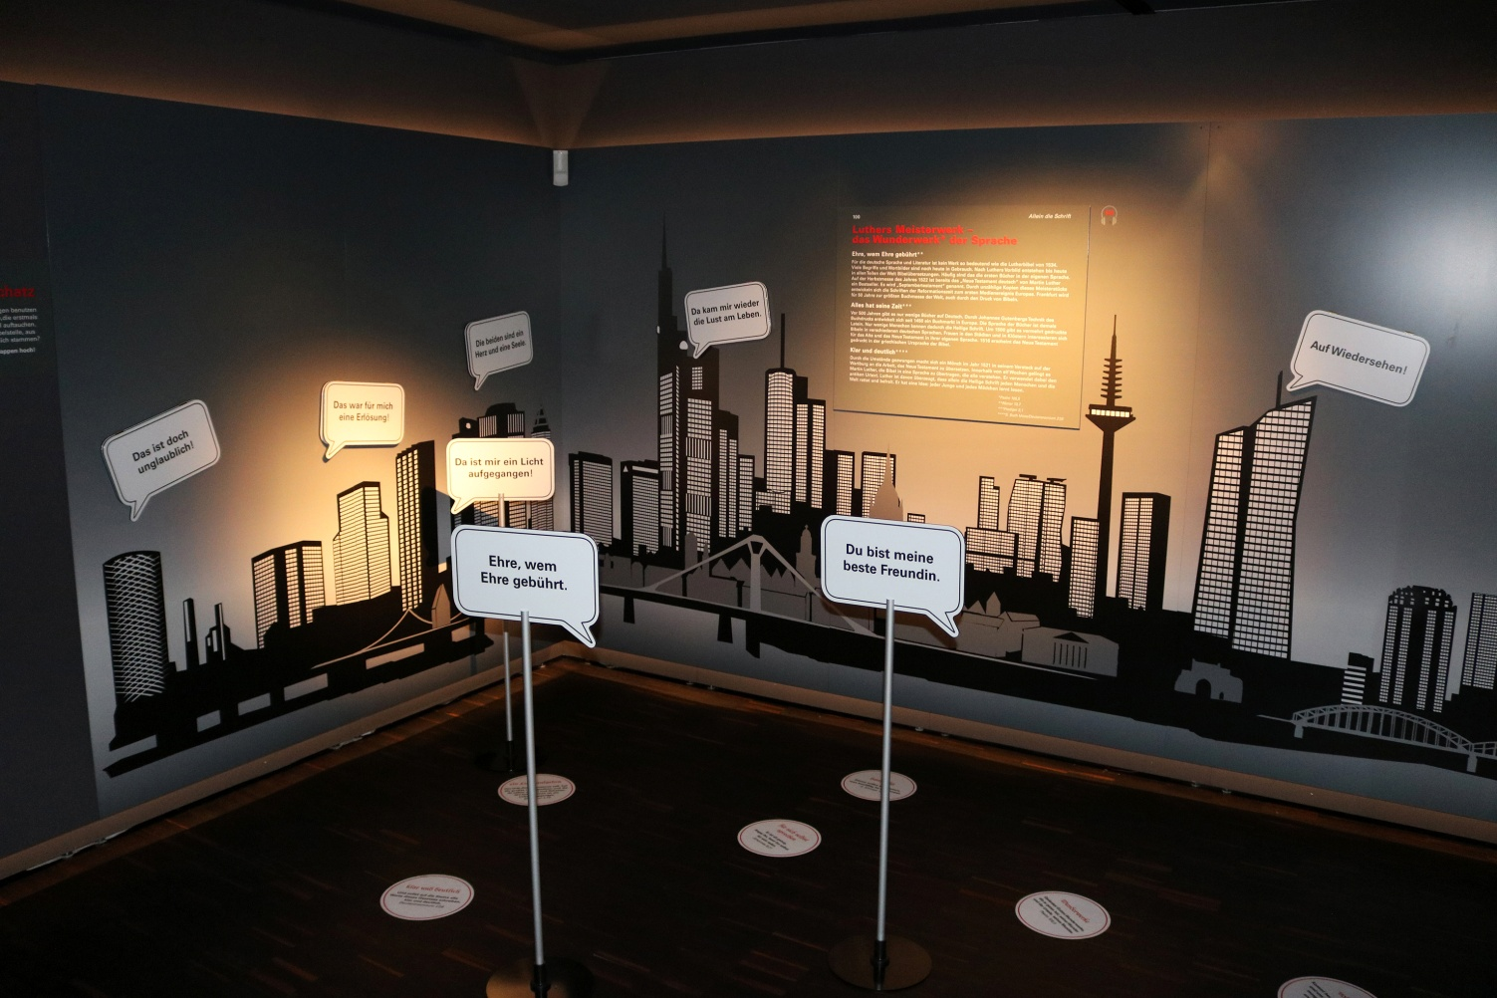
Notes:
8. "Wortschatz"
Book printing as a media event 500 years ago – for us, this is also a starting point in view of current developments in the media. A smartphone app helped us link past media with those of today. Other interactive stations over and beyond this permitted discovery of common phrases in the German language that are based on Luther's translation of the Bible. Hiding behind the "speech bubbles" are the Bible texts they come from.

Slide 9
Notes:
9. IAA-findings "On the way"
Our work is not only about the bible as a book and its cultural meaning in the church and society of today. What we would like to do in the permanent exhibition is to present the texts handed down to us in the Bible as a mirror of a historic epoch. This has involved an intensive cooperation with the Israel Antiquities Authority since 2009. Ever since that year, we have been showing permanent loans from the archives in Israel. Hellenistic ceramics, Roman glassware, coins from the Hellenistic-Roman period, militaria and other typical objects: They all come from archaeological digs in Israel and are on view in an interactive permanent exhibition in Frankfurt.

Slide 10
Notes:
10. Video animation Temple Mount
Added to this are models and media, such as this video animation from UCLA, the University of California Los Angeles, in cooperation with the Davidson Centre Jerusalem, about the archaeological reconstruction of the Temple Mount in Jerusalem. Here you can see a colleague at work. How do we go about this?

Slide 11
Notes:
11. Tyrian shekels
One example is part of a coin hoard found on Mount Carmel with characteristic tetra-drachmas from the turn of the eras. The currency is mentioned in the texts handed down to us in the New Testament of the Bible, for example as a currency for paying the Jewish temple tax. It is a Tyrian shekel.

Slide 12
Notes:
12. Exhibit
We are exhibiting them in connection with the temple in Jerusalem and adding an enlargement of the coin – with various explanations and references.

Slide 13
Notes:
13. Guiding tour presentation
Here you can see a young visitor introduce the coin to her study group. She had been handed a replica of the coin earlier on in the guided tour, with the assignment to inform herself on it. Other visitors are handed further replicas with search assignments for the exhibition. She is holding the replica in her right hand and explaining the coin with her left, while the originals lie in the glass case above. She is talking about the custom of temple tax, but also about Judas Iscariot being paid 30 of these coins for his betrayal according to the tradition of St. Matthew's Gospel. The object thus connects with a content. On the coin, Tyros presents itself as a place of asylum. This could be a starting point for current topics – besides the astonishment at the fact that it shows the face of the god Baal at the temple.

Slide 14
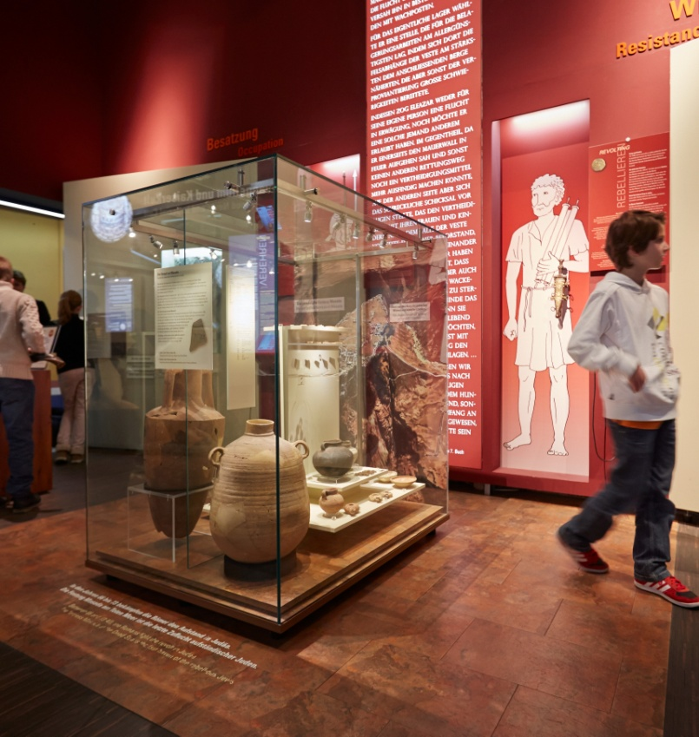
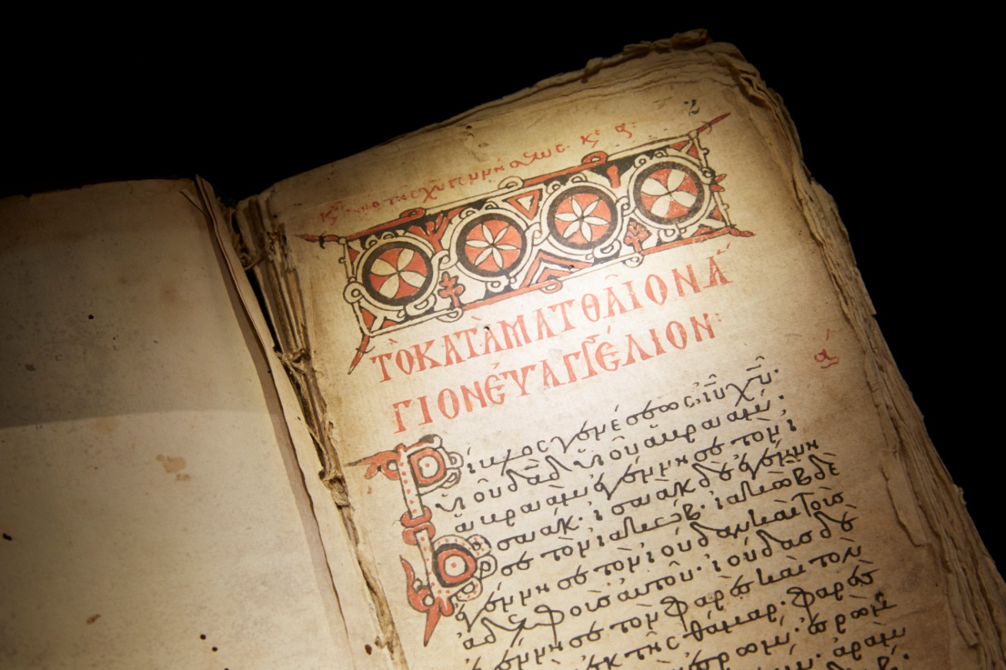
SEBASTOS
EYANGE[LIA]
Notes:
14. Priene calendar inscription
Another example for linking various object categories relates to the original calendar inscription from the town of Priene in Asia Minor. It is on loan from the Collection of Classical Antiquities in Berlin. A Greek inscription dated to the 9th century BC. This official text about a calendar reform treats of the birth of a son of God who is a God himself and brings peace, whose birth is the beginning of all "good tidings" – rendered as eu-angélion in Greek – and whose birthday marks the start of a new calendar. And who is this inscription dedicated to? Emperor Augustus, the sebastos. – The "eu-angélions"/good tidings of the New Testament are created in contrast to the "gospel" of the Roman Imperial Cult – the showcase with finds from the battle of Masada in the Roman-Jewish War makes this historic connection clear.

Slide 15
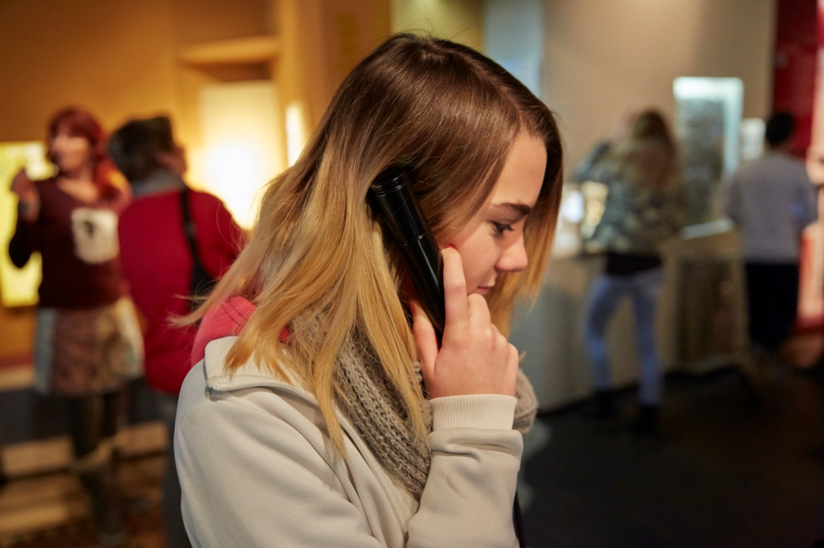
Notes:
15. Audios
rchaeological finds, ceramics, coins, militaria, manuscripts, inscriptions, etc. are embedded in an attractive mise-en-scène with models and replicas, video animations and audio, as well as hands-on stations, including a drop-latch lock.

Slide 16
Notes:
16. Nof Ginosar boat
Also included in this is the original scale reconstruction of the boat from Nof Ginnosar at the Sea of Galilee. It highlights one of the lifeworlds picked up on by the texts that are part of the Bible today. The history of the Bible's influence is great. With the archaeological findings and textual research, we want to awaken an interest in understanding the world these texts come from, in order to better our understanding of them.
Thank you very much for your time.

