Slide 1
Bookbindings and Provenances in Alvin
Per Cullhed
Cecilia Winrow
Uppsala University Library
CERL Annual Seminar 2017
Putting it together: Research Access for Hybrid Collections

Slide 2
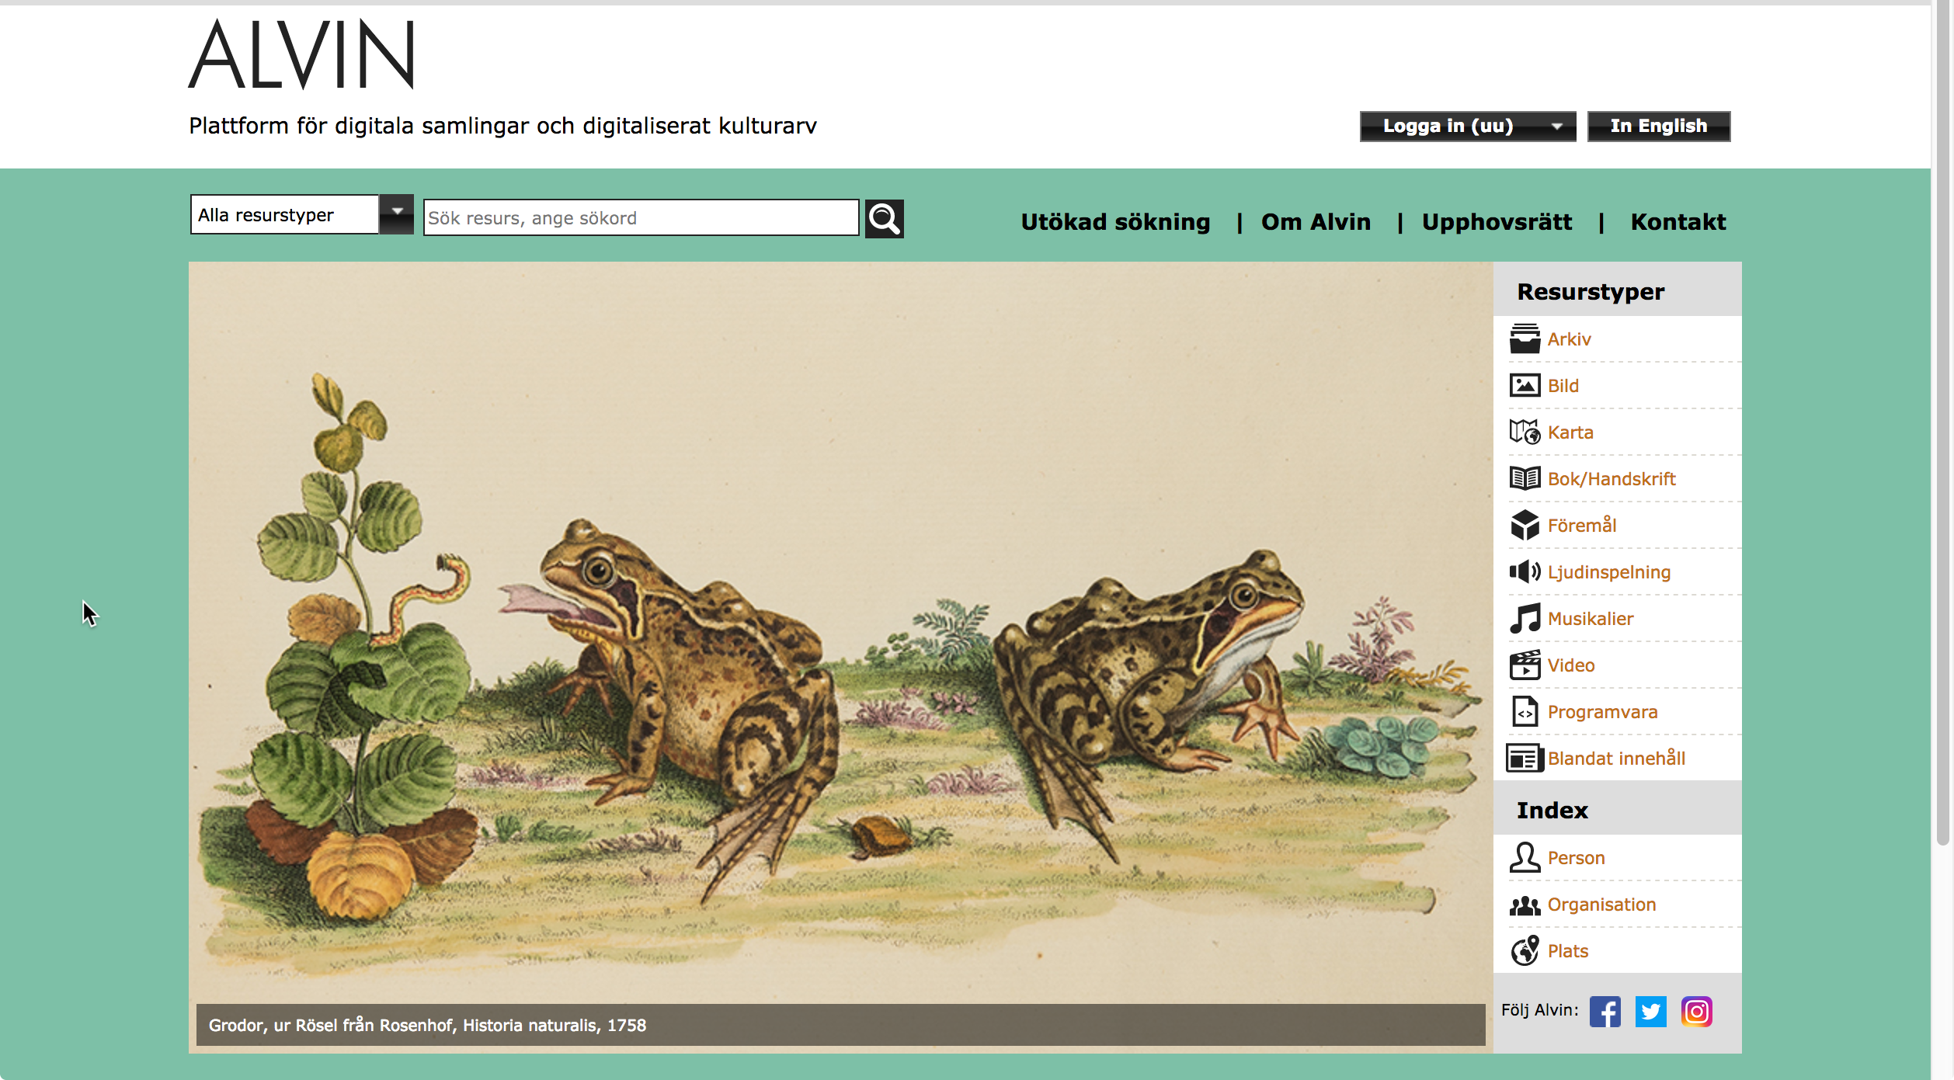
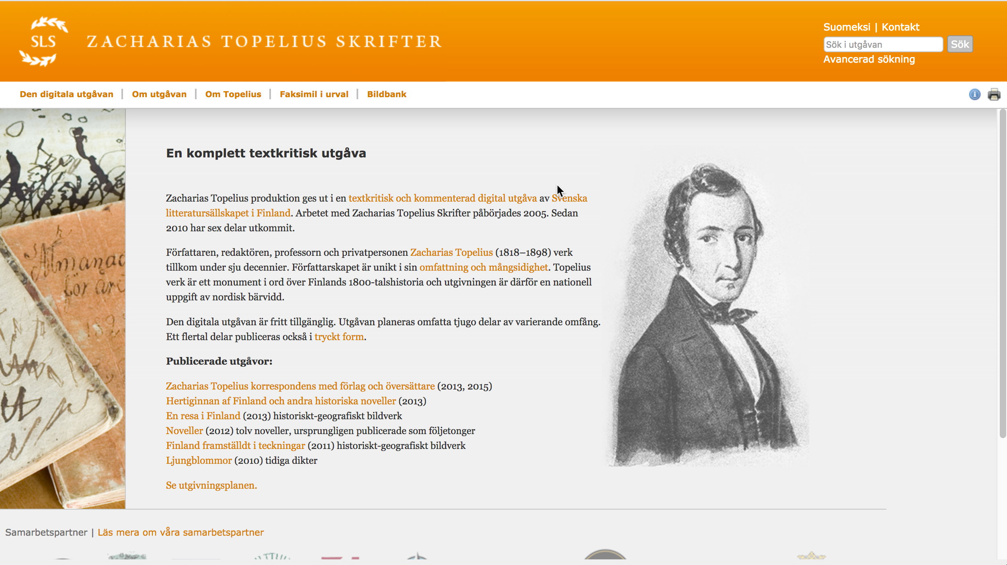
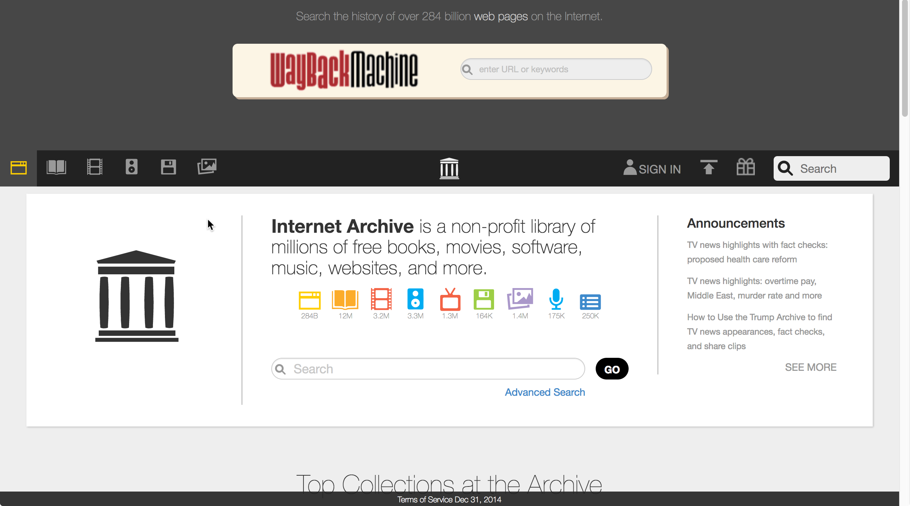
Repositories and research databases
Repositories
Digital editions
Alvin
Topelius
Internet Archive
Pragmata
General character
Digital ”raw-material”
Digital preservation
Close to collections
Specific
Enriched data
Maintenance?
Close to a subject

Slide 3
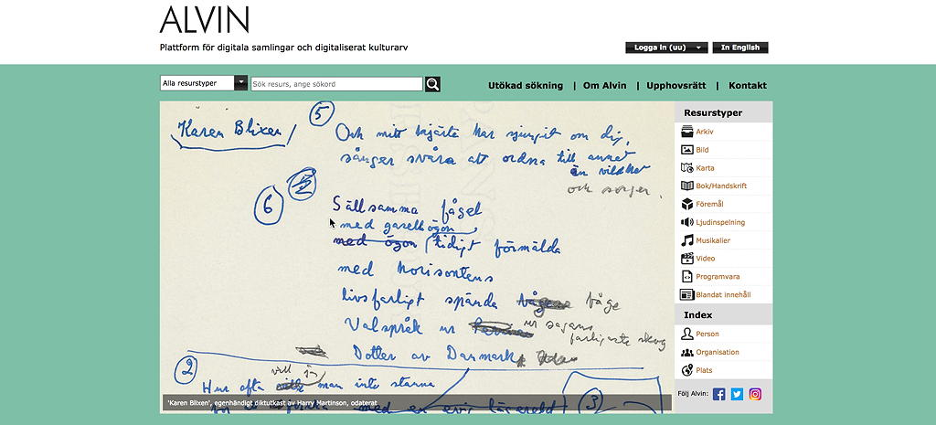
Alvin portal for digital collections and digitized cultural heritage – an introduction
Alvin was established in 2014 and, today, it contains app. 135 000 catalogue entries and
96000 entries with a digital content

Slide 4
Facts and functions
•Alvin is a digital repository and a platform for describing, cataloguing and
publishing free digital resources on the Internet
•Alvin is organised in a consortium consisting of the Swedish university libraries
in Uppsala, Lund and Göteborg and a number of other institutions active within
the ALM-sector in Sweden
•Alvin is built to form an integral part of a digitization workflow
•Alvin is developed and maintained by Uppsala University Library
•Resources can be downloaded freely, metadata can be harvested by OAI-PMH,
permanent links, and internal linking between individual book-pages, persons,
and organisations facilitates scholarly communication. An API will allow for
better interaction with contents in 2018 and better search functions are being
developed

Slide 5
Alvin as a cooperative project
Consortium
Uppsala universitetsbibliotek,
Göteborgs universitetsbibliotek
Universitetsbiblioteket, Lunds universitet
Uppsala university
Medicinhistoriska museet i Uppsala
Museum Gustavianum, historiska samlingar
Akademiintendenturen
Kommunikationsavdelningen
Institutionen för nordiska språk
Institutionen för arkeologi och antikens historia
Konstvetenskapliga institutionen
Uppsala universitets arkiv
Uppsala universitets konstsamlingar
Uppsala universitets myntkabinett
Other members
Karolinska Institutet, Hagströmerbiblioteket
Linköpings stadsbibliotek
Linnéuniversitetets bibliotek
Stockholms universitet, konstsamlingarna
Österåkers bibliotek
Other participating organizations
(via projects)
Kungl. Vetenskapsakademien, Centrum för vetenskapshistoria
Naturhistoriska riksmuseet
Stockholms universitet, Institutionen för naturgeografi
Umeå universitet

Slide 6
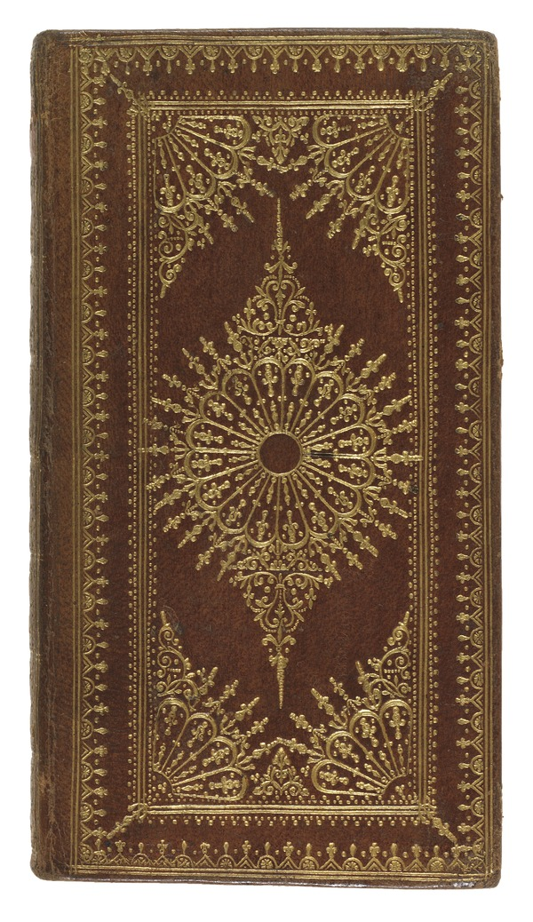
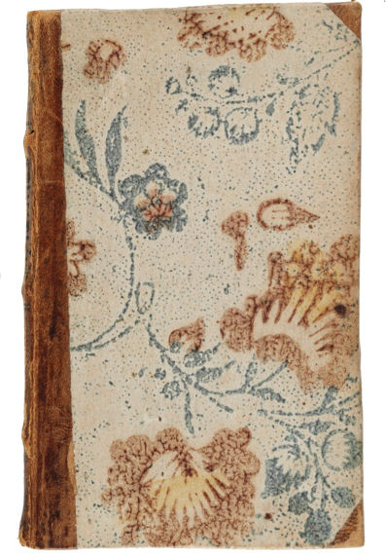
Bookbindings on the Internet
• Materiality
• Book history
• Provenance
• Production and reception
• Price and value
• Visual representation
• Fashion (decorative styles)
• Social and societal events

Slide 7
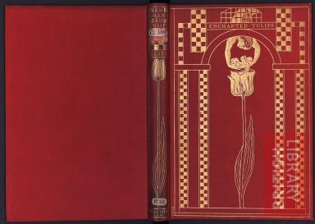
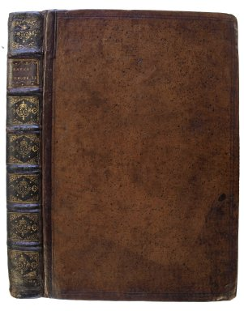
Some bookbinding databases

Slide 8
Bookbinding databases continues

Slide 9
ProBok in three views

Slide 10
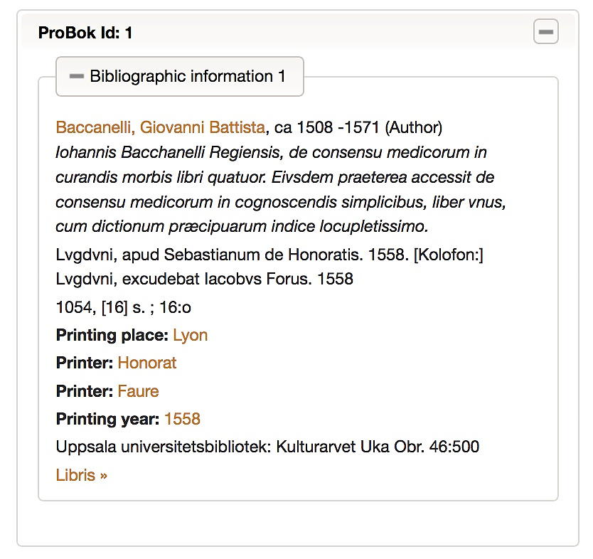
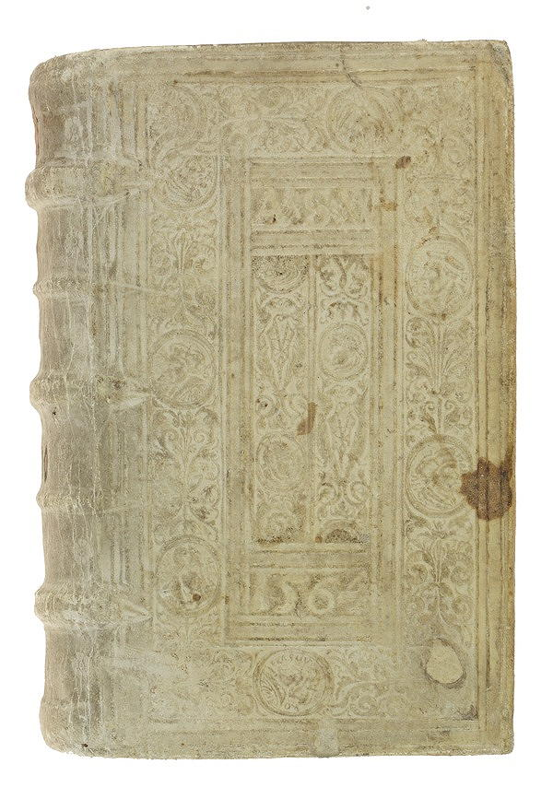
1. ProBok bibliographical information

Slide 11
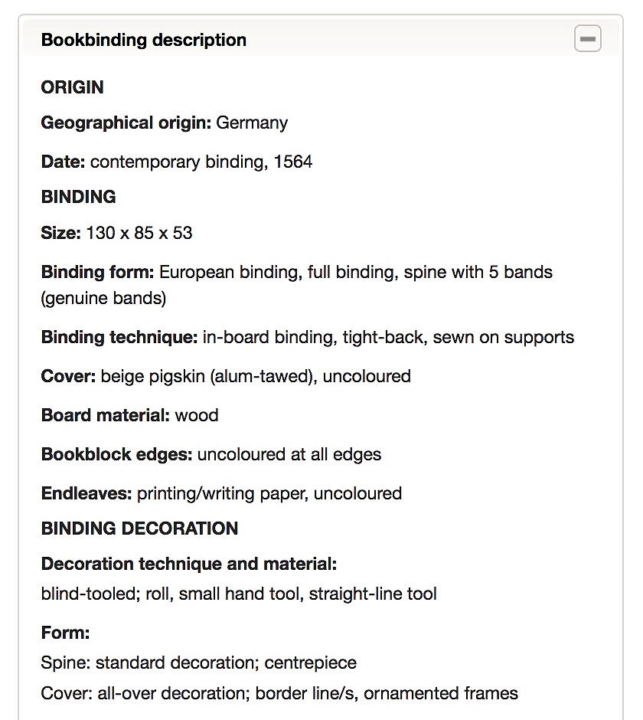
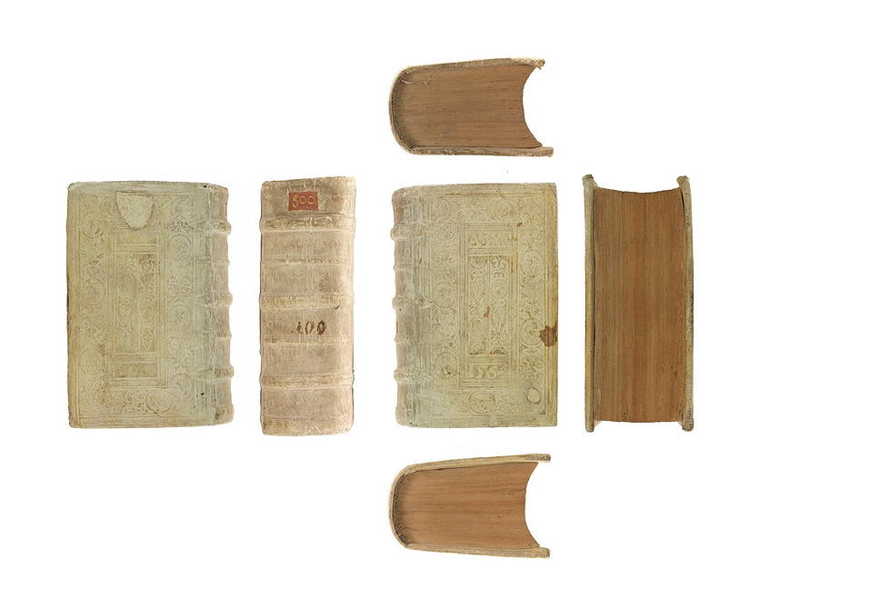
2. ProBok bookbinding description

Slide 12
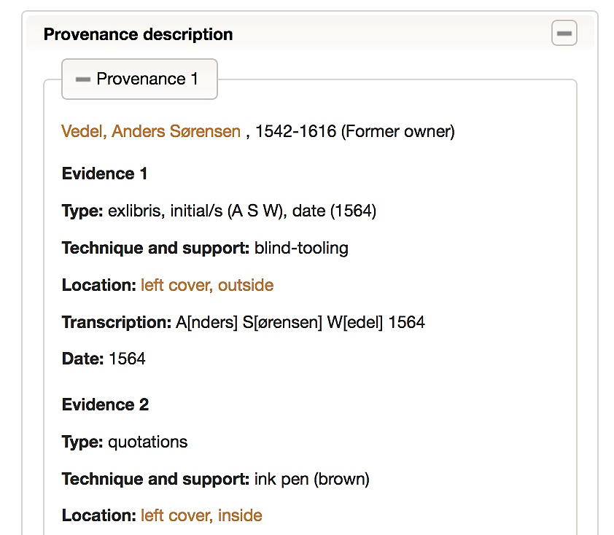
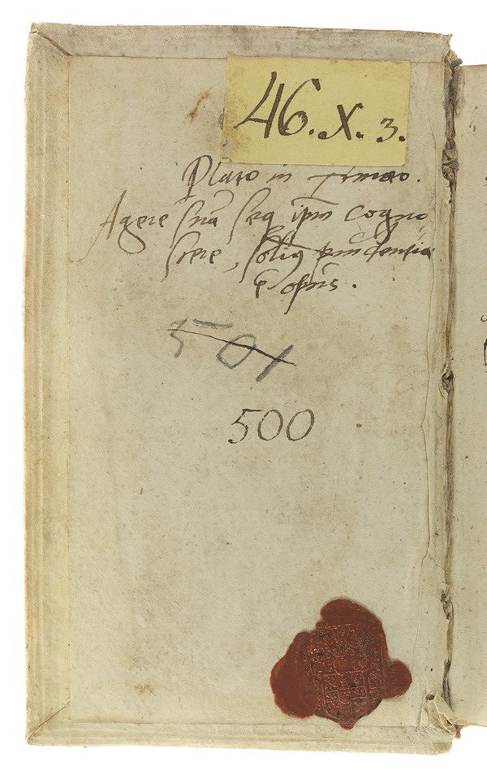
3. ProBok provenance description

Slide 13
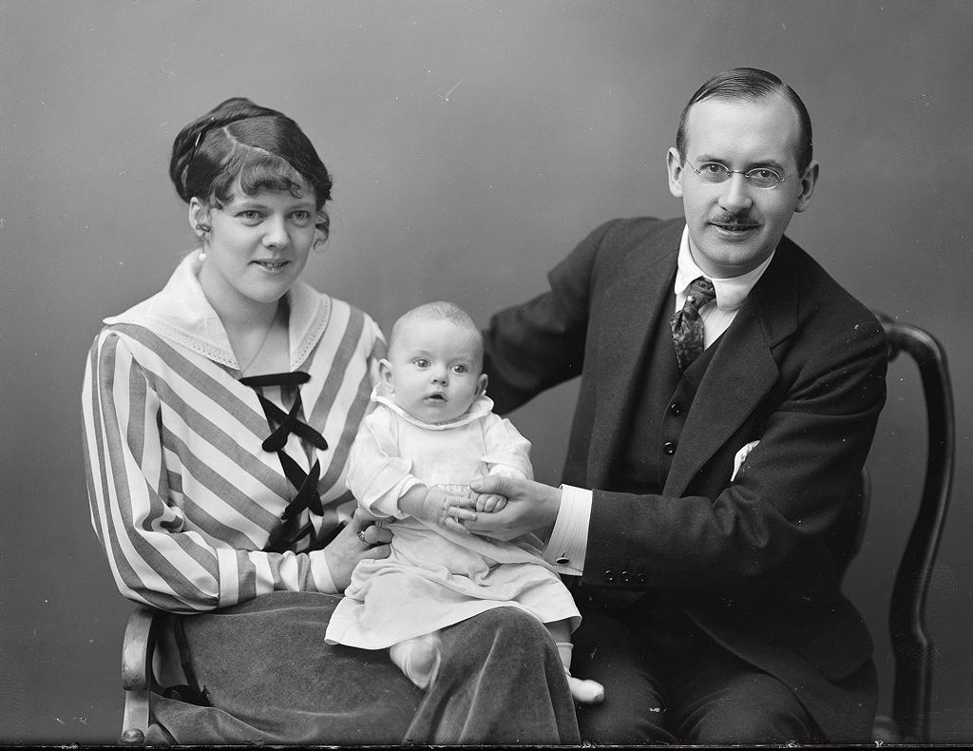
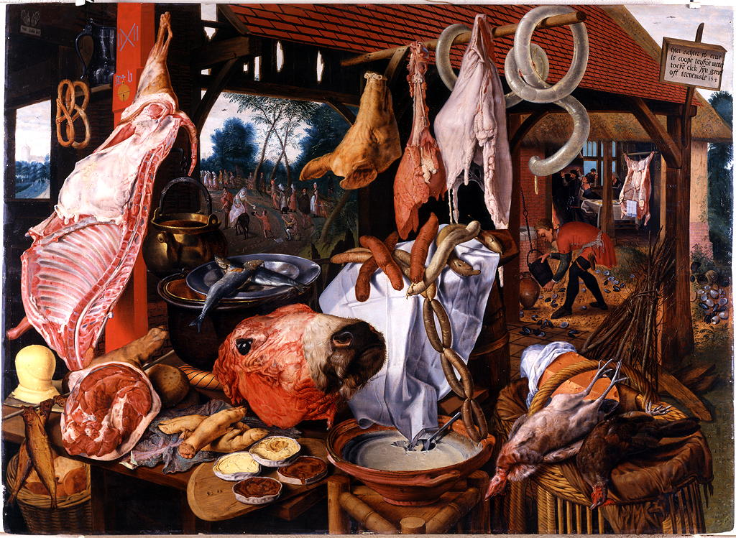
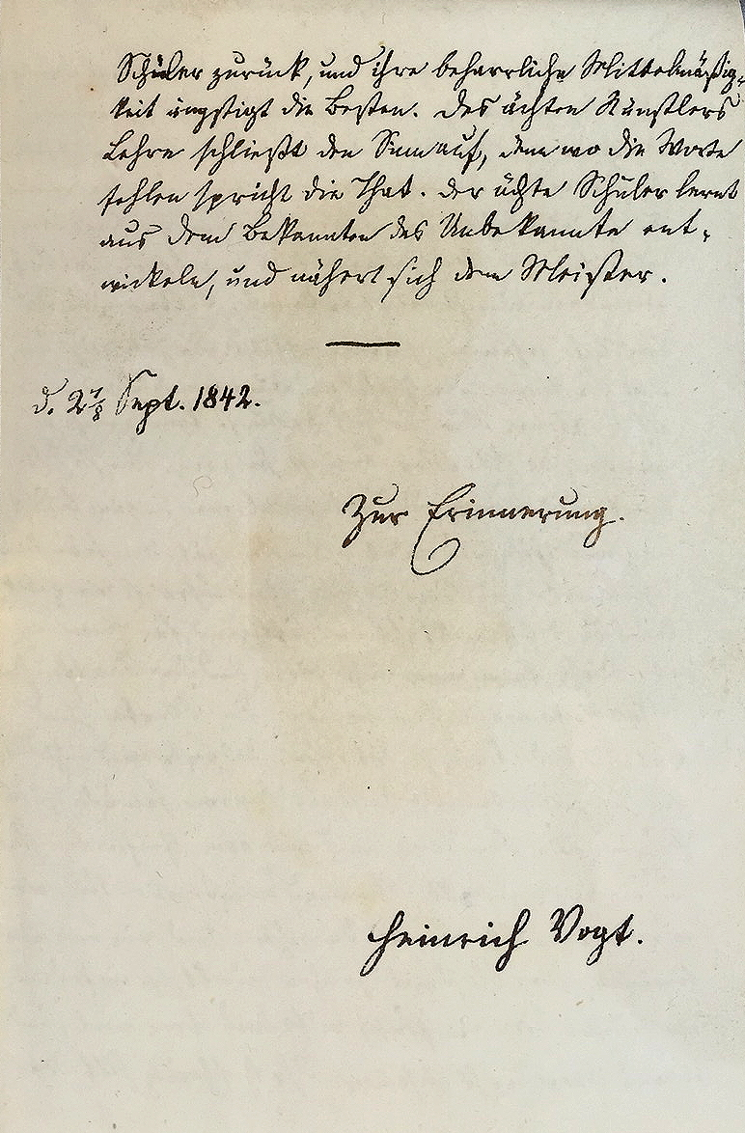
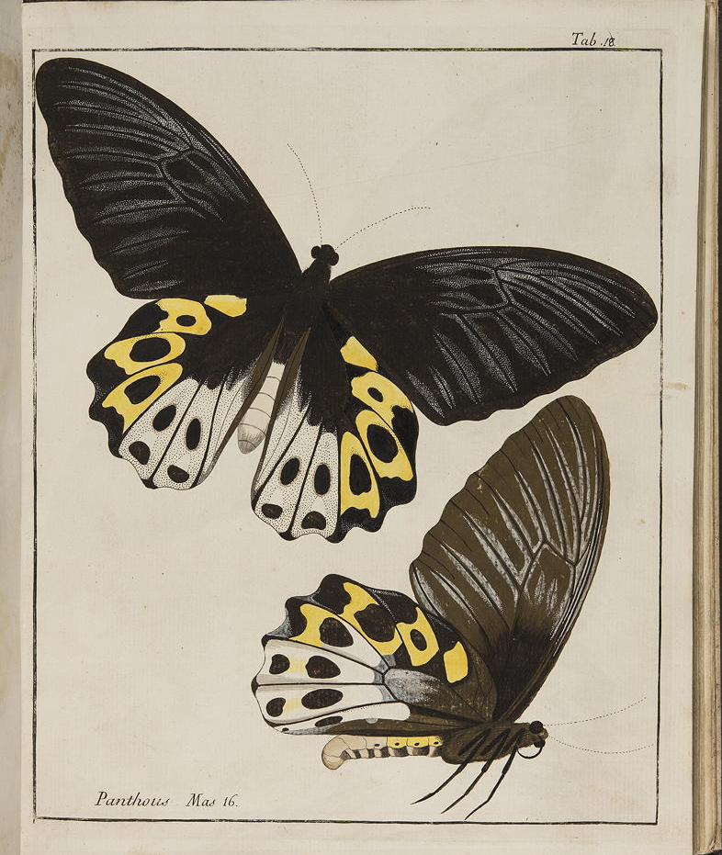
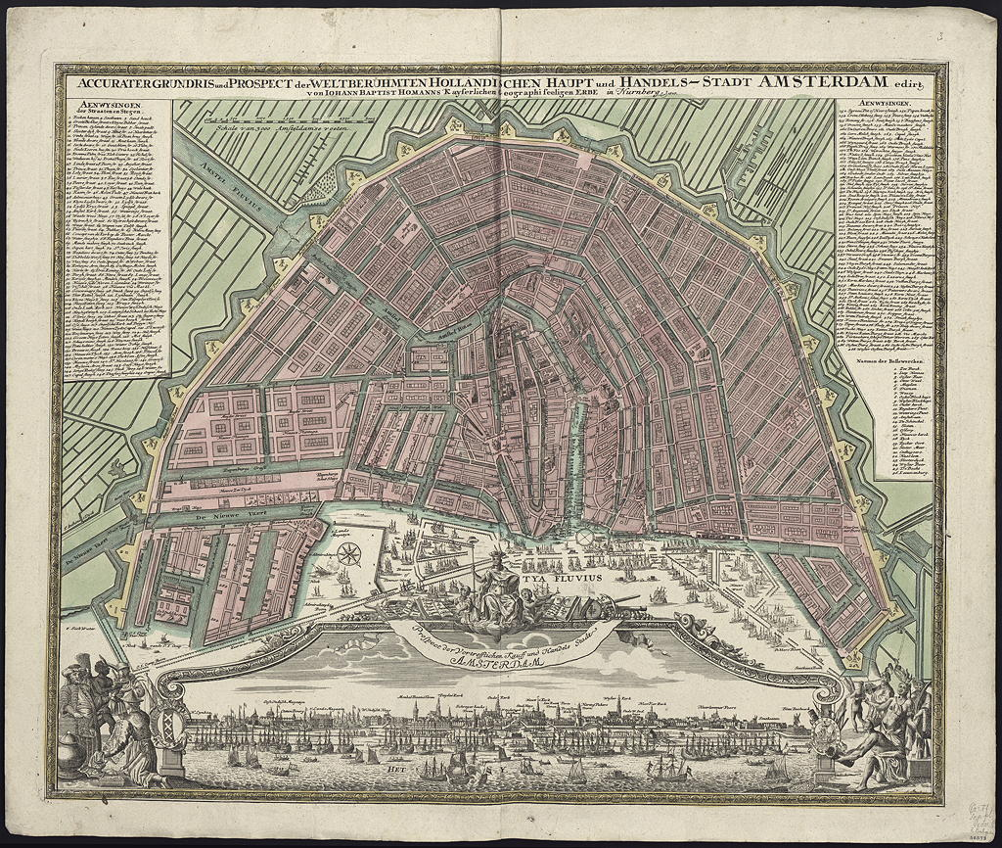
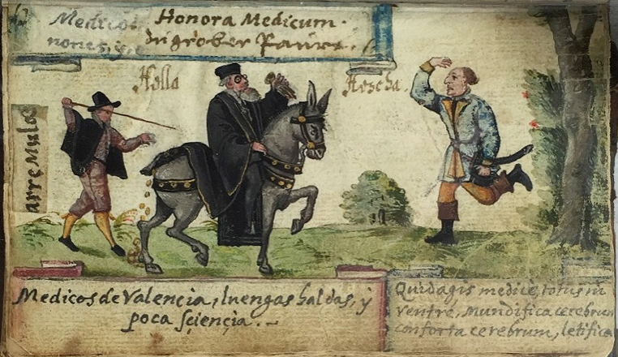
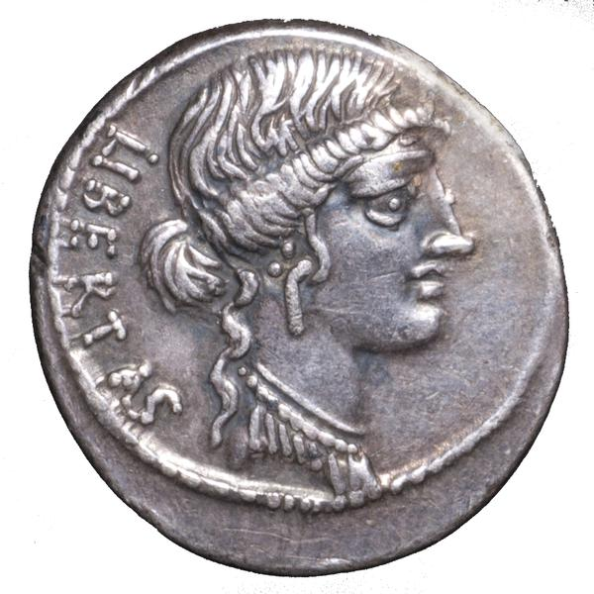
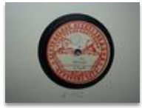
Alvin types of resources
Images
Music
Art
Books
Archives
Maps
Manuscripts
Sound
Objects
Notes:
nnehåller två musiktryck: William Corbett: XII sonate à tre... Amsterdam, E. Roger, s.d. samt Gottfried Finger: X suonate à tre... Amsterdam, E. Roger, s.d. Innehåller två musiktryck: William Corbett: XII sonate à tre... Amsterdam, E. Roger, s.d. samt Gottfried Finger: X suonate à tre... Amsterdam, E. Roger, s.d

Slide 14
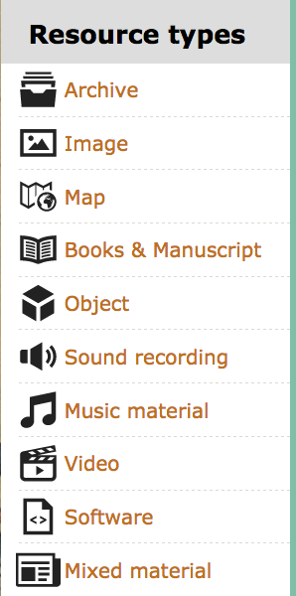
How to add bookbindings from ProBok
3. Provenance description
1. Bibliographic information
2. Bookbinding description

Slide 15
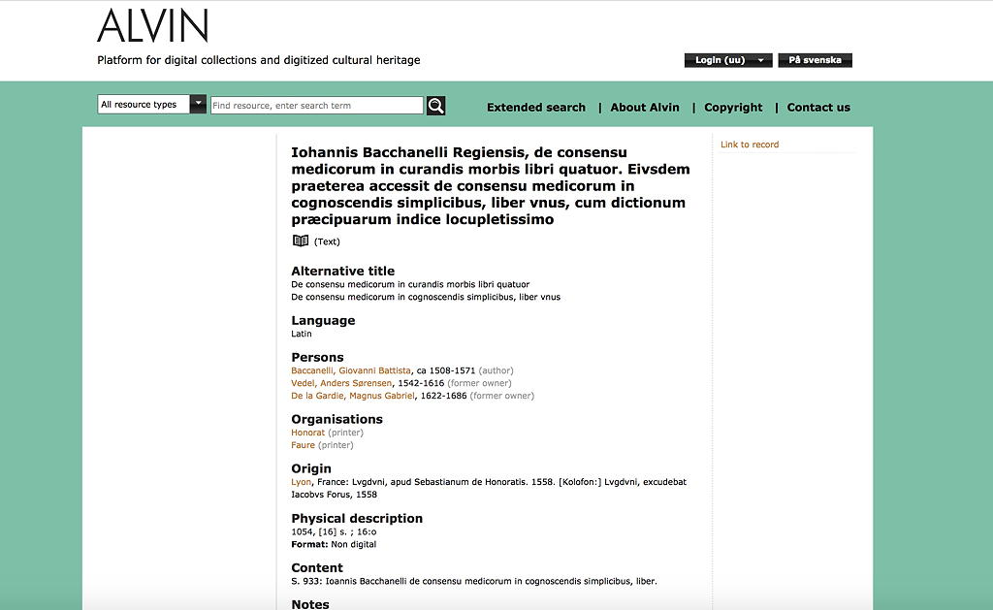
1. Alvin bibliographical data – entry hub

Slide 16
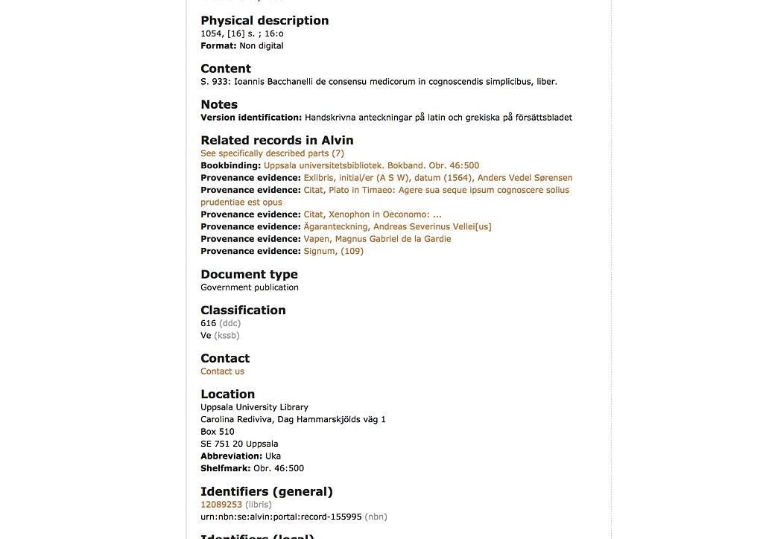
Internal linking
hub
Link to the National Opac

Slide 17
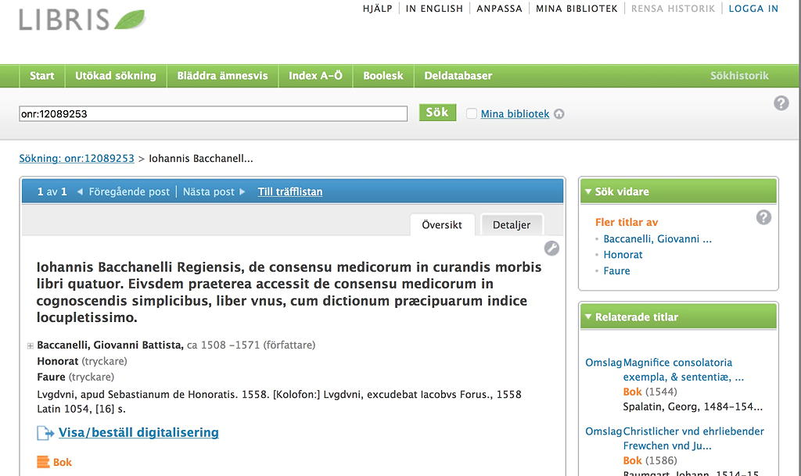
National Opac entry

Slide 18
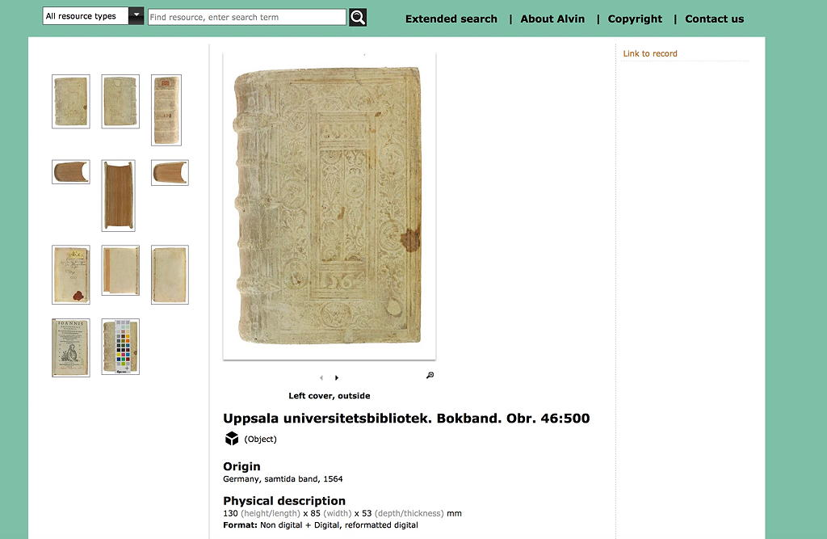
2. Alvin bookbinding entry

Slide 19
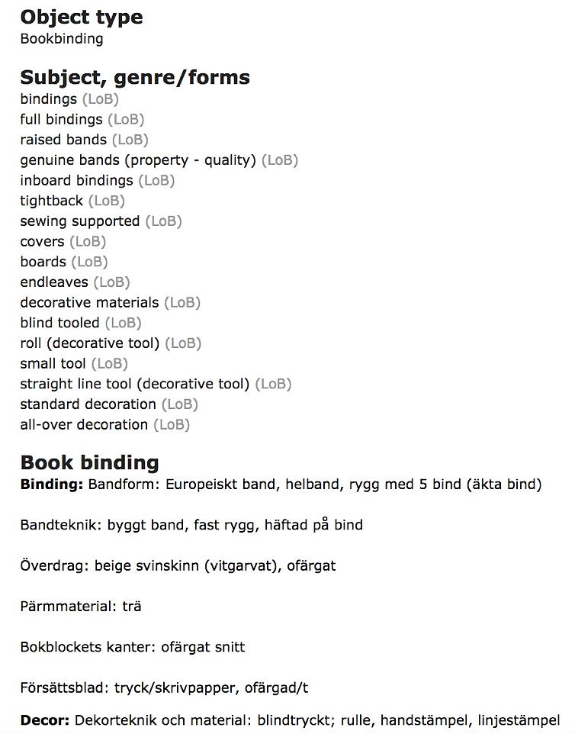
2. Alvin bookbinding description

Slide 20
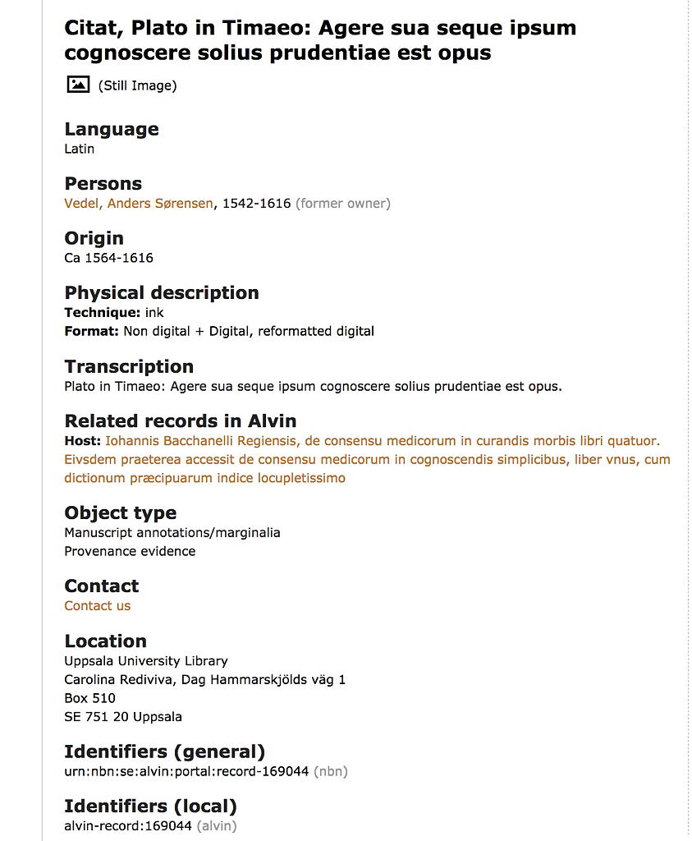
3. Alvin provenance information

Slide 21
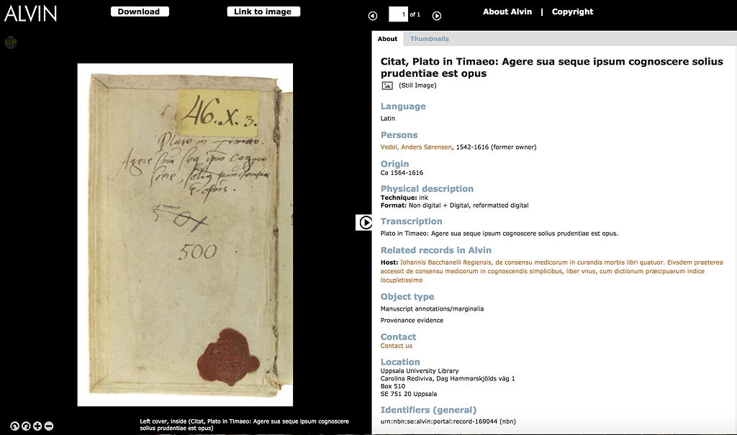
Alvin viewer functions -provenance

Slide 22
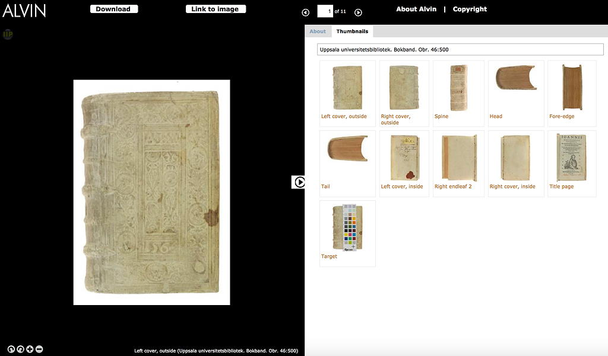
Alvin viewer functions - bookbindings

Slide 23
Back to the bibliographical description
Internal link to all
the described parts
related to this book
Internal linking
hub
Link to the National Opac

Slide 24
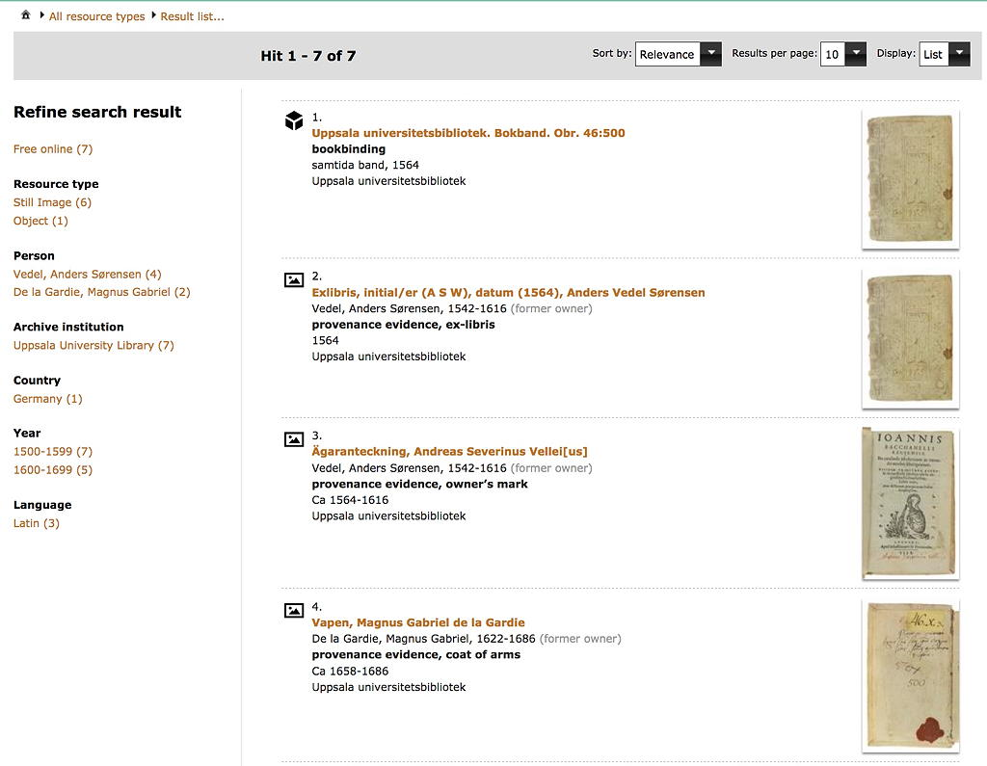
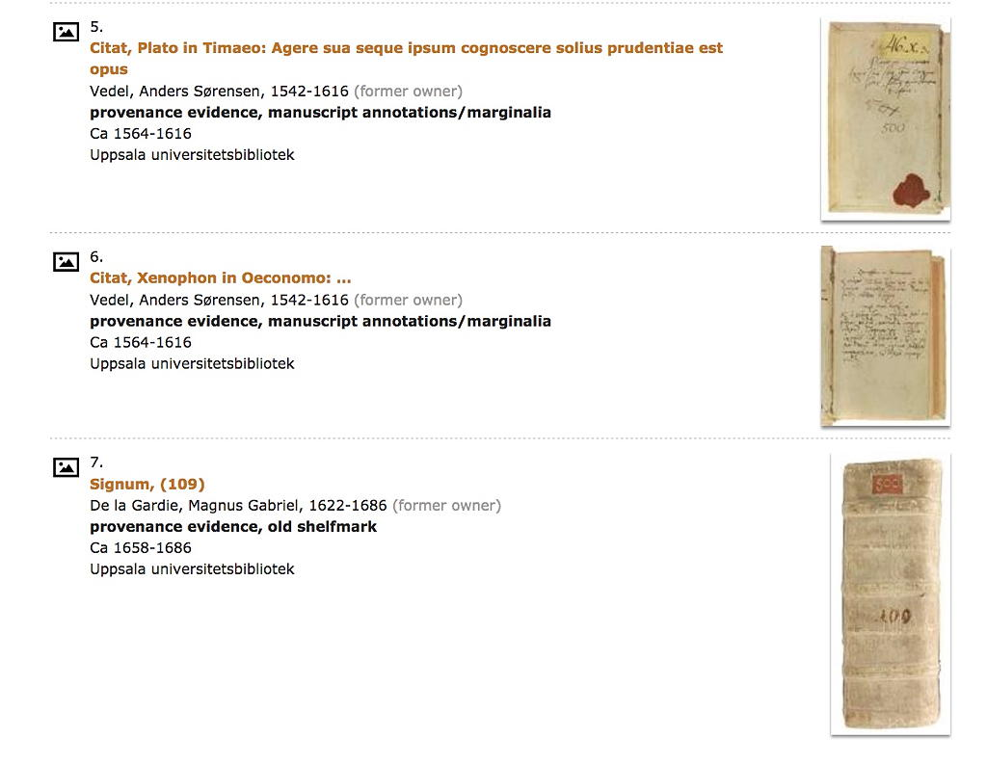
All the described parts are displayed

Slide 25
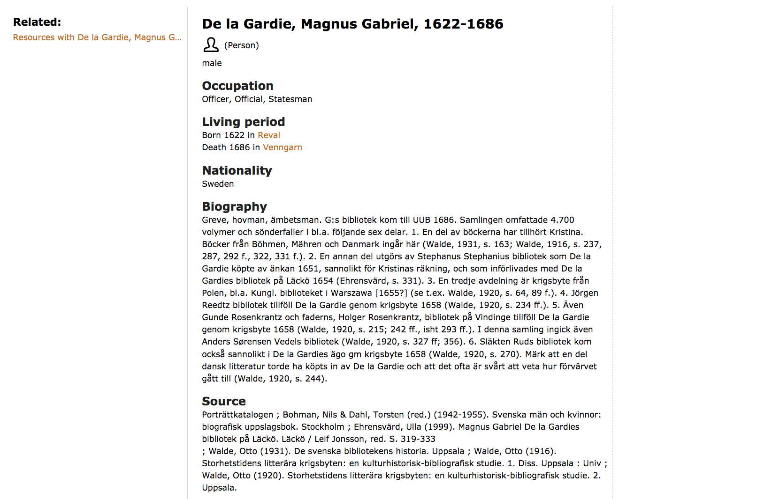
Provenance no. 2

Slide 26
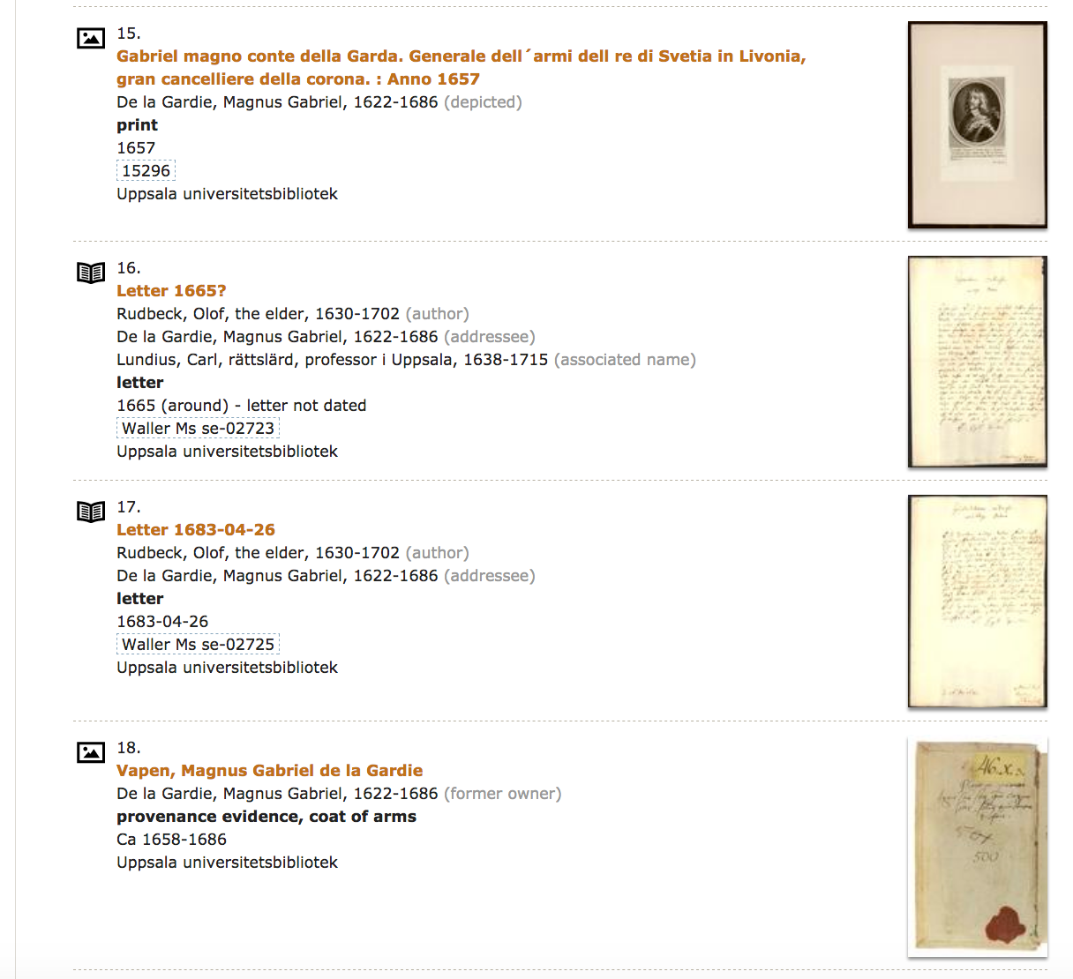
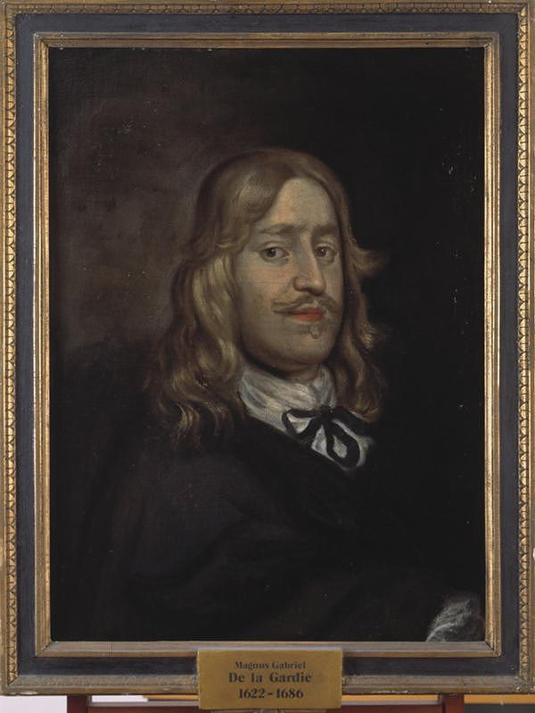
20 related resources
12 text-related resources
incl. 8 letters
5 images (one oil painting)
2 provenances
1 archive

Slide 27
Matters to be decided
A stable model for connecting Alvin to the Ligatus glossary
Including technical consideratios such as an API-connection,
download model etc.

Slide 28
Extending cooperation
•The technical structure of Alvin is based on a shared platform
•The shared platform can allow for extended partnerships with interested institutions
and/or projects for describing and publishing bookbindings
•To be able to evaluate long distance cooperation, we seek an interested partner
institution or project to be able to test the requirements needed for extended
cooperation
•A test will include communication issues, membership organizational issues,
distributed data storage, technical, financial, and language issues, modular or full
use, matters arising etc.

