Slide 1
‘The V&A: an ace library, with quite a nice museum attached’

Slide 2
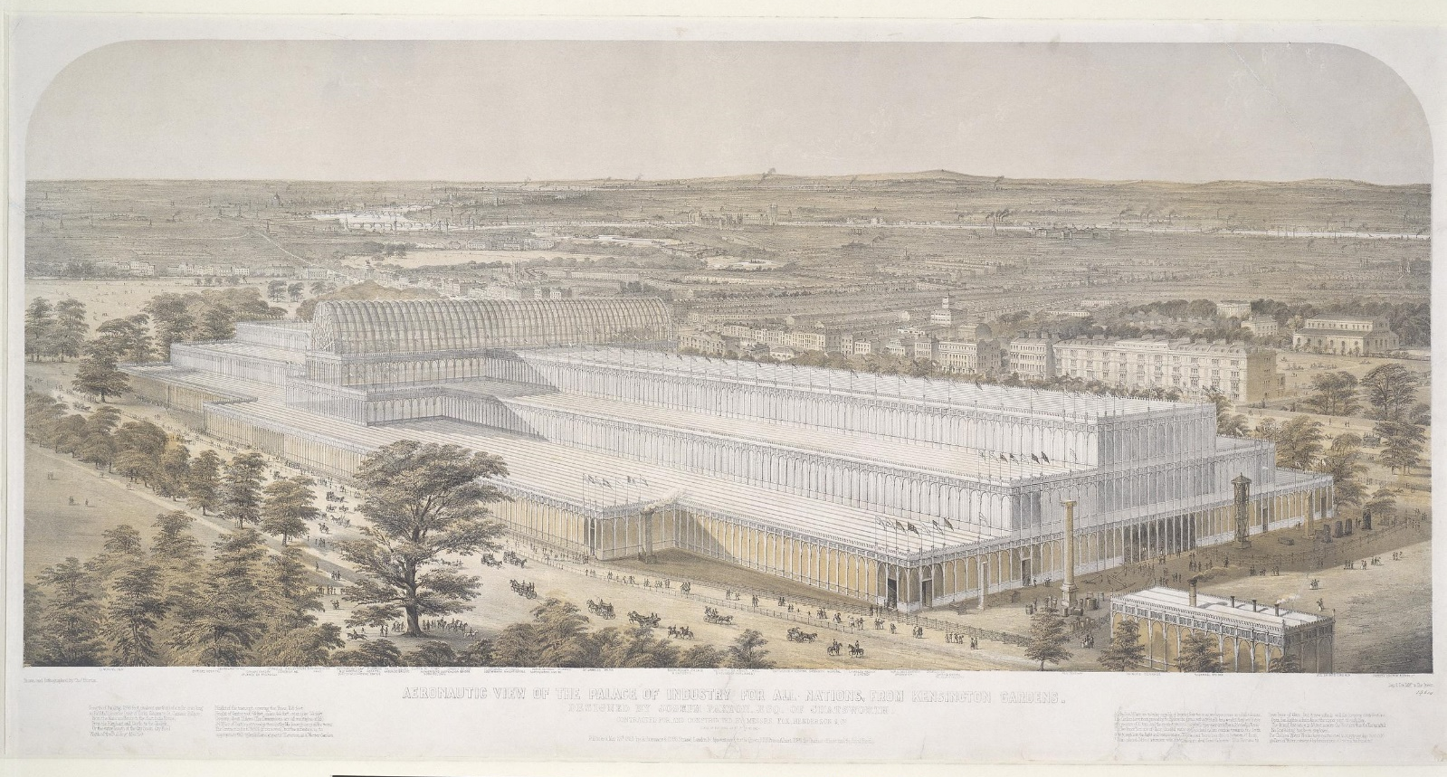
The Great Exhibition of 1851
Charles Burton, Aeronautic view of the Great Exhibition building
Colour lithograph, 1851
19614
J. Michael, Part of the Fine Arts Court
watercolour and gouache over pencil on paper, 1851
19538:5

Slide 3
The National Art Library
Notes:
ADD PICTURE TAKEN AT FRONT THROUGH GLASS DOORS

Slide 5
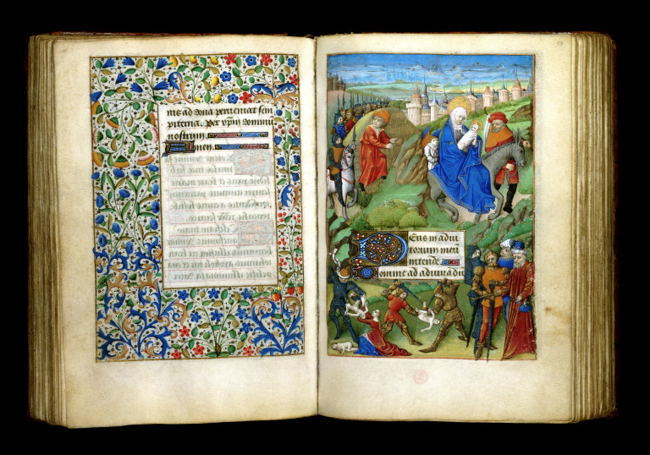
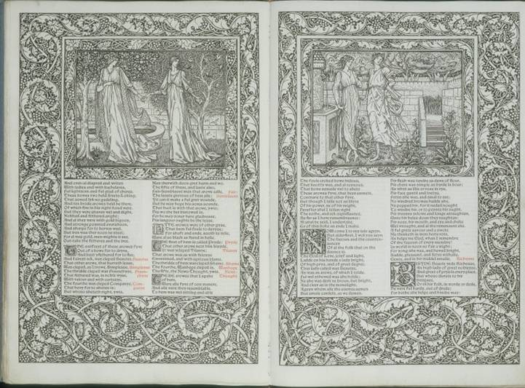
Special Collections
The Margaret de Foix Hours, Rennes (?), 1471-1476.
MSL/1910/2387
The Works of Geoffrey Chaucer (Hammersmith: Kelmscott Press, 1896), illustrations by Edward Burne-Jones (1896)
L.757-1896
Notes:
Special Collections

Slide 6
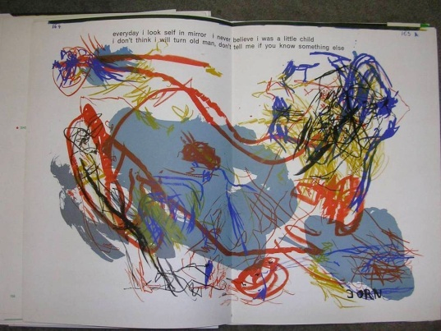
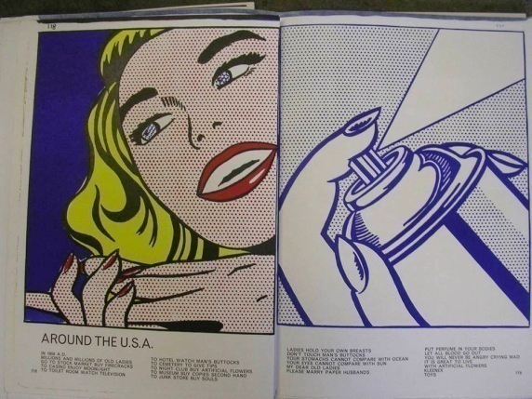
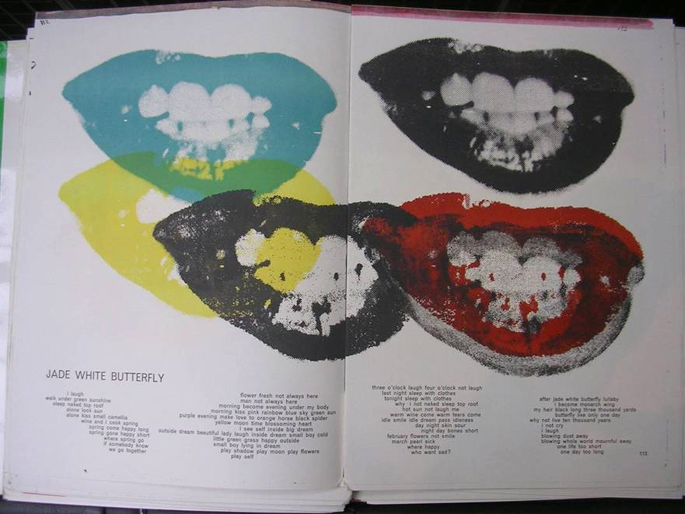
Walasse Ting, 1 ¢ Life (1964): Asger Jorn, Roy Lichtenstein, Andy Warhol.
L.5854-1982
The Book of Nails (Floating Concrete Octopus, 1992).
38041992107227
Notes:
Art of the Book

Slide 7
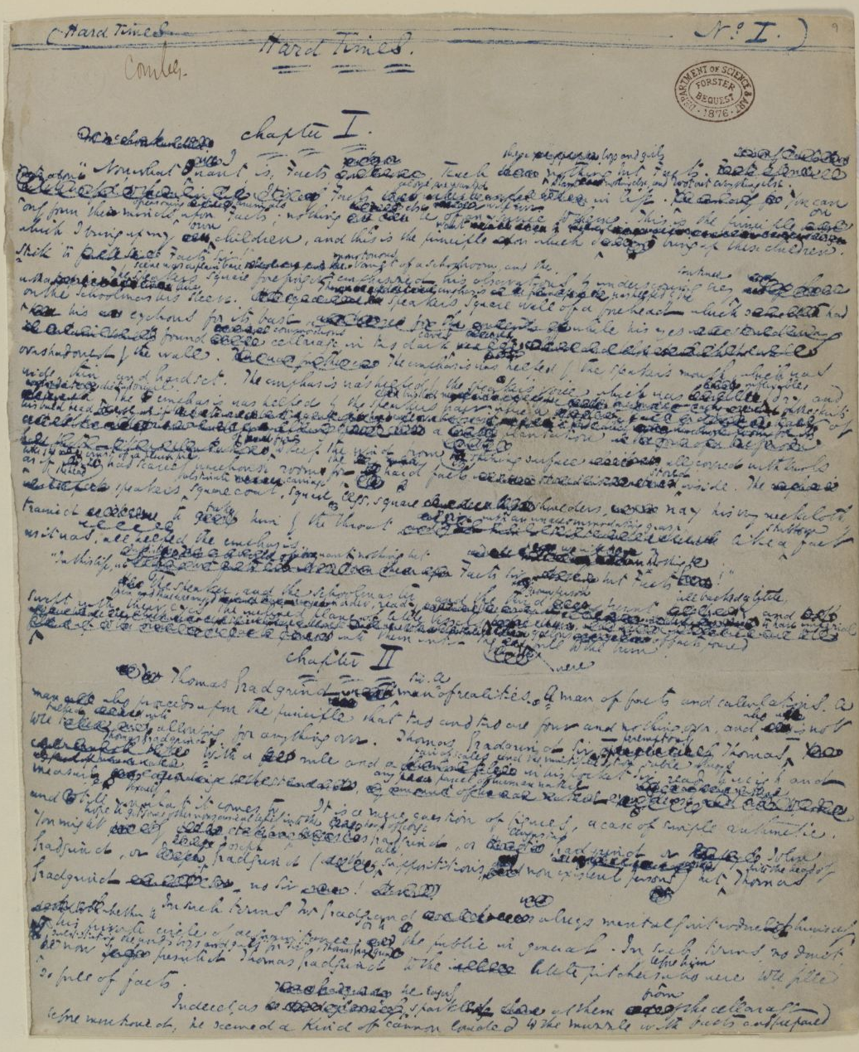
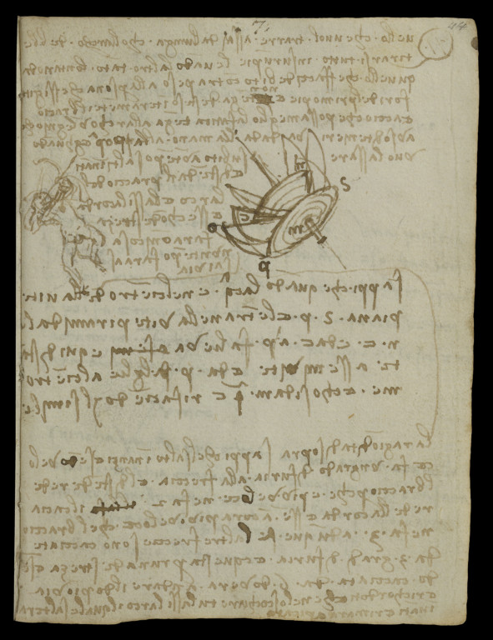
Forster Collection
Charles Dickens, Hard Times [original manuscript], c. 1854
MSL/1876/Forster/163
Edward Matthew Ward, John Forster in his library, ca.1850.
P.74-1935
Leonardo da Vinci (1452-1519), Five Notebooks bound up into three volumes, known as Codex Forster
MSL/1876/Forster/141/I-III

Slide 8
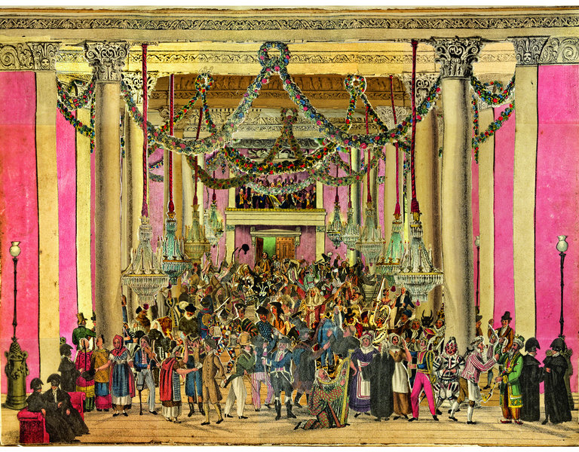
The Jacqueline and Jonathan Gestetner Paper Peepshows Collection
Masquerade
London, ca.1826
Hand-coloured lithographs
Gestetner 207
Perspectivische Ansicht des Tunnel unter der Themse / Vue perspective du Tunnel sous la Tamise
German, ca.1835
Hand-coloured lithographs
Gestetner 118
Notes:
Masquerade
London, ca.1826
Gestetner 207

Slide 11
CollectionsIndex+

Slide 12
V&A Search the Collections

Slide 16
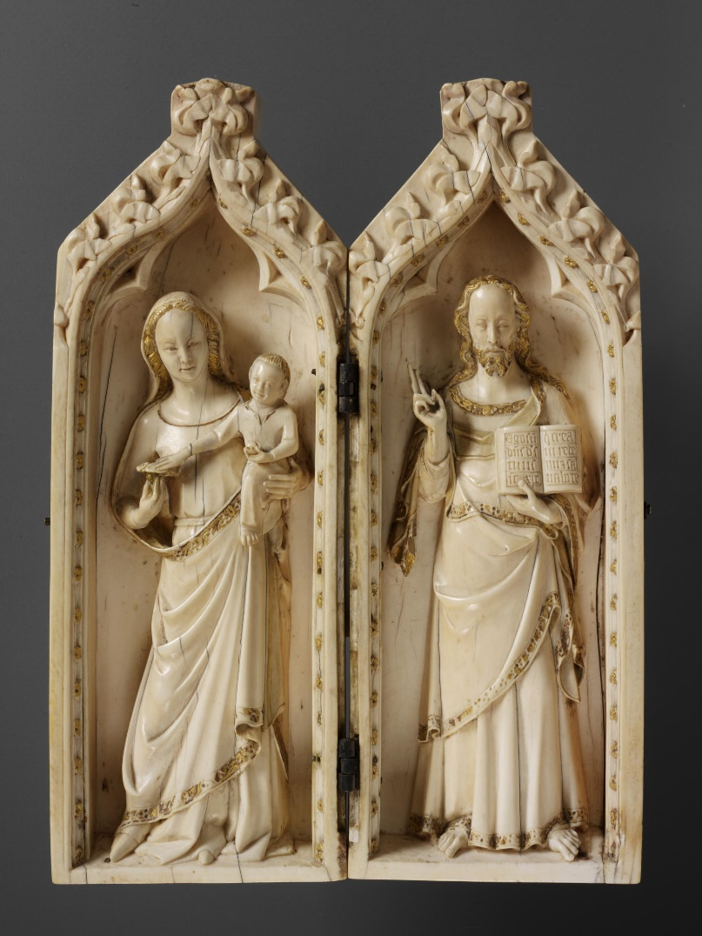
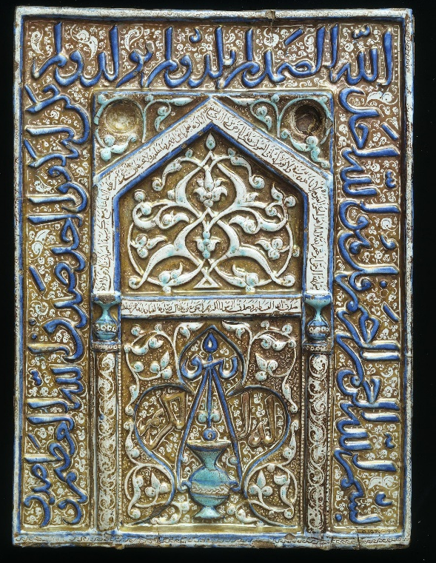
George Salting (1835-1909)
So-called Salting Mihrab
Iran, ca.1300
Moulded tile
C.1977-1910
The Margaret de Foix Hours,
Rennes (?), 1471-76
MSL/1910/2387
So-called Salting Diptych
Probably Westminster, c. 1310-20
Ivory
London, V&A, A.545-1910

Slide 19
International Image Interoperability Format (IIIF)
Notes:
Leonardo in IIIF

Slide 20
Notes:
Leonardo in IIIF

Slide 23
Notes:
Lemoyne de Morgues

Slide 24
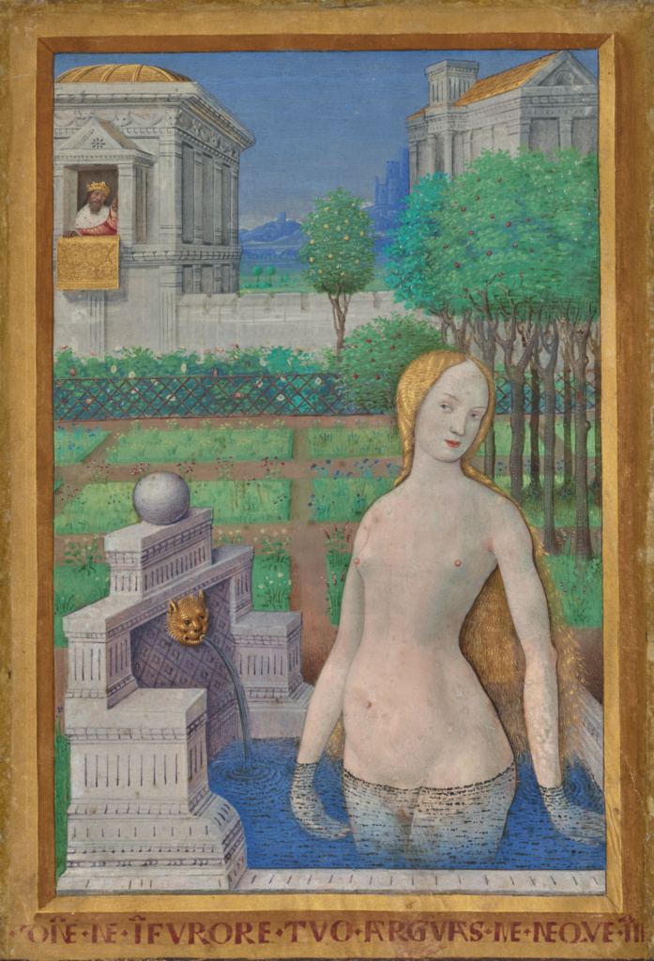
The Hours of Louis XII
London, V&A, Prints and Drawings dpt, E.949-2003
Los Angeles, J.P. Getty Museum, ms. 79 recto

Slide 25
Notes:
Lafreri

Slide 26
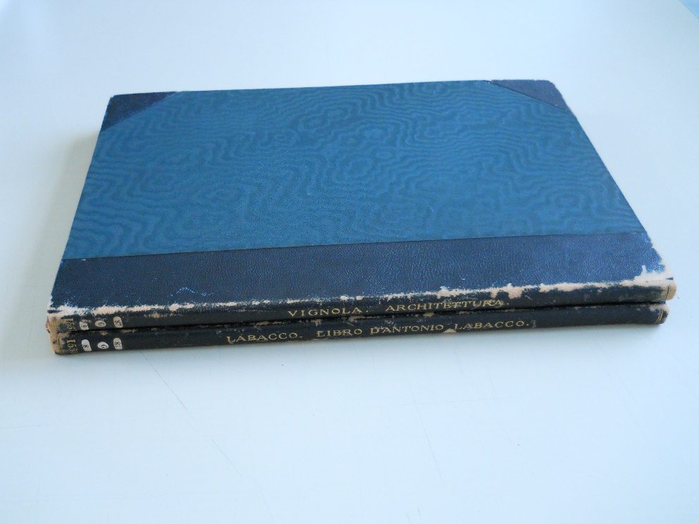
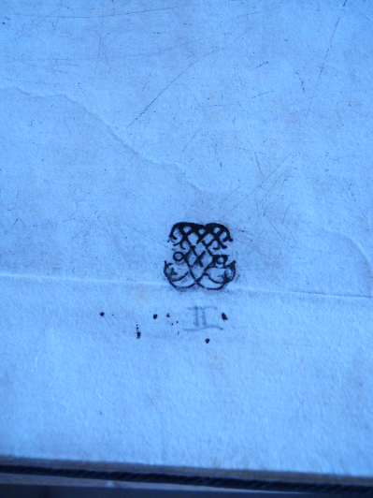
Lafreri Project – Elizabeth Miller

Slide 28
Dr Catherine Yvard c.yvard@vam.ac.uk

