Slide 2
CERL
Promotion Working Group
Presentation for Annual General Meeting, Antwerp 2015

Slide 3
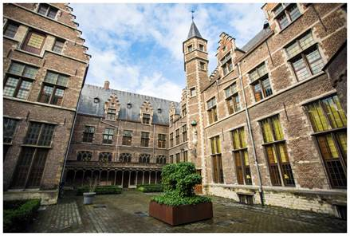
Background
Working Group comprises: Adrian Edwards (Chair), Cristina Dondi, Kimberley Hart, Marian Lefferts, Timo Schleier and Ingeborg Versprille.
Relates primarily to the prioritization of work undertaken by the CERL staff and the website team at Göttingen.

Slide 4

Promotion Action Plan
  Early 2014 Promotion Working Group developed an Action Plan to coordinate and professionalise its activities.
  Approved by the CERL Coordinating Committee and work began straight away.
Main programme of work from March 2014 focused on:
  Website
  Welcoming new members
  Raising awareness of CERL and its products through presentations at events and through a re-freshed series of leaflets

Slide 5
Website
  Redesigned as well as refreshed homepage; developed new content and navigation. ✓
  Created a new facility for CERL and the members to promote their events by way of a carousel and timeline. ✓
  (Ongoing: we need member libraries to provide links on their own websites to the CERL homepage, and for individuals who use Google+ to mark CERL as trusted site).

Slide 6
Welcoming new members
  Re-drafted the welcoming letter to include an invitation to new members to put CERL leaflets in their reading rooms. ✓
  Standard invitation to new members to introduce and promote themselves by contributing a piece for the CERL Newsletter. ✓

Slide 7
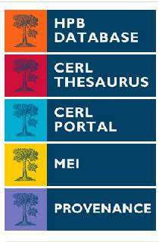
Events & Leaflets
  Successfully presented CERL to key organisations and at targeted events
  (e.g. at the Ligatus/CERL Seminar, London, June 2015) ✓
  Finished updating the series of printed publicity leaflets using a new professionally designed template. ✓

Slide 8
Next Steps
Promotion Action Plan 2014-15 now complete.
CERL Coordintating Committee has endorsed a new Marketing Strategy, which focuses on audiences, messages, communication channels, including the enhanced use of social media.

Slide 9

Join in!
We need your help to:
  contribute content for the December issue of the CERL Newsletter
  ensure that our leaflets are visible in your reading rooms
  provide information about your events for the
  CERL Website homepage (Carousel and
  Timeline)
  follow CERL on Facebook, Twitter and LinkedIn.

Slide 10
Thank you
adrian.edwards@bl.uk

