Slide 1
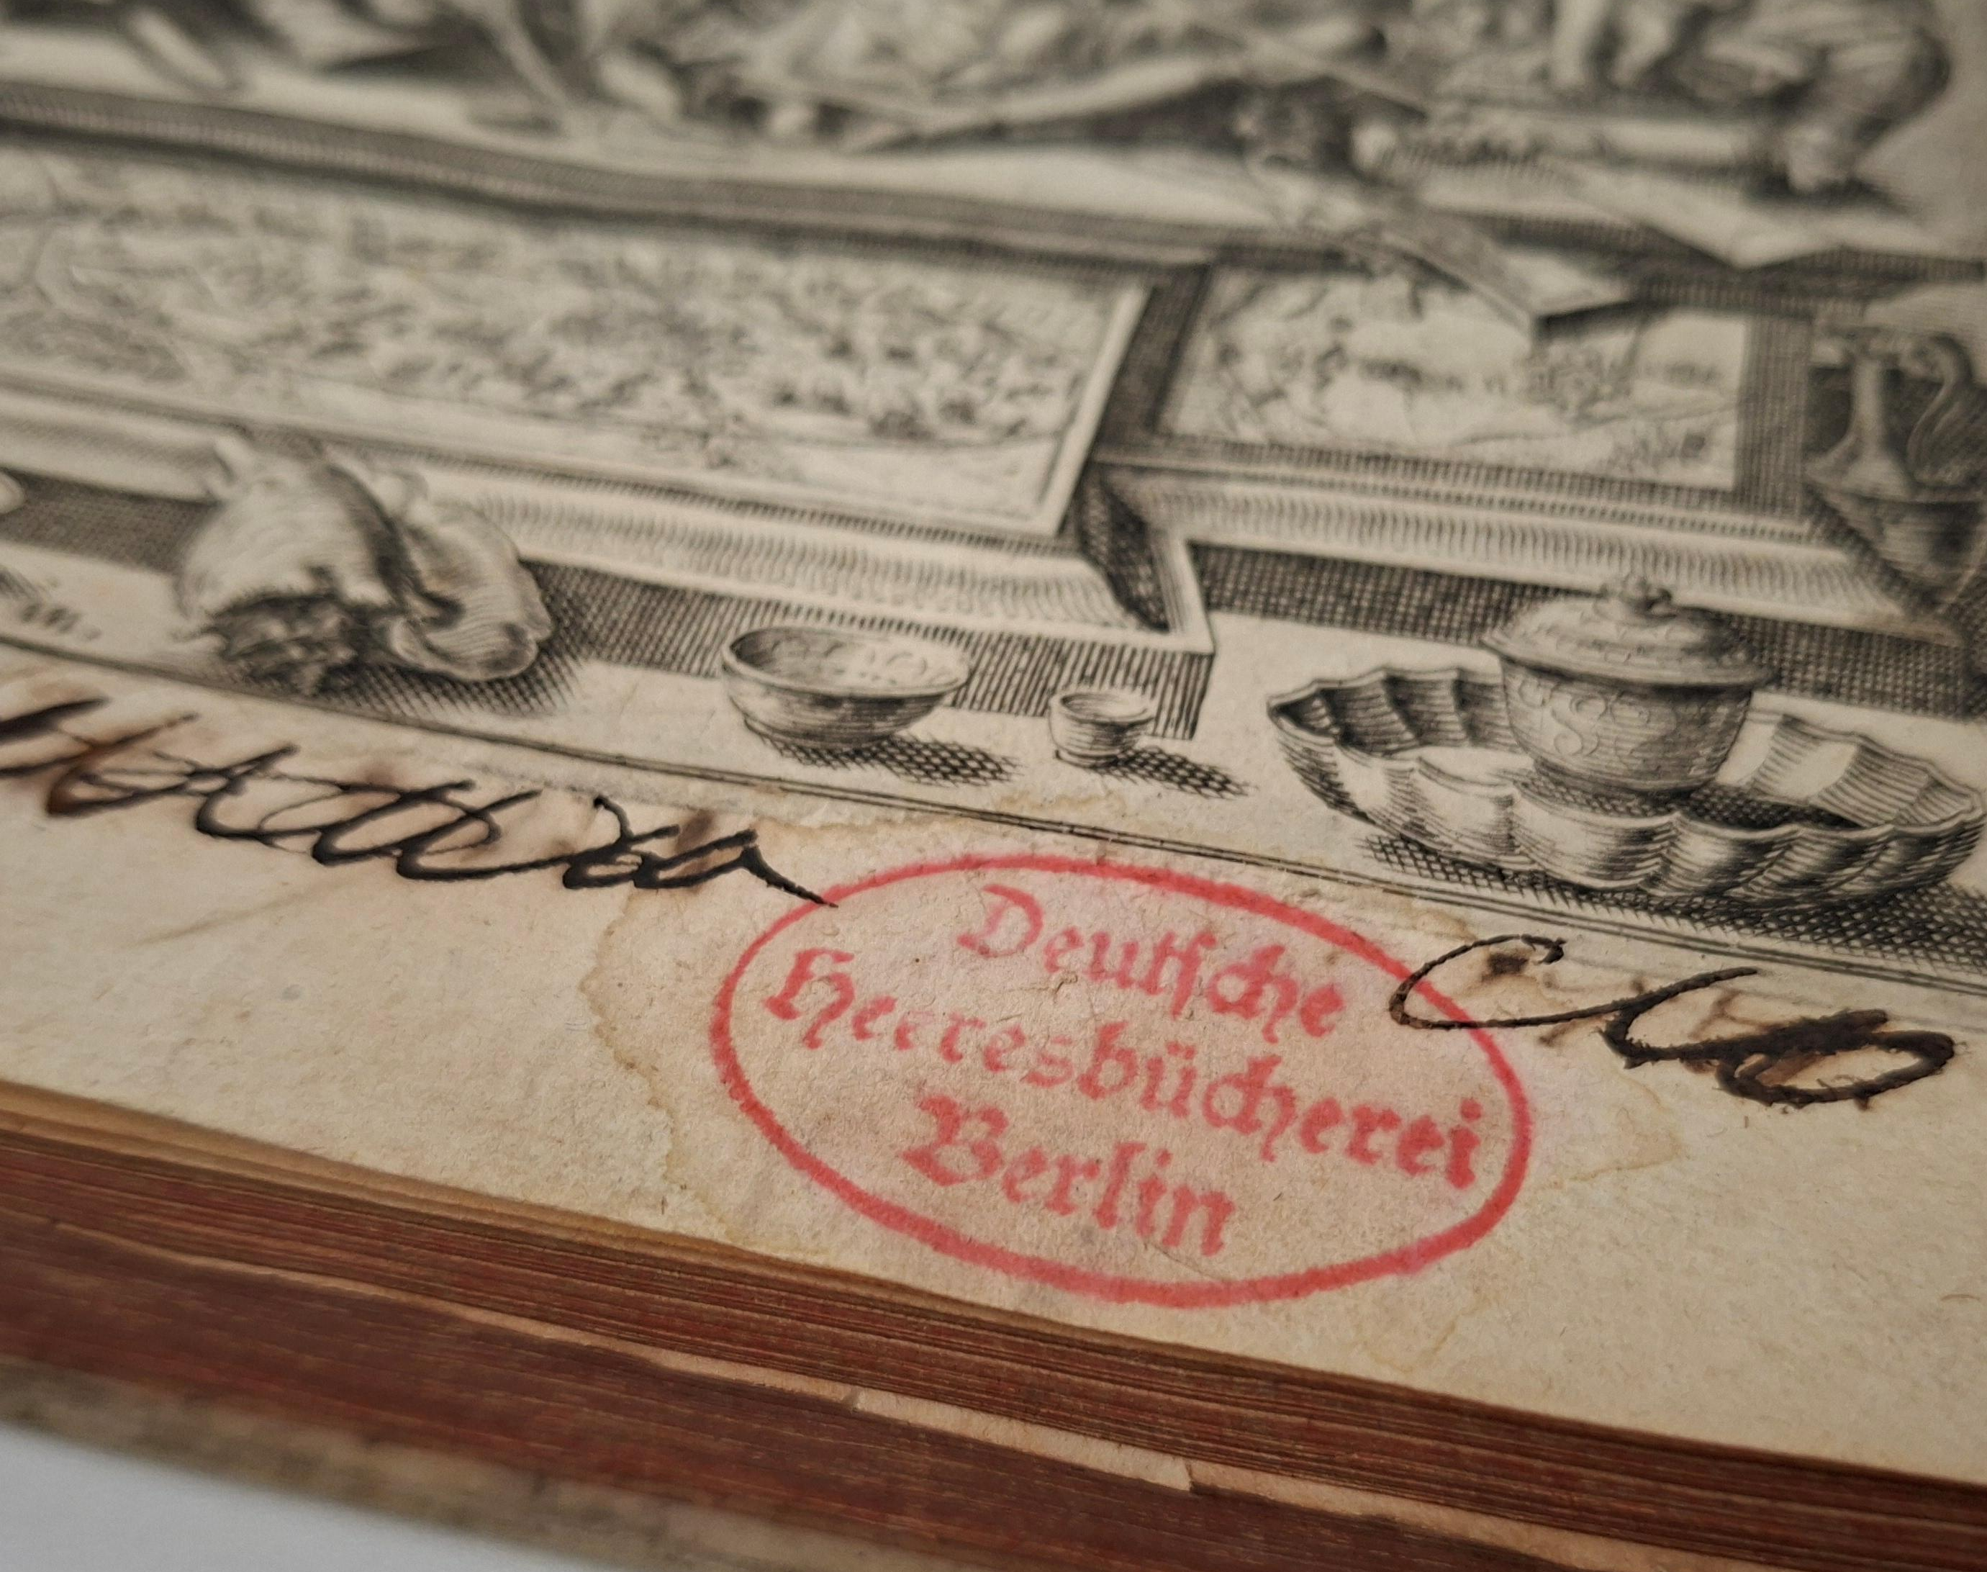
Four books from the Deutsche Heeresbücherei
The multi-layered provenance history of a recent donation to the Rijksmuseum Research Library
Alex Alsemgeest
Curator of Library Collections,
Rijksmuseum

Slide 2
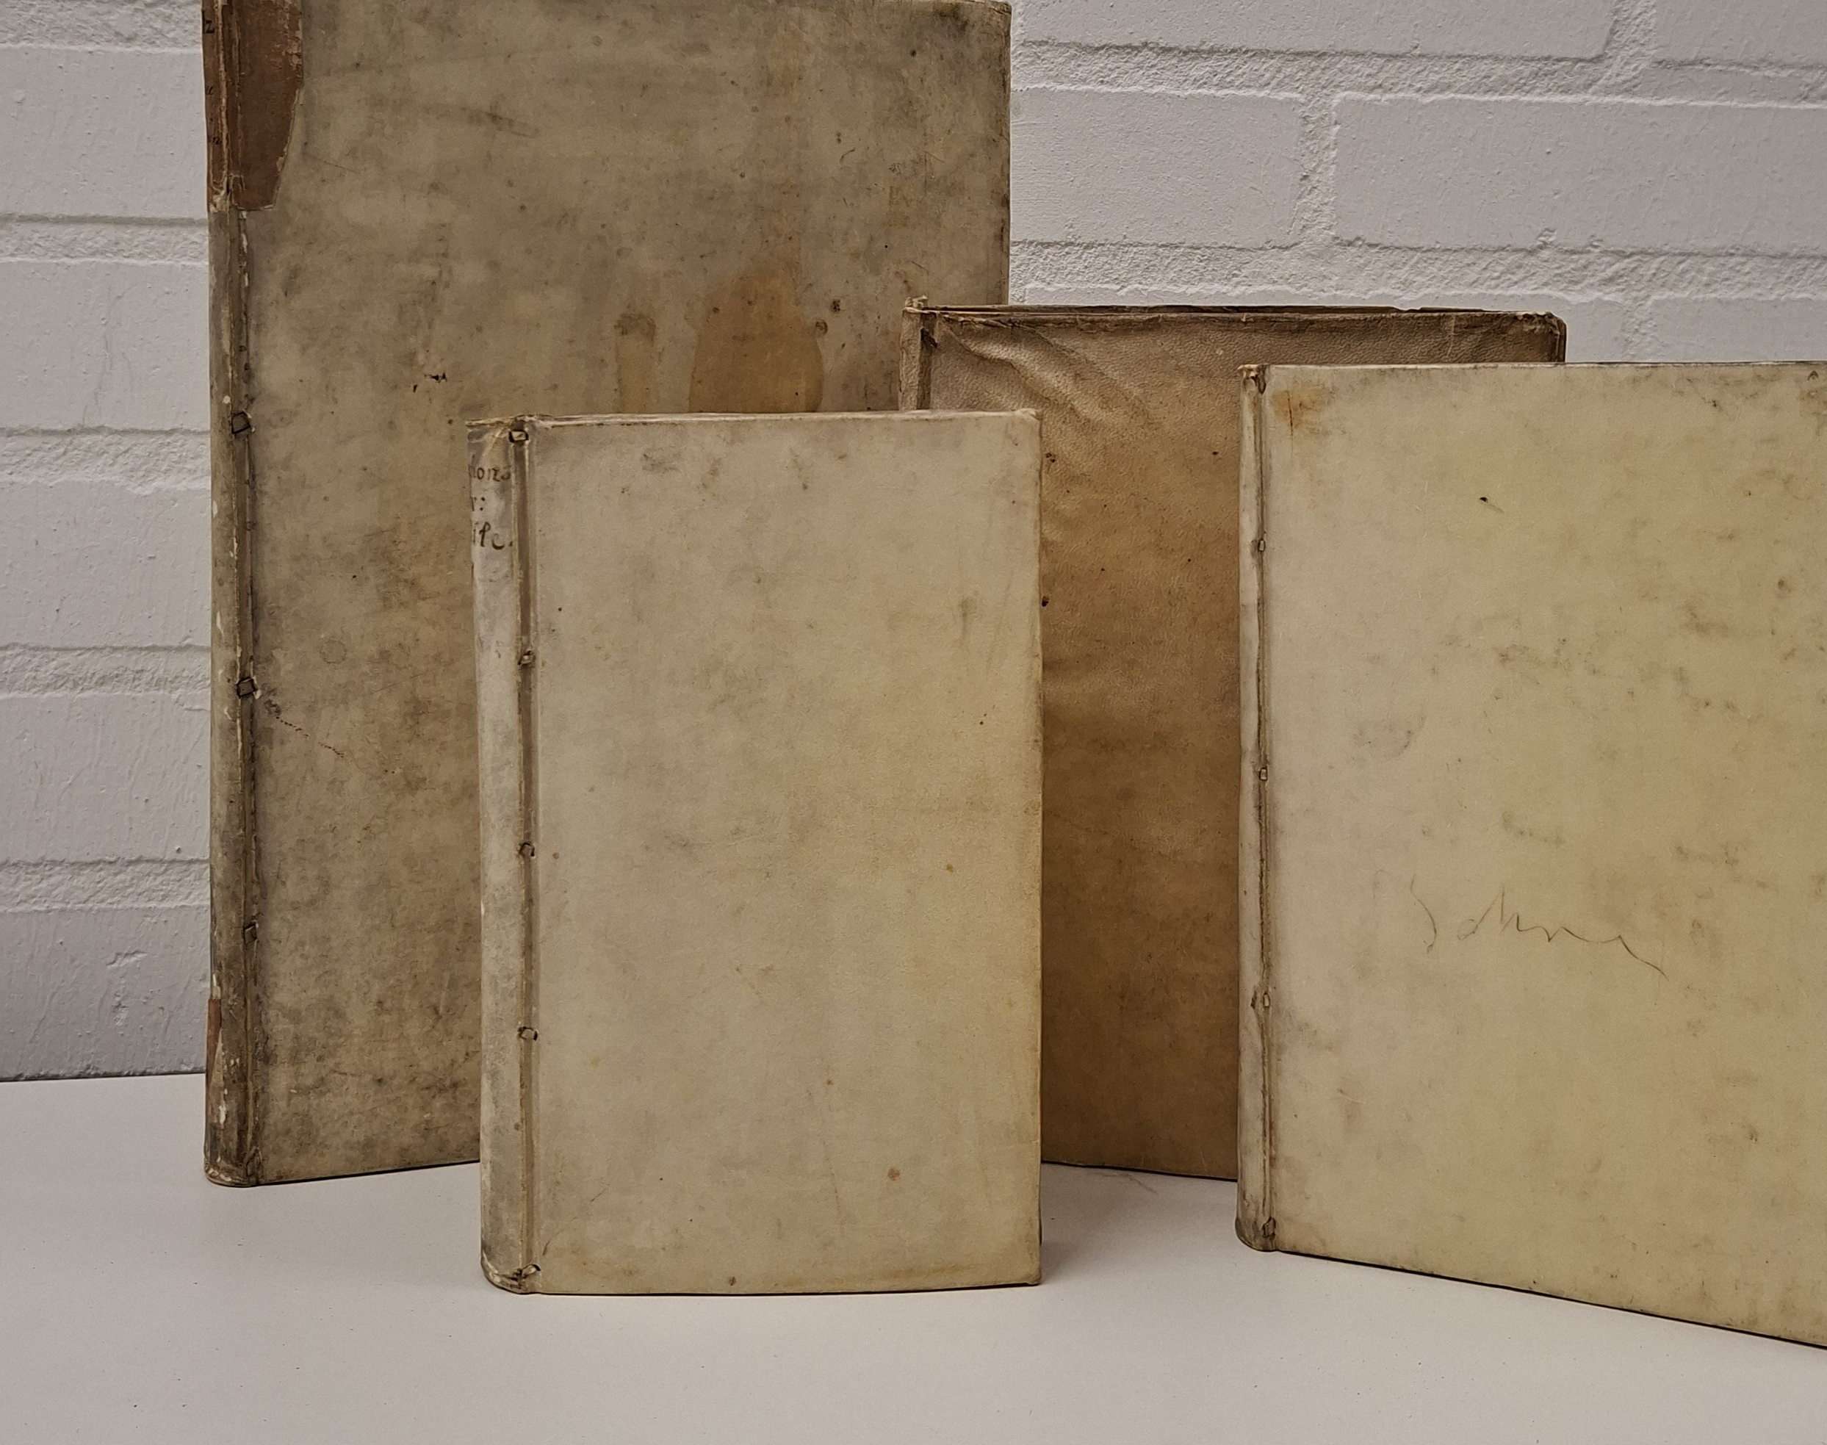

Four books from the Deutsche Heeresbücherei

Slide 3
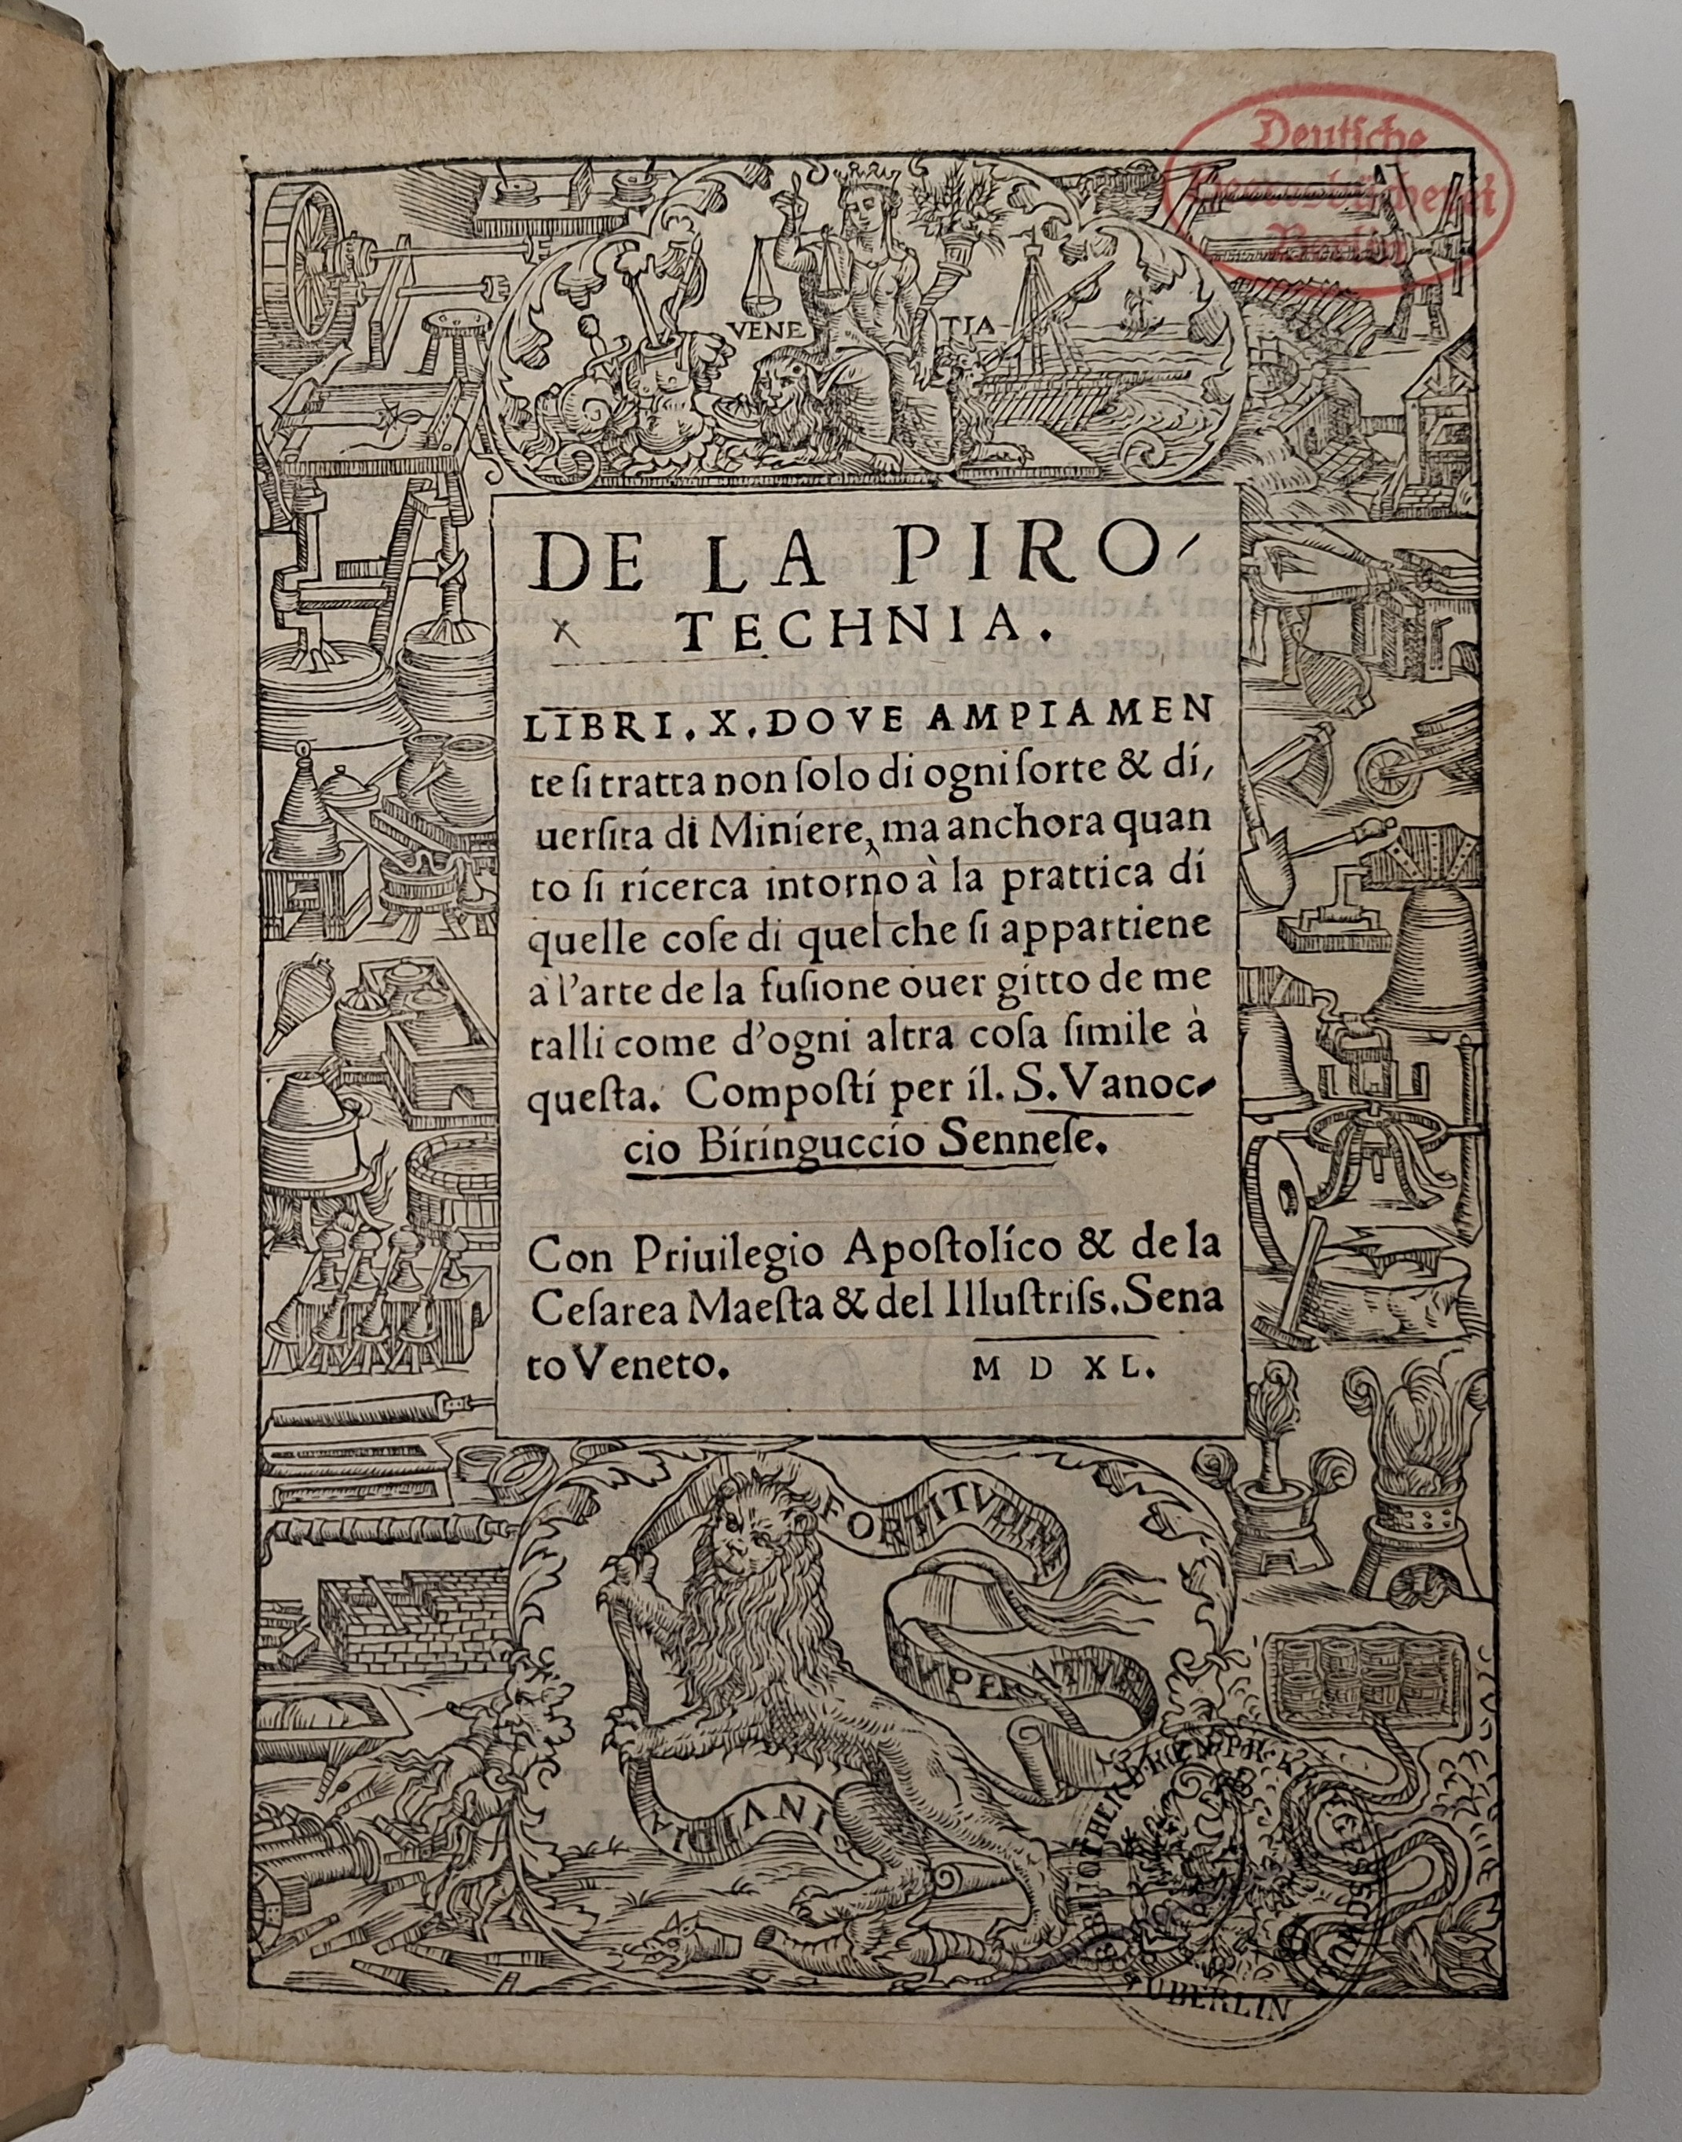
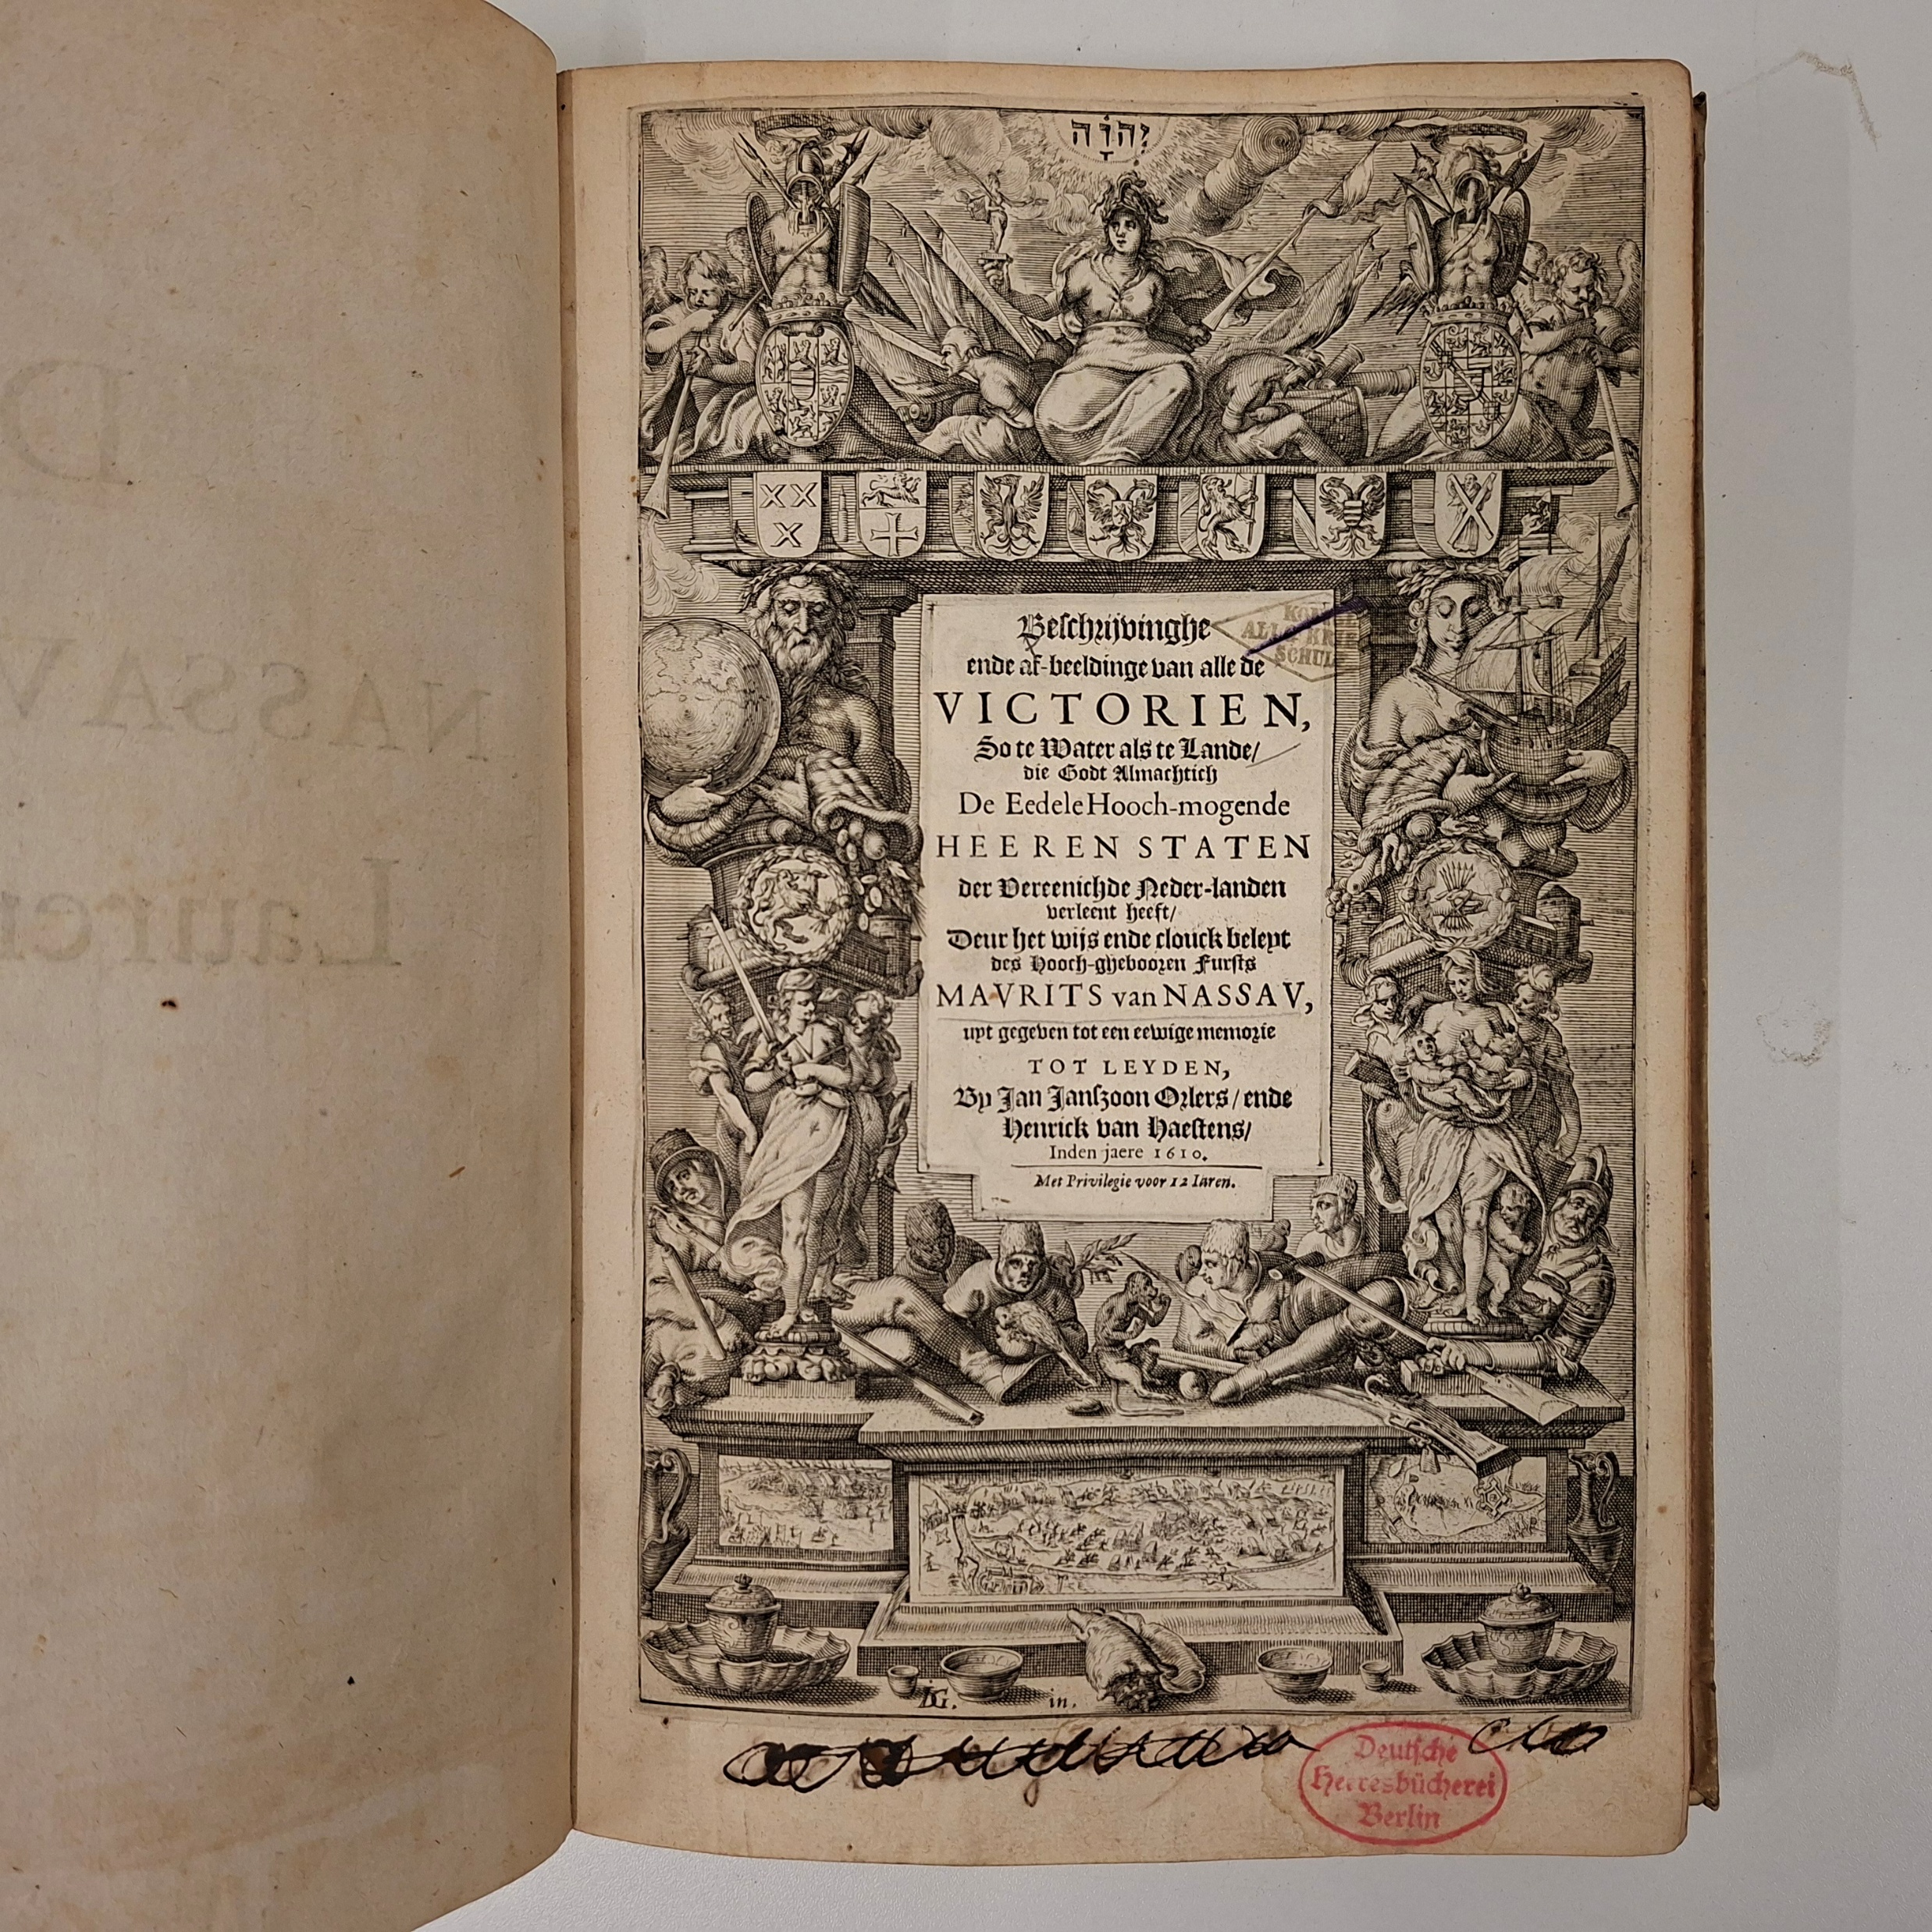
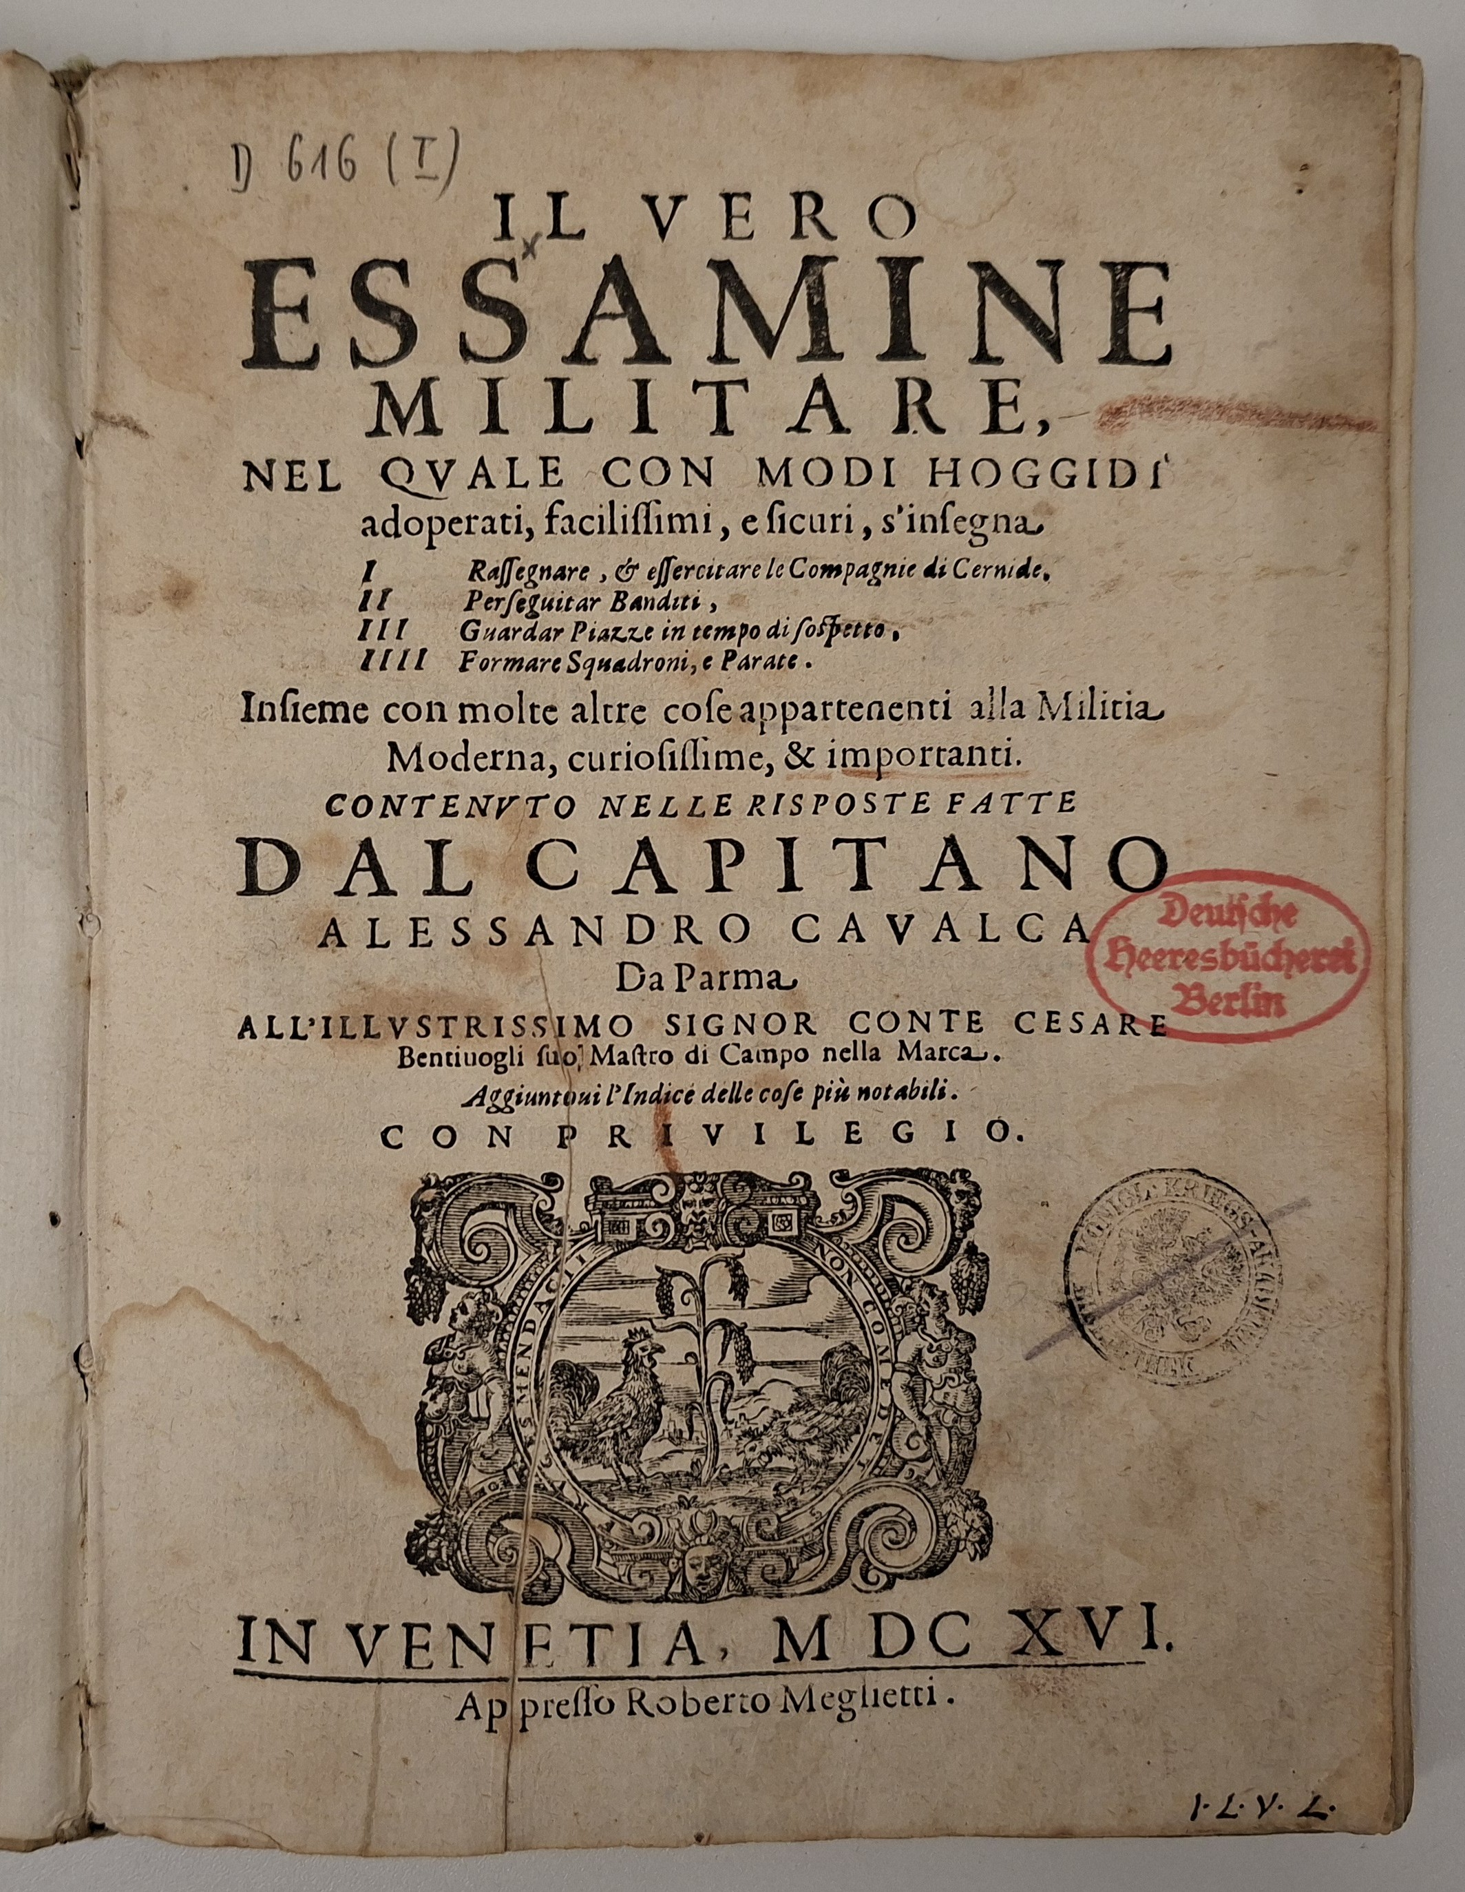
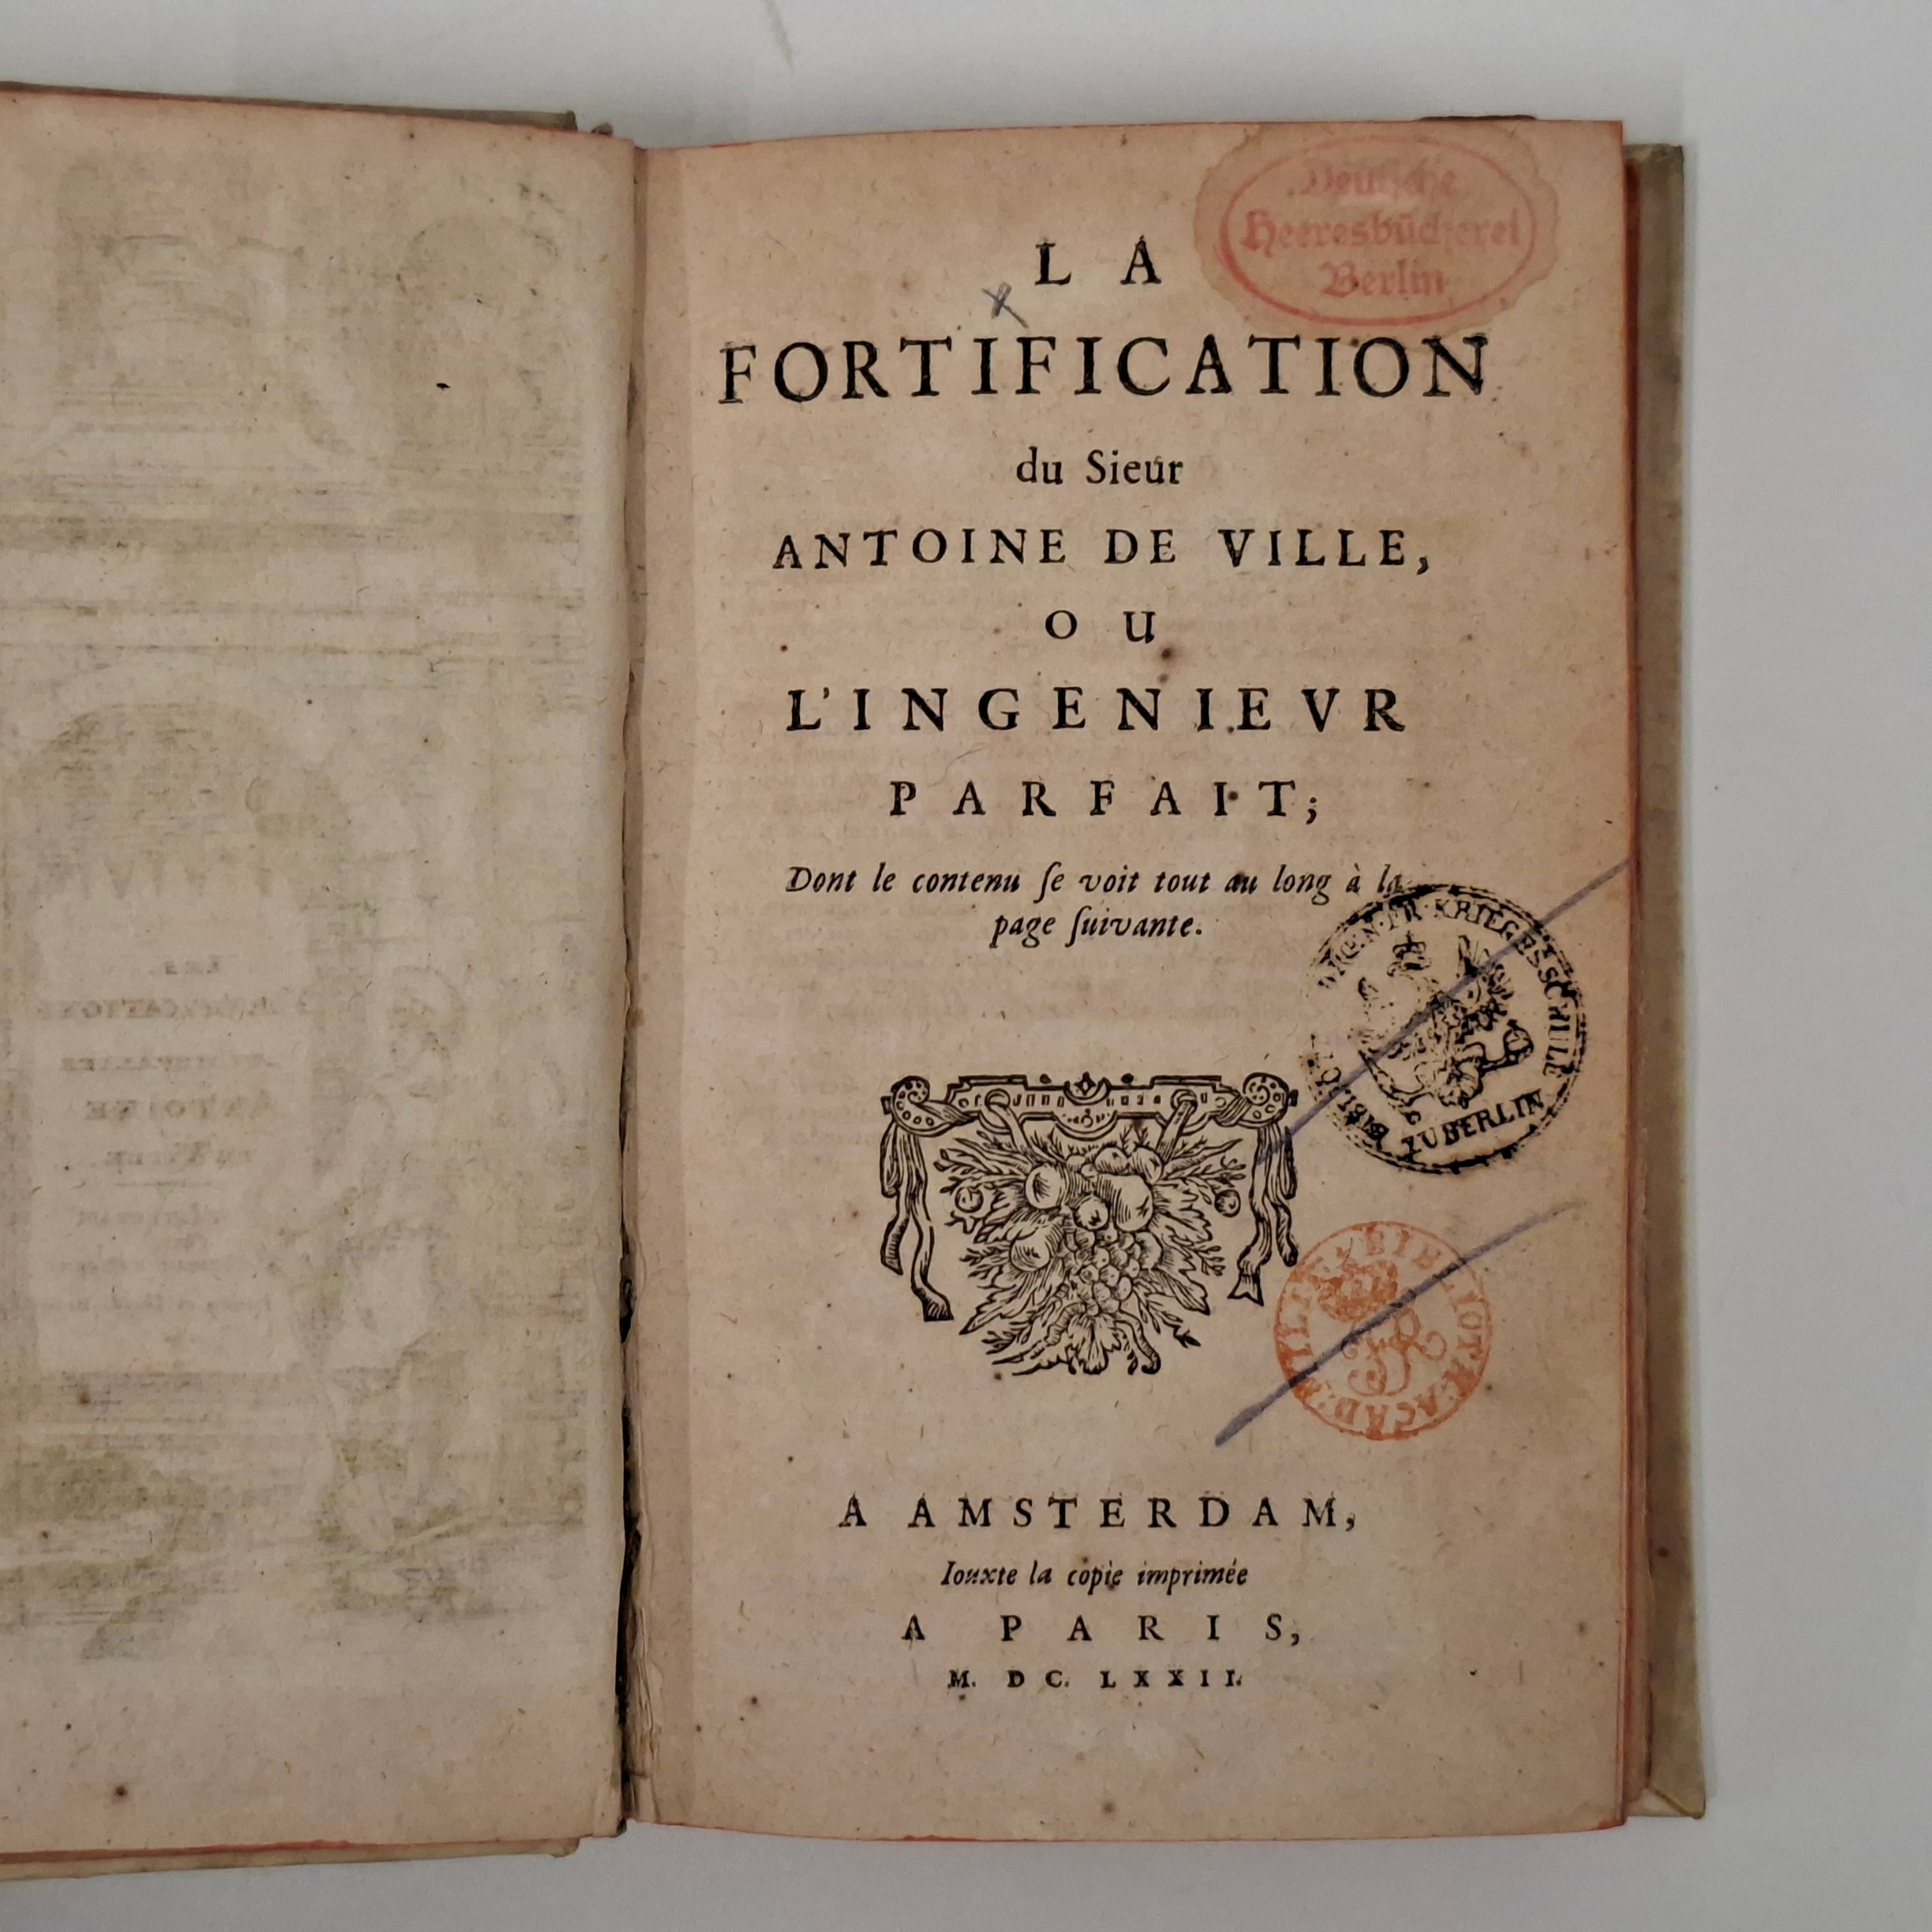
1. De la pirotechnia, Libri X. Venetia, 1540. Rijksmuseum 201 C 19.
2. Il vero essamine militare. Venetia, 1616. Rijksmuseum 201 C 18.
3. Nassavschen lauren-crans. Leyden, 1610. Rijksmuseum 200 D 19
4. La fortification du sieur Antoine de Ville. Amsterdam, 1672. Rijksmuseum 201 B 30.

Slide 5
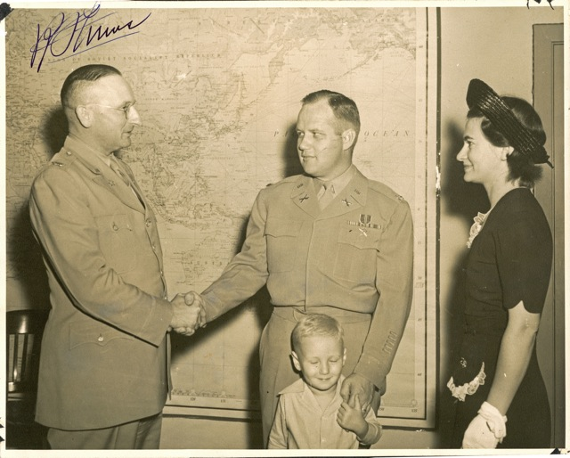
Lt. Col. (Ret.) William Henry Smith, 1945, receiving the Bronze Star.
Photo credit: Heirs of W.H. Smith

Slide 6


Slide 7
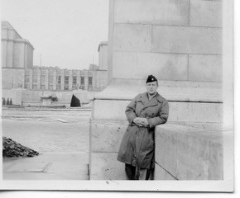
Lt. Col. (Ret.) William Henry Smith, 1945, presumably at the document collection center in Paris.
Photo credit: Heirs of W.H. Smith

Slide 8
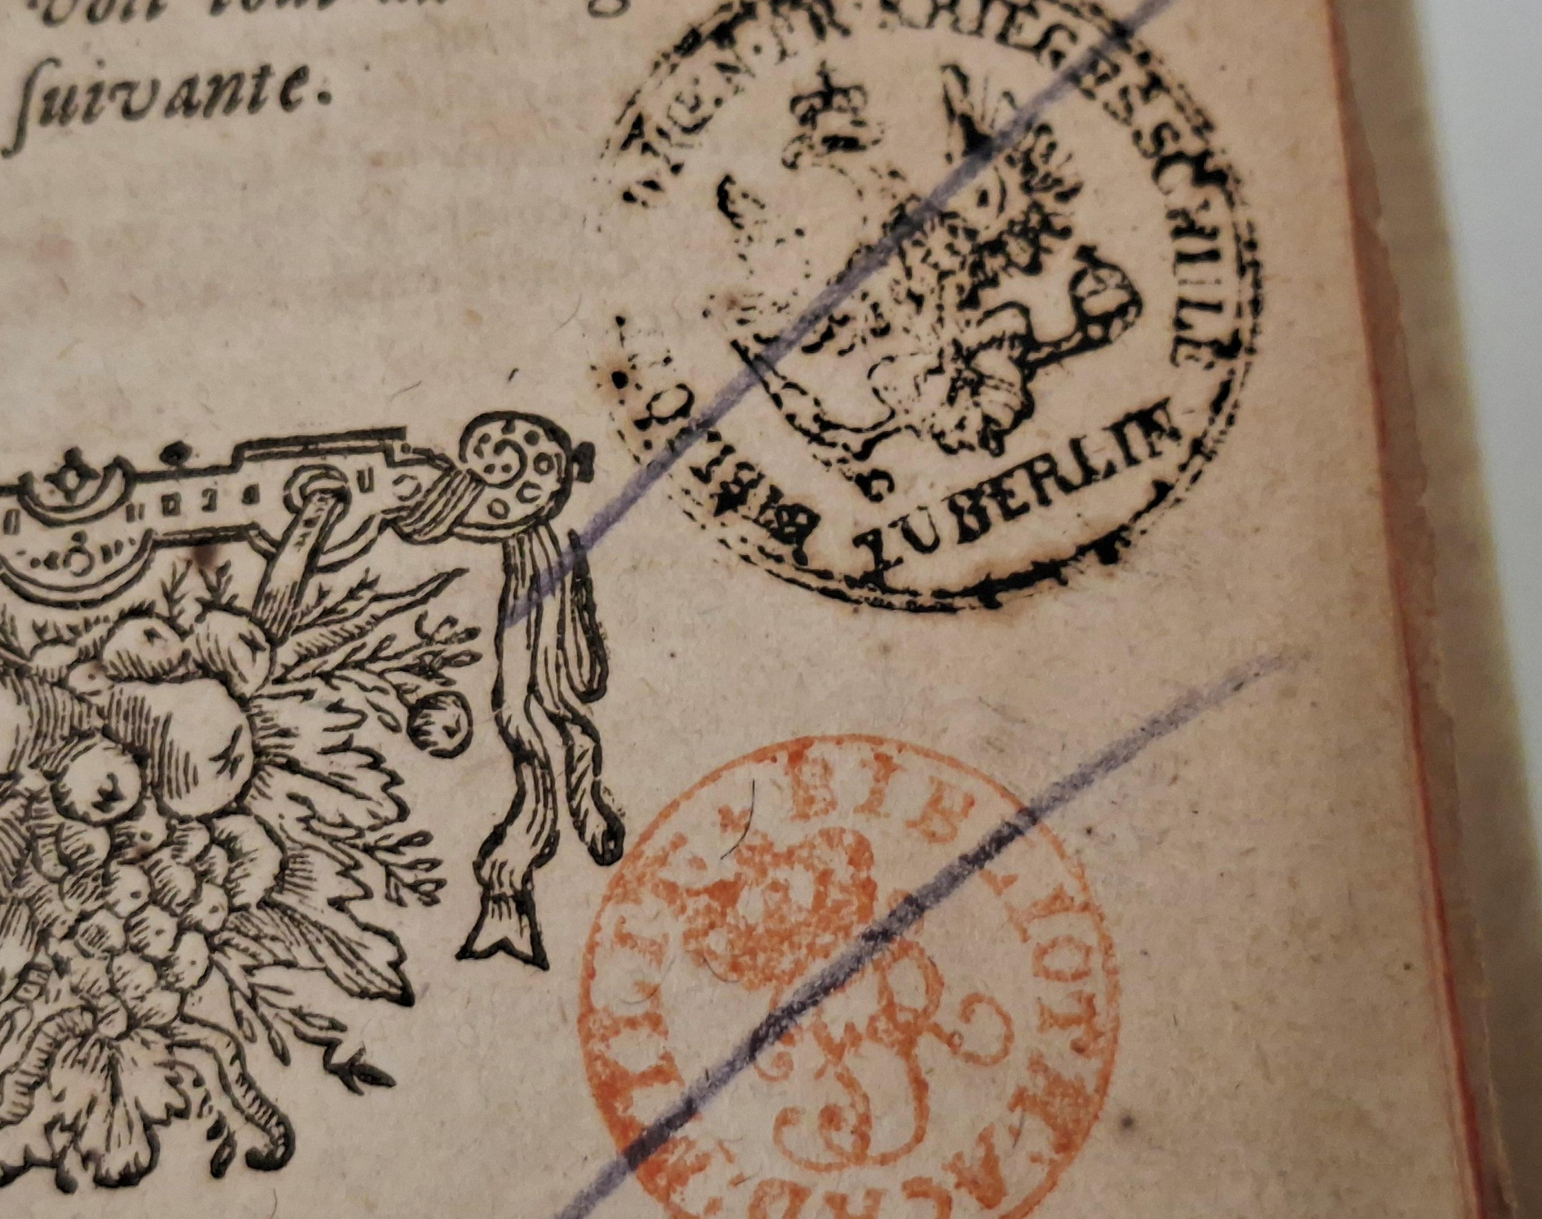
Crossed out library stamps of Königlich Preußische Kriegsakademie or Königliche Allgemeine Kriegsschule

Slide 9
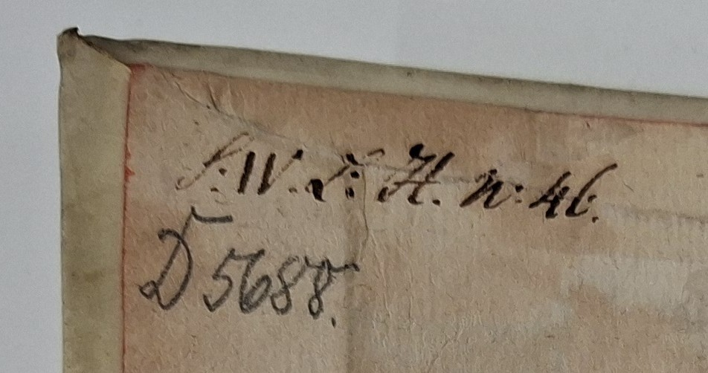
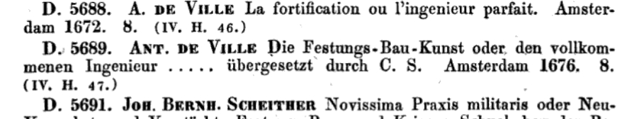
Stamps and shelf marks in La fortification du sieur Antoine de Ville. Amsterdam, 1672. Rijksmuseum 201 B 30, and a catalogue entry in Katalog der Bibliothek und Kartensammlung der Königlichen allgemeinen Kriegsschule, 1851.

Slide 10
The Rijksmuseum Study Room, fortified with sandbags in response to the threat of war in 1939. Rijksmuseum, Historical Archives, RMA-SSA-F-05230-1

Slide 11
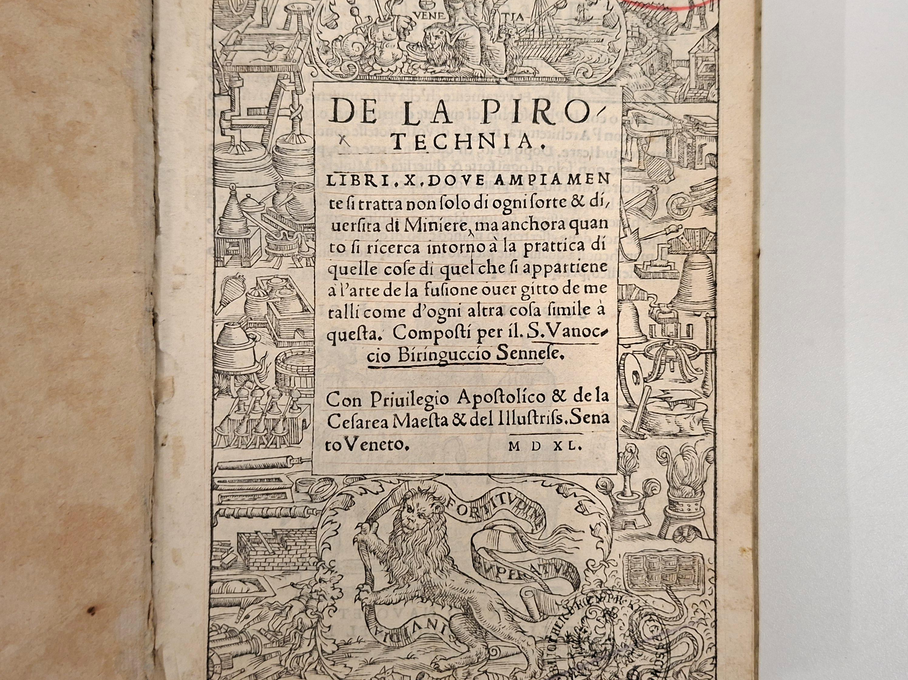
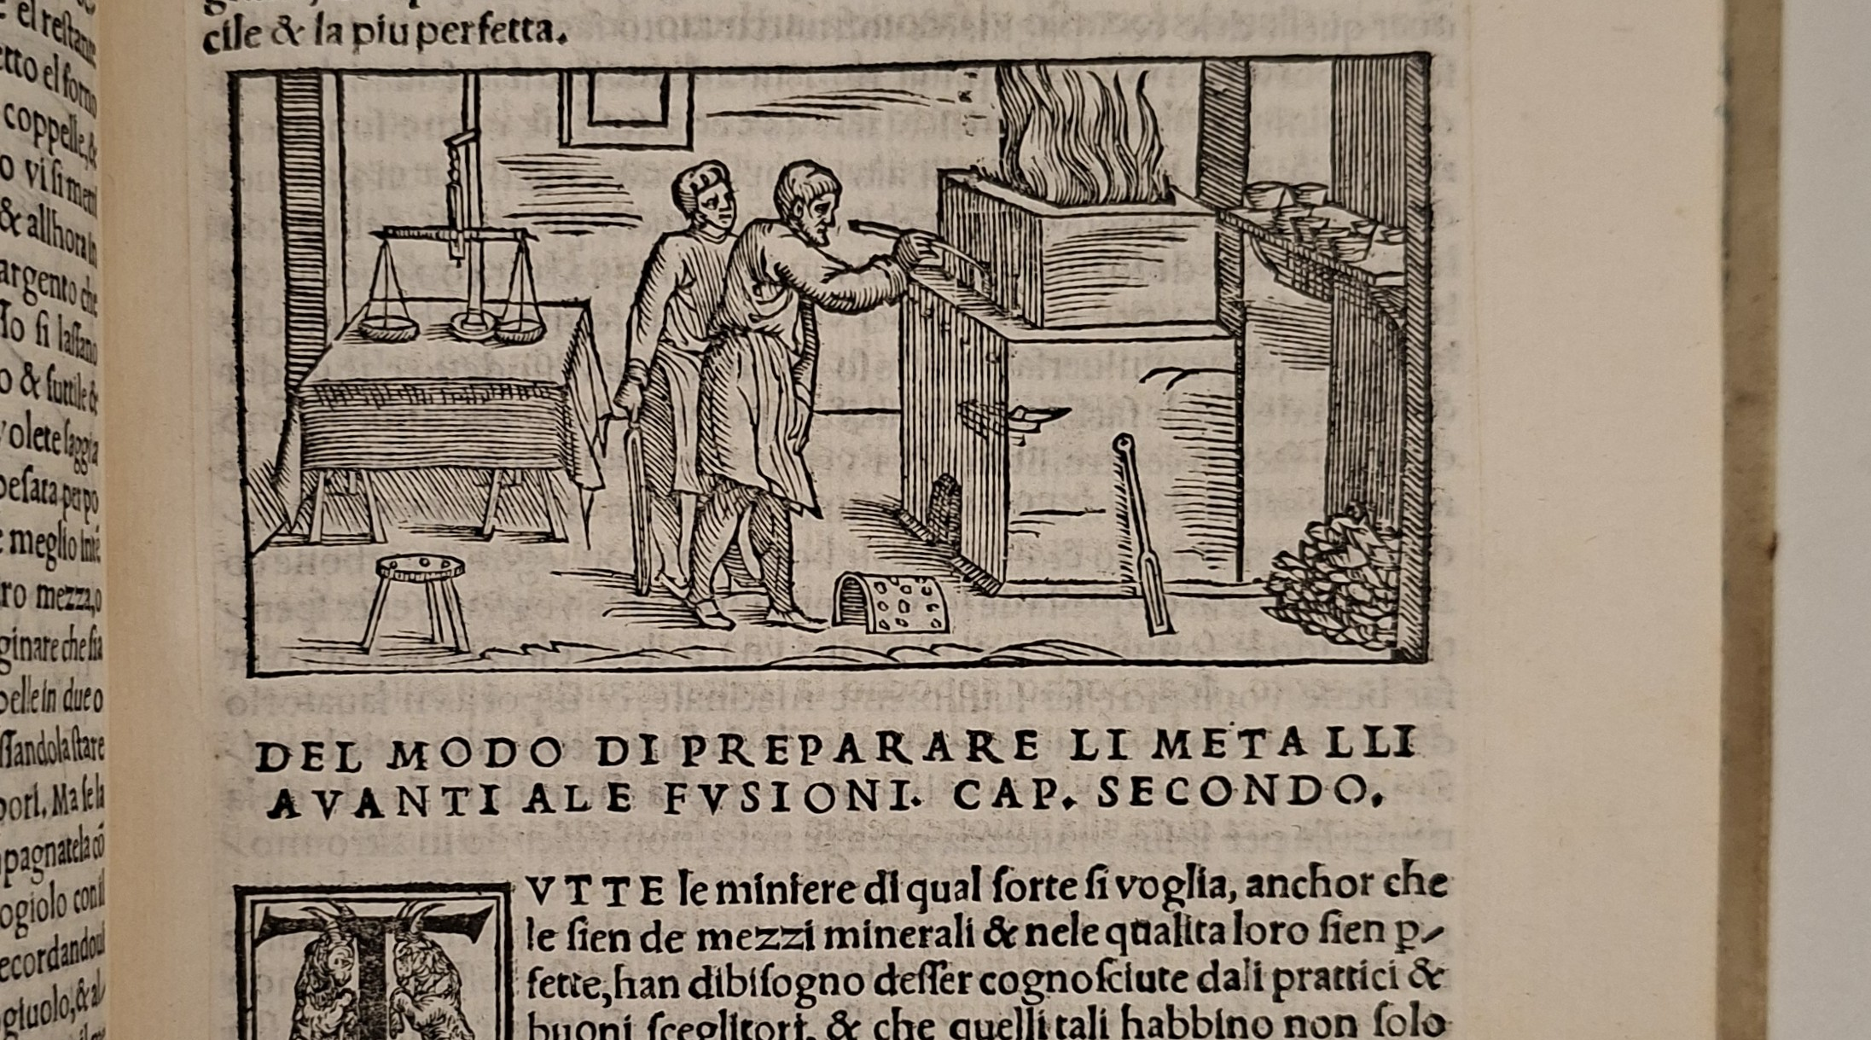
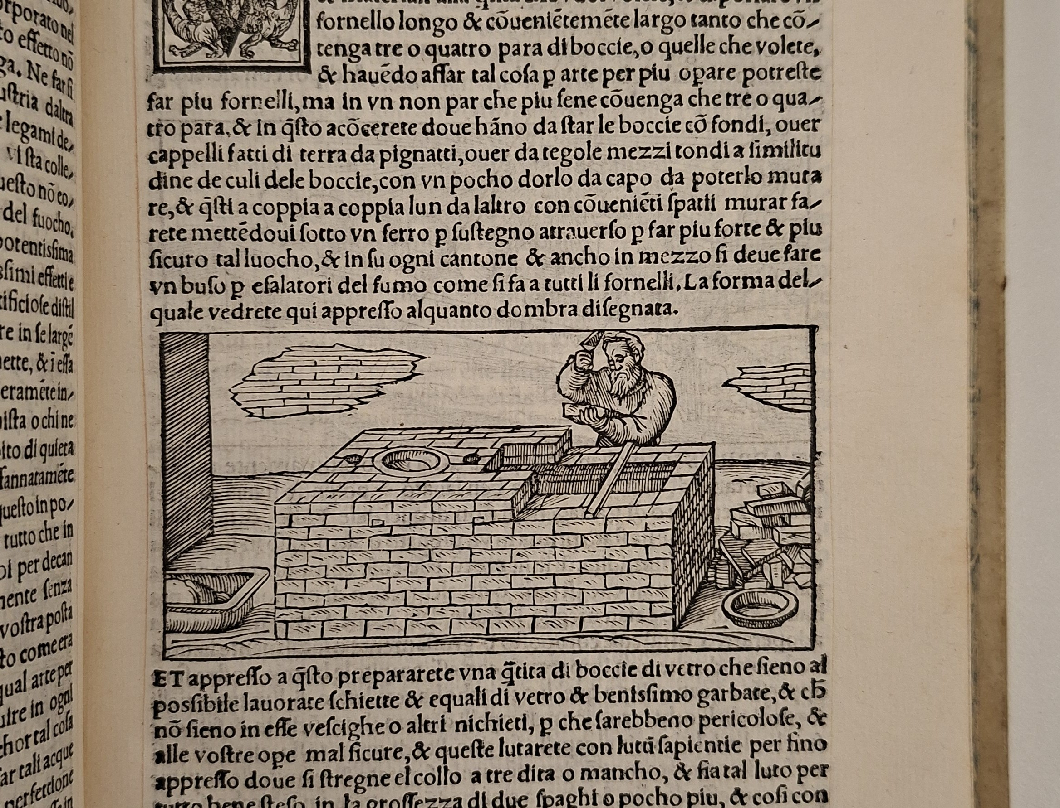

Slide 12
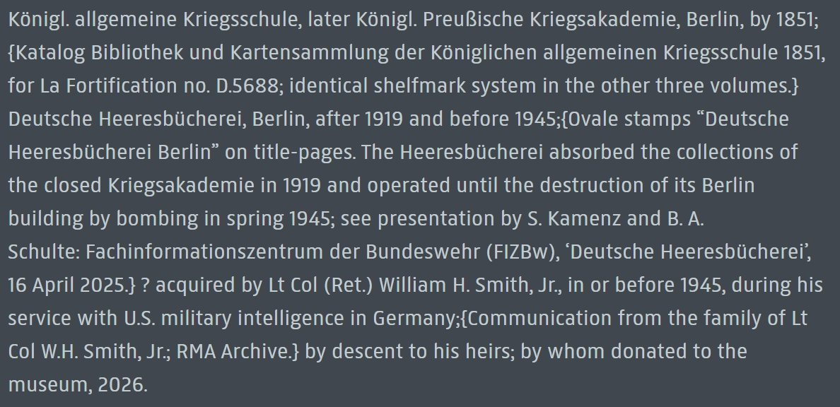
Provenance history, recorded by Lea Grüter in the style of the Rijksmuseum Provenance Handbook.

Slide 13
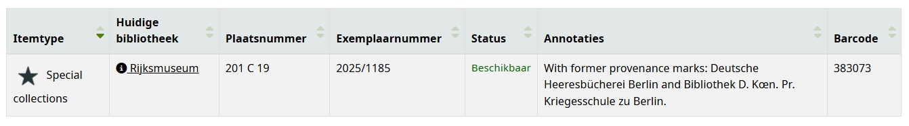
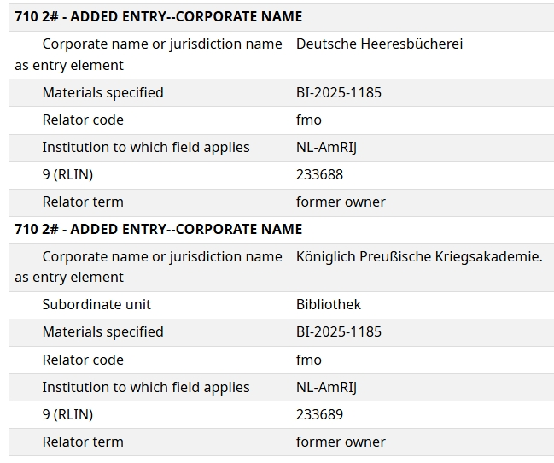
Provenance history, recorded by the Rijksmuseum library administration as unstructured tekst (above) and in MARC21 format (right)

Slide 14
Thank you!
Four books from the Deutsche Heeresbücherei
The multi-layered provenance history of a recent donation to the Rijksmuseum Research Library
Alex Alsemgeest
Curator of Library Collections,
Rijksmuseum
a.alsemgeest@rijksmuseum.nl

