Slide 1
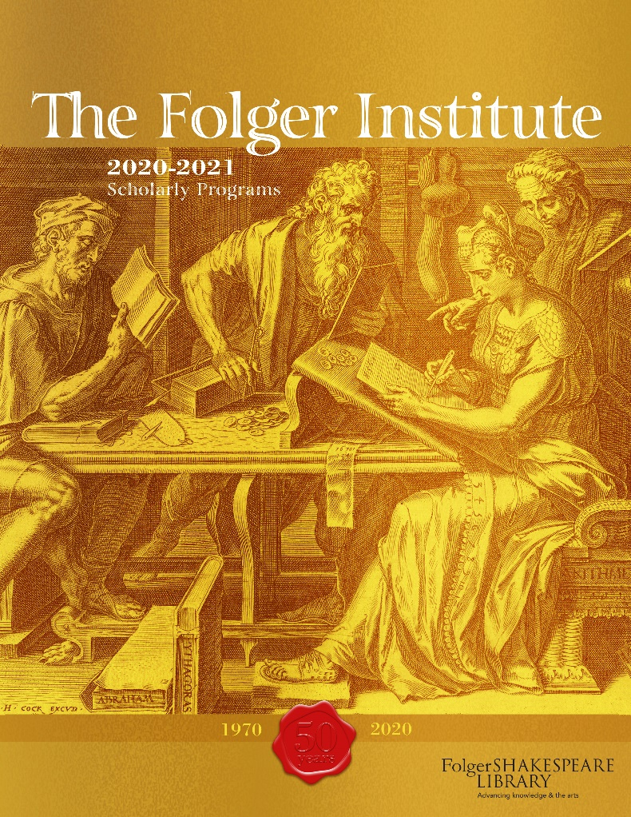
What do you do with an anniversary?
OR
Bringing our audiences in to Critical Race Conversations
Kathleen Lynch,
Executive Director, Folger Institute klynch@folger.edu

Slide 2
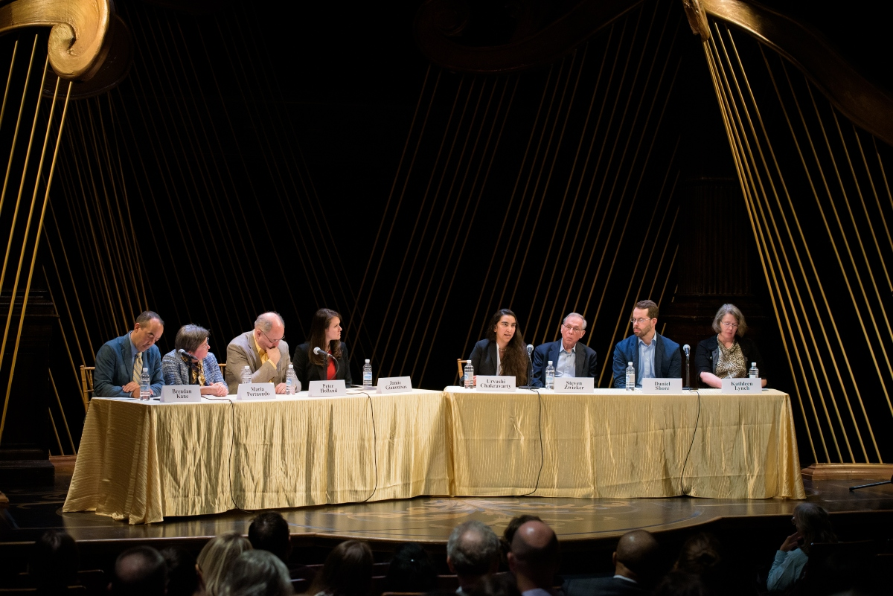
We all wondered about the effects on our intellectual communities of new technologies and of more dispersed gatherings away from our beloved reading room and seminar rooms. Now, in recent months, we’ve experienced all that and more. We’ve experienced, too, the resilience, adaptivity, and forward-looking nature of the community of scholars who work at the Folger. We hope you enjoy this glimpse into the discussion then, as we continue to chart new paths towards refreshed goals.

Slide 3
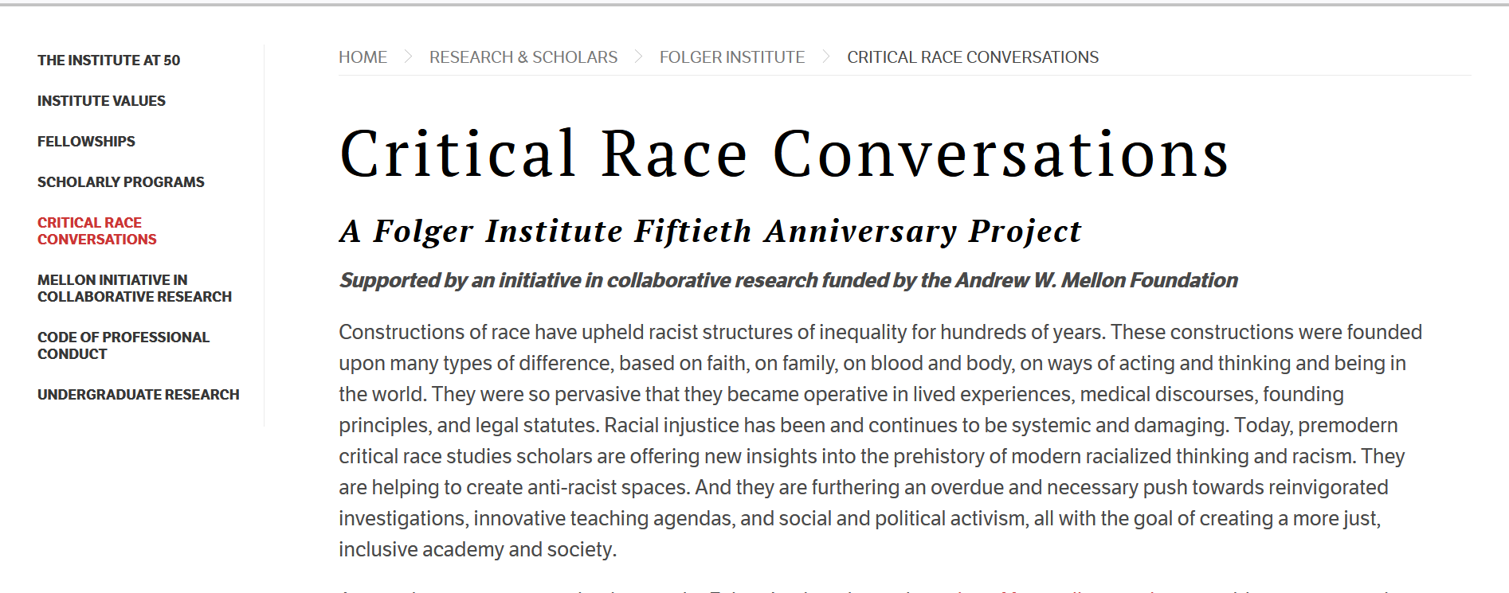
https://www.folger.edu/critical-race-conversations

Slide 4
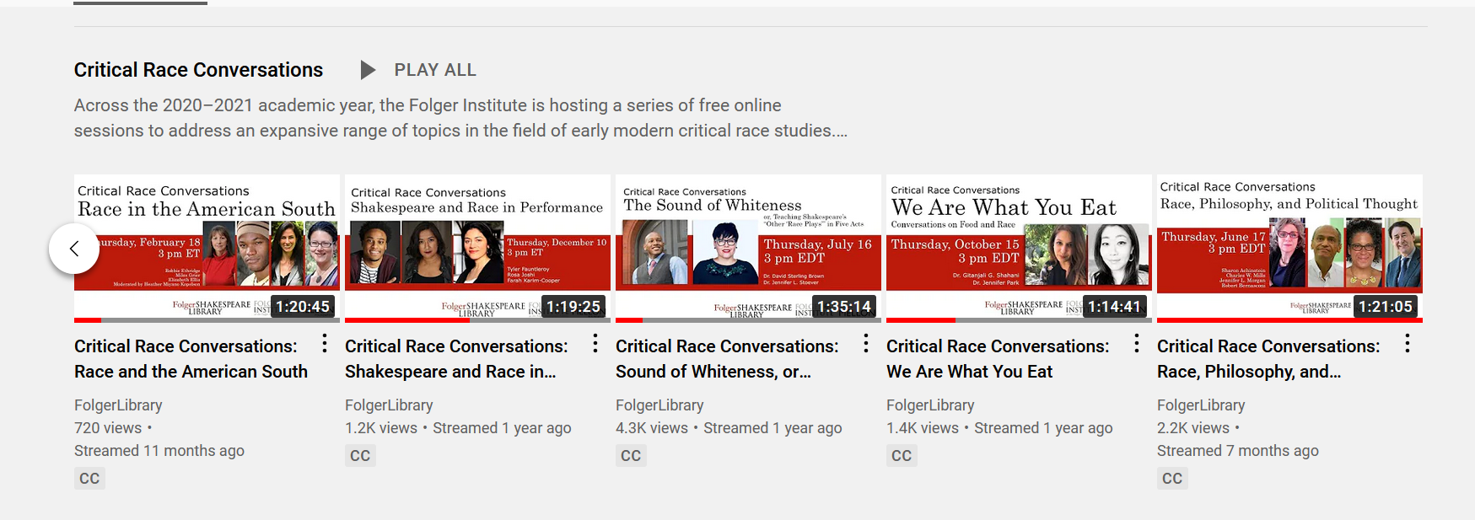
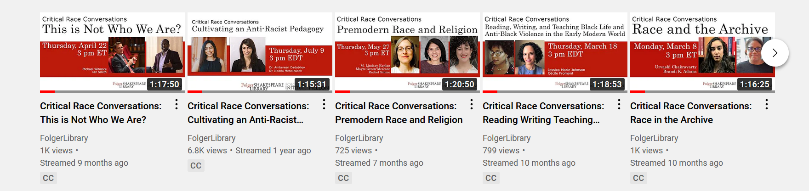

Slide 5
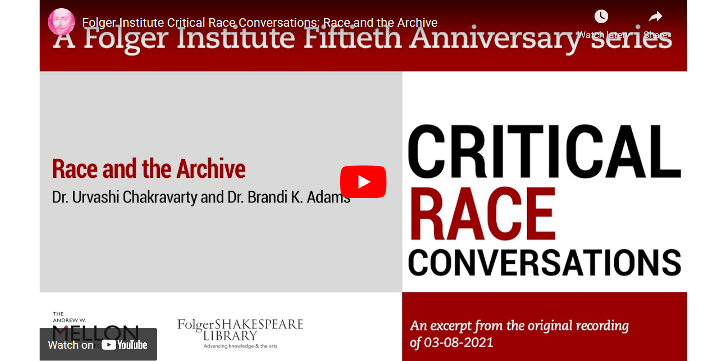

Slide 6
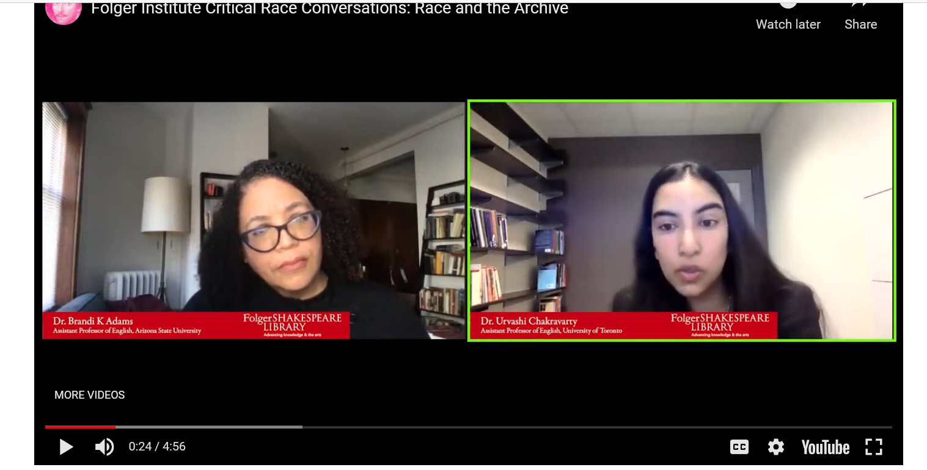
Who gets to go to the archive?

Slide 7

How does the physical space of the archive operate?

Slide 8

Who has the financial resources to travel to archives?

Slide 9
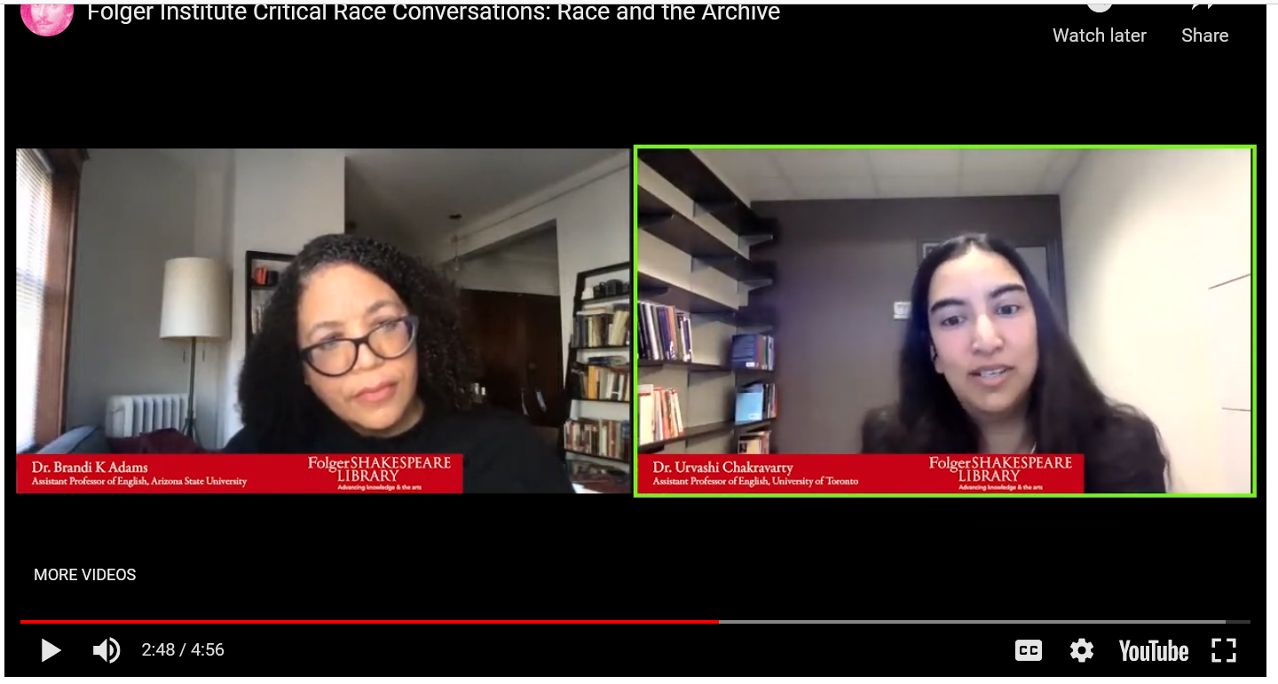
What kind of work fits into the traditional archival research model?

Slide 10

Is the archive demanding or rewarding a particular kind of white affect?

Slide 11

What do we go to the archive to do, and what do we do with the discourse of ‘discovery’?

