Slide 1
Challenging legacies: making the British Library’s collections and metadata more inclusive
Xerxes Mazda (Head of Collections and Curation)
Alan Danskin (Collection Metadata Standards Manager)
CERL Equality, diversity and inclusivity.
27th January 2022

Slide 2
Anti-Racism Project (ARP)
In July 2020, following the brutal murder of George Floyd and the global protests against racism that resulted, the Anti-Racism Project (ARP), a pan-Library working group was set up.
The ARP’s work is to develop an action plan to transform the British Library into an actively anti-racist organisation.
Designed as bottom-up, staff led, project
Subgroups
Audiences
Behaviour values & Experiences
Cataloguing & Metadata (CAM)
Collections & Content
Data Research and Insights
People & HR Policy
Leaders and Coordinators

Slide 3
Audiences
Commission research into non-users
Increase community-led programming
Ensure diverse voices are present in the planning and delivery of exhibition projects.
Include diverse voices in our exhibitions and displays
Content statements and additional interpretation onsite and online.

Slide 4
People and HR Policies
Sign up to Race at Work Charter and implement the Charter’s principles.
Review all policies and processes to remove unfairness and bias
Develop a strategy to recruit, develop and promote more diverse staff into senior leadership positions
Set targets to improve BAME representation in key areas

Slide 5
Data, Research and insight
Develop relevant Key Performance Indicators following data gathering and research analysis
Identify data requirements to monitor progress and propose areas of improvement
Publish an annual report of progress

Slide 6
Collections and Curation
Undertake provenance research
Build collections working closer with communities
Include community engagement in curatorial roles
Deliver Black Studies action plan
Publicise Race Equality work we are doing this area

Slide 7
Behaviour, Values and Experiences
Run staff survey on experiences and attitudes with recommendations for improvement
Develop networks to provide continuous improvement and learning opportunities
Use staff performance review to reinforce values
Consider other values and wellbeing models
Establish clear procedures for dealing with racism onsite and online

Slide 8
Cataloguing & Metadata
Recommendations from the British Library’s Anti-Racism Project’s subgroup on Cataloguing & Metadata
alan.danskin@bl.uk

Slide 9
Cataloguing & Metadata Subgroup: Purpose
To understand and expose the extent and impact of discrimination and bias in the Library's cataloguing practices and metadata.
To facilitate the development and enhancement of descriptions, interpretations and presentations of collection items
To collaborate with colleagues involved in these areas of the Library, and to learn from best practice beyond the Library, to make recommendations to enhance the safety, inclusivity and accessibility of the Library’s collections for all potential users.
Notes:
We defined the purpose of the group as follows:
To understand and expose the extent and impact of discrimination and bias in the Library's cataloguing practices and metadata.
To facilitate the development and enhancement of descriptions, interpretations and presentations of collection items
To collaborate with colleagues involved in these areas of the Library, and to learn from best practice beyond the Library, to make recommendations to enhance the safety, inclusivity and accessibility of the Library’s collections for all potential users.

Slide 10
Cataloguing & Metadata subgroup: scope
Definition of metadata : “the information we record to describe, contextualise, manage and preserve our collections”.
Audit existing cataloguing and metadata content, practices and processes to capture the full extent of racial bias and offence.
Audit external spaces that make use of BL metadata (e.g. Flickr)
Gather expertise and opinions of colleagues across the Library and make full use of international collaborations and policy groups we are already part of to inform our work.
Develop ambitious recommendations that fulfil the Library’s responsibility as a significant international institution, and that set an example as to how to embed an ethical metadata approach.
Notes:
We defined metadata as broadly as possible.
We set out some ambitious information gathering tasks that we knew were beyond the capacity of the subgroup to conduct, but which could be carried forward as recommendations
We consulted with colleagues and managers within the Library and beyond
I’ll get to the recommendations in a minute.

Slide 11
Outcomes
3 Broad objectives covering:
Metadata
Access & Discovery
Policy & principles
Making the case for resources:
“Communicate the centrality of cataloguing and metadata to the production of knowledge and to the presentation of cultural heritage for our diverse communities “
“Provide greater resource to cataloguing and metadata teams through the creation of new projects and posts and greater resource to Technology to support our infrastructure.”
“
Notes:
There were three broad objectives to address issues with Metadata, Access & discovery, Policy & principles, which I’ll discuss in turn shortly. But first:
Importantly, the recommendations also made the case for the resources necessary to effect the change. The importance of cataloguing & metadata for enabling these messages. The need to resource the teams who are expected to deliver this change and to sustain the Library’s anti-racist stance over time.

Slide 12
Metadata
We will establish a comprehensive glossary of inclusive terminology to support a multifaceted collections audit.
We will create a flexible approach for treating problematic terminology that ensures descriptions are contextualised and accurate, and that ensures users are able to experience the catalogue and website safely, warning them where necessary of the potential for discriminatory and harmful content
Notes:
Underpinning much of the work needed to enhance our metadata is the creation of a comprehensive glossary of inclusive terminology to inform an audit of the catalogues and collections.
The outcome will be a flexible approach to addressing problematic terminology with sensitivity and respect for the source material.

Slide 13
Access and Discovery
We will develop more flexible subject terminologies and discovery approaches
to bypass outdated and inappropriate language;
to surface under-described and undiscoverable collections;
to respect access protocols of culturally sensitive heritage.
We will improve discovery of marginalised experiences in the collection through the creation of guides, finding aids, blogs, social media, as well as increased, targeted, and fuller cataloguing.
Notes:
One of the concerns that was raised by many staff, is the inadequacy of some subject current vocabularies. We will develop short term and longer terms solutions to address out dated or inappropriate language. We will aim to surface hidden collections. Where appropriate we can use protocols such as CARE to mediate access to culturally senstive heritage. New resources will also be developed to improve the discovery experience.

Slide 14
Policy & Principles
We will:
establish ethical principles for cataloguing and metadata
ensure that staff tasked to work on sensitive material receive adequate knowledge, training, and emotional support.
provide regular and mandatory training to all staff on best practice.
Notes:
Saving the most important until last, we will inculate cultural change by embedding ethical principles in cataloguer education and training. We will also provide support to staff engaged working with sensitive or disturbing content. Ethical training should be regularly updated in line with other types of mandatory training.

Slide 15
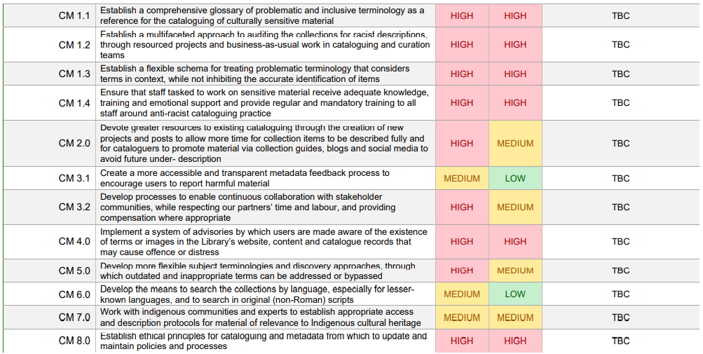
Priorities
Notes:
The key take away from this is that nearly everything is high priority – which will be an issue for prioritization. I don’t expect you to read all the small print, but I have picked out a few of the objectives in the remaining slides.

Slide 16
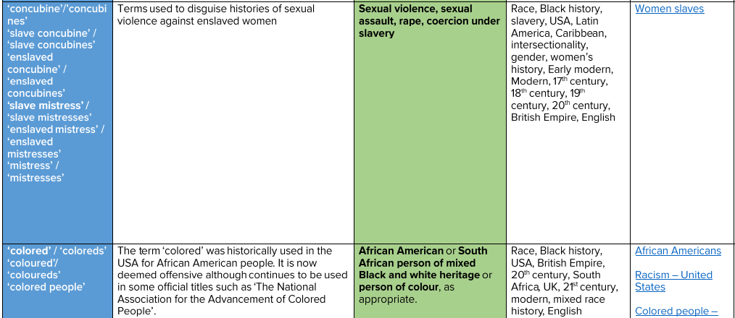
CM1.1 Establish a comprehensive glossary of problematic and inclusive terminology as a reference for the cataloguing of culturally sensitive material
Carissa Chew – Inclusive terminology: guide & glossary for the cultural heritage sector. May, 2021
Creative Commons — Attribution 4.0 International — CC BY 4.0
Notes:
Carissa Chew ‘s Inclusive terminology: guide & glossary for the cultural heritage sector May, 2021 provides a starting point for developing an expanded glossary of terms in the library’s metadata and content that may be discriminatory, harmful or offensive

Slide 17
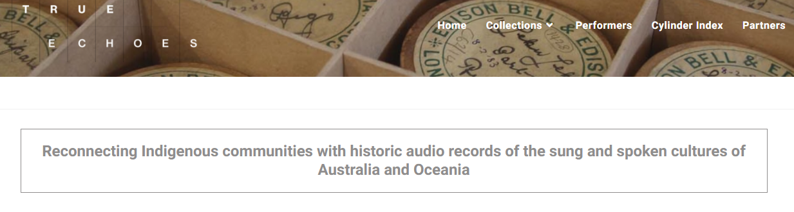
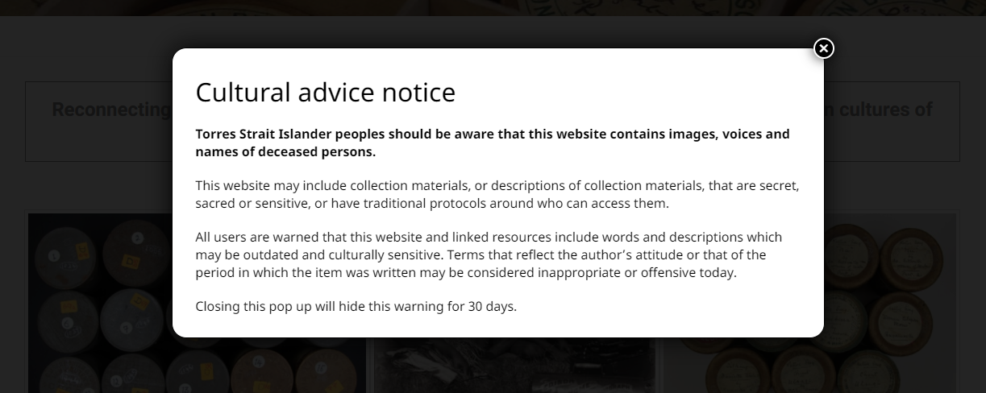
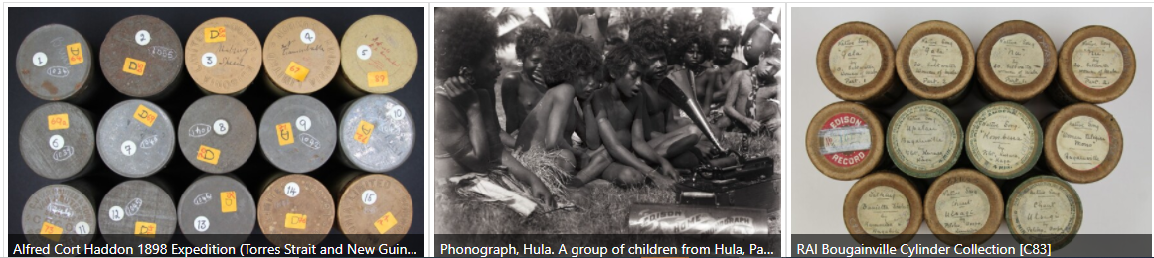
CM.4 Implement a system of advisories by which users are made aware of the existence of terms or images in the Library’s website, content and catalogue records that may cause offence or distress
General
Specific
Contextual
Representative
Responsive
Oversight
Notes:
Objective 4 is to implement a system of advisories by which users are made aware of the existence of terms or images in the Library’s website, content or catalogue records that may cause offense or distress.
The subgroup felt strongly that the library is behind the curve on this. Many peer institutions already provide such information. The example from the True Echoes project is illustrative of the approach we may take to provide a system of advisories from the general to the specific. It is recommended that advisories be supported by explanations to put them in historical context. We will respect content, but we will amend our catalogue data. We will encourage users to report issues. Appropriate levels of oversight for the whole process will have to be established,

Slide 18
CM.8 Establish ethical principles for cataloguing and metadata from which to update and maintain policies and processes
Align British Library Values with international codes of ethics
IFLA Code of Ethics for Librarians and other Information Workers. 2012
Cataloguing code of ethics. Cataloguing Ethics Steering Committee. Jan. 2021
Archives & Records Association Code of Ethics. 2020
1. Put users at the heart of everything we do
We catalogue resources in our collections with the end-user in mind to facilitate access and promote discovery.
We recognise that interoperability and consistent application of standards help our users find and access materials. However, all standards contain biases; we will approach them critically and advocate to make cataloguing more inclusive.
Notes:
A task group established some parameters for what can be done to embed ethical principles in metadata policies and procedures. We reviewed external ethical codes and guidelines issued by professional bodies and have used the Cataloguing code of ethics: 2021 and the Archives and Records Association Code of Ethics 2020 to add practical guidance to the Library’s Values

Slide 19
Next steps
British Library Board reviewed the recommendations in November
Senior Managers will draw up plans on how to implement proposed recommendations with potential timescale and associated cost resources
Actions to be incorporated into:
British Library Race Equality Action Plan
Collection Metadata Implementation Plan 2022-3
Collection Metadata Strategy 2023-2027

