Slide 1
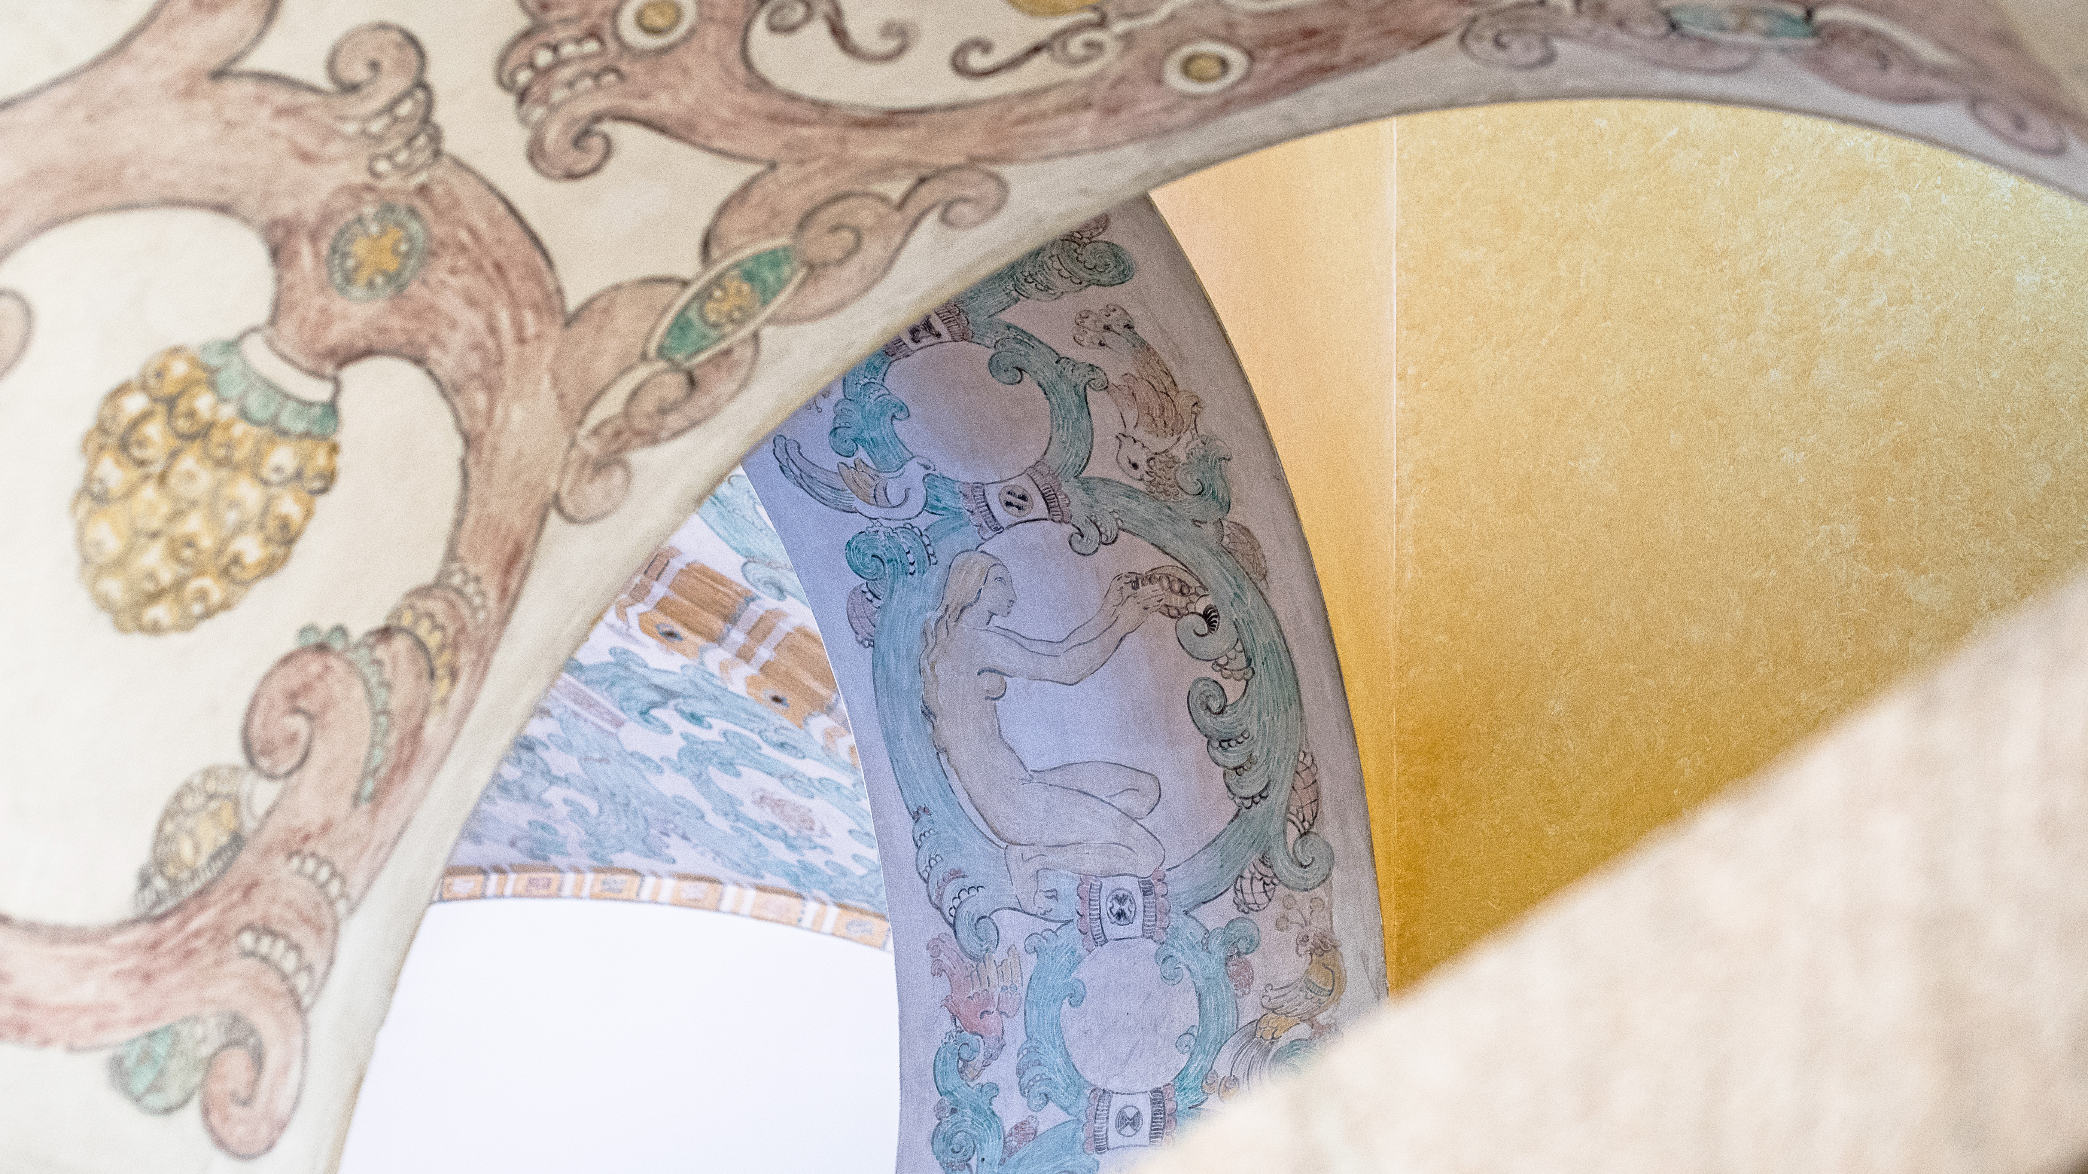
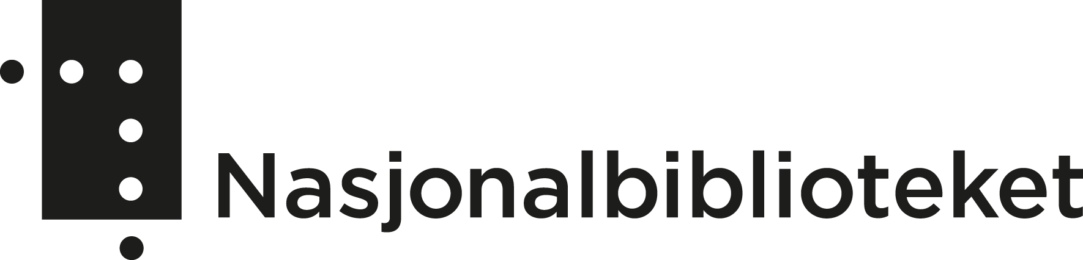
Trust and due diligence– a case study
Bente Granrud, Head of Rare Books and Manuscripts
Acquiring material from private dealers and collectors.

Slide 2
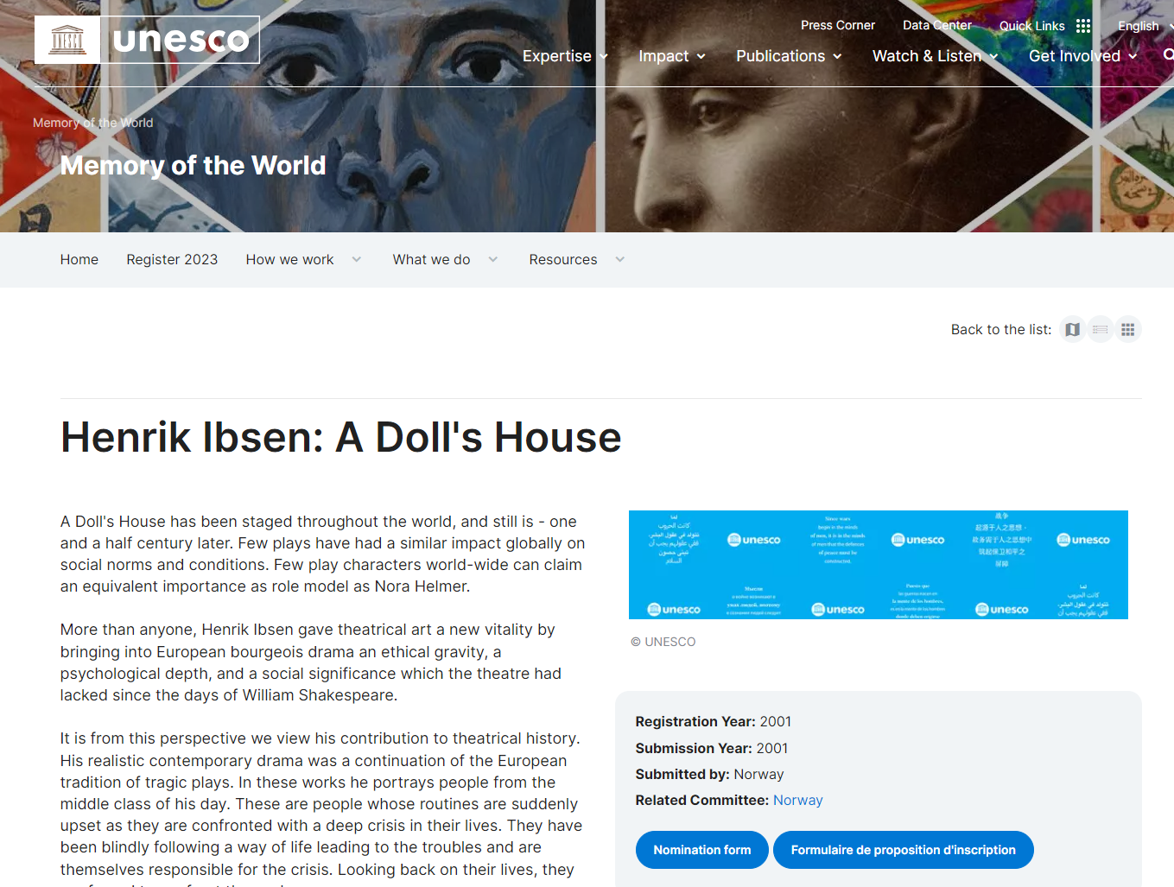
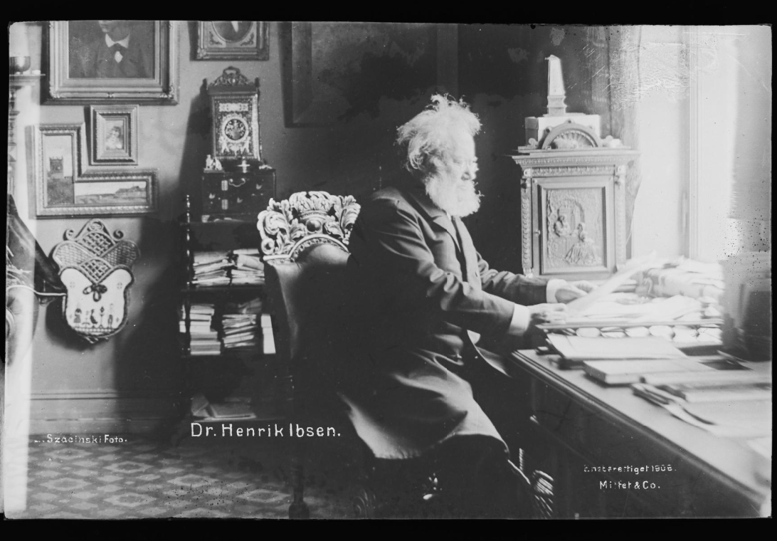
Literary Commemorations at the National Library
2006: 100th anniversary of Henrik Ibsen’s death
Henrik Ibsen (1828-1906) in his study in Oslo. Photograph ca 1895 by Hulda Szacinski, National Library of Norway. The manuscript to «A Doll’s House» is part of the Unesco Memory of the World register.

Slide 3
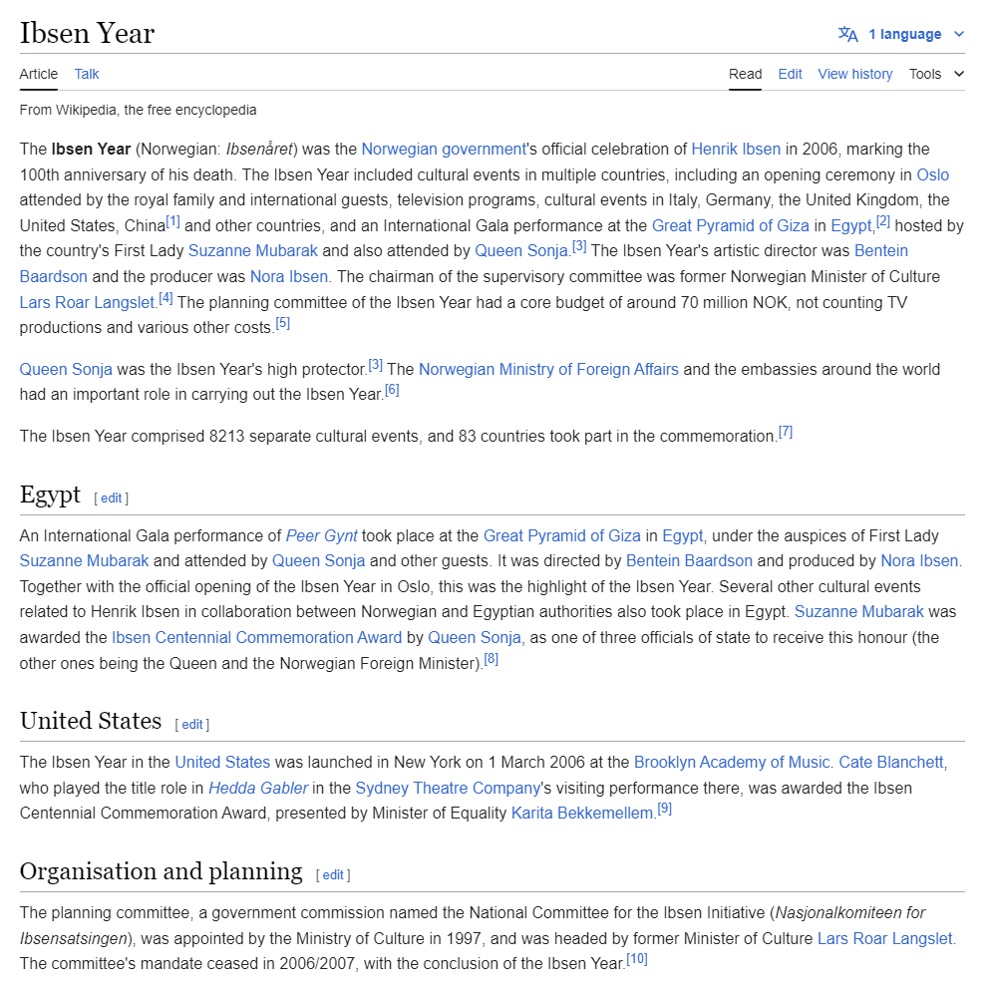
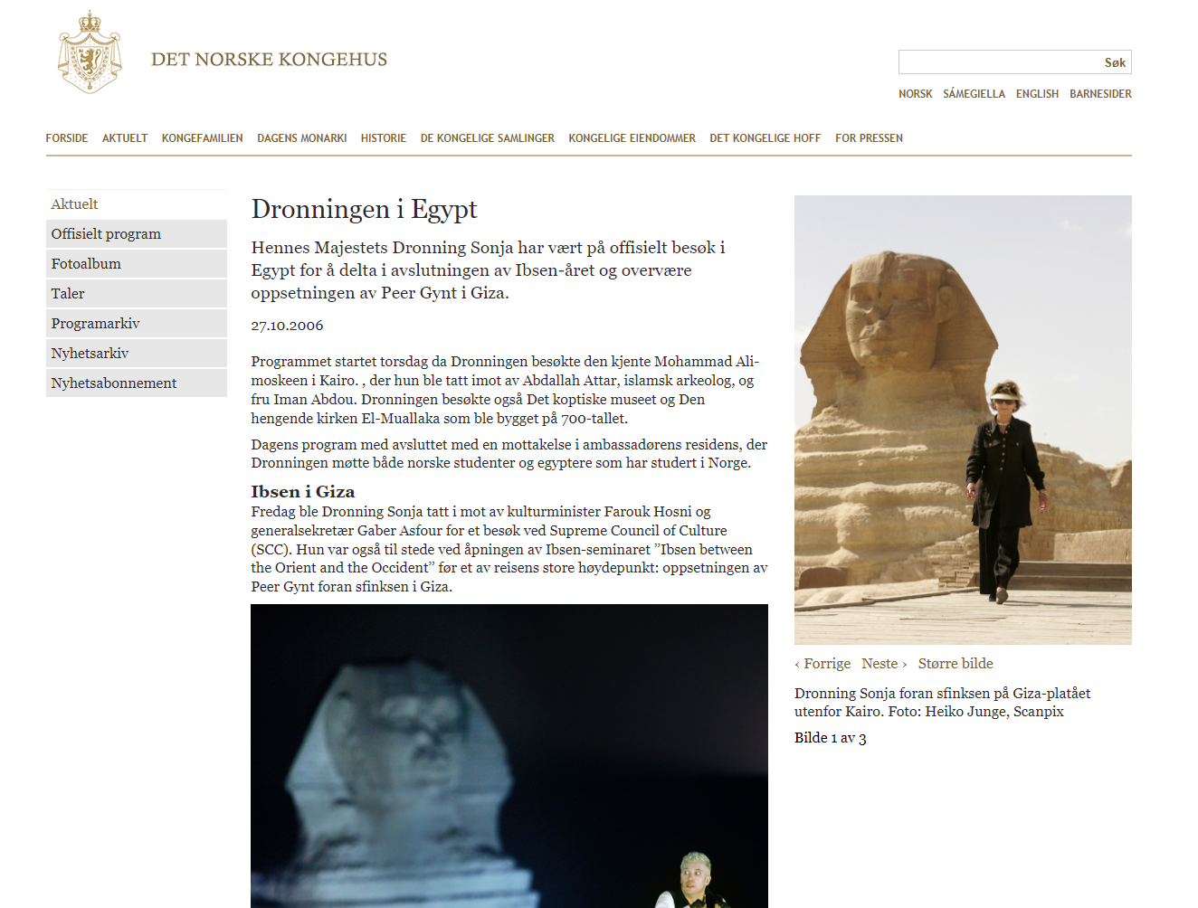

Slide 4
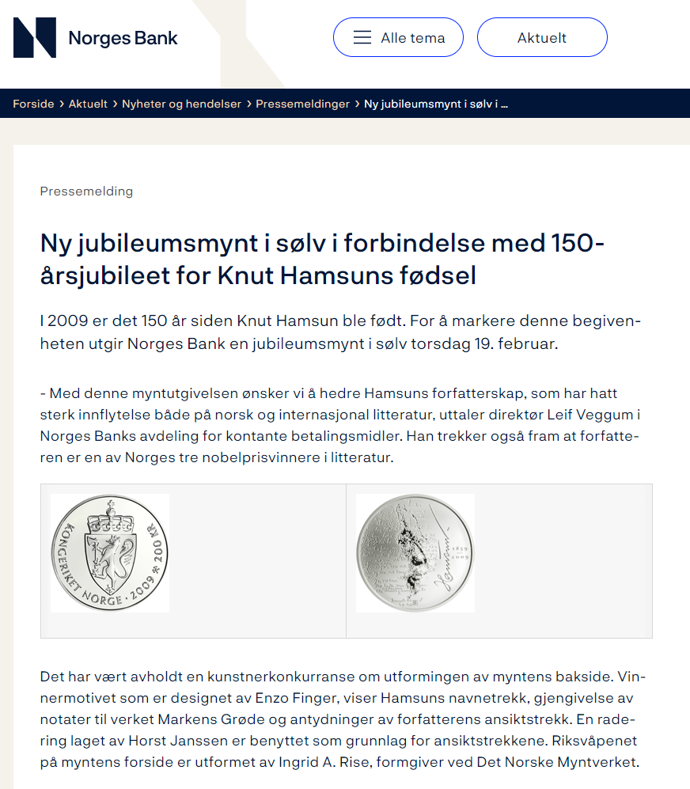
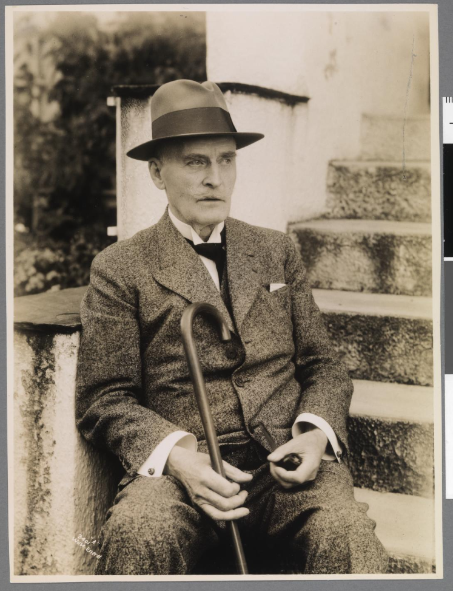
Literary Commemorations at the National Library
2009: 150 year since Knut Hamsun was born
Knut Hamsun(1859-1952). Awarded the Nobel Prize in Literature in 1920. Photograph 1936 by Anders Beer Wilse, National library of Norway.

Slide 5
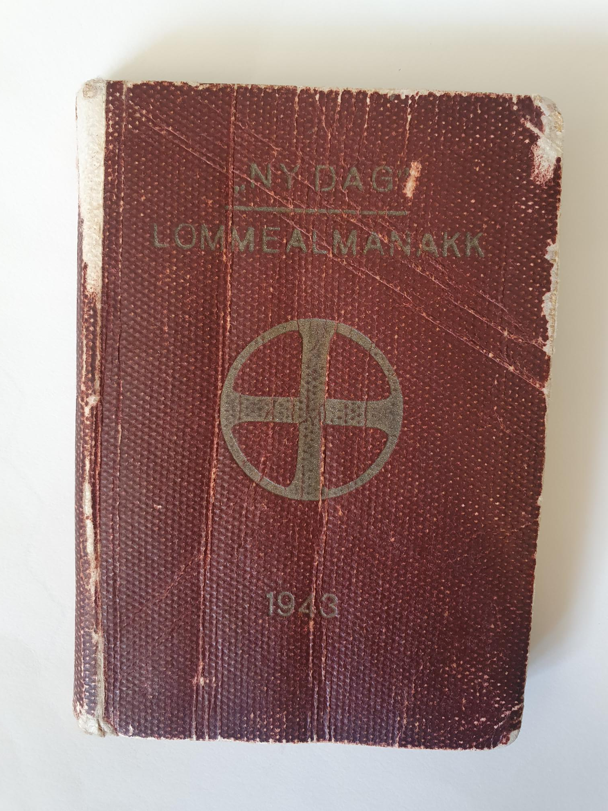
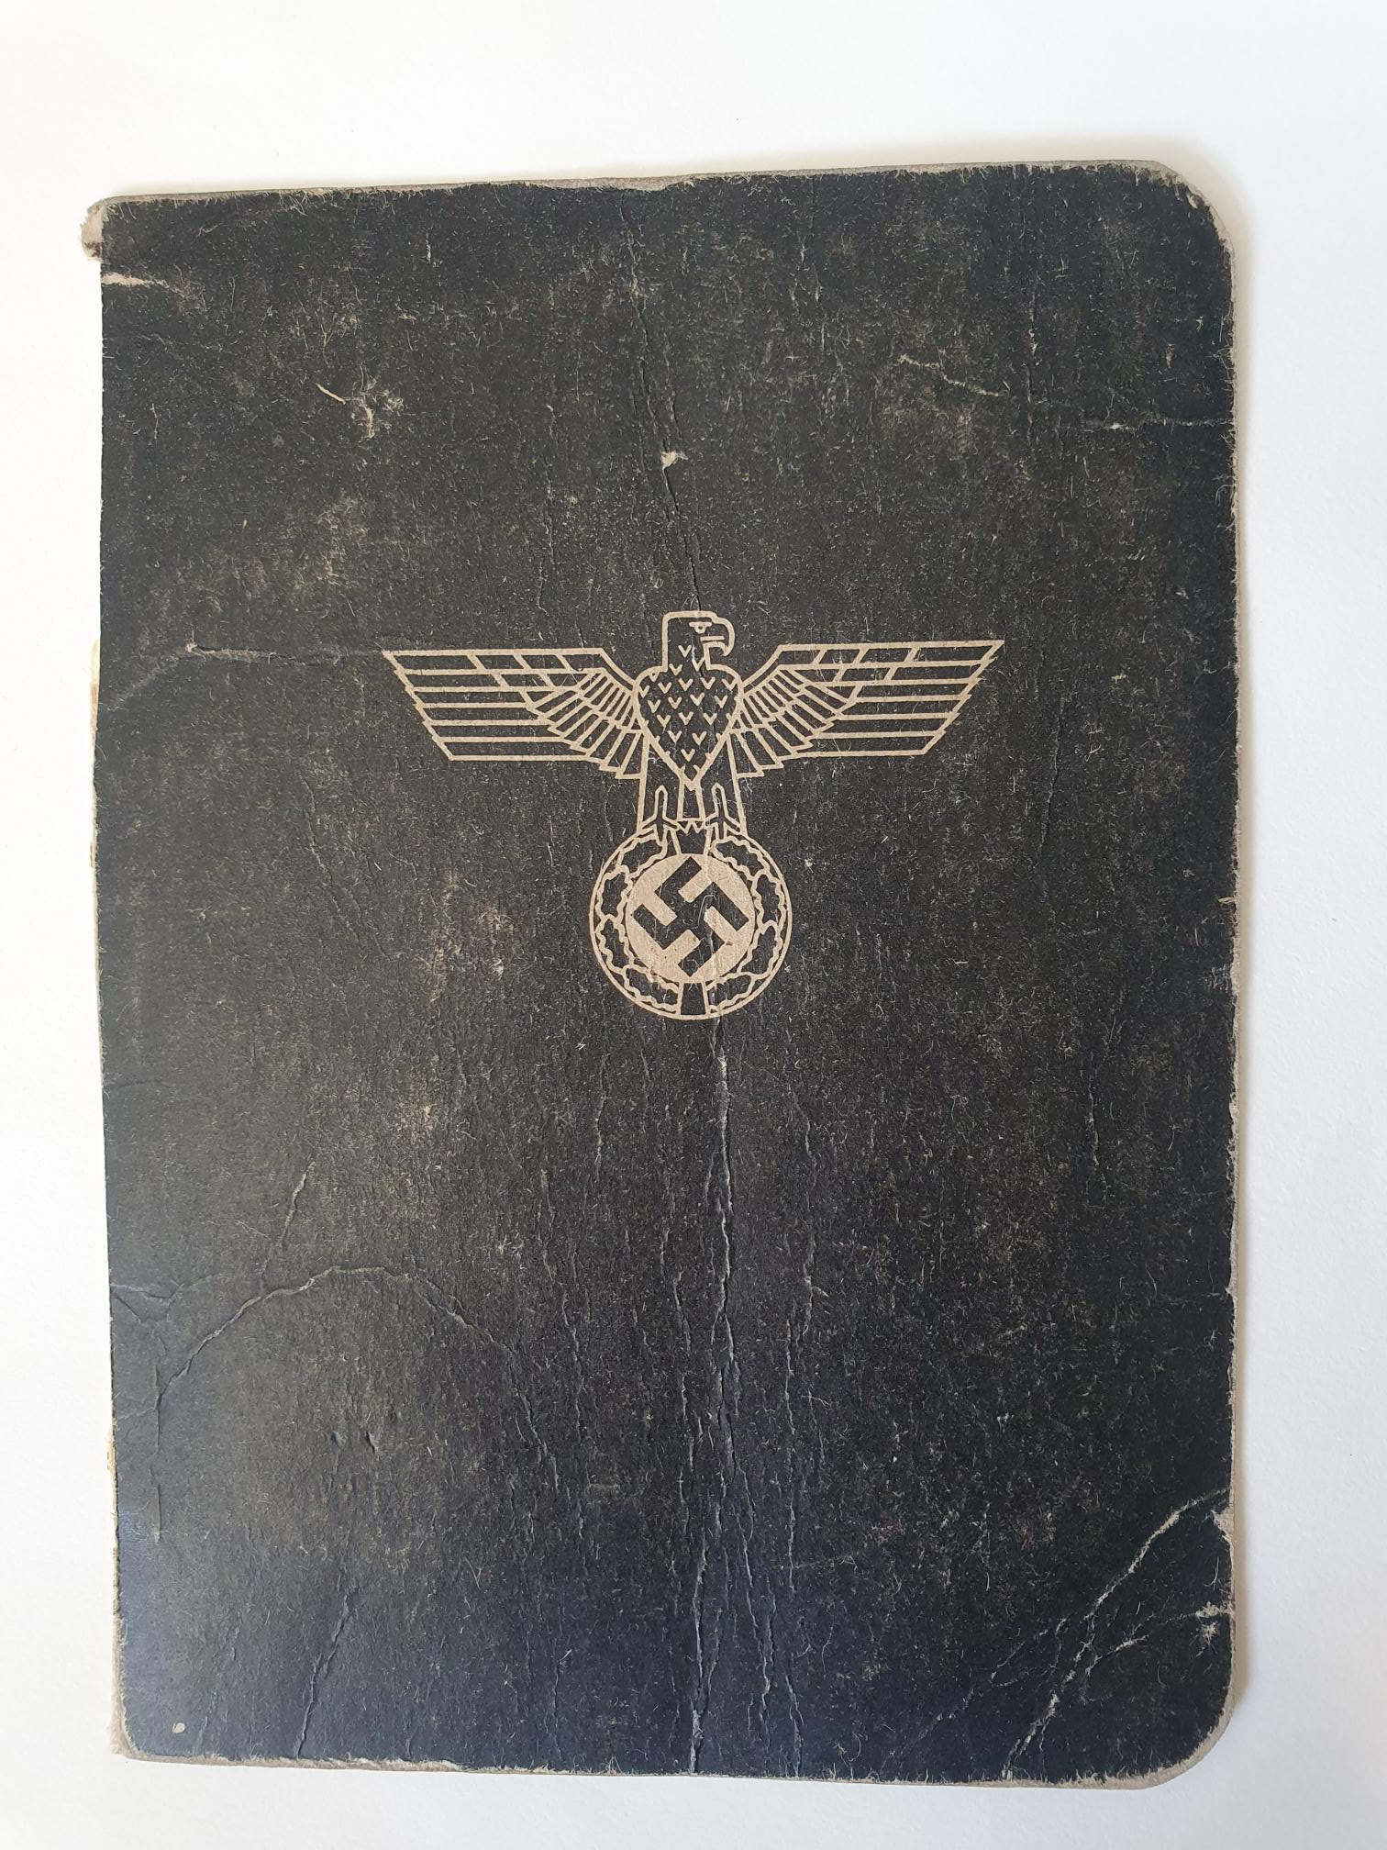
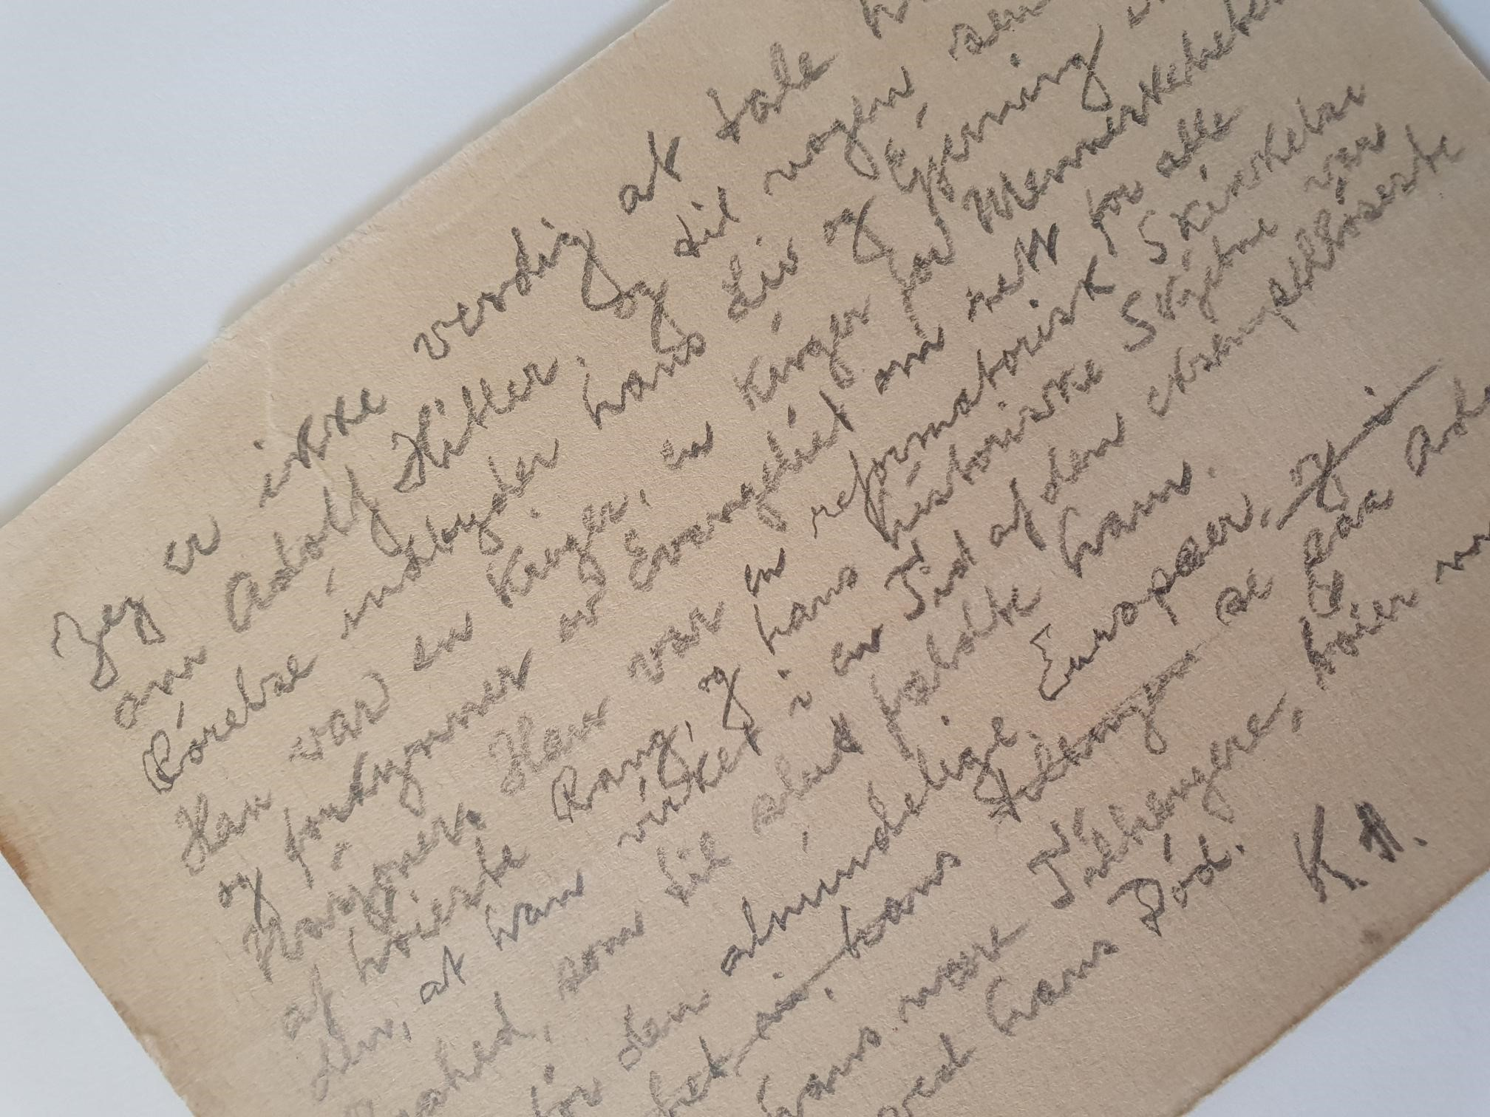
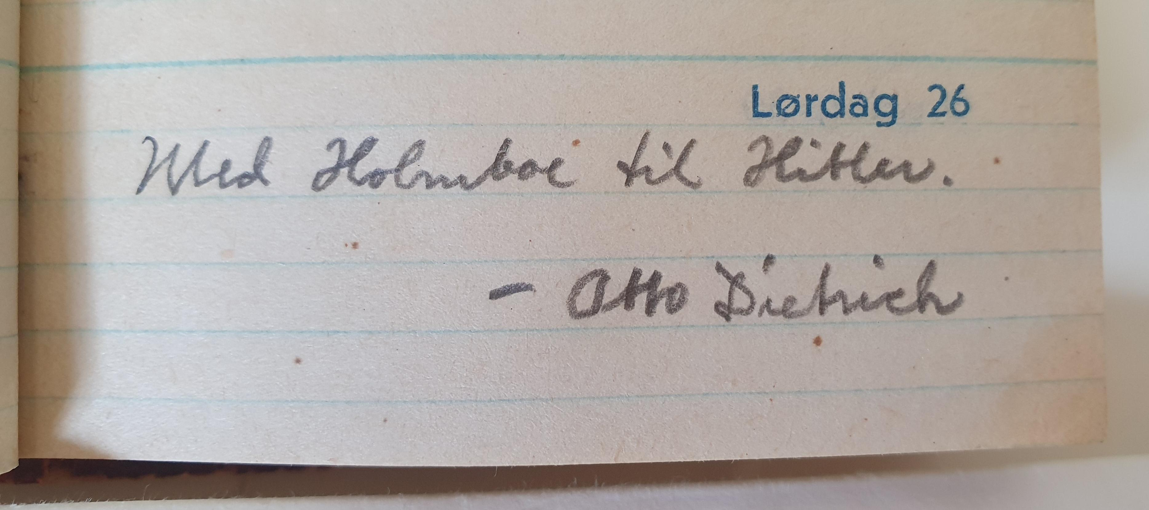
Almanac 1943 – when Knut Hamsun met Hitler in Berlin
Obituary over Adolf Hitler

Slide 6
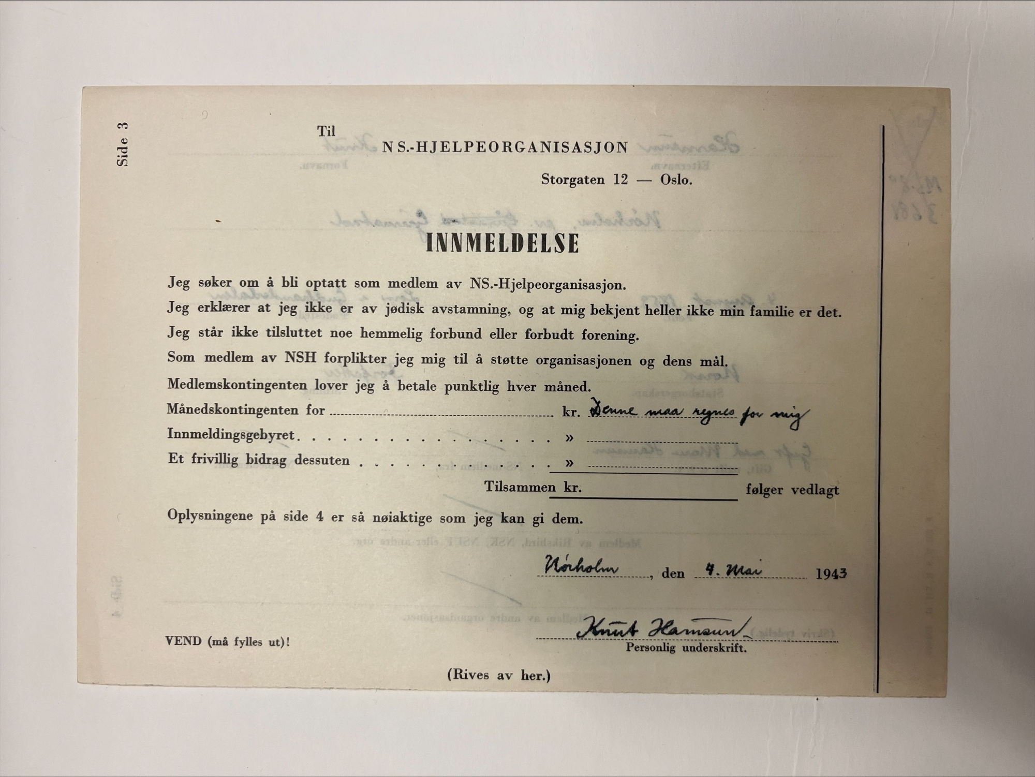
Form for membership in an wartime aid-organization that was part of Nasjonal Samling, the Norwegian Nazi Party.

Slide 7
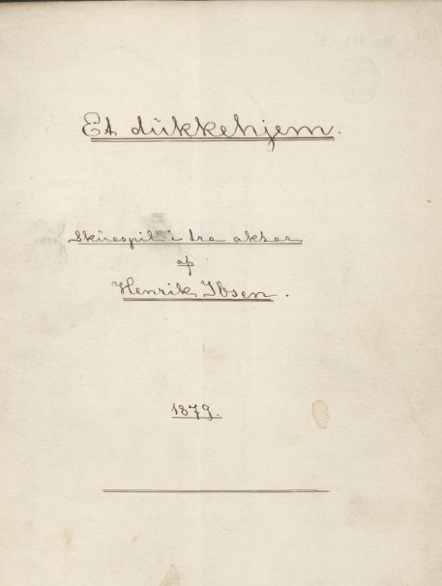
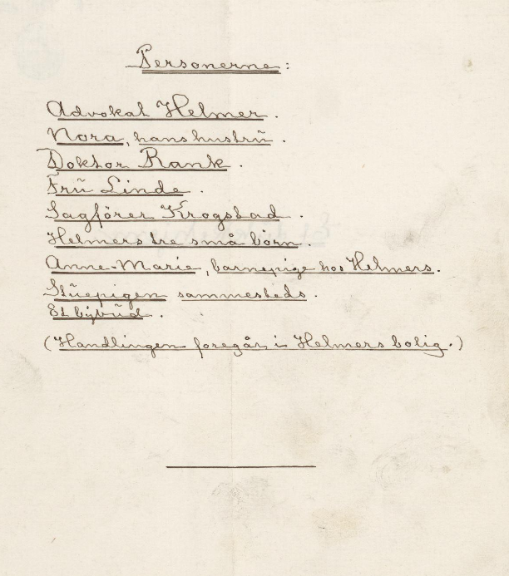
Henrik Ibsen: The Sun God. Mss for sale 2006.
Henrik Ibsen: A Doll’s House, ms.8° 952, The National Library of Norway. Donation 1931.

Slide 8
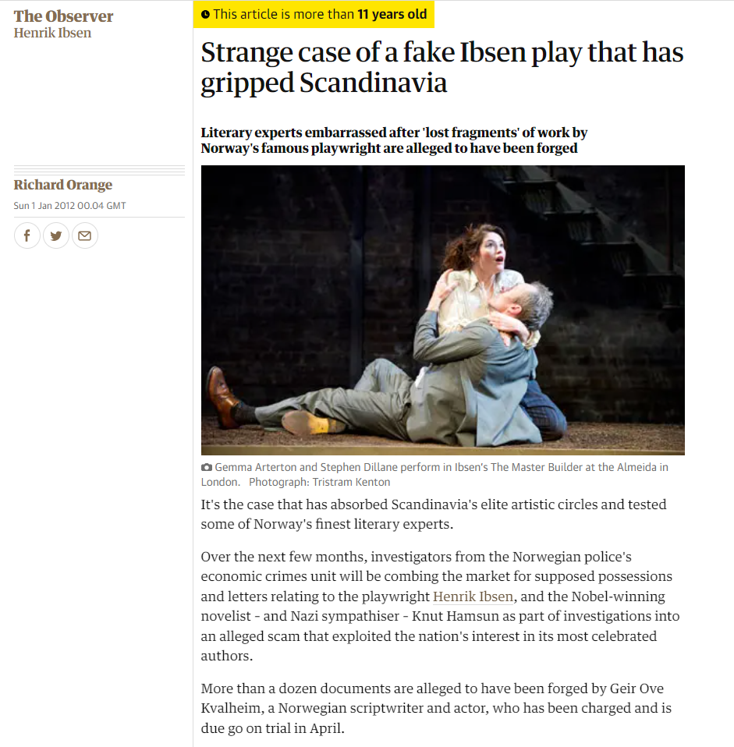
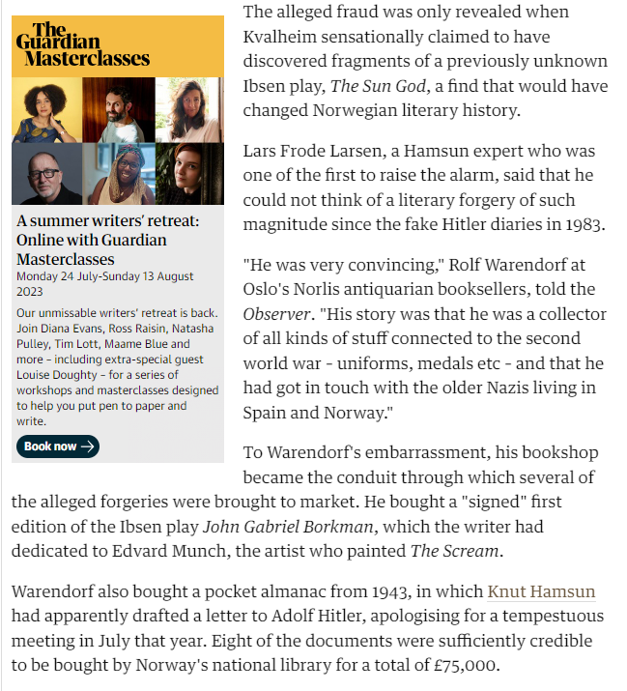

Slide 9
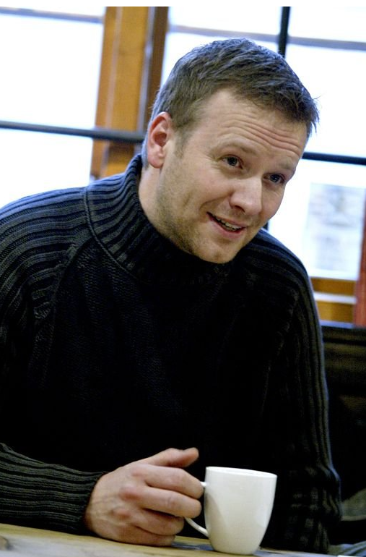
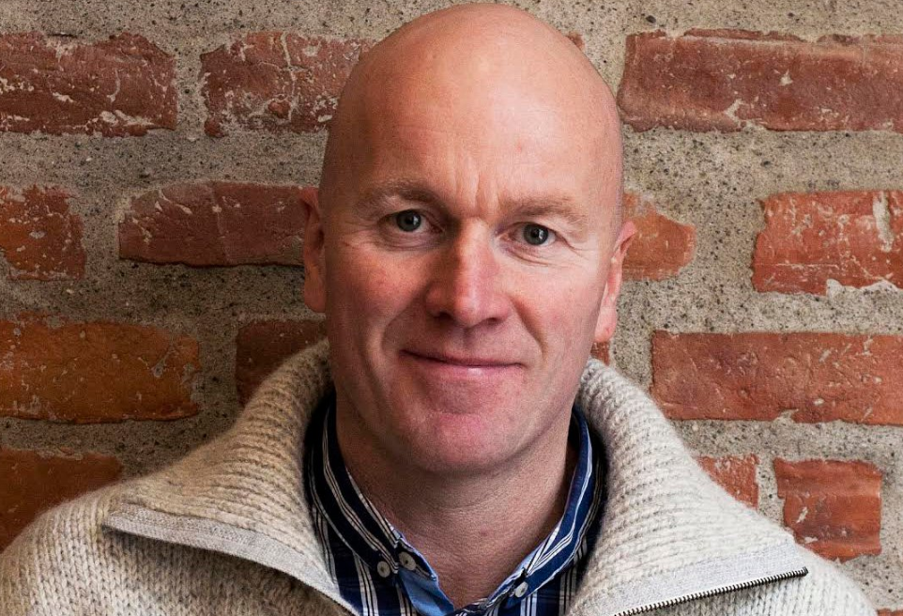
Geir Ove Kvalheim (1970-)
In June 2013 he was sentenced to one year and nine months in prison for selling counterfeit manuscripts and letters from Knut Hamsun and Henrik Ibsen. https://no.wikipedia.org/wiki/Geir_Ove_Kvalheim

Slide 10
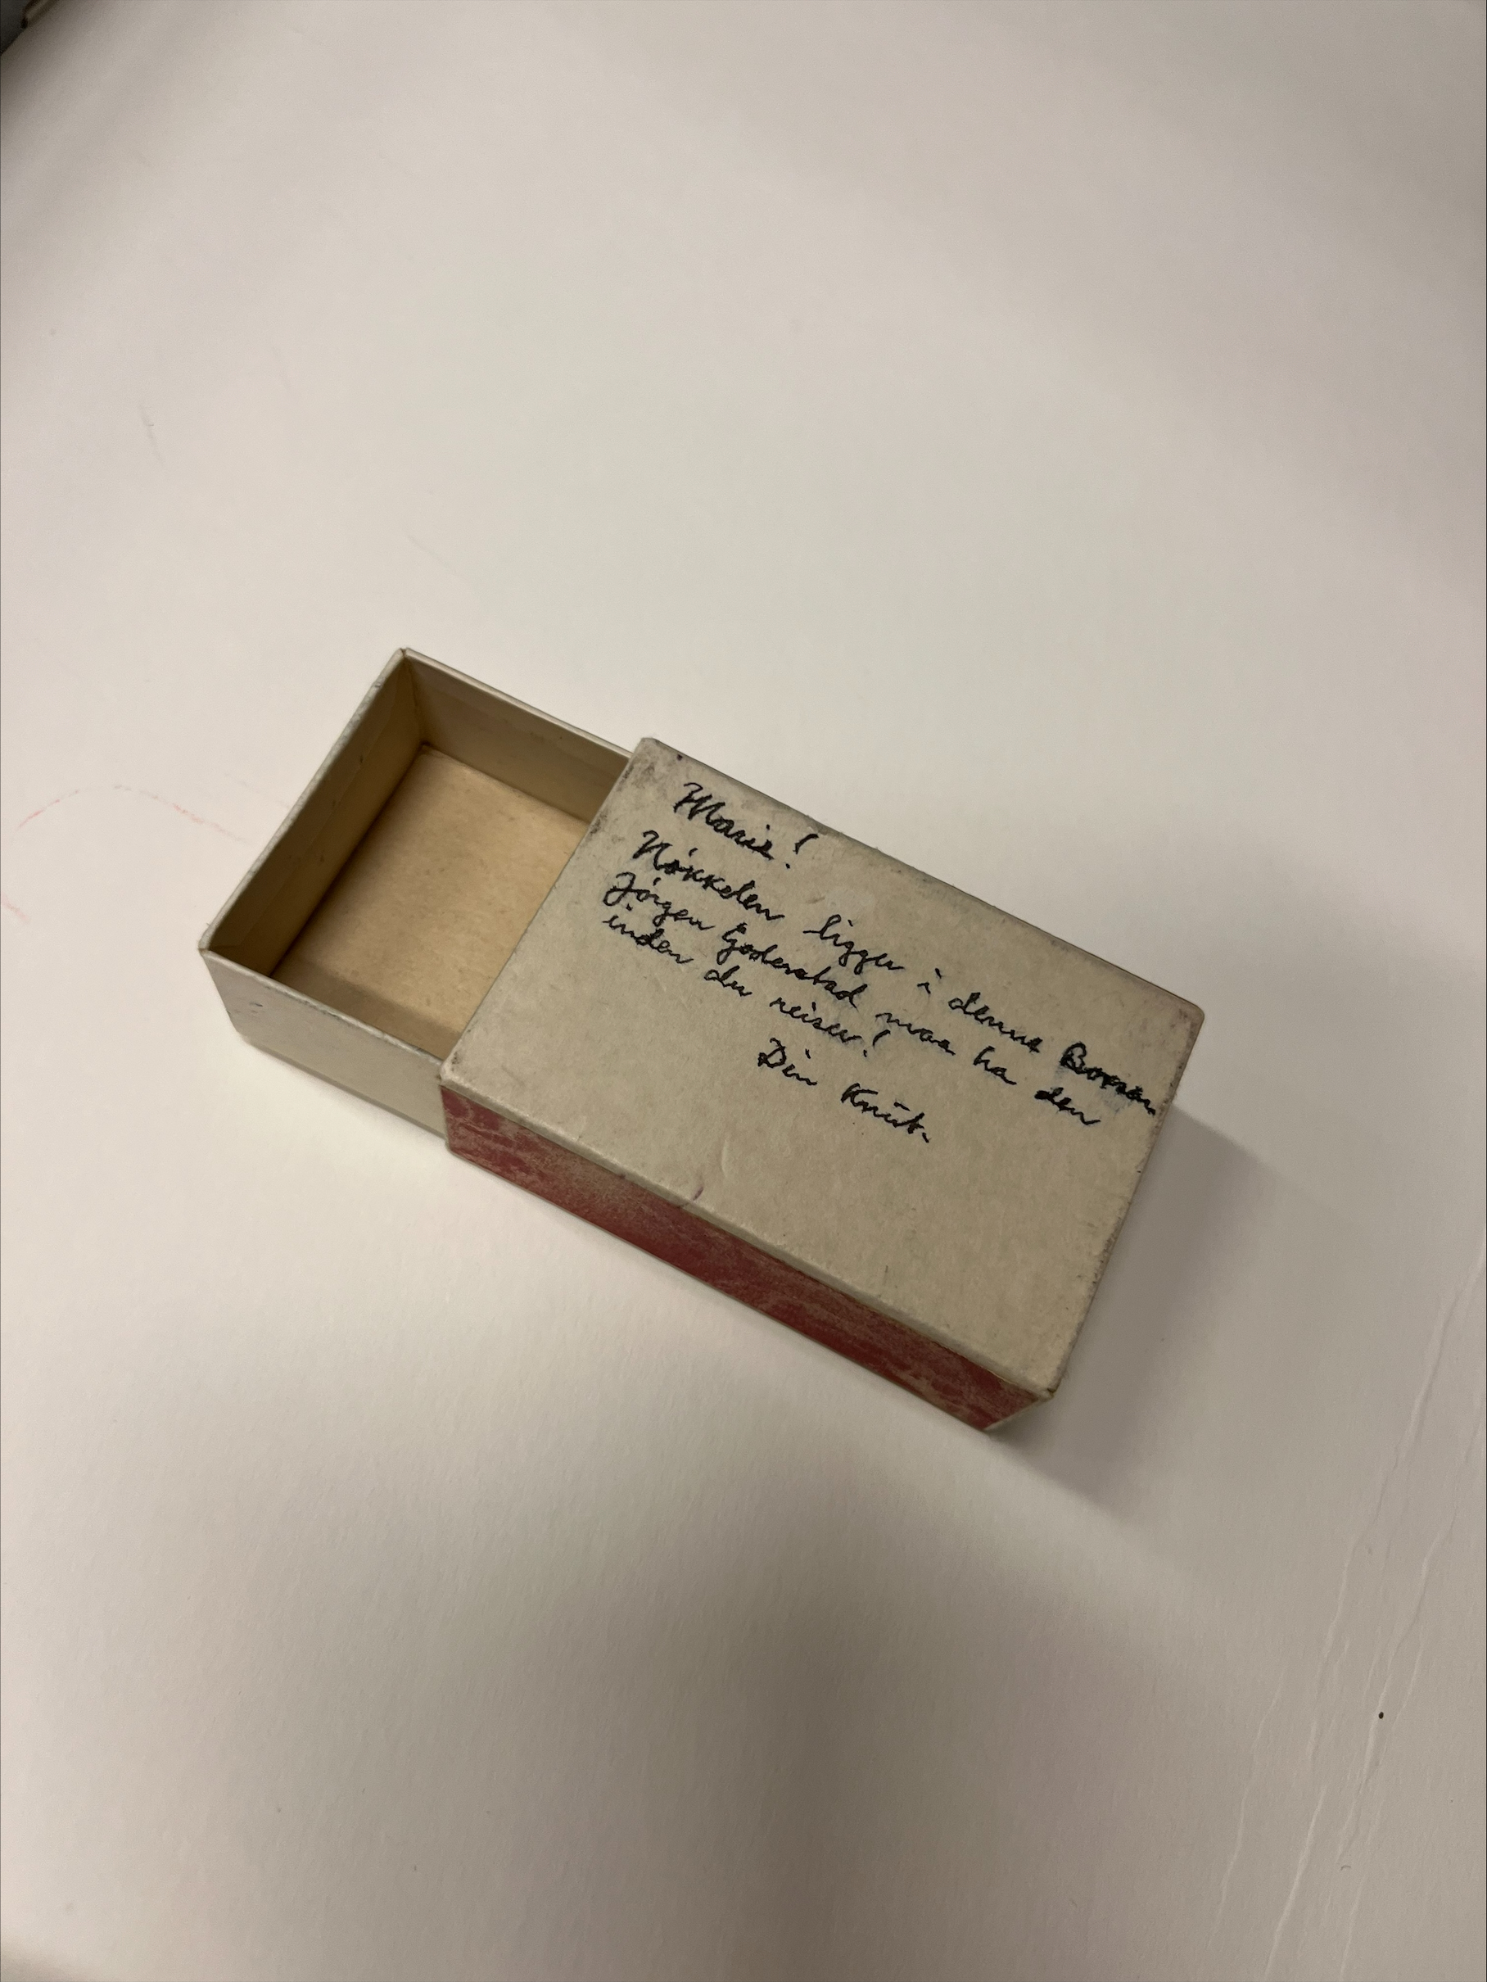
There is no such thing as a free lunch…
A small pill box from the local apothecary near Hamsuns home. A note from Knut Hamsun to his wife Marie is written on the back side. The note says the box contains the key to the house (?) to be given to a neighbour (?) when Marie leaves (for holiday?).
Gifted to the National Library of Norway from Geir Ove Kvalheim, as a token of our close collaboration.

Slide 11
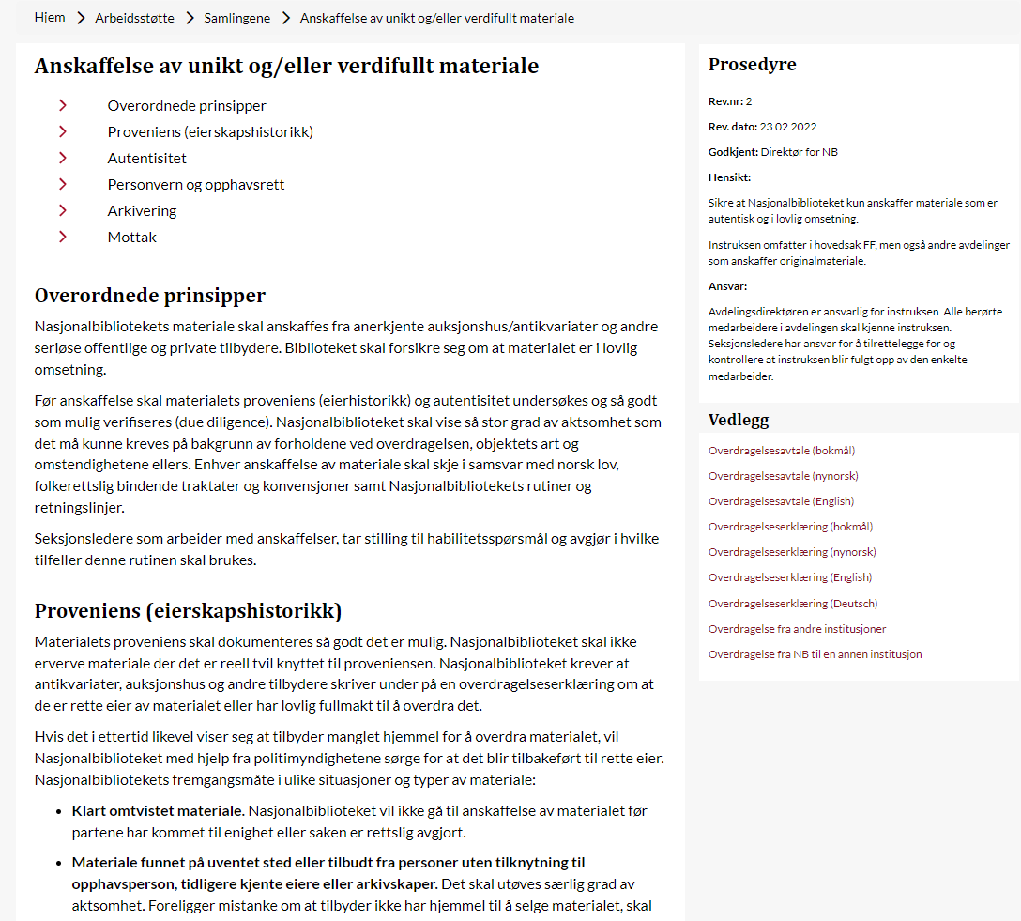
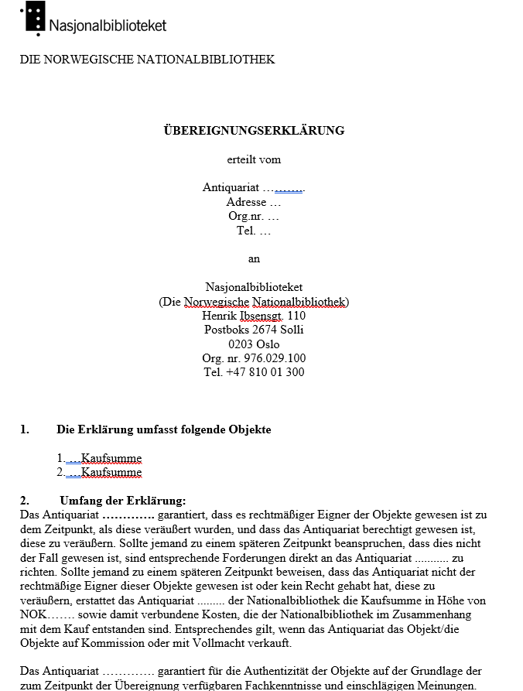
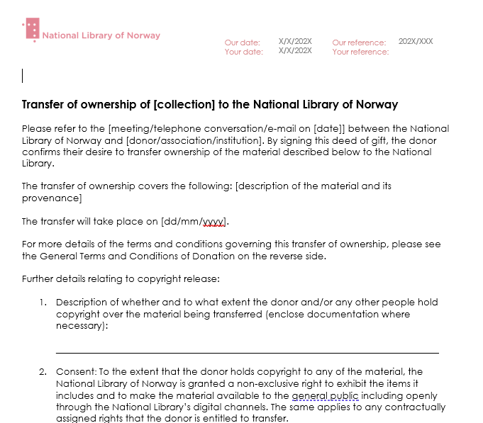
Formal procedures instead of personal trust
Set
te inn bilde av overdragesle og antikvairaterklæring på engelsk

Slide 12
From the sentencing, page 26 (my translation):
«I skjerpende retning må det endelig tillegges vekt at flere av de håndskrifter som var falske gjaldt skrifter som - dersom de hadde vært ekte - ville hatt betydning for kultur- og litteraturhistorien. ... Siden håndskriftene ved Håndskriftsamlingen i stor grad benyttes av forskere, biografer og historikere, er det også meget viktig at opplysningene som disse gir virkelig stammer fra den angivelige utsteder. Falske skrifter kan for eksempel lett føre til ukorrekt historieskrivning.»
«In an aggravating direction, it must finally be emphasized that several of the manuscripts that were fake concerned writings that - if they had been genuine - would have been significant for the history of culture and literature. ... Since the manuscripts at the Manuscript Collection are used to a large extent by researchers, biographers and historians, it is also very important that the information provided by these really originates from the alleged issuer. For example, false writings can easily lead to incorrect writing of history.»

Slide 13
The people we meet
Points for discussion – 20 min group discussion – presentation
Do you have «priveliged users», people outside your institution that feels like colleagues? Fellow students from university, antiquarian dealers or people working at auction houses?
Do you have close contact with private collectors or academics working at private institutions with similar collections to your own?
Are these involved in discussions about acquisitions, authenticity and price valuations, provenance research? If so, how?
Are they treated differently from ordinary users if they visit the special collections reading room?
Do you have procedures/ethical guidelines regarding your connection with these people?
Do you reflect on different hats, roles, policies?

Slide 14
The documents we meet
Points for discussion – 20 min group discussion – presentation
Do you or your library examine letters/manuscripts in private ownership or for sale?
Does your paper conservators or conservation atelier examine/test/repair items owned by others?
Do you take in and keep for in house examination items you consider acquiring?
Do you share the results of these examinations with the owners, dealers or persons outside your institution?
Do you state opinions about authenticity, or about whom the author might be?
Do you help read/transcribe material not in your collection?
Do you have procedures/ethical guidelines regarding your connection with documents not owned by your institution?

