Slide 1
Moving books from off-site locations to the library:
methods of security employed
and lessons learned

Slide 2
What do we do in the (hopefully unlikely) event of a disaster?

Slide 3
Some thoughts …
Time as the crucial factor!
Moving the items out of the danger zone as quickly as possible to a dry or secure shelter
Items may be picked and placed in random order
Helpers may not be qualified staff
Storage room may not be fit for storing books (climate!)
Helpers may be hired on short notice
Technical facilities may be lacking (e.g. freezers)
Items placed on the floor / in storage rooms that are not part of the normal bookstacks

Slide 4
And how do we act in „normal“ times?
Notes:
The normal times are, as the images …., a little bit more relaxed. There is enough time to plan things and prepare for several secenarios.

Slide 5
Recent cases

Slide 6
Recent cases
Acquisition of (former) private collections
Dissolution of monasteries / religious houses
Cataloguing / digitisation projects

Slide 7
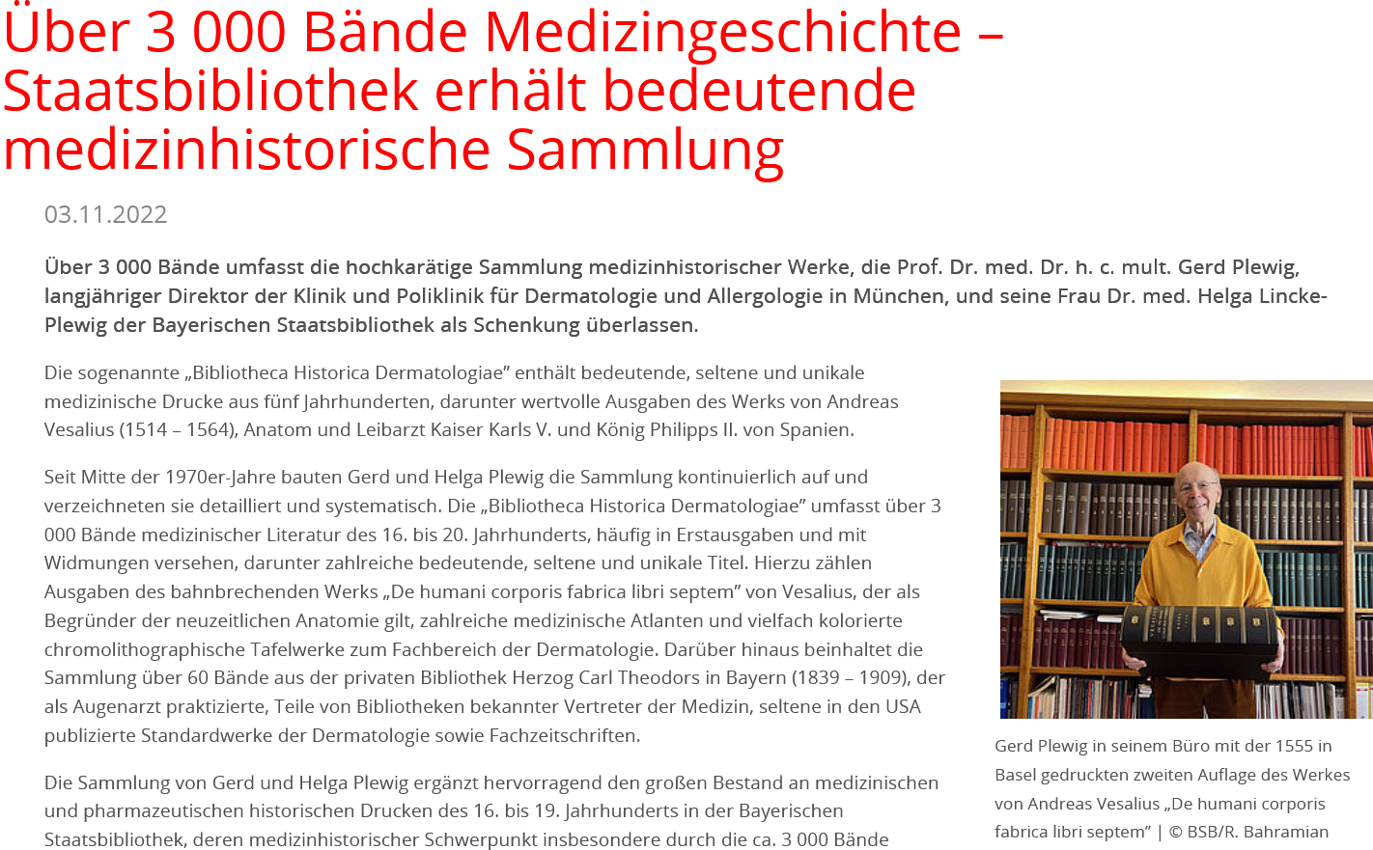
(1) Acquisitions

Slide 8
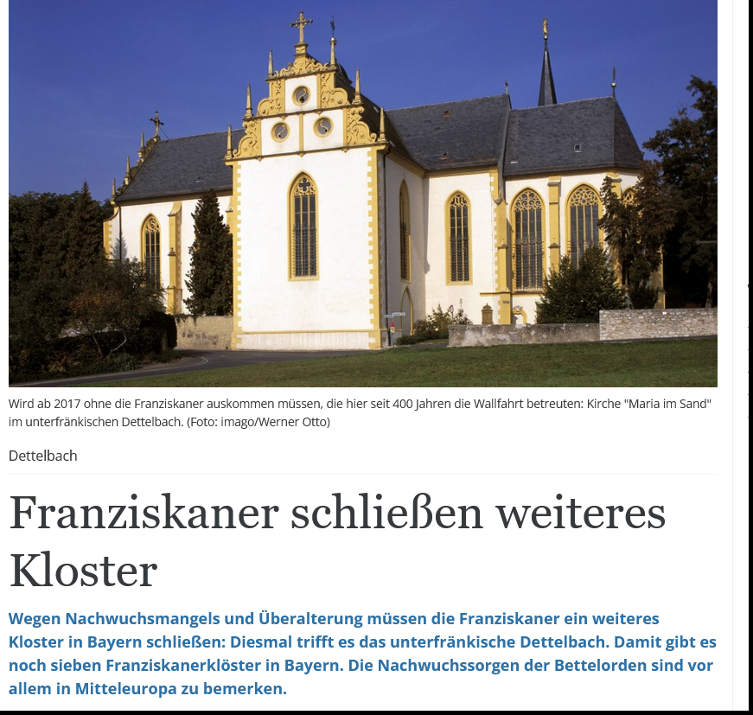
(2) Dissolution of religious houses

Slide 9
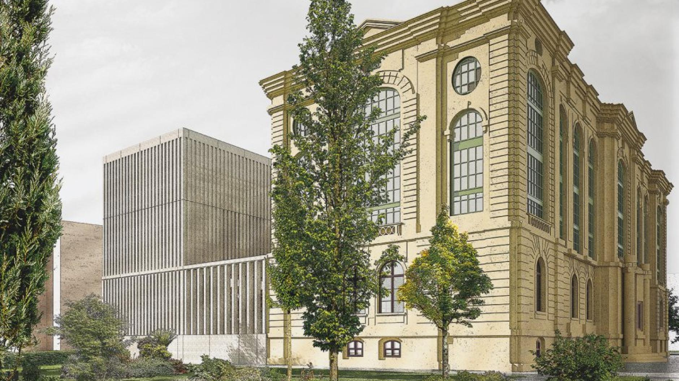
(3) Construction project: Staats- und Stadtbibliothek Augsburg

Slide 10
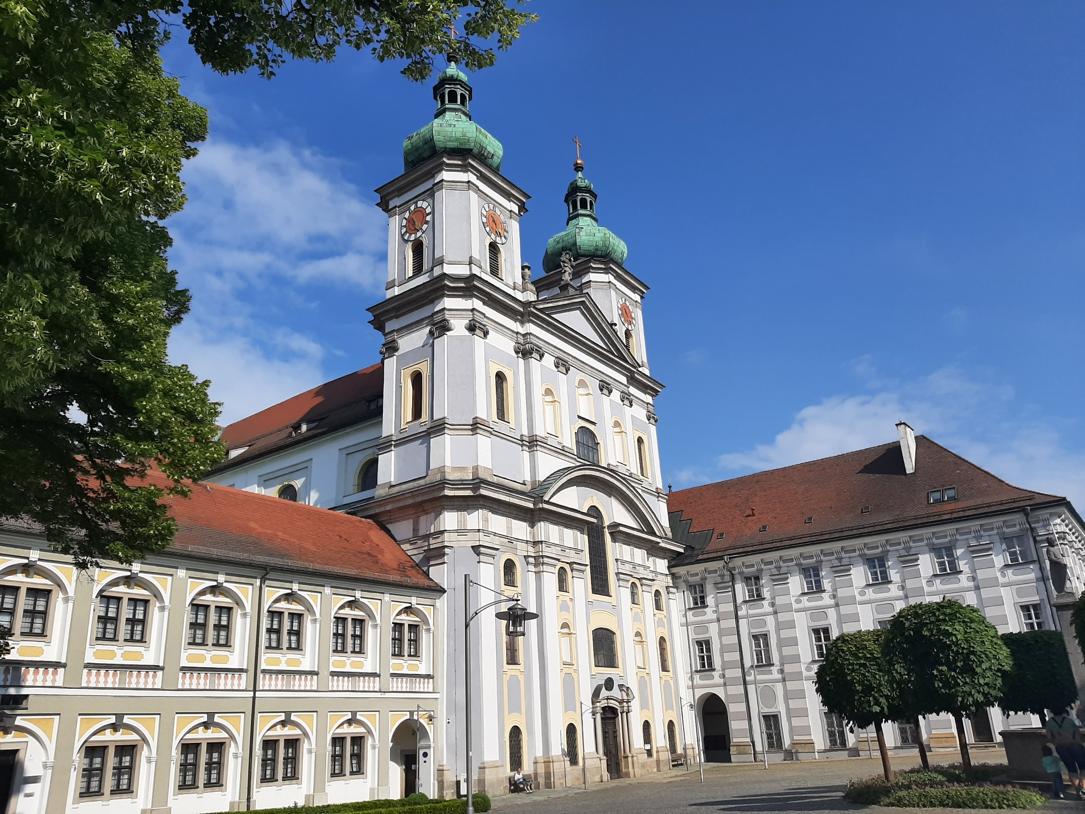
(4) Cataloguing / digitisation projects

Slide 11
The case of Waldsassen Abbey
Cistercian abbey of nuns - still inhabited
A portion of the books owned by the state (since 1803) – on loan deposited in the baroque „reading room“
The library hall will be refurbished in due course – hence the books have to be removed for a couple of years
In the meantime the books are to be catalogued and (if appropriate) also digitised
The background
The good news: planned moving,
coordinated steps of work,
enough time to consider the most appropriate procedures
Notes:
Kurz auf die Säkularisation 1803 hinweisen (reason for the ownership by the State – the monastery had been a religious house for men for some 600 years up to 1803, then dissolved and re-founded as a nunery some 60 years later)

Slide 12
Some visual impressions of the library …

Slide 13
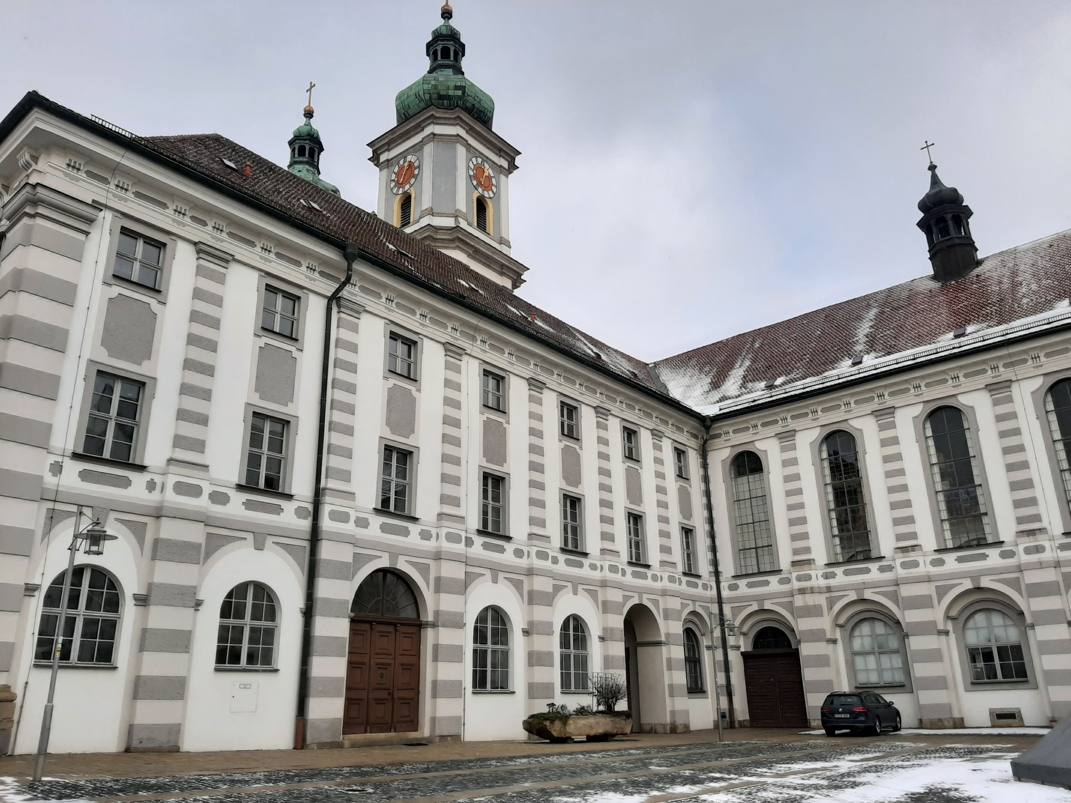
The library
Its outer appearance
… in February 2023

Slide 14
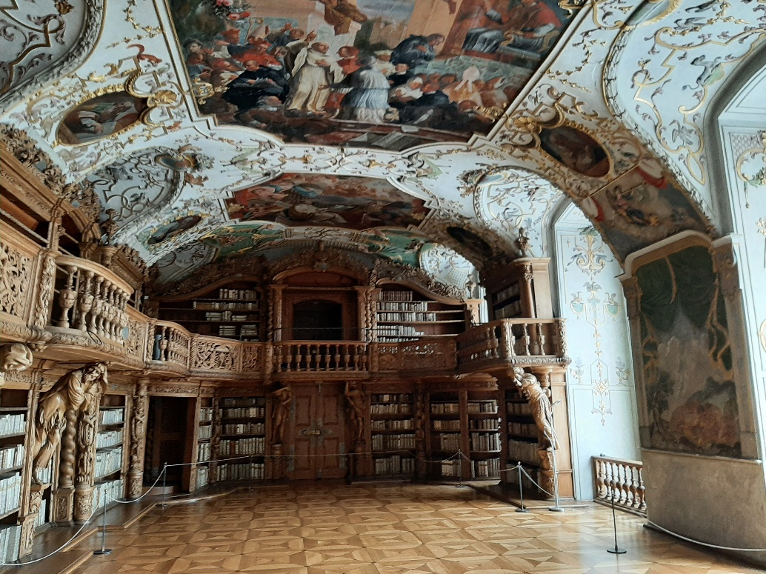
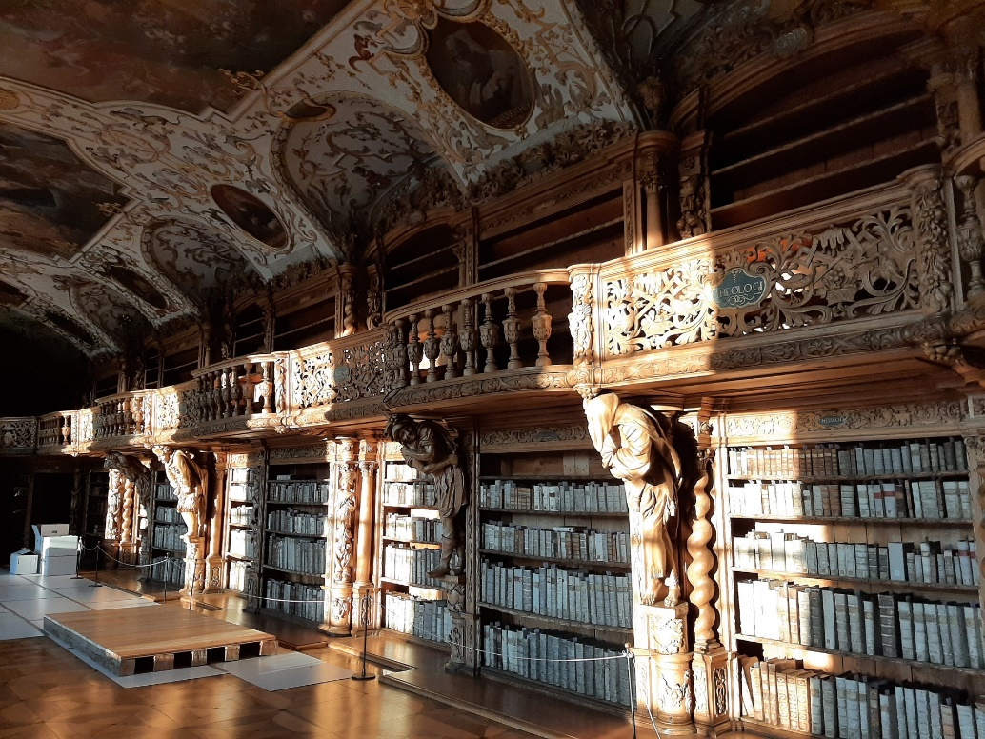
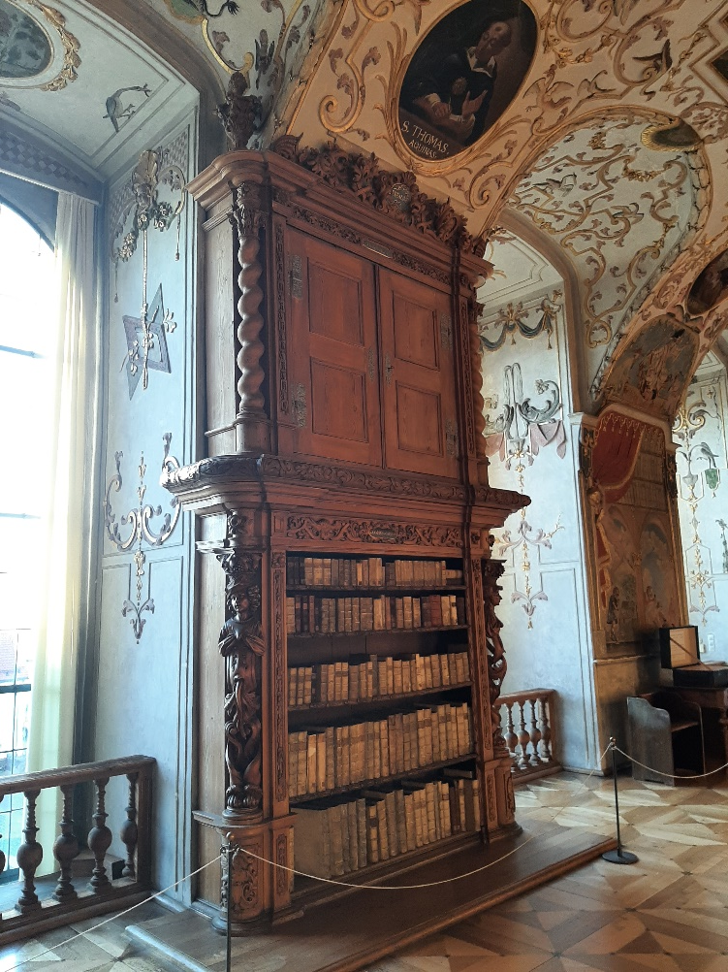
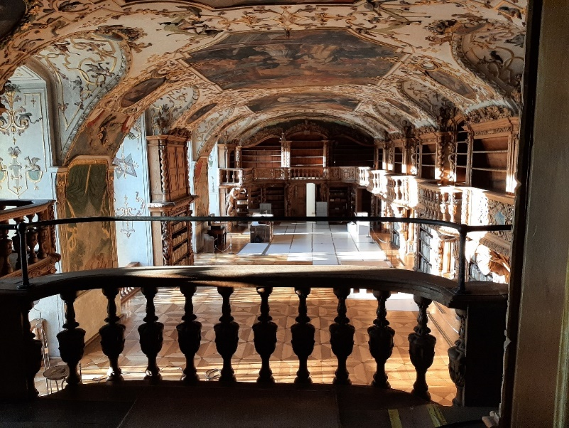
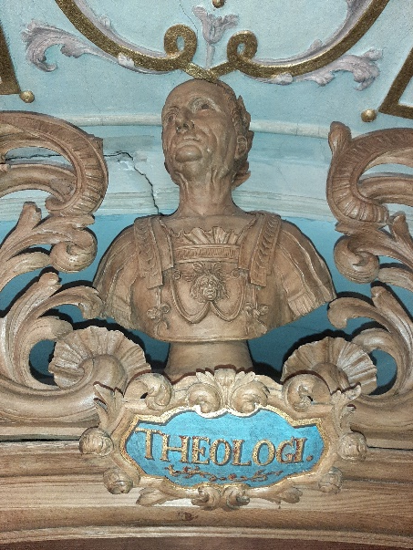
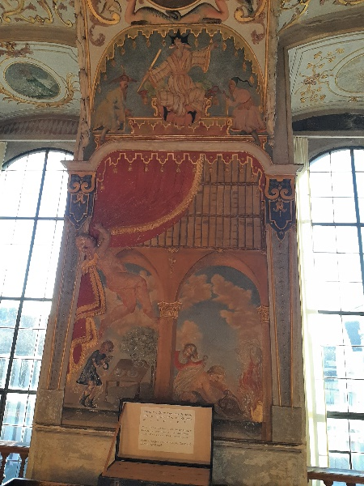
The library hall
Notes:
Vaulted ceiling, full of stucco and frescoes, with a wooden gallery and wooden busts surmounting the bookshelves

Slide 15
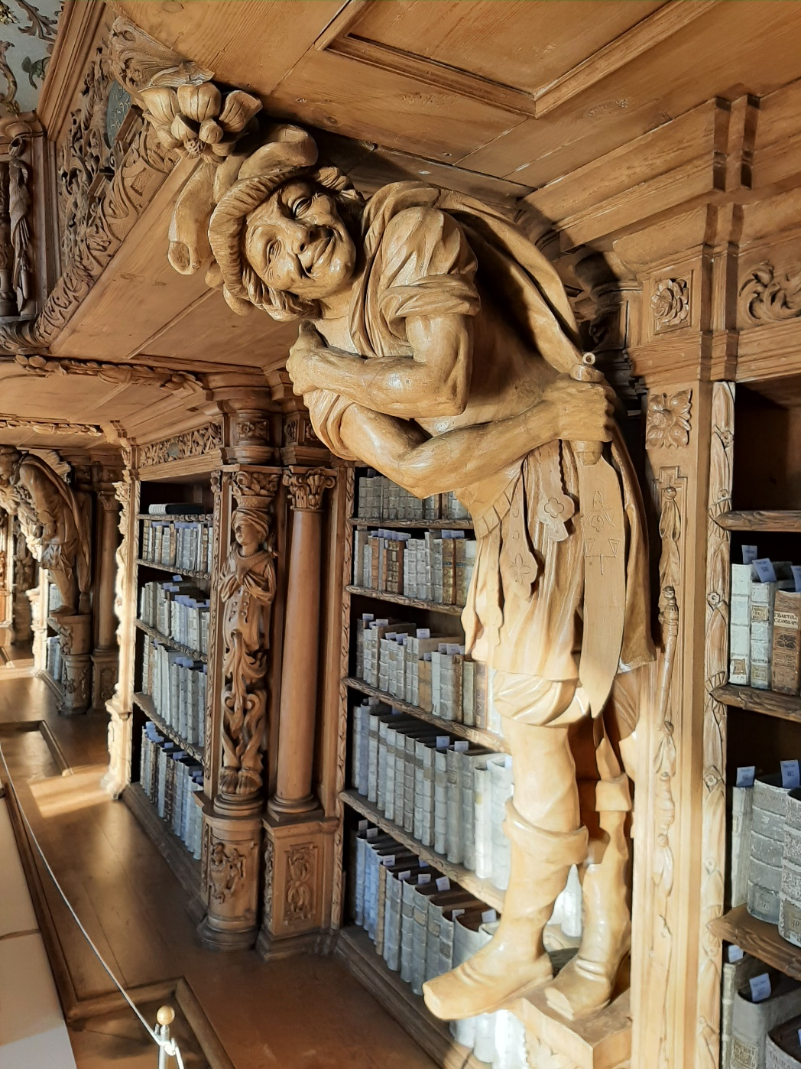
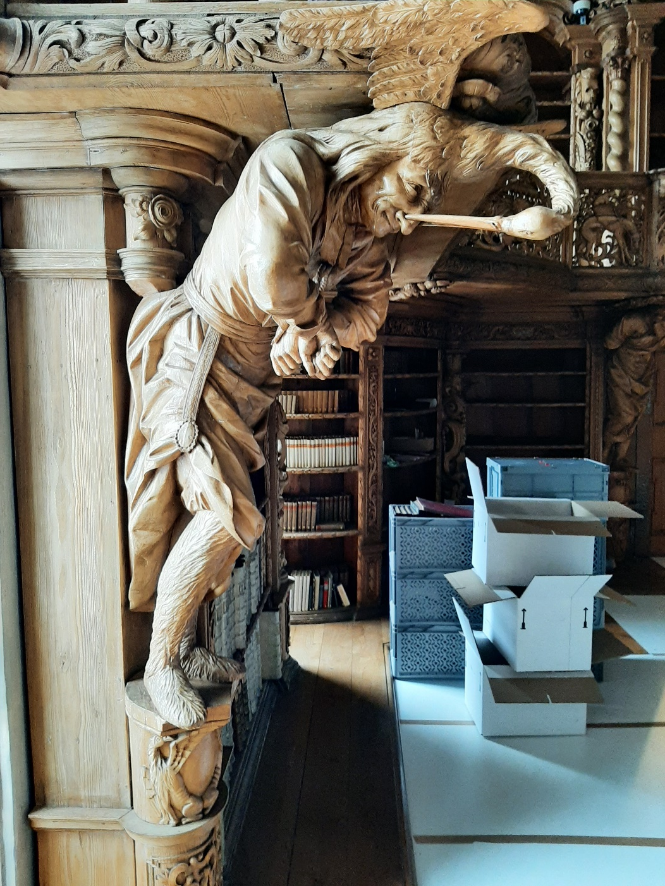
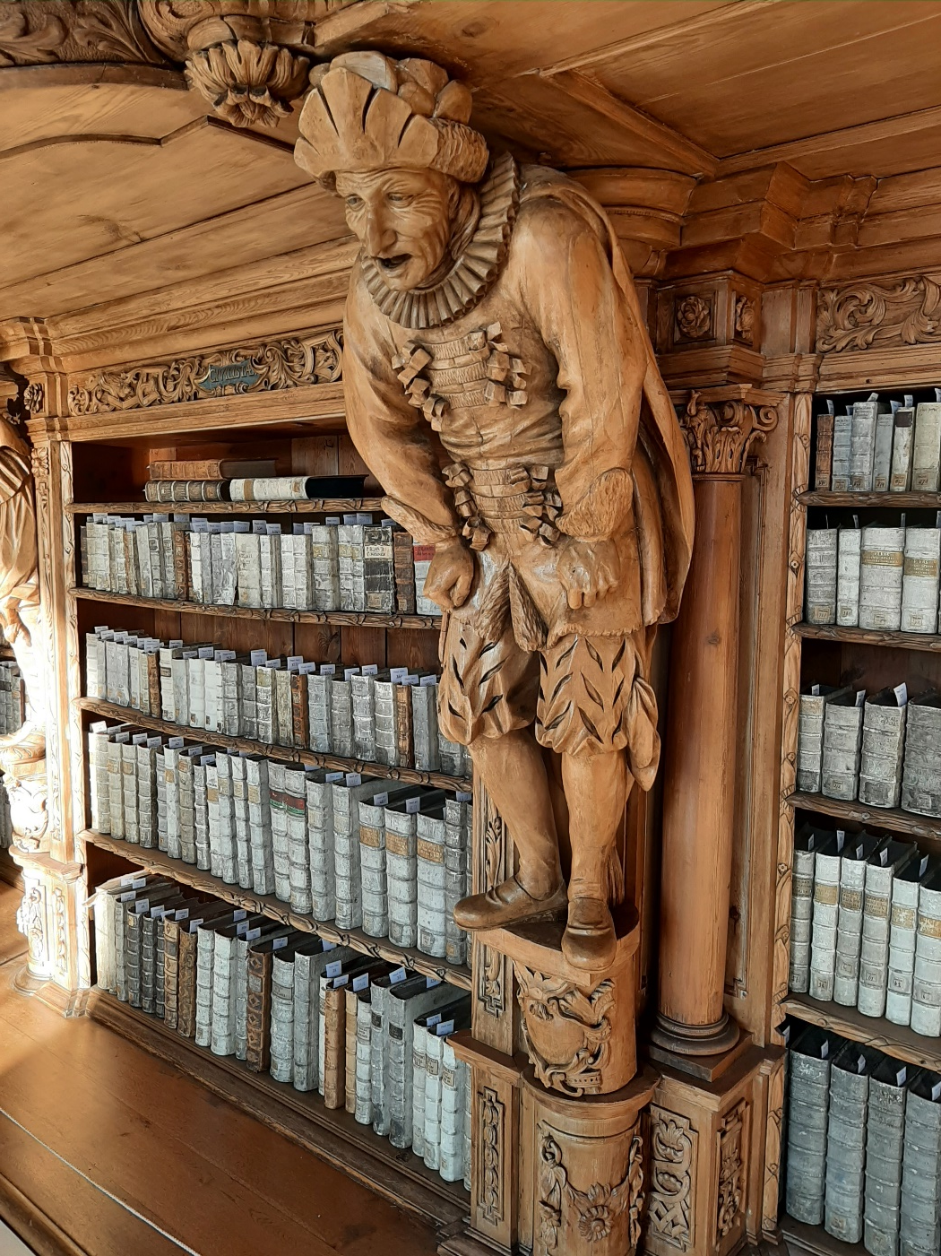
The library hall – also famous for its wooden atlantes
Notes:
Persinifications of virtues and vices

Slide 16
Measures to be taken prior to the moving

Slide 17
To be done prior to the moving
Revisions: checking for completeness
Lists: ideally provided by the institution / collector / donor
Paper slips: to be inserted into the books
Photographic documentation: as detailed as possible
Notes:
The main problem here: the lists are rather dated (the books have been on loan since 1965, in the 1980 the last revision took place). The library hall is not guarded but open both to the nuns and the public (in the form of guided tours on a regular basis, i.e. at least 5 times a week). As a result, you – as a librarian – cannot control the safekeeping of the holdings as you could do when having them in your own library or, rather, your bookstacks.

Slide 18
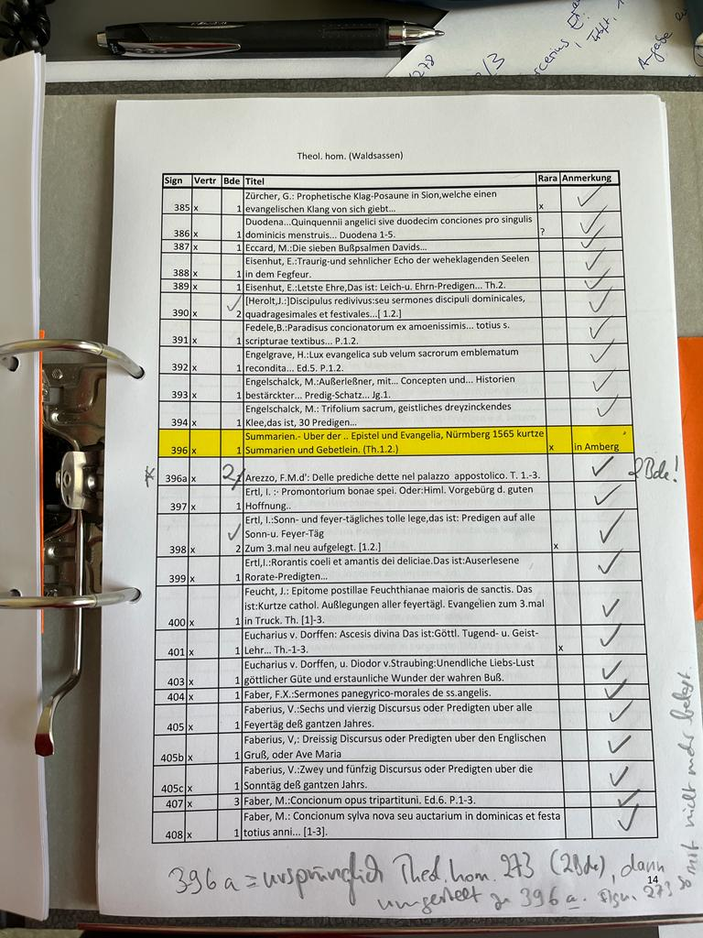
Revisions: checking for completeness
(1) Lists: ideally provided by the institution / collector / donor

Slide 19
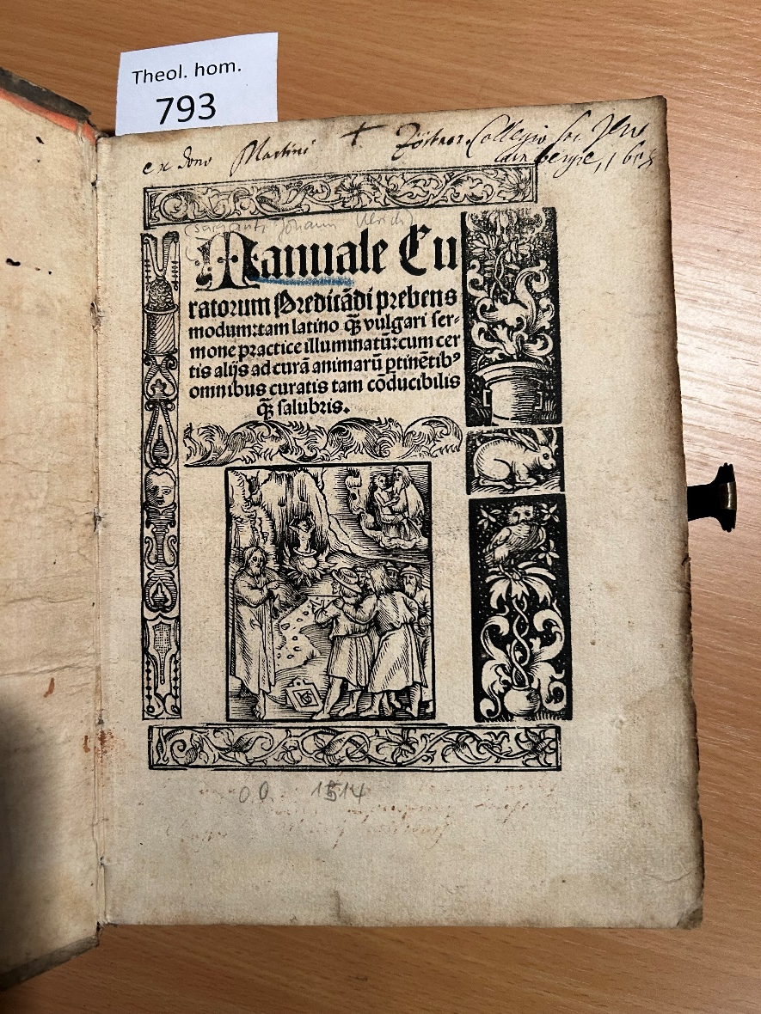
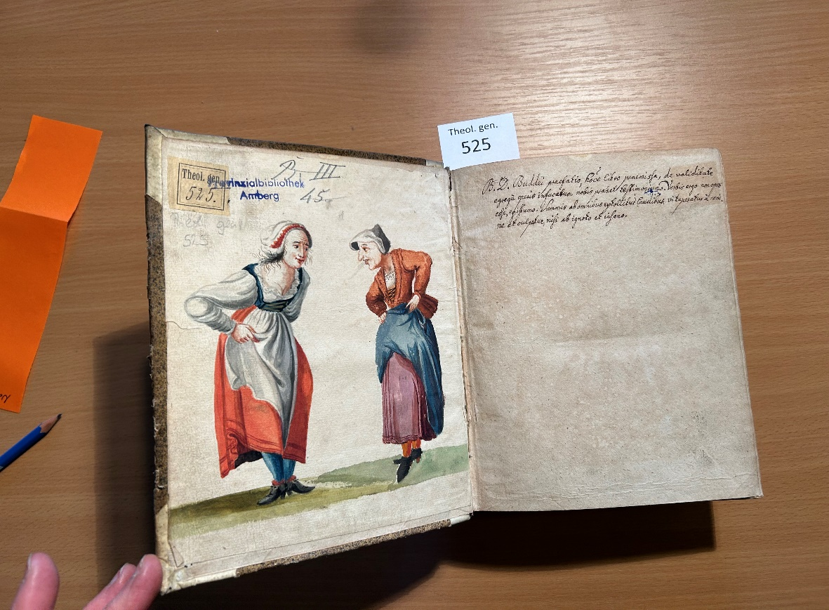
Revisions: checking for completeness
(2) Paper slips: to be inserted into the books
Notes:
Advantantages of the paper slips (which have been produced / printed out prior to the revision):
(1) you can easily see (on the bookshelf), which books you have already dealt with.
(2) Double checking: When spotting the shelfmark you both tick the boxes on your list AND insert the paper slips. In case that there is a discrepancy in the end (for instance: you have forgotten to tick the shelfmark on your list), there is a hint to the fact, that you have actually only forgotten to tick the list that is really there (and that you have marked with the slip)
NB: In this case we had to open the books anyway, as the shelfmarks stated on the spines may differ from those noted in the books themselves (in the covers or on the pastedowns)

Slide 20
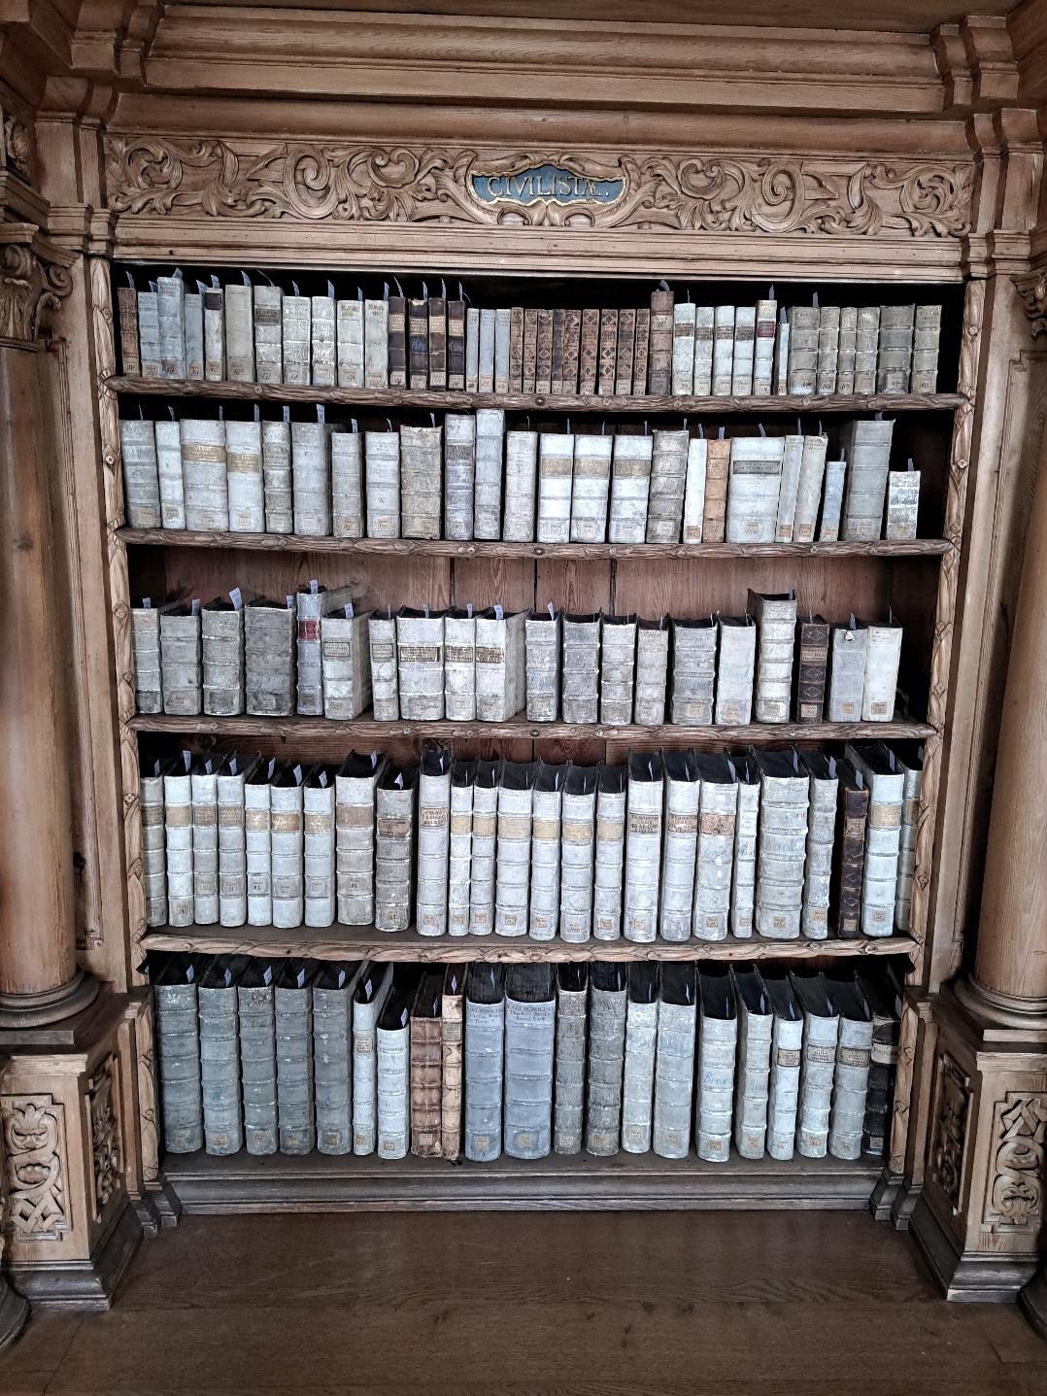
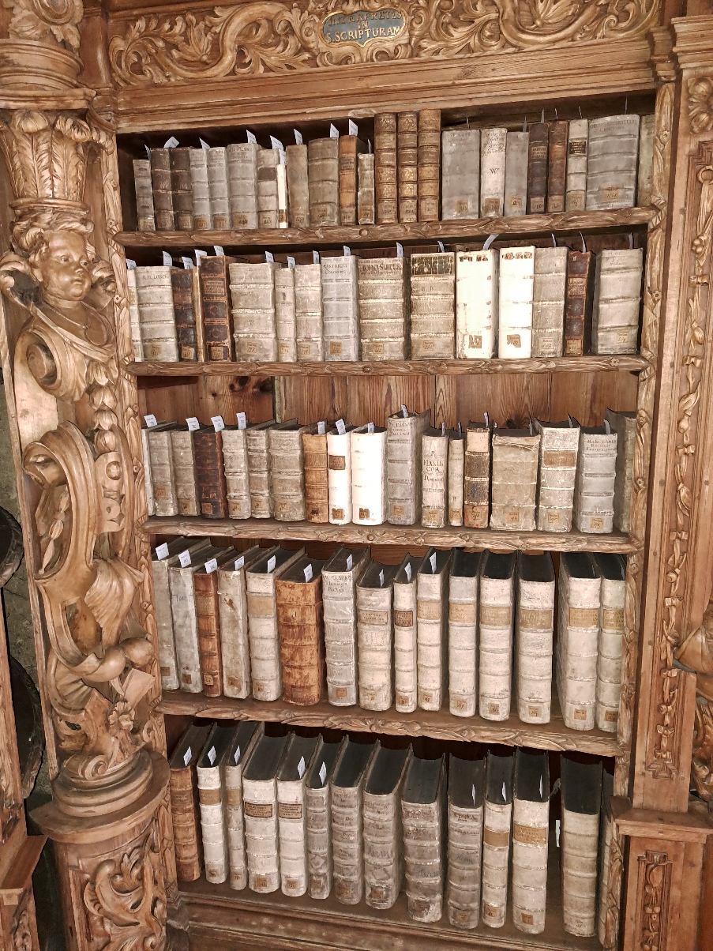
Revisions: checking for completeness
(3) Photographic documentation
Notes:
Ideally BEFORE and AFTER working with the books, as the sequence of shelfmarks here was a tiny bit tricky ..

Slide 21
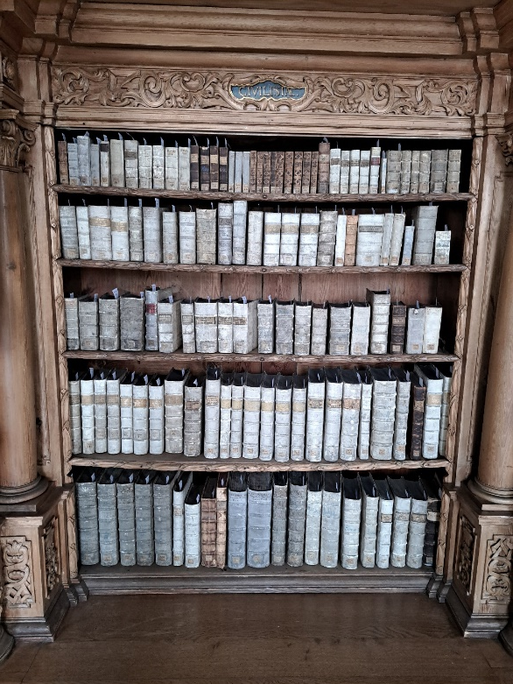
„Tricky“ sequence of shelfmarks
Running numbers with numerous gaps (due to the selection of „pretty book bindings“ for the touristic purpose of the library)
Two sequences intermingled: Theol.hom. and Theol.gen. are taking turns, e.g. Theol.gen. 1, Theol. gen. 1 a, Theol.hom. 1, Theol.hom. 3, Theol.gen. 4
Presence of up to three different formats in one wooden compartment
Octavo
Quarto
Folio
Notes:
The fact that the two sequences take turns, and the presence of up to three different formats in one wooden compartment we were forced to keep three times two, which equals 6 separate lists of shelfmarks at hand

Slide 22
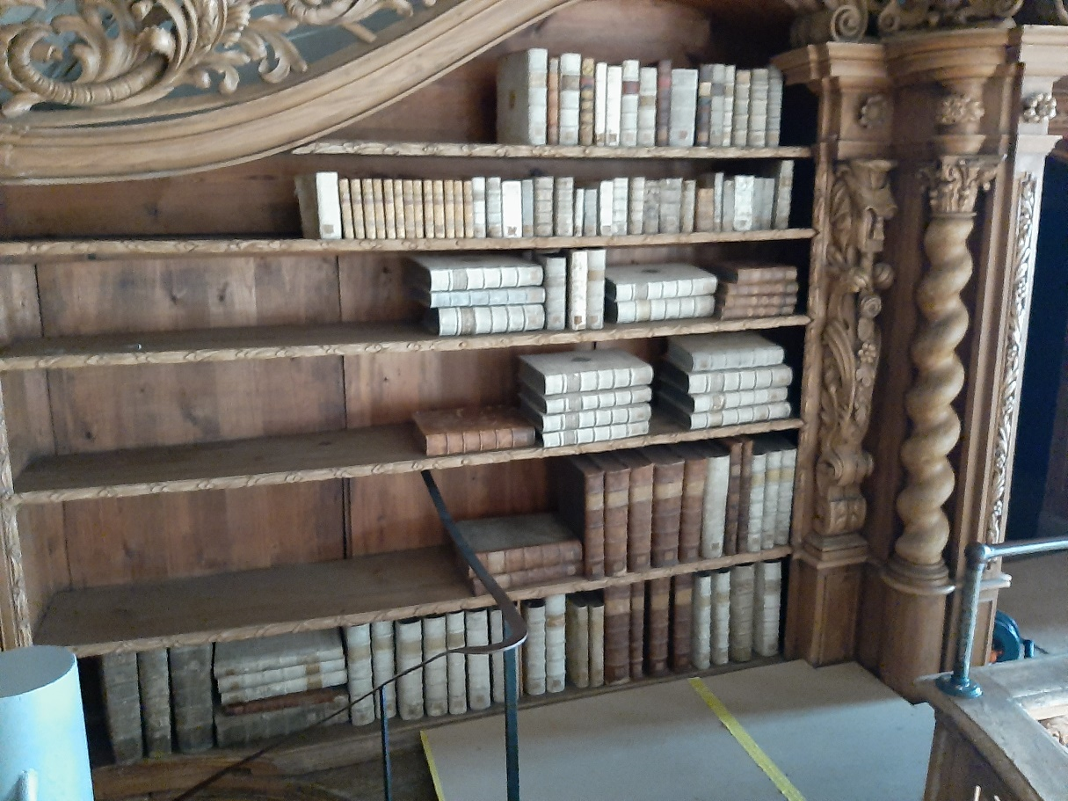
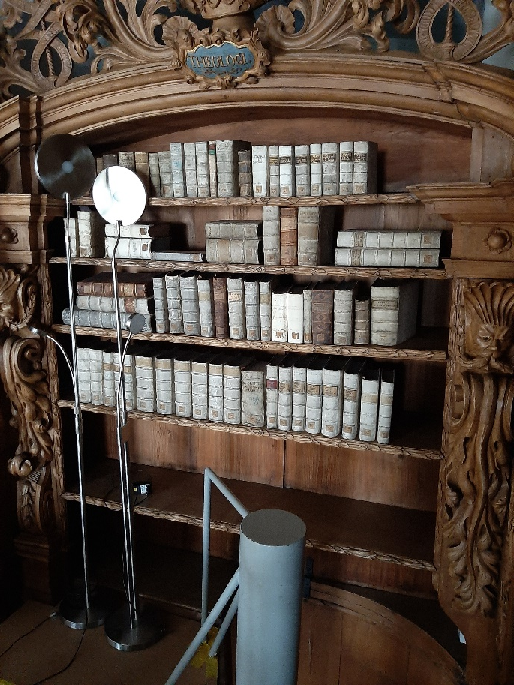
„Tricky“ sequence of shelfmarks
Some bookshelves were too low or „too short“ to store the books adaequately → thus some items had to be taken out of the normal sequence and were shelved in a neighbouring compartment
At some time a couple of books were taken to the gallery
Notes:
The fact that the two sequences take turns, and the presence of up to three different formats in one wooden compartment we were forced to keep three times two, which equals 6 separate lists of shelfmarks to be dealt with
At some time a couple of books were taken to the gallery … for reasons we do not know.

Slide 23
The actual moving of the books
Dealing with external staff
Supervision
Acting as a courier

Slide 24
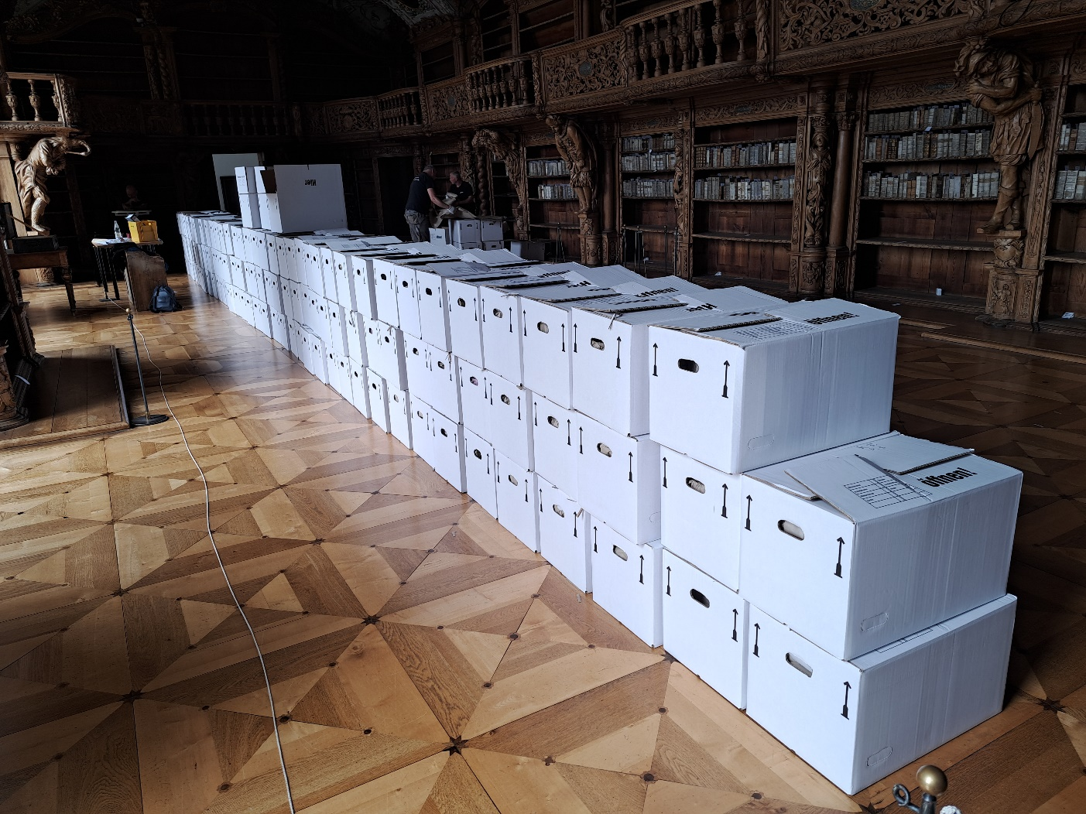
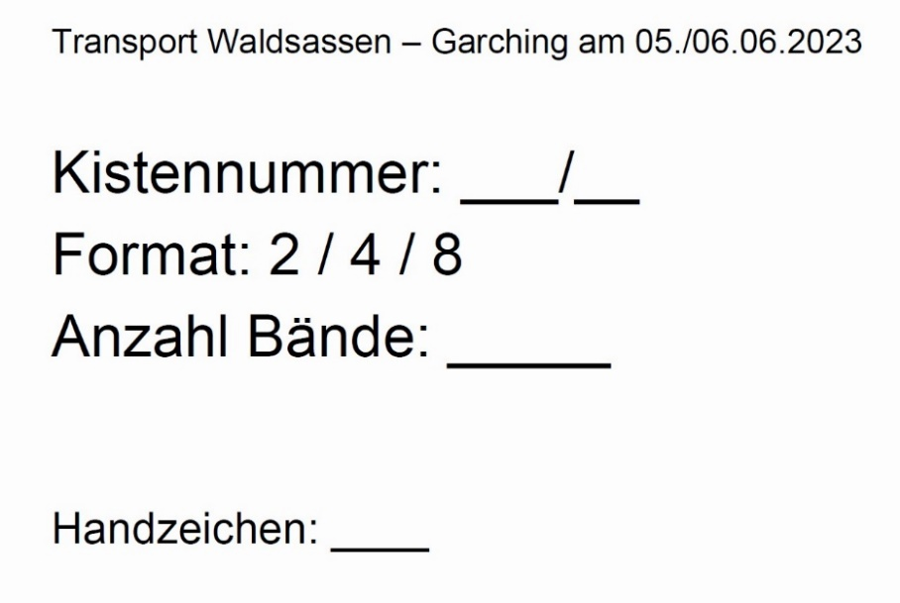
Dealing with external staff
Defined working hours
Keeping control of the doors / the keys
Filling in packing lists

Slide 25
The actual re-shelving of the books
Checking for completeness
Checking against the lists
Shelving (for the time being) in a separate quarantine room

Slide 26
To sum up – lessons learnt
Practical advice: Double checking / „four-eyes-principle“
As checking books / operating with numbers can be a tiring work at times …
Thus: take frequent „refreshing breakes“ with coffee and fresh air ☺

Slide 27
Thank you for your attention! Any questions?

