Slide 1
Benchmarking the balance of access, security and preservation for significant library collections
Philippa Stevens

Slide 2
Where have I come from?

Slide 3
Brief History
I would like to acknowledge the Gadigal people of the Eora Nation, the traditional custodians of the land that the State Library of New South Wales is built on and pay my respects to the Elders both past and present in Australia.
The State Library of NSW is the oldest library in Australia.
The Australian Subscription Library was established in 1826 in Sydney (less than 30 years after colonisation).
In 1869 the NSW Government purchased it to form the Sydney Free Public Library, the first truly public library for the people of NSW.
The Mitchell Library, the first library in the country to concentrate entirely on Australian content, opened in 1910 and is named after its major benefactor David Scott Mitchell.
The Dixson Wing was added after Sir William Dixson, another great collector of Australian material donated his collection and funds also to the Library.
So for Australians, this Library is very significant.

Slide 4
Mitchell Library Reading Room

Slide 5
Spot the difference – we moved the staff desk in one of the many renovations

Slide 6
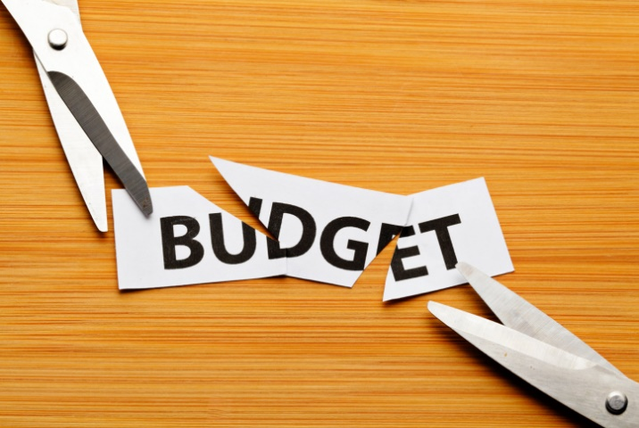
My Story . . . . . . .
Began as a casual General Library Assistant at the University of Sydney Library as a first year student in 1989.
Finished in 2011 at the University with a position of managing Fisher Library the largest and busiest Library in the network.
Moved to the State Library of NSW at the beginning of 2012 as the new Manager of Access & Information.
Within 3 months of starting the government had changed, large budget cuts were made and through two rounds of redundancies and completed a process of reducing staff from about 96 FTE to 66 FTE without cutting back hours or services

Slide 7
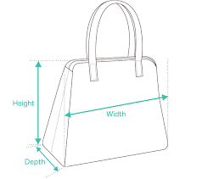
My story con’t . . .
When I was not dealing with those few small challenges I had become aware that there some issues with collection security throughout the whole “life cycle” of providing access to researchers.
Also one of the restructuring processes moved more of the responsibility for accessing special collections into my role.
Started small, what could we do with no money?
Defined bags and their size
Improved information to clients about requirements for accessing special collections
Approvals for access to high value material were centralised for clarity and consistency
Redefined staff processes and try to reduce number of staff going to the Stacks

Slide 8
Some other changes
With a little bit of money we purchased lockable trolleys to move high value collection about the Library
With some more money we purchased a high security safe with a higher level of security and tracking of access and fireproof for 24 hours to use for high value material in use
Added a higher security flat map / plan cabinet for large flat items
With a lot more money and a special project compactus storage was installed on successive floors of the storage area allowing the return to onsite storage of some of the collections eg the bulk of the manuscripts

Slide 9
But what else could be done?
Literature tends to be fairly unexplicit and says thing like “Minimise the number of staff”
We needed practical ideas and better strategies to take us to the next step

Slide 10
What is the Churchill Trust?

Slide 11
My Churchill Fellowship
Went to Churchill Fellowship Information evening in 2017 and then in 2018 and then again in 2019
Applied successfully in 2019 and was aiming to come to this Summer School in 2020 – we all know what happened and the option for virtual Fellowship very unappealing especially as I am doubtful that it could be successfully done

Slide 12
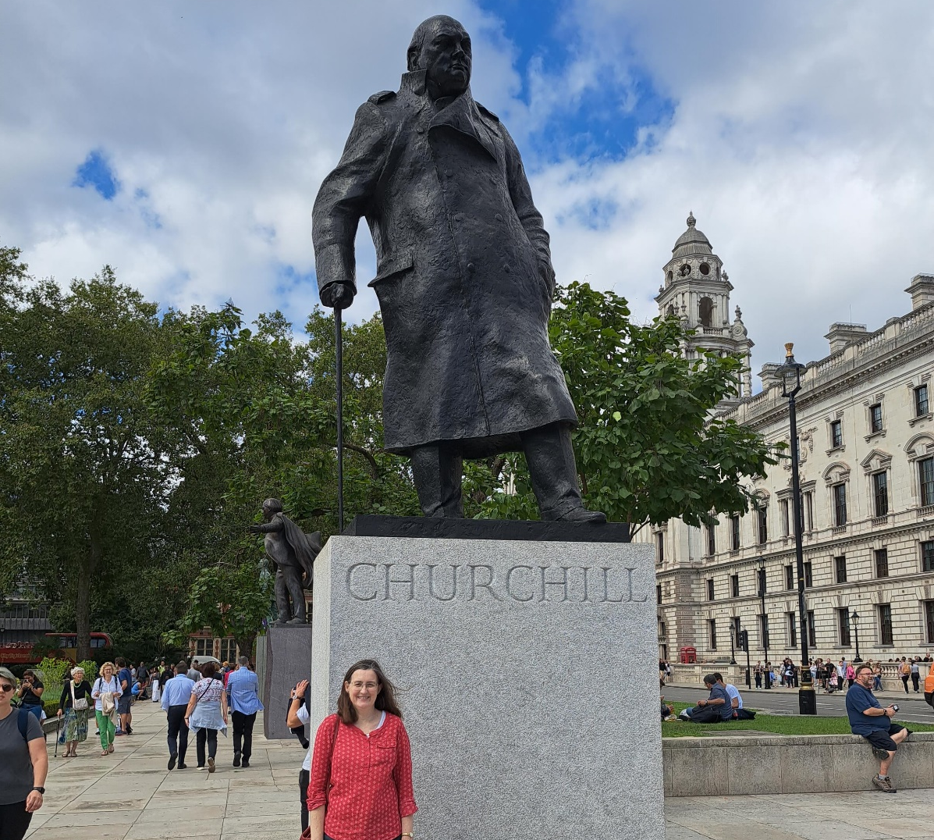
Project almost cancelled several times does live again in 2023
Australia took being an island to the next level and closed its borders for two years. Just as travel took off again I become very unwell and eventually had to leave my position at the Library . . . . .
Title of project “To benchmark the balance of access, security and preservation for significant library collections”

Slide 13
Prior to trip – Australian networking
National and State Libraries Australasia Visitor Experience Group
University of Sydney Rare Books Librarian – Julie Sommerfeldt
Convenor of the ALIA (Australian Library and Information Association) Rare Books Group
National Archives of Australia
Will contact the Public Libraries team who work with New South Wales Public Libraries when I return

Slide 14
Project Data
Questions loosely grouped into categories
Readers
High value and unique collection items
Storage
Staff
Security Incidents
Policies
Future Planning

Slide 15
Q’s - Readers
Reader identification and cards, photo on cards
Conditions of Use example
Items permitted in reading room
Layout of reading room
Lockers
Any clothing limitations
Education about handling
Is there an induction of new readers process?
How do readers leave the reading room, is there a check?
Do you allow papers and notes to be taken in?
Weighing machine? Discrepancies? What do you do?
Any other deterrents?
Age, 18 +? Other requirements for access eg letters?
Use of cameras etc by readers

Slide 16
Q’s - High value and unique collection material
Philosophy of marking of collection? This can incl hidden marking and security tagging
Any special procedures in addition to the usual in the reading rooms
Where do supervised viewings take place?
Any particular accessories or tools that you use?
What about small items eg stamps and coins? Anything special?
Cameras and occasions for use
Criteria of value for high value?
Digitised or photographed for identification before allowed to view / access?
Compliance checks of high value storage areas with all items with stack slips are accounted
Any limit on how many times “popular “ items can be retrieved for the safe each year or other tracking methods?
How easy should it be to request such items? What constitutes a valid request especially if something has been digitised? Are there criteria or decision making process?
What about requests from VIPs?

Slide 17
Q’s Storage
When is item retrieved for a viewing and how is it stored?
Stocktakes?
Safes and other equipment? Eg Mobile cameras?
Is a marker placed where the collection should be when item in use?
Method of access? Swipe? Any keys?
Access to high value areas eg what percentage of staff have access to the high value collection areas?
Light exposure on items not being used ie are items stored individually so lights in room for retrieval only disturb the item being collected?
Any suggested arrangement of shelves / cupboards etc etc

Slide 18
Q’s Staff
Use of high value collection material for work purposes and any special procedures?
What training do staff receive for supervising high value collection activities?
How do you balance these activities in terms of rostering staff and having staff available both for retrieval and for supervision?
Is material loaned using the usual system?
Ways to manage changes in this area?
Are collection security measures part of the induction of new staff?
Is there a staff member who has particular responsibility for managing collection security?
Handling refresher training provided and how often
Police checks on staff prior to employment and subsequent
Monitoring staff access to high value storage areas. How is it done? Is any analysis done?

Slide 19
Q’s Policies
Title and function and if possible a copy of relevant policies.
How often do you review these?
Is the sense of the policies getting more strict or more relaxed

Slide 20
Q’s Security Incidents
By readers?
By staff?
Any suspected incidents that you were unable to follow up?
Do you have a protocol in place? How long is something missing then been considered stolen?
What would you do differently next time?
Have incidents acted as a catalyst for change?

Slide 21
Q’s Future Planning
Are you planning any changes to collection security?
What was the most recent change you have made?
What would be the next change you would like to make in regard to collection security if you had unlimited funds?
Are there any other obstacles preventing you making particular changes? Eg reader reaction

Slide 22
Security of project data
Handwriting notes on visit and then typing up in cloud document anonymised. Each site has a number and the key is held elsewhere
Created separate doc of photos (mainly of public areas and rules signs)with locations identified (to help me remember!)
Will be destroying original notes post trip
Report will be written using Site numbers and all Visit hosts will be sent a copy prior to deadline for their review but also possible request to make a “best practice” feature named

Slide 23
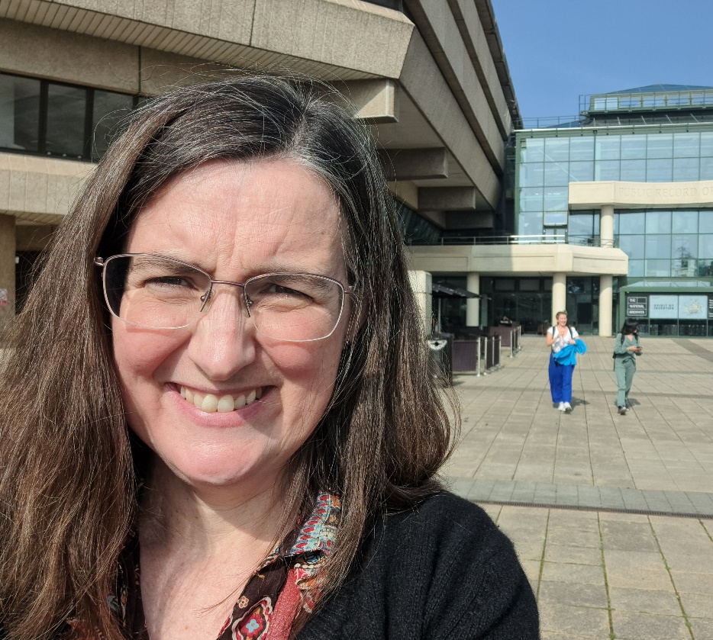
Where am I going?
UK – National Archives, British Library, Weston Library at Oxford, Cambridge University Library and Churchill Archives Centre
France – Bibliotheque Nationale de France, Archives Nationale de France and Bibliotheque de Saint-Genevieve (Sorbonne)
Spain – Biblioteca Nacional de Espana
Denmark – Det Kongelige Bibliotek
Netherlands - Koninklijke Bibliotheek
Belgium - Bibliothèque royale de Belgique / Koninklijke bibliotheek van België

Slide 24
. . . . . . almost 9 weeks of travel
Munich – Bayerische Staatsbibliothek
Rome - Biblioteca Nazionale Centrale di Roma
US – New York State Archives, New York Public Library, Princeton, Yale, Harvard, Boston Public Library, National Archives and Records Administration Washington, Seattle Public Library, Berkeley and last but not least San Francisco Public Library
An amazing list of libraries and a such a wonderful testament to the information sharing and willingness to collaborate within our profession in a true global sense.

Slide 25
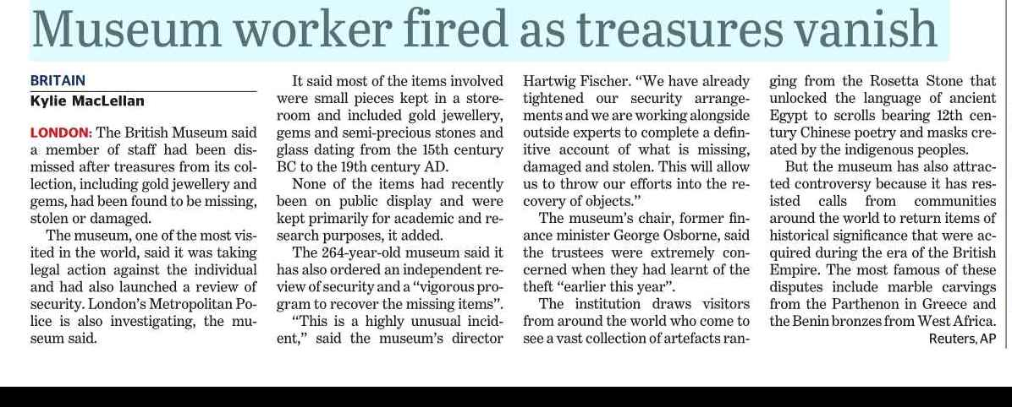
Ooohh the topic is timely after all

Slide 26
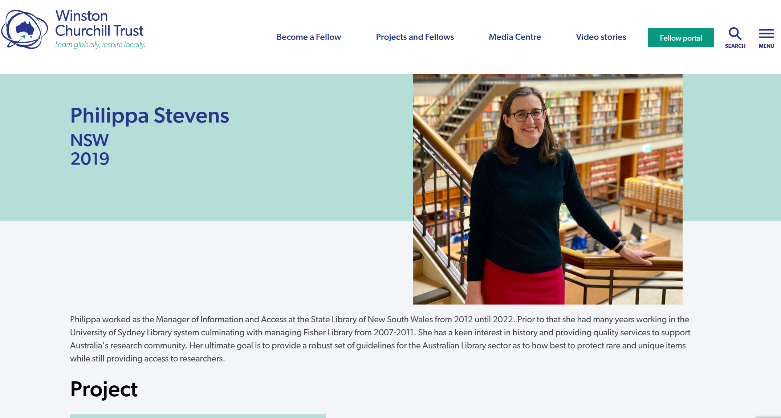
8 weeks after I get back . . . .
Formal report for the Churchill Trust is required.
Plan to is send all libraries I visited a draft copy at the 7 week mark to invite any comments or requests for correction.
The timing is slightly awkward due to December being generally a very busy month but can’t be helped

Slide 27
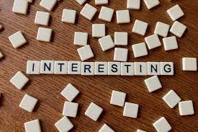
A few early observations
One location has a wonderful slideshow for new researchers to that site to watch about handling, the clearest I have ever seen and images can say a thousand words sometimes.
I saw one collection where all special collections are boxed – looked beautiful on the shelf but is probably unachievable for most of us
Another location had a system of full checks of entry and exit processes at the front door and some of the toughest limitations on what you can take into the RR but the manner of the guards was excellent

Slide 28
. . . .and a few others
Stamps can rescue an item even after it went missing in 1956, it then turned up for auction in 2023 and was recovered
Using the library management system to connect to exit gates and only readers with no loans can activate gates to open
A general sense that reader access to collection has been made easier but there are more checks and controls on staff now than there used to be and much more awareness that staff are “our greatest asset and biggest risk” and the risk is not negligible but actually quite tangible

Slide 29
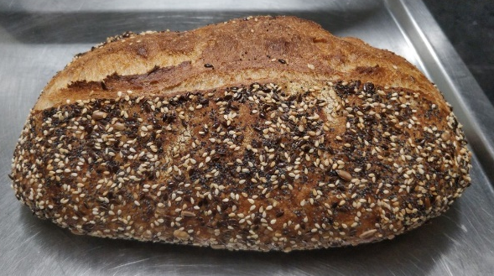
Plan for 2024
Develop industry supported (fingers crossed!) guidelines for Australian libraries with special collections (am in contact with various Australian organisations to try and help me achieve this)
Written in the form of building blocks so once you have achieved a certain level you start looking to incorporate the next level up as your forward strategy
Develop a collection security strategic forward plan for the State Library of NSW with current staff
Continue working in my part time bakery job which gives me enough time to do the above

Slide 30
Any questions?

