Slide 1
Programme Fortify Digital Security
Liedewij Lamers
8th of September 2017

Slide 3
What do you expect as a member?
Your personal data is safe
What I read is my business only
E-books just ‘work’
Downloads can be trusted
Data in catalogue is accurate
Websites and portals work and are safe

Slide 4
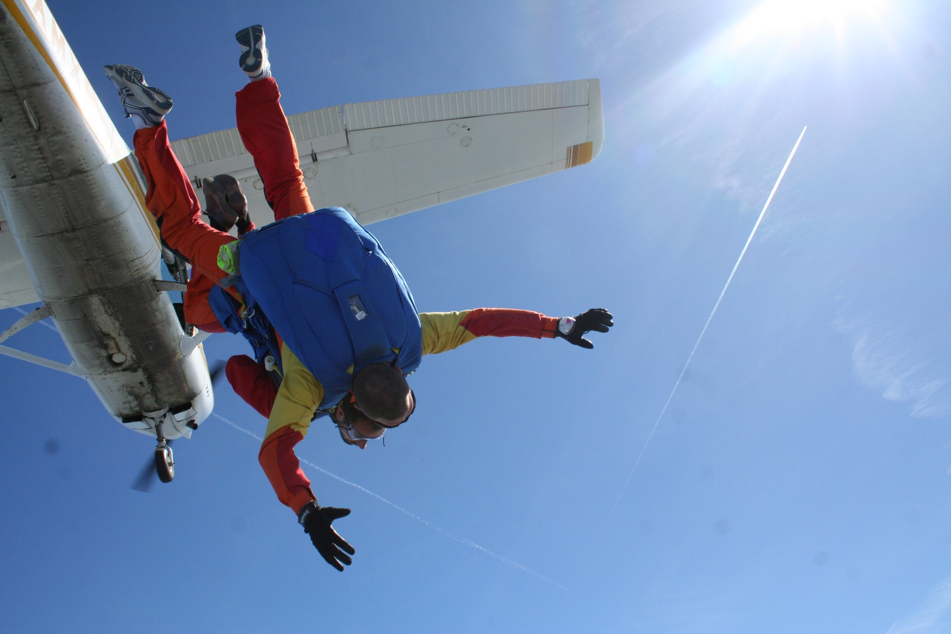
What do you as a customer expect?

Slide 5
The future of the KB
Transformation
Physical collections Fully digital library
Full speed digital
Enhance use of collections
Strengthen our international position

Slide 6
Digital Security increasingly important
Keep the trust
Of our members
Of our partners
Of the copyright holders
Of our financiers
Continuity of our organisation

Slide 7
Trust is built on strong foundations
What are the foundations for digital security within the KB?

Slide 8
The six foundations
Roles and funding are available
Laws and regulations form basic level
Prepared for incidents and limits impacts
Perdurable storage and availability is our priority
Guarantee content, catalogue and service of national digital library
Accomplish digital security in close co-operation with our partners

Slide 9
What is the quality of these foundations?

Slide 10
CURRENT STATE
TARGET
STATE
GAP

Slide 11
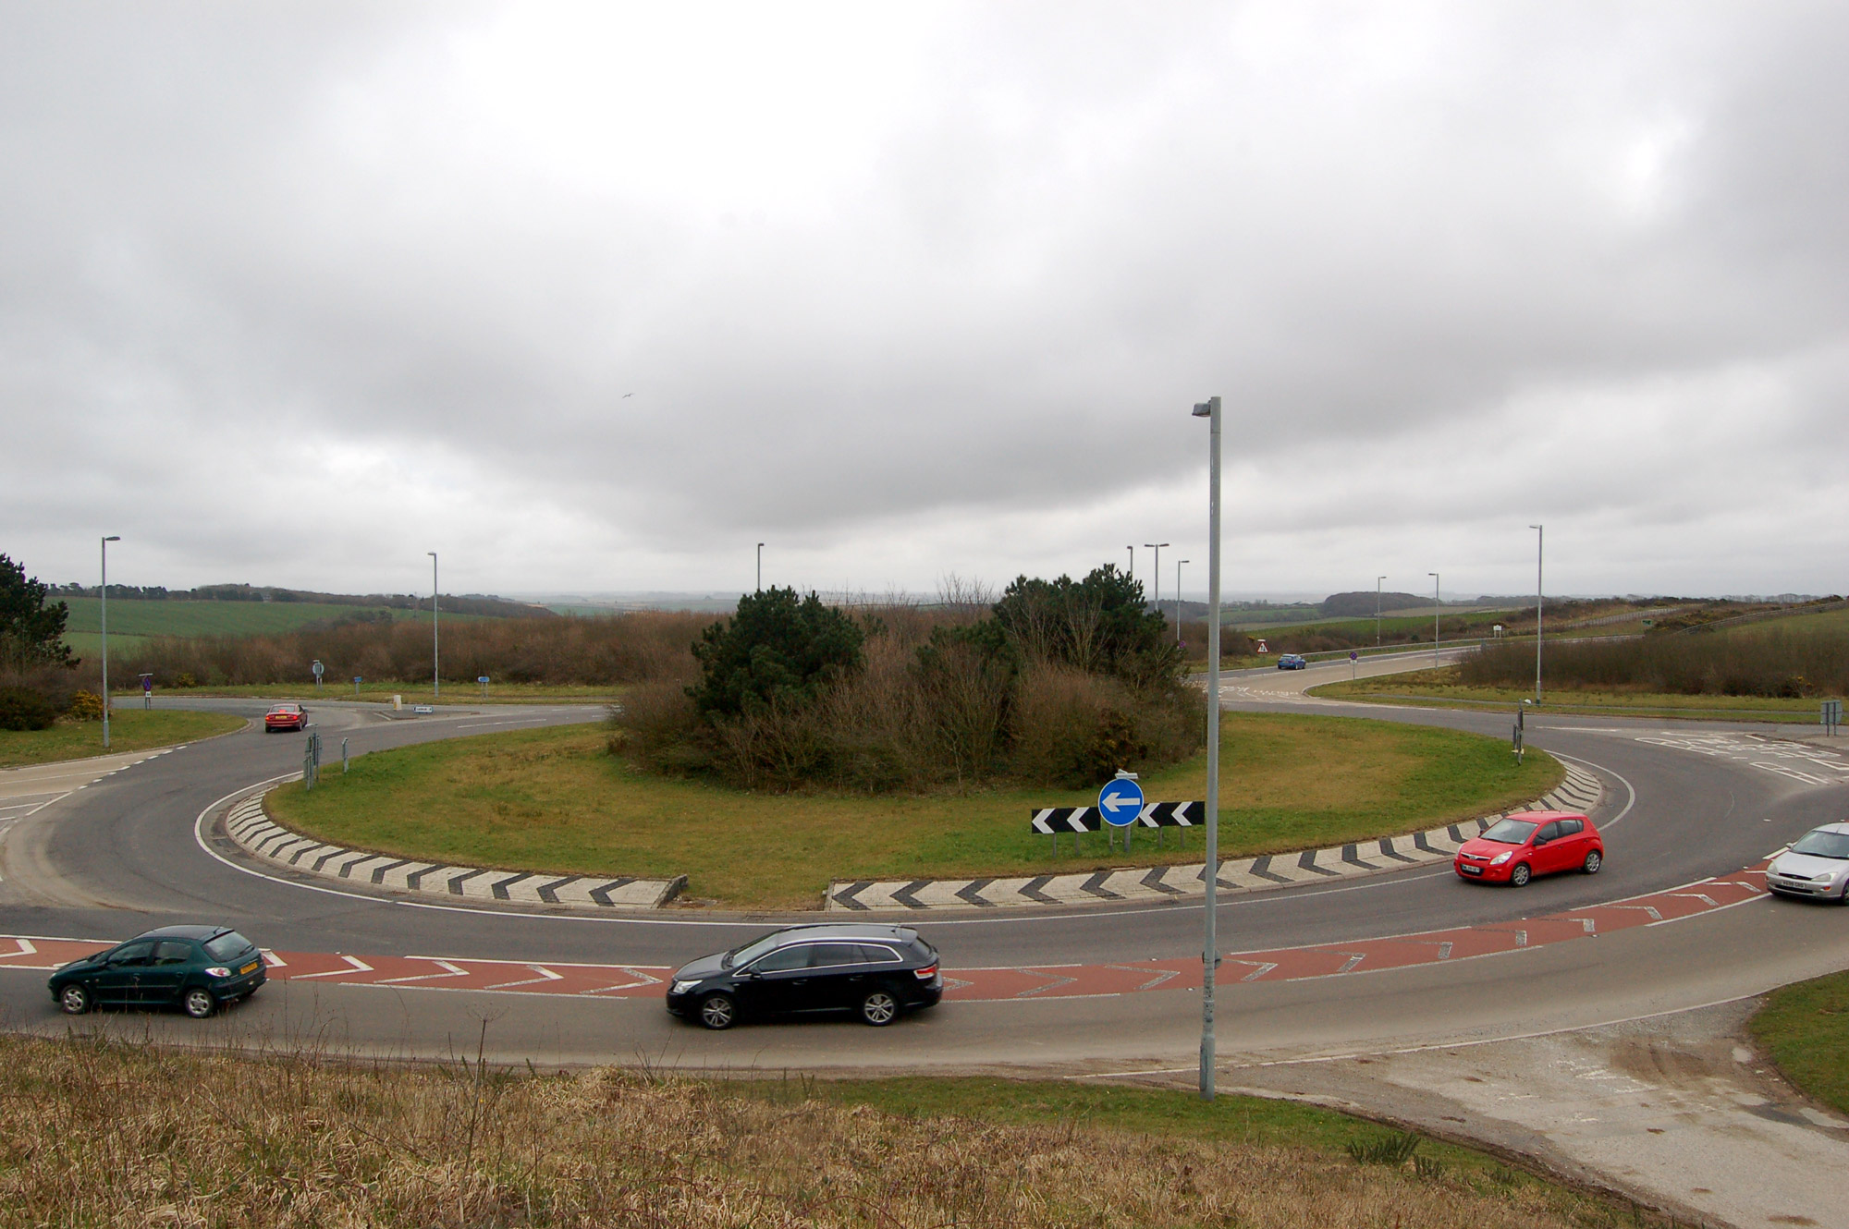
Fortify Digital Security Programme

Slide 12
What are those paths to take?
Strengthen our organisation
Prove we can fullfill our obligations
Be prepared for incidents and impact management
Secure storage and accesibility of collections
Continuity of the national digital library online service
Security in the full chain (close co-operation with our partners)

Slide 14
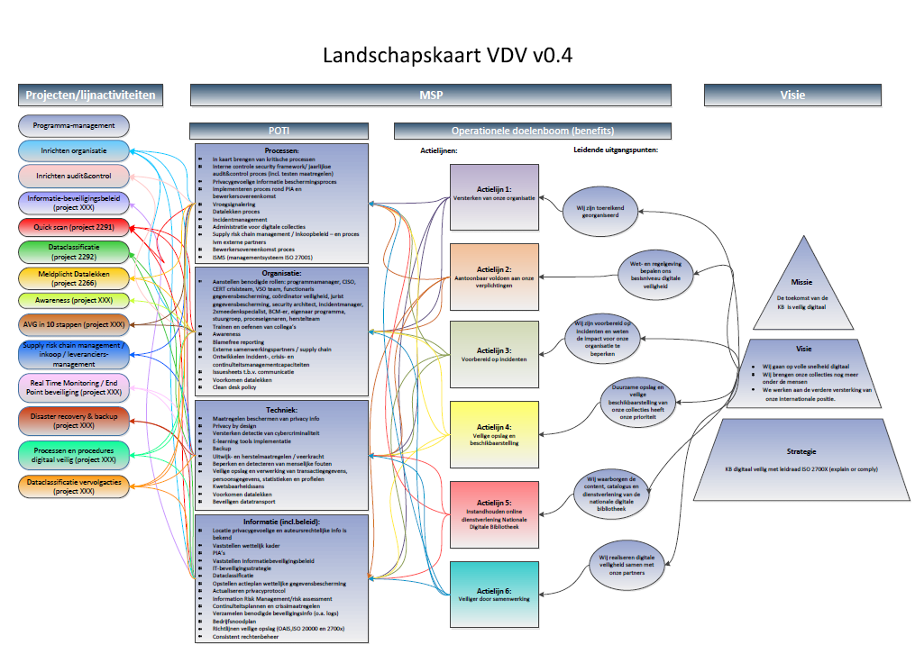
Programme map

Slide 15
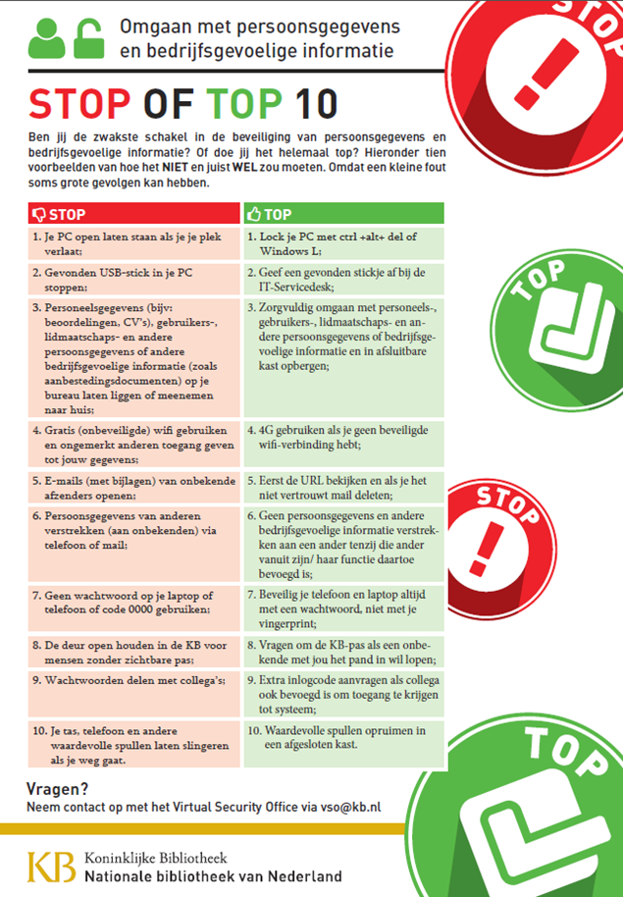
Accomplishments
Organisation is stronger
Monitoring ‘early warning’ has been improved
Increased awareness among staff
Developed processes and procedures regarding digital security
Scan by expert company on to determine strenghts and weaknesses in more detail

Slide 16
Goals 2017
Data classification
Continuous focus on awareness
Start implementation EU General Data Protection Regulation (GDPR)
Defining proper actions resulting the quick scan

Slide 17
Overall plan for 2018
Strong focus on strenghtening awareness
Rerun data classification
Compliancy to GDPR
Implement actions from scan and rerun scan (yearly)

Slide 18
Questions?

