Slide 1

Moving Collections in an emergency: Vilnius University Library
Vienna, 2022 09 07
Notes:
Its a pleasure to be here and to mmet you all. Its my first seminar and I am grateful for the opportunity to be here.

Slide 2
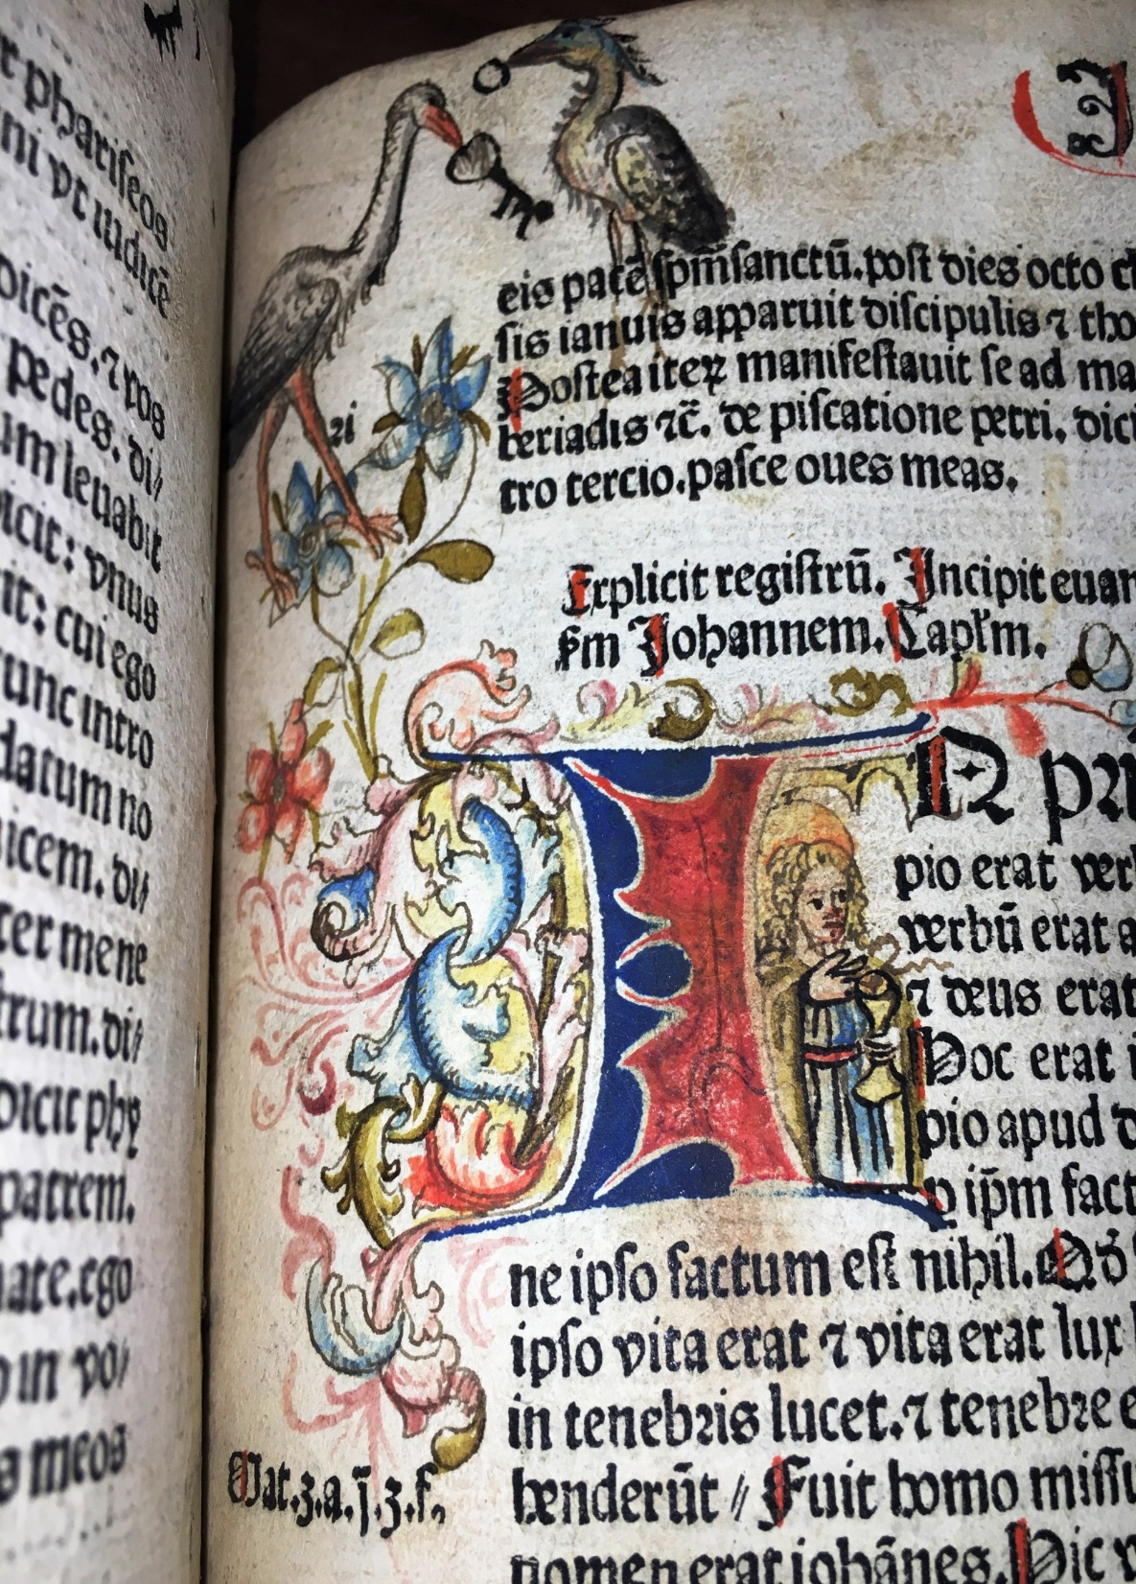
Main points
Planning and preparations
Protecting the collections
Trusted partners / staff and procedusres
Appropriate and trusted storage
Notes:
I decided to star my short presentation the main points which are identified in our programme. I'm probably safe in saying that we've come across all of these points durring las half a year.

Slide 3
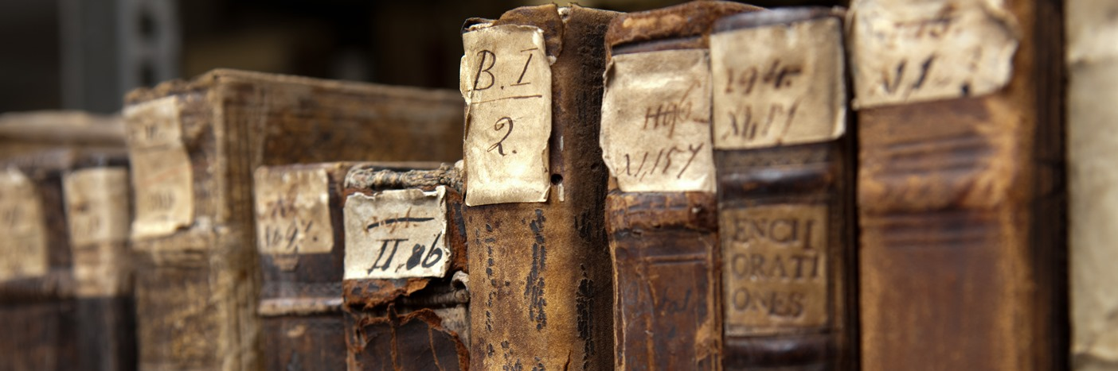
Jesuit colledge library
Founded in 1570
Library of state importance
1+1=1 philosophy
Situated in the city Center (Central Library)
and
In the student campus (SCI Center)
Manuscripts – more than 347 000 documents and still growing
Rare books – more than 165 000 items
Graphics – over 95 000 artwoks
The 19th century collection (circa 150 000 items)
1900-1945 books (over 450 000 items)
Digital collections (18 000 digital objects, ~ 1 million pages)
Notes:
VUL already has experience with the loss of collections: in 1832-1842 collections were moved to various cities is Russian Empire, in 1915 collections of Vilnius Public Library were transfered to Russian Empire, mostly Moscow, Sank Petersbourg, Kiev, Charkov, Odessa. In 1956 a small part of more that 300 000 items was retrieved – apr 18 000 reached Vilnius and now are called „Bibliotheca academiae Vilnensis“
Let me give you some idea (or refresh your memory) of our Library first.
our collections began from donations – similar to all libraries of that period.
At the moment we have:
I would like to highlight digital collections as one of the methods of protection.

Slide 4
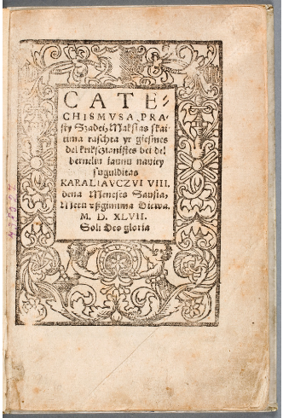
Some treasures
The first Lithuanian book (M. Mažvydas. Catechismusa prasty szadei... Königsberg, 1547)
The first Lithuanian book in GDL (Daukša, Mikalojus. Katechizmas arba mokslas kiekwienam krikszczionii priwalus. [Vilnius: Akademijos sp.], 1595. [108] p.)
342 incunabula (Valturio, Roberto. De re militari. [Verona], 1472)
The oldest manuscript from the beginning of the 13th century
600 court books
Collection of cartography and atlases
Portraits of Radvila family, Vilnius Album
15 positions in UNESCO Memory of the world programme national and regional registers

Slide 5
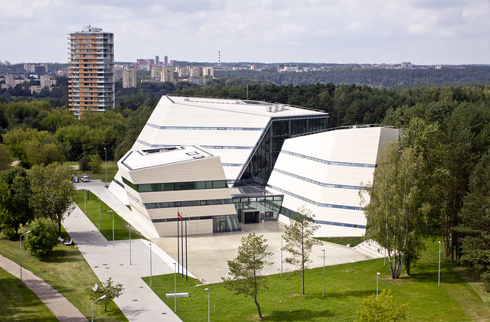
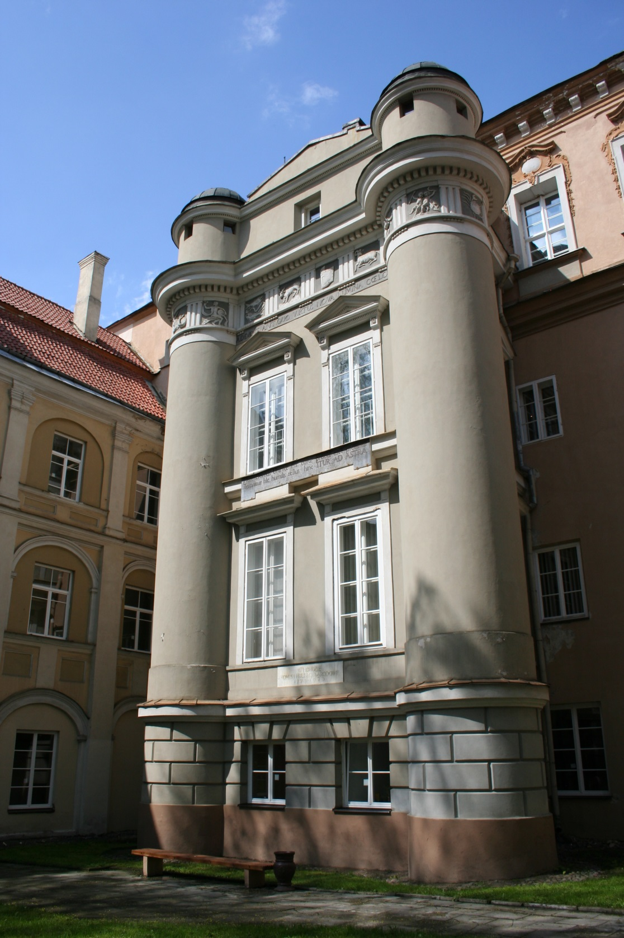
Scholarly Communication and Information Center
Central Library
+
Notes:
1+1=1 philosophy
Situated in the city Center (Central Library) and In the student campus (SCI Center)
Modern building opened in March 2013
24/7
Modern systems (e.g. fire extinguishing system by fog, RFID etc.)
Modern collections for students‘ needs
Self service (even in some part of stacks)
Space for learning and creating
Home for Heritage Collections
Situated in various parts of historical ensemble of Vilnius University (protected by UNESCO)
Storages (since 1970s) – 13 floors (apx 350 m3 each) in two buidings
4 floors dedicated to Heritage Collections
3 special reading rooms for Heritage Collections

Slide 6
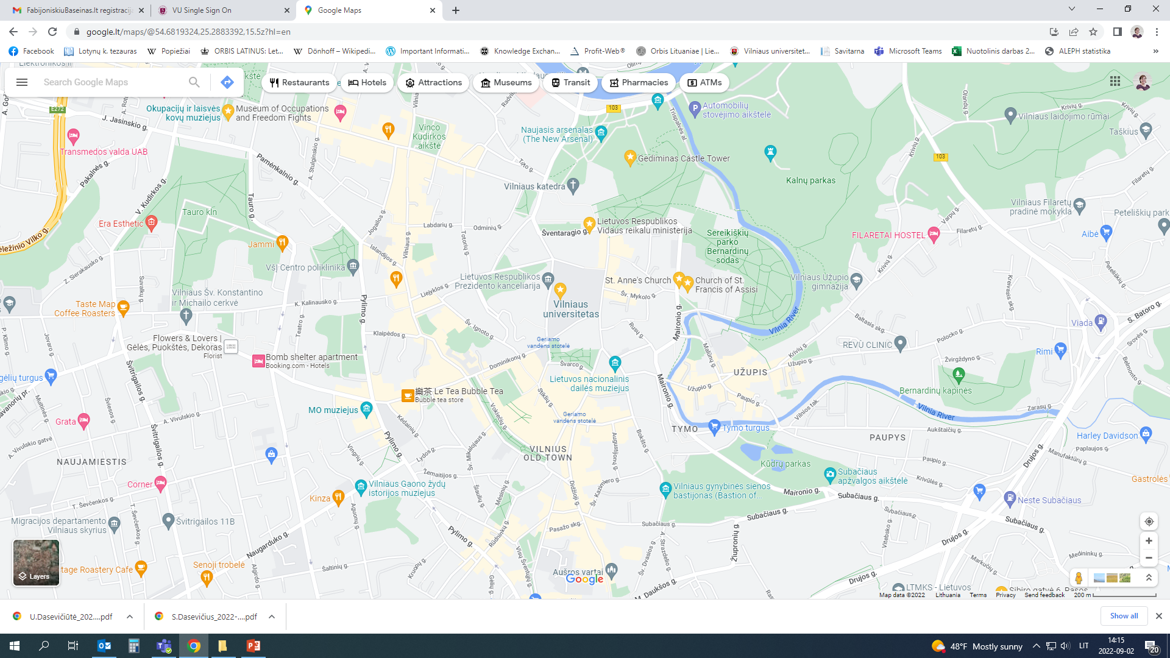
Notes:
Situated in the hart of the city, in UNESCO heritage site, near the Presidential palace and Ministry of Defence, multiple architectural monuments and museam, narow medieval streets, connection to the other part of Vilnius via brigdes on river Neris

Slide 7
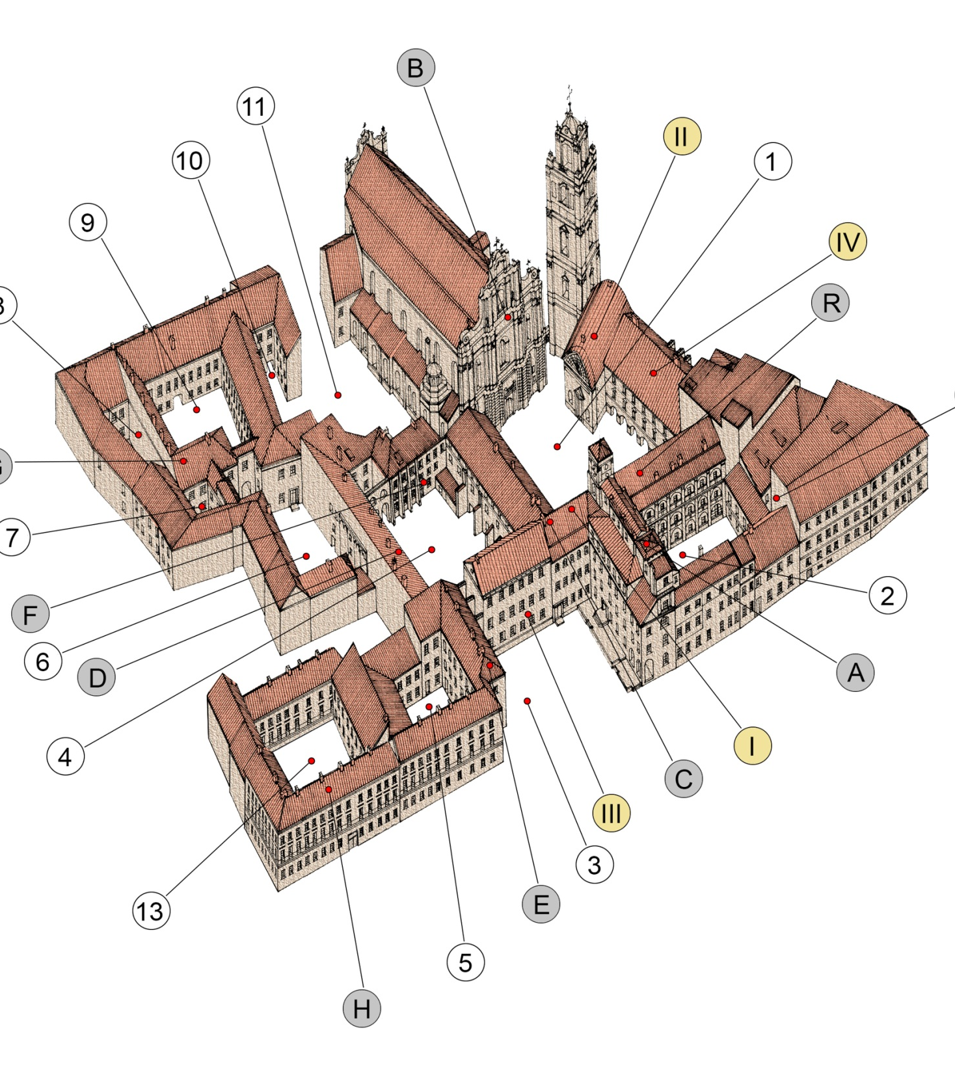
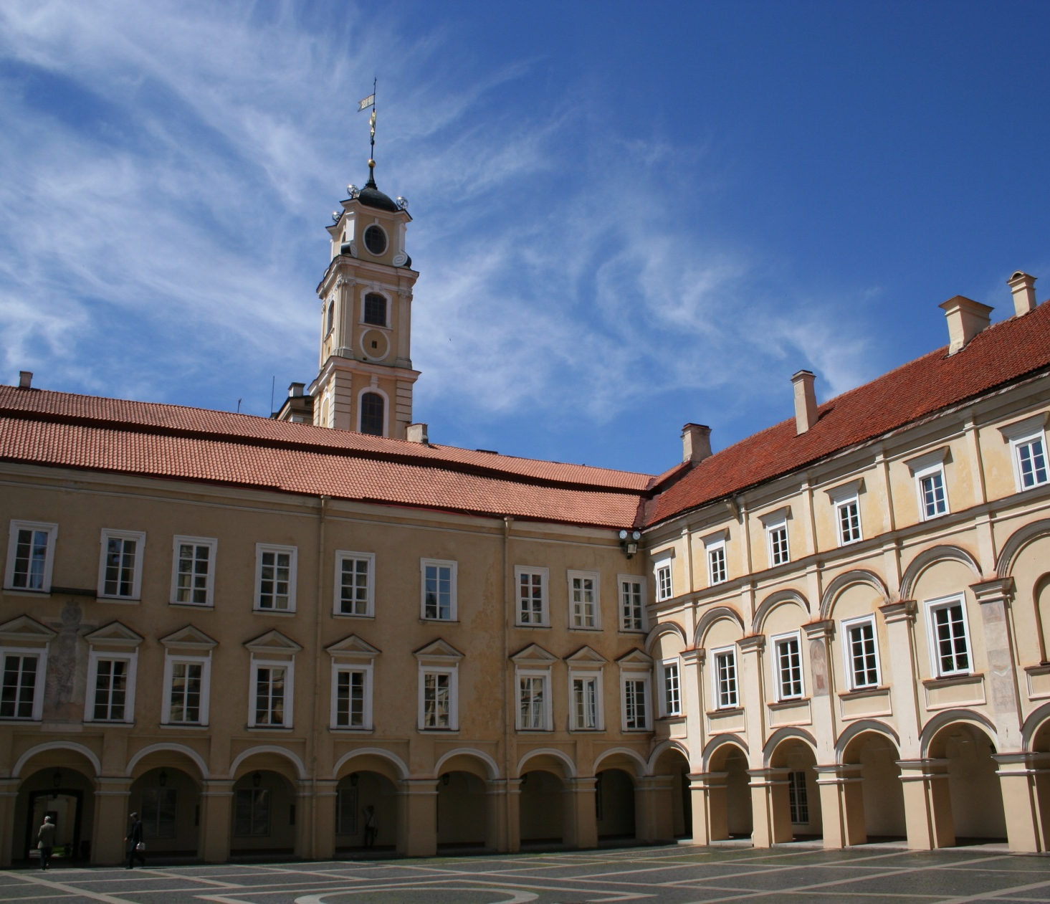

Slide 8
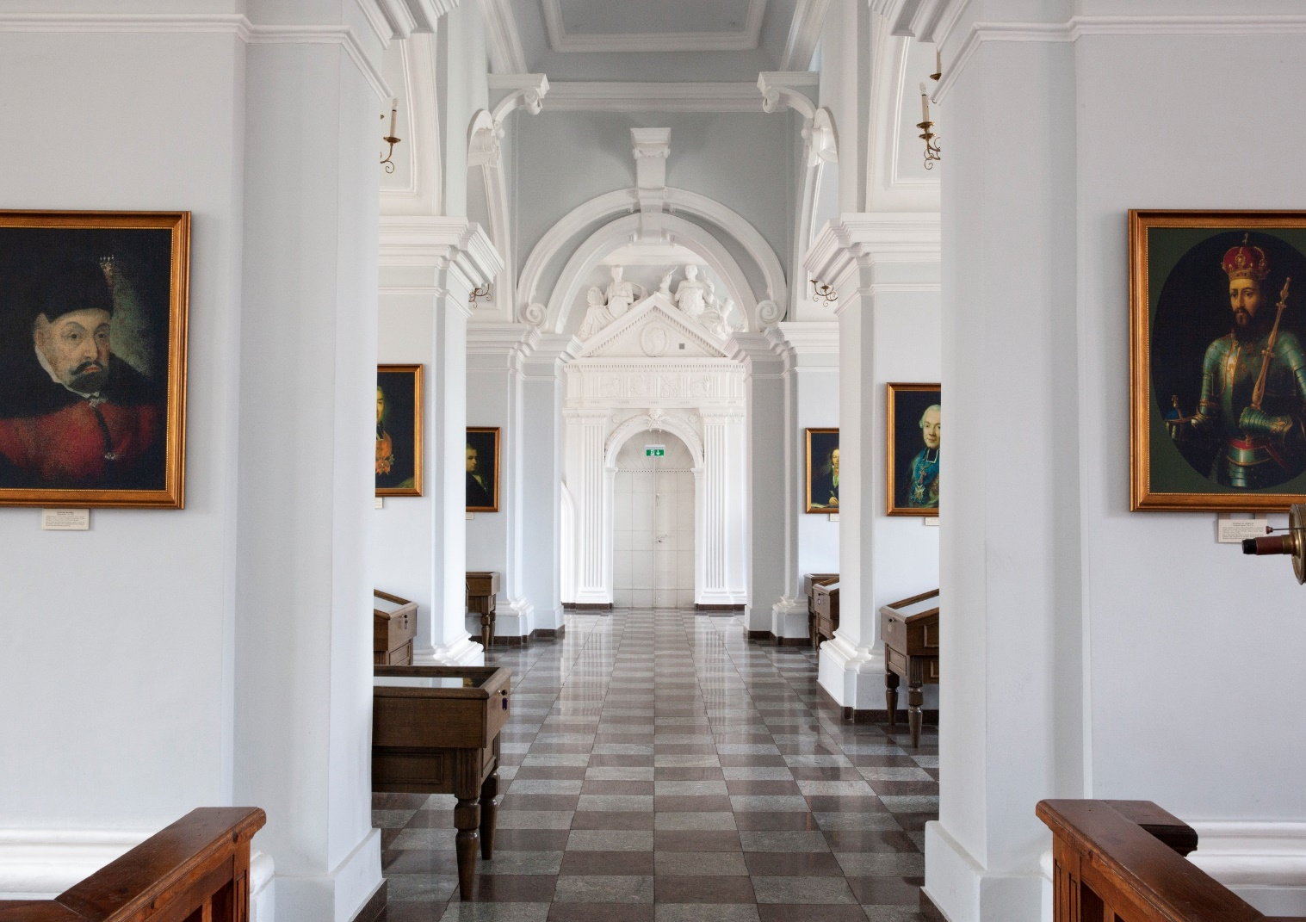
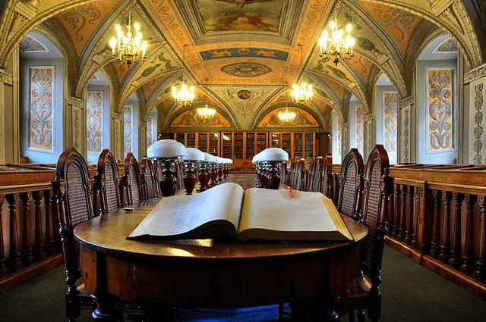
Historical halls
Notes:
Historical hall with heritage furniture

Slide 9
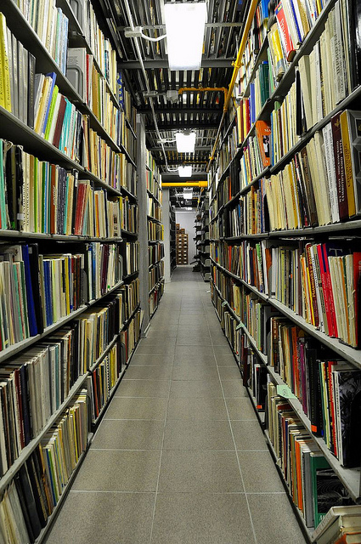
Storage of cultural heritage
Special premisses
14 floors, apr 5300 m2, special collections – 1600 m2
Microclimate system, fire extinguishing system
Special conditions for document storage (boxes, drawers, folders etc.)
Restricted access, special order of service
Notes:
Documents of the Manuscripts and Rare Prints Departments are stored in closed funds on the 3rd, 4th, 7th and 8th storage floors of the Central Palace. Documents of special sets are stored in folders, boxes, cases, on which the code of the document is written.
Limited use of lift, access through 2 entrances

Slide 10
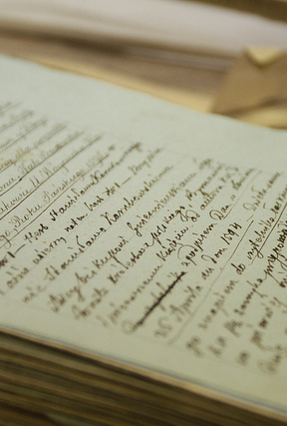
Legal basis
Emergency management plan of Vilnius University (2018)
Document preservation guidelines of Vilnius University Library (2016)
    General and special requirements for document storages
    Requirements for exhibitions and packing
    Preservation of documents
    Microbiological control
    General principles of document use
VUL collection policy (2014)
Guidelines for using special collections
Notes:
Due to our legal regulations the main players in LT are Ministry of Culture, Ministry of National Defense (challenges: VU belongs to ŠMSM, heritage is curated by Ministry of Culture - lack of communication and information)
Emergency management plan focuses on civil defense rather than asset protection. The library should develop its own plan. The challenge is the lack of methodological support. So a lot of questions occure then it comes to collection security.
We are currently at the end of the chain, executing orders (providing information, doing calculations, etc., but not seeing the big picture, e.g. we don't know where the collections would be shipped)

Slide 11
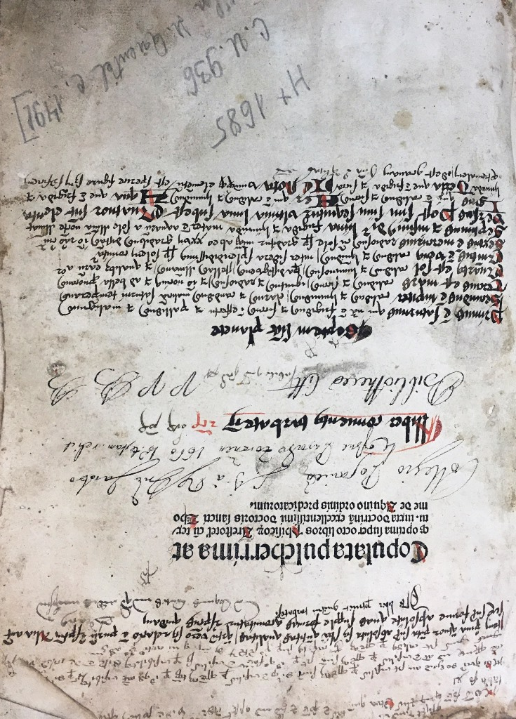
Step by step
Collection assessment (prioritised):
    High priority (UNESCO protected documents, documents that are particularly important for the historical, cultural and political identity of the state and nation of Lithuania and that have social, cultural and economic value)
    Medium priority (prints to 1800, manuscripts to 1945)
    Low priority (prints to 1945, contemporary manuscripts)
Personnel mobilization lists prepared and approved, all the related persons informed
VUL core team was formed (main people responsible for the emergency activities)
Quick response scenarios prepared
The most necessary materials have been purchased;
Important collection accounting documents were digitized, their copies were taken to a secure location
Notes:
High priority – 15 UNESCO protected documents, 47 other highly important prints, 50 archival boxes of manuscripts (N.B. all has to fit in one small minibus)

Slide 12
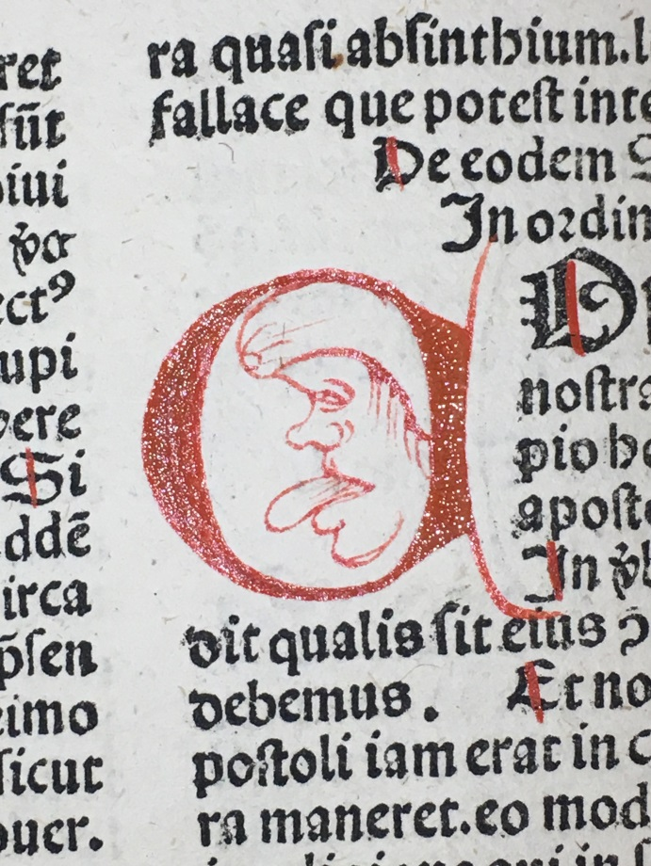
Chalenges
Decision making
Requirement not to disclose too much information
Work without publicizing information, having only part of the information
There are no specialists to advise us, everything is focused on civil safety
Limited funds, storage space limit
Main questions discussed:
    to move collections or to leave them in storages?
    Move where (another building, old building basements)?
    How to pack?
    How to move around the building?
    How to transport?

Slide 13
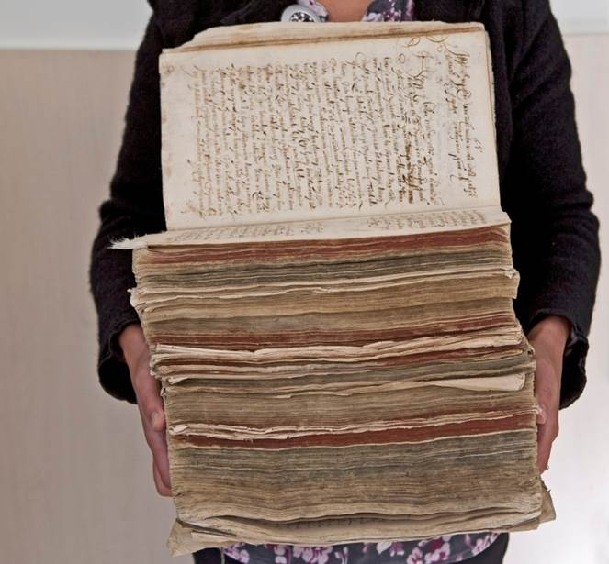
Final remarks
Tested scenarios showed some flaws we hadn't thought of
The storage location has not yet been decided
We haven't held any exercises yet

Slide 14
Contacts
Nijolė Klingaitė-Dasevičienė
Director of Heritage Collections and Research Department
nijole.klingaite@mb.vu.lt

