Slide 1
Potential Crises in Reading Rooms -
Privileged Readers and Visiting Dignitaries
Nina Korbu
National Library of Norway
CERL Collection Security Summer School
Vienna, September 2022

Slide 2
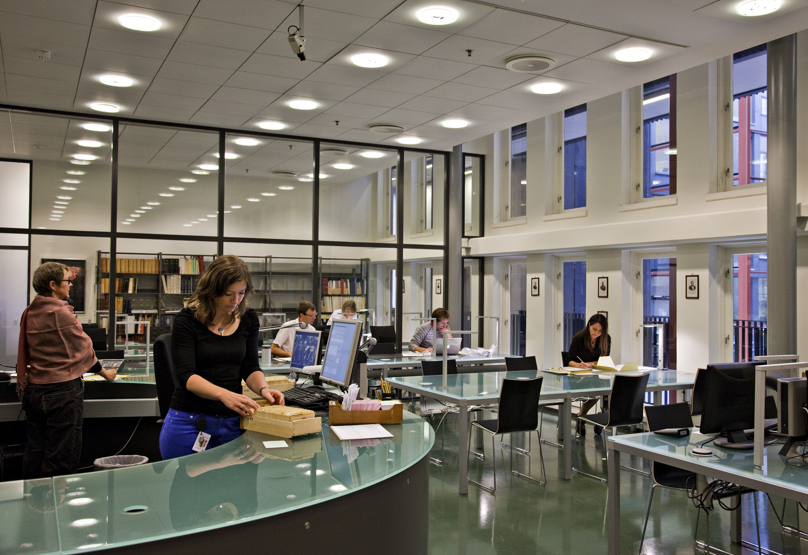
The Special Collections Reading Room
Even the best run and seemingly most secure Reading Rooms and institutions have been subjected to thefts and vandalism of their materials.
Regrettably, all the security in the world is not going to stop all the thieves all the time.
Guide to Security Considerations & Practices for Rare Book, Manuscript, and Special Collection Libraries

Slide 3
What types of readers do we have in our reading rooms?
general readers with no special needs
aggressive readers
over-friendly and talkative readers
privileged readers
distinguished and demanding scholars
visiting dignitaries

Slide 4
Over-friendly and talkative readers
these readers can be first time visitors and non-academics who have not studied rare materials in a special collections reading room before
may need extra help and information on how to handle books, manuscripts or other materials
may have several questions to ask of the desk staff and will go back and forth to the reference desk and can take up the desk staff’s time
can take the desk staff’s attention away from the other readers

Slide 5
Privileged readers
readers we have come to know and would like to give extra service
since we have come to know them as nice and knowledgeable readers we want them to like us and be very content with the service we provide
can lead us to forget our regulations and guidelines and make it easier for them to commit thefts or vandalism

Slide 6
Distinguished and demanding scholars
important readers we would like to give the best service
readers we want to like both us, our collections and our services
we want them to be very content with the service we provide so they will refer us to other distinguished scholars

Slide 7
Visiting dignitaries
persons who visit the reading room with library’s directors and senior management
can be readers who need to study material
can be visitors who are shown rare and precious books, manuscripts or other objects in reading room or in another room
can make reading room staff break regulations and guidelines to accommodate directors’ and visitors’ wishes
can take reading room staff’s attention away from other readers if visit has not been planned ahead

Slide 8
Useful literature:
Guide to Security Considerations & Practices for Rare Book, Manuscript, and Special Collection Libraries, compiled & edited by Everett C. Wilkie. Chicago, Association of College & Research Libraries, 2011.
ACRL/RBMS Guidelines Regarding Security and Theft in Special Collections. Association of College & Research Libraries. http://www.ala.org/acrl/standards/security_theft
Walch, Timoty. Archives and Manuscripts: Security. Society of American Archivists, 1977.

