Slide 1

Collection Security Summer School Vienna
Collections in Crisis:
Reading Rooms
Theft (in progress)

Slide 2
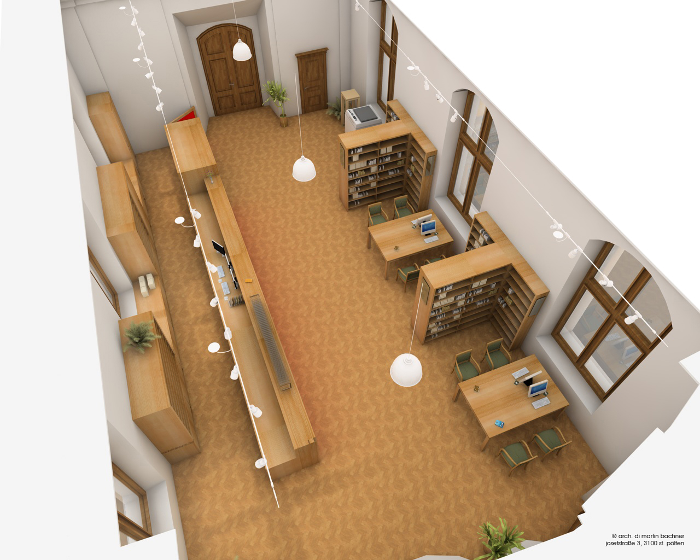
Reading Rooms –
Theft (in progress)
Video surveillance throughout the entire service area (entrance, wardrobes, … and each table in the reading room).
Silent alarm with two hidden buttons, one at each end of the circulation desk
The door between the wardrobe and the circulation desk is shut and has to be opened remotely by library staff to get out;
(In case of emergency (e.g. fire alarm) of course all doors within the library will open.)

Slide 3
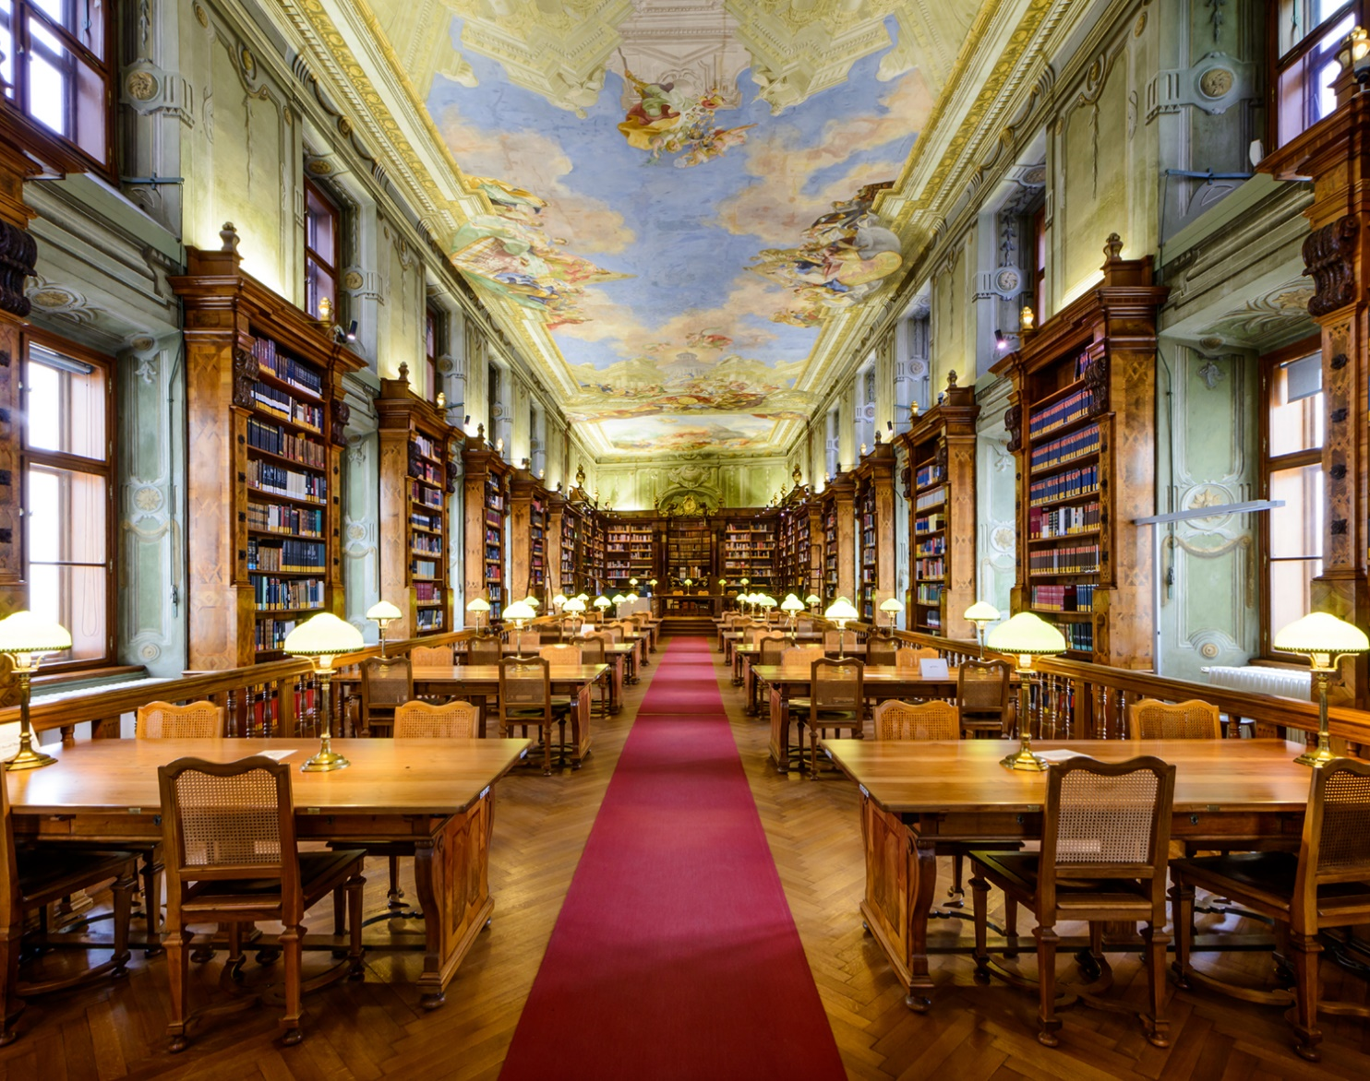
Reading Rooms –
Theft (in progress)
Readers have to hand in the readers card and an identity card, which are only given back after all material is returned
Readers cannot choose where to sit; they get placed depending on the material they use, e.g. in the very front rows with manuscripts.
Readers have to sit facing the information desk, so that staff can see them working on their desks in addition to video surveillance
Staff has to walk through the reading room every half hour if possible

Slide 4

Reading Rooms –
Theft (in progress)
Real thefts in history:
Paintings of roses in the 1950s (ANL)
Maps of the United States (as reported)
Others???
Following the general opinion thefts are mainly commited by members of the staff?!
(E.g. Jesper Jørgensen, Chief Security Advisor Det Kongelige Bibliotek, Kopenhagen & others)

Slide 5

Reading Rooms –
Theft (in progress)
Questions
Internal control:
Admittance to different areas: Who is allowed to get there?
How does staff check the material when it is returned?
What about lack of personnel, readers waiting in line, …)
Visit of tourists and persons, who want to rent the room for an event:
Do you have the same problem?

