Slide 1
Exhibitions
CERL Collection Security Summer School
7 September 2017

Slide 2
Exhibitions (Q 83-96)

Slide 3
Exhibitions

Slide 4
Exhibitions

Slide 5
Exhibitions

Slide 6
The KB Exhibition Room

Slide 7
Testing

Slide 8
Heavy stuff

Slide 9
Security in the exhibition room
No guards
Strong showcases
Double lock system
Minimum of two people required to open
Alarmed
CCTV

Slide 10
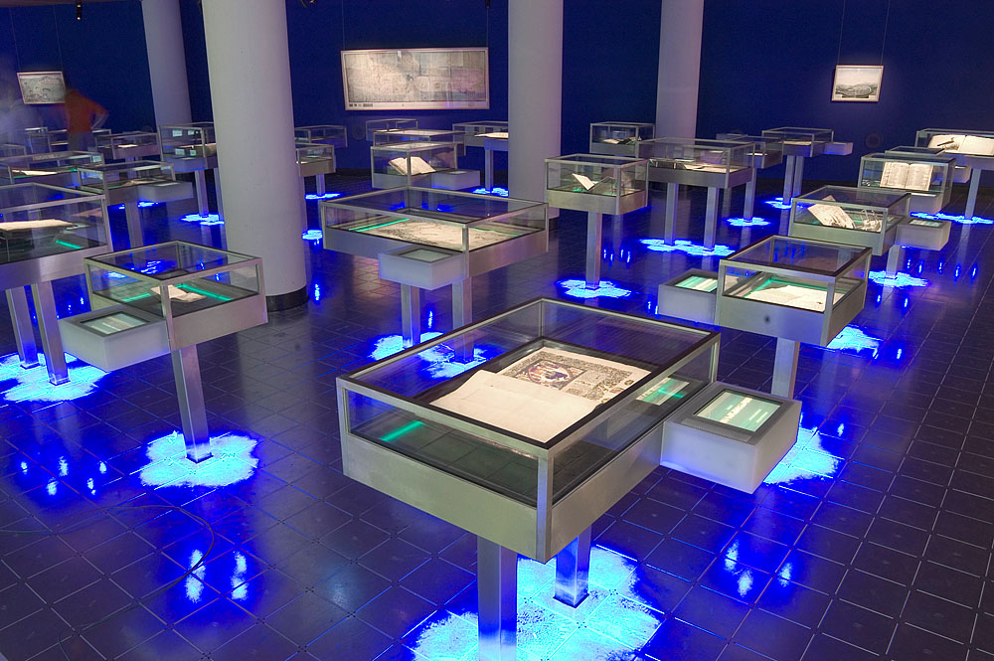
Loans to exhibitions
Sabina de Weerdt, registrar

