Slide 1
Practical issues
CERL Collection Security Summer School
7 September 2017

Slide 2
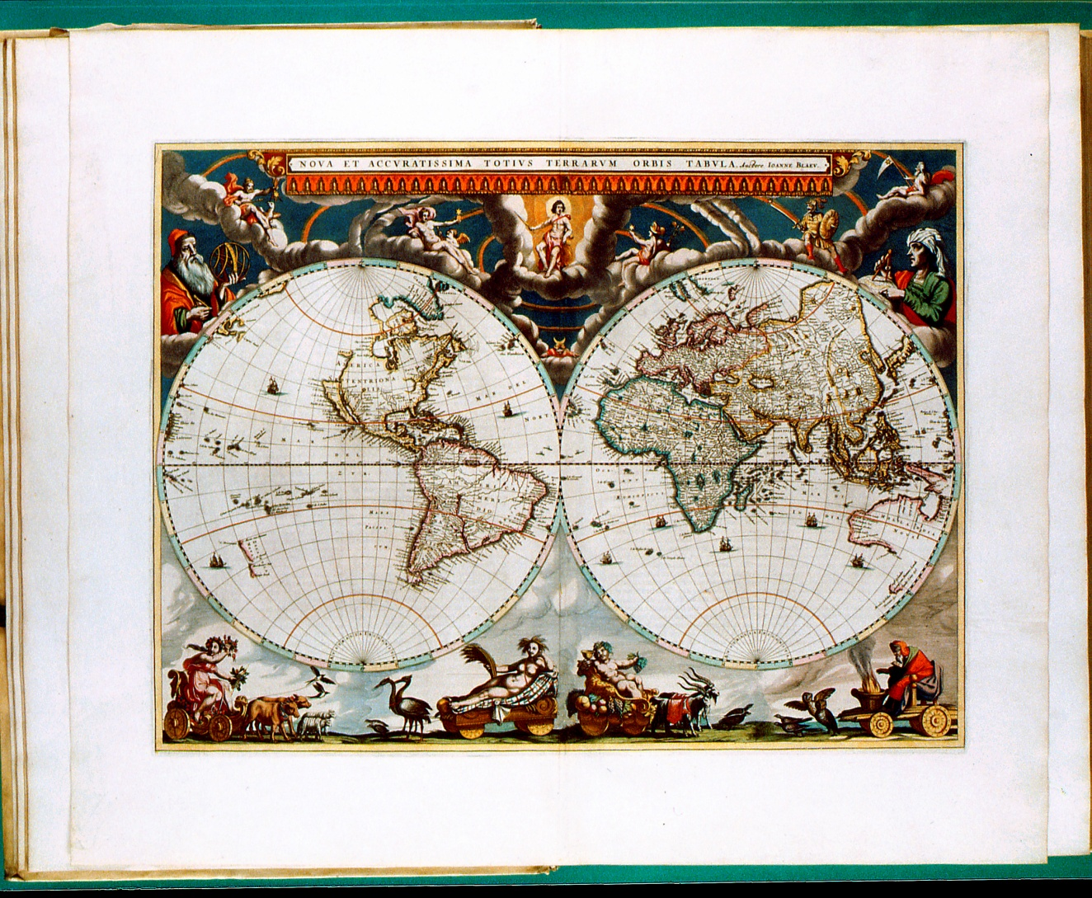
What is our ‘raison d’être’?

Slide 3
What is our ‘raison d’être’?
To keep
To make available
Conflicting interests

Slide 4
So what to do next?
Can we avoid it? No, not entirely
Question is: what are the risks?
And what can we do to manage them?

Slide 5
Profiling crooks
In the Reading Room
  Deviant behaviour
Staff
  Who is the internal thief?

Slide 6
Profile
Cleaning or security staff?
Long working relation with the institution (10 to 30 years or more)
Well respected, trusted and with an independent position in the institution
Responsible for acquisition, and possibly also for registration and description
Unlimited access to the collection
Often national and international well respected specialists
Often with an important social role (in unions or professional community)
The people you less expect to do so
Hardly ever introvert with few contacts in the institution, but charming, with many contacts and open communicating
Other possible aspects:

Slide 7
Profile
Expensive lifestyle (sports cars, luxury clothing)
Vain (hair implant, lying about age to girlfriend)
Debts (betting) and addiction
Frustated career prospects
Be aware of change of behaviour!

Slide 8
Staff responsibilities
Who is responsible for what?
Who controls who?
On what criteria are these decisions based?
Is any risk assessment involved?

Slide 9
Readers (Q 36-38)

Slide 10
Reading Room (Q 39-40, 42-46)

Slide 11
Reading Room

Slide 12
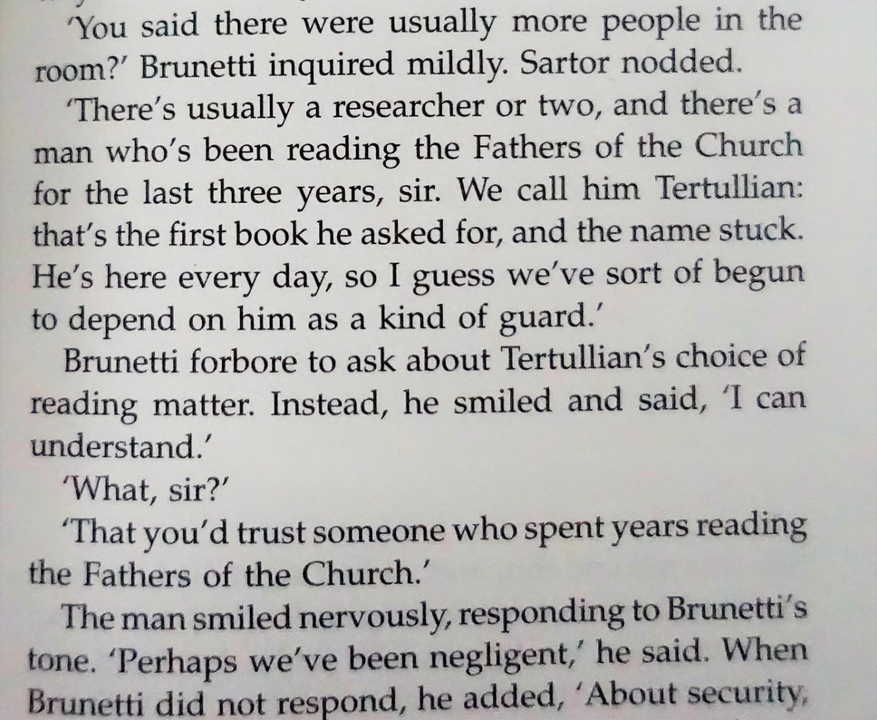
Reading room procedures

Slide 13
Reading room
Special reading room for special collections?
Supervision
Access
Procedures
Readers’ behaviour
  How are maps taken out of the book?
  How are they taken out of the Reading Room?

Slide 14
KB Practice (Special Collections)
Desk always double manned
No coats, bags, etc.
Maximum four items on the table
All items checked before and after use
Check weighed items every time reader leaves the room
Vulnerable categories weighed
  Small deviation tolerated: fixed criteria
Stick to the procedures

Slide 15
Conditions for effective checks
Clear procedures, followed by all colleagues
  ‘last week your colleague said it was OK’
Good exchange of information when changing shifts
Foliate loose leaves in folders
Good descriptions, for atlasses best on map level
Availability of digital copies will help as well

Slide 16
Reading Room
What topics should be covered in the Reading Room rules and regulations? How do you make them known? Who enforces them?
General topics not covered in the survey: how do you position staff in the Reading Room, where to place cameras (if any), use of laptops and cameras
What is the best place to search readers’ belongings? When leaving the reading room, leaving the building? Visual inspection? Electronic? What happens when the electronic gates go off?
Is there any difference between libraries and archives in this?
Are other methods of inspection available?
What tools are available for an assessment of collection vulnerabilities?

Slide 17
Tracking what readers borrow

Slide 18
Tanja de Boer
Warehouse management
Recording collections
How to mark individual items

Slide 19
Stacks (Q 31)

Slide 20
Catalogue (Q 21, 22, 29, 41)

Slide 21
Specific copy information (Q 24-26)

