Slide 1
Collection Security Summer School Österreichische Nationalbibliothek Vienna 7-9 September 2022
Card Game session
Eng. Jacqueline Lambert
Prevention advisor
Head ISPP departement
jacqueline.lambert@kbr.be
Chairman CERL’s Security Working Group

Slide 2
Card Game session
Game Principle

Slide 3
Card Game session
Specific Support

Slide 4
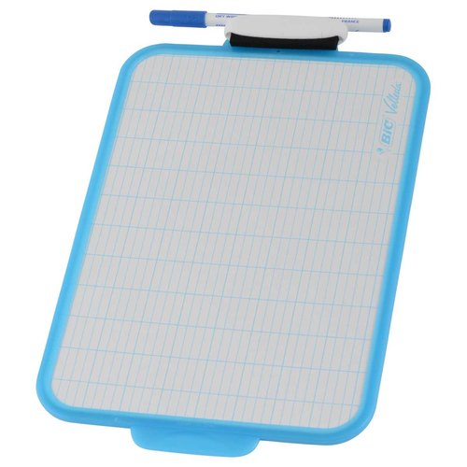
Card Game session
Specific support

Slide 5
Card Game session
Other important element of the game available in the member’s area of the CERL website:

Slide 6
Card Game session
Let’s play
Have fun
May this session bring you many ideas

