Slide 1
Collection Security Summer School Österreichische Nationalbibliothek Vienna 7-9 September 2022
The CERL Security Working Group & this Summer School ‘s theme
Eng. Jacqueline Lambert
Prevention advisor
Head ISPP departement
jacqueline.lambert@kbr.be
Chairman CERL’s Security Working Group

Slide 2
The Security Working Group
Our strengths and objective
Members of the Working Group
Chairman: Jacqueline Lambert, Koninklijke Bibliotheek van België – Bibliothèque royale de Belgique, Brussels Jarle Rui Aadna and Anna Magdalena Lindskog Midtgaard, Det Kongelige Bibliotek, Copenhagen Núria Altarriba , Biblioteca de Catalunya, Spain Greger Bergvall, Kungliga Biblioteket, Sweden László Boka, National Széchényi Library of Hungary, Budapest Andrea Cappa, Biblioteca Nazionale Centrale di Roma (BNCR) and Flavia Bruni, Istituto Centrale per il Catalogo Unico delle biblioteche italiane e per le informazioni bibliografiche (ICCU) (Per Cullhed), Uppsala University Library, Uppsala Adrian Edwards, British Library, London Claudia Fabian and Wolfgang-Valentin Ikas, Bayerische Staatsbibliothek, München Julie Gardham, Glasgow University Library Nina Korbu, National Library of Norway, Oslo Joe Marshall and Paul Hambelton, National Library of Scotland María Jesús Morillo Calero, Biblioteca Nacional de España Eva Nylander, University Library, Lund - on behalf of the CERL Swedish group members Brian O'Donnell, National Library of Ireland, Dublin Anne Pasquignon, Bibliothèque nationale de France, Paris Fran Stroobants, Koninklijke Bibliotheek van België – Bibliothèque royale de Belgique, Brussels Wim Tromp and Foekje Boersma, Koninklijke Bibliotheek, The Hague
A diversity
13 nationalities
National, regional, university libraries including one on behalf of a group of libraries
Representatives with various profiles (training, position)
Serving a cause
Helping libraries and archives, large and small, to enhance the security of their collections
by
Offering concrete support for the risks management of theft and depredation of collections

Slide 3
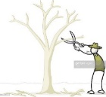
The Security Working Group
Our philosophy: Systems-based approach
Within a network which we would like to be the most active possible
To meet expectations
To ensure adequacy
Raise awareness Sensitize
Year on year
Improve / Initiate policies
Improved prevention & increased ability to response
A concrete offer
Including « ready to use» practical support
For all kind of institutions:
Small / large
With various means at disposal
Share / Collaborate
To meet needs
Support one another
To ensure coherence

Slide 4
The Security Working Group
Quick overview of our principal offer/ achievments
Practical Tools
The Quick Audit Tool =Quick self assessment
Available to all Available to CERL’s Members
Card Game
QAT Library (under development)
2 support tools
Specific activities promoting the exchange of experiences and mutual support
Summer Schools: The Hague 2017- Rome 2018- Tartu 2019 – Vienna 2022
The programme and some presentations from previous editions are available on the website. https://www.cerl.org/collaboration/security/summerschools
Online events
2 in December 2020
One over different security issues→ A/Q based on recorded presentations which were made available a few days before the event
Panel on the impact of COVID-19 on libraries/special collections
https://www.youtube.com/playlist?list=PLWdvmalzEqYc6n_8MQObahOS6rqnKZyKN
Coming before the end of the year: a webinar in collaboration with IFLA
Contribution to seminars/conferences
June 2022 –RBMS conference- Panel on “Finding the balance: An international Approach to Security Guidelines and Accessibility”

Slide 5
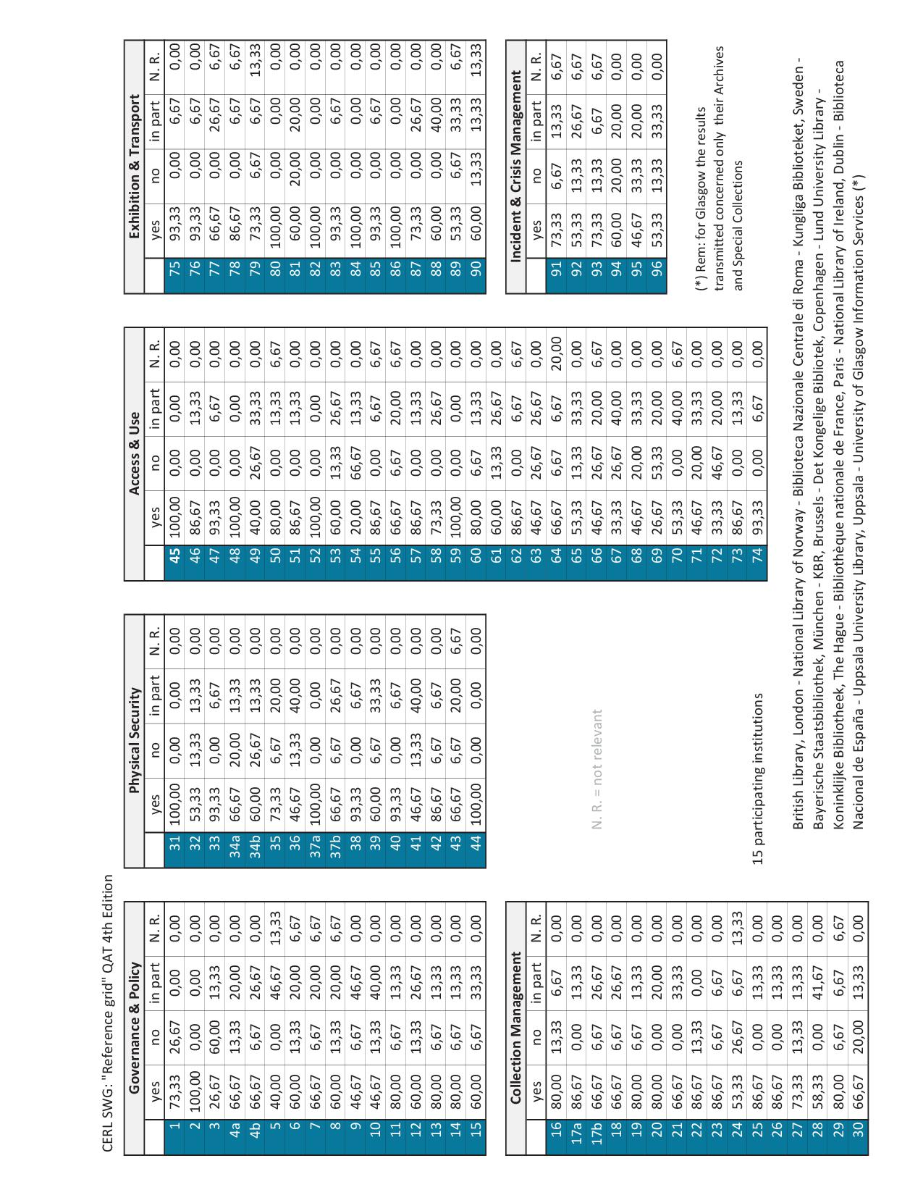
The QAT
General outline
Based on:
A questionnaire ± 100 questions
6 key areas
A reference grid → resulting of the results in the survey from the institutions represented within the SWG .
Tips, based on:
Various relevant considerations related to your institution
The figures of the reference grid (how to use them)
An Excel file: which will help you to obtain your positioning grid
Governance & Policy
Collection Management
Physical Security
73,33% of the participating institutions answered yes to the first question
Quick self assessment
Regularly reviewed
4th edition available to all on CERL’s website since February 2022
Access & Use
Exhibition & Transport
Incident & Crisis Management
https://www.cerl.org/collaboration/security/qat

Slide 6
The QAT
The Excel file, a great help to obtain your positioning grid
Yes →
No →
In part →
N.R (not relevant) →
At a simple glance you get clear first visualization of your situation = the starting point to shape your actions

Slide 7
The QAT Supporting Tools
The Card Game
Based on 32 scenarios that could happen in the day life of our institutions:
A help to make the link between the measures that the QAT questionnaire prompts you to take and the incidents /problems that they help to prevent and solve
Ideal for animating workshop, gathering colleagues to address collections security issues → 2 major assets
get the buy-in, raise awareness and stimulate thinking about security issues
thanks to the discussions it generates, a good way of bringing up near-misses and thus better identifying the risks specific to your institution

Slide 8
The QAT Supporting Tools
The QAT Library
Why?
We feel that many of the resources which are available on-line often require a lot of time, before anything concrete can be derived from them
Aim?
Made available, in an easy way, both sample documents such as forms, procedures, checklists, etc. and background discussions in all relevant areas which could help in the choice of specific equipment, strategic alternatives or other.
Inputs?
For the launch (Autumn 2022): some institutions represented in the SWG → this allowed us to develop and refine the validation procedure (formalization of the collaboration between the parent institutions of the documents and the CERL).
After: call to the network
For who?
Will exclusively be available to CERL members via CERL’s website (members area)

Slide 9
The QAT Supporting Tools
The QAT Library
4

Slide 10
The QAT Supporting Tools
The QAT Library

Slide 11
Summer School Vienna
Theme
why focusing on crisis ?
Most of the crisis affecting our institutions can have an impact on collection security
We are going through difficult times (chaotic period associated to paradigm shift) → crisis increase
Be aware and prepared can help to avoid or decrease risks
The systemic approach is always a winner, making it a habit will only bring you more

Slide 12
Thank you for your attention

