Slide 1
Use of technology, architecture to reduce risks
Jarle Aadna
Wien

Slide 2
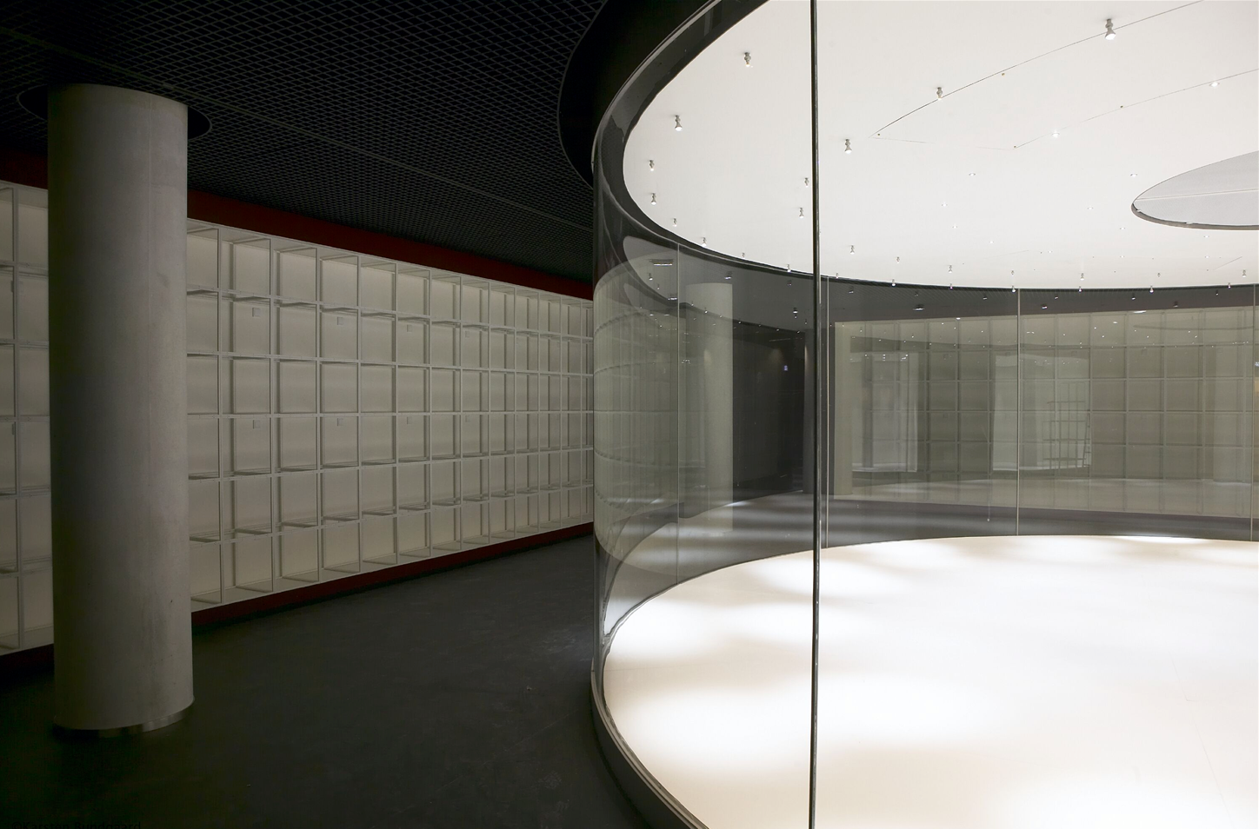
Architecture as a panopticon
A building so arranged that all parts of the interior are visible from a single point
An area where everything is visible
The feeling of being in a panopticon
Glass surfaces; to see and be seen
Possibility of permanent surveillance in the reading room by library guests, staff who passes by and reading room users
The monitoring becomes so complete that it possibly does not need to be exercised

Slide 3
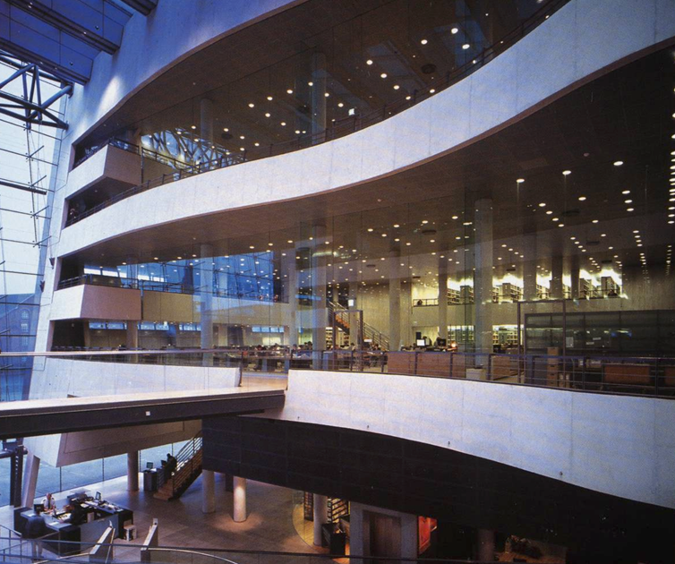
Use of technology
Open glass facades
Overlooking balconies
Overlooking office areas
Clean surfaces
Transparency
Light
Avoid blind spots / pillars

Slide 4
Arkitema Architects

Slide 5
Other technologies
CCTV (and the knowledge of it)
Random seating (chosen by staff)
Different security zones
Staff placed in several directions
Weighing
Registering / showing ID
Photograph users
Descriptive catalogue posts

Slide 6
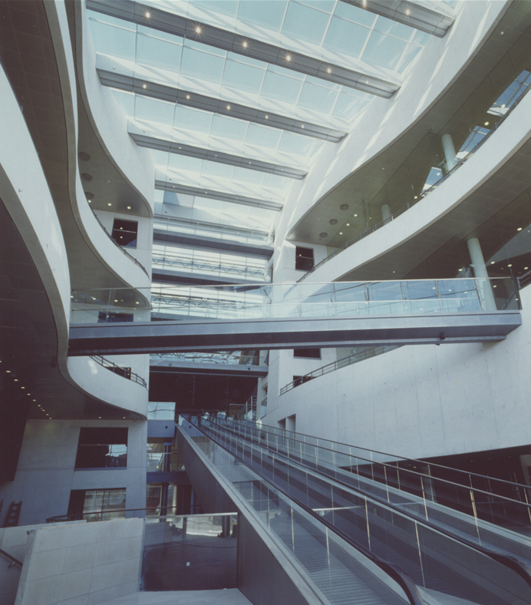
Is it safe?
With all this in mind, how is it possible for a user to go under the radar in a reading room of a panopticon kind?
Do we want a reading room of a panopticon kind?
What is it like to work in a reading room of a panopticon kind (users and staff)?
What does it do to us?

