Slide 1
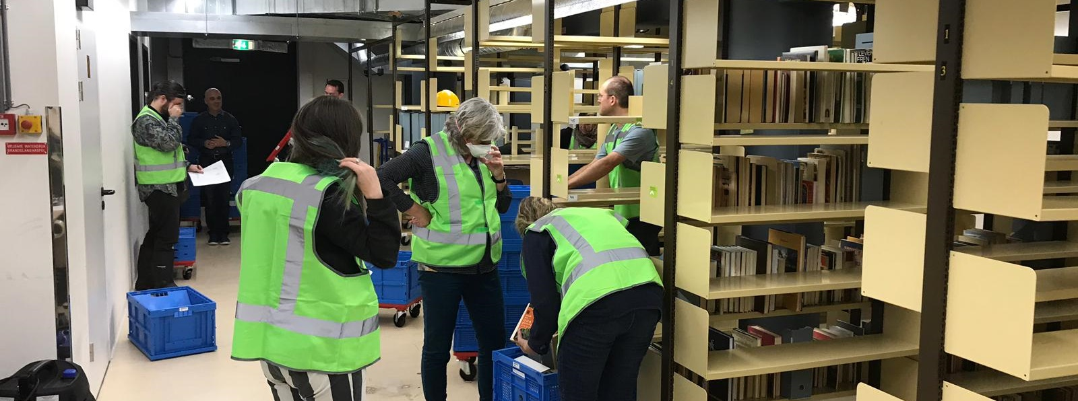
Moving collections in an emergency
Foekje Boersma
7 sept 2022
CERL Summerschool, Vienna

Slide 2
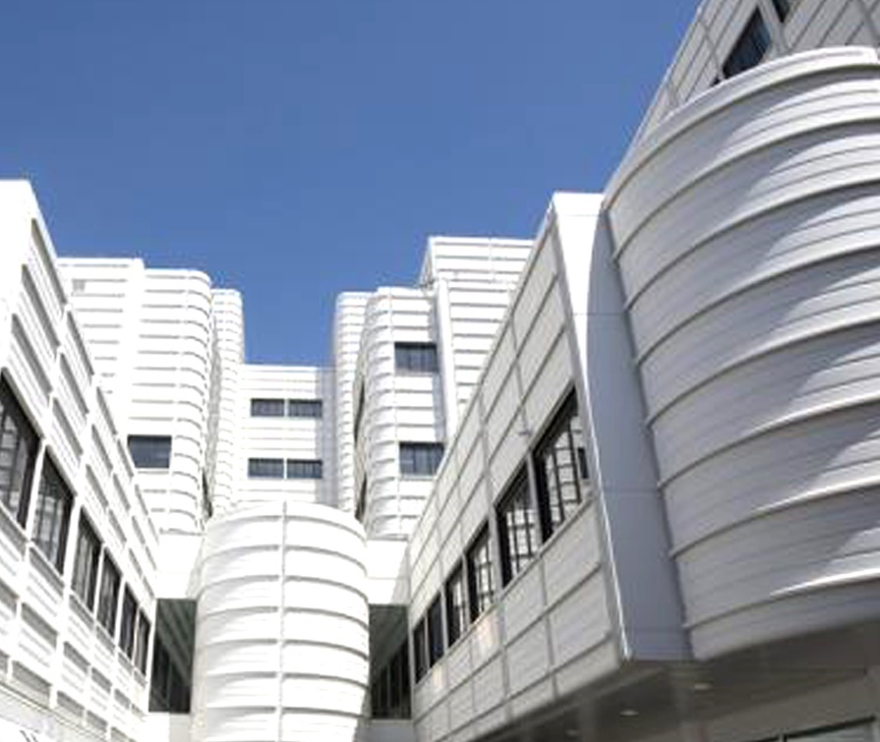
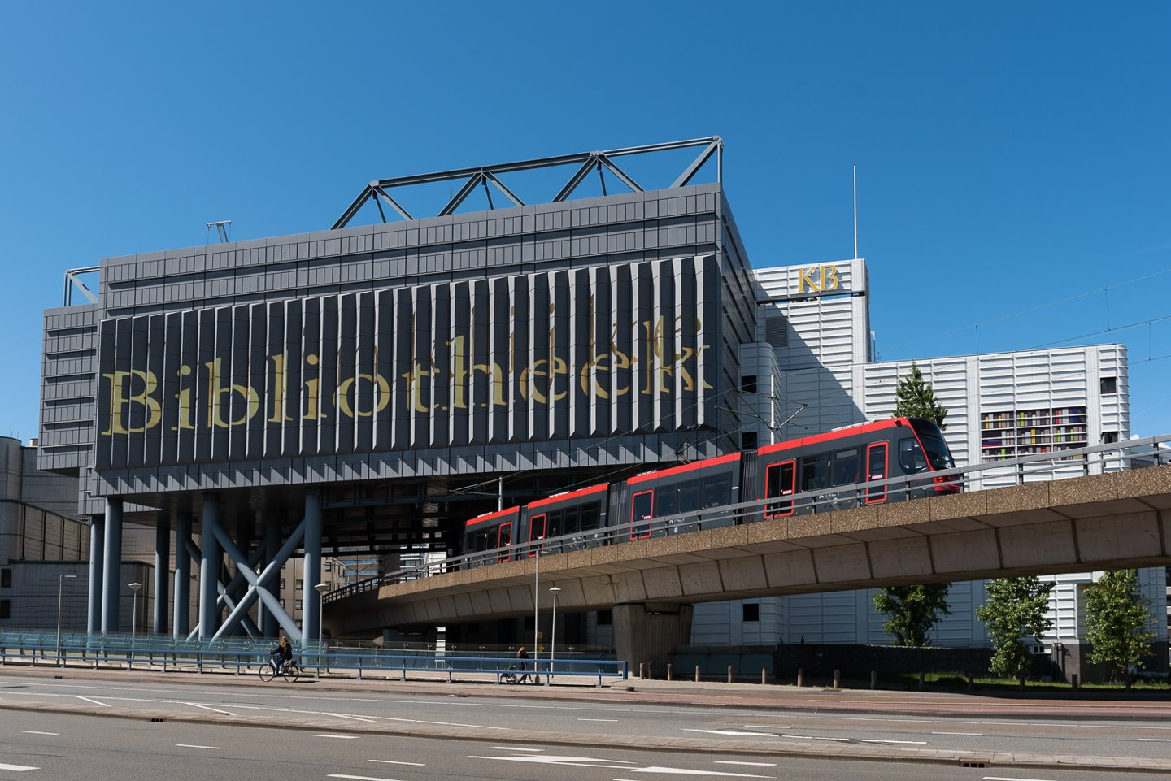
KB national library of the Netherlands, The Hague
1982 main building, reading rooms 2007 additional storage
and (underground) storage
Notes:
Moved into purpose built library in 1982 and extension for storage in 2007.
At the time fitted with high end, state of the art climate control system.
Consequently our current energy consumption is enormous. I’ll come back to that.

Slide 3
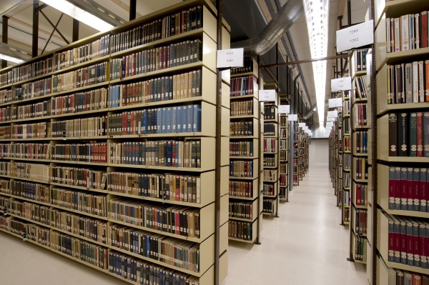
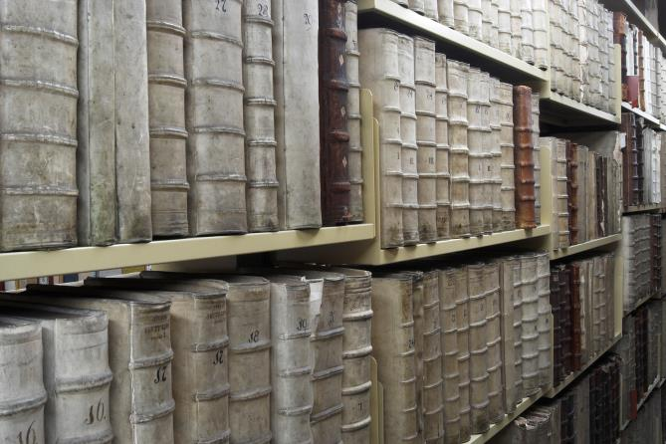
Physical collections
Books 3.500.000
Periodicals 700.000
Newspaper 100.000
Special collections 575.000
Total > 4,4 million items
125 linear kilometres

Slide 4
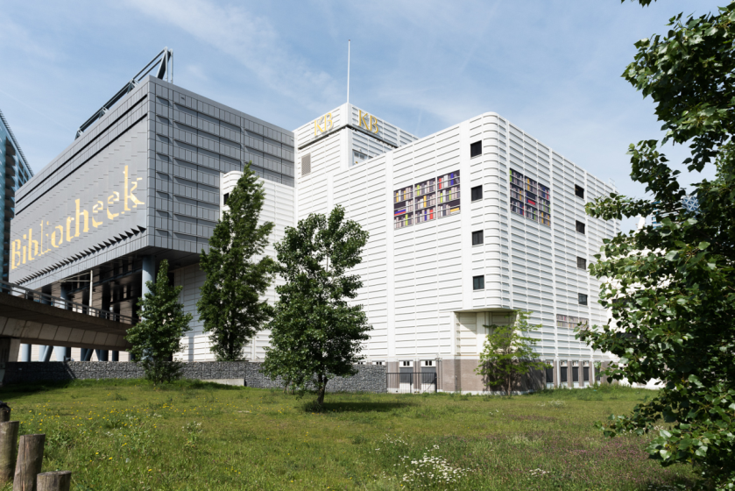
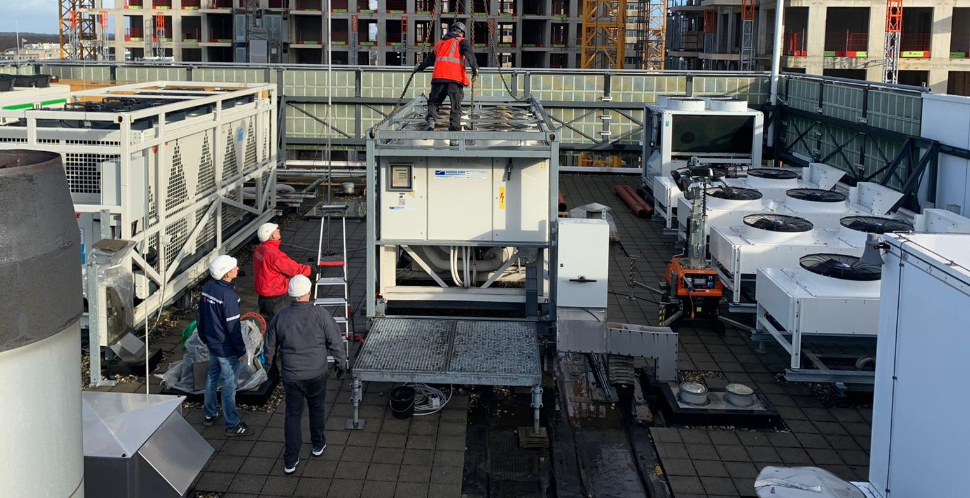
Challenge
Current location is not ‘future-proof’:
Renovation is too costly
Long term exploitation is not sustainable:
Active climate control (HVAC)
Systems out of date
Huge replacement costs
Increasing energy costs
Our new storage facility is not ready until 2026/2028
Our current building is not properly maintained

Slide 5
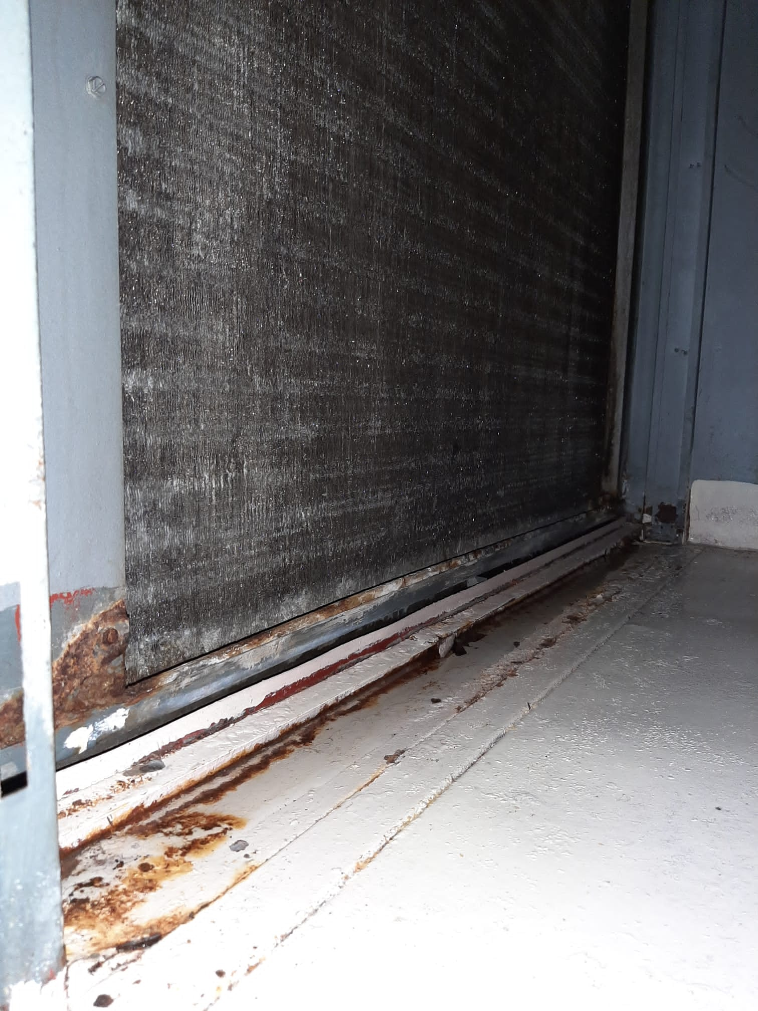
Challenge
Installations and systems (hardware and software) in current building are beyond lifetime.
Increased risk for flooding
Increased risk for fire
Increased risk for mould

Slide 6
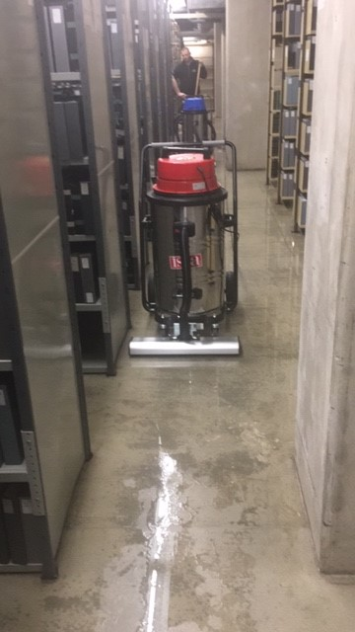
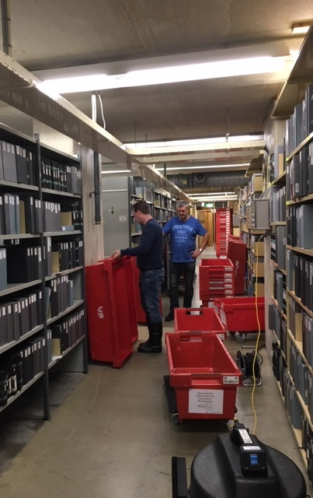
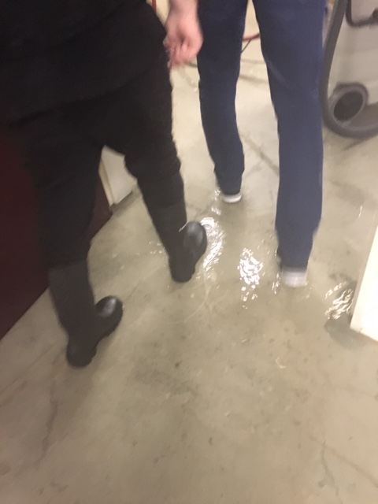
31 May 2019 KB national library
Clean water from a burst drainage pipe leaked about 8.000 liters in the underground storage.
The excess water was quickly removed, but it took several days for the concrete to dry and the RH to drop below 60%. Building driers were used to collect the moisture from the air.

Slide 7
What to do for emergency preparedness?
Standard practice:
Update emergency preparedness plan
Emergency organisation: crisis team, collection-help-team
Staff training in crisis management, collection salvage, fire extinguishing
Regular exercises – table top and simulations
In addition:
Creating a risk map
Plotting collection priorities

Slide 8
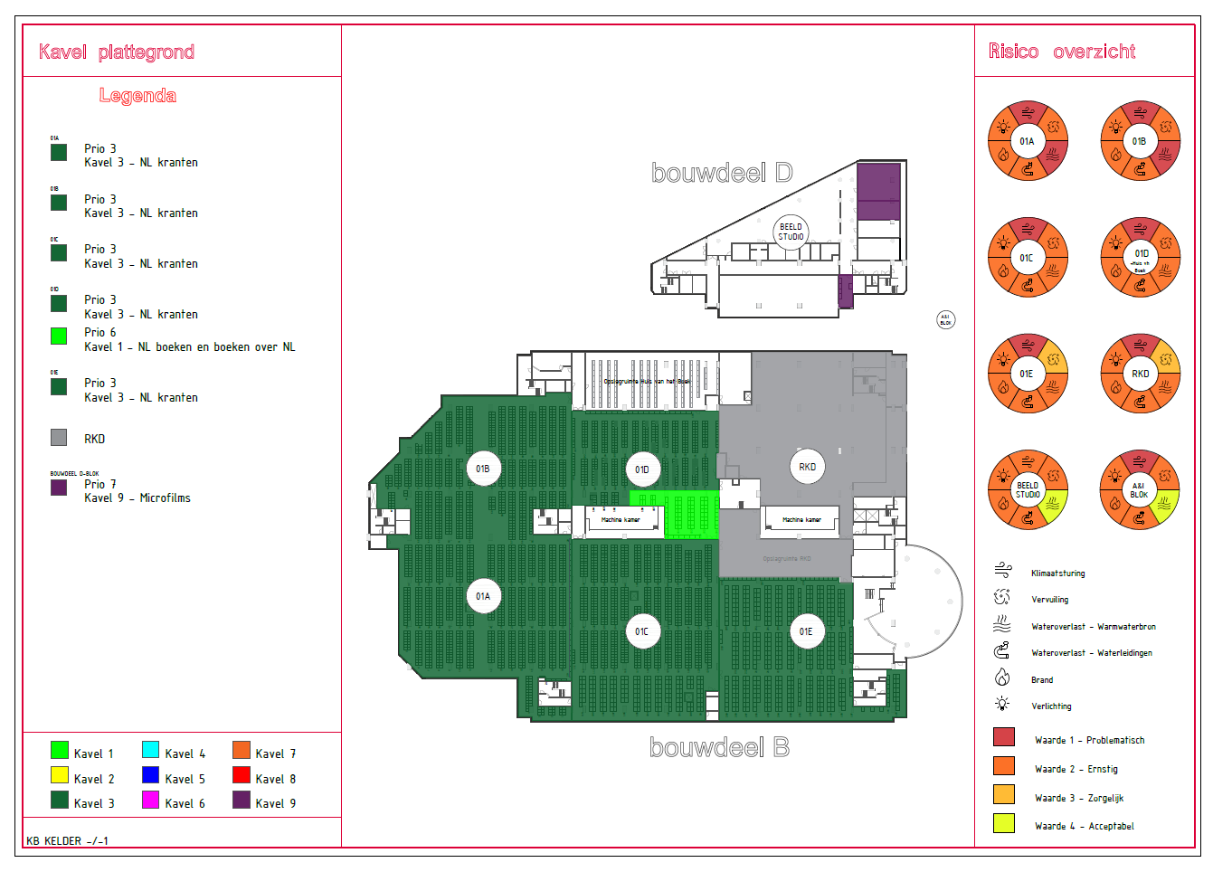

Slide 9
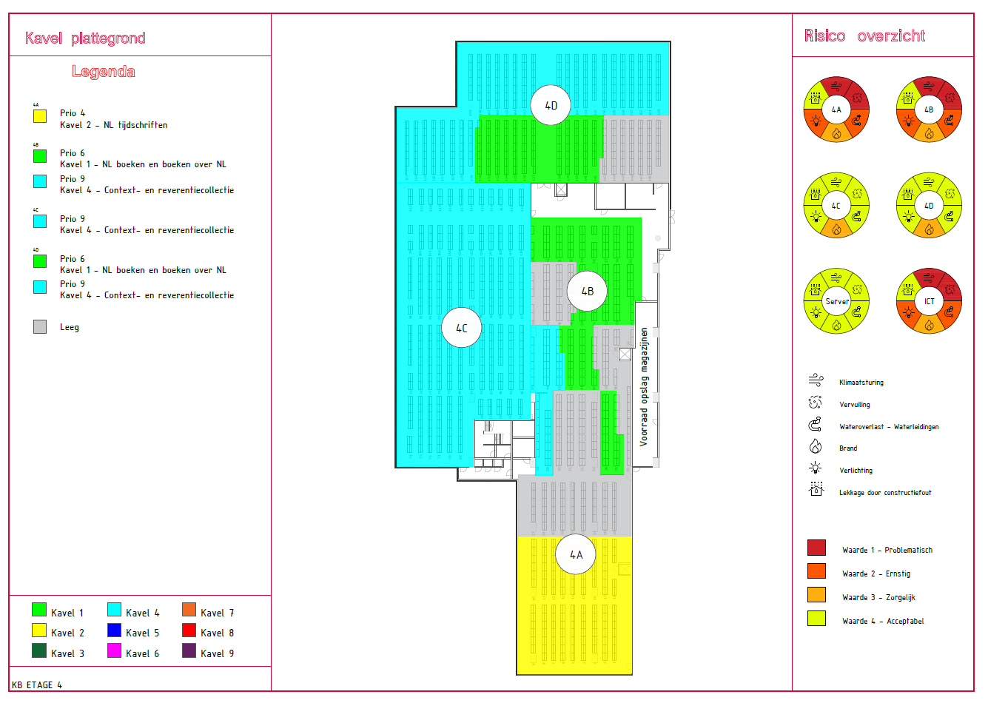

Slide 10
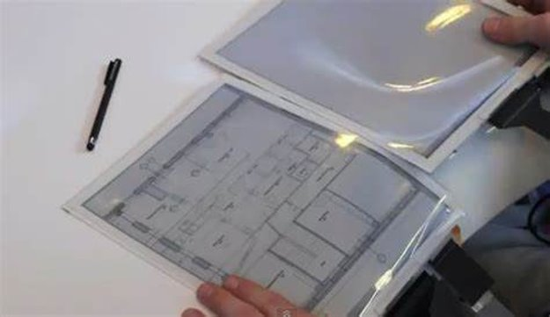
What to do for emergency preparedness?
In addition:
Creating a risk map
Plotting collection priorities
Developing 3 disaster scenario scripts with salvage experts
Evacuation and treatment of large parts of collection
Indication of costs
Re-connect with security region first aiders (fire brigade)
Creation of waterproof floorplans for use in an emergency
Improve emergency documentation for quick evacuation

