Slide 1
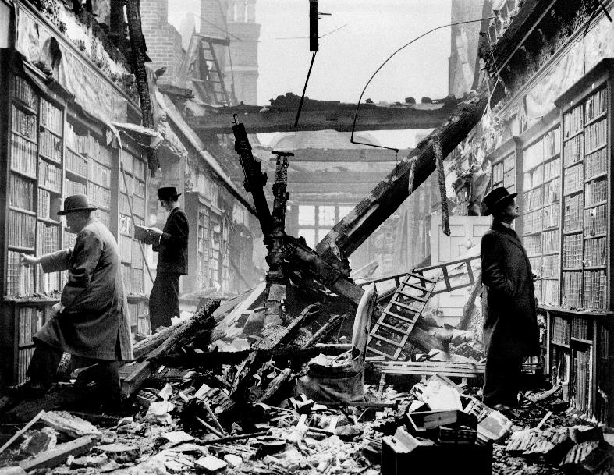
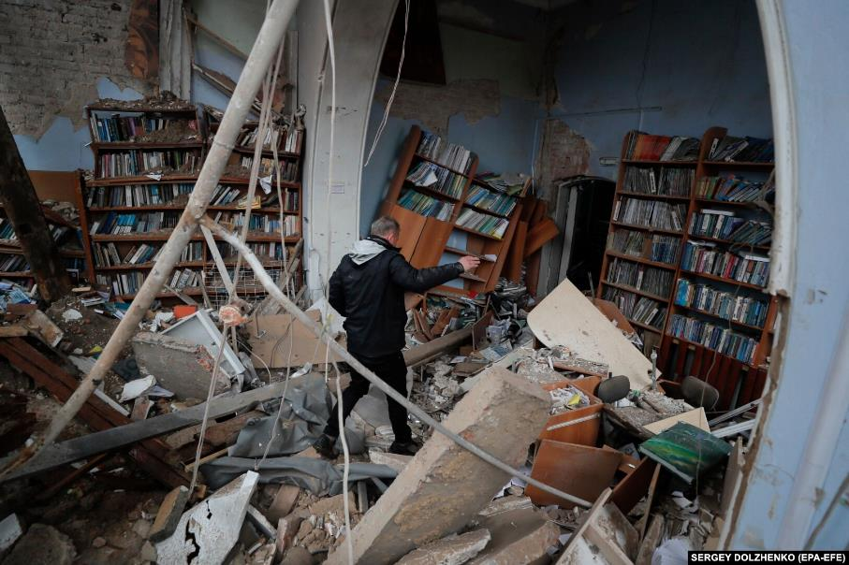
What is the impact of a crisis on your organization?
23 October 1940, Holland House, London A library was shelled in the city of Chernihiv. A man
looks at the damage on April 9, 2022
CERL Summerschool, Vienna
7 sept 2022
Notes:
Original caption: "HOLLAND HOUSE BADLY BURNED. WS/57.
Holland House, Lord Ilchester's historic 17th. Century house, has been damaged during the recent air raids on London.
An oil bomb started a fire on one of the towers and a 'Molotoff breadbasket' and a shower of incendiaries fell on the building.
Firemen saved the east wing from complete destruction, but the rest of the house is a shell.
Holland House, just off Kensington High-street, was London's great Whig salon in the 18th century and the home of Charles James Fox, and also earlier, of Joseph Addison, founder of the Spectator.
Photo shows - The famous library containing a number of valuable and historical books was completely wrecked. FOX. OCT. 23rd. 40. [7]"^{[1]} The spectacle of the three men shown inspecting books in the library was likely staged for propaganda purposes.

Slide 2
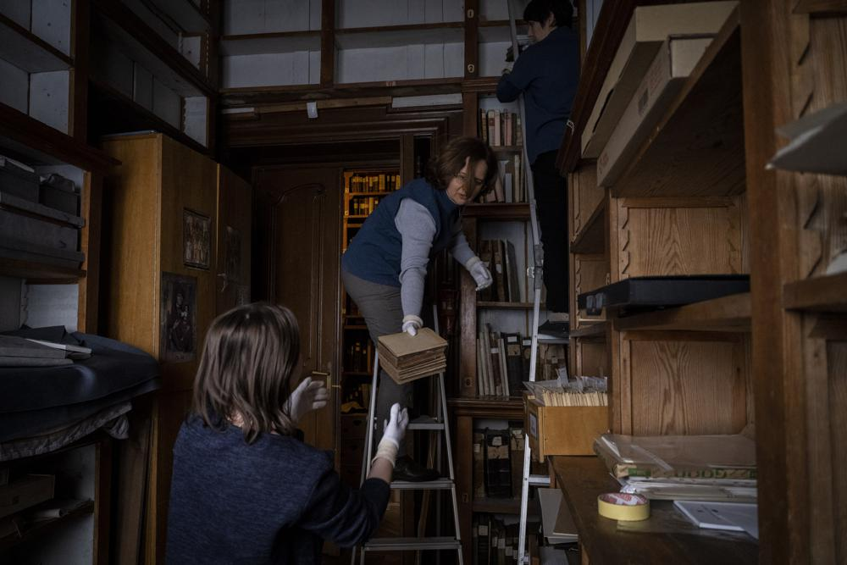
Friday, March 4, 2022.
Workers at the rare manuscripts and old printed books department of the Andrey Sheptytsky National Museum store them in cardboard boxes to reduce the risk of damage in the event of an attack in the western Ukrainian city of Lviv.
The doors of the museum have been closed since Russia’s war on Ukraine began on Feb. 24, and heritage sites across the country face danger as the fighting continues.
(AP Photo/Bernat Armangue)
Notes:
https://apnews.com/article/russia-ukraine-travel-europe-art-museums-museums-768ce266673b85965edc8367c2257370

Slide 3
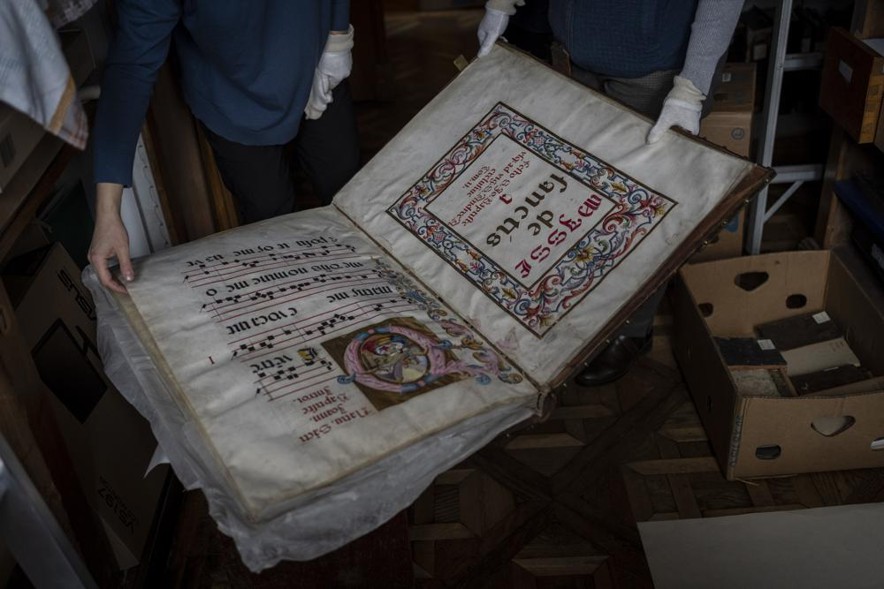
Workers at the rare manuscripts and old printed books department of the Andrey Sheptytsky National Museum
Notes:
https://apnews.com/article/russia-ukraine-travel-europe-art-museums-museums-768ce266673b85965edc8367c2257370

Slide 4
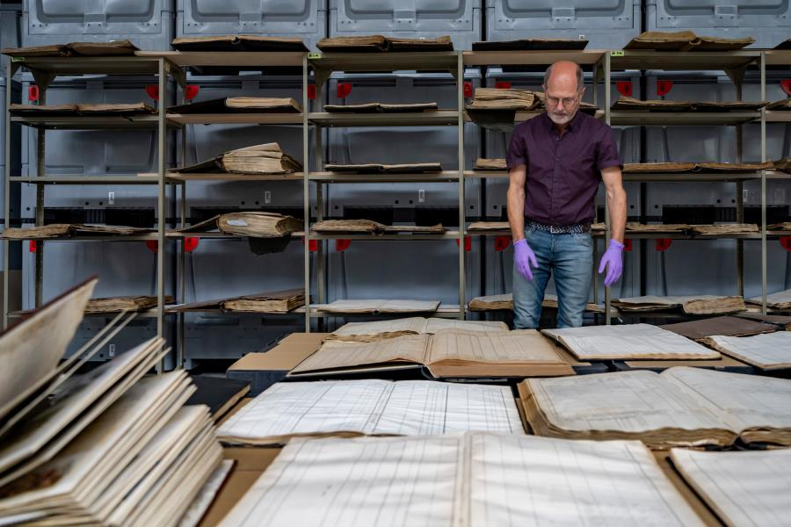
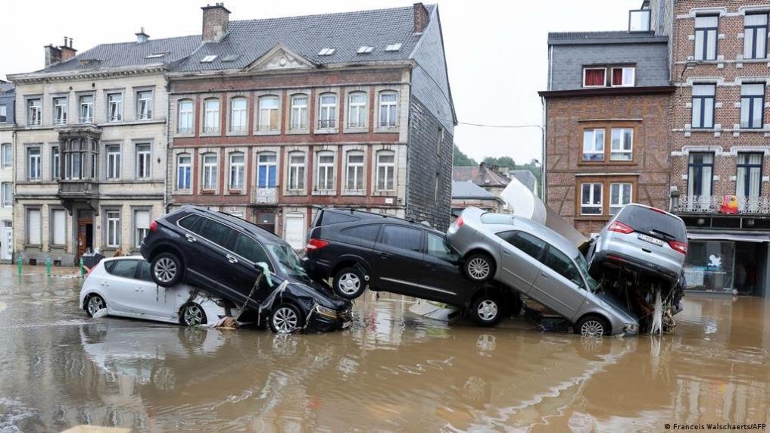
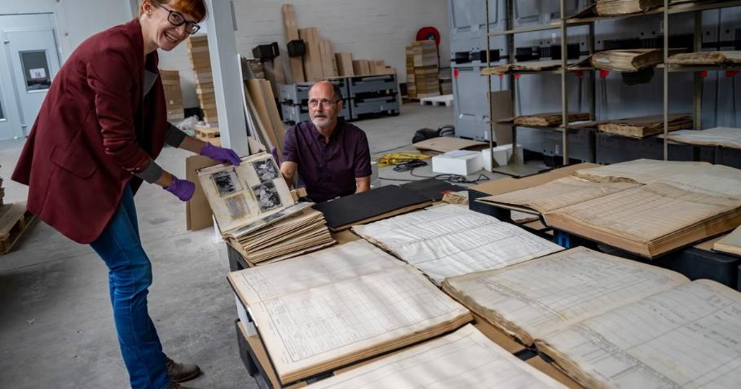
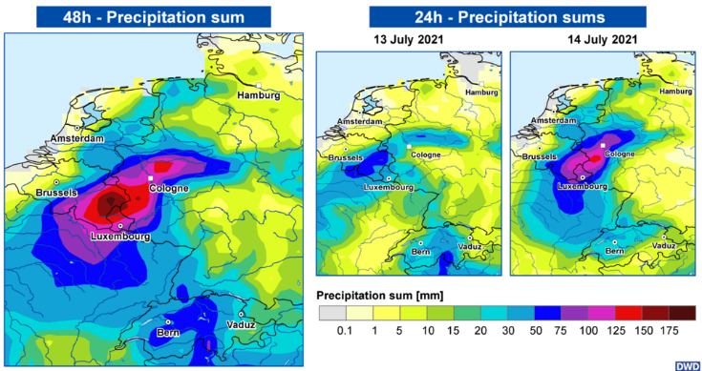
July 2021 flooding in Belgium, Germany, the Netherlands
Notes:
https://www.hln.be/dendermonde/baasroods-bedrijf-object-care-in-de-bres-om-archiefmateriaal-uit-watersnood-wallonie-te-redden-zeker-drie-jaar-nodig-om-documenten-te-redden~aed13845/206530600/

Slide 5
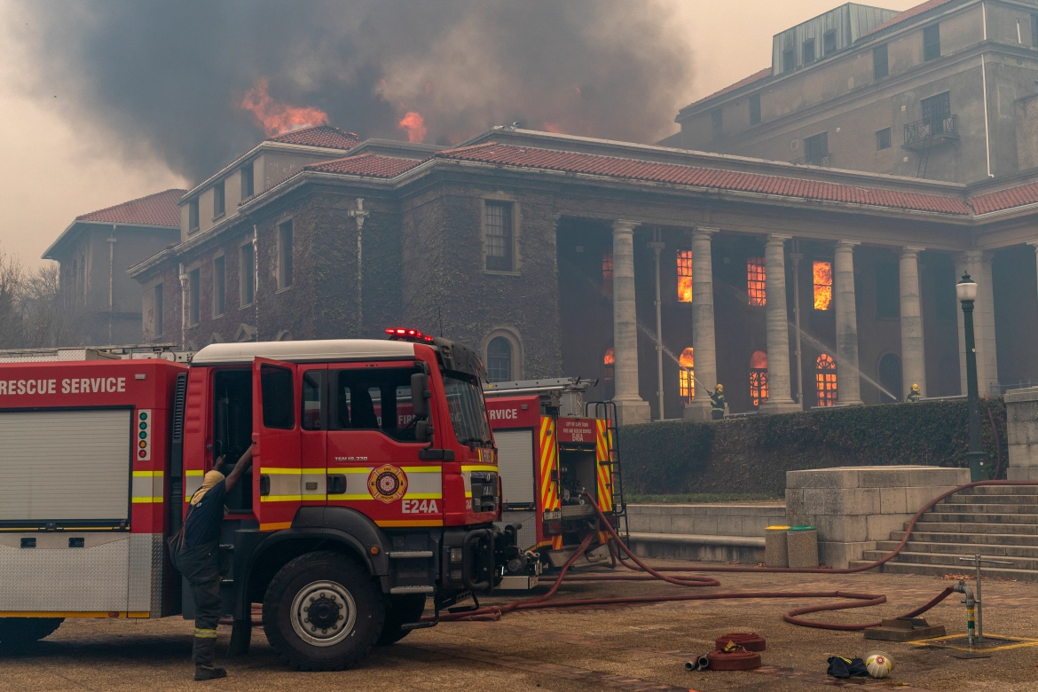
18 April 2021 South Africa
Wildfire raging on Cape Town’s Table Mountain spread to the University of Cape Town, forcing thousands of students to evacuate. The Cape Town fire damages the 200-year-old library
Notes:
https://www.aljazeera.com/gallery/2021/4/19/cape-town-fire-burns-university-library-students-evacuated
https://www.theguardian.com/world/2021/apr/19/cape-town-fire-table-mountain-evacuate-university-jagger-library

Slide 6
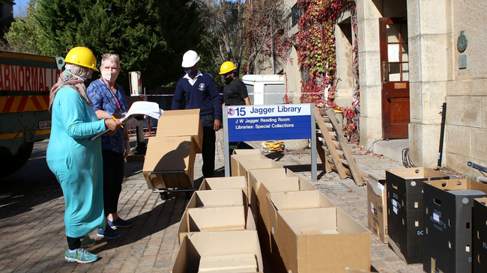
The Jagger Reading Room, which was destroyed by the fire on Table Mountain, is part of UCT Libraries’ Special Collections and housed a unique collection of more than 83 000 items of African studies material and other specialised subjects, as well as 1300 sub-collections of unique manuscripts and personal papers.
UCT Staff removing the books and documents from the Jagger Reading Room that was damaged by recent wild fires. Pictures: Brendan Magaar/African News Agency(ANA)
Notes:
The Jagger Reading Room, which was destroyed by the fire on Table Mountain, is part of UCT Libraries’ Special Collections and housed a unique collection of more than 83 000 items of African studies material and other specialised subjects, as well as 1 300 sub-collections of unique manuscripts and personal papers.
UCT’s executive director of libraries, Ujala Satgoor

Slide 7
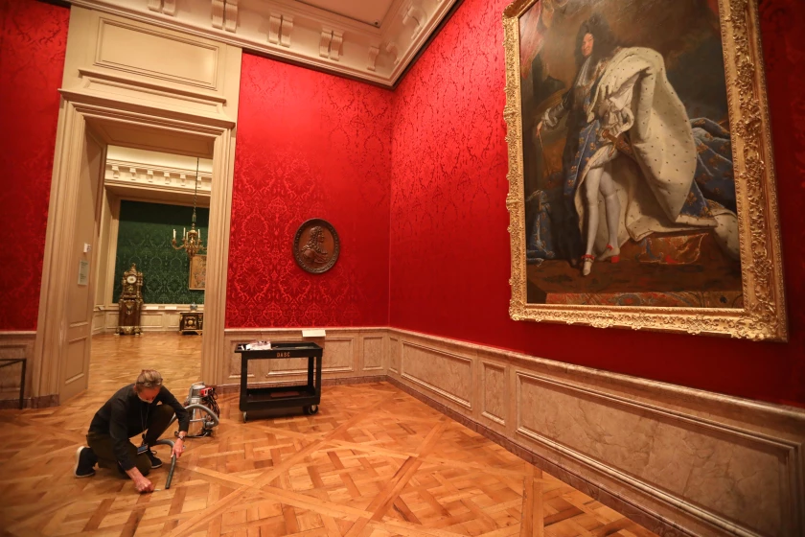
April 2021 Los Angeles
Last March, as the lights went off in museums across California and galleries were shut in the first wave of coronavirus closures, a dangerous invader penetrated the Getty Museum.
The interloper was the webbing clothes moth, which feeds on silk, wool and other organic material. The insect posed a particular threat to the fragile textiles and upholstered furniture.

Slide 8
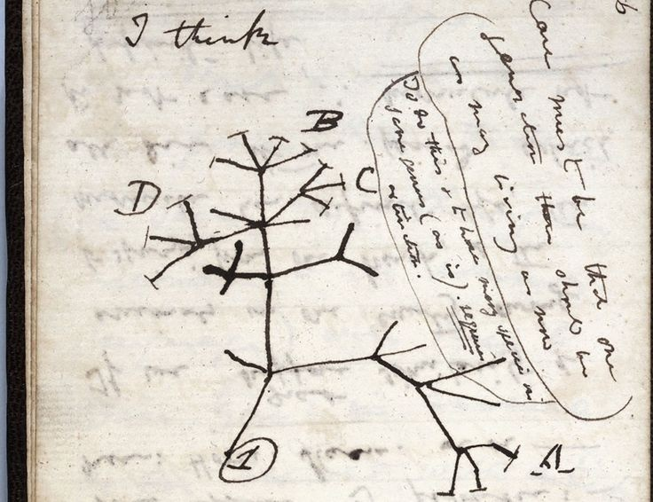
24 November 2020 Cambridge University Library has announced that two notebooks written by Charles Darwin, worth many millions of pounds, have been missing for 20 years. One of them contains the famous Tree of Life sketch.
Following an "extensive search", curators have now concluded they have probably been stolen.
They are launching a public appeal for help in trying to find them.

Slide 9
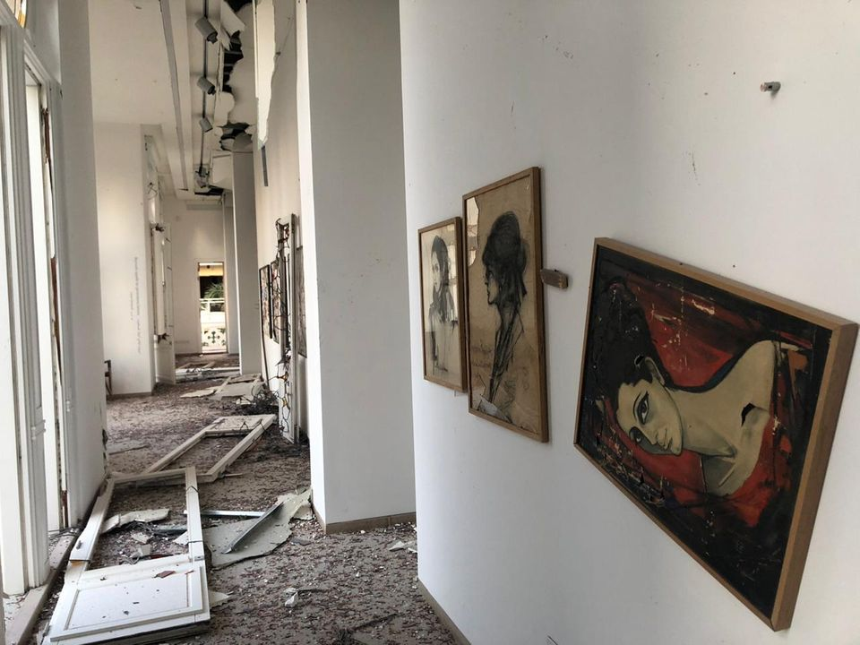
4 Aug 2020, Beirut: Two powerful explosions at the Port of Beirut left more than 70 people dead and over 4,000 injured. Beirut's Sursock Museum suffered extensive damage from the explosion.
“A lot of damage has been done to the structure of the building at a time when the dollar in Lebanon is so high that I don’t know how we will afford to buy new glass for the skylights, the windows and the exit doors” said the museum’s director Zeina Arida.

Slide 10
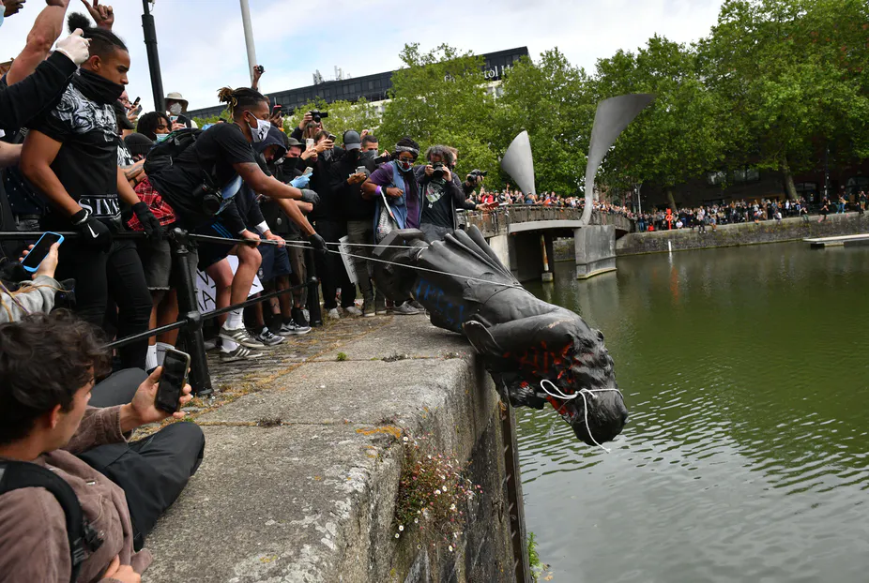
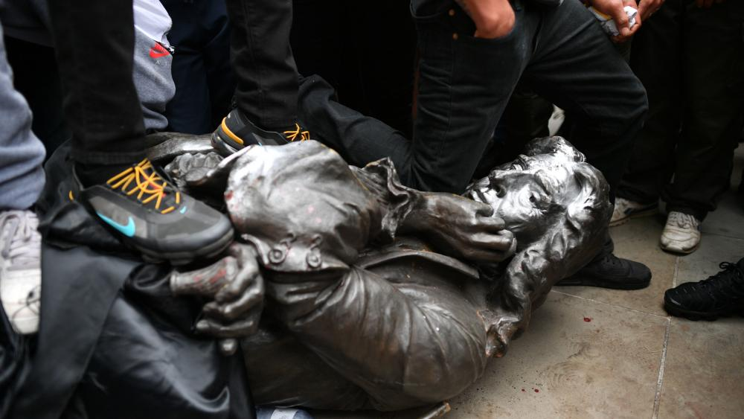
June 7, 2020 UK: protesters topple statue of slave trader Edward Colston.
Anti-racism protesters in England have pulled down a statue of a 17th-century slave trader while demonstrating in solidarity with the US Black Lives Matter movement.
The protesters in the city of Bristol, in southwest England, tied the bronze statue of Edward Colston with rope before toppling it to cheers from the surrounding crowd.

Slide 11
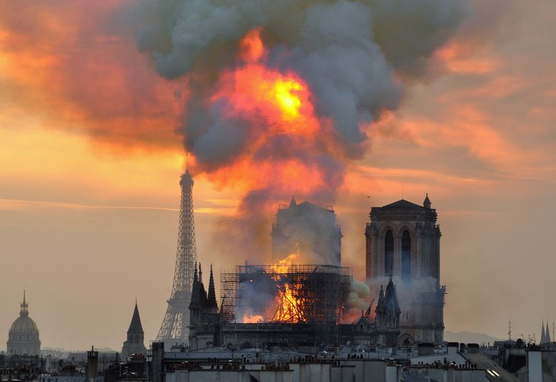
The Notre-Dame de Paris fire broke out on 15 April 2019, just before 18:20 CEST.
By the time the fire was extinguished, the building’s spire had collapsed and most of its roof had been destroyed and its upper walls were severely damaged. Extensive damage to the interior was prevented by its stone vaulted ceiling, which largely contained the burning roof as it collapsed.
Notes:
Many works of art and religious relics were moved to safety early in the emergency, but others suffered smoke damage, and some of the exterior art was damaged or destroyed. The cathedral's altar, two pipe organs, and its three 13th-century rose windows, suffered little or no damage. Three emergency workers were injured.
https://en.wikipedia.org/wiki/Notre-Dame_de_Paris_fire

Slide 12
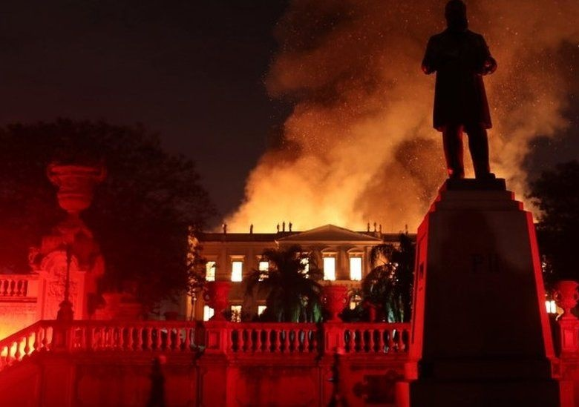
Flames rip through the main building of the Museu Nacional in Rio de Janeiro, Bazil, on September 2, 2018.
A faulty air conditioning unit sparked fire, which destroyed the 200-year-old building and reduced the majority of its 20-million artifact collection to ash.
Notes:
https://www.nationalgeographic.com/science/article/news-museu-nacional-fire-rio-de-janeiro-natural-history
https://www.smithsonianmag.com/smart-news/faulty-air-conditioning-unit-sparked-devastating-brazil-national-museum-fire-180971903/

Slide 13
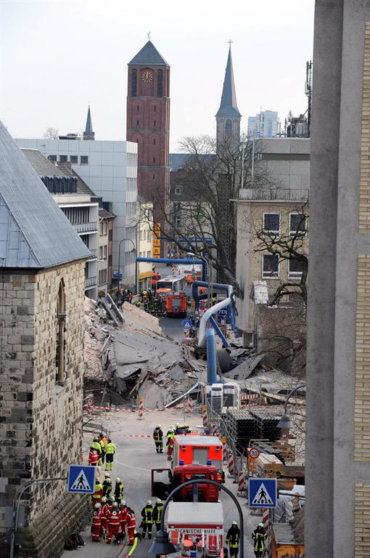
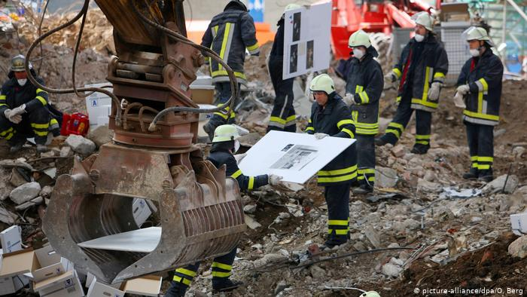
3 March 2009 at 1:58 p.m. Cologne's archive building collapsed, killing two people, destroying historical documents and caused millions in damage. Public prosecutors in 2017 confirmed that the construction of a new underground railway line of the Cologne Stadtbahn system had been the cause

Slide 14
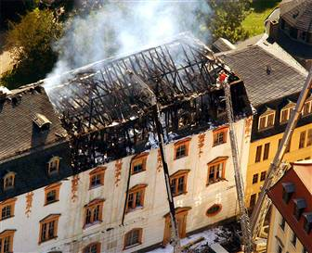
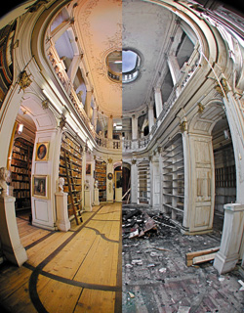
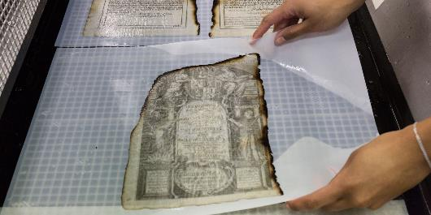
1 Sept 2004 Germany
In the fire of the Anna-Amalia library in Weimar, more books were lost than the 30.000 initially anticipated.
https://www.klassik-stiftung.de/en/herzogin-anna-amalia-bibliothek/the-library/after-the-fire/
https://3dtopevent.info/haab/#pano=252

Slide 15
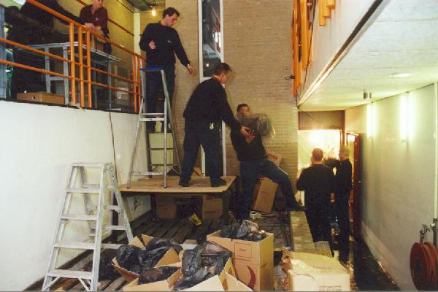
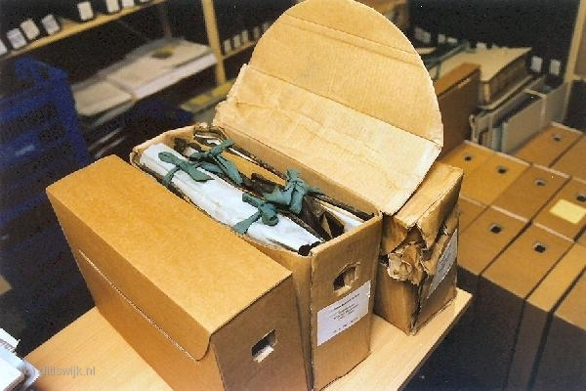
17 and 18th Oct 2002 Flooding in the archive of Wijk bij Duurstede, the Netherlands

