Slide 1
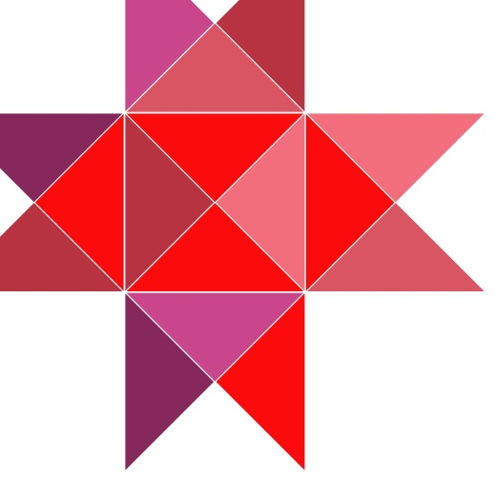
Digital Heritage Serving Two Masters: the Great Public and the Academia
Jussi-Pekka Hakkarainen
Project Manager
Liber 2016
29.6.2016, Helsinkii

Slide 2
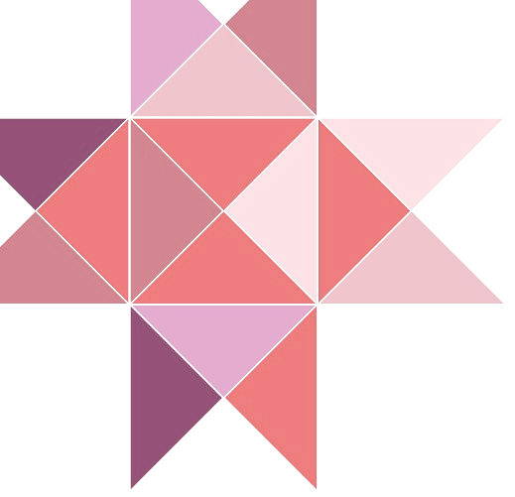
Overview of the Project
The National Library of Finland has been implementing the Minority Languages Project since 2012.
Within the project we have digitized materials in 17 Uralic languages as well as developed tools to support the 1) linguistic research and 2) citizen science.
Through this project, 1) researchers would gain access to new corpora which they have not been able to study before and to which 2) all users would have open access regardless of their place of residence.

Slide 3
Materials and Collection
Within the project, National Library of Finland has digitized and published around 1150 monograph titles and more than 100 newspapers titles in 18 Uralic languages.
The online collection, Fenno-Ugrica, will consist of 110,000 monograph pages, 150,000 newspaper and journal pages as well as some manuscripts. All in all, ca. 30 000 items were published.
The majority of materials belong to the collections of the National Library of Russia in Saint Petersburg.

Slide 4
The Content
Aim to digitize items which would precisely fill the gaps in linguistic research and in corpora, vocabularies etc.
After 1917, the languages were converted into a medium of popular education, enlightenment and dissemination of information pertinent to the developing political agenda of the Soviet state.
The deluge of literature in 1920s-1930s suddenly challenged the lexical orthographic norms of the limited ecclesiastical publications from the 1880s. New concepts were introduced in the language. This was the beginning of a renaissance and period of enlightenment.

Slide 7
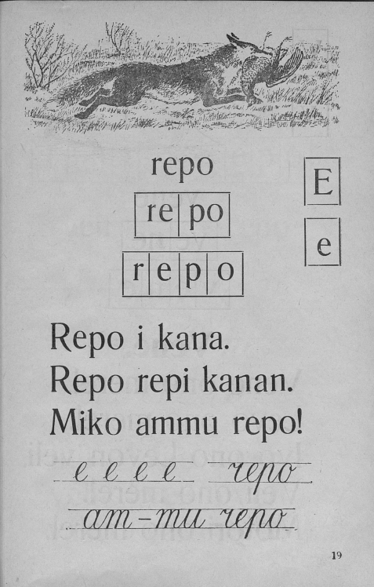
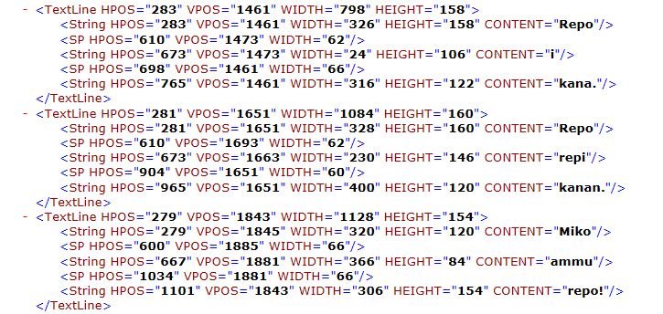
Materials and Collection

Slide 8
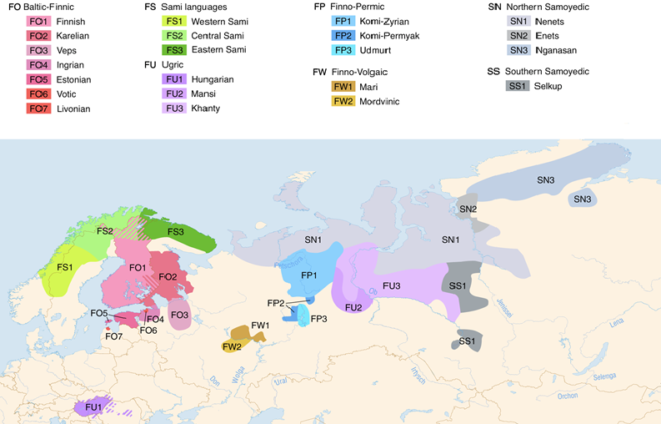
Languages of Publications
Scandinavia
Russian Federation
Europe
https://commons.wikimedia.org/wiki/File:Linguistic_map_of_the_Uralic_languages_%28en%29.png By Maximilian Dörrbecker

Slide 9
Engaging the Academia
Key factor for success was the engaging the researchers to the project. The researchers were in the loop from the very beginning, even before the money was raised.
Researchers did participate in
Planning
Decision-making
Communications
Networking
Distribution of data

Slide 10
Selection Criteria of Material
The selection of the materials has been made in co-operation with the researchers and we used several criteria upon the selection of material:
genesis and consolidation period of literary languages
availablility of material in Finnish libraries and institutions
online access to collections in Russia
locality – the languages of peripheries are more tempting
cost efficiency – loads of parallel titles (translations)
No-one else would digitize and publish this material!

Slide 11
Researchers and Decision-making
Once the money was granted, we called researchers to the steering group, so they were part of decision-making.
In addition to that, the meetings with the researchers in the field took place, both formally and informally:
Coffee sessions with the Helsinki-based researchers on the weekly basis
Annual meetings to discuss about the needs within the Academia
Participating the seminars, congresses, workshops etc.
Forcing them to communicate on our behalf.

Slide 12
Researchers and Networking
The participation of researchers and the co-operation with the researchers took off once we got the reputation.
2 projects in 2012
7 projects and 2 institutions in 2013
4 PhD students, 11 projects, 4 NGOs and 8 institutions in 2015.

Slide 13
Datasets and Further Use
We have created the data ourselves and released the data for other operators in Fenno-Ugrica as wordlists > raw data for linguistic solutions like online dictionaries, spell-checkers, corpora etc.
Edited material is available also in Korp, which is the concordance search tool of the Finnish Language Bank.
Some parts of available also at Giellatekno of Arctic University of Norway and Institut für Deutsche Sprache and FU-Lab in Syktyvkar, Komi Republic (Russia)

Slide 14
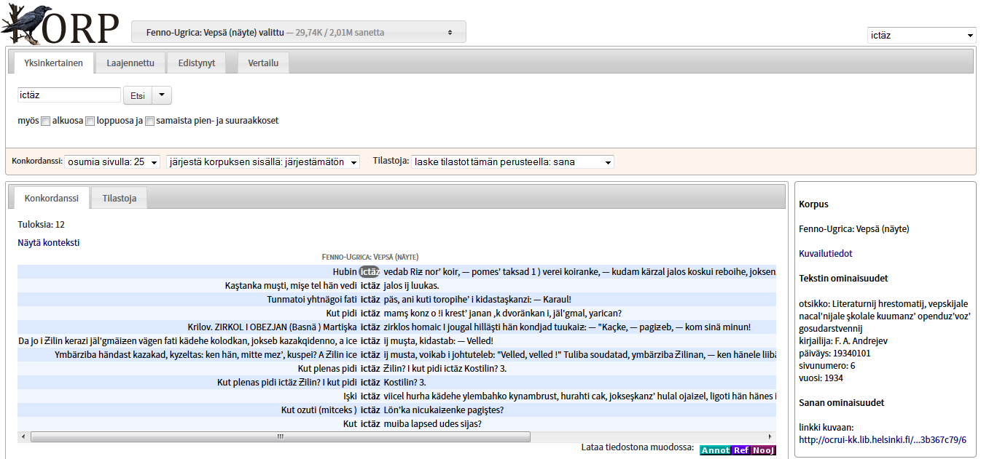
Datasets and Further Use

Slide 15
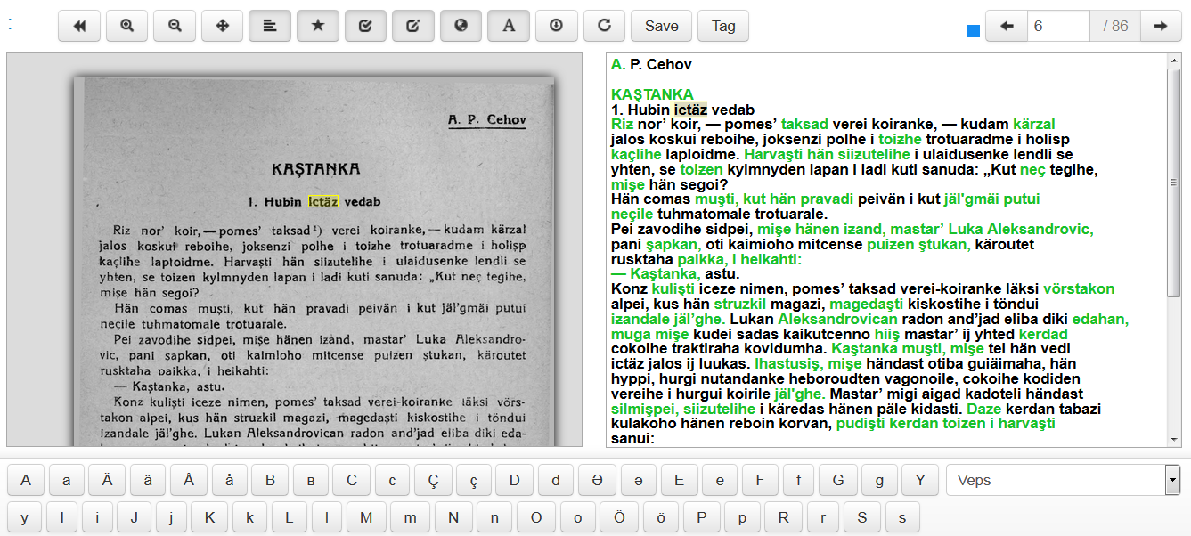
Datasets and Further Use

Slide 16
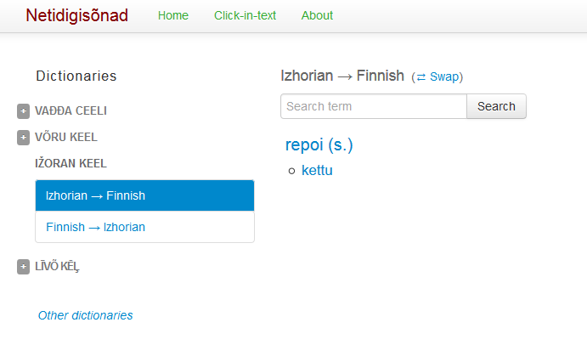
Datasets and Further Use

Slide 17
Finding the Language Communities
How to locate people who could use the content for their benefit?
Co-operation with universities and libraries didn’t really work out
Activity in English-oriented social media did not help us
No remarkable networking, contact or results via WWW, Twitter, Facebook or Project Blog
No interactivity with native-speakers

Slide 18
Language Communities, ie. The Great Public
When thinking of the possible wider audiences, one must bear in mind that the most of the people, who speak these languages are located in Russia.
Communication and marketing
Schedule for blog posts and Vkontakte messages
Accessible user interface for Russian-speaking audience
Fenno-Ugrica, Uralica
Activitity in social media in Russian is necessary
Vkontakte
Chat forums (for linguists etc)
IRC channels

Slide 19
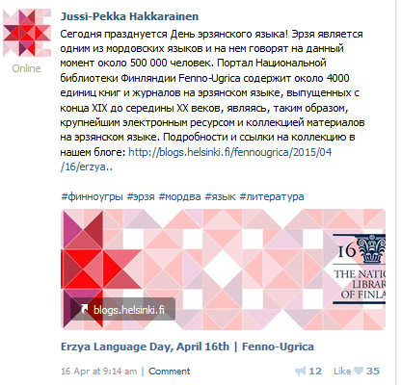
The Vkontakte Effect

Slide 20
Some Conclusions
Involvement of the researchers did build up our reputation, but only among the academia.
The great audience was reached with the help of social media. One cannot underestimate its power. We benefitted on this in several ways.
More active and returning users, more audience and more opportunities to find suitable user-groups etc.
Increased co-operation with Russian institutions (when speaking Russian)
Makes our work open and understandable for the great audience.

Slide 21
Contact Details
jussi-pekka.hakkarainen@helsinki.fi
@hakkarainen
fennougrica.kansalliskirjasto.fi
blogs.helsinki.fi/fennougrica

