Slide 1
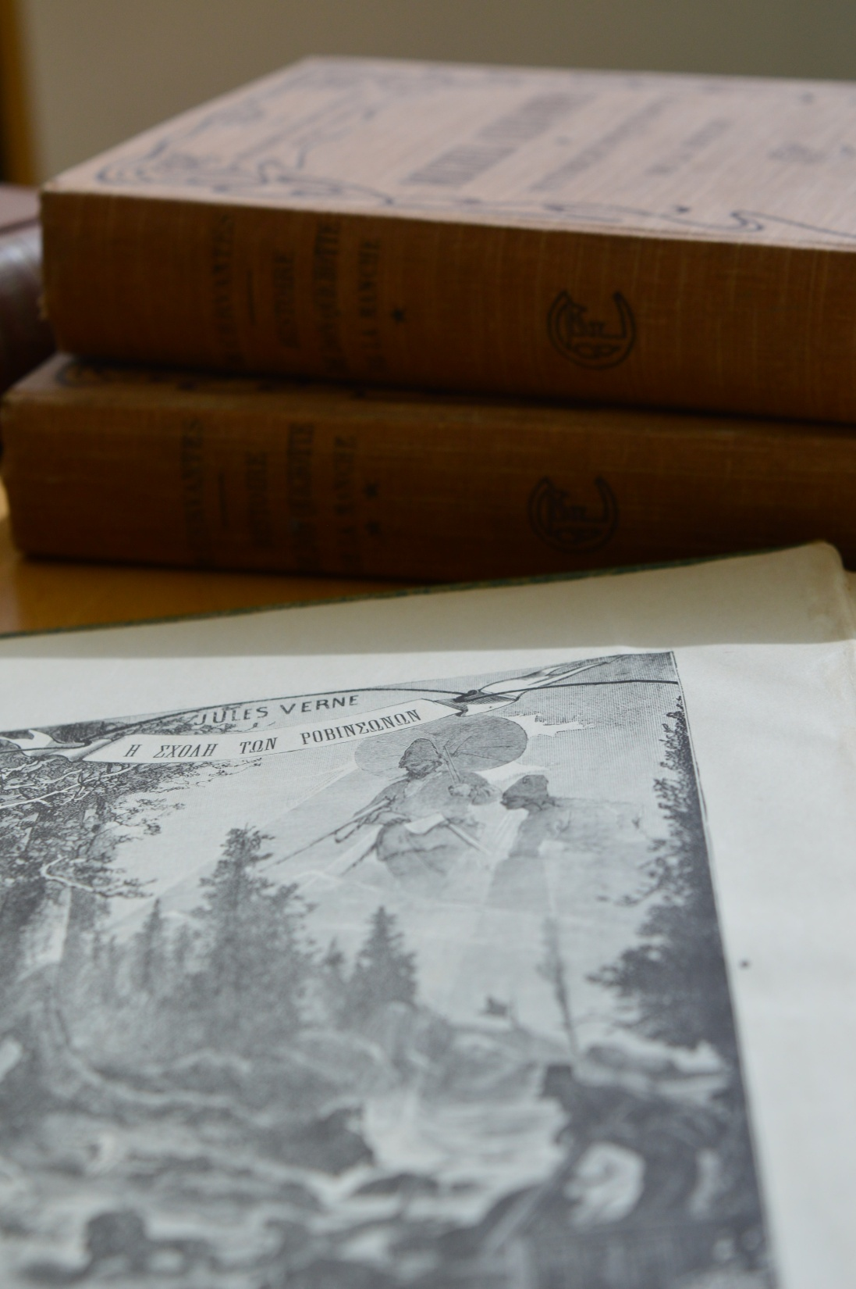
University of Patras digitization projects
filling gaps
in humanities research

Slide 2
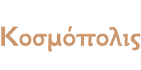
Digital collections
Kosmopolis (19th century)
Pleias (19th-20th century)
Daniilis (regional interest)
Latest addition
Diogeneia (general archival interest)
Details at http://www.lis.upatras.gr/en/digitalcollections-en/

Slide 3
Who, How and Key features
Open Access
Collaboration within and outside the UPAT
Department of Philology
Hellenic Literary and Historical Archive (E.L.I.A.)
Municipal Library of Patras
Library of the Parliament
Partially funded by project TELEPHAESSA
Technically provided on OJS (Open Journal System)

Slide 4
Whom It May Concern
Philologists
Historians and Historians of the Press
Academics
Everyday users

Slide 5
Some steps forward
Make good use of relative curricula
i.e. through internship or theses
Adding new features, such as authorities for bibliographic description (lifting some language barriers)
Some technical and content problems still exist, but Openness manages to exceed them all!

Slide 6
Thank you for your attention
Despoina Gkogkou
gkogkou@upatras.gr

