Slide 1
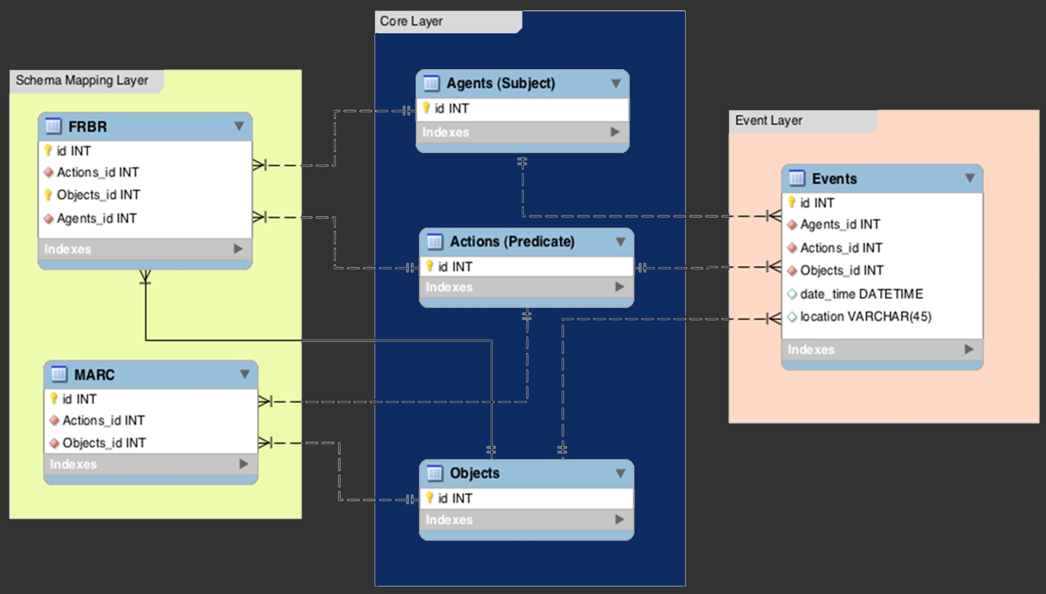
ESTC21: Linked Data and Researcher Editing
Brian Geiger, CBSR
Bryan Tarpley, ARC
Notes:
I’m Director of the ESTC/North America, and Bryan is with the Advanced Research Consortium at Texas A&M. 2 parts to talk. First I’ll talk about vision and rational for the ESTC21 project. 2nd Bryan will talk about the technical details of project, particularly challenges we’ve face, and demo the software. 3rd member of the software dev team, who couldn’t be here tonight, is Adeel Malik, an independent software developer based in Pakistan.

Slide 2
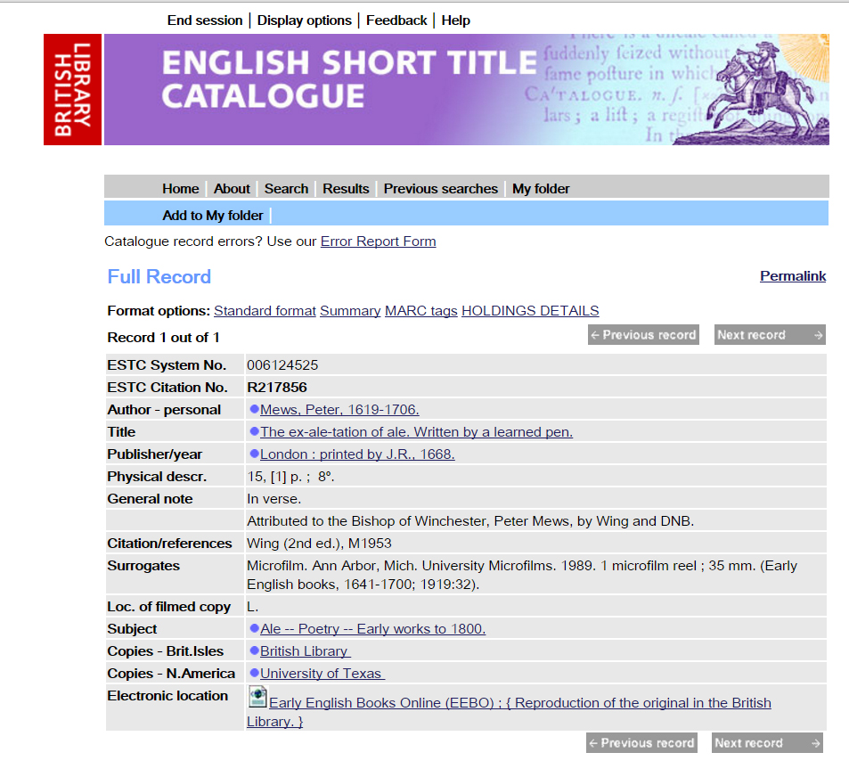
Notes:
ESTC is a bibliography and union catalog of pre-1800 English imprints. Technically, scope is any handpress item printed in England or its former colonies, or in the English language anywhere else, before 1801. Currently contains close to half million records, millions of holdings, and over 50,000 links to digitized copies and growing rapidly.
Project started in late 1970s as Eighteenth-century STC. In late 1980s expanded to include pre-1700 imprints. Co-managed by the CBSR and BL. Since 2006 hosted by the BL in Aleph.

Slide 3
Placeholder Record
Notes:
I joined the ESTC in 2007 and quickly realized number of challenges and opportunities. 1st, “legacy data”.

Slide 4
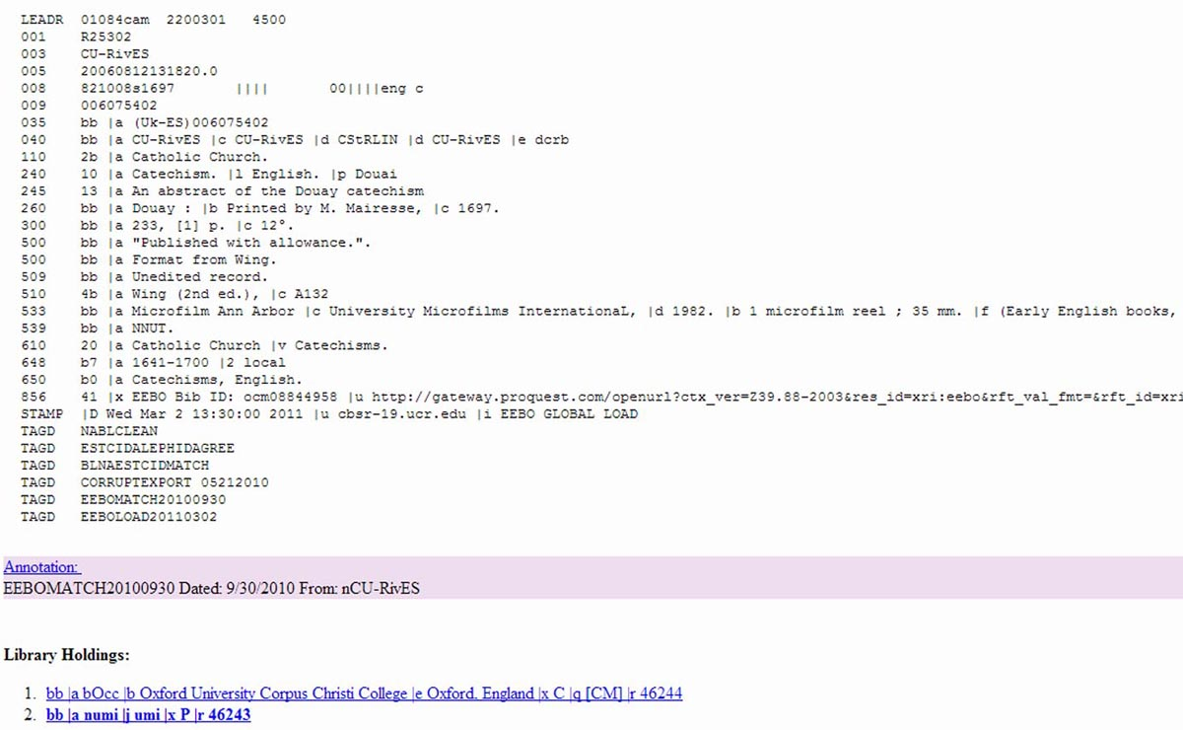
Unedited Record
Notes:
ESTC remarkably rich and accurate resource, but a lot of works remains to be done. At same time, “user curation” become common in other projects, researchers now want to edit and comment on ESTC data.

Slide 5
ESTC Continues to Grow
Notes:
2nd challenge vast area of data we’ve accumulated over the last roughly 2 decades. Since early 2000s CBSR has been collecting records “extracts” from contributing institutions and projects. At the same time, our staff to match or catalog those records has diminished substantially. ESTC users can and will help with that matching.

Slide 6
Development Timeline
2019: Prototype at Scale
2013: Implementation Grant
2017: ARC’s Involvement
2011: Planning Grant
2015: Grant Finished
Post-Grant Project Development
Notes:
2011 awarded “Planning Grant” from Mellon Fnd. From 2013-15 we had an implementation grant. The lead developer on those awards was Carl Stahmer at UC Davis. By 2016 it was clear that we needed more powerful hardware to run the software and a more stable home for it, so we approached ARC about continuing development together

Slide 7
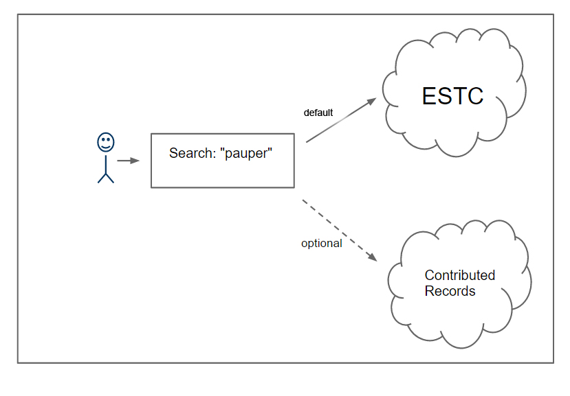
Searching ESTC21
Notes:
Bryan will demo current iteration of the software. I’d like, in non-technical and simple terms, summarize its functionality. First, most fundamental to the ESTC21 is that researchers are searching both ESTC records and records from contributing institutions. When the CBSR receives records from institutions or projects we programmatically match them to the ESTC. The result will be one of 3 outcomes: a record will match an ESTC record and get added as a holding, it will match more than one ESTC record, or it will match nothing and possibly be new to the catalog. The last 2 types, multi-matches and possibly new, get added to the ESTC21 where they can be searched by users.

Slide 8
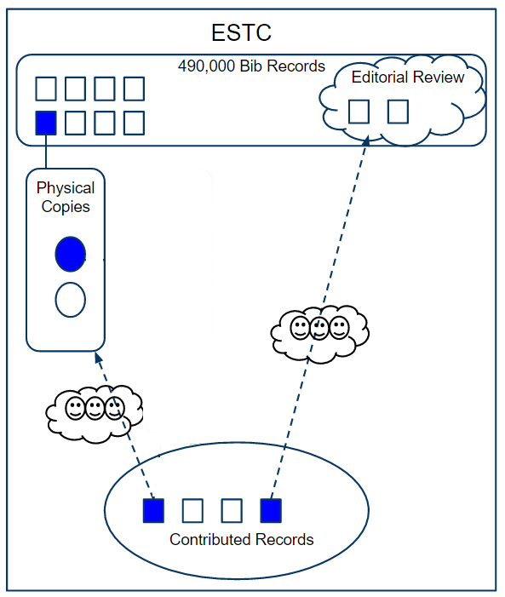
Record Curation
Notes:
If a researcher selects a contributed record, they can “curate” it in 3 different ways. They can say it’s either 1 a copy of an existing ESTC record, 2 new to the catalog, 3 (not shown here) it’s out of scope. If it’s a new holding, the recommendation just needs confirmation by other researchers to become part of the record. If it’s a new item, the recommendation gets further review by ESTC catalogers (editorial board).

Slide 9
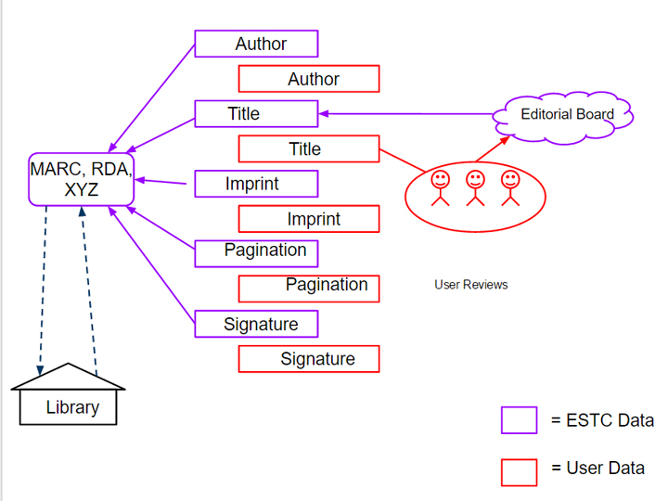
Data Curation
Notes:
2nd functionality is the ability for researchers to edit and comment on existing ESTC data. Edits to MARC fields like “Title” require both confirmation by other researchers and editorial review. Edits to 856 fields, or urls, might only need confirmation by other researchers. Point is that the software harness efforts of researchers to continually improve and enrich the ESTC, and thus our understanding of em printing.

Slide 10
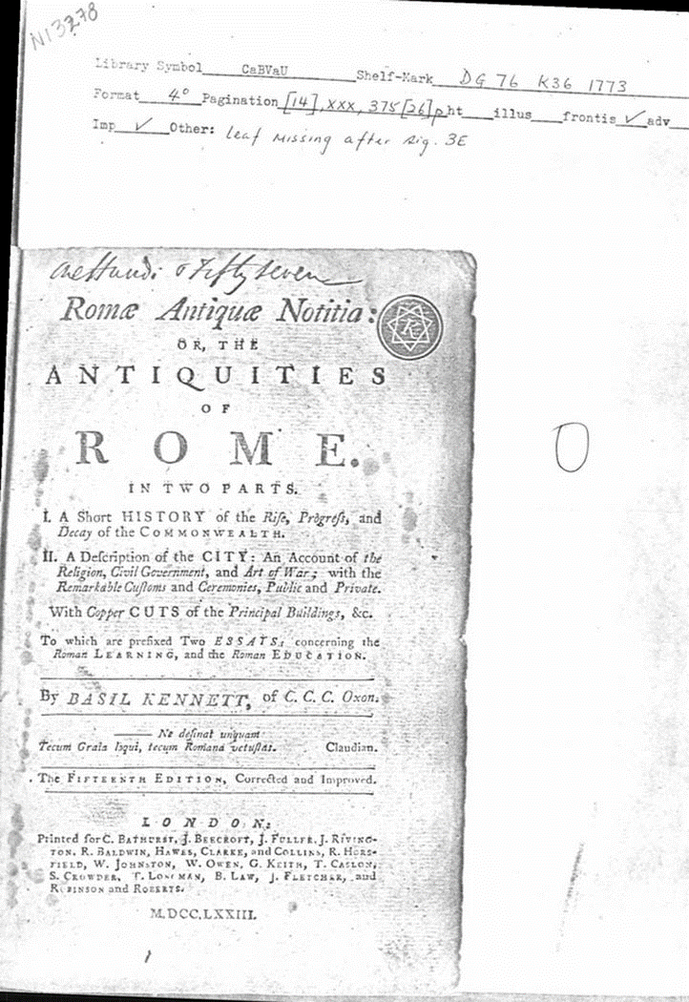
Report from
University of British Columbia
Notes:
Final point, goes back to legacy data in the ESTC. We have hundreds of thousands of scanned paper reports, and more recently digital title page images, that are currently inaccessible to researchers. ESTC21 will link those images to their appropriate records, and eventually hopefully holdings, so that researchers can investigate more closely the history of a record’s creation.

Slide 11
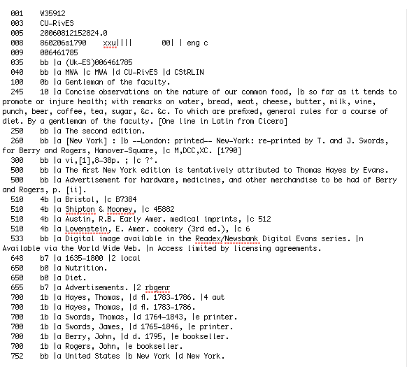
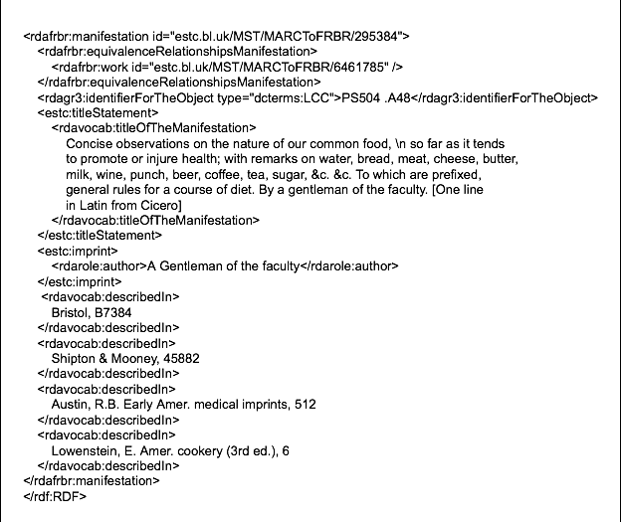
ESTC as Linked Data
Notes:
Very early on decided to model ESTC21 around linked data. In 2017 we had a vendor review the software and they recommended that we pursue the proposed functionality within MARC. But we’ve stuck with linked data. So why?

Slide 12
FRBRizing ESTC Data
N504302
100 1b |a Strype, John, |d 1643-1737.
245 10 |a Annals of the reformation and establishment of religion, |b in the Church of England. Containing accounts of the government and inspection of the bishops in their respective diocesses; as matters, requiring their care, fell out each year: ecclesiastical commissions. The busy actings of Papists and Puritans: The difficulties and dangers the state as well as the church met with from time to time: occasioned chiefly from the endeavours to overthrow both, by the power and practices of such as favoured Mary, Queen of Scots: of whom many special transactions; and chiefly of her sentence and death; and the consequences thereof, are shewn: and the Spanish invasion in 1588. Both serving to enlighten those two great crises of Queen Elizabeth's reign. Together with divers other political affairs of note interspersed. This history is also improved by notices given concerning the state and events of the Church of Ireland; occurrences and differences that fell out in our universities… by John Strype, M.A. Vol. III.
260 bb |a London : |b printed for Edward Symon, in Cornhill, |c MDCCXXVIII. [1728]
300 bb |a v.3 ([40], 624; 274 p.) ; |c 2°.
500 bb |a Title page printed in red and black.
500 bb |a 'An appendix of original papers of state, ..' has separate pagination and register.
500 bb |a Signatures: [pi]2 a-h2 B-4k4; A-2L4 2M2(-M2).
648 b7 |a 1701-1800 |2 local
651 b0 |a Great Britain |x Church history |y 16th century |v Sources.
655 b7 |a Annals. |2 rbgenr
752 bb |a Great Britain |b England |d London.
856 41 |u http://www.mdz-nbn-resolving.de/urn/resolver.pl?urn=urn:nbn:de:bvb:12-bsb10328922-7 |y Bayerische Staatsbibliothek
856 41 |u http://books.google.com/books?vid=Ac9DAAAAcAAJ |y Google Books |z Source Library: eMUbsb
Library Holdings:
bb |a bLmh |b Congregational Library |e London, England (County Greater London ), United Kingdom. |j 167.4.6 |x P |r 3694617
bb |a eMUbsb |b Bayerische Staatsbibliothek |e Munich, Germany |x V |r 3864561
Notes:
1st, I think it allows us to FRBRize the project, in particular focusing on Work, Manifestation, and Item, and to make richer statements about and attributions to Items (i.e. Holdings in MARC).

Slide 13
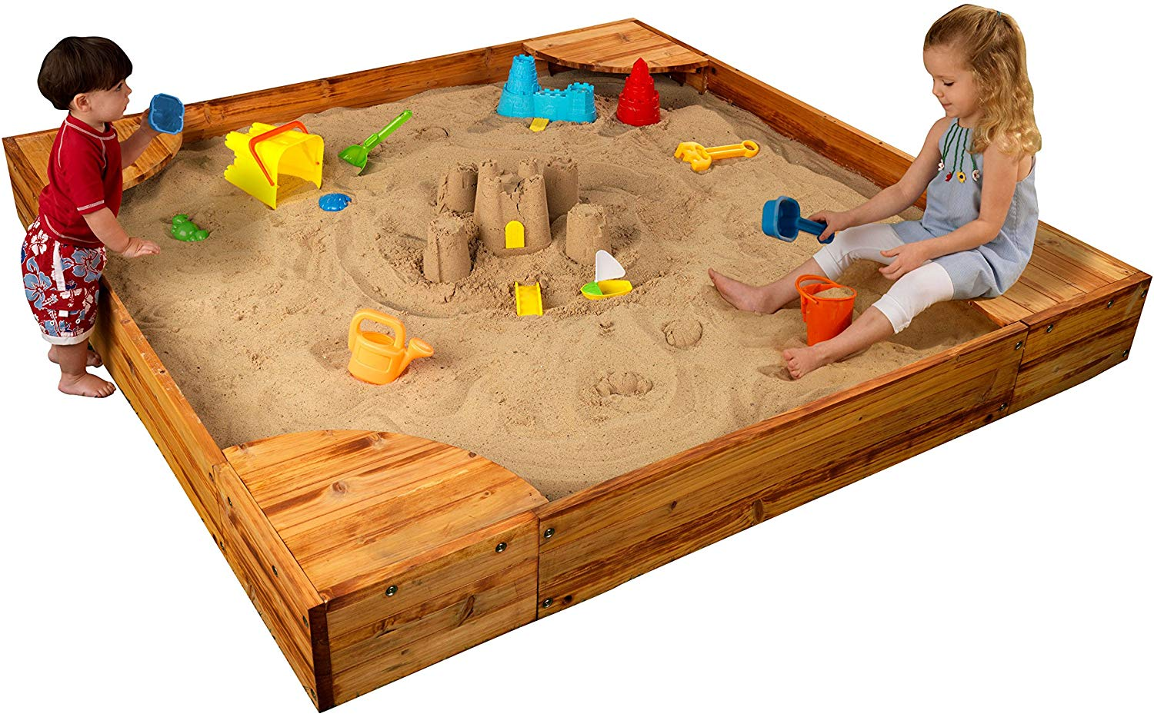
ESTC21 as a Sandbox
Notes:
Second, eventually linked data will enable other projects to connect to ESTC data in ways that best suit their needs and enable the ESTC to connect to and incorporate data from other systems. In the short to medium term, however, choosing to implement linked data likely means, as one developer said, that the ESTC21 remains a sandbox rather than anything approaching enterprise-level software. With that in mind, I’ll let Bryan talk about some of the things we’ve learned during our time in the sandbox.

Slide 14
Facing ESTC21 Technical Challenges
Dr. Bryan Tarpley
bptarpley@tamu.edu
Lead Software Applications Developer
Center of Digital Humanities Research
Texas A&M University
http://codhr.dh.tamu.edu
Associate Director of Technology
Advanced Research Consortium
http://ar-c.org
Notes:
Thanks, Brian! My name also happens to be Bryan, and I appreciate the opportunity to present to you today the various challenges we faced in producing a prototype for the ESTC21 project.

Slide 15
Challenge #1: Containerization
Docker Compose Stack
Collex
Database
Catalog
Index
Notes:
My first real technical challenge was finding a way to install the various components of ESTC21 on one of our ARC servers without interfering with our existing services. I accomplished this by breaking each of those components out into their own separate Docker containers, and enabled communication between them by creating a Docker Compose stack.
I will now talk about each of the 4 containers briefly. The “Index” container runs Apache Solr, which is built on the Lucene search engine. It’s job is to take all the metadata from each bibliographic record and store it in such a way that enables efficient full-text searching and faceted browsing.
The ”Catalog” container is a Ruby-on-Rails application that allows administrators to manage various archives of bibliographic records. Once an archive is created in the Catalog, it also provides various tasks we can run on that archive, such as the indexing of new RDF metadata. Aside from providing us a way to manage archives, it also acts as a REST API, providing a kind of gateway between the Solr index and Collex, such that Collex can request queries of data from the Catalog, and the Catalog then returns those query results in the form of either XML or JSON.
The “Collex” container is also a Ruby-on-Rails application. It provides the web-based front-end for ESTC21, allowing users to search, browse, and meaningfully interact with the data indexed by Solr and managed by the Catalog. Collex also provides a way for researchers to create an account for themselves. When logged in with an account, users can save searches, and also collect and tag individual bibliographic records.
While Collex has been around for some time, and is most prominently used by the various scholarly communities that comprise ARC, such as 18thConnect and NINES, the version of Collex used by the ESTC21 project has been custom tailored to also support the crowd-sourced correction and enhancement of bibliographic data, which is functionality I’ll be demonstrating shortly.
Finally, the Database container, which runs MySQL, stores user account information and information about each archive.

Slide 16
Challenge #1: Containerization
Public Cloud
Public TAMU
Private TAMU
Full root access for Adeel
HTTPS port exposed
No outside access
2GB RAM, 2 CPU Cores
32GB RAM, 8 CPU Cores
64GB RAM, 32 CPU Cores
200,000 Records Indexed
1 Million Records Indexed
4 Million Records Indexed
Notes:
By containerizing the project in this way, I was able to quickly deploy the entire stack onto 3 different environments. That dashed vertical line represents the Texas A&M University firewall, and for security reasons, the university typically doesn’t grant access to private contractors like Adeel who are being paid by someone outside the university. As such, the ARC office provisioned a small virtual machine in the cloud for Adeel to use for development purposes, with the advantage being that we could grant him full root access to the server. After developing on that machine, Adeel commits his code changes to our repository and I deploy them to that second environment, which has significantly greater horsepower.
When we initially attempted to index all of ESTC21’s data, which consisted of about 4 million RDF XML files, we maxed out even that server’s hardware capacity, and so we eventually deployed to a 3rd environment with even more capacity in order to get the job done.

Slide 17
Challenge #2: Wrangling Big Data
Marc -> RDF Conversion
Conversion Script
MARC Records
Notes:
All of the other obstacles we’ve faced so far have stemmed from the scale of the data involved. Since Collex was originally designed to ingest data in RDF format, and since RDF provides support for linked-open-data (LOD), we needed to convert the ESTC’s MARC records to RDF, while keeping track of unique persons, subjects, publishers, etc. for the purpose of creating RDF triples. Believe it or not, the conversion process took something like 3-4 months to run through and convert all the data.

Slide 18
Challenge #2: Wrangling Big Data
Notes:
After the conversion process, we were left with over 4,200,000 individual XML files, all stored in a single directory. We soon discovered that one of the limitations with the Linux operating system is the number of files you can have in a directory while still being able to meaningfully interact with those files. Just performing a list command to print out the names of each of those files to a terminal window takes something like 6-7 minutes.
When attempting to index all of those files with our RDF indexer, we discovered that it was listing all of the files after reading each one. Had we allowed the indexer to run that way, I estimate it would have completed the task in roughly 55 years. So we retooled the indexer code such that it only has to list all of the files one time ☺. After that and several other adjustments, we can now index all 4 million files in 10-12 hours.

Slide 19
Challenge #2: Wrangling Big Data
Total RAM Usage: ~25GB
Collex
Catalog
Database
Index
2GB
17GB
< 1GB
5GB
Notes:
After converting and indexing all 4 million+ records, we could finally start evaluating the efficiency of the current architecture for handling data at scale. In its current form, we found that certain queries of the data caused RAM usage on the server to skyrocket—particularly within the Catalog container. We suspect the reason behind this has to do with the way the Catalog attempts to cache certain queries, and are currently investigating ways to break those types of queries into much smaller, more manageable sets of results.
Suffice it to say, the current architecture of the project is not quite production ready, for while the server it’s running on can handle that kind of RAM usage, there’s no way it would hold up under the load of multiple users running the same kind of RAM intensive queries.

Slide 20
Future Directions
Continue to investigate how to speed up query performance for the current architecture, and produce a production ready version of the ESTC21 project.
Explore other architectures, i.e. incorporating document based databases for keeping track of annotations, other indexers like Elasticsearch which more readily scale, and graph databases like Neo4J or Blazegraph for the purpose of querying linked-open-data
Perform named-entity-recognition and coreference resolution on our unique set of persons, subjects, etc. for the purpose of linking up to existing URI’s in knowledge graphs like VIAFF and Wikidata.
Mint URI’s for entities not existing in knowledge graphs.

Slide 21
Demo

Slide 22
Questions?
Brian Geiger
brian.geiger@ucr.edu
Bryan Tarpley
bptarpley@tamu.edu

