Slide 1
Moving to the Remote Store
Michael Williams & Robin James, Cambridge University Libraries
Toby Kirtley, Bodleian Libraries
Notes:
Introductions
Explain my current and previous roles
2009-2012 ICP
2012-2019 S&L
2019- Head of CDM

Slide 2
Moving to the Remote Store
Oxford & Cambridge remote stores
Barcoding workflows
Problems & challenges
Trays & shelving plans
Equipment procurement
Processing, moves and preservation
Notes:
I’m going to introduce the topics related to preparing collections for transfer to the remote store and the work to prepare the store to receive these collections.
Introduce the remote stores at both Oxford and Cambridge

Slide 3


Bodleian Libraries
Book Storage Facility
(BSF)
Cambridge University Library Storage Facility (LSF)
246km (153 miles) shelving
Capacity ~13M items
£26M construction cost
Opened October 2010
47km (30 miles) from Oxford
106km (65 miles) shelving
Capacity ~5.5M items
£17M construction cost
Opened June 2018
27km (17 miles) from Cambridge

Slide 4
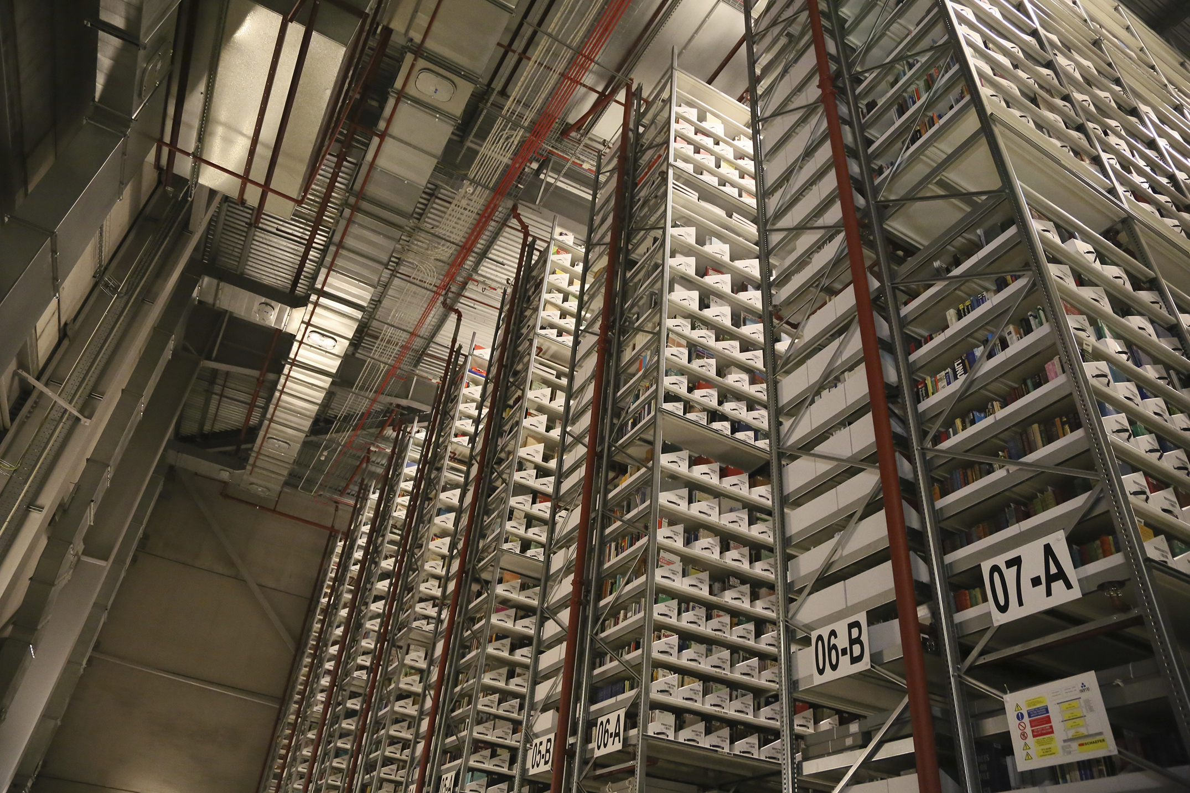
Notes:
Bodleian’s Book Storage Facility

Slide 5
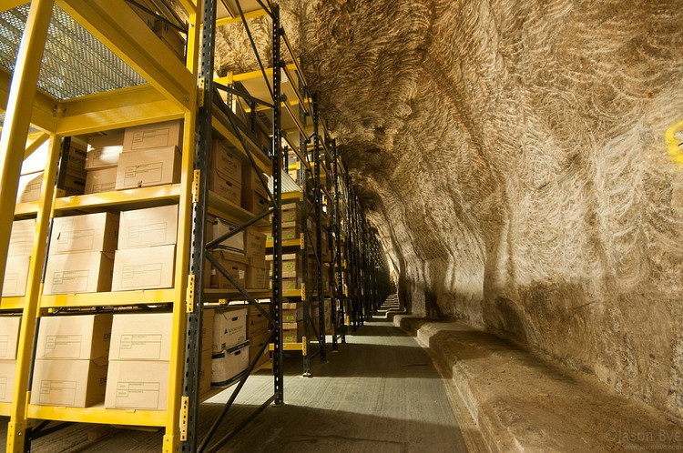
Notes:
Why build an off-site store? The answers are different for the two institutions.
Driven by financial considerations
Costing the Bodleian Libraries £??? Per year to store collections in salt mines in NW England

Slide 6
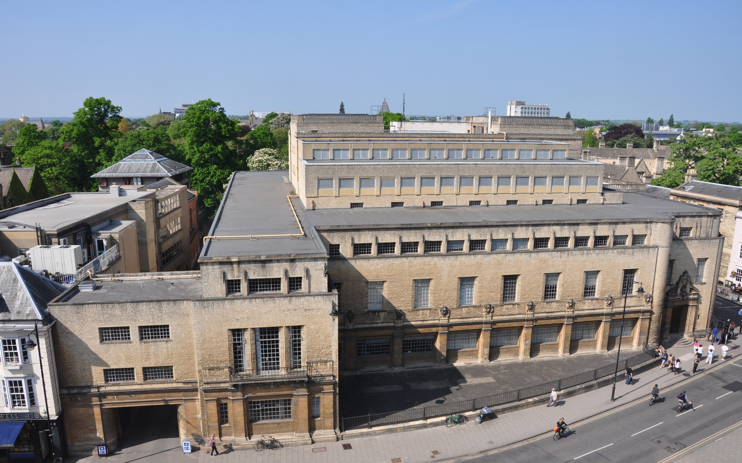
Notes:
Also driven by a major project to renovate the New Bodleian Library in the heart of Oxford

Slide 7
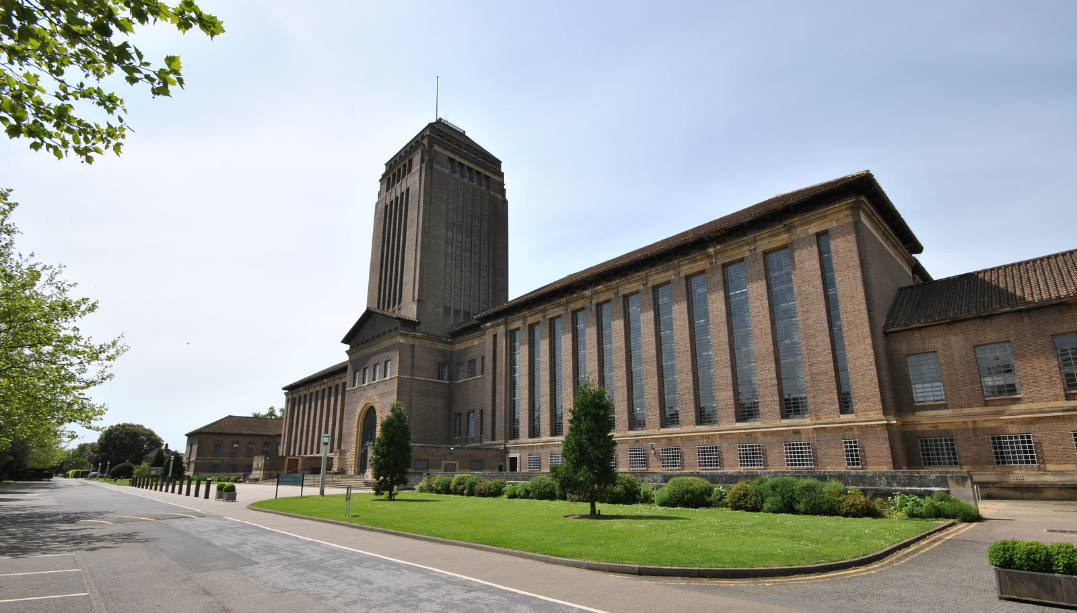
Notes:
In Cambridge almost all of the collections were still retained with the main UL building
Around 9M

Slide 8
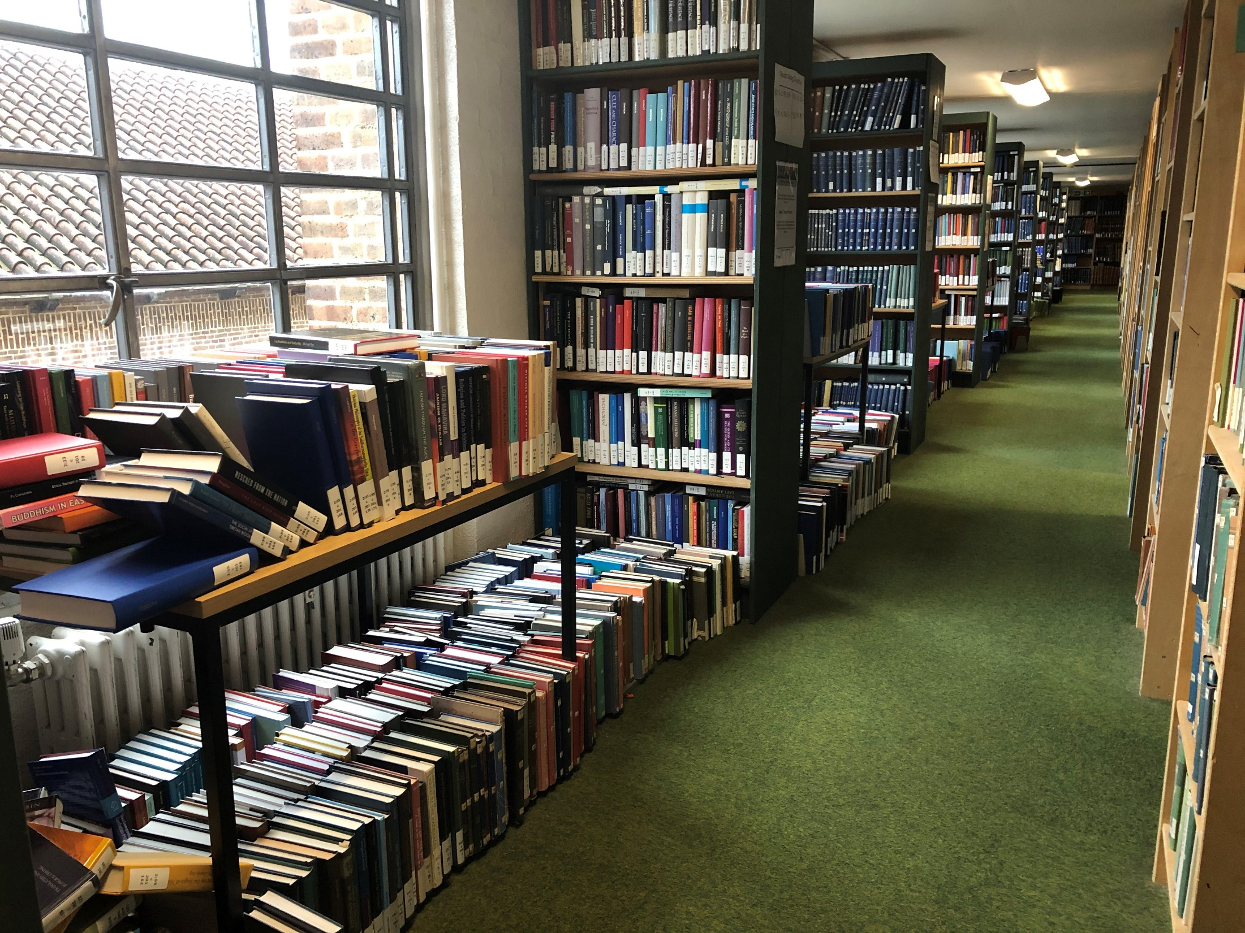
Notes:
Overcrowding was a major issue
Poor preservation
Loss of reader desks

Slide 9

Bodleian barcoding
6.5 million items
22 months
100 FTE staff
Transforming the Bodleian: Chapter 9 – Barcoding: the Inventory Control Project
https://doi.org/10.1515/9783110289398.109
Notes:
I’m going to briefly cover the barcoding of Bodleian collections. Robin will cover the details of barcoding operations in much more detail from his experience in Cambridge
<*>The Bodleian Inventory Control Project had 6.5M items within scope
<*>and just under two years to complete the implementation phase of the project.
Very large scale project of the scale that the Bodleian had never attempted before.
Planning had started around six months earlier with a trial in summer 2009
<*>100 staff involved ranging from agency staff doing the barcoding through to staff supervisors, cataloguers and project management team
<*>Full details of the project planning and implementation are detailed in chapter 9 of this book, Transforming the Bodleian. Copies can be downloaded free from the Bodleian’s institutional repository

Slide 10
Notes:
A lot of barcoding was done at the shelf then moved after data had been processed.
The barcoding project had a head start of 8 months before the warehouse opened so material could not be moved
Cambridge’s approach has been different and Robin will talk about that.

Slide 11
Bodleian barcoding
7 million items
~15,000 items per day
£3.6M = 51 pence per item
Notes:
<*>Ended up barcoding more items than we expected.
<*>15k items per day, sometimes barcoding 3km a day
<*>The cost to barcode and prepare the material for moving and then ingest into the warehouse was 51 pence per item

