Slide 1
My last five years in a nutshell (2016-2021)
by Laura Carnelos
l.carnelos@etoncollege.org.uk

Slide 2
Marie S. Curie Fellowship
(2016-18) From ephemeral to rare 16th-Century Italian Popular Books in the British and the Bodleian Libraries

Slide 3
EDIT16
9192
16th-century Italian books at the BL
ca. 900 UNIQUE COPIES!!!
UK0001 British Library - London

Slide 4
PATRIMONiT

Slide 5
Dissemination
‘From popular to rare. Acquisition and preservation policies at the British Museum Library in Panizzi’s time’, eBLJ, [forthcoming 2021].
[with Elisa Marazzi], ‘Children and Cheap Print from a Transnational Perspective (1500-1900)’, Quaerendo, Special issue 3-4, [forthcoming 2021].
‘Popular print under the press: strategies, practices and materials’, Quaerendo, Special issue 3-4, [forthcoming 2021].
‘Learning from Mistakes: Paper and Printing Defects in 16th-Century Italian Popular Books’, in Printing and Misprinting: Typographical Mistakes and Publishers’ Corrections (1450–1650), edited by Antony T. Grafton, Paolo Sachet, Geri Della Rocca de Candal, Oxford, Oxford University Press, [forthcoming 2021].
‘La catalogazione delle cinquecentine italiane in British Library: Passato e Presente’, in Il libro antico. Limiti e prospettive dei censimenti (14-15 novembre 2017), Bologna, [forthcoming 2021].
‘‘Rare and Curious Objects’. Politiche di acquisto e di conservazione di materiale italiano nella biblioteca del British Museum ai tempi di Panizzi’, La Bibliofilia, 3 (2019), pp. 501–519.
‘Svista o norma? La produzione di libri di larga diffusione nell’Italia della prima età moderna’, Paratesto, 16 (2019), pp. 135–141.
PATRIMONiT. Cinquecentine Italiane nella British Library: da libri popolari a oggetti da preservare, in Editoria popolare in Italia tra XVI e XVII secolo. Testi, collezioni, mestieri. Atti delle giornate di studio (Roma, 13-14 dicembre 2017), edited by Gabriele Bucchi, Paola Cosentino, Giuseppe Crimi, Manziana, Vecchiarelli, 2019, pp. 203–225.
‘Cheap Printing and Street Sellers in Early Modern Italy’, in David Atkinson and Steve Roud, Cheap Print and the People: Popular Literature in the European Perspective, Newcastle upon Tyne, Cambridge Scholars Publishing, 2019, pp. 324–353.
‘Sacre rappresentazioni in the British Library: the history of a collection’, Italian Studies Library Group, 2017, pp. 20–28.

Slide 6
Collections research assistant (2018-19)

Slide 7
Dissemination
Revise completely the cataloguing rules
and the catalogue

Slide 9
The online catalogue
Dissemination

Slide 10
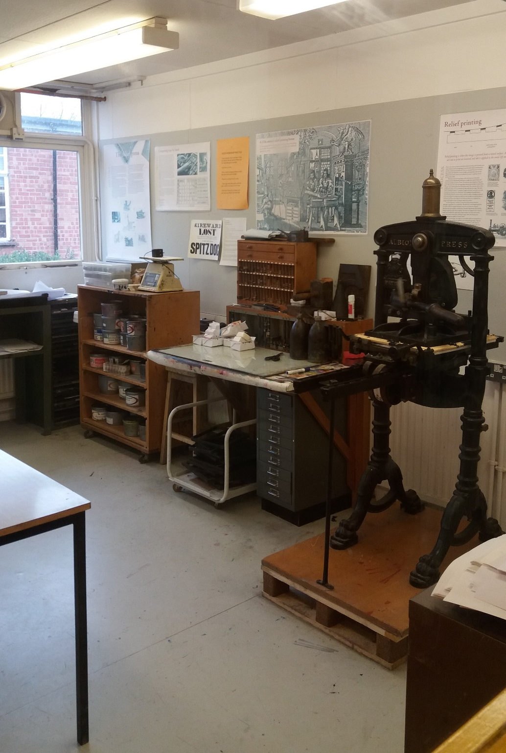
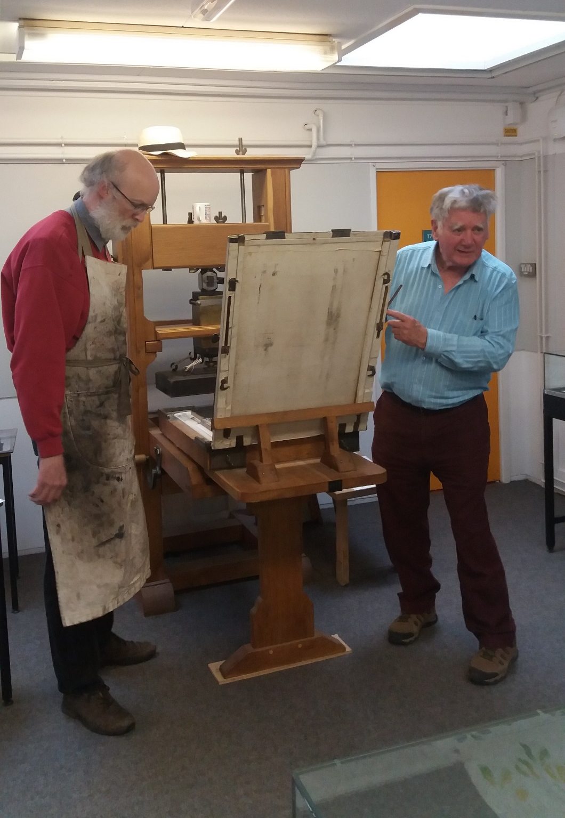

Slide 11
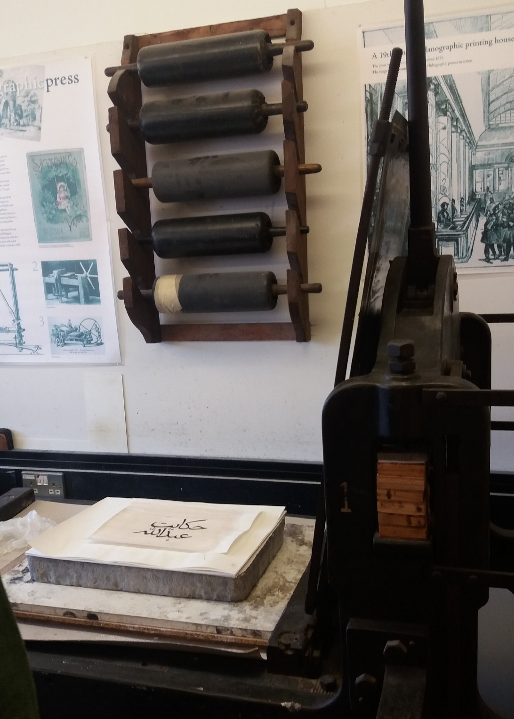
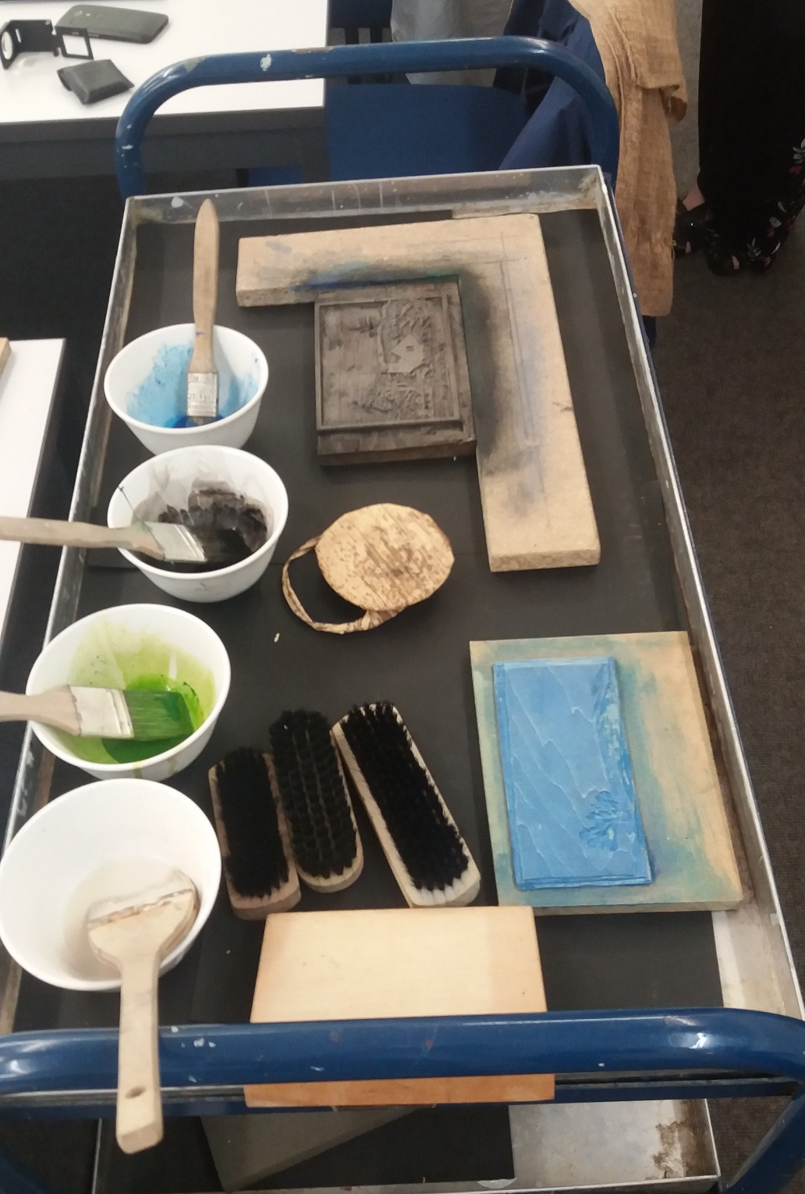

Slide 12
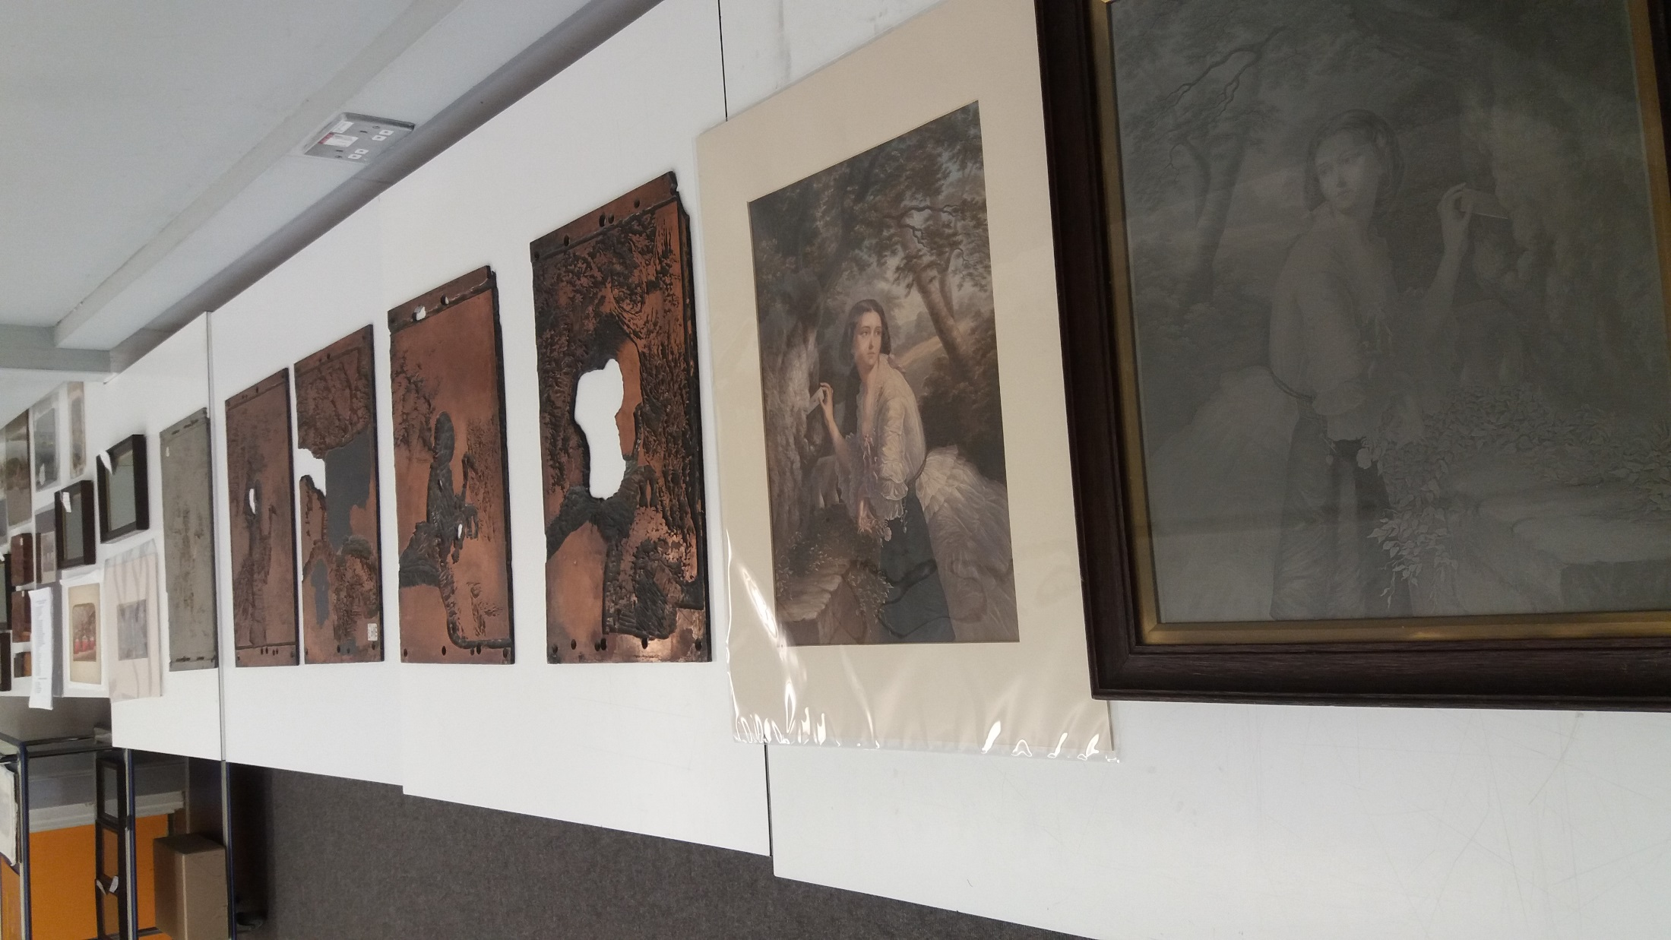

Slide 13
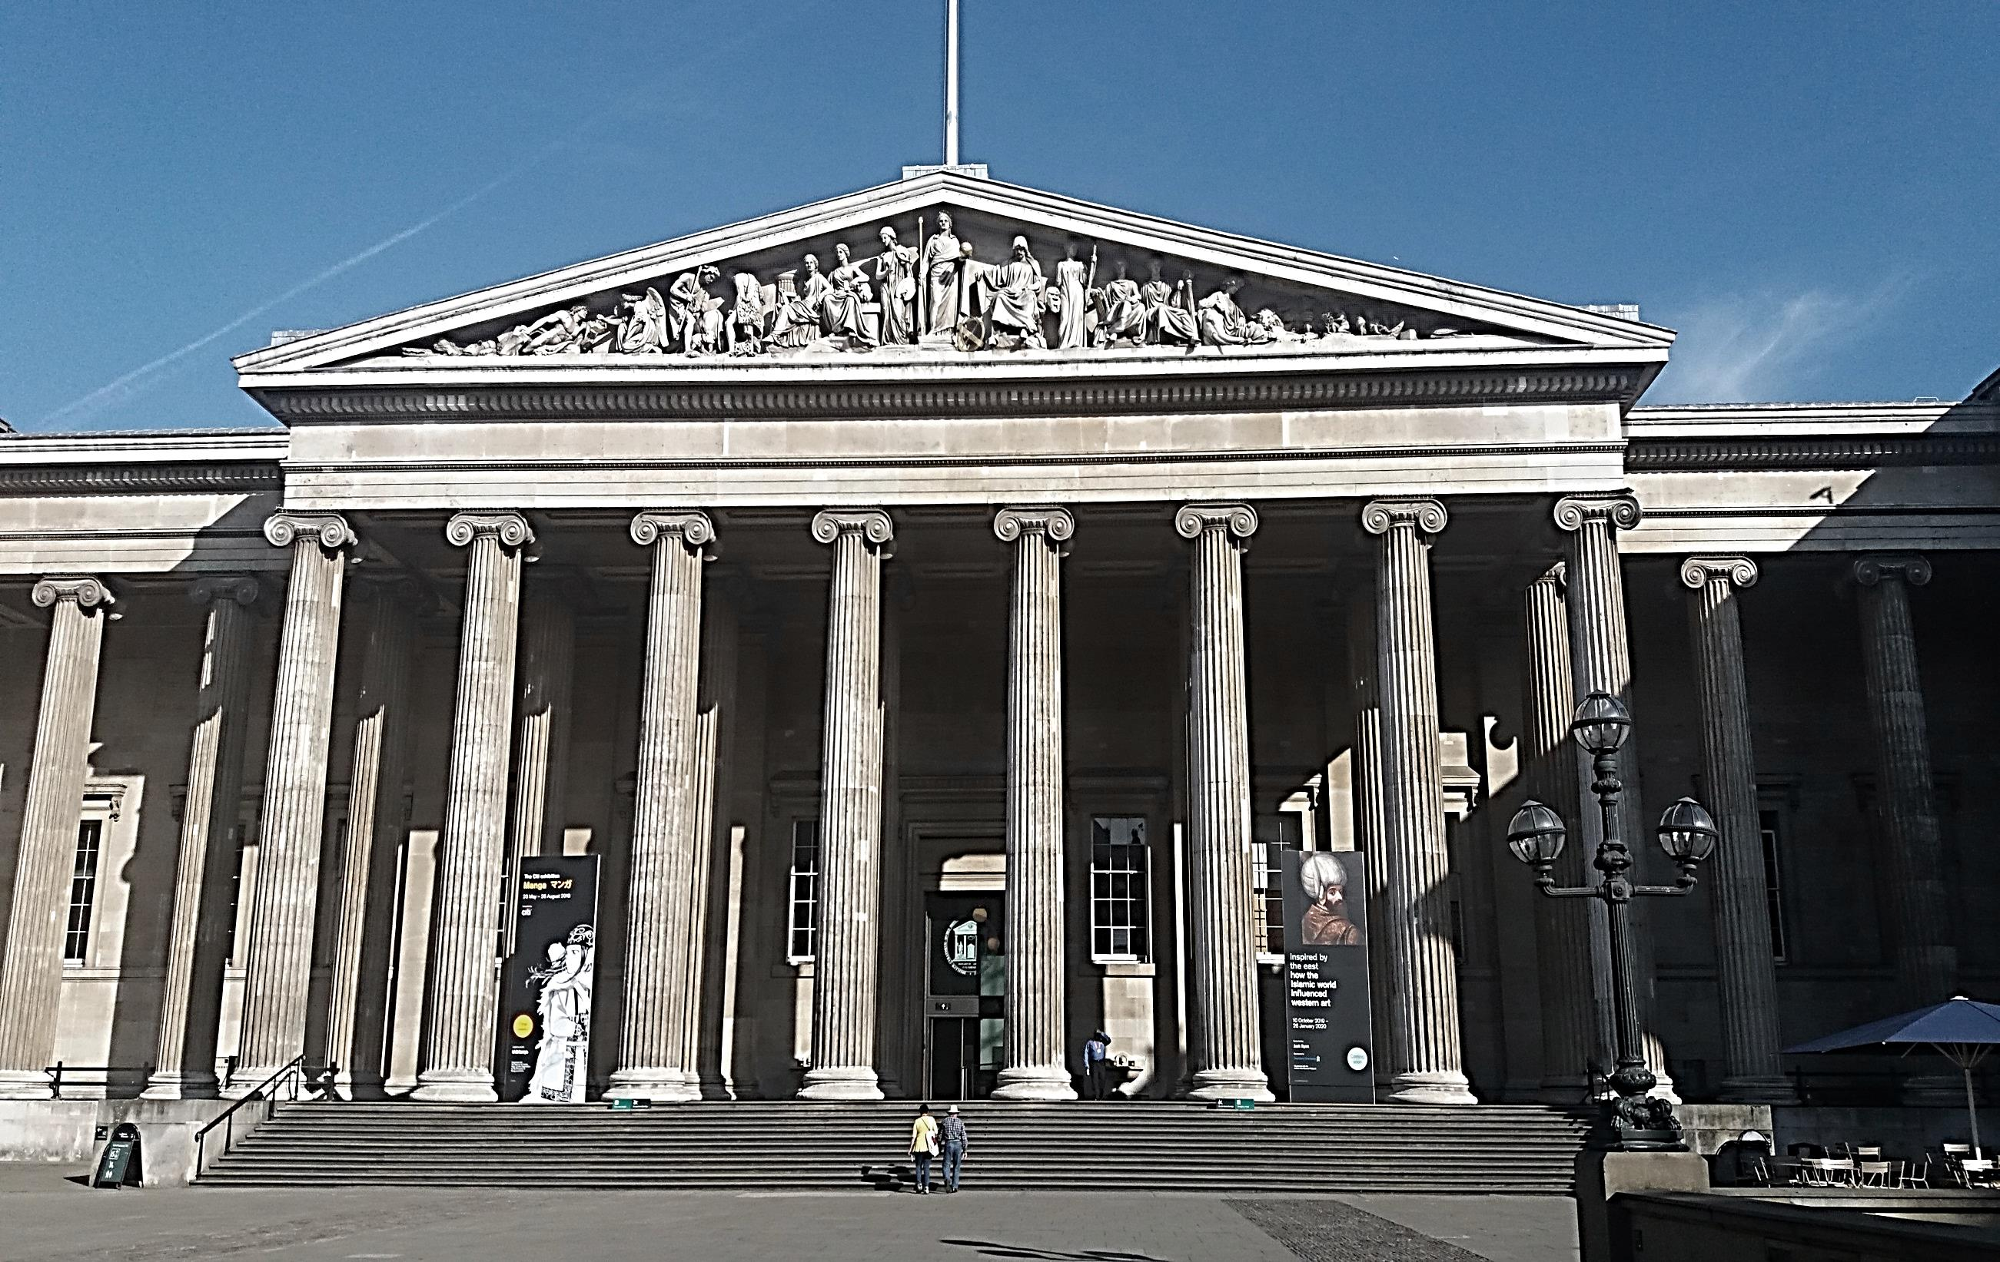
The British Museum
Project Librarian:
Science and Conservation Library
(2019-2020)

Slide 14
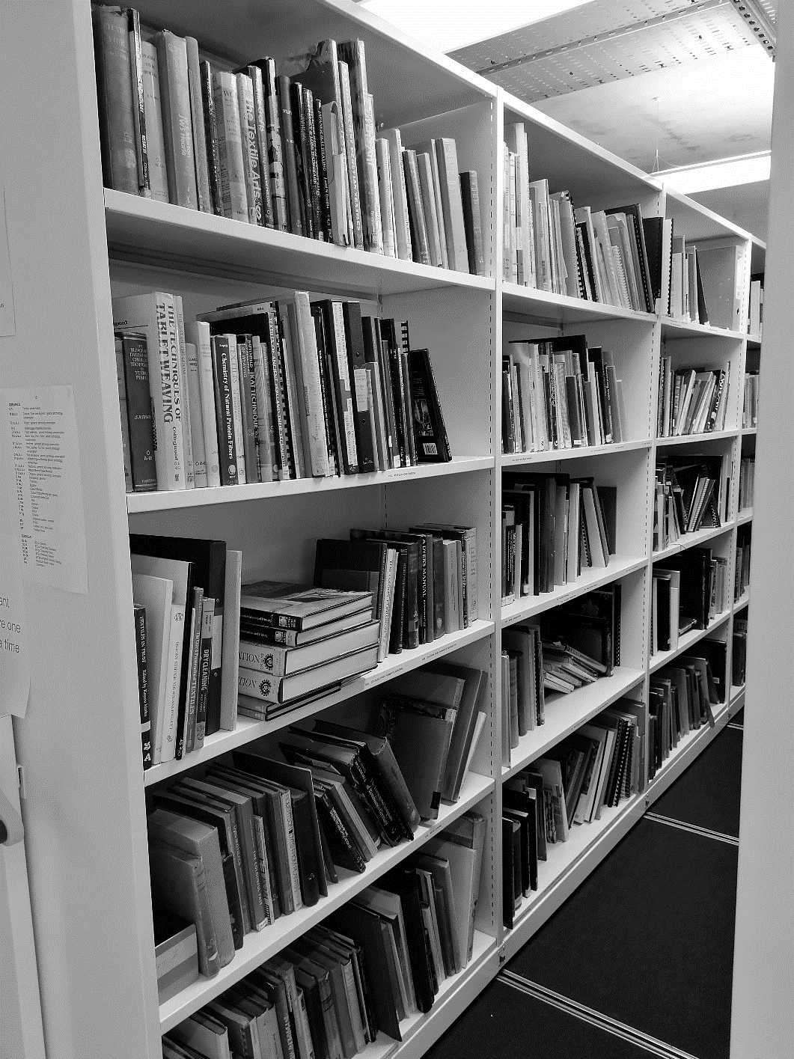
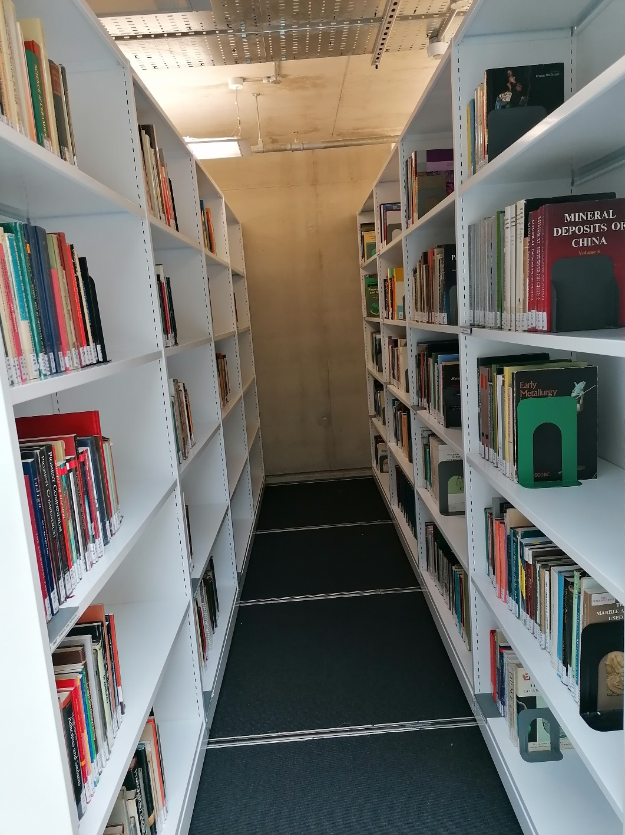
How it started
Now

Slide 15
New Structure
AM – Museology (methods, techniques)
B – Philosophy, Psychology
C – Auxiliary Sciences of History
CC70 Archaeology (methodology)
CC130 Archaeology (conservation/restoration)
CD Diplomatics, Archives, Seals
CJ Numismatics, Coins, Medals
D – World History
DA Great Britain
DS Asia
E/F – History: Americas
E USA
F Canada, Central America, South America, Caribbean
G – Geography, Anthropology
GN Anthropology, Excavations
GR Folklore
GT Manners, Customs
H – Social Sciences
KD – Law: United Kingdom, Ireland
M – Music
N – Fine Arts
N7000 Eastern Art
N8500 Art objects (Conservation/restoration)
N8700 Fakes, Forgeries
NA Architecture
NB Sculpture
NC Illustration, Design, Drawing
ND1000 Painting techniques, styles, materials
ND1600 Paintings (conservation/restoration)
ND2500 Wall Paintings
NE Prints, Printmaking
NK Decorative Arts
NK3700 Ceramics, Pottery (conservation/restoration)
NK5000 Glass
NK6400 Metalwork (conservation)
NK8000 Textiles
NK9500 Woodwork
P – Language and Literature
Q – Science
QC Physics
QD Chemistry
QE Geology
QH Natural History, Biology
QK Botany
QL Zoology
QP Physiology
R – Medicine
S – Agriculture
SB Plant Culture
SD Forestry
SF Animal Culture
T – Technology
T Hazards
TA400 Metals and metal corrosion
TH Buildings, Stones (conservation)
TN Mining, Metallurgy
TP800 Ceramic Science
TP900 Pigments, Inks, Adhesives
TR Photography
TS Manufactures, Leather, Papermaking
TT Arts & Crafts, Handicrafts
U – Military Science
V – Naval Science
Z – Books, Writing, Libraries (preservation, conservation, restoration)

Slide 16
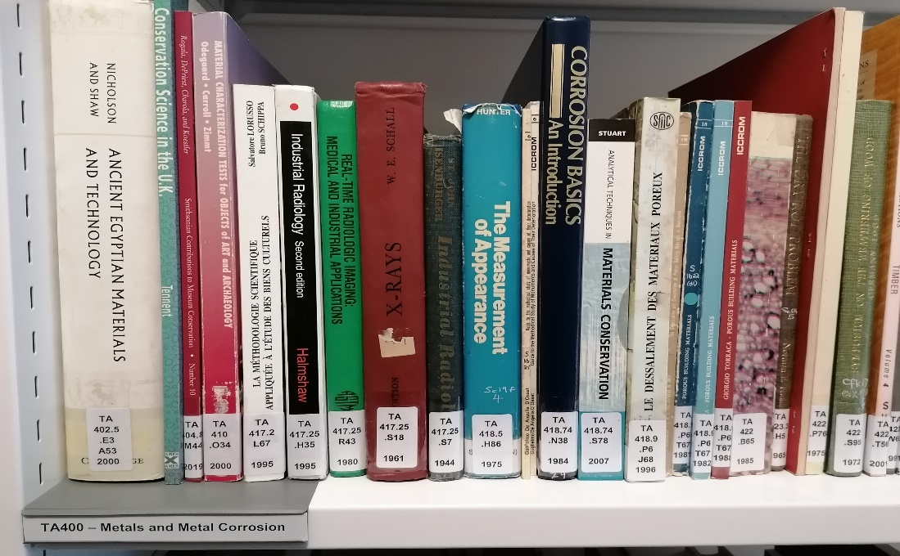
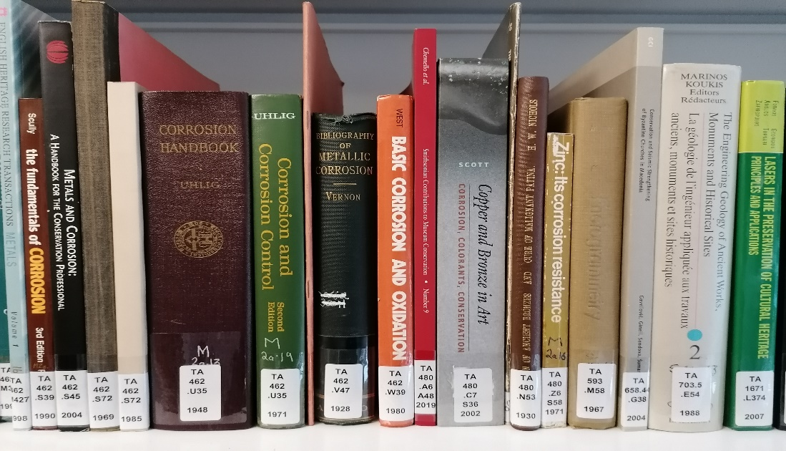
Signs/Sections

Slide 17
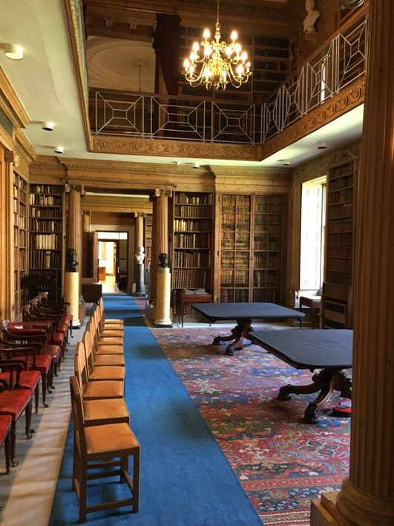
Library Curator of Rare Books and Manuscripts
(2021-)
Eton College Library

