Slide 1
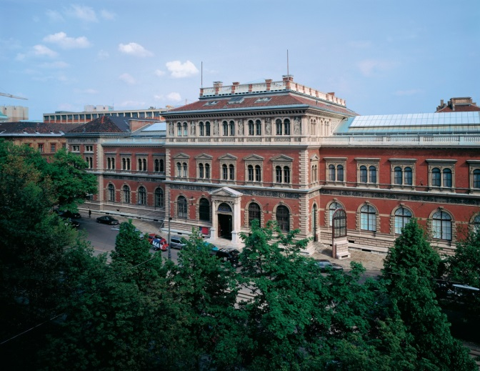

UNDERSTANDING THE FUTURE MEANS KNOWING THE PAST.
RARE BOOKS FOR PUBLIC ACCESS AT THE MAK VIENNA
Kathrin Pokorny-Nagel
Head of the MAK Library and Works on Paper Collection
26th of October 2017

Slide 2
2 PARTS OF PRESENTATION
History of the MAK collection of “Rare Books”
Publicity and expansion of the collection of “Rare Books”

Slide 3
THE FOUNDING OF THE COLLECTION
Gottfried Semper:
  synthesis between art, industry, science
Rudolf Eitelberger:
  Library as a “museion”

Slide 4
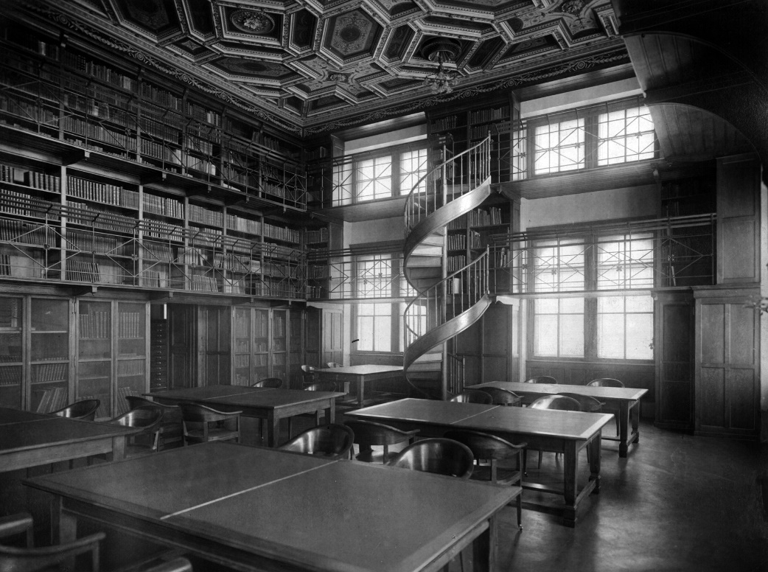
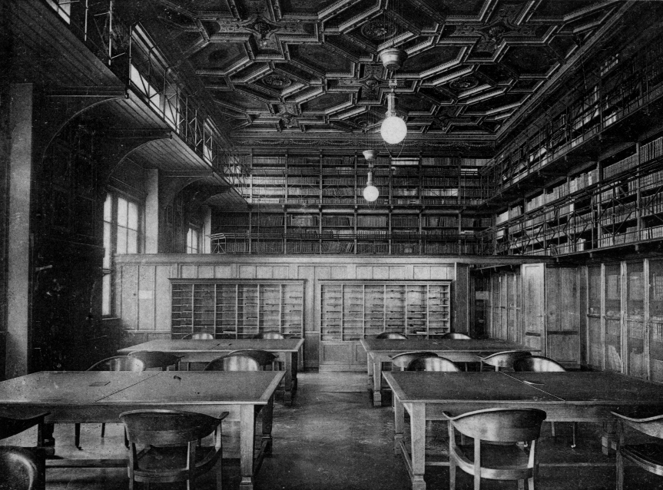
MAK LIBRARY AND WORKS ON PAPER COLLECTION AT THE 19th CENTURY

Slide 5
COLLECTIONS OF RARE BOOKS
Baroque Library
  15th to 18th century
Artist´s Books
  19th century until today

Slide 6
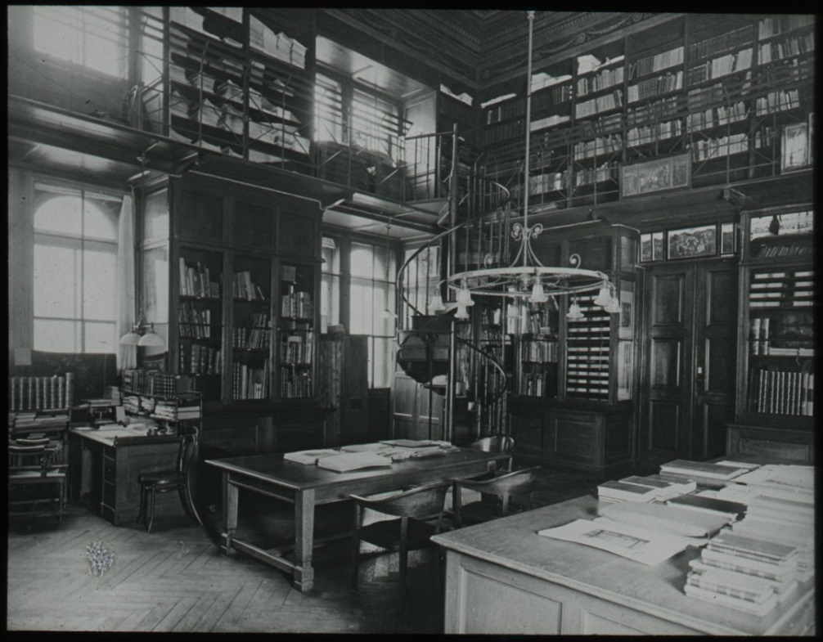
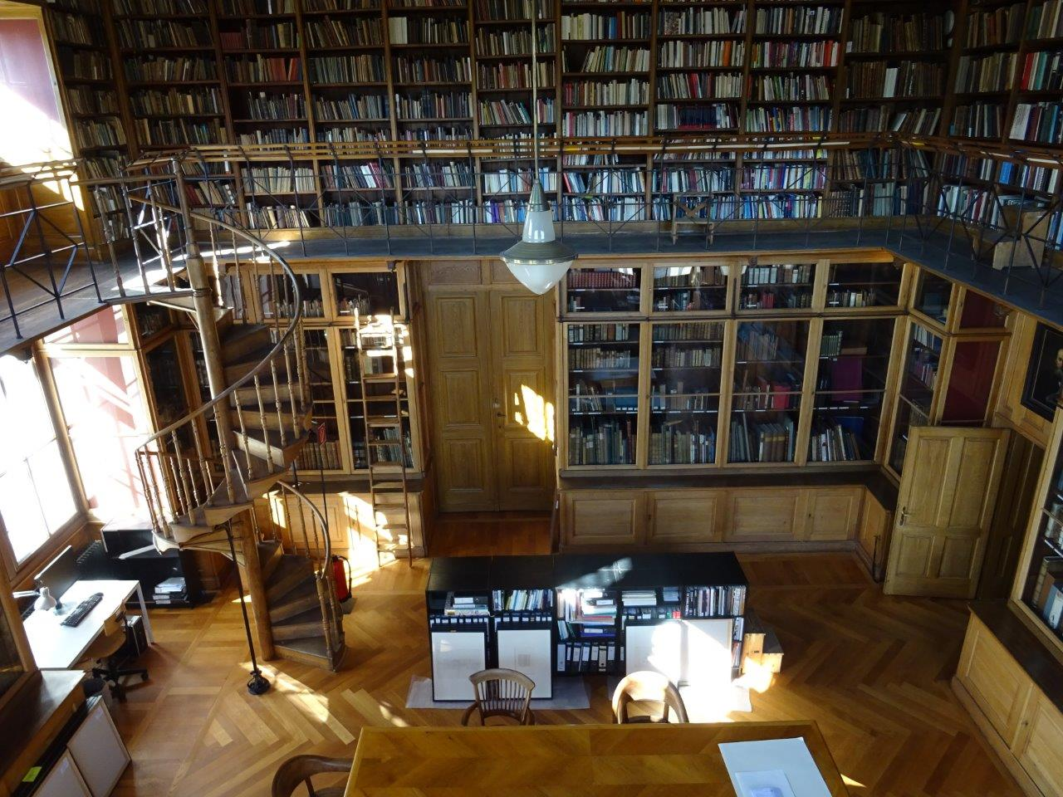
MAK BAROQUE LIBRARY

Slide 7
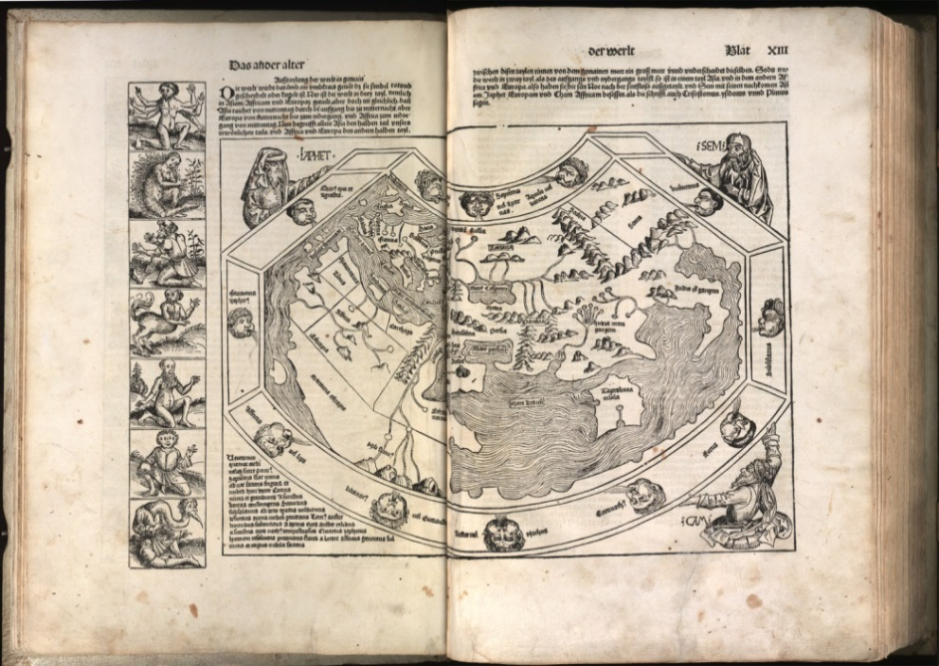
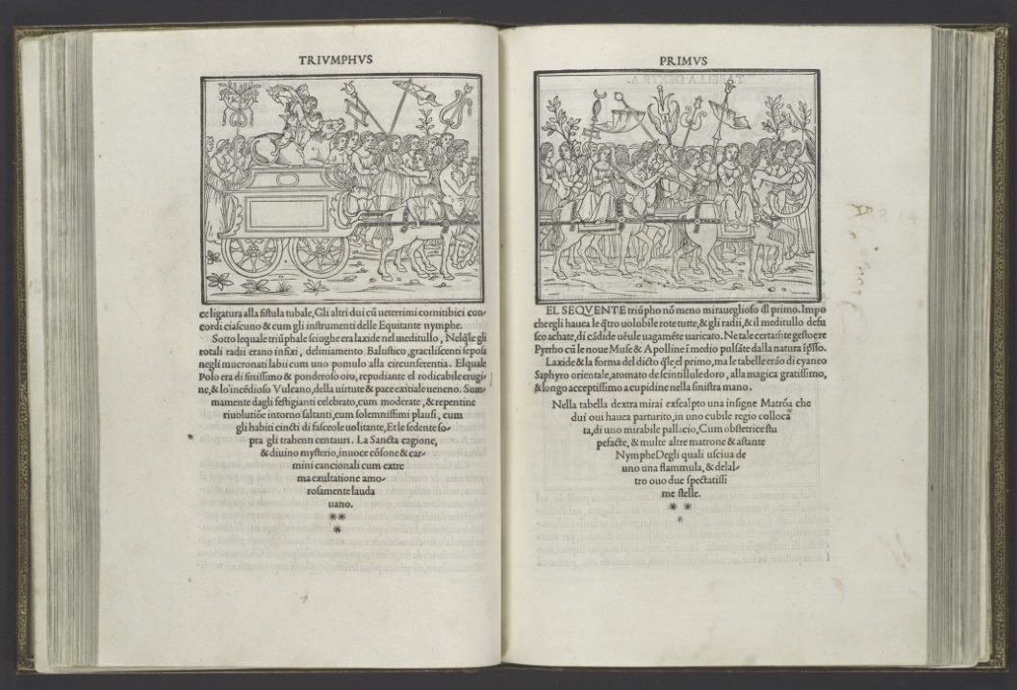
STANDARD WORKS
Hartmut Schedel Weltchronik, 1493
Aldus Manutius Hypnerotomachia Poliphili, 1499

Slide 8
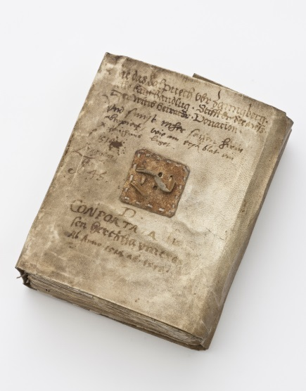
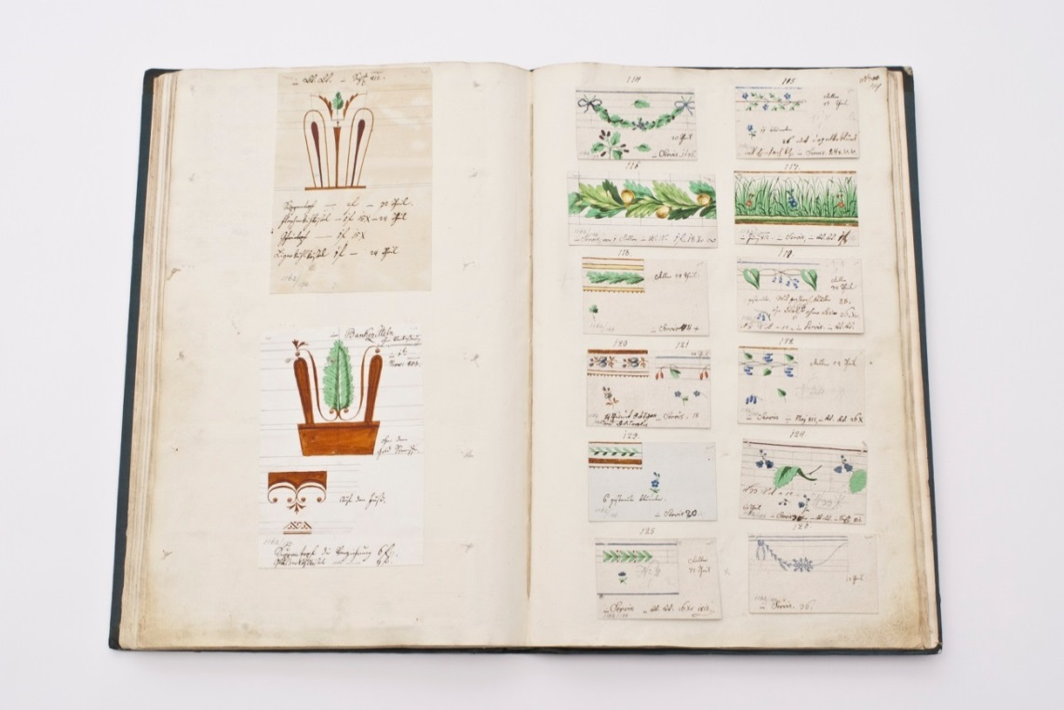
UNIQUE PRINTS
Porcelain Manufactory Order Book, 1790
Hans Herzheimer’s Chronicle, 1514-19

Slide 9
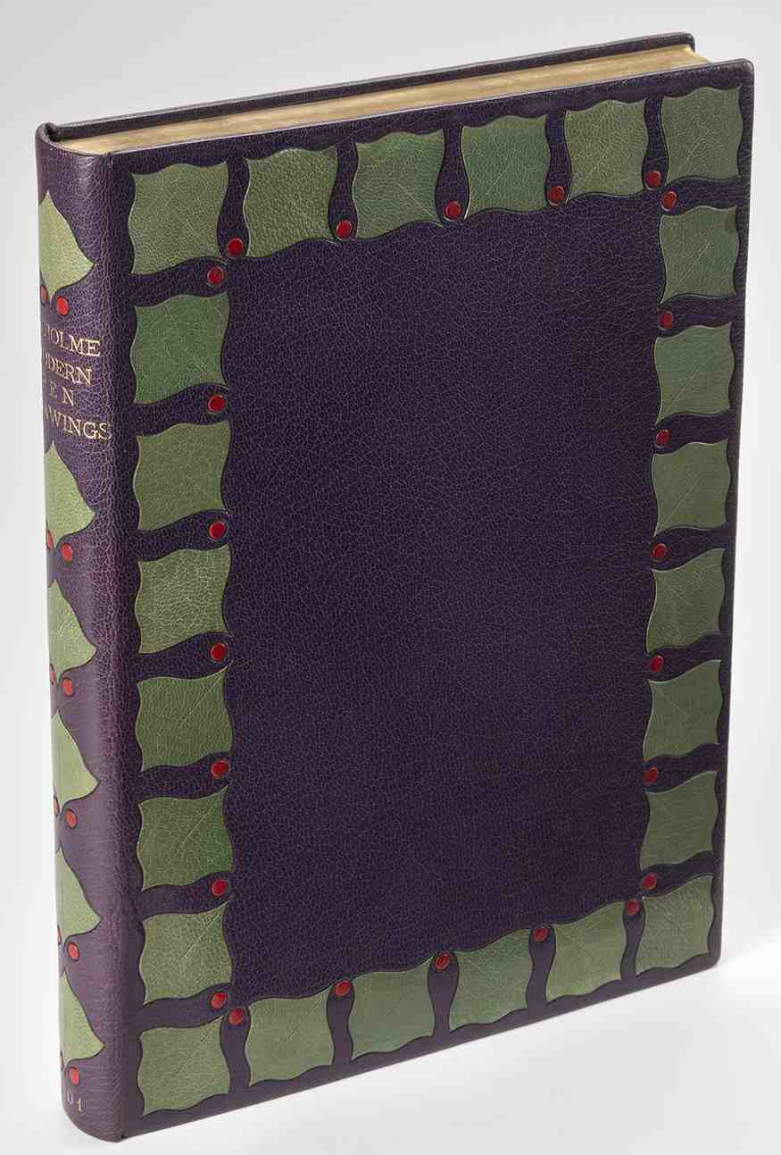
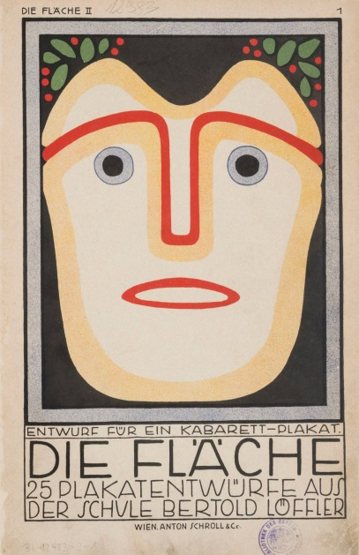
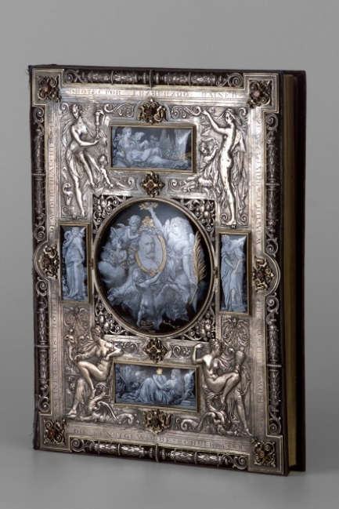
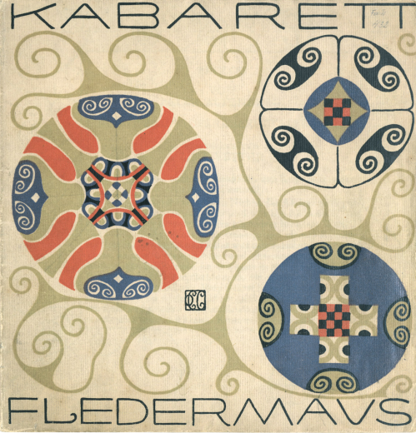
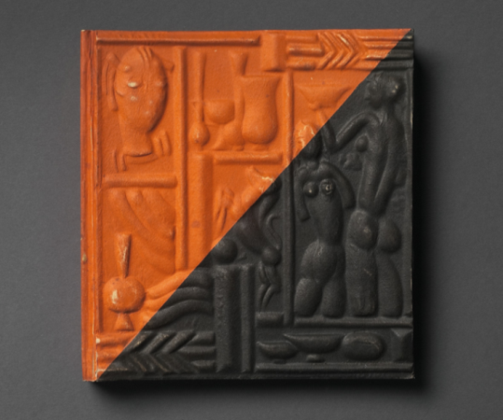
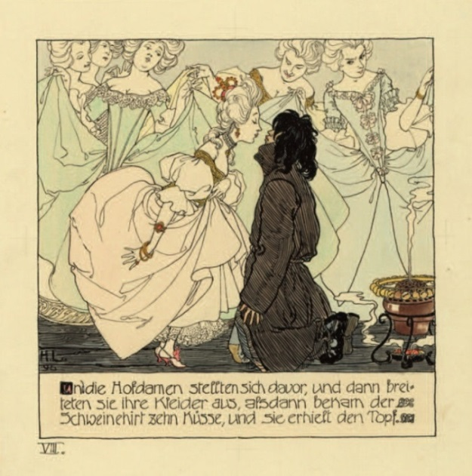
ARTIST´S BOOKS

Slide 10

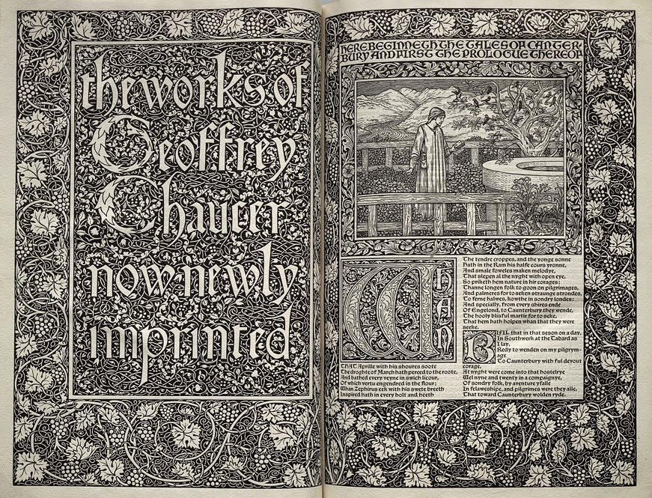
ARTIST´S BOOKS

Slide 11
ARTIST´S BOOKS

Slide 12
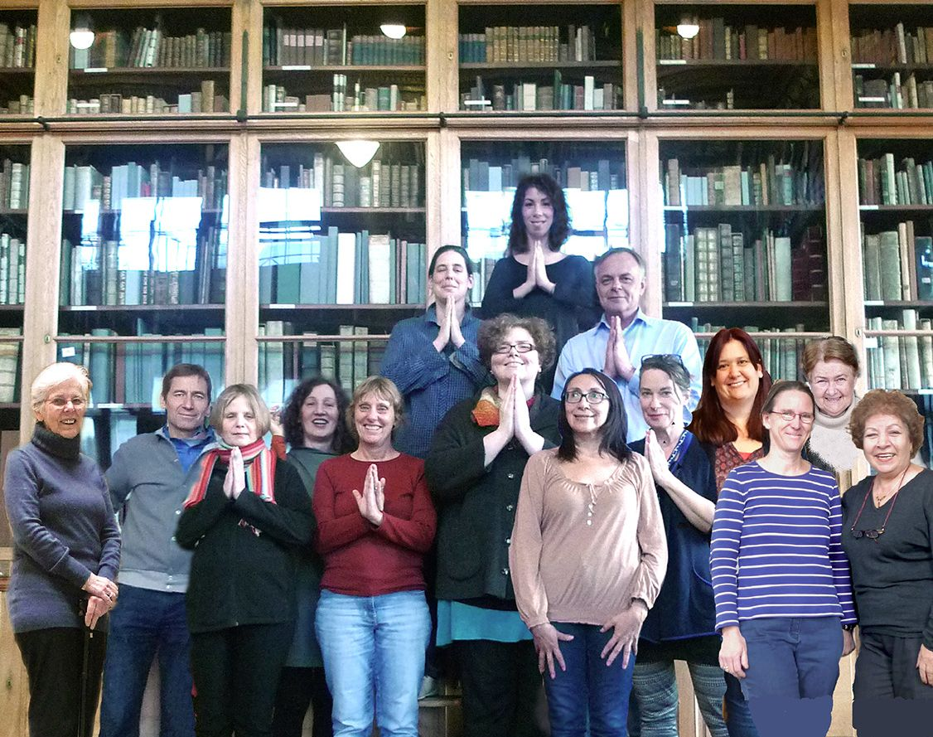
LIBRARY STAFF

Slide 13
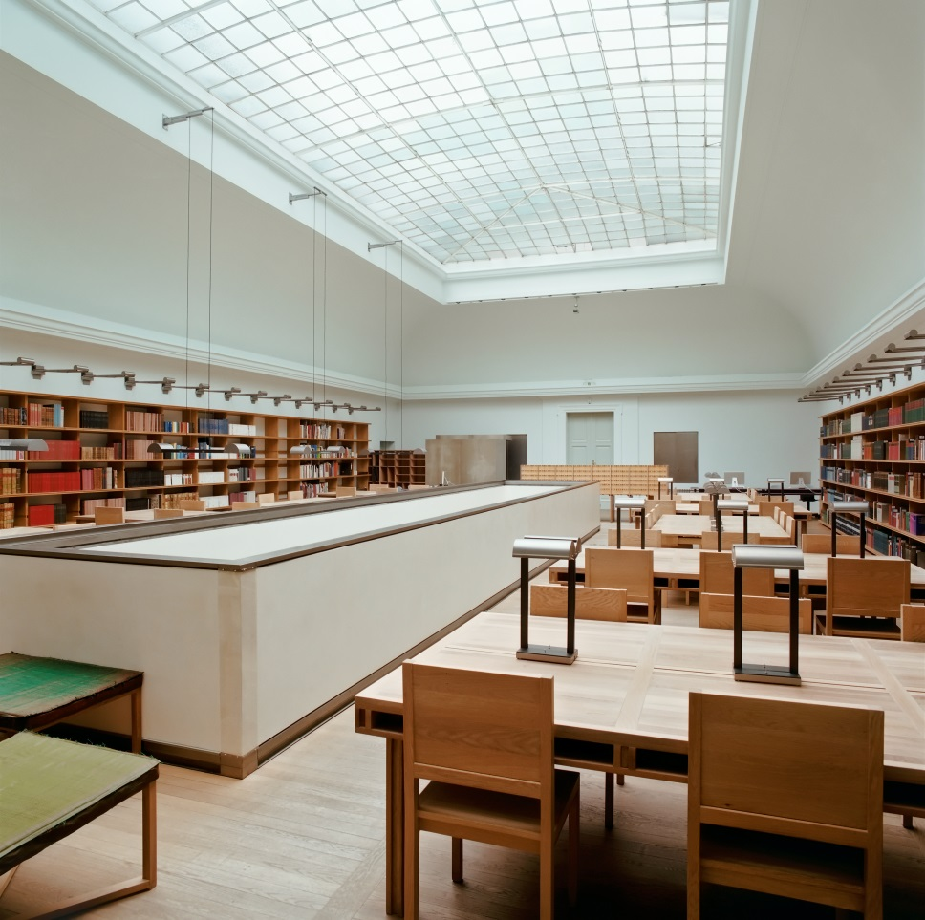
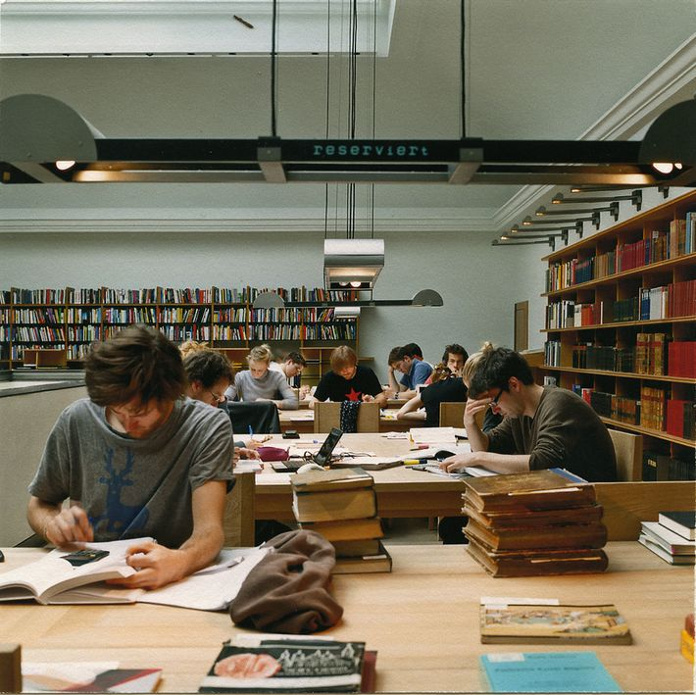
MAK READING ROOM

Slide 14
MAK READING ROOM - SERVICES
50 workstations
Open Tuesday to Sunday from 10am to 6pm
Free Entry
Short retrieval times
Unique ambience
Over 10.000 user a year

Slide 15
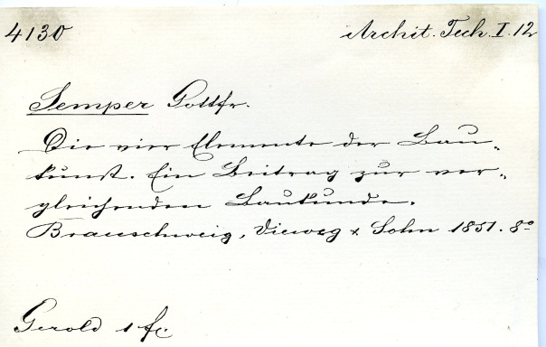

Slide 16
ONLINE CATALOGUES
The Austrian Library Network and Service Ltd
  www.obvsg.at
MAK Homepage
  www.sammlung.mak.at
  Europeana
  www.europeana.eu
Graphikportal
  www.graphikportal.org

Slide 17
AFFECTS OF THE AVAILABILITY
OF THE COLLECTION
Rising numbers of:
Users at the Reading Room
Loan enquiries
Requests for reproductions
Scientific research and enquiries

Slide 18
EU-PROJECTS
Ornamental Prints
ABoT-Artists´Books on Tour. Artist Competition and Mobile Museum
Partage Plus
Art Nouveau Danube

Slide 19
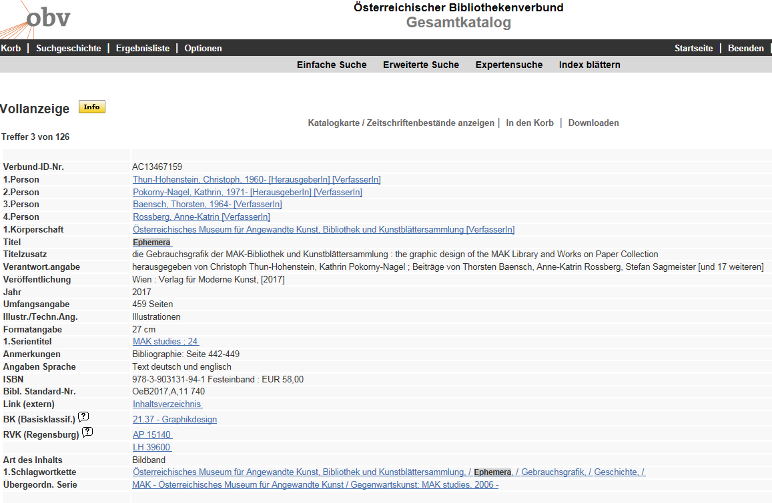
AUSTRIAN LIBRARIES NETWORK

Slide 20
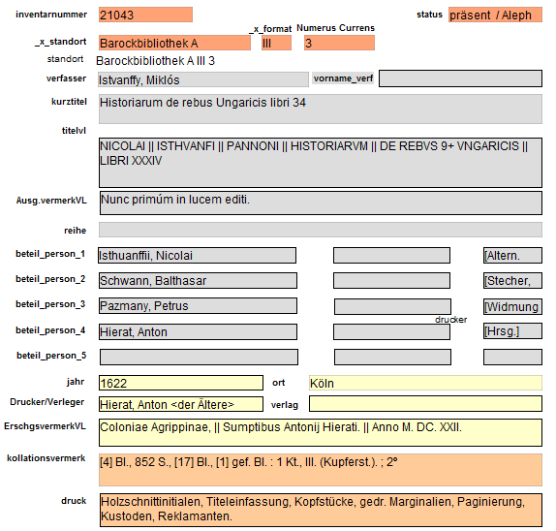
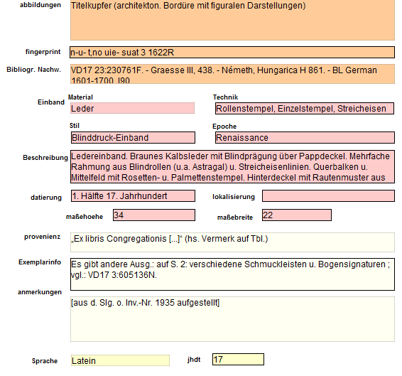
FILEMAKER DATABASE

Slide 21
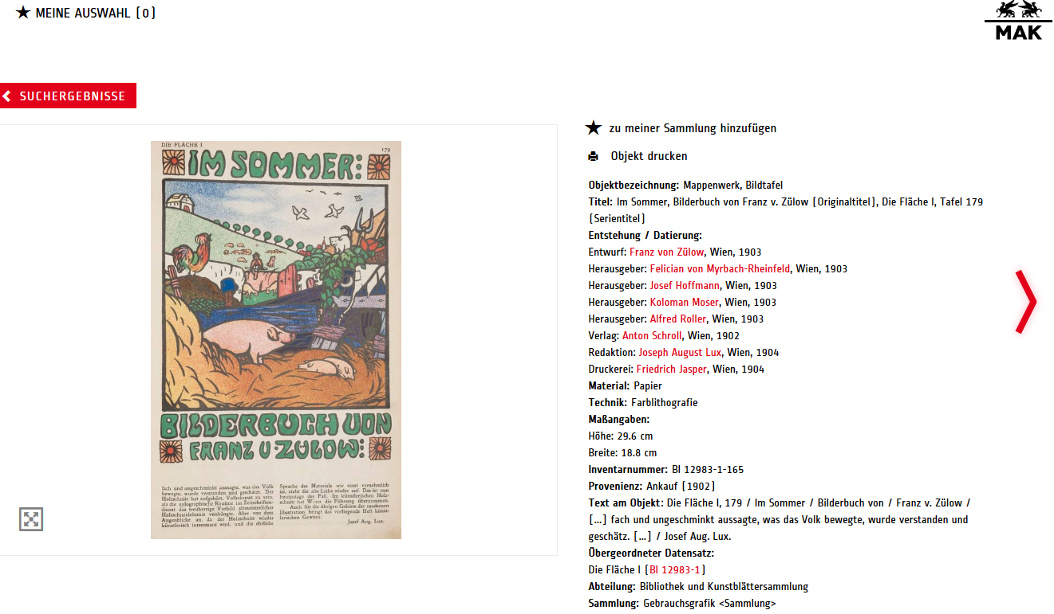
ONLINE DATABASE

Slide 22
PUBLICITY FOR THE COLLECTION
Online presence
Marketing and Public Relation
Networks
Publications
Exhibitions

Slide 23
