Slide 1
KU Leuven Libraries External storage facilities & management

Slide 2
KU Leuven
KU Leuven is Europe’s most innovative university (Reuters) and ranks 48th in the world (Times Higher Education).
Located in Belgium, it is dedicated to research, education, and service to society.
KU Leuven is a founding member of the League of European Research Universities (LERU) and has a strong European and international orientation.
Our scientists conduct basic and applied research in a comprehensive range of disciplines. University Hospitals Leuven, our network of research hospitals, provides high-quality healthcare and develops new therapeutic and diagnostic insights with an emphasis on translational research.
The university welcomes more than 50,000 students from over 140 countries. The KU Leuven Doctoral Schools train approximately 4,500 PhD students.

Slide 3
A library history with hickups
University |  | Library
Foundation of the University (by the City of Leuven) | 1425 | Diverse libraries, mainly at offices of professors
 | 1636 | First Central Library in the Hallen
University closed by the French | 1797 | Books transported to Bibliothèque Nationale Paris and Brussels
State University founded | 1817
Reopening Catholic University | 1835 | Library in the Hallen, Naamsestraat
WWI: fire of Leuven | 24 August 1914 | Destruction of complete collection (1000 ms, 800 incunabels, 300.000 vol)
WW II | 16 May 1940 | Bomb in the tower, destruction of the stacks (900.000 volumes) and reading room
Split of University | 1970 | Division of the collections with Louvain-la-Neuve (unpair Leuven, pair UCL)

Slide 4
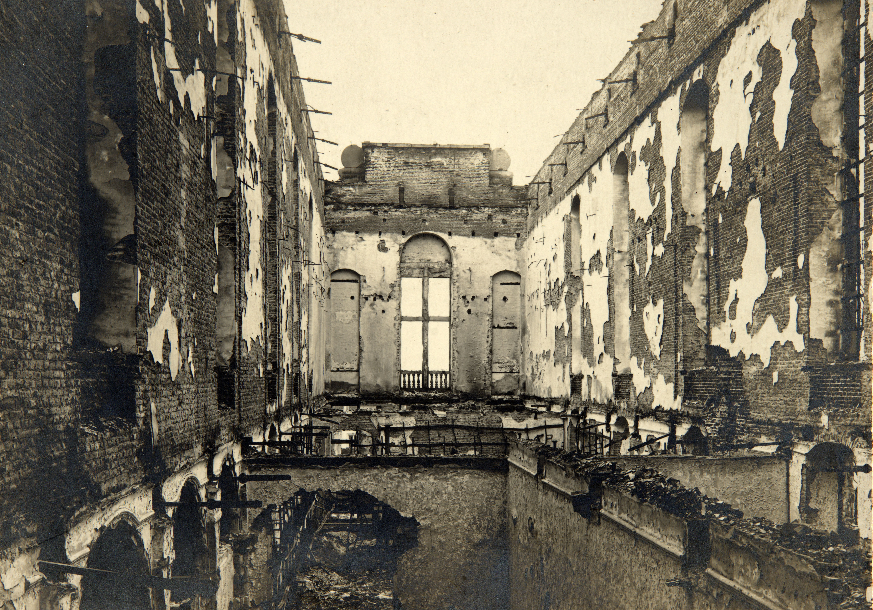
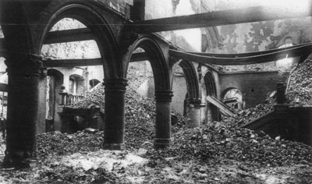
WWI : August 25th 1914
destruction of complete collection:
1000 manuscripts
800 incunabels
300.000 volumes

Slide 5
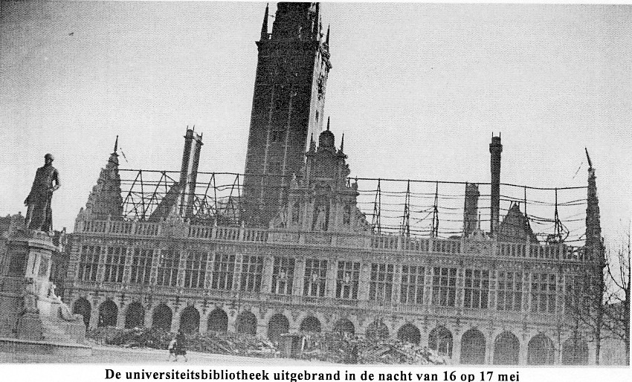
WWII: May 16th 1940
bomb in the tower
destruction of the stacks
(900.000 volumes) and reading room

Slide 6
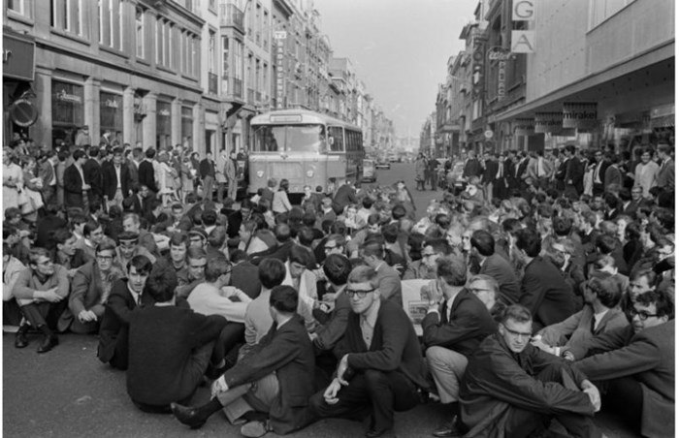
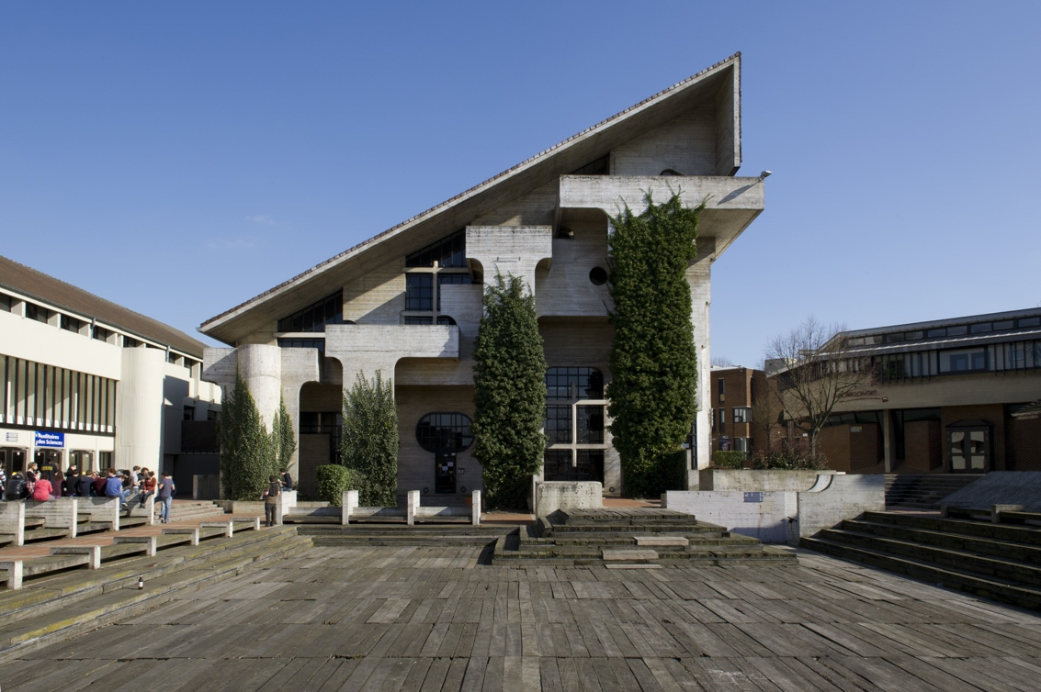
May 1968 – 1971 creation of a French speaking university in Louvain-la-Neuve
division of the Library collections between the two universities

Slide 7
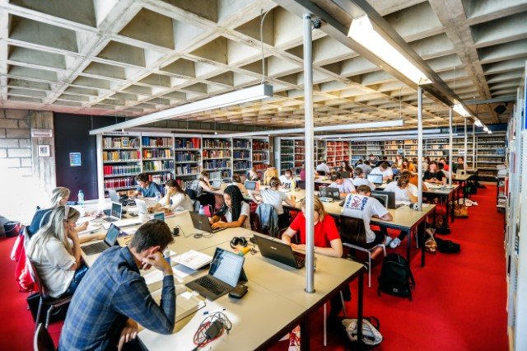
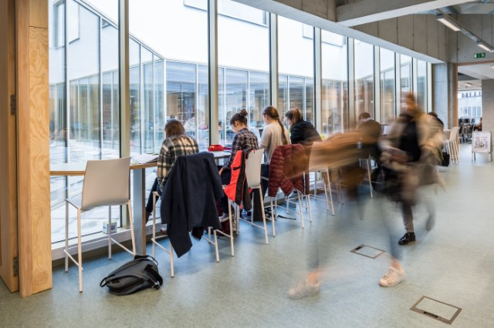
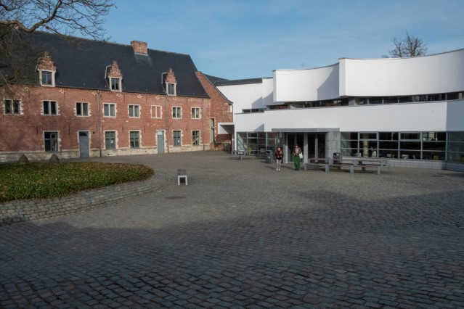
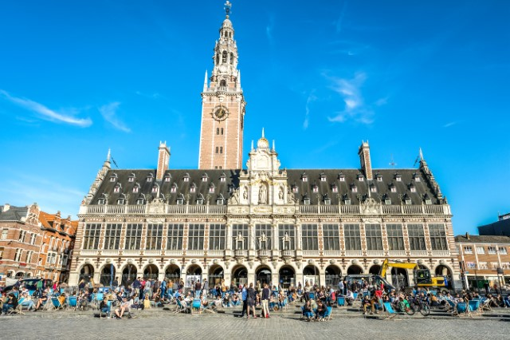
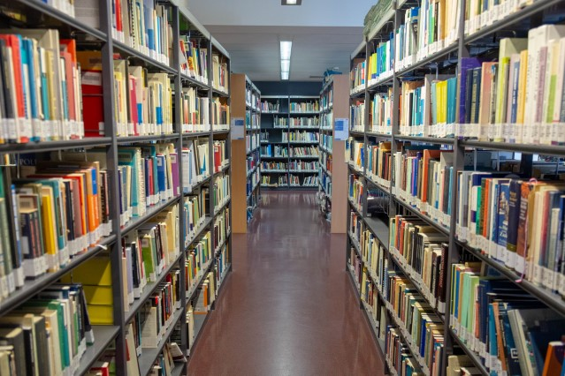
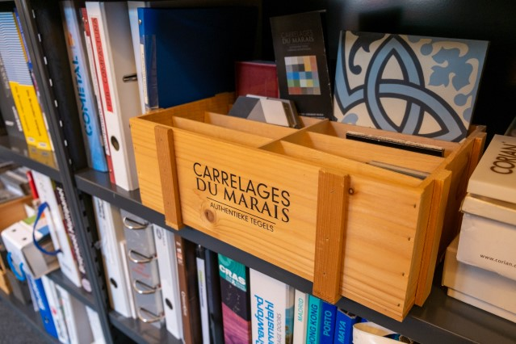
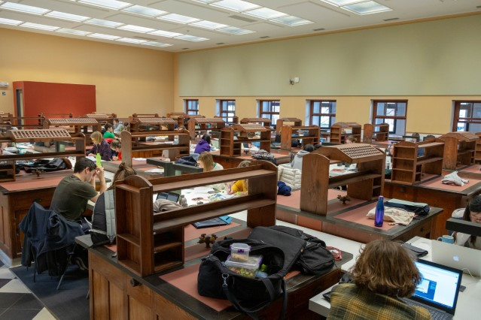
KU Leuven Libraries today

Slide 8
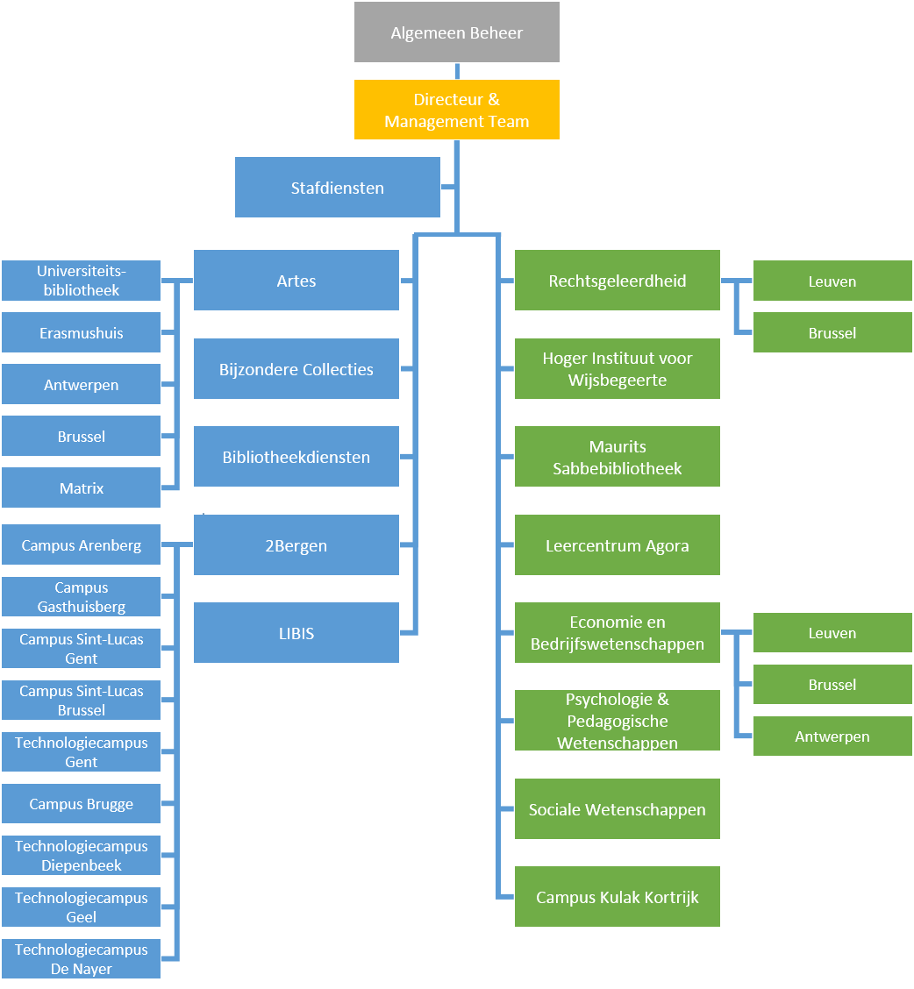
KU Leuven Libraries
24 locations
12 in Leuven,
12 elsewhere in Flanders:
Brugge, Gent (2), Antwerpen (2), Brussel (2), Kortrijk, Geel, Diepenbeek, Mechelen, Aalst
mixed governance, 1 strategic plan
Directly under director
Faculty staff and budget

Slide 9
Facts & Figures
around 4.000.000 bib records in our catalogue
3 million physical collection
500.000 electronic collection
more than 3.500.000 visits on a yearly basis
7.000.000 full text downloads on our e-collection
5.000 seats in our libraries (on a total of 52.000 students)
250 staff
10.000.000 € collection budget
1.5 million paper collection
8.5 million e-collection

Slide 10
Special collections
Theological Library
https://bib.kuleuven.be/english/msb/special-collections/our-special-collections
1.200 Manuscripts
200.000 Rare Books
KU Leuven Libraries Special Collections
https://bib.kuleuven.be/bijzondere-collecties/english/home
2000 Manuscrpts (including 200 student notes)
Papyri snippets
40.000 Rare Books
140 Incunabula

Slide 11
(External) Storage

Slide 12
Available storage
Closed Stacks in University Library | 21.500 m
(13.000 m special collections included);
Closed Stacks in external facility BEXT | 9.000 m
Closed Stacks in Theological library | 27.900 m
(27.000 m special collections included)
Storage Biomedical collection | 6.990 m
Storage Science & Technology collection | 22.122 m
Total | 87.512 m
Special collections (included in total number above):
University Library: 13.000 m
Theological Library: 27.000 m

Slide 13
Reasons for change
Reorganisation of the library structure
Historical University Library building
End of lease of external facility BEXT
Opportunity through Leuven Heritage Lab.
Need for better and more state of the art storage facilities.

Slide 14
Reorganisation of the library structure
2010: STM libraries became part of the central library services
KU Leuven Libraries, 2 Bergen
2014: Library of the Art Faculty becomes part of the central library services
KU Leuven Libraries, Artes
Collections should be open
Collections spread over two buildings => History and Art History should be on one place, preferably University Library

Slide 15
Historical University Library Building
Opened 1928, rebuild because of fire WWII
In the 1960’s additional flooring to accommodate both French and Flemish speaking library function
Update necessary for electrical wiring
New electricity Reading Rooms
Moving East Asian library one floor down
Open Stacks on Floor 2 and 3 : East –Asian collection, Art and History
Main Reading Room, LadeuzeRoom, MercierRoom

Slide 16
End of lease External Facility (BEXT)
9.000 m
Beginning 2016 building sold, end of lease will be 30/12/2019
Search for new facility
New facility: Loods
Has to be climatised
Stacks have to be installed
Internal reorganization necessary as 1/3 of space BEXT was taken up by unselected donations

Slide 17
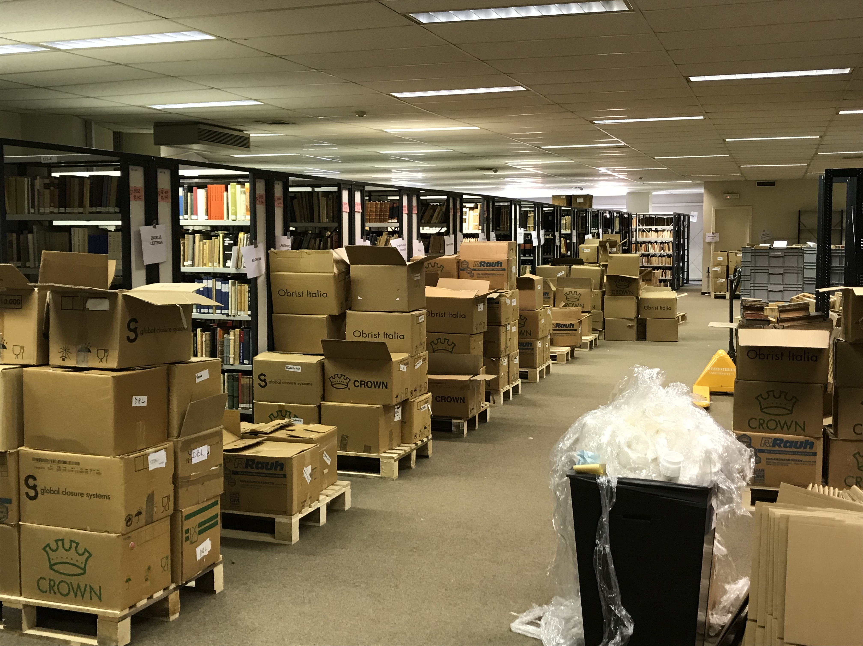
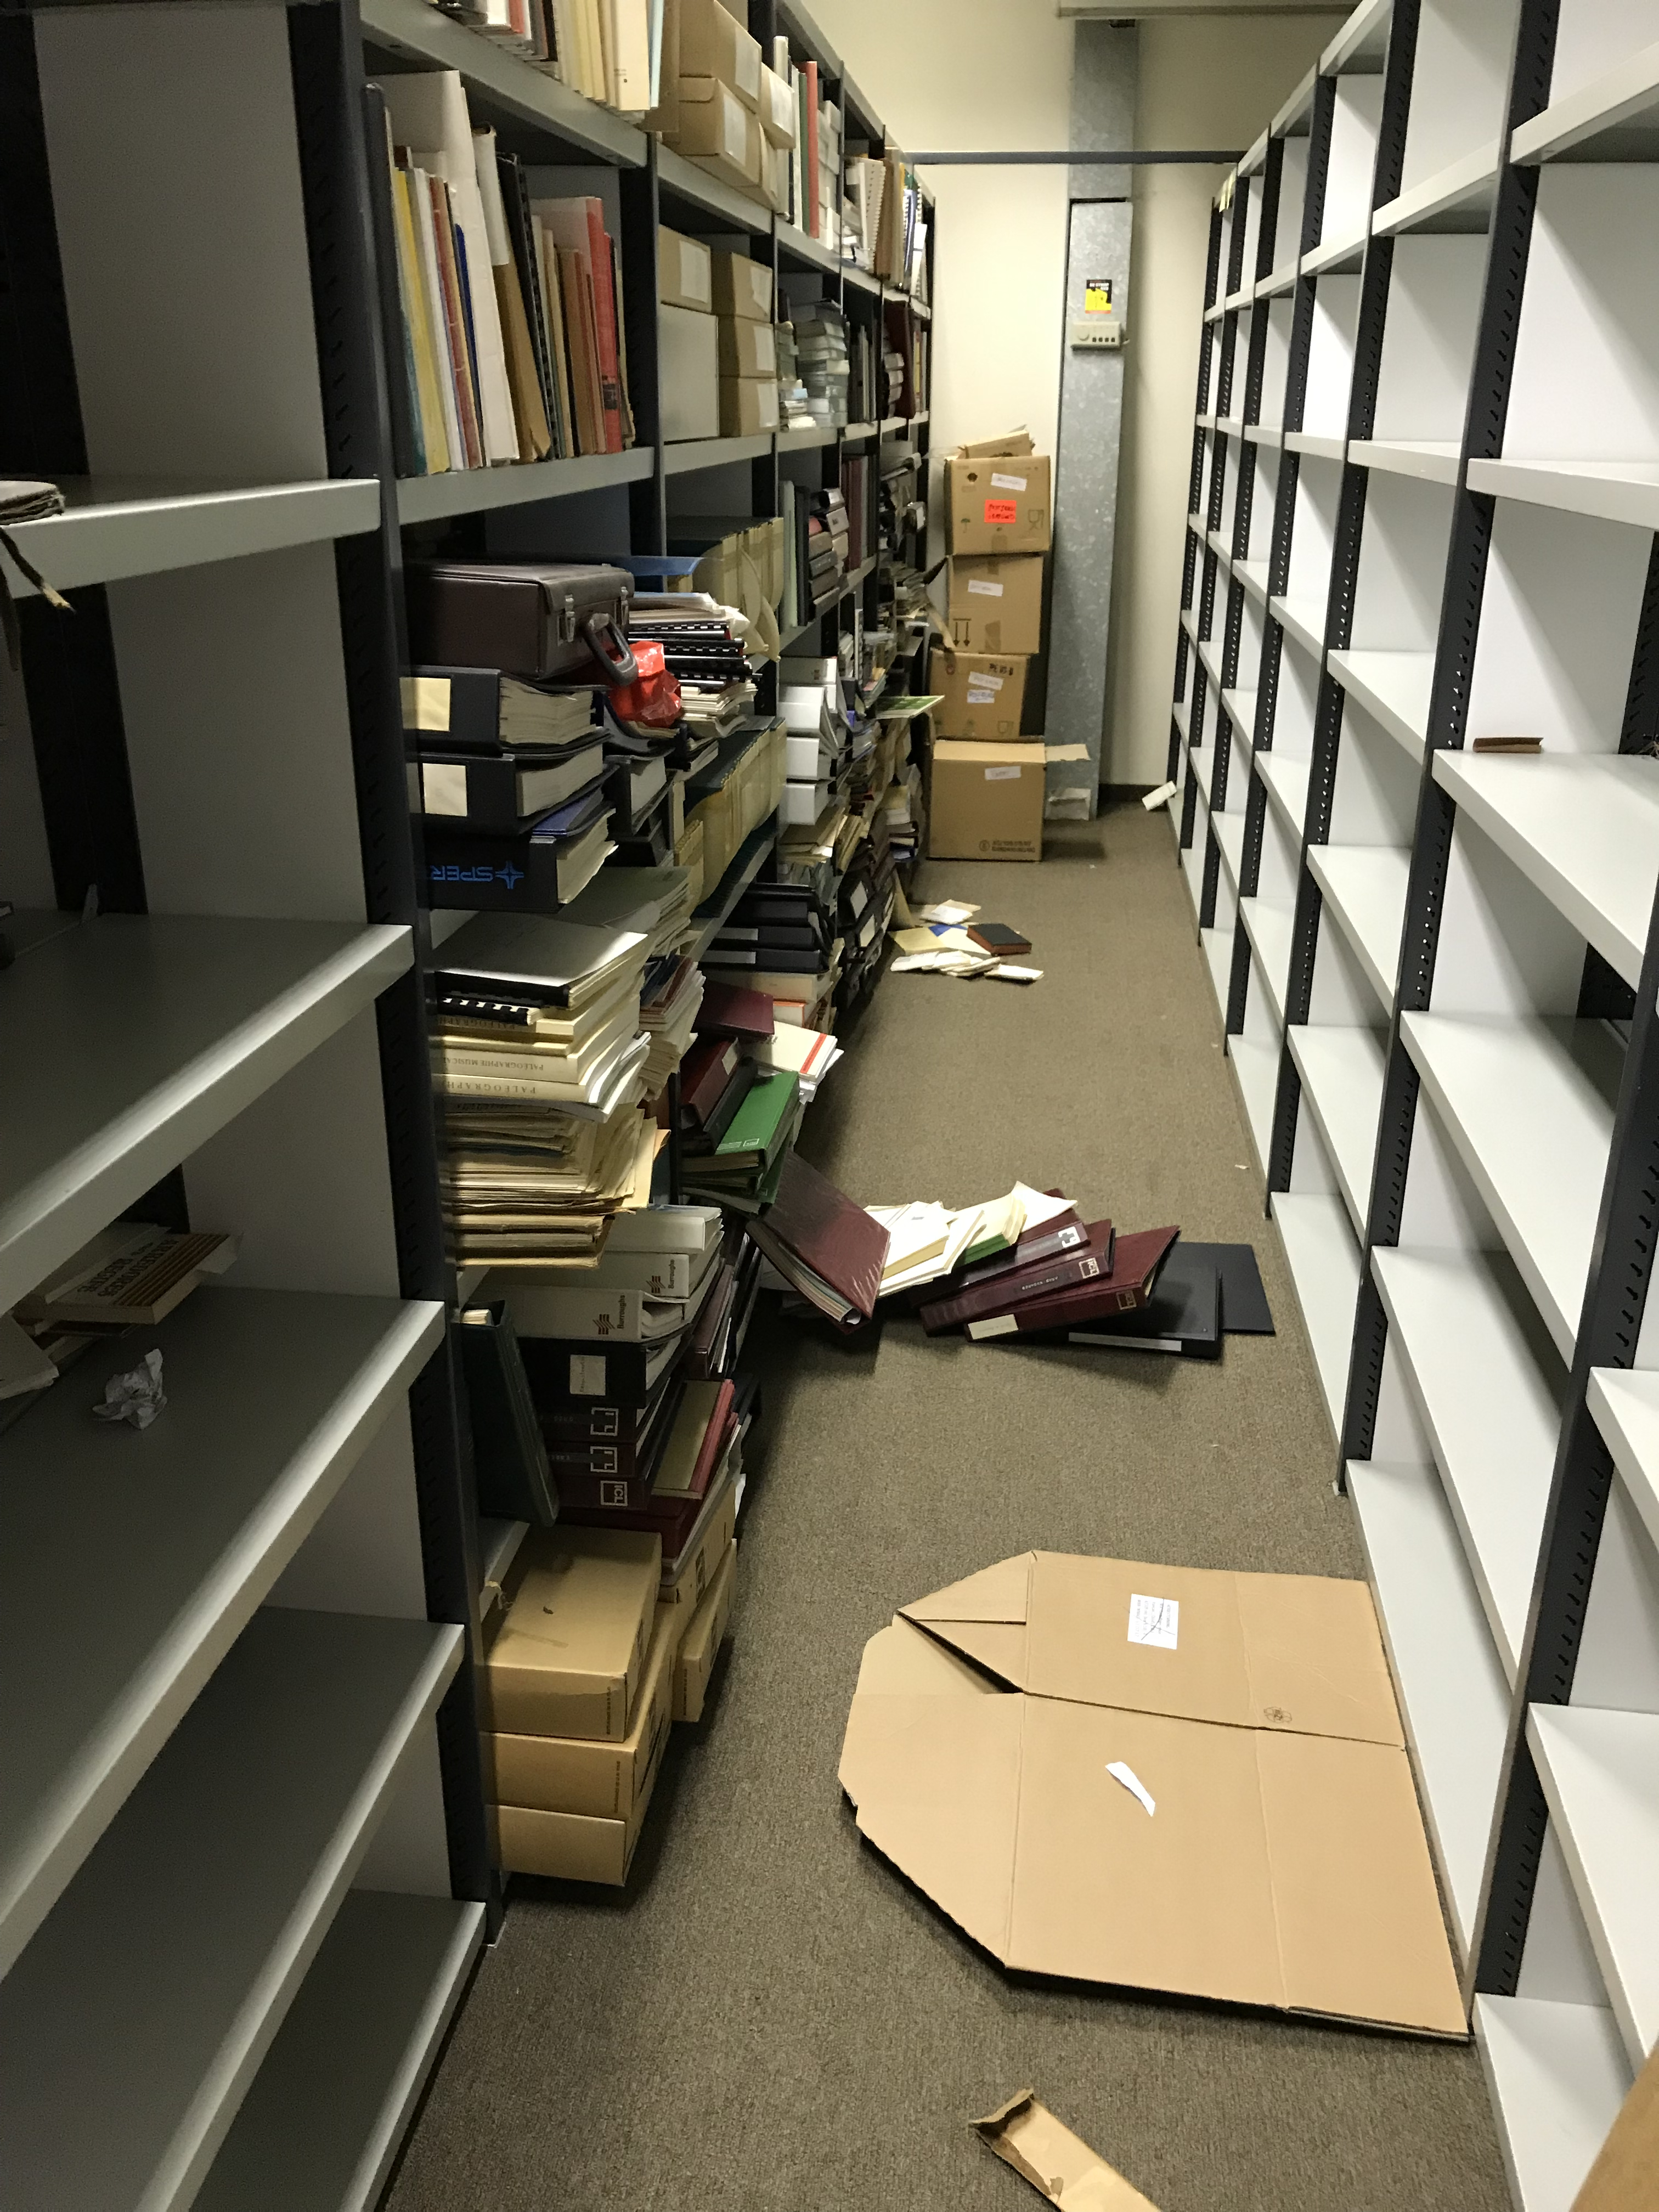
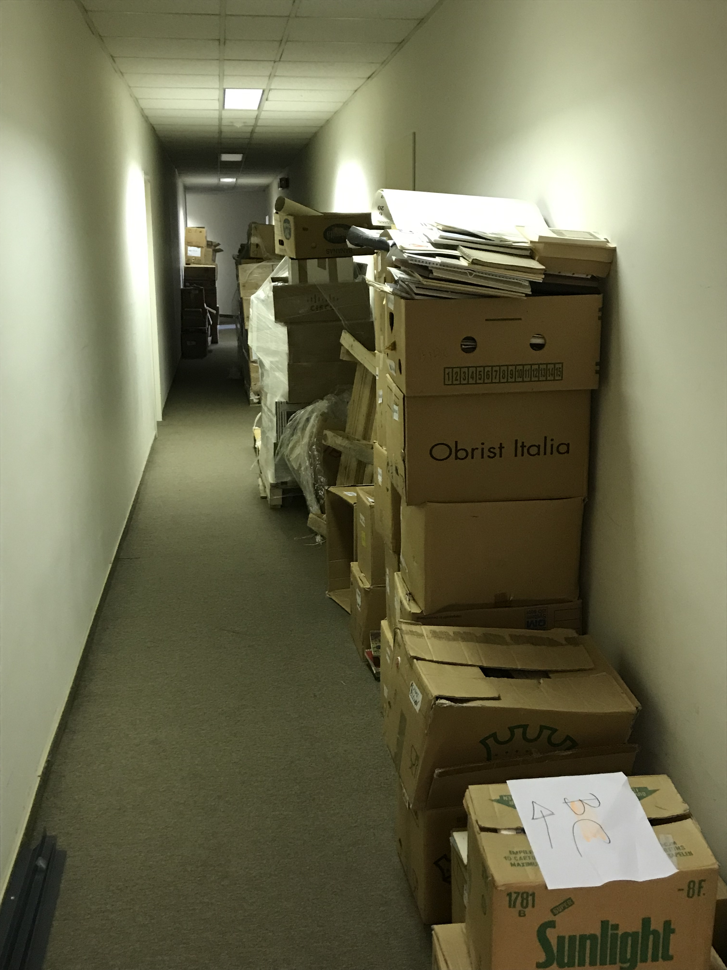
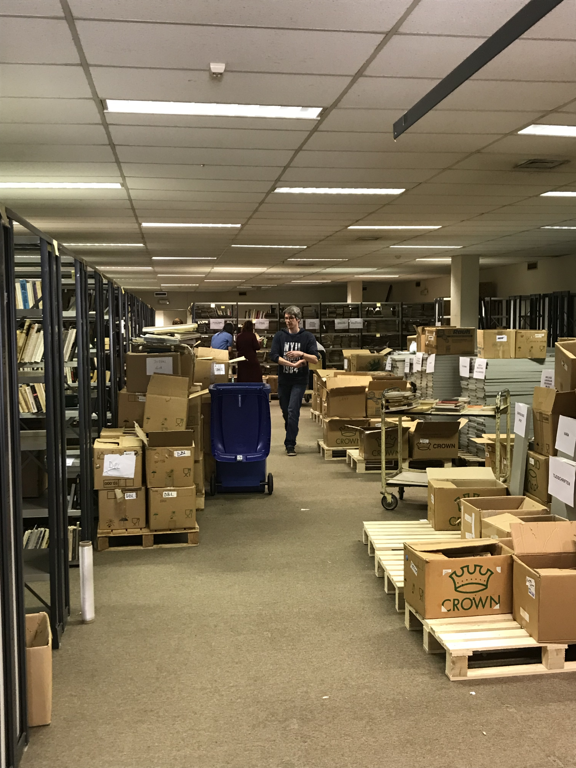
BEXT: the old facility

Slide 18
The Warehouse
Rented for 7 years
Industrial warehouse
2 parts:
1 climatised ASHRAE A: newspapers and journals
1 serves as stock for exhibition material and location for climate installation
Office for 3 people, occasional visits possible
New management: 1 team, only digitization
Large boxing project for newspapers

Slide 19
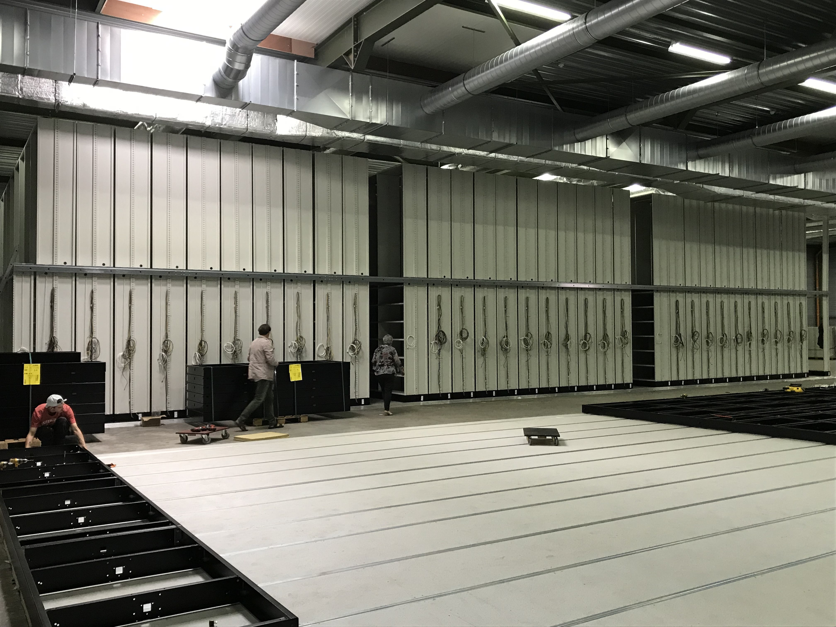
The Warehouse

Slide 20
Heritage Lab Leuven (https://erfgoedlabo.be/)
13 heritage institutions working together on 5 yards
Stack for different types of collections
Digital
Knowledge and experience
Communication and agenda
Collection management
Main investors: City of Leuven – KU Leuven University
Partners: M-Museum, Parcum, Annunciaten, Heritage Cell Leuven, Centre for agriculture studies, KU Leuven Libraries Special Collections and Theological Library, KU Leuven University Archives - Art collection - Academic Collections, State Archives Leuven, CRKC, KADOC, Abdij van Park,

Slide 21
Leuven shared heritage facility
2 previous attempts: 2009 and 2016
Now: May 15th 2020 applying for subsidy Flemish Government
Involvement of external partners neccesary
Juridical structure and financial organisation: Law Firm: Laga => CVSO
External firm to aid for organisation of the stacks (architectural): Toornend
Financially very hard to get engagement from City of Leuven (and because of that of KU Leuven)

Slide 22
Leuven shared heritage facility
Will be a place for innovation because of the different types of collections => mix of best practices
Through digital platform and linked data: collections more visible
All partners will take part in one organisation (CVSO)
Staff will be part of the CVSO
Collections will be placed on type of object, not on owner
Shared facilities for quarantaine, digitization, education, technical rooms

Slide 23
Questions
How are your stacks managed?
Do you have one team or different teams for special collections and modern stacks?
How do you work with/manage external storage
Are you familiar with the management of different types of materials in one facility?
How do you counter the idea that, now that everything is electronic, we only need preciosa? Stacks are no longer necessary….

