Slide 1
The library at the National Archives:
A door into a complex archive collection

Slide 2
Internal correspondence showing support

Slide 3
‘There are occasions when it is immensely valuable to me’
Miss Peake, 1953 (PRO 1/1414)

Slide 4
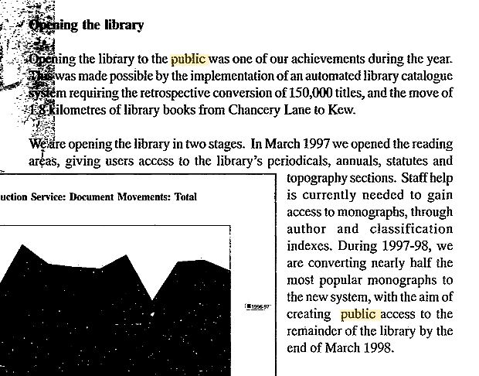
Opening doors to the public

Slide 5
Beyond the boundaries
But there was a world Somewhere Out there And Mrs. Long opened that wardrobe But no lions or witches scared me I went through Knowing there would be Spring
A POEM FOR MY LIBRARIAN, MRS. LONG
By Nikki Giovanni

Slide 6
ENDS

