Slide 1
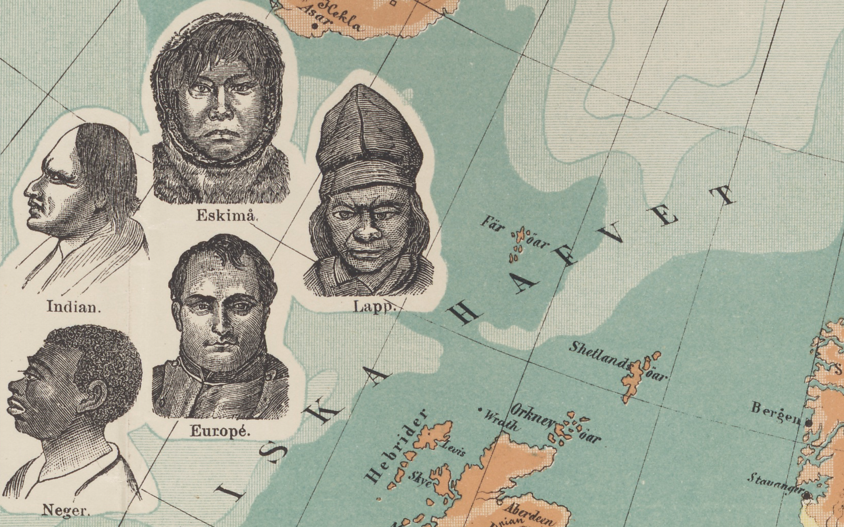
Equality,
Diversity
Inclusivity
Lars Ilshammar
CERL 2022-01-27

Slide 2
Sensitive collections?
Racist or colonial
Stereotypical
Misogynistic
Sexist or homophobic
Offensive
Generaly unpleasent
Outdated or discriminatory

Slide 3
Draft policy in three parts
Making available and accessibility
Terminology and metadata
Mediation and curation
Acquisition
Action plan to be supplemented

Slide 4
Making available and accessibility
The making available of material from NLS's collections must take place to the greatest possible extent, regardless of who the administrator or user is - and regardless of whether the content can in various ways be perceived as offensive or outdated.
The exceptions to this principle must be as few as possible and assume that material that is not illegal to possess or make available must always be made available without NLS's administrator taking a position on the content.
Accessibility according to the above shall also as far as possible take place without NLS’s staff expressing personal values ​​or opinions in connection with the accessibility.
The same principles shall apply to all forms of accessibility and on all platforms.

Slide 5
Terminology and metadata
Descriptions in catalog entries (metadata) of material in NLS's collections must be as neutral and factual as possible, without unnecessary interpretations and values.
Terminology used in descriptions must always follow established and updated standards and terminology lists, regardless of which system the material is cataloged in.
Existing concepts and descriptions in NLS's catalogs should in principle not be changed, however, outdated or problematic concepts or descriptions that express, for example, discrimination should be commented on and put in an updated context.
To the extent that such adjustments are made in catalogs and descriptions, this must be done with transparency and traceability.

Slide 6
Termonology and metadata, cont.
Older catalogs and metadata that accompany deliveries or are imported must routinely be provided with a disclaimer stating that the descriptions may contain outdated or problematic concepts.
Due to NLS's assignment to implement the national minorities' libraries as a resource library, special attention should be paid to descriptions that concern the national minorities, including the indigenous Sami people. If necessary, NLS's ethics council with representatives of the national minorities can be consulted on terminology issues.
In case of uncertainty about the presence of outdated or problematic concepts and interpretations in catalog entries, etc., a more general comment can be made in connection with, for example, a catalog or a search service.

Slide 7
Mediation and curation
To the extent that material that is actively highlighted by NLS's staff through mediation or curation can be perceived as offensive or contains outdated or discriminatory terminology, the selection must be justified on the basis of clear and transparent criteria.
When material referred to above is highlighted through mediation or curation, the selection should, if possible, be commented on and placed in an updated context.
In case of uncertainty about the sensitivity of a specific material, a more general comment can be made in connection with, for example, an exhibition or a public program.
The same principles shall apply to all forms of mediation and curation on all platforms.

Slide 8
And what now?
Continous internal process at NLS, with hope for a finalised document after the summer of 2022.
Consultation with national minorities (Sámi, Swedish Finns, Tornedalers, Roma and Jews) plus fellow cultural heritage institutions in Sweden and in the Nordic region.
Input, criticism and inspiration from the broader library and cultural heritage community.
Dialog with CERL and you!

Slide 9
Contact & Feedback
Lars Ilshammar
Deputy National Librarian
National Library of Sweden
P.O. Box 5039, SE-102 41 Stockholm, Sweden Visiting address: Humlegården Phone: +46-10-709 33 69 Mobile: +46-70-007 33 69 / +46-70-677 47 75 (private) E-mail: lars.ilshammar@kb.se Web: www.kb.se

